Slide 1
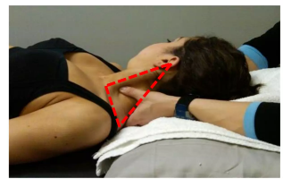
Posterior Triangle of the Neck
Mr. M. Banda
University of Zambia

Slide 2
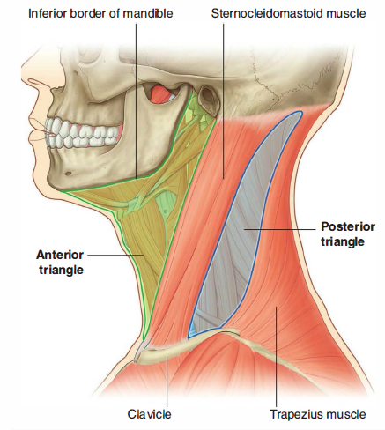
Posterior Triangle

Slide 3
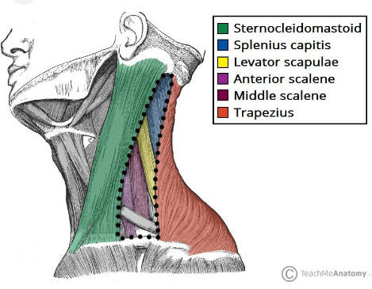
Posterior Triangle

Slide 4
Posterior Triangle: Boundaries
The posterior triangle is formed anteriorly by the posterior edge of sternocleidomastoid
posteriorly by the anterior edge of trapezius
inferiorly by the middle third of the clavicle
Its apex is the meeting point between the attachments of sternocleidomastoid and trapezius on the superior nuchal line

Slide 5
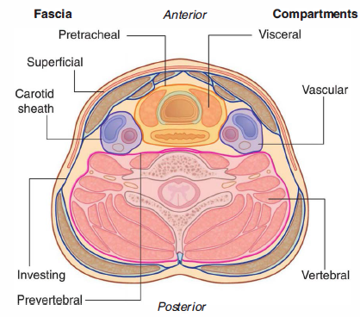
Posterior Triangle: Boundaries
The roof of the posterior triangle is formed by the investing layer of the deep cervical fascia
The floor of the triangle is formed by the prevertebral fascia overlying splenius capitis, levator scapulae and the scalene muscles

Slide 6
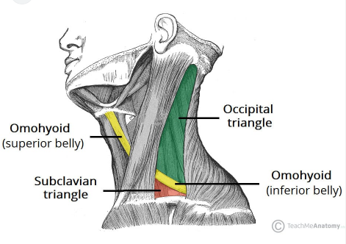
Subdivisions of the Posterior triangle
It is crossed by the inferior belly of omohyoid, which subdivides it into occipital and subclavian or supraclavicular triangles

Slide 7
Occipital triangle
upper and larger part of the posterior triangle
Its floor, from above down, is formed by splenius capitis, levator scapulae, and scaleni medius and posterior; semispinalis capitis occasionally appears at the apex.

Slide 8
Occipital triangle
The triangle is covered by skin, superficial and deep fasciae and inferiorly by platysma
The spinal accessory nerve pierces sternocleidomastoid and crosses levator scapulae obliquely downwards and backwards to reach the deep surface of trapezius

Slide 9
Occipital triangle
Cutaneous and muscular branches of the cervical plexus emerge at the posterior border of sternocleidomastoid
Inferiorly, supraclavicular nerves, transverse cervical vessels and the uppermost part of the brachial plexus cross the triangle

Slide 10
Supraclavicular triangle
The supraclavicular triangle is the lower and smaller division of the posterior triangle
The triangle is covered by skin, superficial and deep fasciae and platysma and crossed by the supraclavicular nerves

Slide 11
Supraclavicular triangle
Just above the clavicle, the third part of the subclavian artery curves inferolaterally from the lateral margin of scalenus anterior
The brachial plexus is partly superior, and partly posterior to the artery

Slide 12
Contents of the posterior triangle
Fat
lymph nodes
spinal accessory nerve
cutaneous branches of the cervical plexus
inferior belly of omohyoid
branches of the thyrocervical trunk (transverse cervical and suprascapular arteries)
the third part of the subclavian artery
External jugular vein

Slide 13
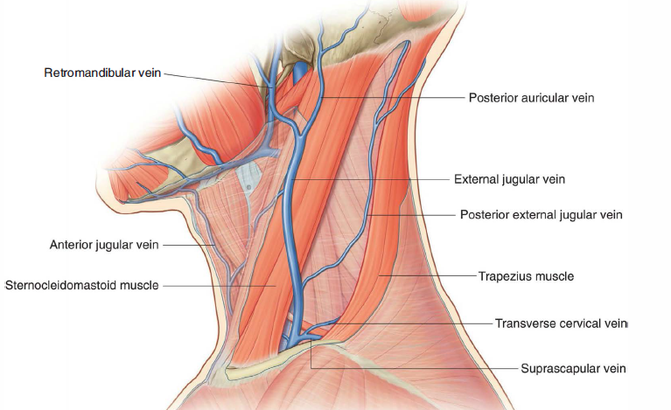
Contents of the posterior triangle
External jugular vein

Slide 14
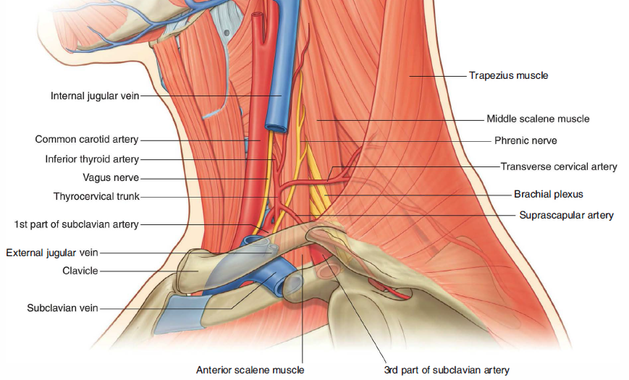
Contents of the posterior triangle
Arteries

Slide 15
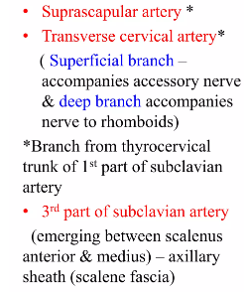
Contents of the posterior triangle
Arteries

Slide 16
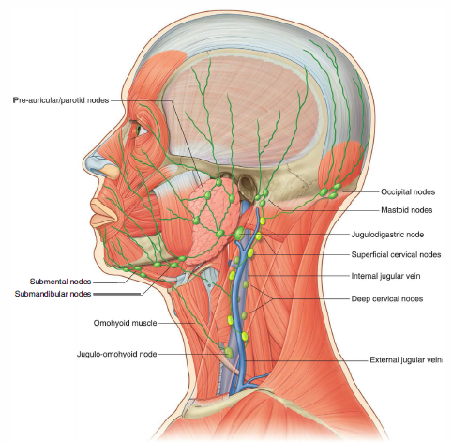
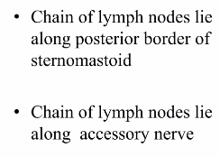
Contents of the posterior triangle
Lymph Nodes

Slide 17
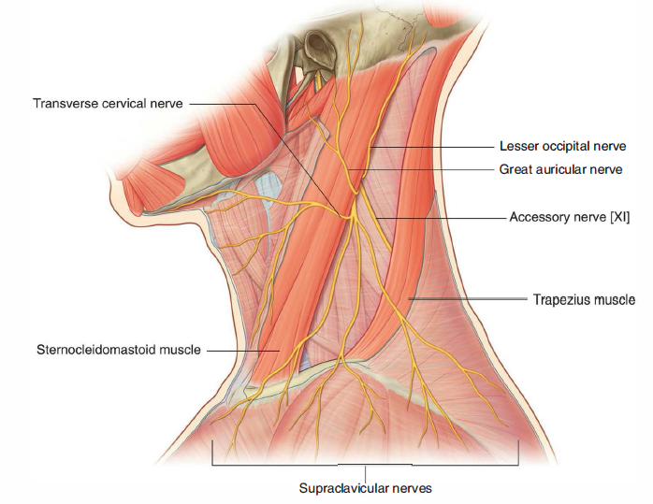
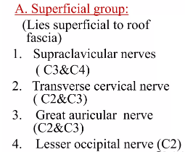
Contents of the posterior triangle
Nerves

Slide 18
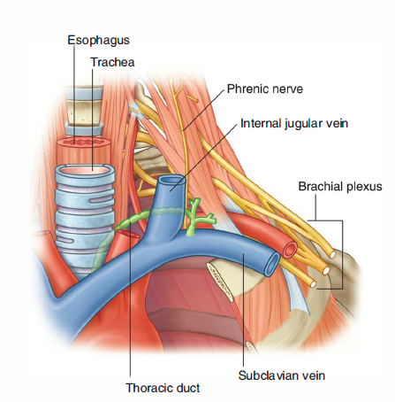
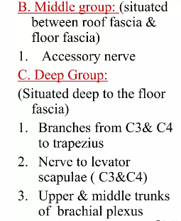
Trunks of the brachial plexus

Slide 19
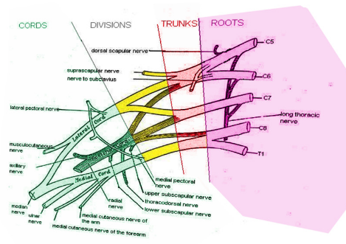
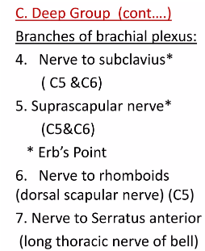
Trunks of the brachial plexus

Slide 20
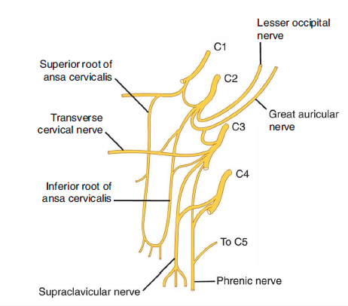
Cervical Plexus

Slide 21
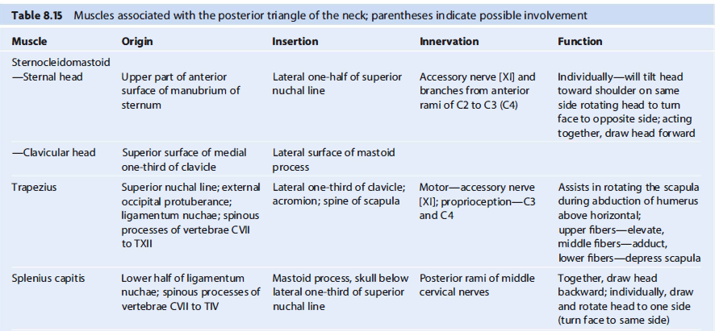
Muscles associated with the PT

Slide 22
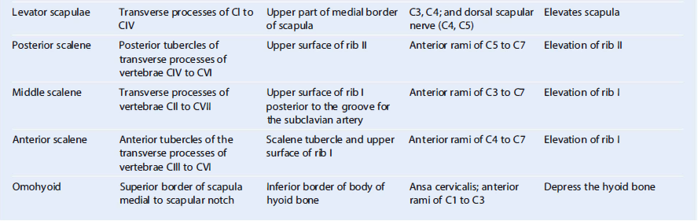
Muscles associated with the PT

Slide 23
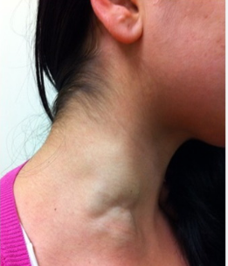
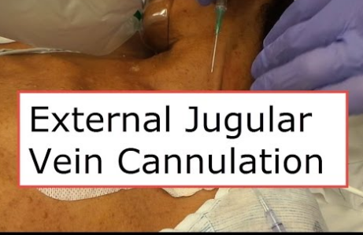
Applied Anatomy
Aneurysm of EJV

Slide 24
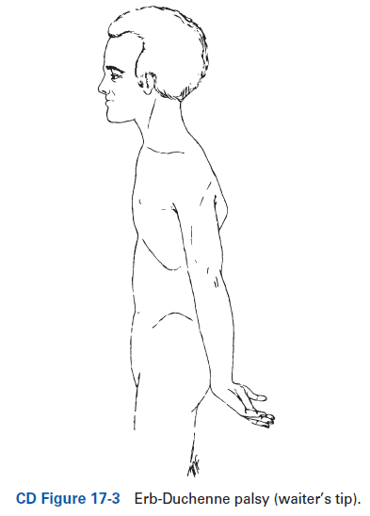
Upper Lesions of the Brachial Plexus
(Erb-Duchenne Palsy)

Slide 25
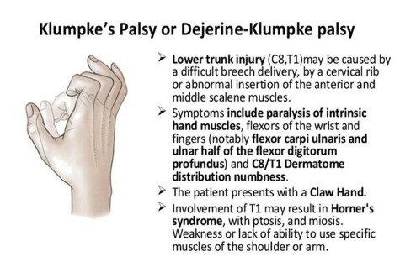
Lower Lesions of the Brachial Plexus
(Klumpke Palsy)

Slide 26
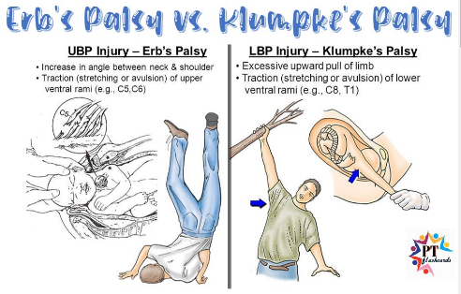

Slide 27
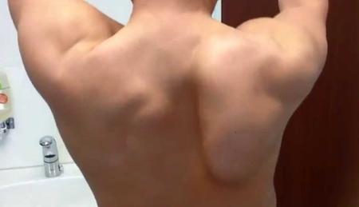
Injuries to the Long Thoracic Nerve
Winging of the Scapular

Slide 28
The End!
Thank you!

