Slide 1
THE EYEBALL

Slide 2
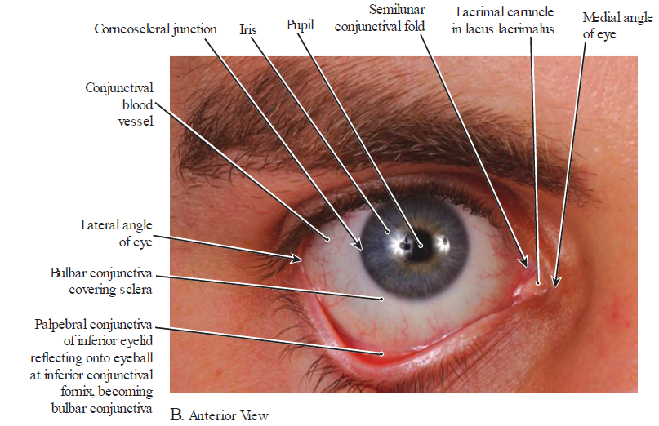

Slide 3
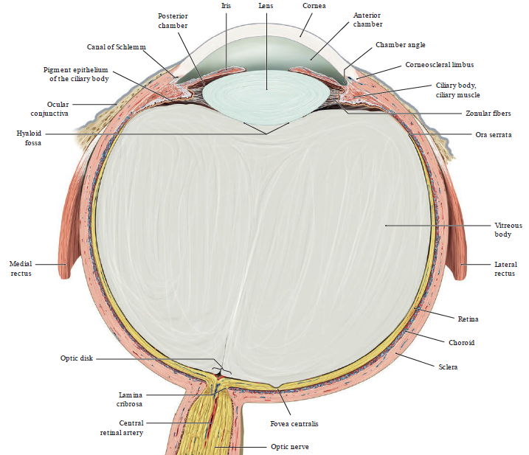

Slide 4
Introduction
The eyeball is the organ of sight.
It is almost spherical in shape.
It is made up of 2 components - internal & external
  Internal - anterior chamber to vitreous chamber
  External – 3 concentric coats:
    Outer or fibrous coat - sclera and cornea.
    Middle or vascular coat (uveal tract) - choroid, ciliary body & iris.
    Inner or nervous coat - retina

Slide 5
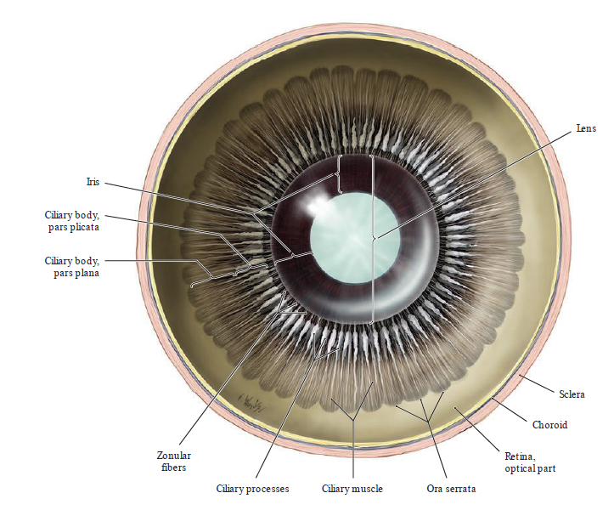
Coronal section – posterior view

Slide 6
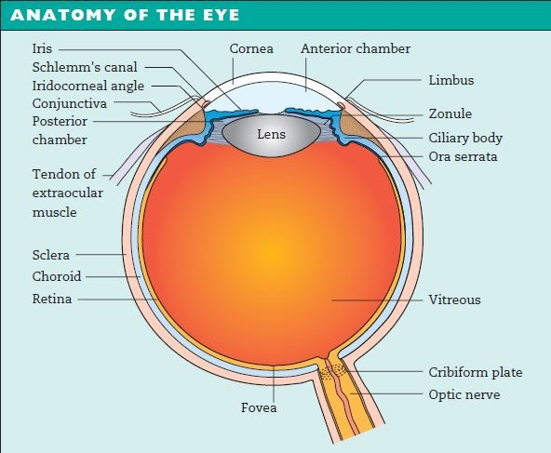
Cont’d
Its round shape is disrupted anteriorly
It bulges outwards & is transparent (cornea).
Layers of eyeball from anterior to posterior
  posterior to cornea is anterior chamber
  iris & pupil, posterior chamber
  lens,vitreous & retina

Slide 7
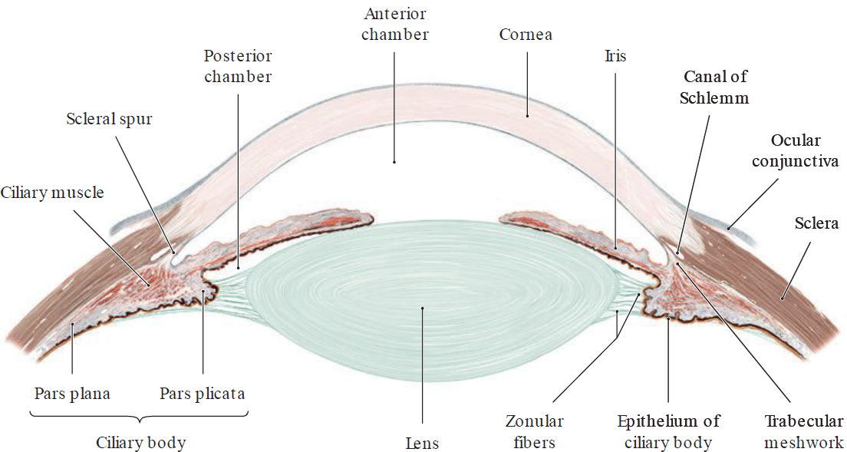
Internal component
It is comprised of: Anterior chamber & pupil, posterior chamber, lens & vitreous chamber.

Slide 8
Cont’d
Anterior & posterior chamber
  Are continuous through pupillary opening
  The chambers are filled with aqueous humor which is absorbed into scleral venous sinus (canal of Schlemm).
  Aqueous humor supplies nutrients to lens & cornea (avascular).
  The aqueous humor also maintains the intra-ocular pressure.

Slide 9
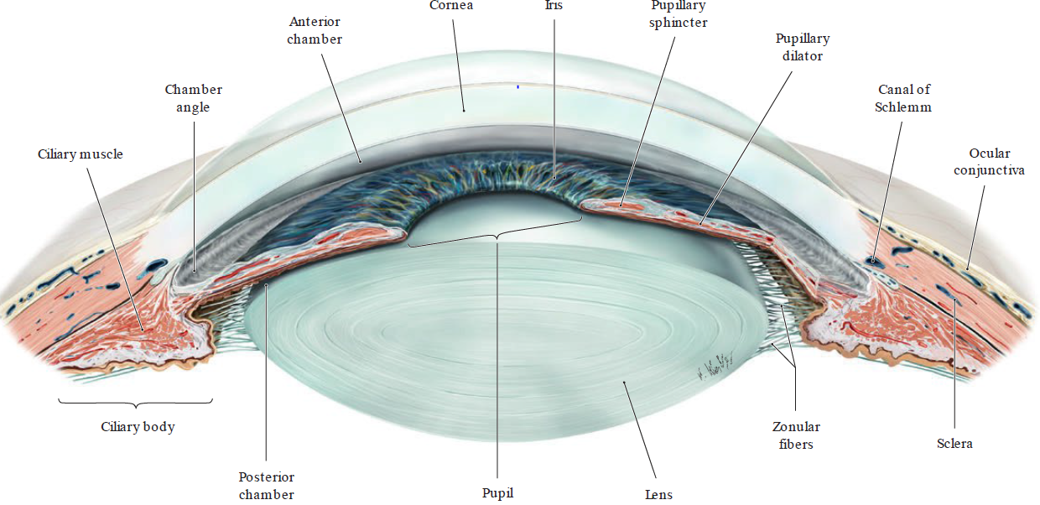
Location of the iris & anterior & posterior chambers

Slide 10
Cont’d
Lens
  It is a transparent, biconvex elastic disc that is attached circumferential by muscles.
  Separates the anterior 1/5 from posterior 4/5
  Opacity of a lens is known as cataract
Vitreous humor
  Posterior 4/5 from lens to retina is occupied by vitreous chamber.
  The chamber is filled with transparent gelatinous substance-vitreous body (humor) which is unreplaceable.

Slide 11
External components
Comprised of 3 walls
  Outer (sclera & cornea)
  Middle (choroid, ciliary body & iris)
  Inner (retina)

Slide 12
Fibrous or outer layer
  Sclera posterolateral & cornea anteriorly
Sclera
  It is opaque & forms the posterior five of the eyeball
  It is composed of dense fibrous tissue
  It is firm & maintains the shape of the eyeball
  It is thickest behind but weakest at the entrance of the optic nerve (perforations) a region referred to as the lamina cribrosa of sclera.

Slide 13
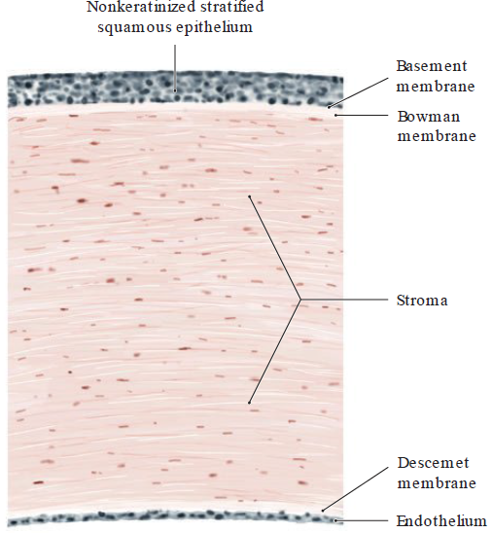
Cornea
  It is transparent & replaces the sclera over the anterior 1/5 of the eyeball.
  It is more convex than the sclera
  The cornea is avascular.
  It is made of corneal epithelium (stratified squamous non keratinized).

Slide 14
Middle or vascular layer
3 continuous parts:
  Choroid
  Ciliary body
  Iris

Slide 15
Choroid
  it is a thin pigmented layer which separates the posterior part of the sclera from the retina.
  anteriorly - ends at the Ora Serrata by merging with ciliary body
  Posteriorly - it is perforated by the optic nerve
  it is highly vascular
  Bruch’s membrane (5 layers)
    basement membrane (BM) of RPE
    inner collagenous layer
    elastic layer
    outer collagenous layer
    choriocapillaris endothelium BM

Slide 16
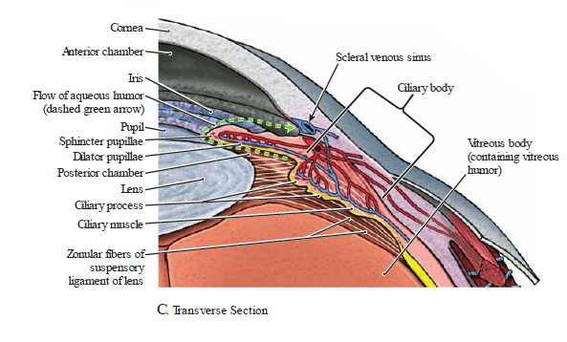
Ciliary body
  Extend anteriorly from the choroid
  Consist of ciliary muscle & processes
  Ciliary muscles
    smooth muscle fibers
    arranged in longitudinal, circular
    & radially manner
  Ciliary processes
    are ridges, attaches suspensory ligaments
    involved in the production of aqueous humor.

Slide 17
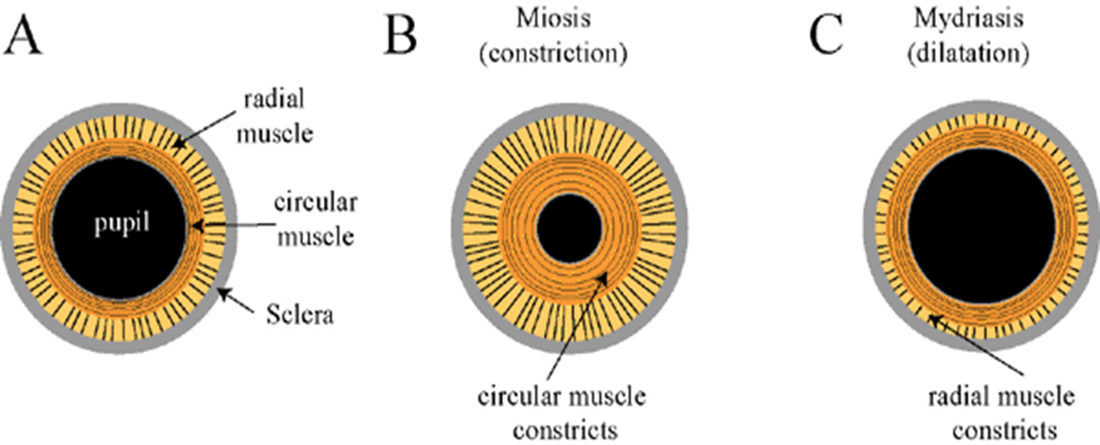
Iris
  Circular structure, projecting from ciliary body
  It is coloured part of eye with opening (pupil)
  adjusts the size of pupil - controlling the amount of light entering the eye.
  It is covered by mesothelium layer
  The sphincter pupillae forms a ring of smooth muscle
  The dilator pupillae muscles are radial arranged fibers that dilate pupil.

Slide 18
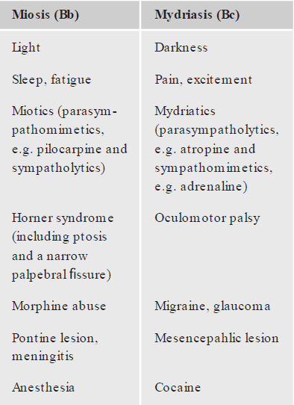
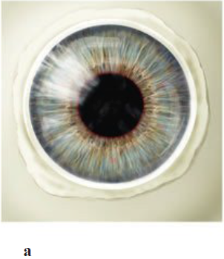
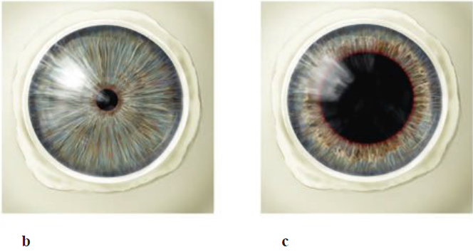
Pupil size
Normal pupil size
maximum constriction maximum dilation (miosis) (mydriasis)

Slide 19
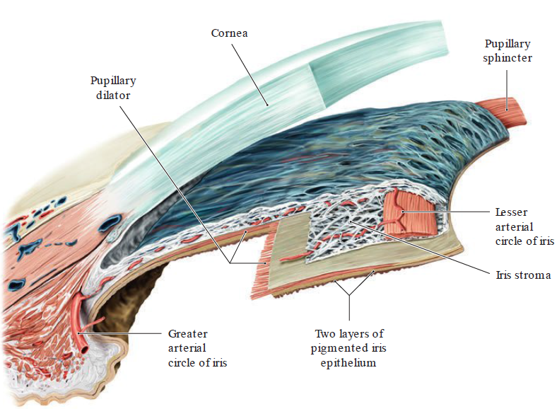
Structure of iris

Slide 20
Inner layer
Retina
  thin delicate layer of the eyeball that is continous posteriorly with the optic nerve.
  It’s outer part is attached to the choroid while the inner surface is in contact with the vitreous.
  Opposite the entrance of the optic nerve, there is a circular area known as the optic disc (blind spot).

Slide 21
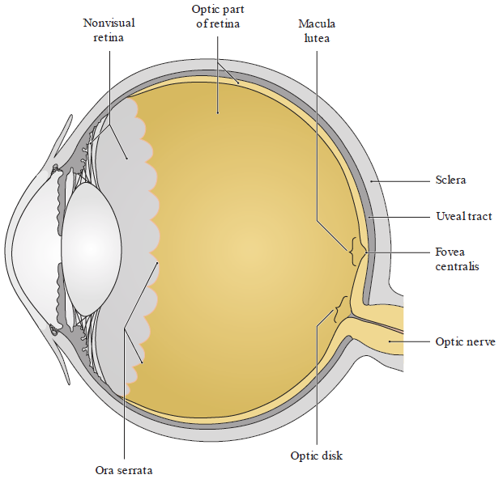
Overview of retina

Slide 22
Retina cont’d
Retina consists of 2 parts:
- Optic part posterolateral - sensitive to light
- Nonvisual part (anteriorly) covers internal surface of ciliary body & iris.
- The junction is irregular line (Ora Serrata).

Slide 23
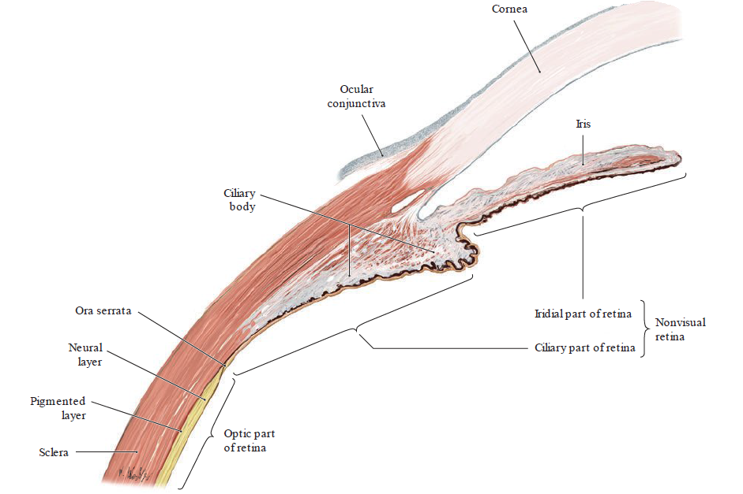
Parts of the retina

Slide 24
Retina cont’d
Optic part - consists of 2 layers:
  Outer pigmented attached to choroid & continues anteriorly over ciliary body & iris
  Inner neural is only attached to pigmented layer around optic nerve & Ora Seratta
Features on the posterior surface of the optic part of retina are:
  Optic disc - optic nerve leaves the retina
  blind spot (no light receptors)
  Macula lutea
  Fovea centralis - thin & higher visual sensitivity

Slide 25
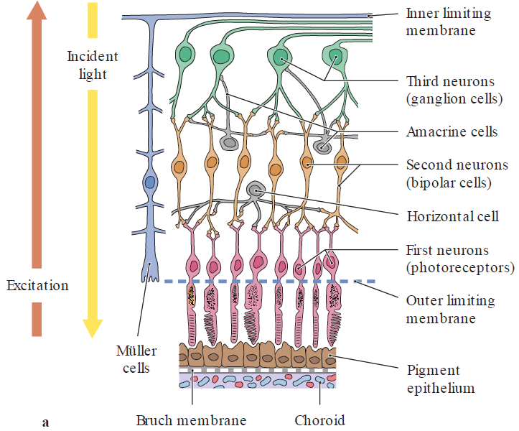
Structure of retina (Schematic diagram)
Schematic diagram of the first three neurons in the visual pathway and their connections

Slide 26
First 3 neurons in visual pathway
First neuron
  Photoreceptor cells (rods and cones)
  light-sensitive sensory cells
  transform light stimuli into electrochemical signals
  rods
    responsible for twilight and night vision
    respond to dim light & insensitive to colour
  cones
    different cones are specialized for the perception of red, green, blue
    respond to bright light & sensitive to colour

Slide 27
Cont’d
Second neuron (bipolar cells)
  receive impulses from the photoreceptors
  relay them to the ganglion cells
Third neuron (retinal ganglion cells)
  their axons converge at the optic disk (form the optic nerve)
  reach the lateral geniculate and superior colliculus

Slide 28
Retinal cells
Horizontal & Amacrine cells
  function as interneurons to establish lateral connections
Retinal Müller cells
  are glial cells
  radially span neural layer - inner to outer limiting membranes
  create a supporting framework for the neurons.
External to these cells - pigment epithelium
  their BM is attached to Bruch membrane
  mediates the exchange of substances between the adjacent choriocapillaris & photoreceptor cells.

Slide 29
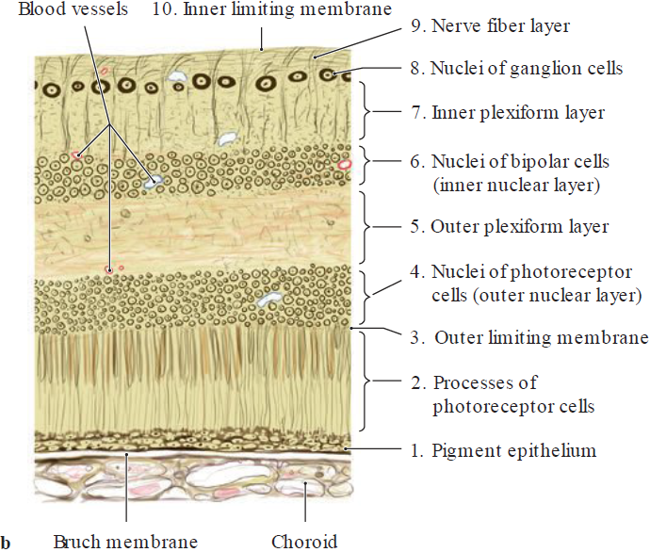
Ten anatomical layers of the retina

Slide 30
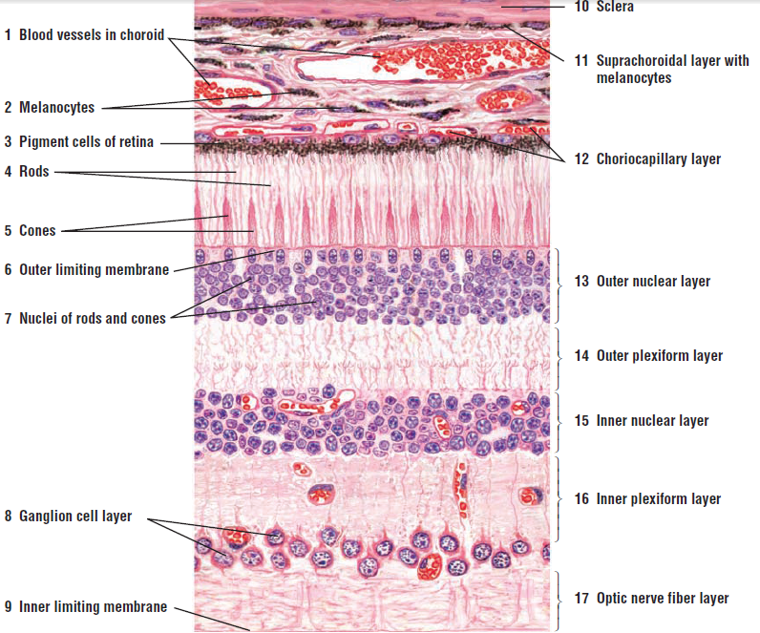
Histology of the retina, choroid & sclera
H & E stain

Slide 31
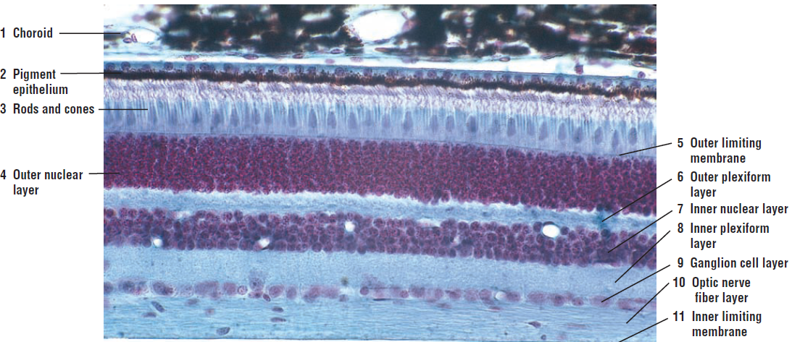
Choroid & retina (Mason’s trichrome)

Slide 32
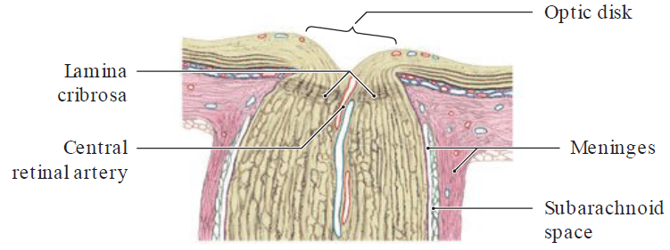
Features on the posterior surface
Optic disk (“blind spot”) & lamina cribrosa
  unmyelinated axons of the retinal ganglion cells
  pass to a collecting point at the posterior pole
  of the eye (optic disk)
  there they unite to form the optic nerve
  leave the retina through numerous perforations
  in the sclera (lamina cribrosa).

Slide 33
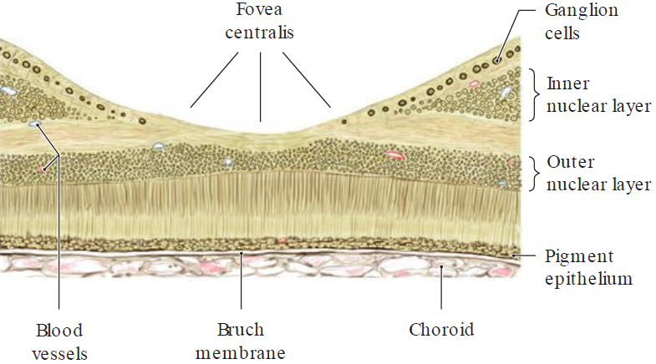
Cont’d
Macula lutea and fovea centralis

Slide 34
Cont’d
Temporal to the optic disk is the macula lutea
  At its center - the fovea centralis
  site of maximum visual acuity
  At this site the inner retinal layers are heaped toward the margin of the depression
  Importance - cells of the photoreceptors (just cones, no rods) are directly exposed to the incident light.
  This arrangement significantly reduces scattering of the light rays.

Slide 35
Vessels
Arterial
Branches of ophthalmic artery - ocular branches are as follows:
  central retinal artery - to the retina
  short posterior ciliary arteries - to the choroid
  long posterior ciliary arteries - to the ciliary body and iris
    they supply the greater and lesser arterial circles of the iris
Anterior ciliary arteries
  arise from the vessels of the rectus muscles of the eye and anastomose with the posterior ciliary vessel

Slide 36
Vessels cont’d
Venous
central retina vein
4 large veins (venae vorticosa)
  pierce the sclera behind the equator
  open into the superior or inferior ophthalmic vein.

Slide 37
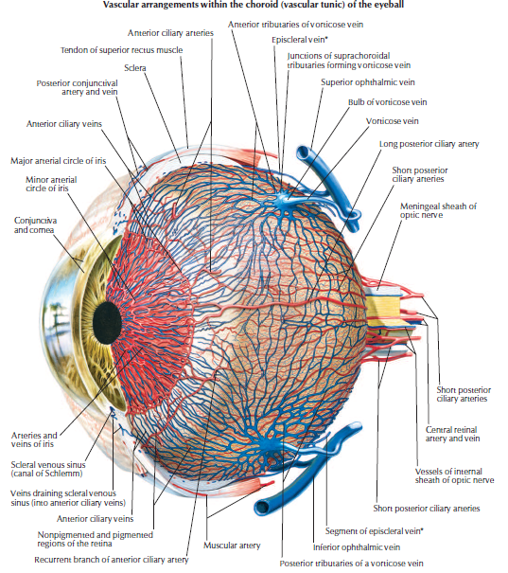

Slide 38
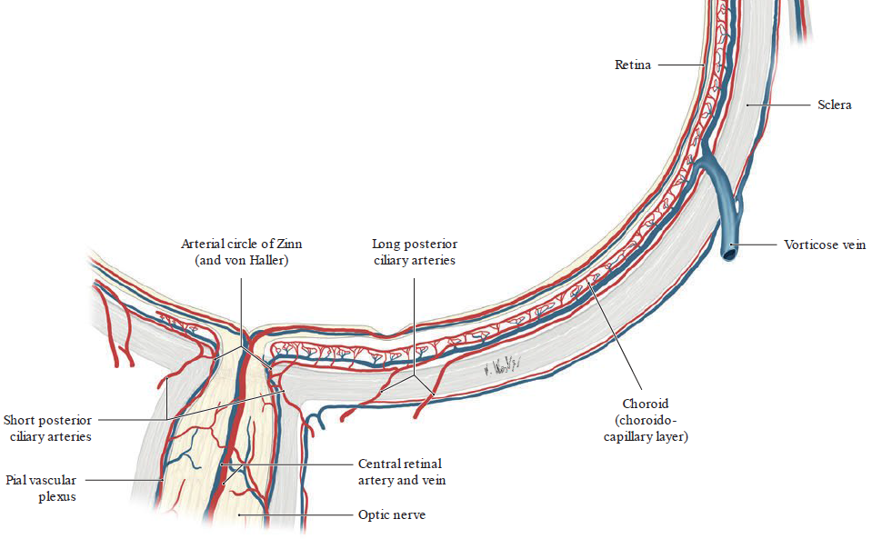
Vessels cont’d

Slide 39
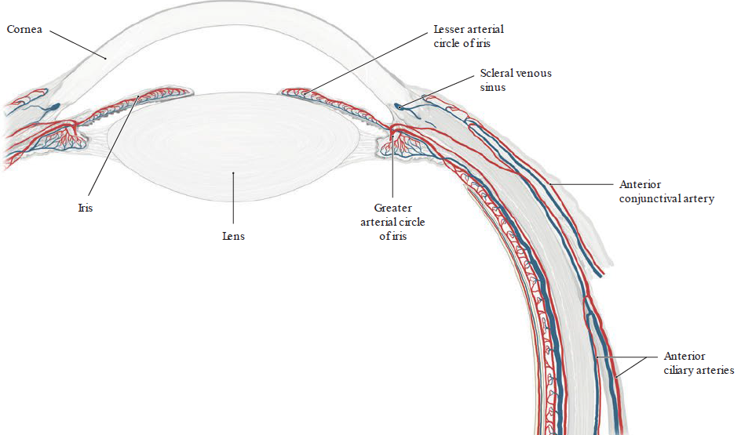
Vessels cont’d

Slide 40
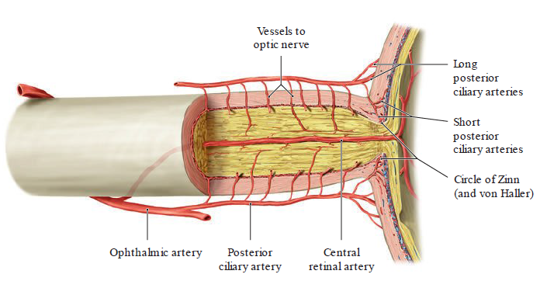
Arterial blood supply to optic nerve

Slide 41
Innervation
It is inverted by both parasympathetic & sympathetic
optic nerve

Slide 42
Embryology of the eye

Slide 43
Introduction
Early eye development results from a series of inductive signals.
The eyes are derived from four sources:
  neuroectodermal evagination of the wall of brain (diencephalon)
  surface ectoderm
  mesoderm
  neural crest cells

Slide 44
Embryology of the eye
Neuroectoderm of the diencephalon
  evaginates to form the optic vesicle,
  which in turn invaginates to form the optic cup & optic stalk.
  This induces the ectoderm to thicken & form the lens placode.
  Optic cup - forms retina, ciliary body & posterior layer of iris
  Optic stalk - forms optic nerve.

Slide 45
Cont’d
Surface ectoderm
  invaginates to form the lens placode
  which forms the lens and anterior epithelium of cornea.
Mesoderm forms:
  sclera
  portions of cornea
  vitreous body
  extraocular muscles.

Slide 46
Cont’d
Neural crest cells form:
  choroids
  sphincter pupillae muscle
  dilator pupillae muscle
  ciliary muscle
Hyaloid artery & vein form:
  central artery
  vein of the retina.

Slide 47
Applied anatomy
Colobomairidis - is a cleft in the iris caused by failure of the choroid fissure to close in week 7 of development and may extend into the ciliary body, retina, choroid, or optic nerve.
Congenital cataracts - are opacities of the lens and are usually bilateral.
Detached retina - may result from head trauma or may be congenital. The site of detachment is between the outer and inner layers of the optic cup

Slide 48
Cont’d
Persistent iridopupillary membrane - consists of strands of connective tissue that partially cover the pupil; however, it seldom affects vision.
Papilloedema - is edema of the optic disk (papilla) due to increased intracranial pressure.
Retinitis pigmentosa (RP) - is a hereditary degeneration and atrophy of the retina.
Retinoblastoma (RB) - is a tumor of the retina that occurs in childhood and develops from precursor cells in the immature retina.

Slide 49
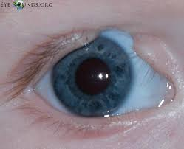
Cont’d
Coloboma of eyelid: usually characterized by a small notch in the superior (upper) eyelid
49
49

Slide 50
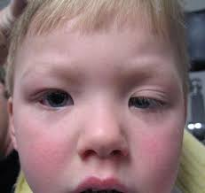
Cont’d
Congenital Ptosis: Drooping of the superior (upper) eyelids

Slide 51
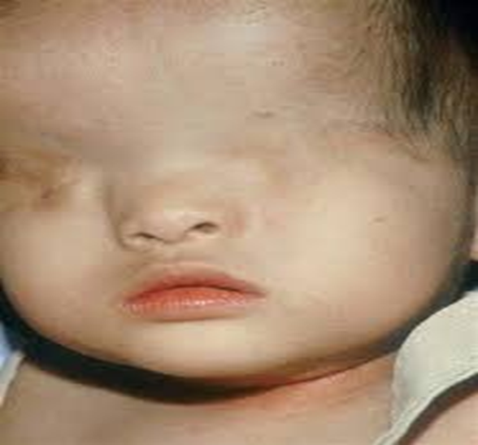
Cont’d
Cryptophthalmos: congenital absence of the eyelids; as a result, skin covers the eye.

Slide 52
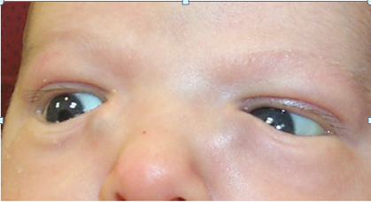
Cont’d
Congenital nasolacrimal obstruction: It is usually caused by persistence of a membrane at the distal valve of Hasner.

Slide 53
THE END
THANK YOU

Slide 54
Detailed embryology of the eye
Early eye development results from a series of inductive signals.
The eyes are derived from four sources:
  The neuroectoderm of the forebrain: differentiates into the retina, the posterior layers of the iris, and the optic nerve
  The surface ectoderm of the head: forms the lens of the eye and the corneal epithelium
  The mesoderm between the above layers: gives rise to the fibrous and vascular coats of the eye
  Neural crest cells: gives rise to the fibrous and vascular coats of the eye

Slide 55
Development of the eye
Developing eye appears in the 22-day embryo.
A pair of shallow grooves form on the sides of the proencephalon (diecephalon).
With neural tube closed, the shallow grooves evaginate to form optic vesicles.
As they grow, their connections with the forebrain constrict to form hollow optic stalks.
Vesicles come in contact with the surface ectoderm and surface ectoderm adjacent to the vesicles thickens to form lens placodes, the primordia of the lenses.

Slide 56
Cont’d
Placodes invaginate as they sink deep to the surface ectoderm, forming lens pits.
The edges of the pits approach each other and fuse to form spherical lens vesicles.
Afterwards, optic vesicles begin to invaginate to form double-layered optic cup .
The optic cup consists of an outer pigment layer and inner neural layer
The retinal fissures (optic fissures)-develop on the ventral surface of the optic cups and along the optic stalks.
The fissures contain vascular mesenchyme from which the hyaloid blood vessels develop.

Slide 57
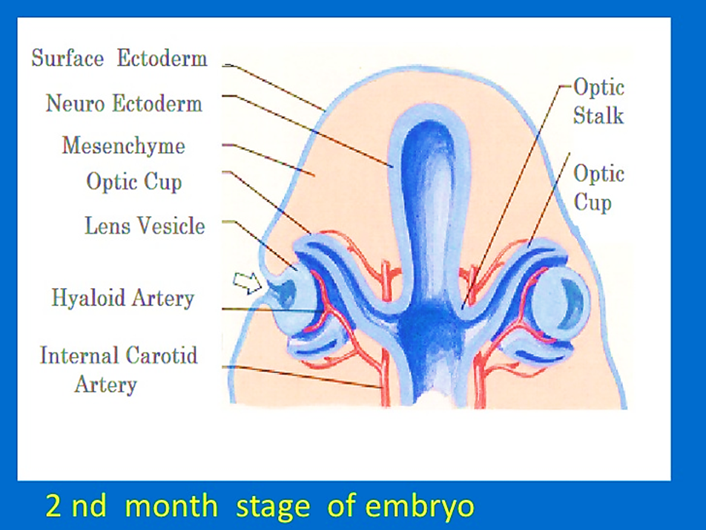
Cont’d
The hyaloid artery: supplies the inner layer of the optic cup, the lens, vesicle, and the mesenchyme in the cavity of the optic cup.
The hyaloid vein returns blood from these structures.
Edges of the retinal fissure fuse enclosing the hyaloid vessels within the primordial optic nerve.
Distal parts of the hyaloid vessels eventually degenerate, but proximal parts persist as the central artery and vein of the retina.

Slide 58
Development of retina
Inner layer of the optic cup proliferates to form a thick neuroepithelium.
The cells of this layer differentiate into the neural retina
This region contains photoreceptors (rods and cones) and the cell bodies of neurons (e.g., bipolar and ganglion cells).
The axons of ganglion cells in the superficial layer of the neural retina grow proximally in the wall of the optic stalk obliterating it as they form the optic nerve.

Slide 59
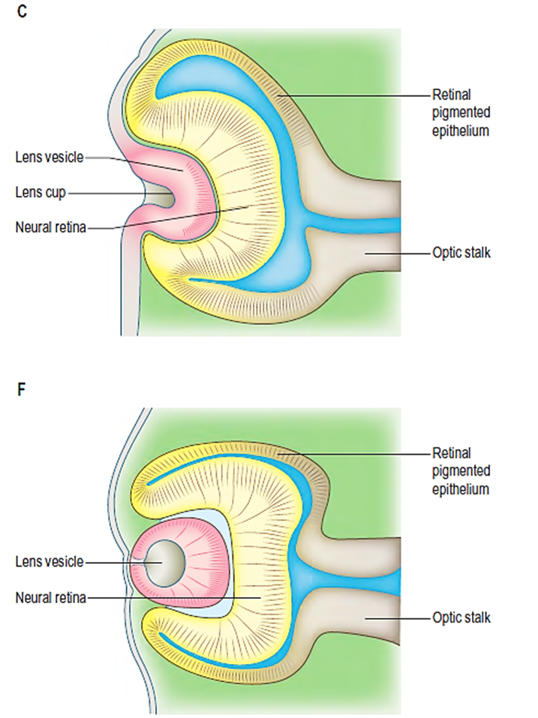
Cont’d
The outer layer of the optic cup becomes the pigmented layer of retina.
The intra-retinal space separates the outer pigment layer from the inner neural layer.
This space gradually disappears as the two layers of the retina fuse but this fusion is not firm.

Slide 60
Development of ciliary body
The ciliary body is a wedge-shaped extension of the choroid.
Its medial surface projects toward the lens, forming ciliary processes.
The pigmented portion of the ciliary epithelium is derived from the outer layer of the optic cup and is continuous with the retinal pigment epithelium.
The nonpigmented portion of the ciliary epithelium is the anterior prolongation of the neural retina in which no neural elements develop.
The ciliary muscle of the ciliary body develop from mesenchyme located in the region between the anterior scleral condensation and the ciliary pigment epithelium.

Slide 61
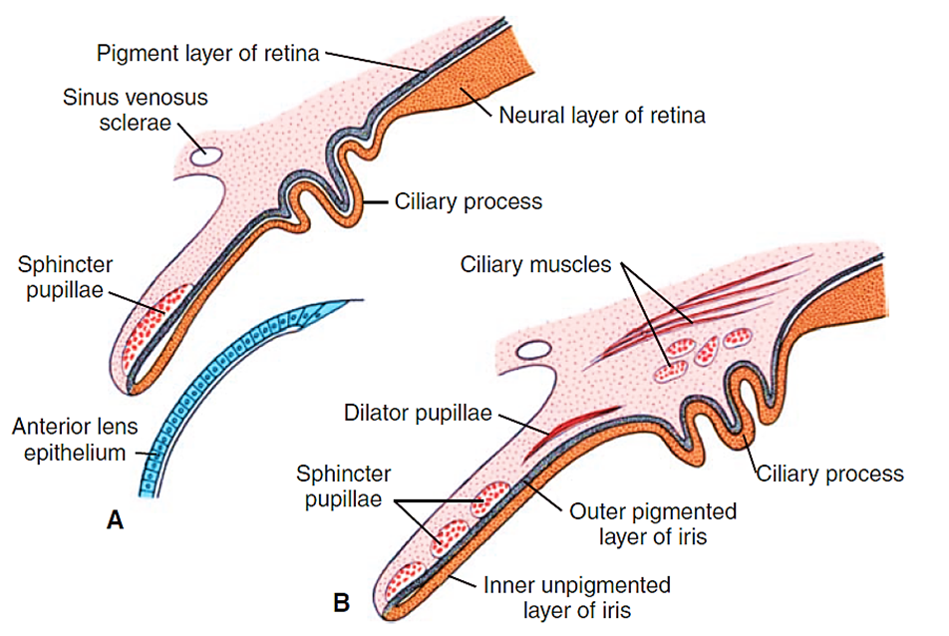
Cont’d

Slide 62
Development of iris
Develops from the rim of the optic cup.
The epithelium of the iris represents both layers of the optic cup
The stroma of the iris is derived from neural crest cells that migrate into the iris.
The dilator pupillae and sphincter pupillae muscles of the iris are derived from neuroectoderm of the optic cup.

Slide 63
Development of lens
The lens develops from the lens vesicle.
The anterior wall of this vesicle, composed of cuboidal epithelium, becomes the subcapsular lens epithelium.
The nuclei of the tall columnar cells forming the posterior wall lengthen forming the primary lens fibers.
As these fibers grow and they gradually obliterate the cavity of the lens vesicle.
Growth of the lens is not finished at this stage,since new (secondary) lens fibers are continuously added to the central core.

Slide 64
Development of vitreous body
The vitreous body forms within the cavity of the optic cup.
It is composed of vitreous humor, an avascular mass of transparent, gel-like, intercellular substance.
The primary vitreous humor is derived from mesenchymal cells of neural crest origin.
The primary vitreous humor does not increase but it is surrounded by a gelatinous secondary vitreous humor believed to arise from the inner layer of the optic cup.
The secondary vitreous humor consists of primitive hyalocytes (vitreous cells), collagenous material, and traces of hyaluronic acid.

Slide 65
Development of Choroid and Sclera
At the end of the 5th week, the eye primordium is completely surrounded by loose mesenchyme.
This tissue soon differentiates into
  An inner layer comparable with the pia mater of the brain
  An outer layer comparable with the dura mater.
The inner layer later forms a highly vascularized pigmented layer known as the choroid.
The outer layer develops into the sclera and is continuous with the dura mater around the optic nerve.

Slide 66
Development of anterior chamber
The anterior chamber develops from mesoderm over the anterior aspect of the eye that is continuous with the sclera.
It undergoes vacuolization to form a chamber.
The anterior chamber essentially splits the mesoderm into two layers:
  The mesoderm posterior to the anterior chamber is called the iridopupillary membrane, which is normally resorbed prior to birth.
  The mesoderm anterior to the anterior chamber develops into the substantia propria of the cornea and corneal endothelium.

Slide 67
Development of posterior chamber
The posterior chamber of the eye develops from a space that forms in the mesenchyme posterior to the developing iris and anterior to the developing lens.
When the pupillary membrane disappears, the pupil, the anterior and posterior chambers of the eye are able to communicate with each other through the scleral venous sinus (canal of Schlemm).
The anterior and posterior chambers are filled with fluid called the aqueous humor produced by the ciliary process of the ciliary body.

Slide 68
Development of cornea
The cornea develops from both surface ectoderm and mesoderm lying anterior to the anterior chamber.
The surface ectoderm - forms the anterior epithelium of the cornea.
The mesoderm - forms the substantia propria of the cornea (i.e., Bowman's layer, stroma, and Descemet's membrane) and corneal endothelium.

Slide 69
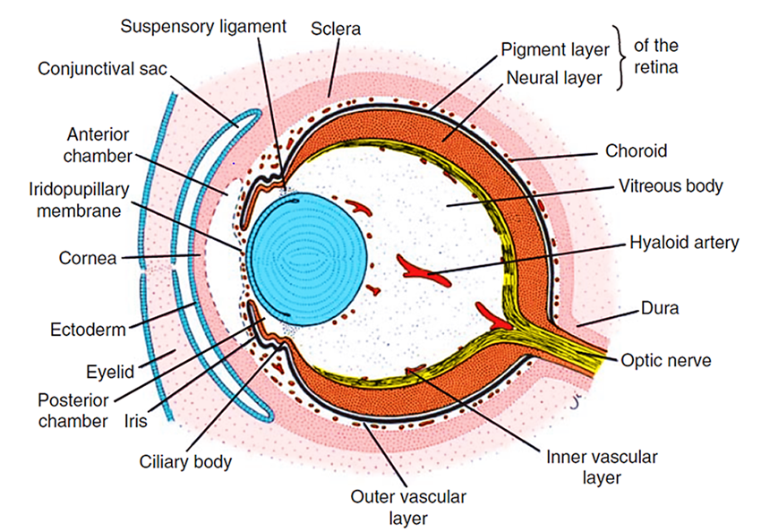
Development of the eyelid
The eyelids develop during the 6th week from neural crest cell mesenchyme and from two cutaneous folds of ectoderm that grow over the cornea.
The eyelids adhere to one another by the beginning of the 10th week enclosing the conjunctival sac
They remain adherent until the 26th to the 28th week.

Slide 70
Cont’d
When the eyelids open, the conjunctiva lining their inner surfaces and covering the scleral region of the eye fuses with the corneal epithelium
The eyelashes and glands in the eyelids are derived from the surface ectoderm
The connective tissue and tarsal plates develop from mesenchyme in the developing eyelids.
The orbicularis oculi muscle is derived from mesenchyme in the second pharyngeal arch

Slide 71
Development of lacrimal gland and duct
At the superolateral angles of the orbits, the lacrimal glands develop from a number of solid buds from the surface ectoderm.
The buds branch and become canalized to form the nasolacrimal ducts.
The lacrimal glands are small at birth and do not function fully until approximately 6 weeks. Therefore, the newborn infant does not produce tears when it cries.
Tears are often not present with crying until 1 to 3 months.

Slide 72
References
BRS Embryology- Dudek & James: 3rd Ed.
Langman’s Medical Embryology-Sadler: 13th Ed.
The Developing Human-Moore & Persuad: 8th Ed.

