Slide 2
A Nuclei and emergence from the ponsa Anterior view.
The larger sensory nuclei of the trigeminal nerve are distributed along the brainstem and extend downward into the spinalcord.
The sensory root (major part) of the trigeminal nerve
  forms the bulk of the fibers, while the motor root (minor part) is formed by fibers arising from the small motor nucleus in the pons.
  They supply motor innervation to the muscles of mastication (see B).
The following somatic afferent nuclei are distinguished:
Mesencephalic nucleus of the trigeminal nerve:
  proprioceptive fibers from the muscles of mastication.
  neurons of this nucleus are pseudounipolar ganglion
Principal (pontine) sensory nucleus of the trigeminal nerve: chiefly mediates touch.
Spinal nucleus of the trigeminal nerve:
  pain
  temperature sensation,
  also touch.
A small, circumscribed lesion of the trigeminal spinal sensory nucleus leads to characteristic sensory disturbances in the face (see D).

Slide 3
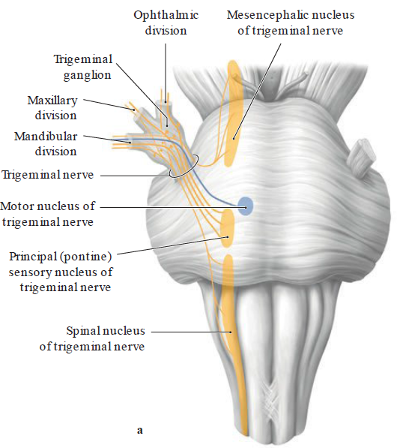

Slide 4
Cross-section
through the pons at the level of emergence of the trigeminal nerve, superior view (schematic as the three nuclei are located at different levels).

Slide 5
C Course and distribution of the trigeminal nerve
a Left lateral view. The three divisions of the trigeminal nerve and clinically
important terminal branches are shown.
All three divisions of the trigeminal nerve supply the skin of the face (b)
and the mucosa of the nasopharynx (c). The anterior two-thirds of the
tongue (d) receives sensory innervation (touch, pain and thermal sensation,
but not taste) via the lingual nerve, which is a branch of the mandibular
division (CN V3). The muscles of mastication are supplied by the
motor root of the trigeminal nerve, whose axons enter the mandibular
division (e ).

Slide 6
Note: The e erent bers course exclusively in the mandibular division.
A peripheral trigeminal nerve lesion involving one of its divisions—
ophthalmic (CN V1), maxillary (CN V2), or mandibular (CN V3)—may
cause loss of somatic sensation (touch, pain, and temperature) in the
area innervated by the a erent nerve (see b). This contrasts with the
more concentric pat tern, and more restricted modality, of sensory decit
produced by a central (CNS) lesion involving trigeminal nuclei and
pathways (see D).

Slide 7
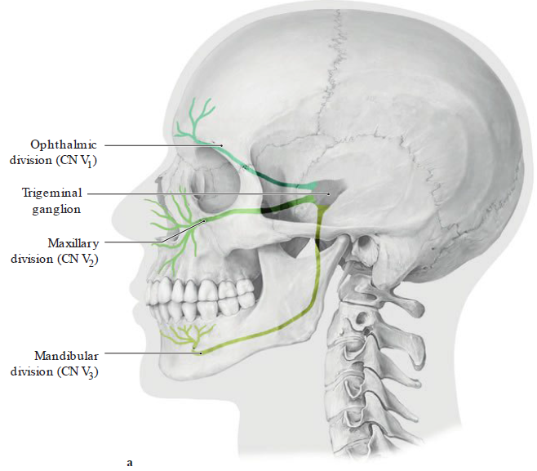

Slide 8
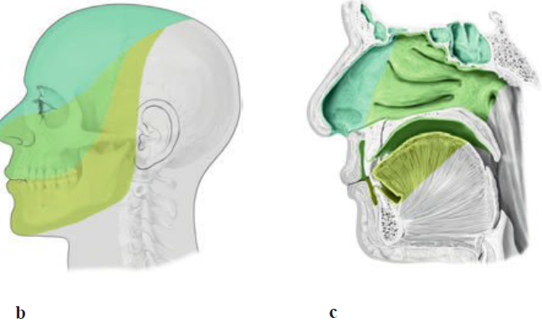

Slide 9
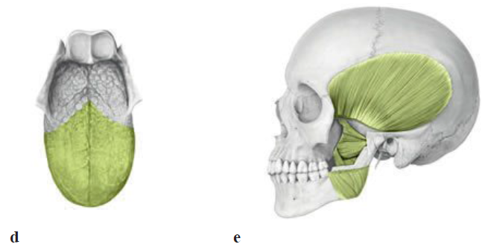

Slide 10
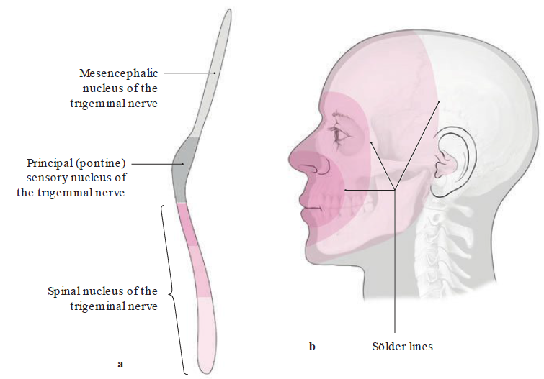

Slide 11
D Central trigeminal lesion
a Somatotopic organization of the spinal nucleus
of the trigeminal nerve. b Facial zones
in which sensory de cits (pain and temperature)
arise when certain regions of the trigeminal
spinal nucleus are destroyed. These zones
follow the concentric Sölder lines in the face.
Their pat tern indicates the corresponding portion
of the trigeminal nucleus in which the lesion
is located (matching color shades).

Slide 12
The trigeminal nerve, the sensory nerve of the head, contains mostly somatic afferent fibers with a smaller proportion of special visceral efferent fibers.
Its three major somatic divisions have the following sites of emergence from the MCF:
  Ophthalmic division (CN V1): enters the orbit through the superior orbital fissure.
  Maxillary division (CN V2): enters the pterygopalatine fossa through the foramen rotundum.
  Mandibular division (CN V3): passes through the foramen ovale to the inferior surface of the base of the skull into the infratemporal fossa; only division containing motor fibers.

Slide 13
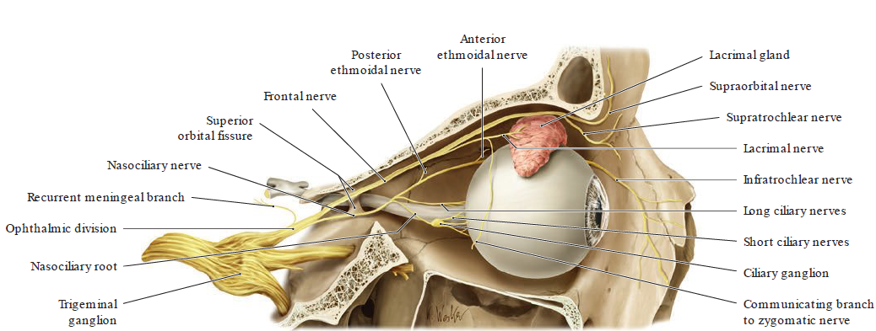

Slide 14
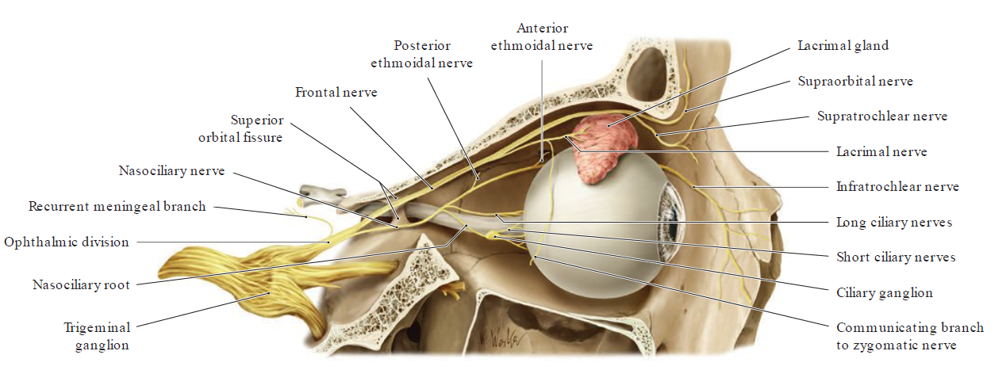

Slide 15
Lateral view of the partially opened right orbit. The rst small branch
arising from the ophthalmic division is the recurrent meningeal branch,
which supplies sensory innervation to the dura mater. The bulk of the
ophthalmic division bers enter the orbit from the middle cranial fossa
by passing through the superior orbital ssure. The ophthalmic division
divides into three branches the names of which indicate their distribution:
the lacrimal nerve, frontal nerve, and nasociliary nerve.

Slide 16
Note: The lacrimal nerve receives postsynaptic, parasympathetic secretomotor
bers from the zygomatic nerve (maxillary division of CN V) via
a communicating branch (branch of the maxillary n., V2; see B). These -
bers travel to the lacrimal gland by the lacrimal nerve. Sympathetic -
bers accompany the long ciliary nerves that arise from the nasociliary
nerve, traveling in these nerves to the pupil. The ciliary nerves also contain
a erent bers that mediate the corneal re ex. Sensory bers from
the eyeball course in the nasociliary root, passing through the ciliary
ganglion to the nasociliary nerve.

Slide 17
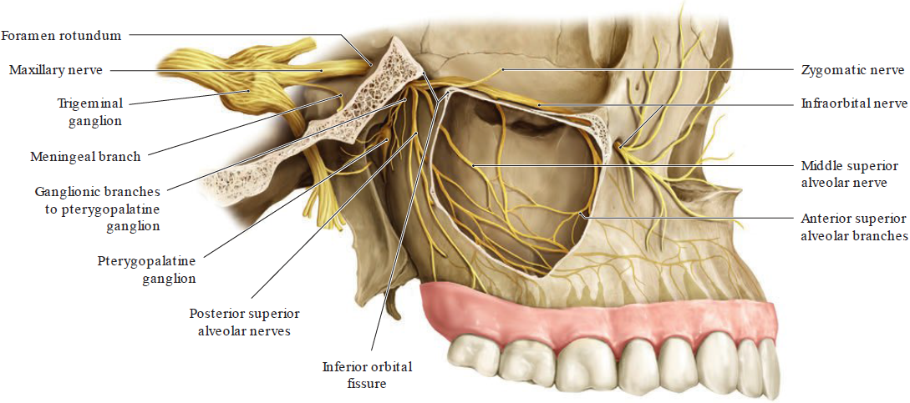
Branches of the maxillary division (= second division of the trigeminal nerve, CN V2) in the maxillary region

Slide 18
Lateral view of the partially opened right maxillary sinus with the zygomatic
arch removed. After giving o a meningeal branch, the maxillary
division leaves the middle cranial fossa through the foramen rotundum
and enters the pterygopalatine fossa, where it divides into the following
branches:
• Zygomatic nerve
• Ganglionic branches to the pterygopalatine ganglion (sensory root of
the pterygopalatine ganglion)
• Infraorbital nerve
The zygomatic nerve enters the orbit through the inferior orbital ssure.
Its two terminal branches, the zygomaticofacial branch and zygomaticotemporal
branch (not shown here), supply sensory innervation to the
skin over the zygomatic arch and temple.

Slide 19
Parasympathetic, postsynaptic
bers from the pterygopalatine ganglion are carried to the lacrimal
nerve by the communicating branch (see p. 121). The preganglionic -
bers originally arise from the facial nerve. The infraorbital nerve also
passes through the inferior orbital ssure into the orbit, from which it
enters the infraorbital canal. Its ne terminal branches supply the skin
between the lower eyelid and upper lip. Its other terminal branches
form the superior dental plexus, which supplies sensory innervation to
the maxillary teeth:
• Anterior superior alveolar branches to the incisors
• Middle superior alveolar branch to the premolars
• Posterior superior alveolar branches to the molars

Slide 20
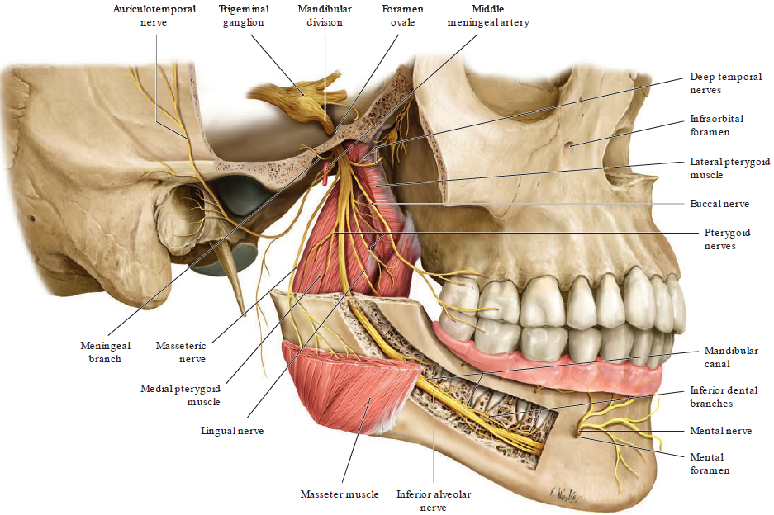
C Branches of the mandibular division (= third division of the trigeminal nerve, CN V3) in the mandibular region

Slide 21
Right lateral view of the partially opened mandible with the zygomatic
arch removed. The mixed a erent-e erent mandibular division leaves
the middle cranial fossa through the foramen ovale and enters the infratemporal
fossa on the external aspect of the base of the skull. Its meningeal
branch re-enters the middle cranial fossa to supply sensory innervation
to the dura. Its sensory branches are as follows:
• Auriculotemporal nerve
• Lingual nerve
• Inferior alveolar nerve (also carries motor bers, see below)
• Buccal nerve

Slide 22
The branches of the auriculotemporal nerve supply the temporal skin,
the external auditory canal, and the tympanic membrane. The lingual
nerve supplies sensory bers to the anterior two-thirds of the tongue,
and gustatory bers from the chorda tympani (facial nerve branch)
travel with it. The a erent bers of the inferior alveolar nerve pass through
the mandibular foramen into the mandibular canal, where they give o
inferior dental branches to the mandibular teeth. The mental nerve is
a terminal branch that supplies the skin of the chin, lower lip, and the
body of the mandible.

Slide 23
The e erent bers that branch from the inferior
alveolar nerve supply the mylohyoid muscle and the anterior belly of
the digastric (not shown). The buccal nerve pierces the buccinator muscle
and supplies sensory innervation to the mucous membrane of the
cheek. The pure motor branches leave the main nerve trunk just distal
to the origin of the meningeal branch. They are:
• Masseteric nerve (masseter muscle)
• Deep temporal nerves (temporalis muscle)
• Pterygoid nerves (pterygoid muscles)
• Nerve of the tensor tympani muscle
• Nerve of the tensor veli palatini muscle (not shown)

Slide 24
Clinical assessment of trigeminal nerve function
D
Each of the three main divisions of the trigeminal nerve is tested separately
during the physical examination. This is done by pressing on the
nerve exit points with one nger to test the sensation there (local tenderness
to pressure). The typical nerve exit points are as follows:
• For CN V1: the supraorbital foramen or supraorbital notch
• For CN V2 : the infraorbital foramen
• For CN V3 : the mental foramen

Slide 25
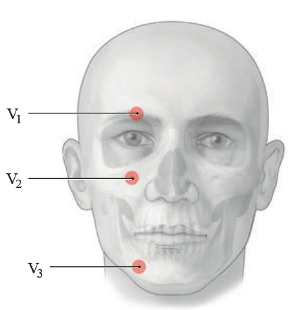

Slide 26
Nuclei and distribution:
• Special visceral e erent: E erent bers from the motor nucleus of the
trigeminal nerve pass in the mandibular division (CN V3) to
– Muscles of mastication (temporalis, masseter, medial, and lateral
pterygoid)
– Oral oor muscles: mylohyoid and anterior belly of the digastric
– Middle ear muscle: tensor tympani
– Pharyngeal muscle: tensor veli palatini
• Somatic a erent: The trigeminal ganglion contains pseudounipolar
ganglion cells whose central bers pass to the sensory nuclei of the
trigeminal nerve (see A a). Their peripheral bers innervate the facial
skin, large portions of the nasopharyngeal mucosa, and the anterior
two-thirds of the tongue (somatic sensation, see C).

Slide 27
• “Visceral e erent pathway”: The visceral e erent bers of some cranial
nerves adhere to branches or sub-branches of the trigeminal nerve,
by which they travel to their destination:
– The lacrimal nerve (branch of CN V1) conveys parasympathetic -
bers from the facial nerve along the zygomatic nerve (branch of
CN V2) to the lacrimal gland.
– The auriculotemporal nerve (branch of CN V3) conveys parasympathetic
bers from the glossopharyngeal nerve to the parotid gland.
– The lingual nerve (branch of CN V3) conveys parasympathetic -
bers from the chorda tympani of the facial nerve to the submandibular
and sublingual glands.
• “Visceral a erent pathway”: Gustatory bers from the facial nerve
(chorda tympani) travel by the lingual nerve (branch of CN V3) to
supply the anterior two-thirds of the tongue.
Developmentally, the trigeminal nerve is the nerve of the rst
branchial arch.

Slide 28
Clinical disorders of the trigeminal nerve :
Sensory disturbances and de cits may arise in various conditions:
• Sensory loss due to traumatic nerve lesions.
• Herpes zoster ophthalmicus (involvement of the territory of the rst
division of the trigeminal nerve, including the skin and/or the eye, by
the varicella-zoster virus); herpes zoster of the face.
The a erent bers of the trigeminal nerve (like the facial nerve, see p.
118) are involved in the corneal re ex (re ex closure of the eyelid; see
C, p. 469).

