Slide 1
SUMMARY OF CRANIAL NERVES

Slide 2
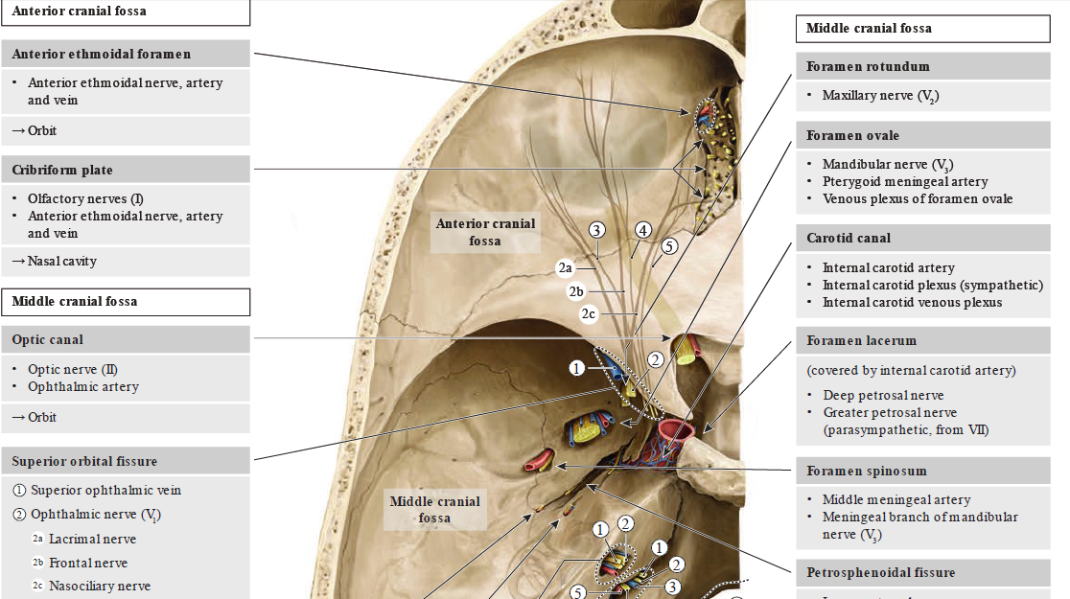

Slide 3
Introduction
12 pairs - CNI – CNXII
CN I & CN II
  CNS pathways that are covered by meninges
  contain oligodendrocytes & microglial cells
CN may contain both afferent & efferent axons which belong either:
  Somatic nervous system (somatic fibers)
  Autonomic nervous system (visceral fibers)
  Combinations of different GFT - 4 possible compositions.

Slide 4
Components with combination of GFT
  General somatic afferents (GSA) - somatic sensation
  impulses from the skin & skeletal muscle spindles
  General somatic efferents (GSE) - somatomotor function
  Innervation to skeletal muscles
  General visceral afferents (GVA) - visceral sensation
  impulses from the viscera & blood vessels
  General visceral efferents (GVE) - visceromotor function
  Innervation to smooth muscle of the viscera, intraocular muscles, heart, salivary glands etc

Slide 5
Components with special fiber types
Special somatic afferents (SSA)
  impulses from the retina, auditory & vestibular apparatus
Special visceral afferents (SVA)
  impulses from the taste buds of the tongue & olfactory mucosa
Special visceral efferents (SVE)
  Innervation to skeletal muscles derived from the branchial arches (branchiogenic efferents & branchiogenic muscles)

Slide 6
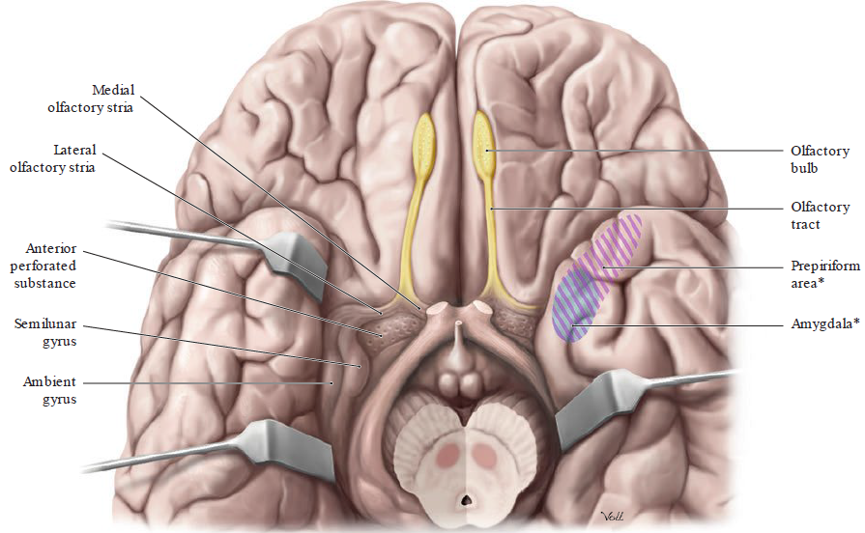
CN I

Slide 7
CN I cont’d
Origin – roof of nasal cavity (olfactory epithelium) & exit through Cribriform plate
Structures supplied – nasal cavity
Fiber components
  SVA
Function – Olfaction (Smell)
Type – sensory nerve

Slide 8
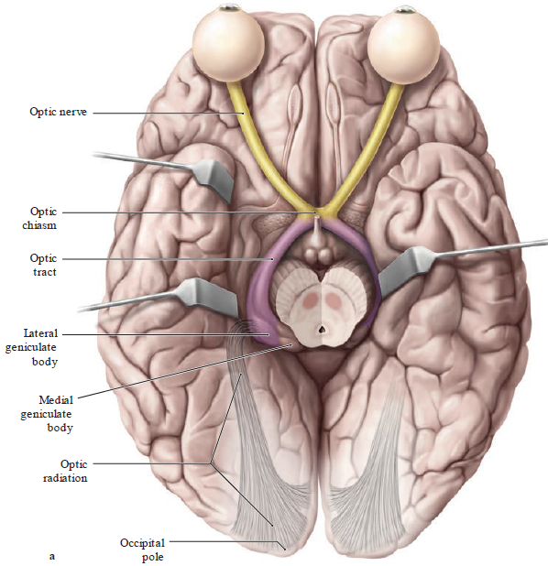
CN II

Slide 9
CN II cont’d
Origin - Ganglion cells of retina & exist through Optic canal together with opthalmic artery
Structures supplied – eye (photorecptors)
Fiber components
  SSA
Function - Vision
Type – Sensory nerve

Slide 10
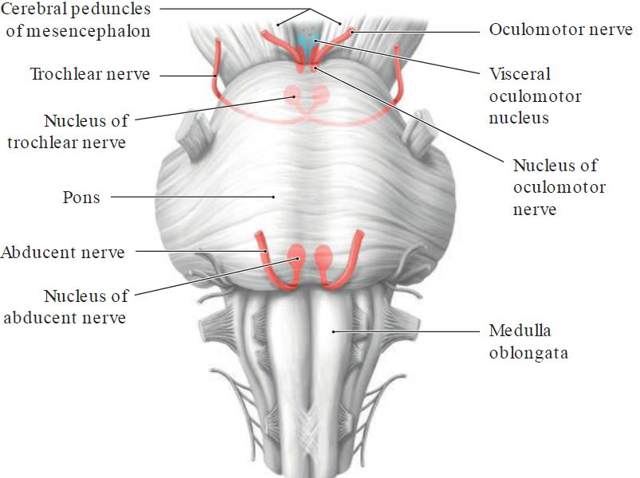
CN of extraocular muscles
CN III, CN IV & CN VI

Slide 11
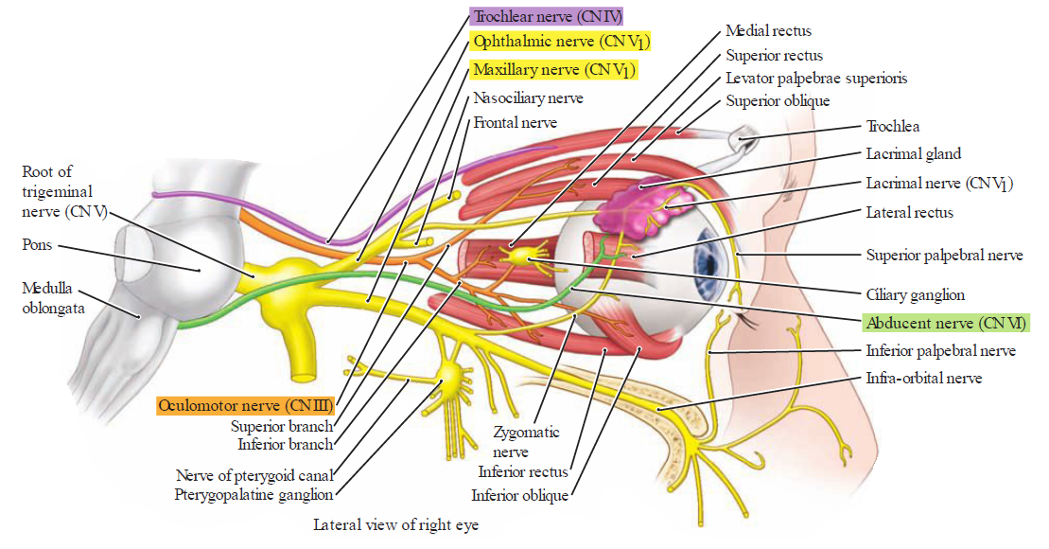
CN III, IV & VI

Slide 12
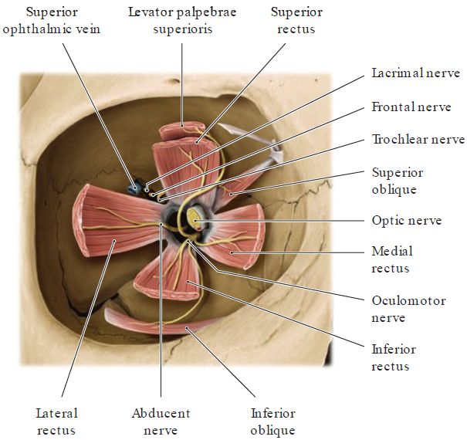
CN III
Origin – midbrain exists through SOF
Nuclei - oculomotor nucleus & visceral oculomotor (Edinger-Westphal)
Fiber components & function
  GSE (eye movts)
    levetor palpebral superioris
    sup, med, inf rectus ms
    inf oblique ms
  GVE (parasympathetic fibers)
    sphincter pupillae ms (constriction of pupil)
    ciliaris ms ( accommodation)
Clinical correlates - ptosis, mydriasis, accommodation difficulties.
Type – primarily motor nerve

Slide 13
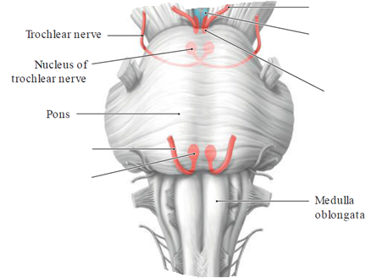
CN IV
Origin - midbrain (Inf. colliculus) & exit through SOF
Nuclei - nucleus CN IV
Fiber components & function
  GSE (eye movts)
    sup oblique ms
Clinical correlates
  affected eye is higher & deviated medially
Function – eye movement (depress & lat rotation)
Type – motor nerve

Slide 14
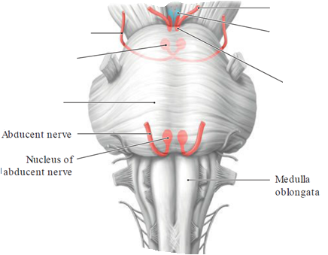
CN VI
Origin - Pons & exist SOF
Nuclei - nucleus CN VI
Fiber components & function
  GSE (eye movts)
    lat rectus ms
Motor nerve
Clinical correlates -the affected eye is deviated medially.

Slide 15
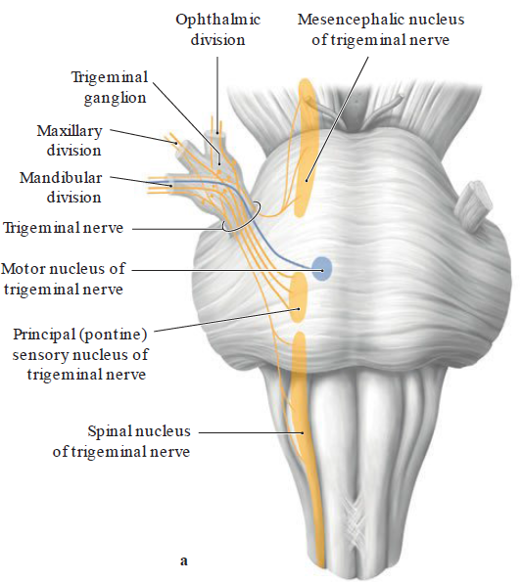
CN V

Slide 16
CN V cont’d
Ophthalmic division (CN V1) - enters the orbit through SOF
Maxillary division (CN V2) - enters the pterygopalatine fossa through the foramen rotundum.
Mandibular division (CN V3) - passes through the foramen ovale - only division containing motor fibers

Slide 17
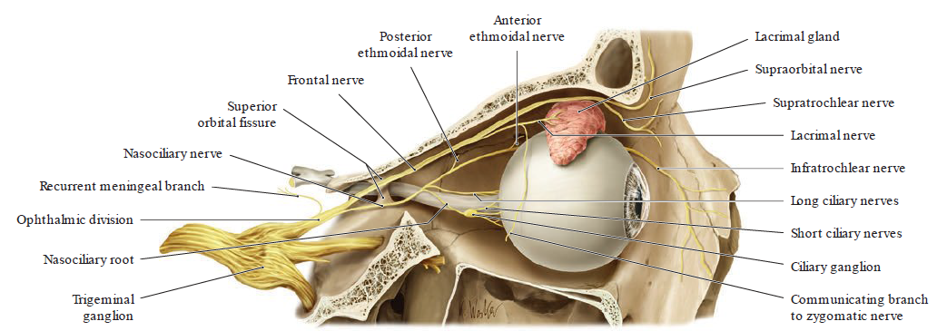
V1

Slide 18
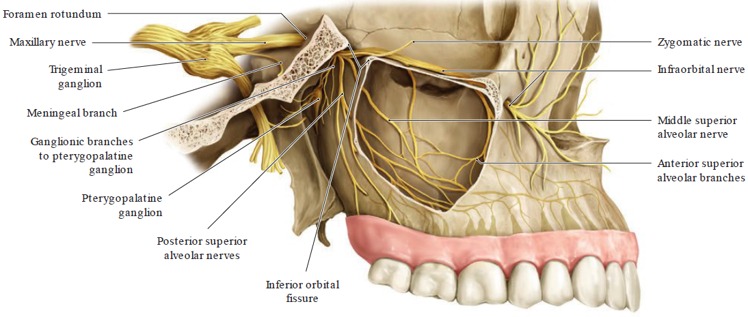
V2

Slide 19
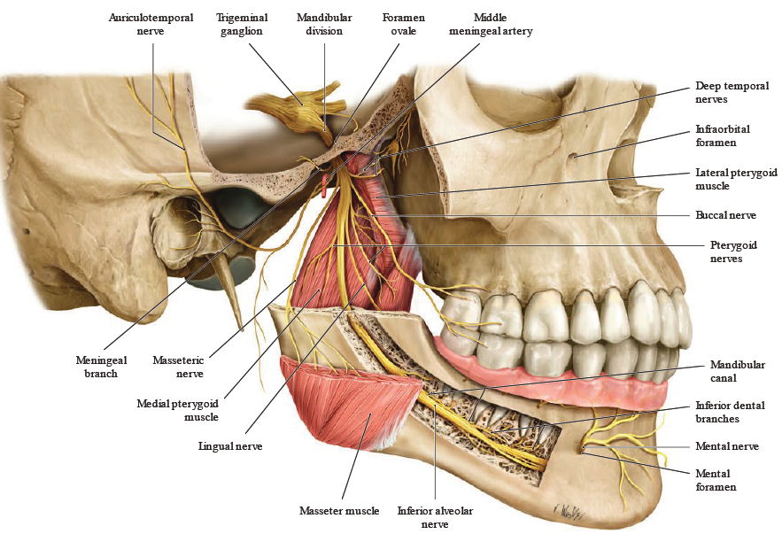
V3

Slide 20
CN V cont’d
SVE (1st brachial arch ms)
  muscles of mastication
  oral floor muscles
  middle ear muscle - tensor tympani
  pharyngeal muscle - tensor veli palatini
GSA( touch, pain ,temp)
  Sensation on head (skin & mucous membrane of face and head)
  Function – mastication & sensation
  Type – mixed nerve

Slide 21
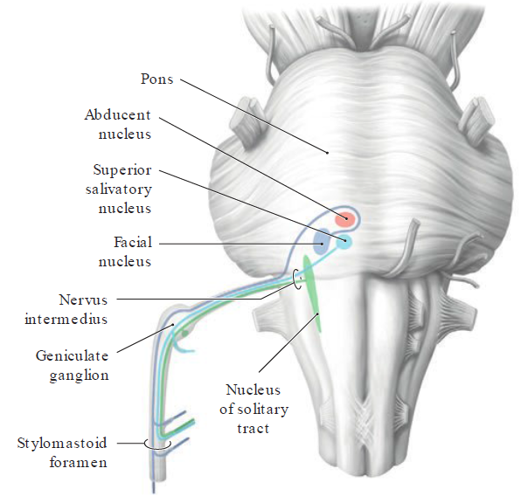
CN VII
Origin
- Pons
Exit
- stylomastoid foramen

Slide 22
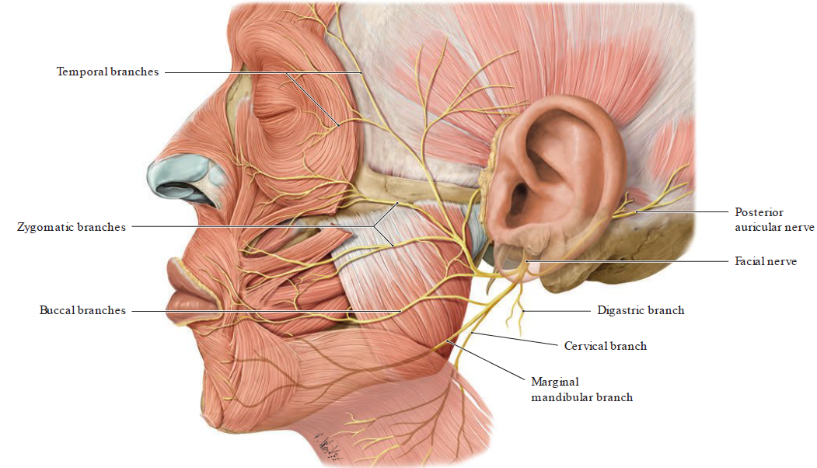
Branches to muscles of facial expression

Slide 23
CN VII
Cell bodies and components
  Motor nucleus CN VII
    GSE - muscle of facial expression, post belly of digastric, stylohyoid and stapeduis
  Superior salivatory nucleus
    visceromotor, presynaptic parasympathetic neurons
    GVE – lacrimal and salivatory secretions

Slide 24
CN VII cont’d
  Geniculate ganglion
    SVA – taste anterior 2/3 of tongue
    GVA – sensation from palate
    GSA – Auricle & external acoustic meatus
Function
  facial expression
  lacrimation
  secretion
  Taste
  Touch pain temperature

Slide 25
CN VIII
Origin – pons-medulla junction & does not exit skull
Vestibular nuclei
  Superior vestibular nucleus (of Bechterew)
  Lateral vestibular nucleus (of Deiters)
  Medial vestibular nucleus (Schwalbe)
  Inferior vestibular nucleus (of Roller)
Cochlear nuclei
  Anterior cochlear nucleus
  Posterior cochlear nucleus

Slide 26
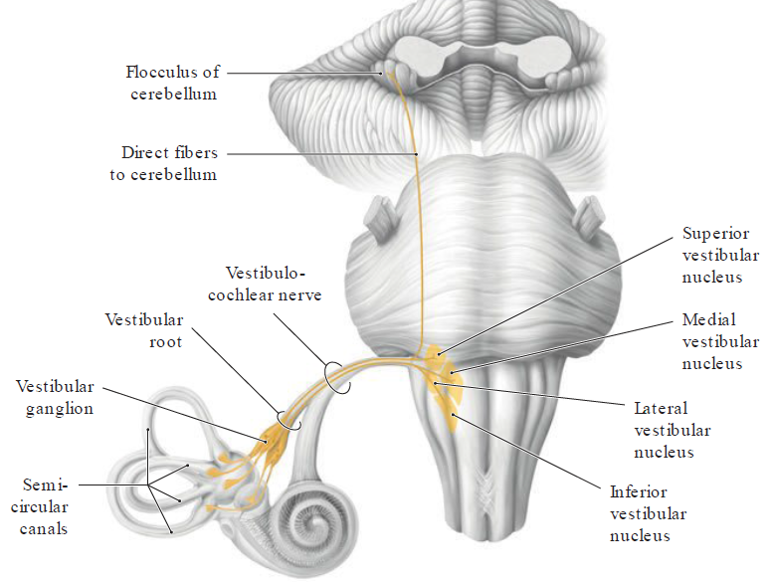
Vestibular nuclei

Slide 27
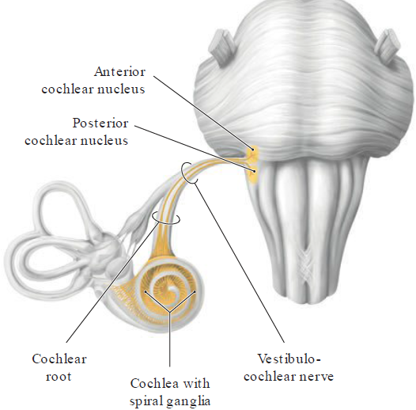
Cochlear nuclei

Slide 28
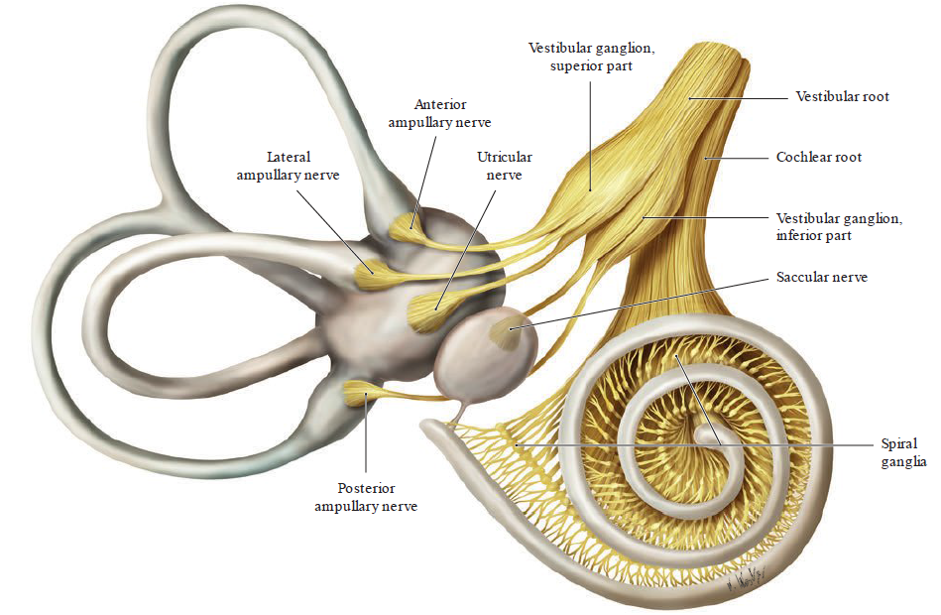
CN VIII cont’d

Slide 29
CN VIII cont’d
Cell bodies and components
  Vestibular ganglion
    Central processes – nuclei
    Peripheral processes – utricle, saccule & semicircular canals
    SSA – equilibrium
  Spiral ganglion
    Central processes – 2 cochlear nuclei
    Peripheral processes – begin hair cells of Organ of Corti
    SSA – hearing

Slide 30
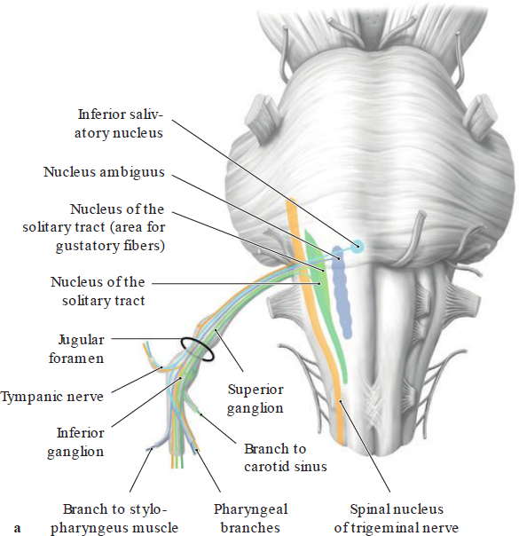
CN IX
Origin
medulla
Exit
through jugular foramen

Slide 31
CN IX cont’d
Cell bodies and components
  Nucleus ambiguus (medulla)
    SVE – elevation of pharynx (stylopharyngeus ms)
  Inferior salivary nucleus
    GVE – secretion of saliva (parotid gland)
  Inferior ganglion
    SVA - taste from post. 1/3 of tongue
  Superior ganglion
    GSA – external ear

Slide 32
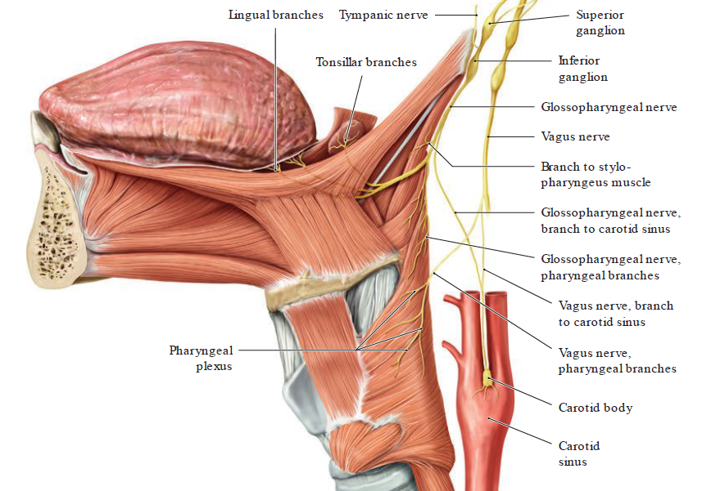
CN IX beyond skull base

Slide 33
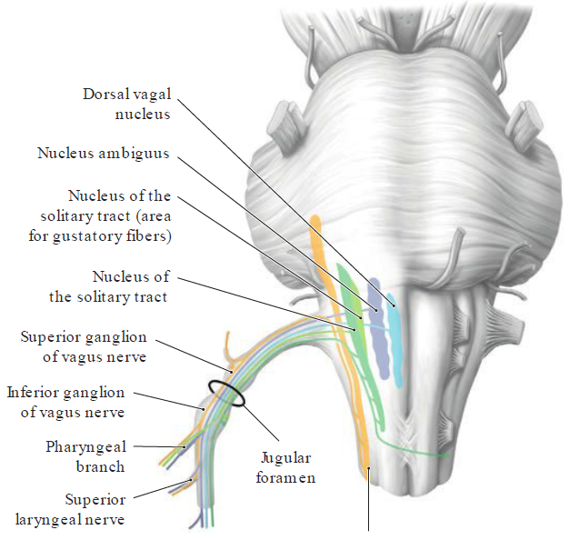
CN X
Origin
medulla
exists through jugular foramen.

Slide 34
CN X
Cell bodies and components
  Nucleus ambiguus (medulla)
    SVE - Muscles of pharynx (except the stylopharyngeus), and palate (except the tensor veli palatini) larynx, & soft palate
  Dorsal nucleus (medulla)
    GVE - Smooth muscles and glands in thoracic and abdominal viscera

Slide 35
  Inferior ganglion
    GVA - sensation in lower pharynx, larynx, trachea, and other viscerae
    SVA - taste on epiglottis
  Superior ganglion
    GSA - Auricle and external acoustic meatus
Function
  Main parasympathetic nerve 90%

Slide 36
CN XI
Origin
  Cranial part – medulla & exist through jugular foramen
  Spinal portion- cervical & ascends through foramen magnum
Cell bodies and components
  Spinal cord (cervical)
    SVE- vagal component
    GSE - Sternocleidomastoid and trapezius muscles
Function – flex of head, contralateral head rotation, elevation & retraction of scapula
Primarily Motor nerve

Slide 37
CN XII
Origin - medulla & exists through hypoglossal canal
Cell bodies and components
Nucleus CN XII (medulla)
  GSE - Extrinsic & intrinsic muscles of tongue
  Function - Shape of tongue, protract, elevate & retract the tongue

