Slide 1
Thyroid and parathyroid glands
Mr. M. Banda

Slide 2
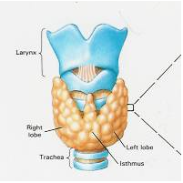
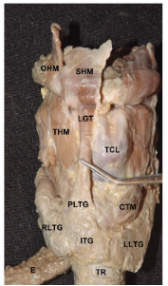
Structure of Thyroid Gland
Endocrine gland
situated in lower
part of anterior and
Lateral aspect of the trachea
Consists of two
lobes joined by isthmus
A third lobe, pyramid
lobe maybe present
(projecting from either
of the lobes or isthmus)
Elevated by a
fibromuscular band,
the levator glandulae
thyroidae

Slide 3
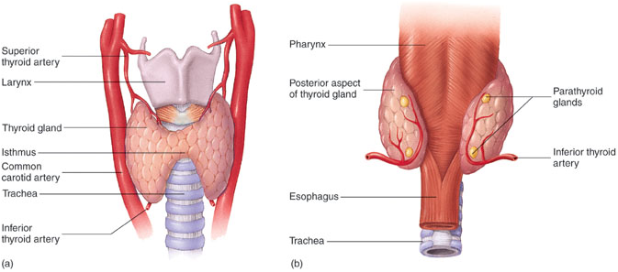
Structure of Thyroid Gland
Each lobe measures 5cm x 2.5cm x 2.5 cm, Isthmus measures 1.2cm x 1.2cm
On average the gland weighs about 25g and is It is larger in females than in males
Decreases during menstruation and in pregnancy (in late stages of pregnancy)
Increases in size in early stage of pregnancy

Slide 4
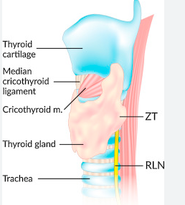
Structure of Thyroid Gland
Zukerkanle Tubercle
ZT is a normal protuberance of the thyroid gland arising from the posterolateral margin
important anatomic landmark for the recurrent laryngeal nerve during thyroidectomy

Slide 5
Function
Regulates basal metabolic rate
Stimulates somatic and psychic growth
Plays an important role in calcium metabolism

Slide 6
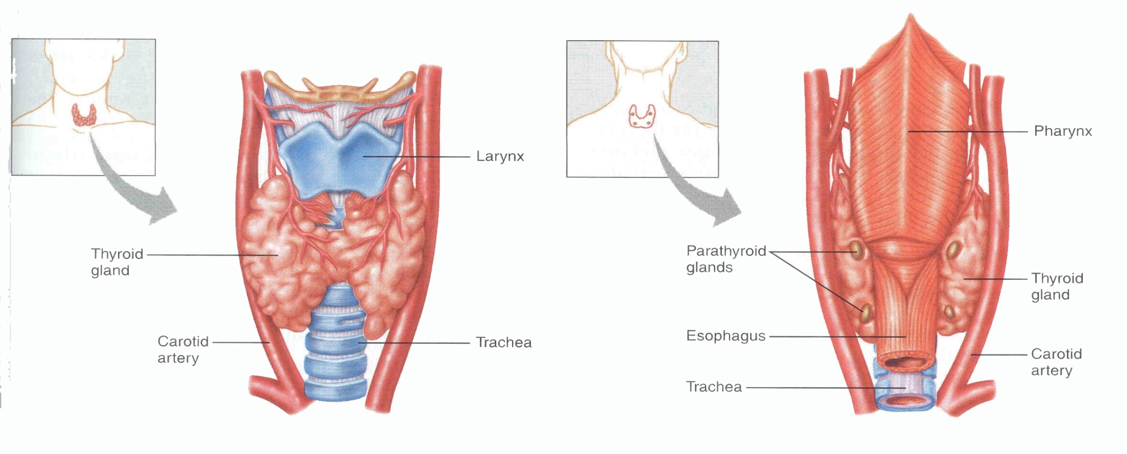
Location
Lobes extend from the thyroid and cricoid cartilages to 4th or 5th tracheal ring
Isthmus extends from 2nd to 4th tracheal ring

Slide 7
Boundaries
Lobes are conical in shape having an apex and a base
Three surfaces: lateral, medial and postero lateral
Two borders: anterior and posterior

Slide 8
Boundaries
Apex is directed upwards and slightly lateral
Superiorly it is limited by the attachment of sternothyroid
The base is at the level of 4th or 5th tracheal ring

Slide 9
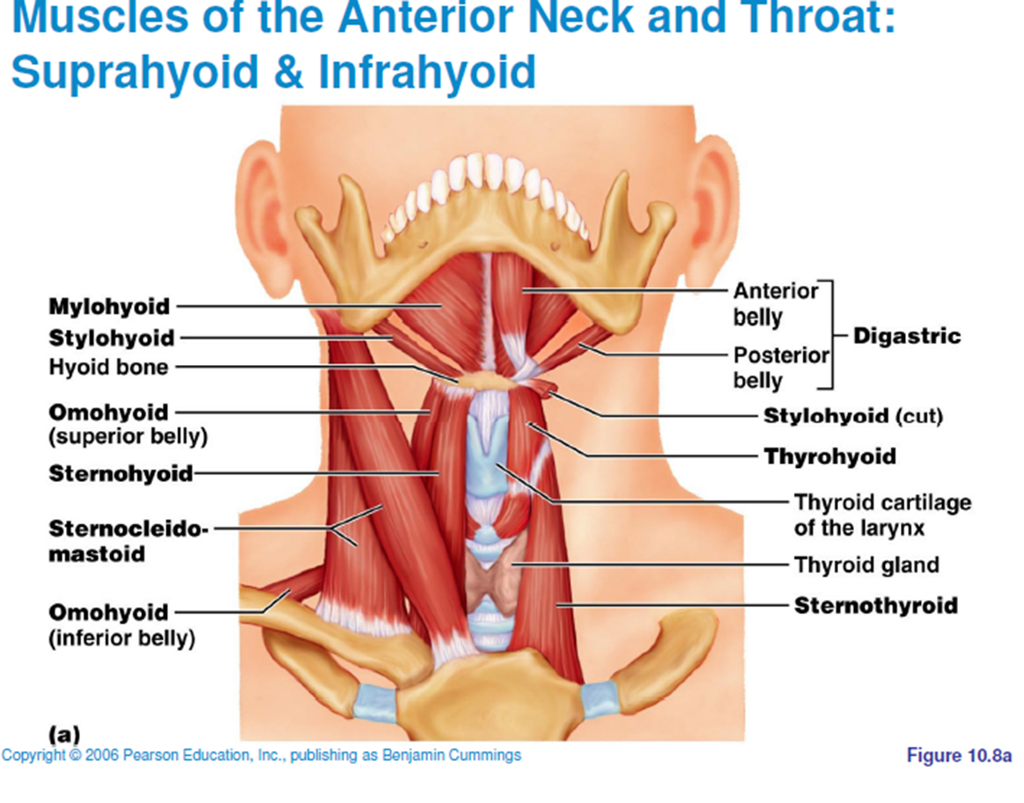
Anatomical Relations
Lateral or superficial
surface is convex and is
covered by:
- Sternohyoid,
- Superior belly of
omohyoid,
- Sternothyroid
Anterior border of
Sternocleidomastoid

Slide 10
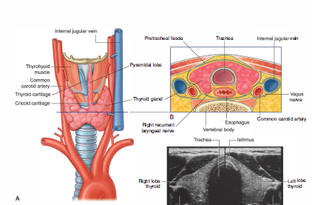
Anatomical Relations
Medial surface is related to: Two tubes (trachea and oesophagus), two muscles (Inferior constrictor and cricothyroid), two nerves (external laryngeal and recurrent laryngeal)

Slide 11
Anatomical Relations
Postero lateral or posterior surface is related to the carotid sheath
It also overlaps the common carotid artery
Anterior border is thin and related to anterior branch of superior thyroid artery

Slide 12
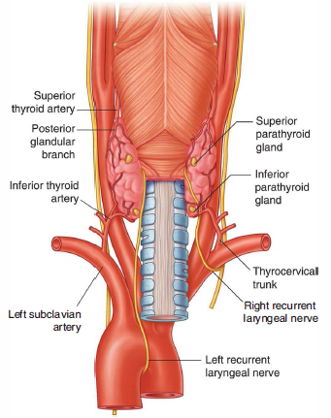
Anatomical Relations
Posterior border is thick and rounded and separates medial and posterior surfaces
Its related to:
Inferior thyroid artery
Anastomosis between superior and inferior thyroid artery
Parathyroid glands
Thoracic duct (on left side only)

Slide 13
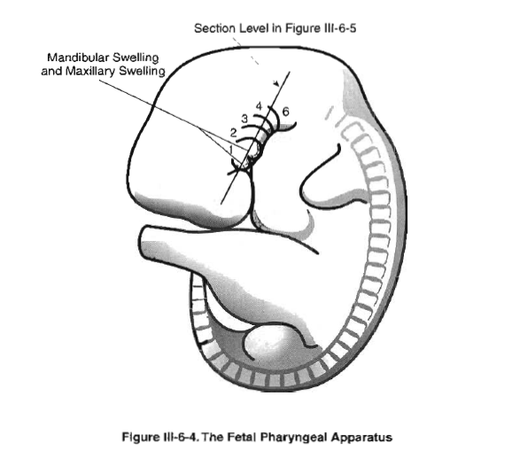
Embryology of the thyroid gland
The thyroid gland
embryologically
originates from
the fourth pouch
of the pharyngeal
apparatus

Slide 14
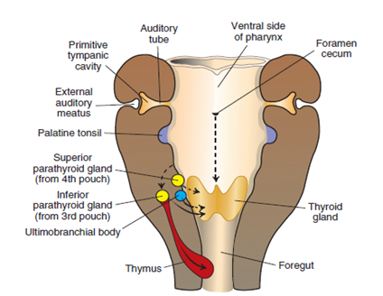
Embryology of the thyroid gland
The ventral region of the fourth pouch gives rise to the ultimobranchial body, which is later incorporated into the thyroid gland
Cells of the ultimobranchial body give rise to the parafollicular, or C, cells of the thyroid gland.
These cells secrete calcitonin, a hormone involved in regulation of the calcium level in the blood

Slide 15
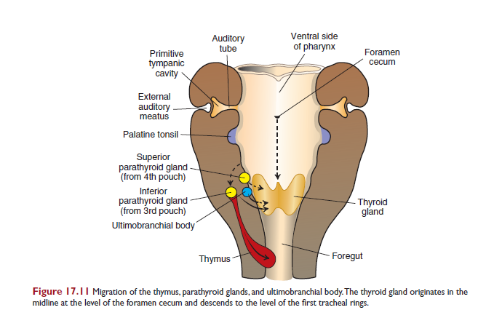
Embryology
Epithelium of the dorsal region of the fourth pouch forms the superior parathyroid gland

Slide 16
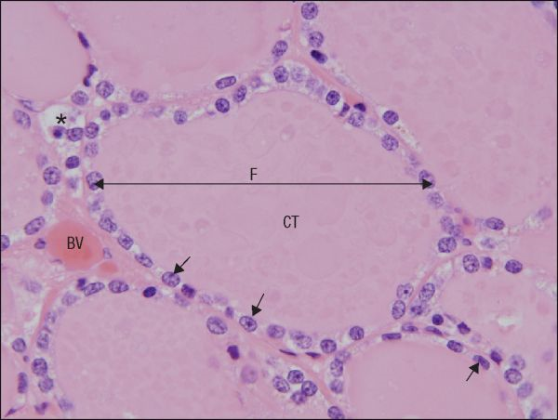
Histology
Made of two secretory cells:
Follicular cells (Lining follicles of gland) and secrete thyroxin (Lining is columnar when active and cuboidal at rest)
Parafollicular cells (c cells):lie in between the follicles (Secrete thyro calcitonin which
promotes calcium deposition in
skeleton)
A section through parts of several
human thyroid follicles (F),
showing the follicular epithelium
(arrows) enclosing a lumen
filled with colloidal thyroglobulin (CT)..
A network of blood vessels (BV)
within connective tissue septa
surrounds the follicles

Slide 17
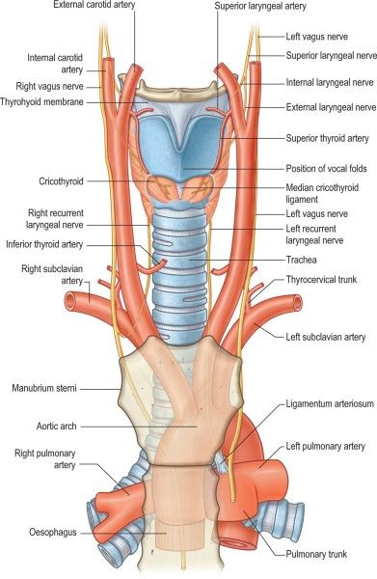
Arterial blood supply
Supplied by the
superior and inferior
thyroid arteries
superior thyroid arteries
is the first anterior branch of the
external carotid artery
Divides into anterior
and posterior branches
inferior thyroid arteries is a
branch of the thyrocervical
trunk (arising from subclavian
artery)

Slide 18
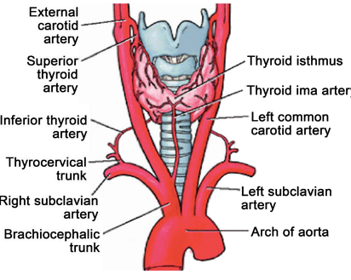
Arterial blood supply
Thyroidea ima is a variation anomalous artery supplying the thyroid gland

Slide 19
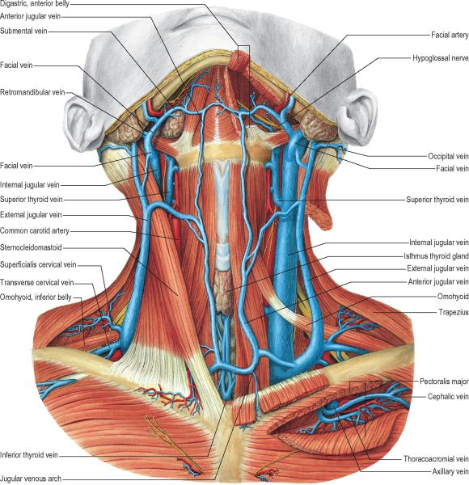
Venous drainage
Drained by the
superior, middle
and inferior
thyroid veins
The superior
and middle
thyroid veins
drain into the internal jugular
The inferior
thyroid form a
plexus in front of the
trachea and drain into
the left brachiocephalic
vein

Slide 20
Lymphatic drainage
Upper part drained by upper deep cervical nodes directly or thru the Prelaryngeal nodes.
Lower part drained to the deep cervical and also thru the pretraecheal node.

Slide 21
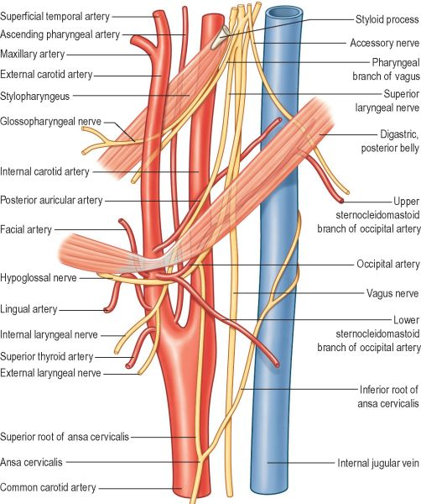
Nerve supply
Parasympathetic
Vagus nerve
Sympathetic
Middle cervical
ganglion
Superior and
inferior cervical
Ganglia

Slide 22
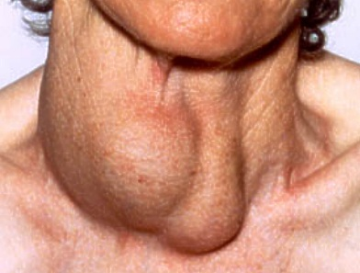
Clinical Relevance
Goiter simply
means enlarged
thyroid
Hypothyroidism
Cretinism
thyroiditis
Hyperthyroidism
Myxedema
thyroid tumours

Slide 23
Clinical Relevance
The left and right recurrent laryngeal nerves lie in close proximity to the thyroid gland and care must be taken not to damage them during thyroid surgery.
RLN hook around the right subclavian artery (right RLN), or the arch of aorta (left RLN).

Slide 24
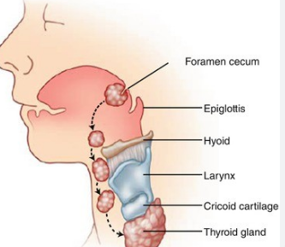
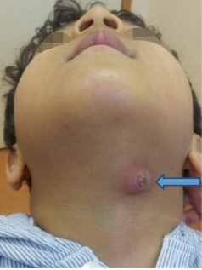
Clinical Relevance: Thyroglossal Cyst
The descent of the developing thyroid gland forms the thyroglossal duct – an epithelialised tract that connects the gland to its origin at the foramen cecum
Ectopic thyroid tissue may remain along its path during descent

Slide 25

PARATHYROID GLAND
Usually paired, very small (less than 5 mm).
Called parathyroid glands because of their position on posterior margins outer surface of thyroid gland.
The superior of each pair is near middle of margin of lobe, and the inferior of each pair usually at inferior apex of lobe

Slide 26
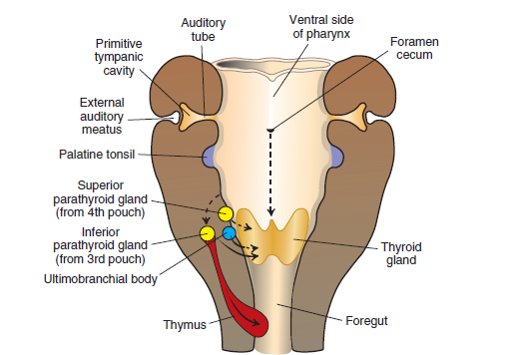
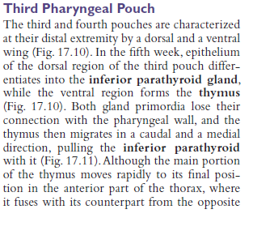
Development
Like thyroid gland, develop from endodermal thickening in floor of early pharynx and epithelium of 3rd and 4th gill slit pouches.

Slide 27
Blood supply, innervation

Slide 28

Function
Produces parathyroid hormone (pth), raises the level of calcium in the blood, decreases levels of blood phosphate.
Partially antagonistic to calcitonin of thyroid gland.

Slide 29
Vascular supply and lymphatic drainage
Both superior and inferior
parathyroid glands are usually
supplied by the inferior
thyroid arteries
the superior thyroid may
be supplied by the superior
thyroid artery.
The glands drain into the
plexus of veins on the anterior
surface of the thyroid.
Lymph vessels are numerous
and associated with those of the
thyroid and thymus glands.

Slide 30
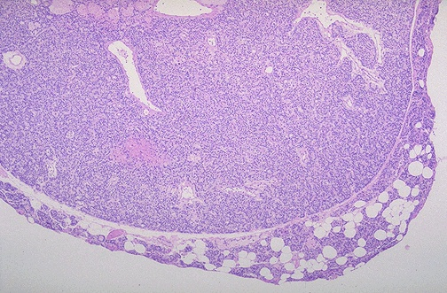
Applied anatomy
adenoma &
hyperplasia
carcinoma of parathyroid
multiple endocrine neoplasia
multiple endocrine neoplasia (men)
Parathyroid adenom/hyperplasia
Hyperparathyroidism

Slide 31
The End
Thank you!

