Slide 1
Retroviruses
PTM4310/3520
DR CHILESHE DAVID

Slide 2
Introduction
Enveloped (+) RNA viruses that encode reverse transcriptase enzyme, which converts retroviral RNA genome into double-stranded DNA.
Oncoretroviruses cause tumours in many animals. HTLV-I and HTLV-II are associated with human leukaemia's/lymphomas.
HIV-1 and HIV-2 are lentiviruses;HIV-1 is the major cause of AIDS worldwide.
Oncoviruses usually not cytolytic; they transform cells by various mechanisms

Slide 3
Introduction
Lentiviruses cause a long clinical latency period in infected patients in the presence of viremia before causing disease.
HIV-1 attacks and destroys CD4+ T-lymphocytes.
HIV-1 also infects monocytes/macrophages, dendritic cells,
Langerhans cells, and certain cells of the central nervous system

Slide 4
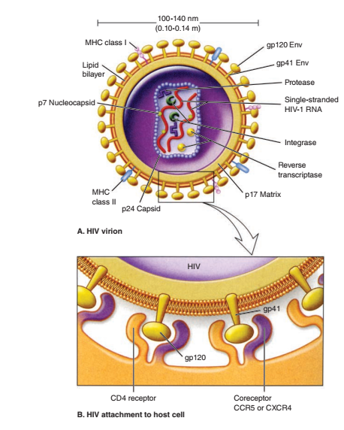
Structure
All retroviruses are remarkably similar in their basic virion composition and structure.

Slide 5
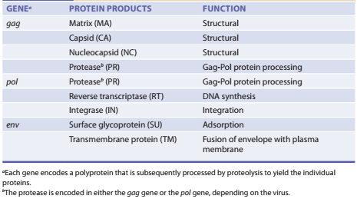
Major Retroviral Genes and Proteins

Slide 6
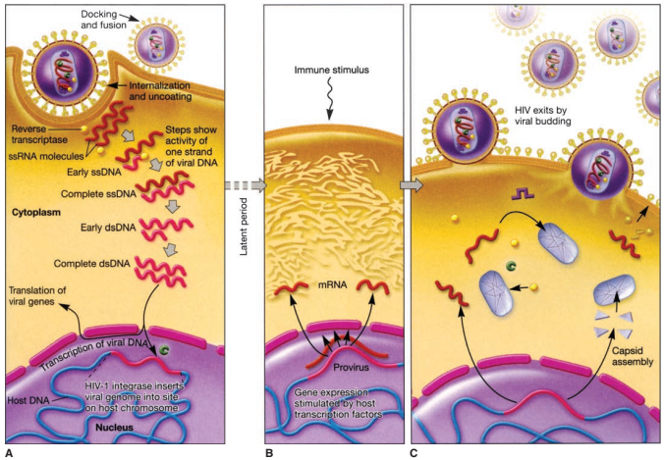
Retroviral Replication Cycle

Slide 7
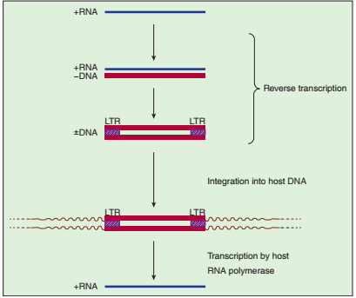
Retroviral Replication Cycle

Slide 8
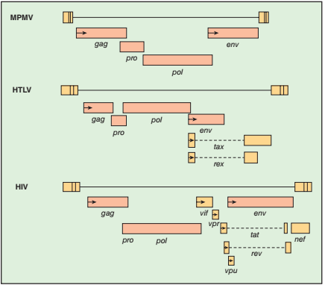
Retroviral Genes

Slide 9
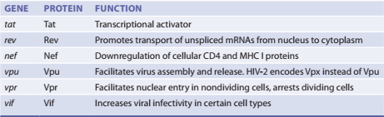
Roles of HIV-1 Regulatory and Accessory Proteins

Slide 10
Epidemiology
First recognized in male homosexuals, haemophiliacs, and drug abusers.
HIV-1 major cause of AIDS worldwide, HIV-2 is endemic in West Africa.
Transmission is through anal and vaginal sex, intravenous drug use, and by exposure to infective bodily fluids. Highest risk in receptive anal sex.
Mother-to-child transmission can readily occur; risk significantly reduced due to ART during pregnancy.

Slide 11
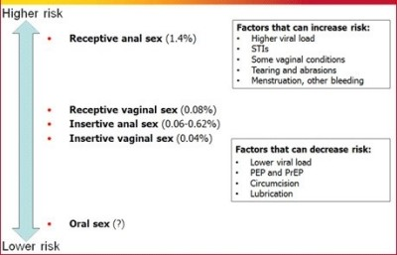
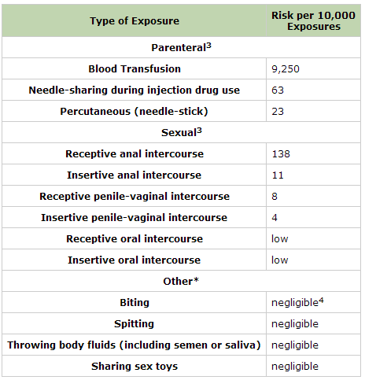
Epidemiology…….

Slide 12
Epidemiology…..
Condom usage, circumcision, and ART reduces risk of transmission.
Transmission risk increases due to disruption of vaginal or rectal mucosal integrity in traumatic sex.
HIV probably recognizes Langerhans cells dendrites followed by transfer to submucosal cells such as macrophages, dendritic cells, CD4 T-cells.
Thirty-seven million people living with HIV worldwide as of 2020.

Slide 13
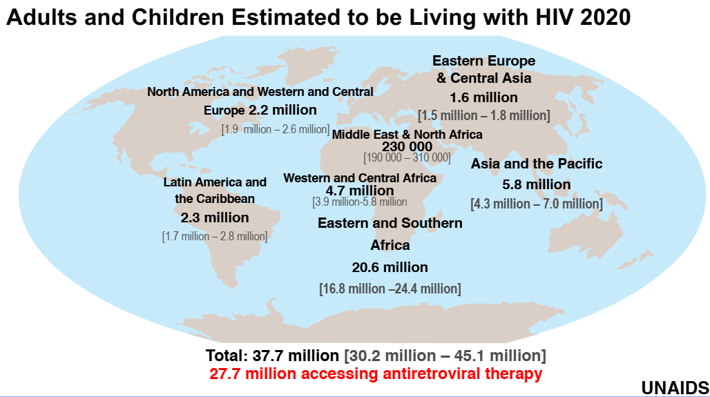

Slide 14
HIV-1 Clades and Geographic Distribution
Based on genetic variation, three classes of HIV-1 have developed worldwide, including M (major), O (outlying), and N (new).
Class M accounts for more than 90% of all HIV-1 cases globally and is further classified into several subtypes or clades, including A to H and recombinants.
There is also some argument that certain clades may have increased risk of transmission and progress to AIDS more rapidly than others.
Understanding the immunopathogenesis of the emerging HIV-1 clades is key to vaccine development.

Slide 15
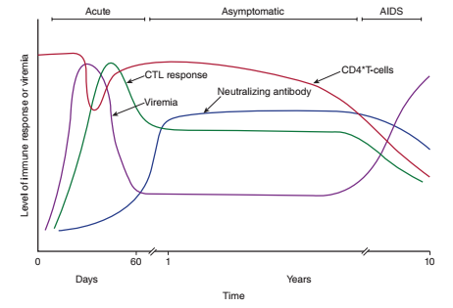
Pathogenesis

Slide 16
Pathogenesis…...
Initial target cells are CD4+/CCR5, most likely Langerhans cells or macrophages.
Cell-to-cell fusion transfers HIV to CD4+/CCR5 mucosal CD4 T-lymphocytes.
Dendritic cells also participate in transfer of HIV to CD4 T-lymphocytes.
Massive depletion of mucosal CD4+ T-lymphocytes in GALT.

Slide 17
Pathogenesis…...
Partial control of HIV by immune response to a set point.
T-lymphocytes expressing CD4+/CXCR4 are infected more
efficiently.
Non-CD4+ cells may also be infected through CCR5 or CXCR4.
HIV-infected monocytes infiltrate the CNS and differentiate into
perivascular macrophages that harbour HIV in the CNS.

Slide 18
Pathogenesis…...
R5-HIV predominates initially in early infection, whereas X4-HIV emerges in late infection.
X4-HIV replicates more efficiently in T-lymphocytes and depletes these cell types.
Ten billion HIV particles produced every day in infected individuals.
Mutation results in altered phenotype and tropisms.
Some immune control of virus is seen during the clinical latency
period, but this is later lost

Slide 19
Pathogenesis…...
Level of plasma viremia directly correlates with disease progression.
HIV infection causes immune activation as a result of production of proinflammatory cytokines and chemokines.
Early control of infection by innate immunity through TLR and induction of INF-, However HIV interferes with the components of innate immunity.
HIV specific CTLs control viremia by killing HIV-infected cells, INF-γ and β-chemokines (MIP 1-α, MIP 1-β, and RANTES) reduce viral spread. Neutralizing antibodies also control viremia.

Slide 20
Pathogenesis…...
CTL and neutralizing antibody escape variants emerge due to mutation that allow continued viral replication.
Lack of help to B and T-lymphocytes due to CD4 T-lymphocytes killing by HIV.
Immune system fails to eliminate HIV from infected hosts.
Immune deficiency related to reduction in numbers and normal functions of CD4+ T-lymphocytes.

Slide 21
Pathogenesis…...
Infected individuals are susceptible to other infections and malignancies due to immune suppression.
HIV persists in reservoirs during treatment:
Lymphoid tissues (GALT, lymph nodes) and cellular reservoirs
(resting T-lymphocytes, monocytes/macrophages) for HIV.
HIV persists in CD4 central, transitional, and effector memory T-lymphocytes.
HIV DNA is found in bone marrow, CD34 stem cells.

Slide 22

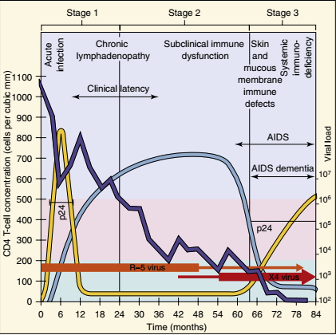
Pathogenesis…...

Slide 23
Clinical syndrome
Early symptoms may include flu or mononucleosis like illness.
Progression to AIDS is highly variable among individuals, HIV treatment prevents progression to AIDS.
Individuals with overt AIDS usually have fewer than 200 CD4+ lymphocytes/mm˄3.
Pneumocystosis, candidiasis, mycobacteriosis, and CMV are common.
HIV is also neurotropic and can lead to dementia.

Slide 24
Diagnosis
Antibodies detected 3 to 12 weeks after infection. Risk of transmission during window period is high.
Three types of HIV-1 test available, antibody, antigen antibody combination and viral nucleic acid.
ELISA screens for antibody, Western blot used for confirmation of HIV-specific antibodies.
HIV rapid tests screen for HIV antibodies, require no instrumentation, but require confirmation.

Slide 25
Diagnosis…..
Combination 4th-generation HIV test detects both HIV antigen and HIV antibody 2 to 6 weeks after infection.
Nucleic acid test detects HIV RNA by PCR in 7 to 28 days after infection.
HIV RNA levels important to assess ART efficacy.
HIV DNA/RNA PCR testing used to diagnose HIV infection in infants and quantitate plasma viremia and assess drug efficacy.

Slide 26
Treatment
Six classes of antiretroviral agents available, several combination pills also available.
Combinations of ARTs used in treatment to bring viral load down to undetectable levels within 6 months.
Three drugs in combination for ART(?).
HIV regimens recommended for occupational and nonoccupational postexposure prophylaxis and preexposure in high-risk individuals to prevent infection

Slide 27
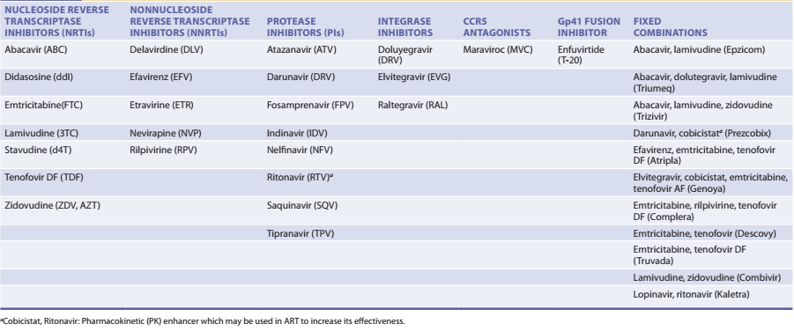
Treatment…..

Slide 28
Treatment…..
Use of ART during pregnancy reduces mother-to-child transmission to less than 1%.
ART has significantly reduced the risk of opportunistic infections.
Reconstitution of immune system due to ART success causes immune reconstitution inflammatory syndrome (IRIS).
Complications of ART include body fat accumulation, dyslipidaemia, abnormal glucose metabolism, cardiovascular disease, and bone disorders.

Slide 29
Treatment…..
Antiretroviral treatment is recommended for all HIV infected individuals regardless of CD4 T-cell count.
Viral load and CD4 T-cell count monitored regularly to determine ART efficacy and immune deficiency.
HIV genotyping to determine ART resistance should be done before initiating therapy.
Drug resistance is an expected development with treatment.
Prophylaxis of opportunistic infections is especially important.

Slide 30
Prevention
Education is the cornerstone of prevention.
Screening for asymptomatic infection in pregnancy aids effective prophylaxis.
Condoms, if properly used, can effectively prevent transmission.
Male circumcision decreases HIV transmission in men.
What are the hurdles for HIV vaccine development?

Slide 31
Human T-Lymphotropic Or T-cell Leukaemia Virus
HTLV has two members, HTLV-I and HTLV-II, which cause disease in humans.
HTLV-I causes two distinct diseases; adult T-cell leukaemia/lymphoma (ATLL) and HTLV-associated myelopathy (HAM, a neurologic disease).
HTLV-II may also cause these diseases but has been primarily linked to variant hairy cell leukaemia.
Similar to other retroviruses, HTLV has the usual retroviral gag, pol, and env genes, but also encode two regulatory proteins: Tax and Rex.

Slide 32
Human T-Lymphotropic Or T-cell Leukaemia Virus……
Tax is a transcriptional activator of HTLV LTR and is also required for transformation.
Rex, similar to HIV-1 Rev, is a posttranscriptional activator that increases transport of structural protein mRNAs from nucleus to cytoplasm.
In addition, other HTLV proteins are similar to HIV-1 proteins but differ in sequence and antigenicity.
The HTLV envelope glycoproteins are gp46 and gp21, whereas the capsid protein is p24.

Slide 33
Human T-Lymphotropic Or T-cell Leukaemia Virus……
HTLV-I and HTLV-II use the same unidentified receptor. Preferentially infects T-lymphocytes. Transmission via cell associated fluids.
Long latency period of 20 to 30 years. 1% to 2.5% of HTLV-infected patients progress to ATLL. CSF finding abnormal in HAM/TSP.
Diagnosis is by EIA or PCR.
In some patients with HAM/TSP, a combination of antiretrovirals and interferon has shown benefit, and corticosteroids may relieve symptoms.
ATLL is generally treated by anticancer chemotherapy.

Slide 34
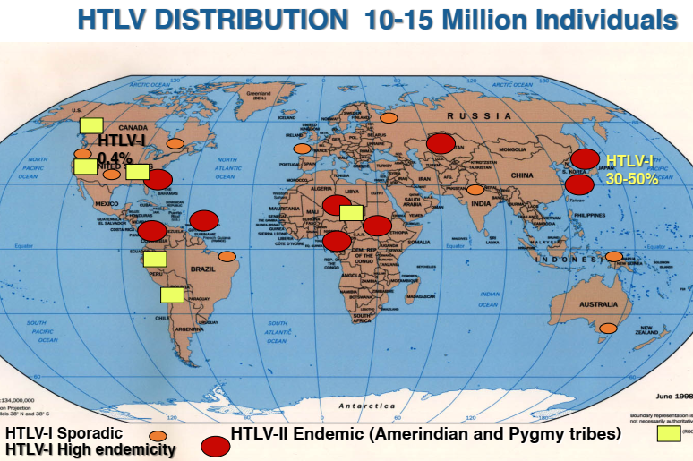

Slide 35
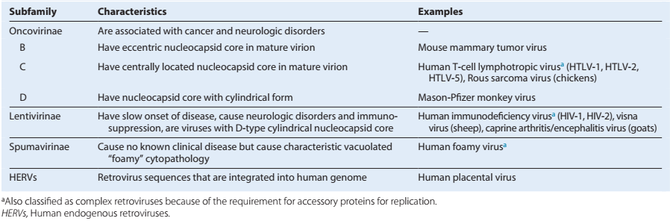
Summary

Slide 36
Lessons
• Viruses are bad and should be avoided
• Except when they save the planet
• And maybe if it saves you from the next virus
• Epidemics are not single events
• Epidemics evolve
• Detailed understanding of replication leads to new therapy
Antivirals are useful:
if Instituted as early as possible; Adherence is essential.

Slide 37
THE END

