Slide 1
Filarial Worms
Dr J Mudenda

Slide 2
Introduction
Filaria are slender thread-like nematodes transmitted by the bite of blood-sucking insects
They reside in the subcutaneous tissues, lymphatic system or body cavities of humans.
Adult worm measures 80–100 mm in length and female worms are longer than males.
Female worms are viviparous and give birth to larvae known as microfilariae.

Slide 3
The microfilariae released can be detected in peripheral blood or cutaneous tissues, depending on the species.
They are either sheathed or unsheathed depending on whether they retain their egg membranes or not.
Filaria exhibit periodicity when large numbers occur in blood; nocturnal, diurnal or no periodicity.
Thought to be an adaptation to the biting habits of the vector.

Slide 4
Their life cycle involves 2 hosts:-
Definitive host : man
Intermediate host: blood-sucking arthropods.
Complete development of microfilariae occur in the arthropod to produce infective larval stages.
Transmission to humans by the arthropod occur during feeding.

Slide 5
The following are the pathogenic species and conditions caused
Lymphatic filariasis:-Wuchereria bancrofti, Brugia malayi & B. timori
Malabar swellings and allergic lesions-Loa loa.
Eye lesions and dermatitis- Onchocerca volvulus.
Skin diseases -Mansonella streptocerca.

Slide 6
Wolbachia spp( Rickettsia like α-proteobacterium) live in close association with filaria .
They play a role in the pathogenesis of filariasis hence have become a target for antifilarial chemotherapy.
They activate the release of pro-inflammatory and chemotactic cytokines.
Toll-like receptors (TLRs) play an important role in the process.

Slide 7
LYMPHATIC FILARIASIS
Caused by Wuchereria bancrofti, Brugia malayi & Brugia timori.
Over 90% of cases are caused by Wuchereria bancrofti.
Transmitted by mosquito vector species, which vary geographically.
Considered endemic in 72 countries.
Classified by WHO as the 2nd most common cause of long-term disability after mental illness.

Slide 8
Wuchereria Bancrofti
Accounts for 90% of the lymphatic filariasis cases.
It is the 2nd leading infectious cause of disability worldwide after leprosy.
The disease involves lymphatics with clinical manifestations ranging from acute to chronic cases.
Acute cases include acute adenolymphangitis, filarial fever, tropical & pulmonary eosinophilia.
Chronic cases include hydrocele, lymphedema & elephantiasis in the most severe of cases.

Slide 9
Epidemiology
The disease is endemic in over 72 countries.
Endemic regions include South East Asia, Sub-Saharan Africa & some areas in Latin America.
An estimated 70 million people in the world suffer from lymphatic filariasis.
25 million people suffer from hydrocele and 15 million suffer from debilitating lymphedema.

Slide 10
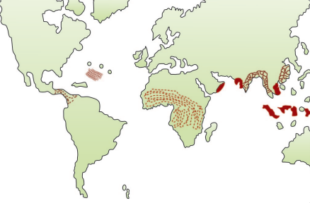
Global distribution

Slide 11
Epidemiology & prevalence in Zambia
The 2003-2011 survey indicated that LF is widely distributed in Zambia.
The prevalence in most sites is low although a few identified foci had prevalences above 25%.
Highest prevalence (above 50%) was recorded from Kalabo district in Western Province.
High prevalence foci located near national borders e.g. Luangwa, Serenje, Lundazi, Kalabo and Senanga.
Anopheles. funestus & gambiae are the principal LF vectors

Slide 12
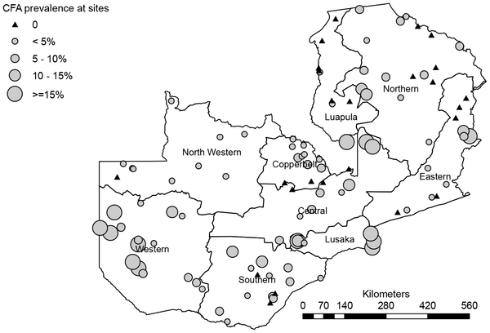
Map of Zambia showing survey sites and prevalences of CFA positivity.
Mwase ET, Stensgaard AS, Nsakashalo-Senkwe M, Mubila L, Mwansa J, et al. (2014) Mapping the Geographical Distribution of Lymphatic Filariasis in Zambia. PLOS Neglected Tropical Diseases 8(2): e2714. https://doi.org/10.1371/journal.pntd.0002714
https://journals.plos.org/plosntds/article?id=10.1371/journal.pntd.0002714

Slide 13
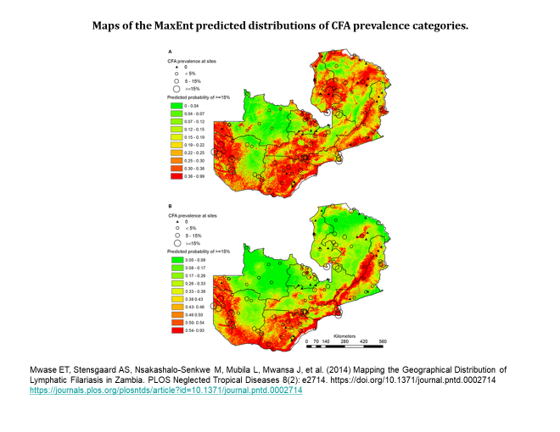

Slide 14
Habitat/Morphology
Adult worms reside in the lymphatic system of man.
Microfilariae are found in blood.
Adult worms
Translucent thread-like with smooth cuticle and tapering ends.
Females are larger with a straight posterior end.
Males are smaller with curved posterior with 2 spicules of unequal length.

Slide 15
Female worm is viviparous -directly liberates sheathed microfilariae into lymph.
The adult worms can live for 10–15 years or more.
The microfilaria has a colorless, translucent body with a blunt head and pointed tail.
Covered by a hyaline sheath within which it can actively move forwards and backwards.

Slide 16
Mf do not multiply or undergo any further devt in the human body.
They die within 2–3 months If not taken up by a female vector mosquito.
Peridiocity
Mf circulate in peripheral blood in large numbers mainly at night (btwn 10 pm & 4 am).
This correlates with the night biting habit of the vector mosquito & also the sleeping habits of the hosts.

Slide 17
Life Cycle
W. bancrofti passes its life cycle in 2 hosts.
Definitive host: Man.
Intermediate host: Female mosquito of different species.
Infective form: third stage filariform larva.
Mode of transmission: bite of an infected mosquito carrying filariform larva.

Slide 18
Development in Mosquito
A mosquito vector takes in Mf as it feeds on a carrier during a blood meal and reach the stomach of the mosquito.
In the stomach, the Mf cast off their sheaths, penetrate the stomach wall & migrate to the thoracic muscles for further devt.
It is actively motile and is the infective form.

Slide 19
No multiplication of Mf in the mosquito hence 1 Mf develops into 1 infective larva only.
Devt in the vector(extrinsic incubation period ) depending on environmental factors such as temp & humidity & also vector species.
Under optimal conditions, its duration is 10–20 days.
When a mosquito feeds on a person, the infective larvae get deposited on the skin near the puncture site.

Slide 20
Development in Man
The larvae enter through the puncture wound or penetrate the skin by themselves.
To ensure transmission to man thousands of infective bites are needed per person.
After penetrating the skin, larvae enter lymphatic vessels and are carried usually to abdominal or inguinal lymph nodes, where they develop into adult forms.
There is no multiplication at this stage and only 1 adult develops from 1 larva, male or female.

Slide 21
Sexual maturity occur in 6 months and mate.
The gravid female worm releases large numbers of Mf as many as 50,000 per day.
The Mf are ingested during a blood meal by mosquito & the cycle is repeated.

Slide 22
Prepatent period
Within 8-12 months ( biological incubation period)from entry of the infective larvae into the human host, Mf can be seen in circulation.
Clinical incubation period is very variable, but is usually 8–16 months, though it may often be much longer.

Slide 23
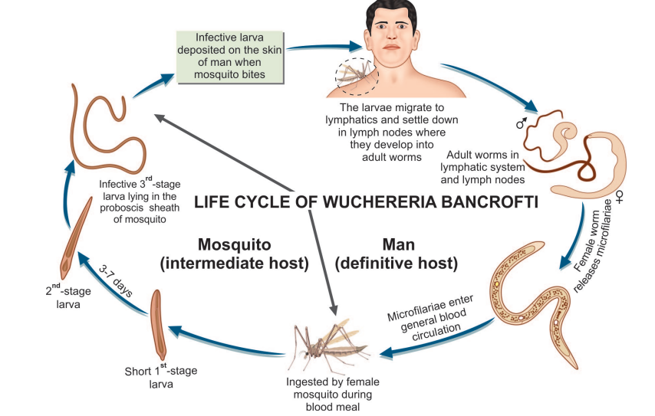
Life cycle

Slide 24
Pathogenesis
The manifestations are due to blockage of lymph vessels and lymph nodes by the adult worms.
The blockage is due to:
mechanical factors
Allergic inflammatory reaction to worm antigens and secretions.
The lymph nodes & vessels are infiltrated by macrophages, eosinophils, lymphocytes & plasma cells.
Vessel walls thicken and the lumen narrow or occludes leading to lymph stasis.
Eventual dilatation of lymph vessels occur due to stasis which is further aggravated by damage to valves.

Slide 25
Granuloma formation with scarring & even calcification occur.
Increased permeability of lymph vessel walls lead to leakage of protein-rich lymph into the tissues.
This produces the typical hard pitting oedema of filariasis.
Fibroblasts invade the edematous tissues, laying down fibrous tissue, producing the non-pitting gross oedema of elephantiasis.
Recurrent 2° bacterial infns cause further damage.

Slide 26
Clinical manifestations
Are subdivided into acute and chronic forms.
Acute presentations include:-
Acute adenolymphangitis -characterized by repeated bouts of fever & painful lymphadenopathy.
Genitals are commonly involved in males resulting in painful epididymitis.
Filarial fever - characterized by episodes of self-limiting fever without any associated lymphadenopathy.
Tropical pulmonary eosinophilia - characterized by repeated bouts of dry nocturnal cough and wheeze.

Slide 27
Chronic presentations include:
Lymphedema
Most common presentation developing over a long period
Characterized by swelling of the upper or lower limbs depending on the involved inguinal or axillary lymphatic vessels.
Elephantiasis is the most severe type of lymphedema characterized by severe swelling of the limbs, genitalia & breasts.
The skin becomes thick and hard, owing to hyperpigmentation & hyperkeratosis.

Slide 28
Hydrocele
One of the debilitating morbidities associated with chronic disease.
Can be unilateral or bilateral leading to enlargement of the scrotum.
Accumulation of fluid occurs due to obstruction of lymph vessels of the spermatic cord and also by exudation from the inflamed testes and epididymis.
The fluid is usually clear and straw colored but may sometimes be cloudy, milky, or hemorrhagic.
The largest reported hydrocoele weighed over 100 kilograms
Involvement of genital lymphatics occurs exclusively with W. bancrofti infection

Slide 29
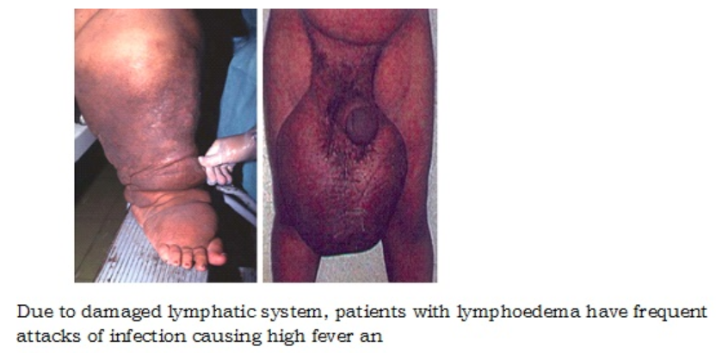

Slide 30
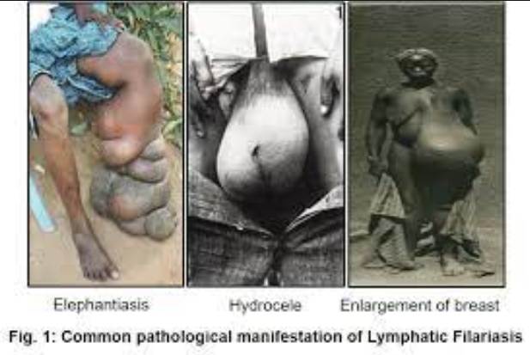

Slide 31
Lymphorrhagia
Rupture of lymph varices leading to release of lymph or chyle and resulting in chyluria, chylous diarrhea, chylous ascites, and chycothorax, depending on the involved site.

Slide 32
Occult Filariasis
It occurs as a result of hypersensitivity reaction to microfilarial antigens, not directly due to lymphatic involvement.
Microfilariae are not found in blood, as they are destroyed in the tissues.
Clinical manifestations include massive eosinophilia (30–80%) & hepatosplenomegaly.
Pulmonary symptoms like dry nocturnal cough, dyspnea & asthmatic wheezing.

Slide 33
Occult filariasis has also been reported to cause arthritis, glomerulonephritis, thrombophlebitis, tenosynovitis, etc.
Classical features of lymphatic filiariasis are absent.
Chest X-ray shows mottled shadows similar to miliary tuberculosis.
It is associated with a high level of serum IgE and filarial antibodies.
Serological tests with filarial antigen are usually strongly positive.

Slide 34
Laboratory Diagnosis
Microfilaria can be demonstrated in blood, chylous urine exudate of lymph varix, and hydrocele fluid.
Peripheral blood is the specimen of choice.
Radiology
Dead and calcified worms can be detected occasionally by X-ray.
In tropical pulmonary eosinophilia (TPE), chest X-ray shows mottled appearance resembling miliary tuberculosis.

Slide 35
Serodiagnosis
Tests are available although not sufficiently sensitive or specific to be used either for individual diagnosis or surveys
Indirect Evidences
Eosinophilia (5–15%) is a common finding in filariasis.
Elevated serum IgE levels can also be seen.

Slide 36
Treatment
DEC is the drug of choice given orally.
It has both macro- and micro-filaricidal properties.
Severe allergic reaction (Mazzotti reaction) may occur due to death of microfilariae following treatment with DEC.
Individuals with lymphedema should maintain good personal hygiene and wash affected areas with antiseptic solution daily.
Compression stockings, regular exercise & using a pillow beneath the affected limb at night can help in reducing the swelling.

Slide 37
Prevention
The main measures include
Eradication of the vector mosquito
Antilarval measures
Elimination of breeding places by providing adequate sanitation & underground waste water disposal system.
Chemical control using antilarval chemicals like Mosquito larvicidal oil like Pyrosene oil ,Organophosphorous larvicides like temephos, fenthion etc,

Slide 38
Anti-adult measures
Use of DDT, dieldrin & pyrethrum as a space spray is still being used.
Personal prophylaxis using mosquito nets & repellants is the best method.
Detection and Treatment of Carriers
The recommended treatment is DEC.

Slide 39
References
Medeiros ZM, Vieira AVB, Xavier AT, Bezerra GSN, Lopes MFC, Bonfim CV, Aguiar-Santos AM. Lymphatic Filariasis: A Systematic Review on Morbidity and Its Repercussions in Countries in the Americas. Int J Environ Res Public Health. 2021 Dec 28;19(1):316. doi: 10.3390/ijerph19010316. PMID: 35010576; PMCID: PMC8751179.
Mwase ET, Stensgaard A-S, Nsakashalo-Senkwe M, Mubila L, Mwansa J, Songolo P, et al. (2014) Mapping the Geographical Distribution of Lymphatic Filariasis in Zambia. PLoS Negl Trop Dis 8(2): e2714. https://doi.org/10.1371/journal.pntd.0002714

