Slide 1
SUBCUTANEOUS FILARIASIS
Dr J Mudenda

Slide 2
Loa Loa

Slide 3
Is one of the filarial nematode that causes subcutaneous filariasis in humans.
Also commonly referred to as African eye worm causes loa loa filariasis (loiasis)
Approximately 10 million people are affected in the endemic areas of Africa.

Slide 4
Epidemiology
Loa loa is endemic across central Africa.
widely prevalent in the rain forest of west & central Africa
Extending from Sierra Leone to Uganda and south ward to Angola.
High rate of infection are found in Nigeria, Cameroon & the DRC.

Slide 5
Morphology / Habitat
Adult Worm
Is thin & transparent, measuring about 30–70 mm in length.
They live in the subcutaneous tissues & often subconjunctival tissue through which they wander.
They have a life span of 4–17 years.
Microfilaria
Mf are sheathed & found in peripheral blood during the day (diurnal periodicity).
Occasionally M.f have been demonstrated in urine, sputum & even CSF.

Slide 6
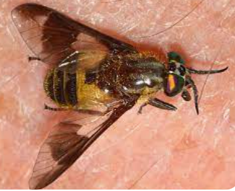
Life cycle
Is completed in 2 hosts.
Definitive host: Man
Intermediate host: Day biting flies of the genus Chrysops (mango flies) such as C. dimidiata, C. silacea & other species) .
In the vector M.f develop into the infective third-stage larvae.
Transmitted to man through the bite of infected Chrysops during their blood meal.
Chrysops

Slide 7
Infective larvae enter the skin then molt to develop into adult worms which migrate to subcut tissues.
The female worm after being fertilized by males produce sheathed M.f that circulate in the peripheral blood
The M.f are ingested by Chrysops during its blood meal.
They cast off their sheaths, penetrate the stomach wall to reach thoracic muscles where they develop into infective larvae.
Devt in chrysops is completed in about 10 days.

Slide 8
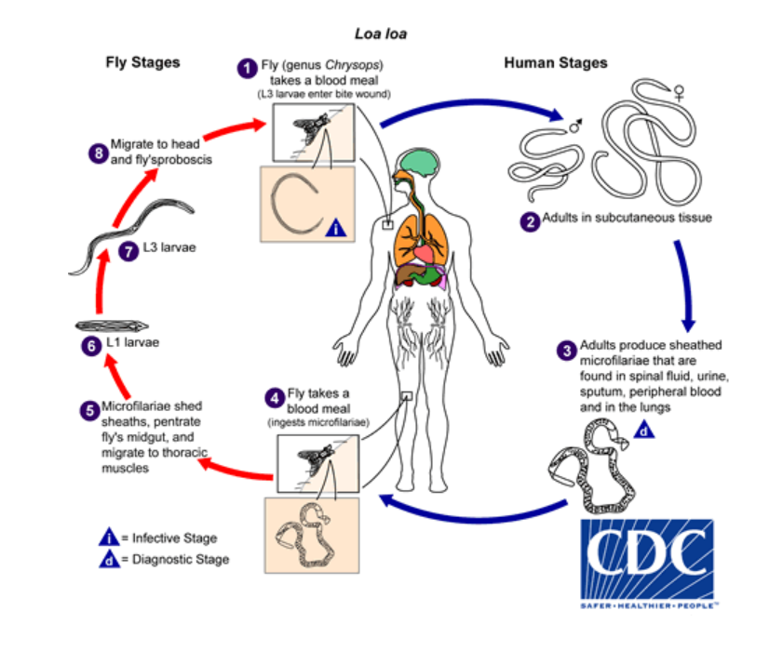

Slide 9
Pathogenesis
Depends on the migratory habit of the adult worm.
Migrating worms provoke an intense inflammatory reaction.
This causes swellings (Calabar swelling) of up to 3 cm in size usually seen on the extremities.
Calabar swelling is the typical pathological feature of the loa loa filariasis.
Formed by an allergic response to adult worms migrating in the subcutaneous tissue.

Slide 10
Ocular manifestations occur when the worm reaches the subconjunctival tissues.
Lesions include granulomata in the bulbar conjunctiva, painless edema of the eyelids & proptosis.
Complications occur rarely & include nephropathy, encephalopathy & cardiomyopathy.

Slide 11
Clinical manifestation
Disease is produced by the adult worm in humans.
The incubation period is on an average 3-4 years.
Loa loa filariasis is asymptomatic in many cases
Manifestation include:-
Skin lesions
Consists of calabar or fugitive swelling
Swellings are non erythematous & usually one develops at a time.
Migrating adult worms cause oedema of subcutaneous tissues which disappear in 2-3 days.

Slide 12
Are regarded as an allergic reaction of the tissues to filarial toxins.
Localized pain and itching for several hours usually precede the onset of the swelling.
Wrist joints or knee joints are most frequently affected.
Worms not usually present in the swellings.

Slide 13
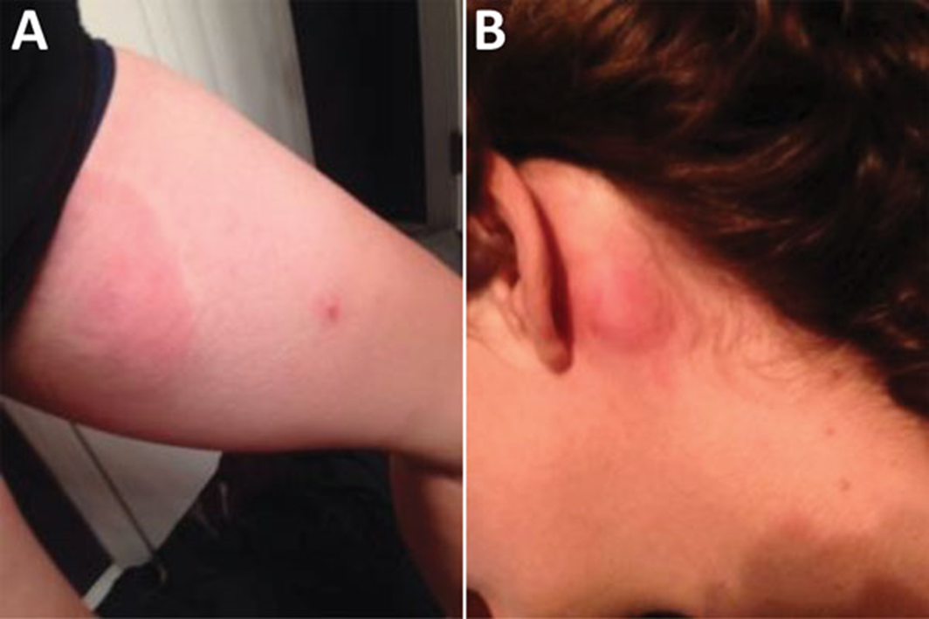
Skin manifestation of Loa loa infection in a US traveler who returned from Equatorial Guinea.
Urticarial lesions on the left thigh showing a coincident papular eruption (A) and behind the left ear (B)

Slide 14
Ocular lesions-present with the following;
Conjunctival granuloma: present as solitary or multiple small nodules(2mm) caused by migrating adult worms in the sub-conjunctival tissues.
Oedema of the eyelid: painless condition frequently accompanied by itching.
Proptosis or ‘bulge eye’ caused by the edema of the orbital cellular tissue.
It is painless & of rapid onset frequently associated with itching.

Slide 15
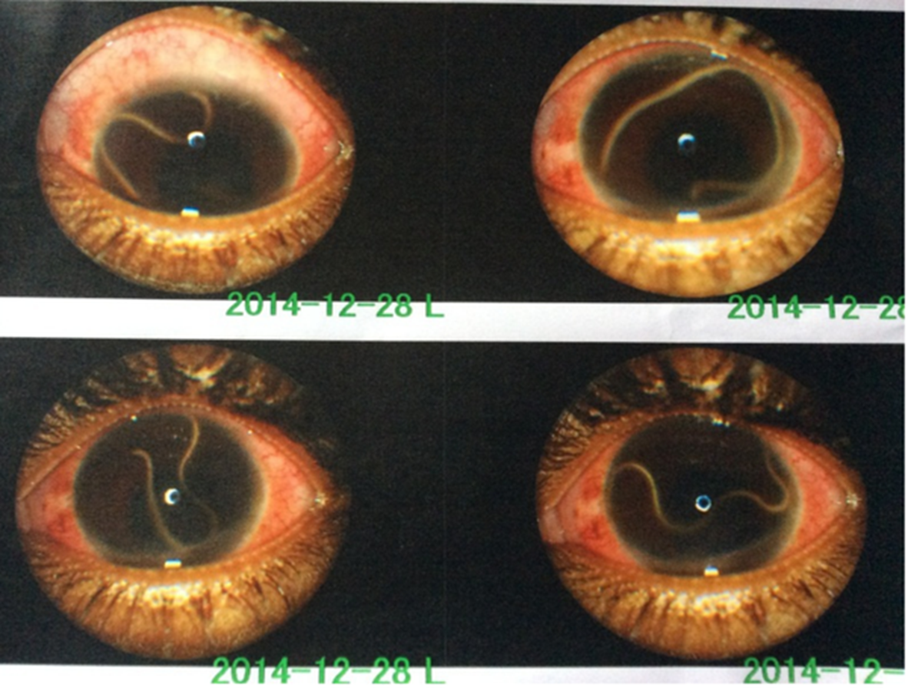
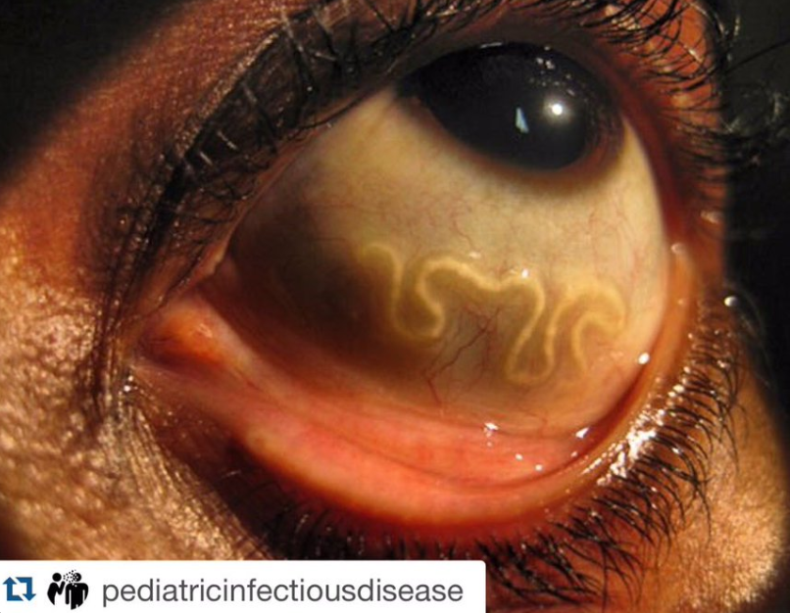
Live adult L.loa worm in the anterior chamber & sub-conjunctival tissues.

Slide 16
Other complications:
Include recurrence of swellings, endomyocardial fibrosis, retinopathy, encephalopathy, neuropathy & arthritis.
Meningoencephalopathy is a severe & often fatal complications of infection.

Slide 17
Laboratory Diagnosis
Diagnosis rests on the appearance of fugitive swelling in persons exposed to infection in endemic area.
Definitive diagnosis involve detection of M.f in peripheral blood or isolation of the adult worm from the skin or eye.
High eosinophil count is common.

Slide 18
Treatment
Diethylcarbamazine(DEC) is the drug of choice & effective against both the adult and the microfilarial forms.
Simultaneous administration of corticosteroids reduces allergic reactions.
Ivermectin or albendazole are effective in reducing microfilarial loads.
Surgical removal of the adult worms is rarely done.

Slide 19
Prevention and control
Treatment of infected populations
Using insect repellent
Wearing protective clothing
Avoiding visit to places endemic for the disease

Slide 20
Onchocerca volvulus
Name derived a Greek word meaning ‘hooked tailed’.
Causes onchocerciasis or ‘River blindness’, mostly in Africa.
It is one of the leading cause of blindness in many parts of the world.
It also causes cutaneous filariasis.
It also shares an endosymbiotic relationship with bacteria Wolbachia which in its absence ,larval devt is disrupted.

Slide 21
Epidemiology
Onchocerca infection are found in tropical climate
Is endemic in 37 countries in Africa, Latin America & Middle East.
Scattered foci of endemic areas occur in Yemen & Saudi Arabia in middle East.
It affects about 40 million people, mainly in tropical Africa
Onchocerciasis is the second major cause of blindness in the world.

Slide 22
Morphology / Habitat
Adult worms are seen in nodules in subcutaneous connective tissue of infected persons.
Are whitish, opalescent & transparent with transverse striations on the cuticle.
The posterior end is curved hence the name Onchocerca meaning ‘curved tail’.
Male worm is smaller than the female with posterior end coiled ventrally & also has 2 spicules of unequal length.
The worms usually live 10 or more years in their host.

Slide 23
The microfilariae are unsheathed and non-periodic.
Are found typically in the skin & subcutaneous lymphatics in the vicinity of parent worms.
May also be found in the conjunctiva & rarely in peripheral blood.
Anterior end is slightly enlarged, & tail is pointed.
Both the anterior and posterior ends are nucleus free.

Slide 24
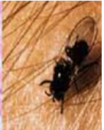
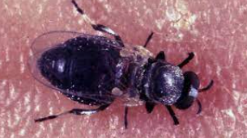
Life Cycle
life cycle is completed in 2 hosts.
Definitive host: Humans(only definitive host).
Intermediate hosts: Day-biting female black flies of the genus Simulium (black flies).
The vector species breed in fast-flowing rivers.
Hence the disease is most common along the course of rivers.
Disease also known as ‘river blindness’ for this reason.

Slide 25
Humans get infected via injection of infective larva into the skin by the bite of female black fly.
Larvae enter the skin through the punctured wound, migrate to the subcut tissue where they molt & develop into adult worms.
They induce the formation of fibrous nodule in which they remain encapsulated
Female worms after being fertilized by males produce unsheathed microfilariae.
M.f migrate out of the fibrous nodule to enter the dermis of the skin and the connective tissue.

Slide 26
They also migrate to the eye and other organs of the body but rarely to the circulation.
M.f from the skin and lymphatics are ingested, develop within the vector to become the infective larvae.
In the stomach of black fly, M.f penetrate the gut wall, migrate to the thoracic muscles and moult twice over a week.
The infective third stage larva then migrate to its mouth parts.
Infection is transmitted when an infected vector bites a person.
The adult worm can live upto 15 years in human host
M.f can live for about 1 year

Slide 27
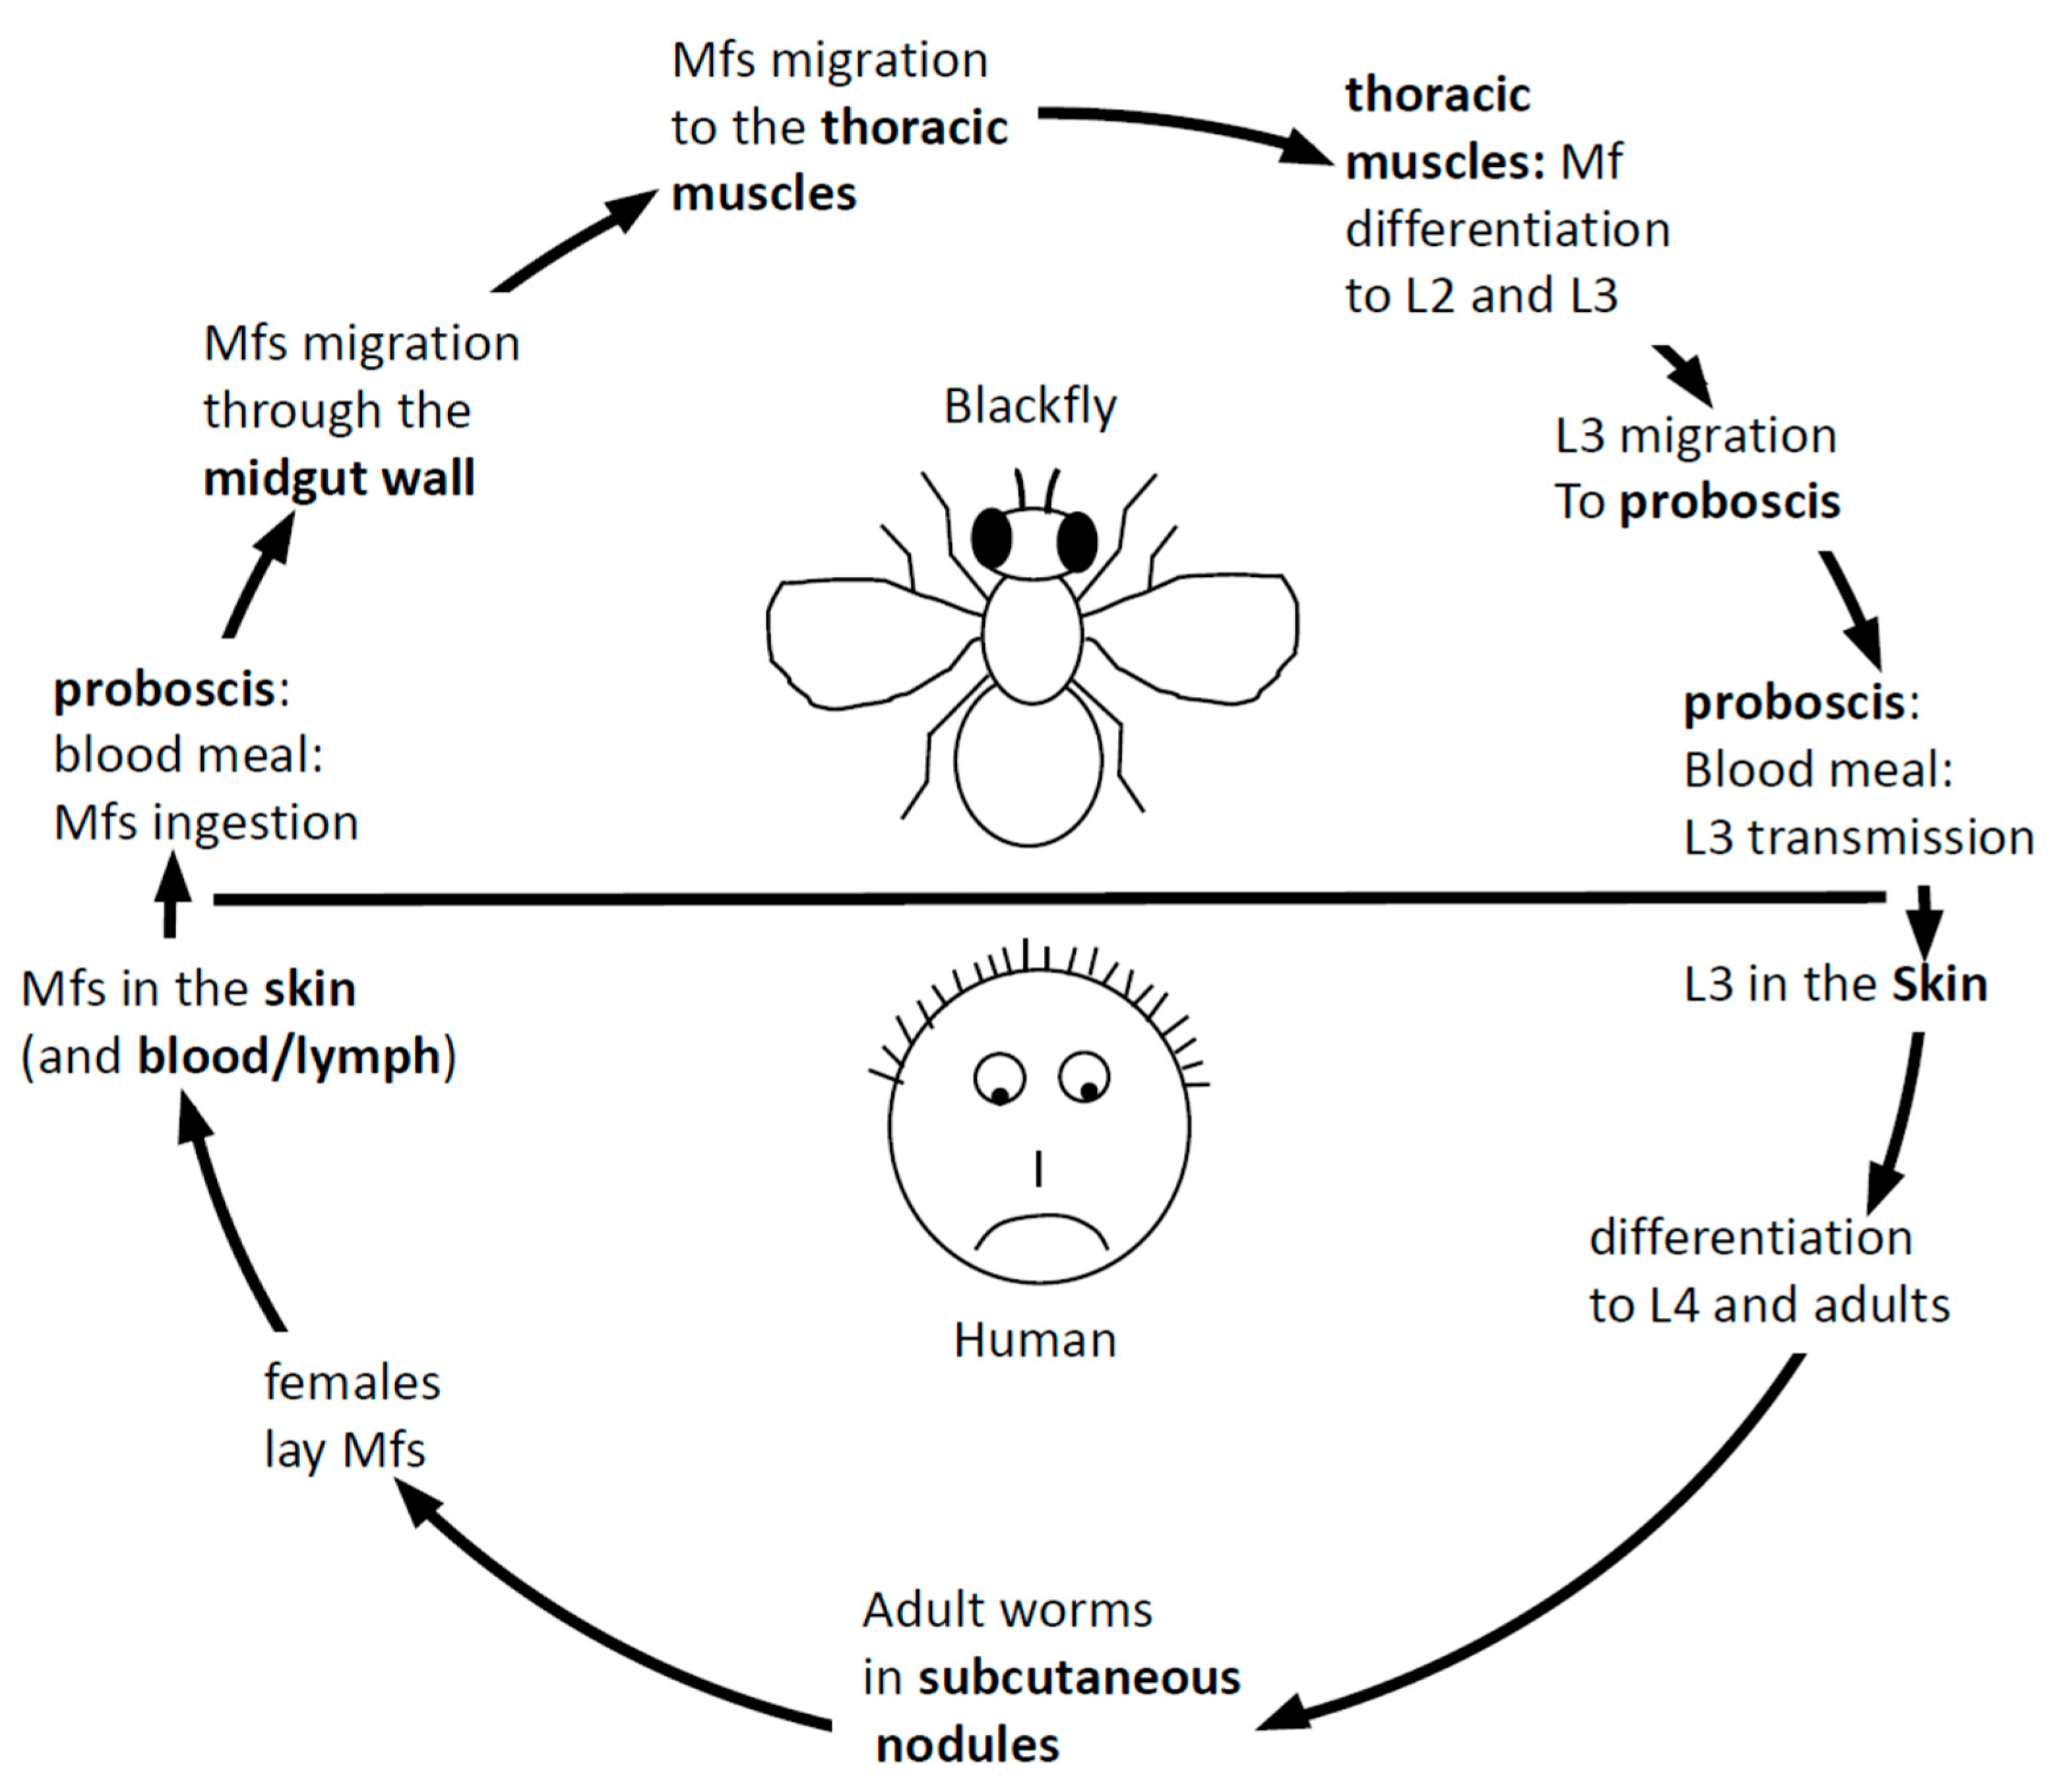

Slide 28
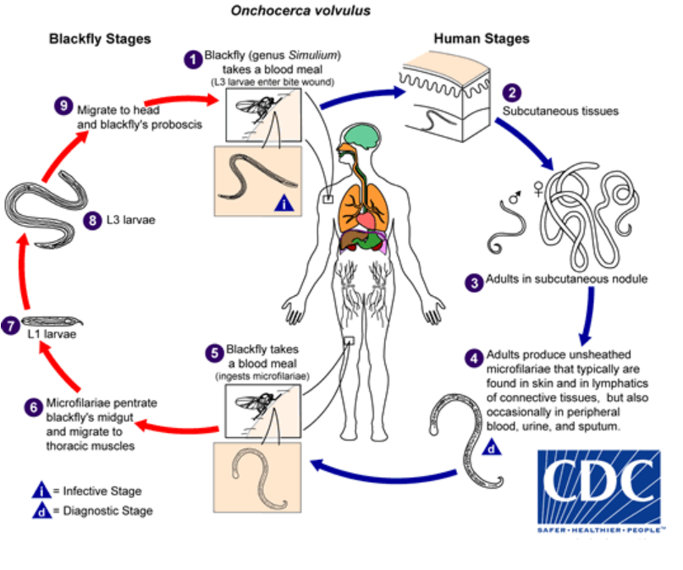

Slide 29
Pathogenesis
Adult worms in the subcutaneous tissue produce varying degree of inflammation and nodules.
These subcutaneous nodules usually appear 3-4 month after the infection.
Subsequently, adult worms elicit a granulomatous inflammatory reaction followed by granuloma formation, fibrosis or calcification.
The M.f are believed to cause many of the disease manifestation of onchocerciasis.
Trauma caused by living M.f & hypersensitivity reactions of the host to dead M.f is responsible for pathology in the eye & also an inflammatory dermatitis in the skin.

Slide 30
Clinical Features
Onchocerca volvulus causes onchocerciasis in humans.
The pathological lesions in the skin and eye result from a hyper sensitivity reaction to the dead or dying microfilaria.
1. Lesions:
The pathological lesions can be divided into two groups.
i. Skin lesions
Skin involvement typically consists of intense itching, swelling and inflammation.
Acute pruritic rashes
Lichenified onchodermatitis spotted depigmentation of the skin leads to “Leopard skin appearance, usually an anterior lower leg.
Skin atrophy and loss of elasticity resulting in “Lizard skin “ appearance

Slide 31
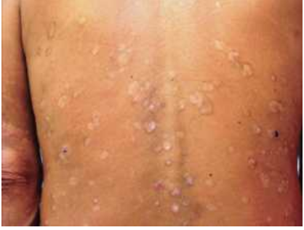
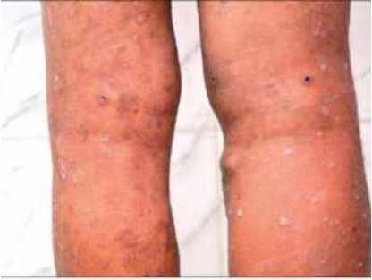
“leopard skin appearance”
Areas of pigment loss with islands of normally pigmented skin surrounding hair follicles
Thickened scaly and hyperpigmented itchy plaques. The lower extremities are commonly affected, and lymph nodes are often enlarged.

Slide 32
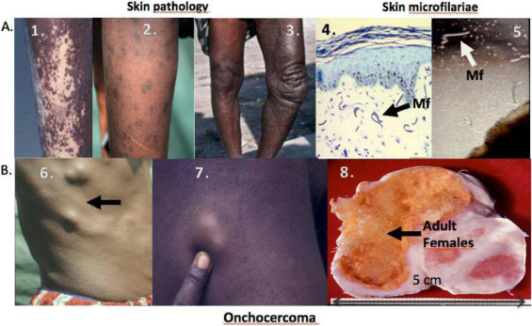
Various skin lesions & microfilariae
(1.) depigmentation
(2.) dermatitis
(3.) lichenification &hyperpigmentation
(4.) microfilariae in a histological section of skin
(5.) microfilaria released in vitro from a skin snip
(6.) nodules in the torso of a man
(7.) nodule in the leg of a boy
(8.) A bisected onchocercoma with adult females

Slide 33
ii. Onchocercoma (subcutaneous nodules)
Are the typical lesions occurring on anatomical sites where the bones are superficial e.g. scalp, scapulae, ribs, knees etc.
They are visible or palpable & contains the adult worm.
A granulomatous inflammatory reaction occur around the worms leading to granuloma formation, then fibrosis or calcification.
They appear 3-4 month after the infection.
The lesions are freely mobile, firm, smooth and rubbery in consistency.

Slide 34
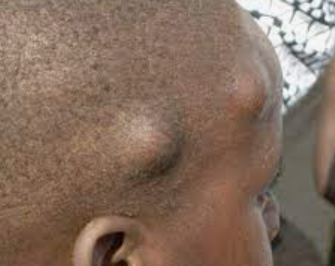
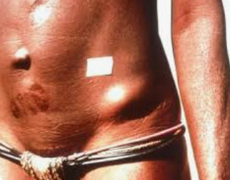
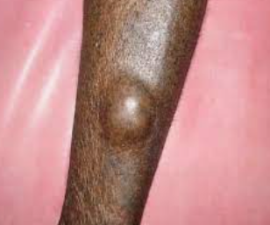
Subcutaneous nodules on superficial bones

Slide 35
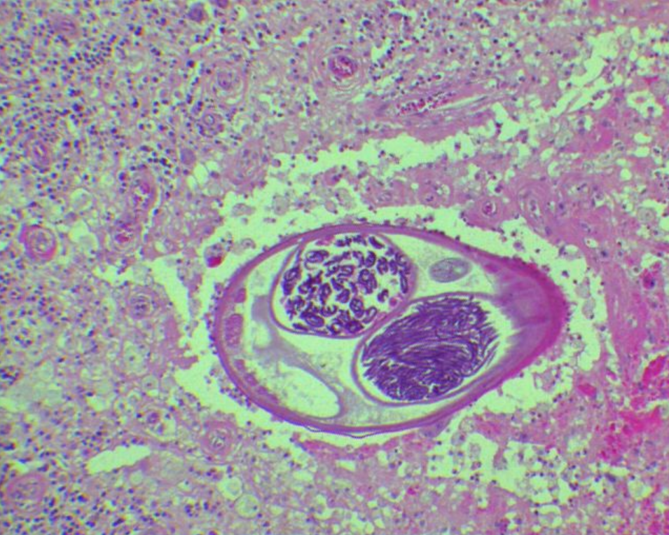
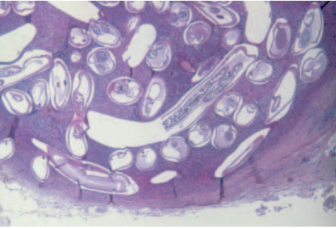
Figure 1.granulomatous reaction around the adult worm
Figure 1
Figure 2
Figure 2.Histology of a nodule showing onchocercoma with numerous cavities surrounded by a fibrous capsule

Slide 36
Other manifestations
i. Lymphadenopathy:
M.f can cause inflammation of lymph nodes especially the inguinal & femoral areas.
The enlarged lymph nodes along with loss of tissue elasticity can lead to a condition known as ‘Hanging groin”.

Slide 37
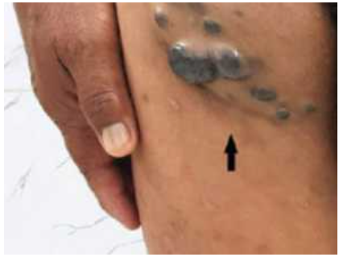
Folds of inelastic atrophic skin in the groin associated with enlarged lymph nodes
Hanging groin sign

Slide 38
ii. Ocular lesions and blindness
It is particularly seen in persons with nodules on the head or face.
Results from presence of M.f in the substantia propria of the cornea & anterior chamber leading to inflammation.
Repeated inflammation in the cornea cause a chronic keratitis & sclerosis affecting the clarity of the cornea
Clinical manifestation include conjunctivitis with photophobia, sclerosing keratitis, iridocyclitis, 2°glaucoma,optic atrophy & blindness.

Slide 39
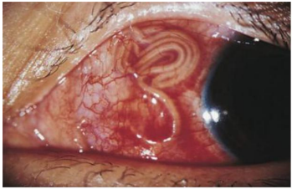
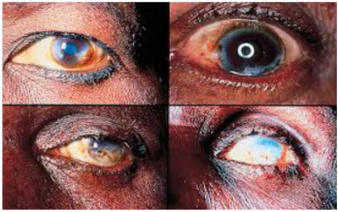
Various eye changes leading to blindness
Microfilariae migrating in the eye

Slide 40
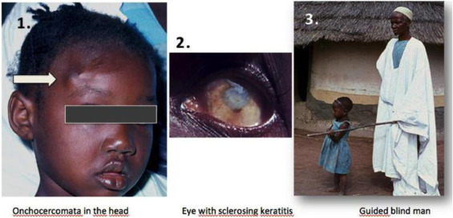
Ocular lesions and blindness

Slide 41
iii. Secondary bacterial infection of the skin lesions
iv. Mazzoki reaction
It is a symptom complex seen in patients after treatment with Diethylcarbamazine (DEC).
Generally occurs within 7 days of treatment.
Characterized by fever, urticaria, lymph node swelling, tachycardia, hypertension, arthralgias, oedema & abdominal pain.
vi. Neurological disease such as epilepsy do occur esp in children

Slide 42
Laboratory Diagnosis
Microscopy
M.f can be demonstrated by examination of skin snip placed in saline @ room temp during which M.f emerge
This method is specific & most accurate.
Adult worms can be detected in the biopsies of subcutaneous nodule.

Slide 43
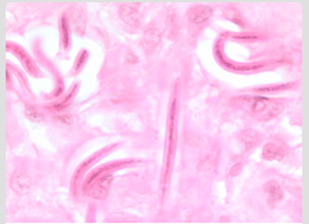
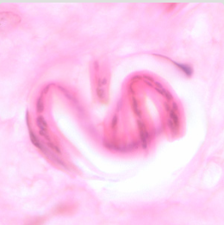
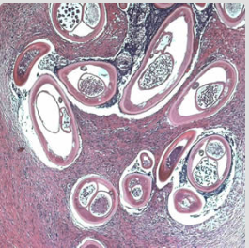
Microfilariae of O. volvulus from a skin nodule of a patient from Zambia, stained with H&E
Coiled microfilaria of O. volvulus, in a skin nodule from a patient from Zambia, stained with H&E.
Adult of O. volvulus in a subcutaneous nodule, stained with H&E

Slide 44
Serology
Useful in cases in which M.f are not demonstrated in the skin.
Detects antibodies against specific onchocercal antigen.
ELISA is more sensitive than skin snip tests.

Slide 45
Other diagnosis test:
USG
Ultrasound is useful for detecting deep onchocercomas & vitreous changes in the eye.
DEC patch test
Also known as Mazzoki patch test.
When the drug patch is placed on the skin, the infected persons show localized pruritus and urticaria as a reaction to dead M.f within 24 hours.
Microfilariae may be directly observed during slit lamp examination of the eye.

Slide 46
Treatment of Onchocerca volvulus:
IVERMECTIN:
  It is a drug of choice for Onchocerca infection.
  Dose: single oral dose of 150 mg per kg weight
HETRAZAN(DEC) and SURAMIN
  DEC destroys M.f but usually causes an intense reaction (Mazzotti reaction)
Doxycycline is macrofilariastatic & makes the female worm sterile as it targets the wolbachia endosymbiont spp of filarial parasites.
Nodulectormy: Surgical removal of detectable nodules wherever possible.

Slide 47
Prevention and control
Control of the vector by destruction of the larva of black flies by applying larvicides in their breeding places.
Personal protection by wearing protective clothing.

Slide 48
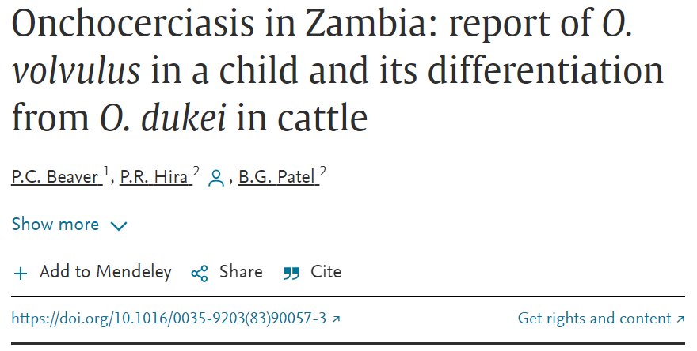

Slide 49
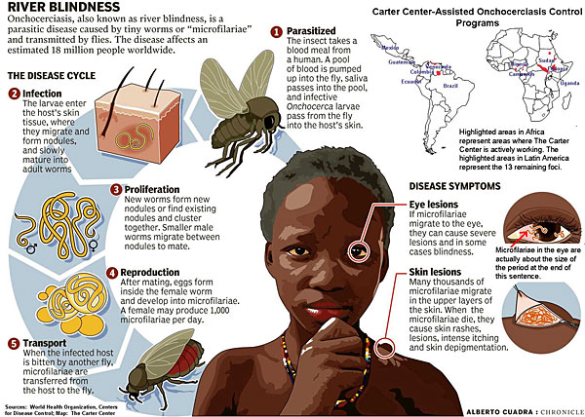
For your quick glance

Slide 50
References
Vanhamme L, Souopgui J, Ghogomu S, Ngale Njume F. The Functional Parasitic Worm Secretome: Mapping the Place of Onchocerca volvulus Excretory Secretory Products. Pathogens. 2020; 9(11):975. https://doi.org/10.3390/pathogens9110975

