Slide 1
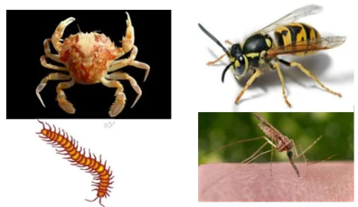
Arthropods of medical importance
Dr Mudenda J

Slide 2
Study objectives
Define entomology and medical entomology
Define arthropods
Classification
Importance of arthropods-why study them
Describe the habit and general control methods of arthropods
Describe different disease transmission mechanisms by arthropods.
Describe Vectorial capacity and its determinants

Slide 3
Entomology is the study of insects & their relationship to humans, the environment & other organisms.
Entomologists make great contributions in several fields e.g agriculture, human/animal health , biology, chemistry, molecular science, criminology, and forensics.

Slide 4
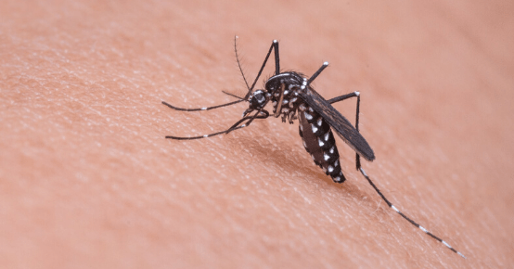
Medical entomology -branch of science that deals with arthropods that cause disease or that serve as carriers (vectors) of organisms that cause disease in humans.

Slide 5
What are arthropods
The term arthropod is derived from the Greek- “arthro” meaning joint & “pod” meaning foot.
Arthropods are small invertebrate animals with jointed legs.
They have an external shell-like skeleton made of a tough, rigid material called chitin.
They have segmented bodies and six or more legs which are jointed.
The body parts & appendage segments are joined by flexible membranes which allow the various parts to move.

Slide 6
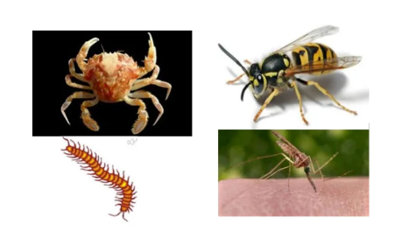
Arthropods have diverse morphological, physiological and behavioral adaptations to their surroundings.

Slide 7
They are the most abundant form of animal life.
Despite their small size, the huge numbers or biomass of insects means that they have significant impact on the environment and humans.

Slide 8
Importance of arthropods-why study them
The majority of arthropods are not harmful to humans.
However, a number of species are considered medically important because they can cause annoyance, physical discomfort or disease in humans.
Arthropods can be put into four main categories.
Harmful- cause nuisance, discomfort and/or blood-loss by their bites (mosquitos, bugs, fleas); or cause nuisance by their mere presence (gnats).

Slide 9
Ectoparasites- live and feed permanently on the exterior of the host without transmitting germs (head lice, pubic lice, scabies mites).
Mechanical transporters -transmit disease passively, by picking up infections from feaces, and then contaminating human food so that disease is contracted orally (flies, cockroaches).
Vectors -actively transmit parasitic disease-causing organisms. The pathogen develops and multiplies in the vector, and is transmitted to humans via the arthropod's bite or excreta (mosquitos, tsetse-flies, body lice, fleas).

Slide 10
Why are these arthropods so successful?
Small size-there are many more niches for small organisms than large organisms.
Short life cycle-this allows many generations within a given time for selection and evolution to take place.
Large reproductive ability-large numbers of offspring support a large variation for selection and evolution to act up on.
Variation in lifestyle of different stages in the insect’s life e.g caterpillar Vs butterfly which reduces competition for resources within species.

Slide 11
Wings-the ability to fly has allowed them to colonise freely.
Sensory sophistication-the sensory capabilities surpasses most other organisms.
Adaptation of appendages-mouthparts,wings and legs have often become highly specialized.

Slide 12
Arthropod Habitats
Depending upon species, arthropods live in various habitats.
Factors that control habitats of arthropods: food, disease, breeding media, climate, competition, natural enemies etc.
Habitats of arthropods include soil, water, ambient air, man, animal and plants.
The soil: may be found on the surface of the soil or under ground e.g spiders, wasps, mites, scorpions, flies, cockroaches, fleas etc.

Slide 13
Water: may live in fresh waters, salty waters or hot springs e.g crabs, lobsters, crayfish, etc.
In the ambient air (temporary fliers):though not a permanent habitat, fliers can be found temporarily e.g bees, mosquitoes, flies, wasps etc.
Fliers are fast spreaders of contamination and pollutions. Therefore, it is hard to control the fliers.

Slide 14
On man(Ectoparasites)- these are dangerous groups to health since they feed on human blood. These could be obligatory ectoparasites (e.g louse) or intermittent (on & off: e.g ticks).
On animals e.g lice, ticks, mites, fleas, mosquitoes etc.
On plants e.g beetles, aphids, spiders etc.

Slide 15
General control methods of arthropods
Control of medically important arthropods employs many principles used against pests of agricultural importance.
The basic purpose of controlling arthropods is to preserve health and well-being of man.
On the other hand, control of arthropods affecting crops and livestock is fundamentally guided by economic principles.
Controlling arthropods includes the following methods:

Slide 16
Personal protection: physical barriers btn man and arthropods e.g chemical barriers that repel arthropods from actual biting & arthropod toxicants that are applied directly e.g. Insecticide treated bed nets for the control of malaria & leishmaniasis.
Environmental manipulation: modification of the specific breeding habitat of an arthropod can provide effective control e.g drainage of marshy areas for controlling malaria .

Slide 17
Barrier zones & quarantines: an area free from certain vectors, either naturally or as a consequence of control programs, may need protection from invasion.
Biological control (Bio control): animal populations including arthropods affecting man & animals are reduced in numbers by certain other forms of life.
Insects can also be controlled genetically.

Slide 18
Local control methods: through trial & error, man has established local ways of fighting & controlling arthropods.
The following are some of the local control methods practiced in communities:
Hot ash to kill or drive away insects like ants.
Hot water against ants, bedbugs, lice, fleas etc.
Certain odorous and sticky leaves like white eucalyptus, mimosa, etc. are used as insect repellants.

Slide 19
Chemical control methods: these act in two ways.
As stomach poisons: these are taken up by the insect in the form of bait or may be applied to surfaces over which the arthropod moves, taking up material on its legs and body.
As contact poison: These may be applied to the atmosphere through which the insect is flying or to surfaces over which it will walk.
The chemical penetrates the cuticle or enters the spiracles and, depending on the active ingredient will act on the nervous system by disrupting nerve impulses causing uncoordinated behavior followed by paralysis & death e.g indoor residual house spraying.

Slide 20
Modes of disease transmission by arthropods
Direct contact
With the direct contact of hosts, the arthropod vectors get transferred from one host to another e.g pediculosis and scabies.
Mechanical Transmission
This is when the pathogen adheres to body hairs, spines or other structures of insects e.g diseases transmitted by house flies,dysentery,cholera,Hep A &E.
In the case of certain insects, transmission may be by regurgitation or defecation.
Biting flies may transmit pathogens by biting with contaminated mouthparts.

Slide 21
Biological Transmission
There are three categories of biological transmission.
Propagative Transmission: in this type of transmission, the pathogen multiplies within the body of the vector but does not undergo any changes in form.
Most viral diseases fall into this category.
Plague (a bacterial disease) in rat flea is an example.

Slide 22
Cyclical Transmission( cyclo- developmental).
The parasites undergo several molts in the body of the vector(arthropod).
No multiplication takes place within the body of the vector.
The only pathogens that are transmitted this way are filarial nematodes(W.Bancroft or filariasis transmitted in culex female)

Slide 23
Propagative and Cyclical Transmission( cyclo-propagative)
Both multiplication and changes in the life form of the pathogen occur within the arthropod.
E.g Plasmodium sp in anopheles female, leishmaniasis, both caused by protozoan parasites

Slide 24
Vectorial Capacity
Vectorial capacity is the potential of a group of arthropods to transmit a given pathogen.
There are 6 main determinants:
Abundance
Host Preference and Host-Feeding Patterns
Reproductive Capacity
Longevity
Dispersal
Vector Competence

Slide 25
Abundance
The more vectors there are, the higher the probability of disease transmission.
Host Preference and Host-Feeding Patterns
Knowing what the vectors feed upon allows for identification of disease transmission.
Reproductive Capacity
A measure of the rate at which a population of vectors increases

Slide 26
Longevity
Longevity is knowing how long the stages of the vector’s life cycle last.
Dispersal
Dispersal is knowing how far a vector can fly or move about freely.
The greater the movement, the greater chance for spread of disease.
Vector Competence
The susceptibility of a group of arthropods to a given strain of pathogen and the ability of those arthropods to transmit the pathogen
This is a genetic characteristic for a particular vector for a given microorganism

Slide 27
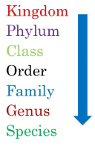
Arthropods of medical importance
These include insects(class insect), crustaceans and arachnids ( class arachnida).
Among arachnids, only mites and ticks(order acarina) are vectors of disease.
Among insects, five groups are of medical importance.
True flies(order Diptera)
True bugs(order Hemiptera)
Lice(order Anoplura)
Fleas(order Siphonaptera)
Cockroaches( order Dictyoptera)
Crustaceans e.g Cyclops and crab

Slide 28
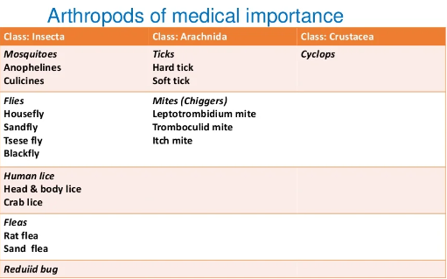

Slide 29
Crustaceans
Most crustaceans have the following features:
Two pairs of antennae
Three pairs of chewing appendages
Various numbers of pairs of legs
They differ from insects in that they have legs on the abdomen and the thorax.

Slide 30
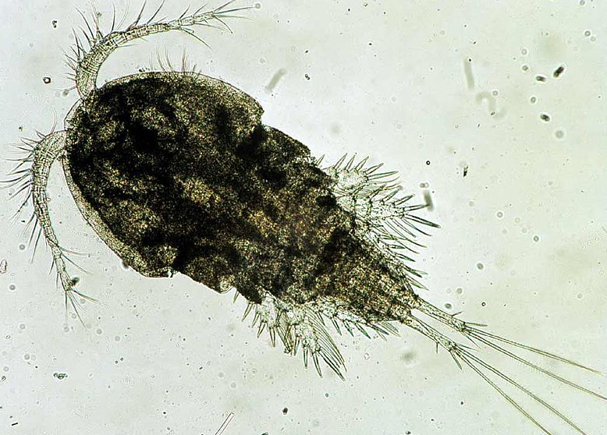
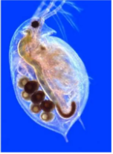
Medical importance
Cyclops are intermediate hosts of the fish tapeworm (Diphyllobothrium latum) and Dracunculus medinensis.

Slide 31
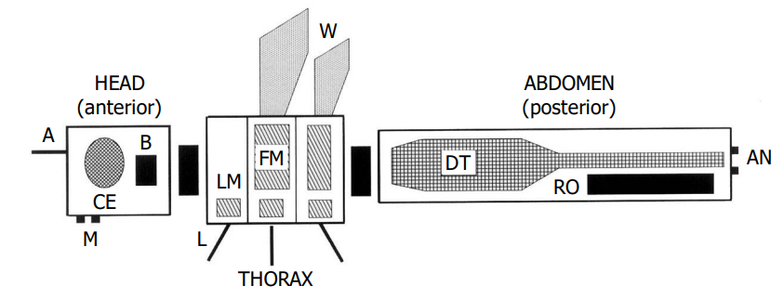
INSECTS
General organization of an insect
Legend: A=antenna, B=brain, CE=compound eye, M=mouth, FM=flight muscle, W=wing, LM=leg muscle, L=leg, DT=digestive tract, RO=reproductive organs, AN=anus

Slide 32
Characteristics of insects
Body divided into Head, Thorax & Abdomen.
The head bears a single pair of Antenna.
Have a pair of mandible and two pairs of maxillae.
Visual organs are compound eyes, maybe absent in some e.g flea.
Thorax possess three pairs of legs & usually one or two pairs of wings.
Abdominal appendages are modified to terminal genital organs near caudal end of the body.

Slide 33
Insects of medical importance
Directly cause damage to human tissue.
Act as vectors for disease causing organisms.
Are useful model systems in biological studies

Slide 34
Mosquitoes
Mosquitoes are insects belonging to the order Diptera, the true flies.
Three subfamilies exist, most important ones are Anophelinae and Culicinae.
Over 3,500 species of mosquitoes have thus far been described.
Examples of most common genera are Aedes,Anopheles,Culex etc.
The mosquito life cycle consists of egg, larva, pupa and adult stages.

Slide 35
Females have tube-like mouthparts (proboscis) that can pierce the skin of a host & feed on blood.
Males differ from females by having mouthparts not suitable for piercing skin(nectar is their principal food source).
Eggs are laid on the water surface, hatch into motile larvae that feed on aquatic algae & organic material.

Slide 36
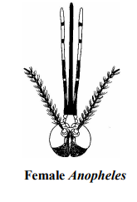
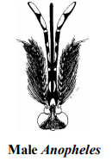
Female mosquitoes have antennae with fewer, shorter hairs. In female Anopheles, the palpi are as long & straight as the proboscis.
Male mosquitoes have a bushy antennae & the palpi are as long as the proboscis & clubbed at the end.

Slide 37
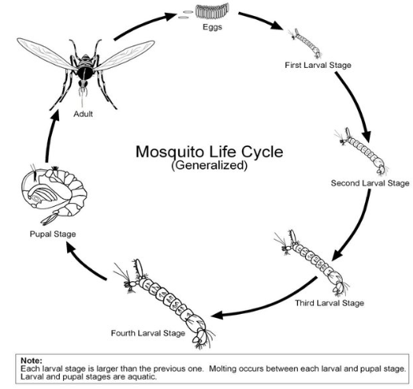

Slide 38
Mosquitoes are important vectors of parasitic diseases such as malaria & filariasis
Also arboviral diseases such as yellow fever,Chikungunya,West Nile,dengue fever and Zika.
Mosquito's saliva is transferred to the host during the bite and can cause an itchy rash.

Slide 39
Anopheles
About 380 species of anopheles occur around the world.
Some 60 species are sufficiently attracted to human to act as vectors of malaria.
A number of anopheles species are also vectors of filariasis and viral diseases.
Female anopheles mosquito spread the disease.

Slide 40
The anophelines that enter houses to feed often rest indoors for a few hours after feeding.
They may then leave for outdoor sheltered resting sites among them vegetation, undersides of bridges, cracks & crevices in trees.
Many anopheles species feed on both humans and animals.
They differ however in the degree to which they prefer one over the other.
Some species feed mostly on animals while others almost entirely on humans.

Slide 41
The most preferred breeding sites are pools, slow running streams, certain epiphytic plants, rice fields and pools of rain water.
Artificial containers such as overhead tanks, cisterns and pots are not usually suitable.
Anopheles mosquitos are active between sunset and sun rise.
Each species has specific biting hours and there are also variations in preference for biting indoors and outdoors.

Slide 42
Diseases transmitted
Malaria caused by various species of Plasmodium.
Culex mosquitos
Culex sp is a markedly domestic specie.
The adult females bite people and animals through out the night, indoors& outdoors.
They are inactive during the day & are often found resting in dark corners of rooms, shelters and calvets.
They also rest outdoors on vegetation and in holes of trees in forested areas.

Slide 43
Diseases transmitted
Lymphatic filariasis
Tularemia a bacterial disease caused by Francisella tularensis.
Arbovirus infections
West Nile virus
Japanese encephalitis

Slide 44
Vector Control Strategies
Residual spraying: The spraying of the indoor surfaces of house with residual insecticides eg. dichloro-diphenyl,trichloroethane (DDT), malathion.
Space application: Space Sprays are those where insecticidal formulation is sprayed into the atmosphere in the form of mist or fog to kill insects (pyrethrum extracts).
Individual protection: Man-vector contact is reduced by preventive measures such as repellants, protective clothing, bed net preferably impregnated with long acting repellant, mosquito coils & screening of house

Slide 45
Genetic control: sterile male technique,sex distortion and gene replacement.
For travelers visiting endemic areas, chemoprophylaxis provides effective protection.
The drugs recommended for chemoprophylaxis are proguanil, chloroquin, or mefloquin weekly or doxycycline daily.

Slide 46
Anti-larval Measures
Old antilarval measures such as oiling the collection of standing water or dusting them with paris green have now become promising with the increase of insecticide resistance.
Source reduction: Techniques to reduce mosquito breeding sites, which include drainage or filling, deepening or flushing, management of water level, intermittent irrigation are among the classical methods of malaria control.
Biological control:Use of Gambusa Affinis(Mosquito fish) and Lebistus reticulatus in pits,sewage and farm ponds.

Slide 47
Flies
Other than the mosquito, this insect is perhaps the single worst nemesis of humans worldwide.
Millions of house flies can be produced in just a couple of days in poorly maintained landfill sites, piles of rotting fruit, and exposed animal feces
Obtain nutrients from a variety of resources including feces and decomposing vegetable matter.

Slide 48
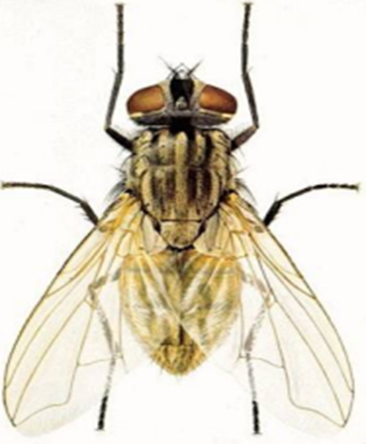
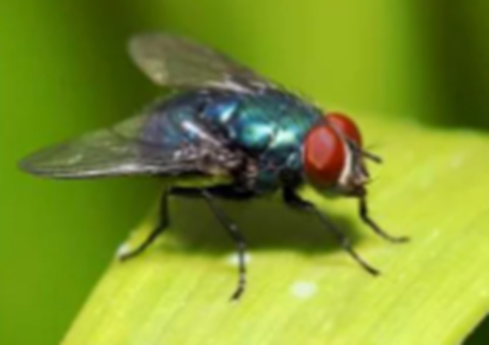
Their reproductive capacity, diet of filth coupled with affinity for man and animals, make flies reservoirs & disseminators of fly-borne parasites & microbial pathogens.
Flies proliferate under warm conditions that accelerate larval development and maximize adult activity.

Slide 49
Disease & Public Health Relationships
Annoyance Factors
Most humans are intolerant of house flies hovering around patios, landing on exposed food & more so when they land on face, arms & legs.
Diseases produced by Microorganisms & Helminths
Flies are incriminated in contaminating exposed food with the bacteria that causes salmonellosis, shigellosis, typhoid & cholera.
The poliovirus can also be transmitted by flies
Diseases caused by intestinal helminths or protozoa such as Giardia, can also be passed on by flies.

Slide 50
Management and Control
The explosive reproductive potential of these flies and their ability to disperse makes these vectors difficult to control.
Balanced Integrated Pest Management (IPM)fly programs include:
Source Reduction: best overall method of fly control is to either prevent or significantly reduce access to larval breeding resources.
Exclusion: keeping flies from entering homes & food establishments, A combination of screening, fans, sticky traps & chemical lures have been used.

Slide 51
Biological Control: Some common predators of flies are species of mites and parasitic wasps that feed on the eggs & internal tissues of pupae.
Chemical Control: These strategies are most commonly applied in suppressing fly infestations and preventing adult flies from contacting humans and domestic animals.
Chemicals can be an oil base, aqueous, wettable powders or liquid concentrates of the product.
Public Education:Used to increase both resident awareness of what conditions breed flies & what actions they can take to effectively reduce fly breeding on their property.

Slide 52
Fleas
Adult fleas are bloodsucking ectoparasites of birds and mammals.
Their mouthparts are used for piercing skin and sucking blood.
Fleas occur primarily on mammals which utilize fairly permanent nests or dens such as rodents.
They can also be found on birds which mostly nest on or near the ground or in burrows.
Most species of fleas usually feed on a single host species, while a few may feed on various host.
A flea can jump vertically and horizontally 150 times its own length.

Slide 53
Public Health Importance
Fleas can be a public health concern by being nuisances as well as vectors.
Their attack on humans & domestic animals can cause irritation, loss of blood, and severe discomfort, while some individuals may suffer severe allergic reactions or secondary infections from their bites.
Fleas can vector disease organisms which cause bubonic plague(Yersinia pestis), murine typhus & trypanosomiasis.
Fleas also serve as intermediate hosts for tapeworms and filarial worms.

Slide 54
Management and Control
Use of pesticides and environmental modifications work best to manage and control fleas.
Rodent burrows, which can harbor fleas, should be avoided.
Dead, dying, or sick rodents should be avoided because their fleas may transfer to humans or pets.

Slide 55
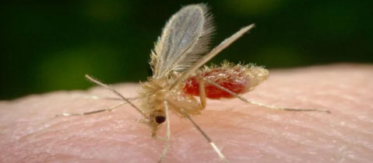
Sandfly
Like a mosquito, except its body is hairy & the wings are feathery.
Smaller than mosquitoes.
Wings rest over the body like angel’s wings.
Large compound eyes.
Long slender legs.

Slide 56
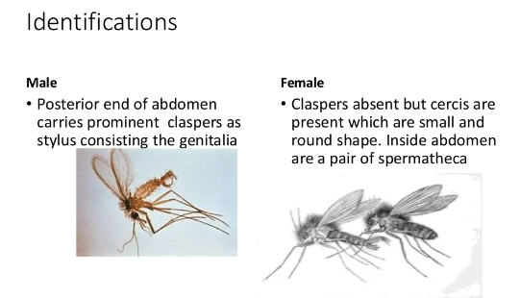

Slide 57
Only females suck blood
Live in warm climates
Breed in rubbish heaps, cracks of walls and soils.
Nocturnal, during day time, they rest in cool damp places.
Vector for leishmaniasis(kala-azar or Visceral leishmaniasis, oriental sore or cutaneous leishmaniasis) & sandfly fever.

Slide 58
Control measures
Breeding is prevented by filling cracks & crevices on walls and removing any stone or rock piles.
The adults are killed by indoor residual spray insecticides like DDT and lindane in concentrations of 1-2 and 0.25g per square meter.
Repellants used on clothes or applied to skin such as deet etc. are effective.

Slide 59
Cockroaches
The German cockroach, Blattella germanica, is the most widespread pest species .
Others include Brownbanded cockroach(Supella longipalpa) ,Oriental cockroach (Blatta orientalis) ,American cockroach (Periplaneta Americana), Smokybrown cockroach (Periplaneta fuliginosa).
Most are uniformly black or brownish.
Most adult cockroaches have wings, immatures ones do not.

Slide 60
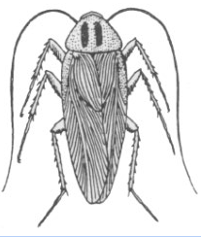
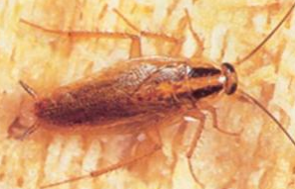
German cockroach(Blattella germanica)

Slide 61
Cockroaches can develop anywhere where there is moderate temperature, humidity, adequate food and water.
Domestic cockroaches often live in close association with bacteria, fungi & viruses,
Hence should be considered significant potential public health pests when they invade or become established indoors.
The term “domestic” refers to their living in structures.

Slide 62
Immature and adult cockroaches have essentially identical food & shelter needs.
Their presence is usually indicative of poor sanitation.
They gain access to buildings from sewer system lines and manholes.
Their presence is often indicative of faulty and deteriorating construction.

Slide 63
Cockroaches have significant adaptive features e.g can survive extended periods of times without food or water, can adapt to a wide range of temperature, moisture and light regimens, can tolerate high doses of noxious substances etc.
Cockroaches exhibit circadian patterns of activity whereby they are quiescent in light and become active in the dark.
They aggregate in groups in cracks, crevices, and other protected places, usually near food and water.

Slide 64
Public Health Importance
All domestic species of cockroaches have pest status by virtue of being an offensive nuisance.
Some are also associated with filth, transmission of disease, and with contact and inhalant allergies.
Cockroaches are a sign of unsanitary conditions.
Special attention should be taken wherever food is prepared, served or stored.

Slide 65
Management and Control
Domestic cockroaches live near people ,food and in environmentally sensitive locations, so it is best to prevent them from gaining initial access into these places.
Preventing continuous invasion or suppressing established infestations usually involves a long-term program of surveillance, exclusion, improved sanitation, management practices & chemical treatment.
Once cockroaches become established, insecticides alone have little long term effect unless accompanied by improved sanitation & structural upgrades.

Slide 66
Food scraps should be cleaned up (do not survive without food & water).
Garbage should be placed in containers with tight-fitting lids & dirty dishes should be cleaned.
Openings that may harbor cockroaches should be sealed.
It is particularly important to keep cockroaches out of commercial buildings, apartments, and other sites where they may establish sites of infestation and come in contact with people.

Slide 67
Aggregation makes them vulnerable to so-called search-and-destroy techniques, such as direct sprays and vacuuming.
Some sprays and powders are designed to be applied into cracks and crevices where they provide control for long periods of time.
Removal of cockroaches with a high velocity vacuum cleaner is becoming increasingly popular esp in situations where absolutely no chemicals are permitted.

Slide 68
Honey Bees
Honey bees belong in the Order Hymenoptera and family Apidae.
Worldwide, 11 honey bee species have been described within the genus Apis.
Honey bees typically live in managed hives but escaped colonies can be found in building voids, dense vegetation, hollow trees, or other locations that provide adequate shelter.
They are of economic importance through pollination of fruits, nuts, and vegetables, honey production, wax production, etc.

Slide 69
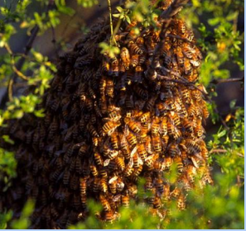
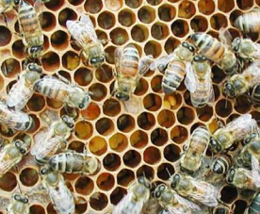
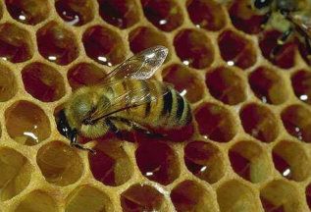
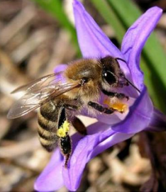
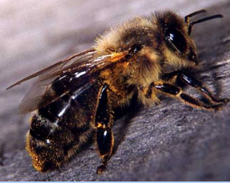
Honey bee hives and combs

Slide 70
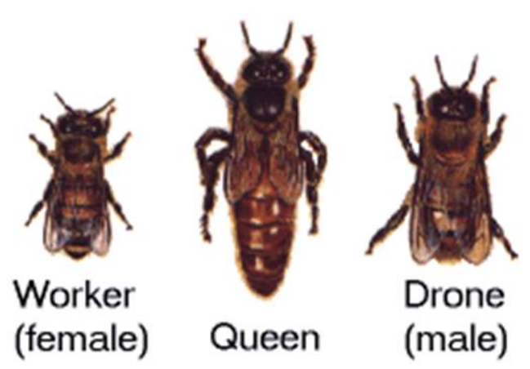
Honey bee characteristics & castes

Slide 71
Bionomics
The stinger is a modified ovipositor, so only female honey bees can sting.
Colonies reproduce by swarming when the old queen and half the workers fly off to start a new colony.
The original colony completes rearing a replacement queen.
Honey bees fly only during daylight hours, when temperatures reach 13o C, there is no rain, and winds are below 19 kph.

Slide 72
Queens are long-lived (~3 years) and only one queen per colony.
Can sting repeatedly because she has a smooth stinger.
She is fed & groomed by retinue bees (assistants).
Only leaves the hive for her initial nuptial flight (mating flight) and if she swarms with her hive.
Females are short-lived (a few weeks in summer, several months in winter) & number in the tens of thousands in larger hives.

Slide 73
Only worker bees forage for nectar and pollen. Older worker bees forage, younger workers stay within hive and perform housekeeping chores.
Will sting to defend the hive.
Males are short-lived, about six weeks & number from a couple of hundred to a few thousand per hive.

Slide 74
Their only purpose is to leave the hive, locate and mate with queens engaging in nuptial flights.
They can’t feed themselves.
Drones die after mating or are expelled from the hive with the onset of winter.
Incapable of stinging in defense of themselves or the hive.

Slide 75
Medical Importance
A worker’s stinger is barbed and can’t be withdrawn after use.
To encourage more bees to attack, the stinger releases pheromones to “mark” a targeted individual.
In hyper sensitized individuals, a sting can bring on anaphylactic shock.
Lowered blood pressure and impaired respiration can lead to death in minutes.

Slide 76
Injected epinephrine usually relieves the symptoms rapidly.
Enzymes continue to break down tissue in patients after treatment, so medical observation (blood test) should continue for many days following a bad stinging event by either bees or wasps.

Slide 77
Management and Control
Efforts should be made by the general public to reduce or prohibit access to potential nesting sites.
Due to the importance of bees, do not destroy bee swarms. Notify a beekeeper and give them the option to capture the swarm.
Newly established colonies should be removed before they increase in size and become unmanageable.
Bees in walls, ceilings, under floors, down chimneys, etc. should be removed by professional pest control operators.

Slide 78
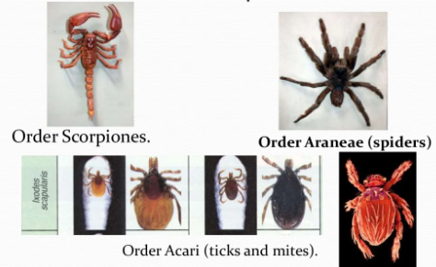
Arachnids

Slide 79
Class arachnida is a group consisting of more than 100,000 species.
These include spiders,scopions,ticks and mites.
They adapted to kill their prey with poison.
Their bodies are divided into cephalothorax and abdomen.
Attached to the cephalothorax are 4 pair of legs, a pair of chelicerae and a pair of appendages called pedipalps.
The pedipalps are used for chewing and in some species for other functions.

Slide 80
Scorpions
Are recognized by their lobster-like pincers and/or long tail terminating in a bulbous stinger.
The body is divided into the cephalothorax & abdomen.
Like other arachnids, scorpions have 4 pairs of legs.
Body coloration varies according to the species & ranges from pale yellow or cream to black.
Scorpions are nocturnal & can detect predators & prey by sensory vibrations in the air and on the ground.
The bigger the claws are, the less venom it has.

Slide 81
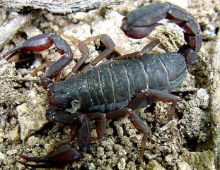
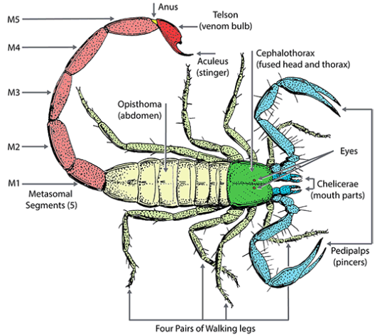

Slide 82
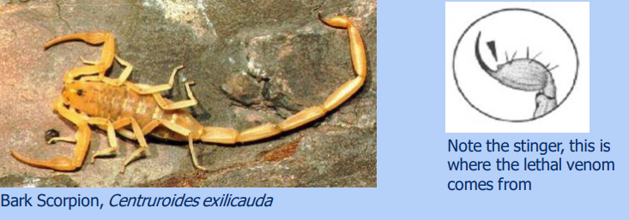
Dangerous species have thin long pincers, & a stinger that releases a lethal venom.

Slide 83
Public Health Significance
When a scorpion strikes defensively, the tail is lashed forward in a quick but well directed thrust, embedding the stinger momentarily into its victim.
At the same time, venom is forced into the puncture wound.
Scorpion venom may be rapidly fatal to invertebrate prey, its effects on vertebrates are highly variable.
In most cases, localized pain and swelling is seen at the sting site.
Few stings are serious enough to warrant medical attention

Slide 84
Muscular spasms occur in severe cases.
Fatal outcome is caused by respiratory failure, pulmonary edema and shock.
Management and Control
Breeding is seasonal and generally occurs during the warm months.
Exposure to scorpion stings is greatest during this period, preventive measures initiated before or during that time can be effective.

Slide 85
Management and Control
Outside dwellings
Accumulation of rocks, rubbish, lumber, and firewood should be moved away from living quarters.
Inside dwellings
Seal all cracks and crevices from the exterior, particularly those near ground level.
Scorpions cannot climb smooth surfaces, so walls should be constructed in this fashion.

Slide 86
Potential benefits
Compounds in scorpion venom can be used to create new drugs.
A toxin found in north African death stalker scorpion has shown potential in treating brain tumours.
Some venom has painkilling potential e.g black mamba venom.

Slide 87
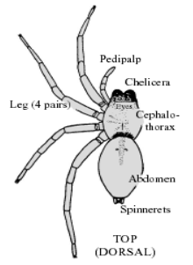
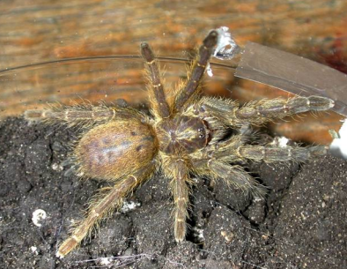
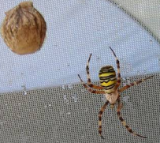
Spiders
About 35000 named species of spiders exist.
Only a very few are considered harmful to man & most species are nocturnal
They are capable of inflicting painful bites and the various reactions caused by the venom.

Slide 88
Morphology
Spiders belong to the class Arachnida; Order Araneae.
All are wingless and have four pairs of legs.
The body is divided into two main regions (cephalothorax & abdomen); joined by a narrow connection, the pedicel.
The poison glands are usually located in the basal segments of the chelicerae.
The captured prey is usually paralyzed by the venom, or crushed by the strong chelicerae, and digestive fluids are introduced via the maxillary glands.

Slide 89
Species of Public Health Significance
Almost all spider bite cases occur when humans accidentally come in contact with them.
They do not “attack” people as is popularly visualized.
Effects of the spider bite range from benign to severe, depending upon a complexity of factors, such as site of bite, amount of venom injected, age, and physical health of the person.

Slide 90
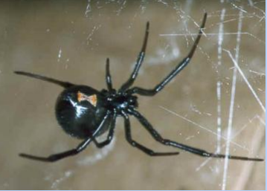
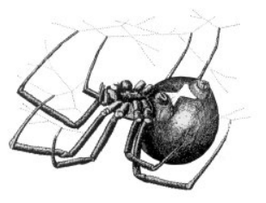
Species of Public Health Significance
Black Widow Spiders (Latrodectus hesperus)
Adult females are black and shiny with a red “hourglass” marking on the underside of the pea-sized abdomen.
The males are usually black and much smaller with brightly colored chevron like bands and spots on the abdomen.

Slide 91
Most dangerous species, are found in every terrestrial and freshwater.
Feed on fungi,plants and animals.
Its venom is neurotoxic affecting the CNS,cramps in the legs, arms and chest occur together with local swelling.
Other symptoms may include headache,nausea,tremors and a slight rise in temperature.

Slide 92
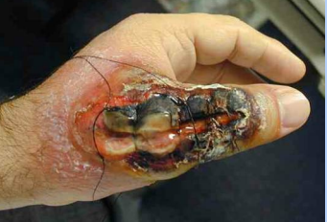
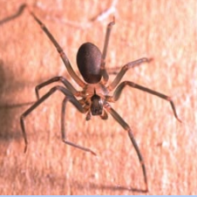
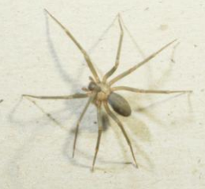
Brown Recluse Spiders, Brown Spiders, Violin Spiders (genus Loxosceles)
All species of Loxosceles spiders possess venom capable of causing skin necrosis.

Slide 93
Management and control
Spiders usually reside where arthropod prey and adequate shelter are available.
Most prefer outdoors, but the periodic appearance or presence of wandering spiders inside dwellings is seasonal, and usually related to their mating habits.
Frequent house cleaning and control of other insect pest often will limit their numbers.

Slide 94
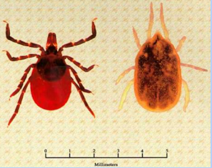
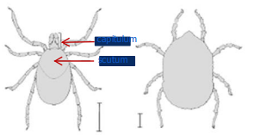
Ticks
Ticks are bloodsucking ectoparasites of reptiles, birds, mammals, and rarely amphibians.
Ixodids & Argasids are referred to respectively as hard-bodied and soft-bodied ticks because of the presence or absence of the scutum
Ixodids(hard ticks) & argasids(soft ticks) differ morphologically in several characteristics.

Slide 95
The capitulum in argasids is situated anteroventrally, versus anteriorly in ixodids.
The scutum, a prominent dorsal sclerotized plate, is absent in argasids, versus present in ixodids.
As larvae, ticks have six legs; as nymphs and adults, they have 8 legs.
Slightly over 90% of hard-tick species undergo a three-host life cycle in which the larva, nymph, and adult each feed on a different vertebrate belonging to the same or two to three different species.

Slide 96
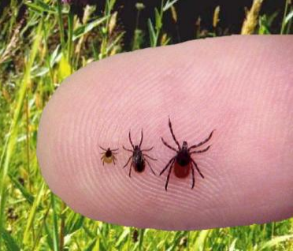
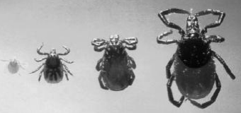
Western black legged tick (Ixodes pacificus)

Slide 97
Public Health Significance
Ticks are of public health significance for numerous reasons:-
Their attachments may cause various kinds of skin disorders.
They may invade the auditory canal of humans producing a condition known as oto-ascariasis.
Females of certain ixodids can cause a flaccid, ascending, and sometimes fatal paralysis known as tick paralysis.
Individuals bitten repeatedly by some ticks may develop allergic or even anaphylatic reactions.
They transmit numerous bacterial, viral, and protozoan diseases.

Slide 98
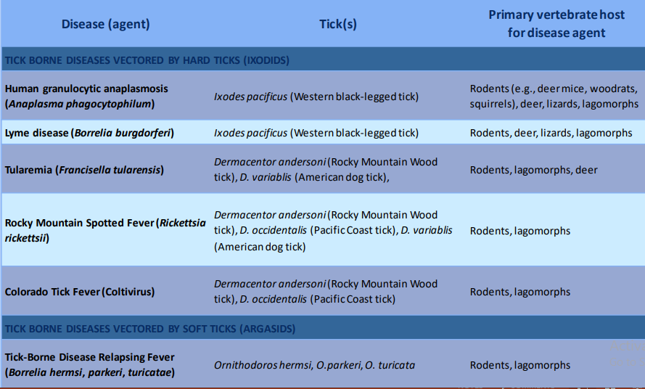

Slide 99
Tick Control and Management
Control measures directed against ticks consist of any method or combination of methods, which either interrupt or minimize contact between a tick and its host.
Control strategies vary considerably according to the species of tick targeted, its life stage, habitat, time of year, and the type, density, and distribution of its host.

Slide 100
Natural Control
Tick populations normally are regulated by climatological factors, availability of suitable vertebrate host populations, and by their natural enemies (parasites and predators).
Chemical Control
Area-wide applications of acaricides to tick habitats may offer short-term control.
Repellents can be applied to pets and humans to decrease the possibility of tick attachment.

Slide 101
Avoidance of Ticks
Individuals visiting tick-infested areas should stay in the center of trails and avoid sitting on the ground or on logs in brushy or woodland areas.
Environmental Modification
Habitat reduction can effectively decrease tick-host interaction

Slide 102
Tick Removal Technique
Use tweezers to grab the tick close to your skin.
Pull the tick firmly, straight out, away from the skin (do not jerk, twist, or burn the tick).
Wash your hands and the bite site with soap and water after the tick is removed and apply an antiseptic to the bite site.
The sooner a tick is removed, the less likely it is that a person will be infected.
Personal protection can be achieved by tucking pants into boots or socks, and shirts into pants.

Slide 103
Personal Protective Measures
Avoid tick-infested areas and wear light-colored clothes.
Wear a hat, long-sleeved shirt, and long pants.
Tuck shirt into pants, pants into boots or socks.
Apply DEET repellent to skin not covered by clothing.
Treat clothing with permethrin repellent as directed on the label.

Slide 104
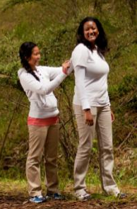
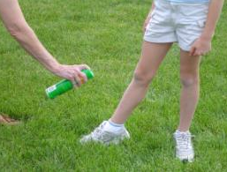
And finally have a friend check your back for ticks.

