Slide 1
PATHOGENIC FREE-LIVING AMOEBAE
Dr J Mudenda

Slide 2
INTRODUCTION
Numerous free-living amoebae are found in water & soil.
However only a few are potentially pathogenic and can cause human Infections.
These are termed as amphizoic organisms -can multiply both in the body of a host (endozoic) and in free-living (exozoic) conditions.

Slide 3
The pathogenic ones are Naegleria Fowleri & Acanthamoeba causing:
Primary amoebic meningoencephalitis (PAM) – caused by amoebofl agellate Naegleria (the brain eating amoeba).
Granulomatous amoebic encephalitis (GAE) and chronic amoebic keratitis (CAK) – caused by Acanthamoeba
Balamuthia have also been reported to cause GAE.
PAM & CAK occur in healthy individuals while GAE has been associated with immunodeficient patients.

Slide 4
Naegleria Fowleri
Fowleri is the only specie of the genus Naegleria which infects man.
It causes the disease called primary amoebic meningoencephalitis (PAM), a brain infection that leads to destruction of brain tissue.
It has world wide distribution.
Commonly found in warm freshwater (e.g. lakes, rivers, and springs) & soil.
N. fowleri is a heat-loving (thermophilic) amoeba that thrives in warm water at low oxygen tension.
Only 32 infections were reported in the US in the last 10 years from 2002 to 2011 with no case reported in Zambia.

Slide 5
Morphology
The parasite occurs in 3 forms:
Cyst
Amoeboid trophozoite form
Flagellate trophozoite form
Trophozoite Stage
The trophozoites occur in 2 forms, the amoeboid and flagellate.

Slide 6
Amoeboid trophozoite form
The amoeboid form has rounded pseudopodia, a spherical nucleus & pulsating vacuoles(used for engulfing RBCs /WBCs).
It is the feeding, growing & replicating form of the parasite, seen on the surface of vegetation, mud and water.
It is also the invasive stage & the infective form of the parasite.

Slide 7
Flagellate form
The biflagellate form occurs within a minute when trophozoites are transferred to distilled water.
The flagellate can revert to the amoeboid form, hence N. fowleri is classified as amoeboflagellate.

Slide 8
Cyst Stage
It’s the resting or the dormant form & can resist unfavorable conditions such as drying and chlorine up to 50 ppm(2ppm kills the cyst).
Trophozoites encyst due to unfavorable conditions such as food deprivation, desiccation, cold temperature etc.
Cysts and flagellate forms of N. fowleri have never been found in tissues of cerebrospinal fluid (CSF).

Slide 9
Life Cycle
Infection occurs during swimming or diving in warm river freshwater/ponds.
Infn can also occur in poorly maintained swimming pools or during nasal irrigation using contaminated tap water.
The amoeboid form is the infective stage to man & multiplies by binary fission.
Under unfavorable conditions, it forms a cyst which undergoes excystation when conditions are favorable .

Slide 10
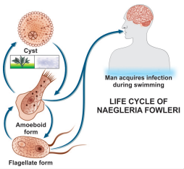
Flagellate form of trophozoite
helps in the spread of N. fowleri
to new water bodies.
Completion of the life cycle occur
in the external environment.

Slide 11
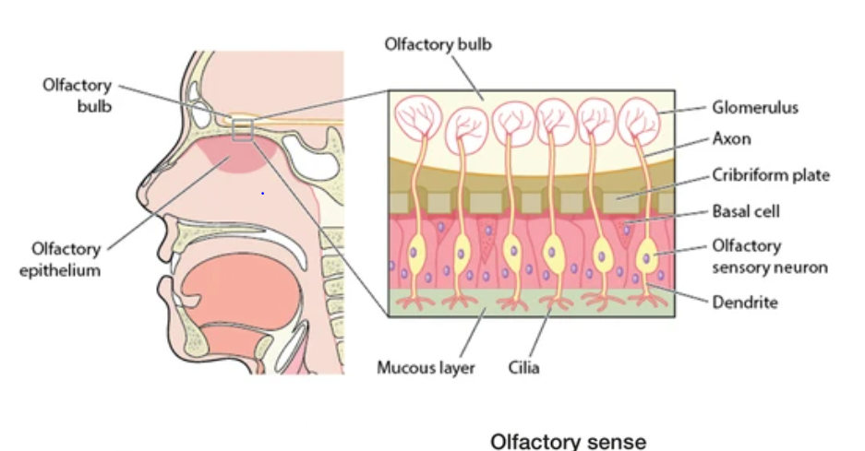
Contact with amoeba contaminated water via olfactory mucosa leads to infection

Slide 12
Pathogenicity and Clinical Features
Patients are mostly previously healthy young adults or children.
Infection occur following swimming or diving in ponds containing amoebae.
The amoebae invade the nasal mucosa, pass through the olfactory nerve branches in the cribriform plate into the meninges & brain.
This initiates an acute purulent meningitis and encephalitis called primary amoebic meningo encephalitis (PAM) .
The incubation period varies from 2 days to 2 weeks during which the patient experiences anosmia.

Slide 13
The disease advances rapidly causing fever, headache, vomiting, stiff neck, ataxia, seizure and coma.
Cranial nerve palsies, especially of the third, fourth, and sixth nerves have also been documented.
The disease almost always ends fatally within a week (average 5 days).

Slide 14
Laboratory Diagnosis
Microscopy
The diagnosis of PAM is by microscopy based on the presence of motile Naegleria trophozoites in wet mounts of freshly-obtained CSF.
The CSF picture resembles that of bacterial meningitis with a cloudy to purulent appearance, prominent neutrophilic leukocytosis, elevated protein & low glucose.
Cysts are not found in CSF or brain.
At autopsy, trophozoites can be demonstrated in brain histologically by immunofluroscent staining.

Slide 15
Culture
N. fowleri can be grown in several kinds of liquid axenic media or non-nutrient agar plates coated with Escherichia coli. Both trophozoites and cysts occur in culture.
Molecular Diagnosis
Newer tests based on polymerase chain reaction (PCR) technology are being developed.

Slide 16
Treatment
Amphotericin-B is the drug of choice administered via IV or intrathecally (injected into the spinal canal or subarachnoid space).
Treatment combining miconazole & sulfadiazine has shown limited success when administered early.
More than 95% cases of PAM are fatal despite of treatment.

Slide 17
Acanthamoeba Species
A. culbertsoni (formerly, Hartmanella culbertsoni) is the species most often responsible for human infection.
Infection by other species like A. polyphagia, A. castalleni, and A. astromyx have also been reported.
This is an opportunistic protozoan pathogen found worldwide in the environment in water and soil.
Approximately 400 cases have been reported worldwide

Slide 18
Morphology
Acanthamoeba exists as active trophozoite form & a highly resistant double-walled cystic form.
The trophozoite is large in size & characterized by spine-like pseudopodia (acanthopodia).
It differs from Naegleria in not having a flagellate stage & in forming cysts in tissues.
Cysts are present in all types of environment all over the world.

Slide 19
Life Cycle
Both trophozoites & cysts are infective.
Infections occur by inhalation of a cyst or trophozoite.
Infection can also occur by ingestion of cysts or through contact with traumatized skin or eyes.
After inhalation of aerosol or dust containing trophozoites and cysts, the trophozoites reach the lungs from which they invade the CNS hematogenously producing granulomatous amoebic encephalitis (GAE).

Slide 20
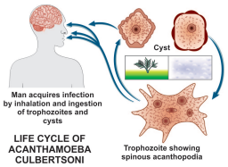
Life cycle of Acanthamoeba culbertsoni

Slide 21
Pathogenesis & Clinical Features
Infection usually occurs in patients with immunodeficiency, diabetes, malignancies, malnutrition, systemic lupus erythematosus.
The parasite spreads hematogenously into central nervous system.
Subsequent invasion of the connective tissue & induction of pro-inflammatory responses lead to neuronal damage that can be fatal within days.
A postmortem biopsy show severe edema & hemorrhagic necrosis.

Slide 22
Clinical Disease
Presents mainly as 2 chronic conditions—keratitis & encephalitis.
Acanthamoeba keratitis
Follows infection of the eye that typically occurs in healthy persons & is due to entry of the amoebic cyst through abrasions on the cornea.
Majority of such cases have been associated with the use of contact lenses.
The picture resembles that of severe herpetic keratitis with a slow relapsing course but the eye is severely painful in amoebic infection

Slide 23
Unilateral photophobia, excessive tearing, redness and foreign body sensation are the early signs & symptoms (disease is bilateral in some contact lens users).
Keratitis and uveitis can result in permanent visual impairment or blindness.
Granulomatous amoebic encephalitis(GAE):
It is a serious infection of the brain and spinal cord that typically occurs in persons with a compromised immune system.

Slide 24
GAE is believed to follow inhalation of the dried cysts.
The incubation period is long with slow evolution of the illness.
Clinical picture is that of intracranial space-occupying lesions with seizures, paresis & mental deterioration.
Disseminated infection
In immuno-comprised states AIDS, widespread infection affecting the skin, lungs, sinuses, and other organs independently or in combination can occur.

Slide 25
Laboratory Diagnosis
Diagnosis of amoebic keratitis is by demonstration of the cyst in corneal scrapings on wet mount, histology and culture. Growth can be obtained from corneal scrapings inoculated on nutrient agar, overlaid with live or dead Escherichia coli and incubated at 30°C.
Diagnosis of GAE is made by demonstration of trophozoites and cysts in brain biopsy, culture & immofluroscence microscopy using monoclonal antibodies.
CSF shows lymphocytic pleocytosis, slightly elevated protein levels, and normal or slightly decreased glucose levels.
CT scan of brain provides is inconclusive.

Slide 26
Treatment
In acanthamoeba keratitis, current therapy involves topical administration of biguanide or chlorhexadine with or without diamidine agent.
In severe cases, where vision is threatened, penetrating keratoplasty can be done.
No effective treatment is available for GAE. Multidrug combinations including pentamidine, sulfadiazine, rifampicin, and fluconazole are being used with limited success.

Slide 27
Balamuthia Mandrillaris
B. mandrillaris, a leptomixid free-living amoeba, is a newly identified specie reported to cause GAE.
Morphology
It exists as a cyst & an amoeboid trophozoite stage(flagellate stage is absent).
It is relatively large, irregular in shape & actively motile by broad pseudopodia.
Cyst of B. mandrillaris are usually spherical surrounded by a three-layered cyst wall comprising an outer irregular ectocyst, a middle mesocyst & an inner endocyst round wall.
Under light microscopy, it appears to have two walls—an outer irregular wall & an inner smooth wall.

Slide 28
Infection is transmitted through respiratory tract, skin lesions or the eyes.
The life cycle is similar to that of Acanthamoeba spp.
Clinical Disease
It causes granulomatous amoebic encephalitis in both healthy & immunocompromised hosts particularly in children & elderly.

Slide 29
Laboratory Diagnosis
Laboratory diagnosis is done by identifying trophozoites of B. mandrillaris in the CSF .
Also identifying trophozoites & cysts in brain tissue.
PCR also gives reliable diagnosis.

Slide 30
NONPATHOGENIC INTESTINAL AMOEBA

Slide 31
Entamoeba Coli
Non-pathogenic intestinal commensal with a worldwide distribution.
Larger than E. histolytica with sluggish motility.
Contains ingested bacteria but no red cells.
The nucleus is clearly visible in unstained films with thick nuclear membrane lined with coarse granules of chromatin.
Cysts are large with a prominent glycogen mass in the early stage.
The mature cyst has 8 nuclei.
Has a similar life cycle as E . histolytica except that its nonpathogenic.

Slide 32
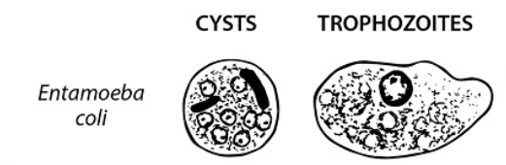
E.coli trophozoite and cyst
Mature cyst with 8 nuclei & 2 chromatoid bodies
Trophozoite with thick nuclear membrane lined with coarse granules of chromatin.

Slide 33
Entamoeba Gingivalis
It is a commensal(not considered to cause any disease) with a global distribution.
Transmitted by direct oral contact.
The amoeba lives in gingival tissues & is abundant in cases of poor oral hygiene.
Has also been found in bronchial washings,vaginal & cervical smears, where it can be mistaken for E. histolytica.
Only the trophozoite is found with no cystic stage.
The trophozoite is actively motile with multiple pseudopodia.

Slide 34
Entamoeba Hartmanni
Found wherever E. histolytica exist but considered a separate specie of nonpathogenic commensal intestinal amoeba.
The trophozoite & cyst are much smaller than E. histolytica.
Trophozoites do not ingest rbcs and their motility is less vigorous.
The cyst resembles that of Endolimax nana.

Slide 35
Endolimax Nana
A non-pathogenic commensal amoeba found in the intestine.
Widely distributed.
The trophozoite is small with a sluggish motility.
The cyst is small, oval & quadrinucleate with glyocogen mass.

