Slide 1
Balantidium Coli
Dr J Mudenda

Slide 2
Outline
Epidemiology
Morphology
Pathogenesis
Clinical signs
Diagnosis and control measures

Slide 3
Taxonomical Clasification
Kingdom: | Protozoa,
Phylum: | Ciliophora,
Class: | Kinetofragminophorea,
Order: | Trichostomatida
Family: | 1. Balantidiidae | 2. Pyenotrichiidae
Genus: | 1. Balantidium | 2. Buxtonella
Species: | 1. B. coli (Malmsten, 1857) | 2. B. sulcata (Jameson 1926)

Slide 4
Buxtonella sulcata
Found in colon of bovines
Balantidium coli
Balantidium coli is the largest protozoan parasite of humans found in the large intestine of man
It is also the only ciliate known to parasitize humans
Causes Balantidiosis also known as ciliary dysentery
Distribution
Has a worldwide distribution although the prevalence is low.
The most endemic area is New Guinea due to close association between man and pigs

Slide 5
Morphology/Habitat
Exist in two morphological forms:-
Trophozoite
Is the actively motile and dividing form found in the large intestine.
Invasive and found in dysenteric stool.
Cyst
Spherical in shape and surrounded by thick transparent double layer wall.
Infective stage of B. coli.
Found in chronic cases and carriers

Slide 6
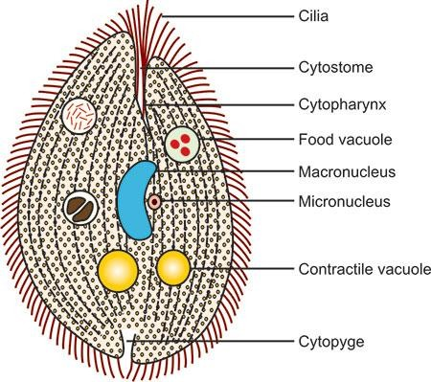
TROPHOZOITE
Found in active stage of disease (dysenteric stool), & invasive form
shape: oval
Size: 30-300 µm long x 30-100 µm breadth
Whole body covered with a row of tiny delicate cilia – organ of locomotion
Cilia present near the mouth part – longer called “adoral cilia”
Anterior end- narrow - Bears a groove (peristome) that leads to a mouth (cytostome) - followed by a short funnel shaped gullet (cytopharynx) extending up to one-third of the body.
Posterior end- broad, round - Bears an excretory opening (Cytopyge)
No anus
Cytoplasm- outer clear ectoplasm and inner granular endoplasm

Slide 7
Endoplasm contains two nuclei 1. Macronucleus: large kidney shaped macronucleus in centre and
responsible for the cytoplasmic activities 2. Micronucleus : small vesicular nucleus, lie in the notch of
macronucleus and responsible for reproductive process
One or two contractile vacuoles: lie side by side or one above the other & maintain the proper osmotic
pressure inside cell
Numerous food vacuole: contains food particles like debris from host gut, bacteria, starch grains, fat
droplets and occasional RBCs, etc. Where digestion of food particles takes place

Slide 8
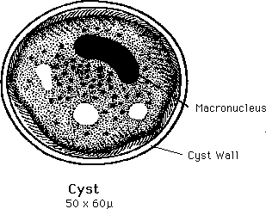
CYST
Shape: round
Size: 40-60 µm
Immobile and dominant
Surrounded by a thick transparent cyst wall allows the cysts to resist degradation in the acidic
environment of the stomach and the basic environment of the small intestine
Contains two nuclei- macronucleus and micronucleus and vacuoles
Cilia- seen in younger cyst but is absorbed on maturity movement ceases
Infective stage of Animals
Non-reproductive stage

Slide 9
Life Cycle
B. coli passes its life cycle in one host only (monoxenous).
It is a zoonosis with infection acquired from pigs & other animal reservoirs
Reservoir hosts :
Pigs and rat are important sources of infection for human beings (Pigs main animal reservoir)
Has also been reported in dogs, cows, horses, rodents and nonhuman primates
Man-to-man transmission ocur
Accidental hosts : Man

Slide 10
Mode of transmission:
Cysts (Infective stage) are responsible for transmission of balantidiosis through ingestion of contaminated food or water through the oral-fecal route.
Water is the vehicle for most cases of Balantidiosis
Site of Infection:
Caecum and colon
Excystation:
occurs in small intestine
Reproduction:
Trophozoites multiply by asexual (transverse binary fission) or sexual (conjugation) occurs in large intestine

Slide 11
Life cycle
The cyst is the infective stage of Balantidium coli
Once the cyst is ingested via feces-contaminated food or water, it passes through the host digestive system There, excystation takes place in small intestine
Excystation produces a trophozoite from the cyst stage Single trophozoite forms from each cyst
The motile trophozoite is the feeding stage of the parasite multiply either in gut lumen or enter the sub mucosa of large intestine
Trophozoites multiply by asexual binary fission or sexual conjugation

Slide 12
Asexual reproduction
Division by binary fission
Micronucleus divide first followed by macronucleus
A transverse septum forms – separates the cytoplasm into halves
Sexual reproduction
Replicate sexually (Syngamy) by conjugation
Two trophozoites come in contact with each other at their anterior ends Exchange the nuclear material for few moments then they detach
No increase in number of trophozoites
Both trophozoite and cyst are excreted in faeces
Trophozoites disintegrates, cysts are resistant and are infective to man and pig

Slide 13
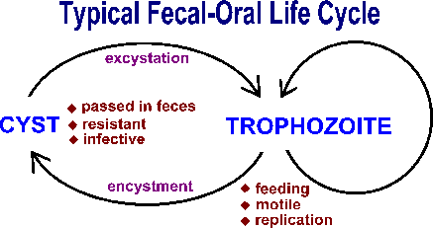

Slide 14
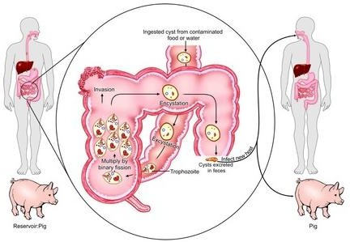

Slide 15
Pathogenesis and Sign and Symptoms
Most cases are asymptomatic
If symptomatic, B. coli infections may cause sever infection that resemble acute amoebiosis
Trophozoites invade gut sub mucosa- form multiple tiny superficial ulcers - Ulcers with necrotic base and undermined edge just as those of Entamoeba histolytica
Virulence factor:
Hyaluronidase- help to penetrate intestinal mucosa, other enzymes are also secreted.
Microscopically- cluster of trophozoites are found in sub mucosa with inflammatory cells
(lymphocytic)
Symptoms include diarrhea with profuse mucus and blood, fever, nausea, vomiting, Abdominal pain, anorexia (loss of appetite) and even dysentery
The diarrhea may persist for long periods of time resulting in acute fluid loss and weight loss
Metastatic and extraintestinal diseases, liver, lung and brain abscesses, usually are very rare

Slide 16
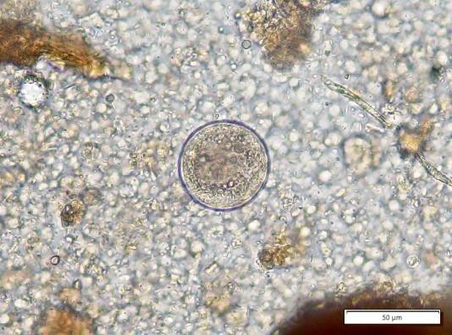
LABORATORY DIAGNOSIS
STOOL MICROSCOPY
Trophozoites- detected in acute disease (dysenteric stool) -easy to identify by its rotatory motility, large kidney shaped macronucleus and presence of cilia
Cysts- seen in chronic cases or carriers - round, 40-60 µm in size, surrounded by a cyst wall and presence of two nuclei

Slide 17
HISTOPATHOLOGY
Scrapings of colonic and ceacal mucosa can be stained with H&E
Histopathological staining of biopsy tissue or scrapping of the ulcers taken by sigmoidoscopy -reveals clusters of trophozoites,cysts and lymphocytic infiltration found in sub mucosa
CULTURE
Media used: Boeck and Drbohlav egg serum media and Balamuth’s media
Culture rarely necessary as parasites are easily detected by stool microscopy or histopathology

Slide 18
TREATMENT
Tetracycline- 500 mg four times a day for 10 days
Alternatively Metronidazole- 750 mg three times a day for 5-7 days
Treatment of carriers prevents spread of the disease
No relapse or drug resistance reported

Slide 19
PREVENTION
Treatment of carriers shedding the cysts
Hygienic rearing of pigs and prevention of pig to human contact
Prevention of contamination of food or water with pig and human faeces

