Slide 1
Haemophilus
Dr. Daka-Lalusha

Slide 2
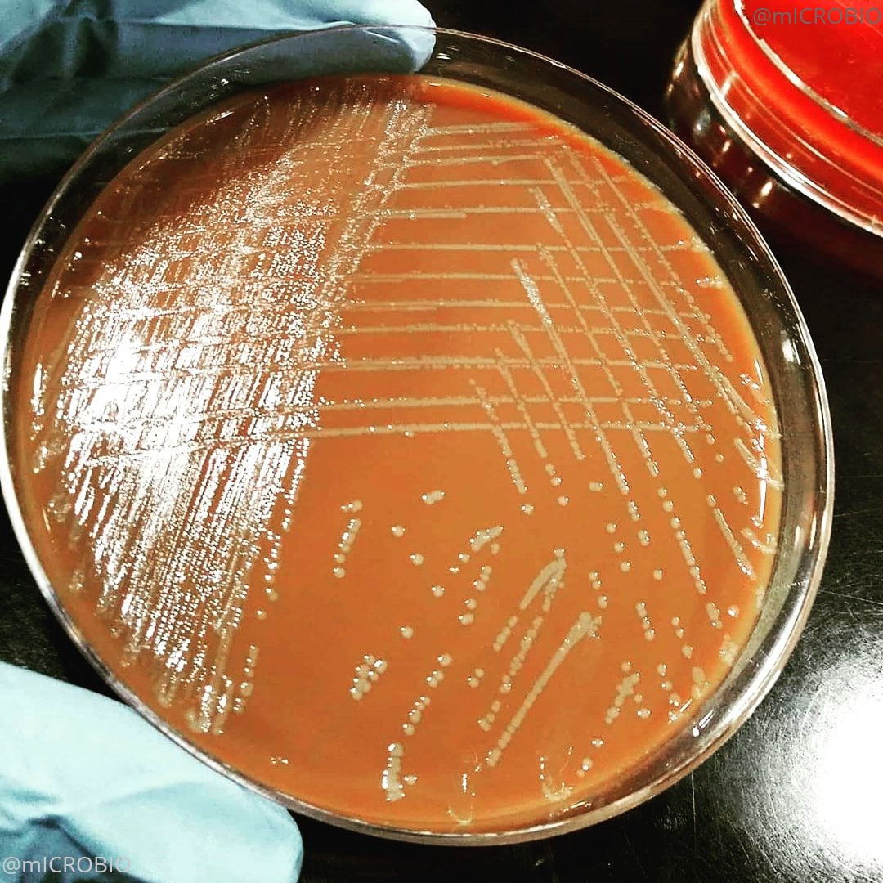
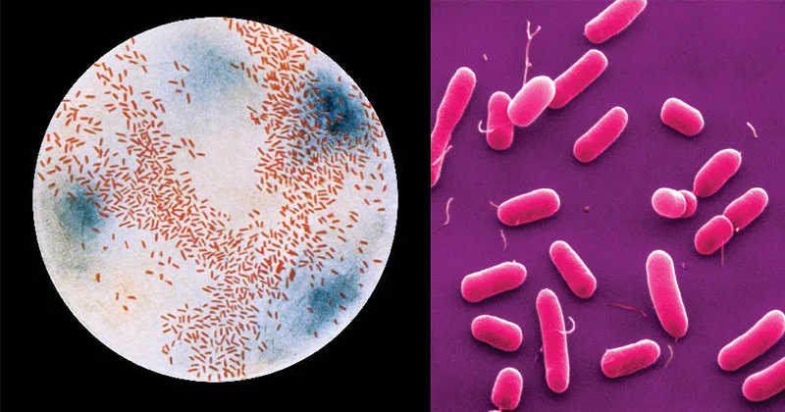

Slide 3
Genus features
Small Gram-negative, pleomorphic rod (coccobacilli)
Requires growth factors to grow - factor X- Hemin and factor V (Nicotinamide Adenine Dinucleotide ) for growth on blood agar.
Grows well on chocolate agar.
2 species of medical importance
Heamophilus influenzae
Heamophilus ducreyi

Slide 4
Haemophilus influenzae
Distinguishing features
Encapsulated (some species do not have a capsule)
Capsulated are divided in 6 serotypes (a-f)
Gram –neg rods (coccobacillus)
Fastidious – requires factors X and V

Slide 5
Epidemiology
Strictly human pathogen
No known animal or environmental reserviour
Nasopharygeal flora of 20-80% of healthy persons
Spread is via respiratory droplets

Slide 6
Pathogenesis
Only encapsulated are invasive
Use pili and adhesins to bind epithelial cells.
Virulence factors
– polysaccharide capsule is able to evade the immune system ( antiphagocytic- confers resistance to C3b deposition in the )
Ig A protease
Lipooligosaccharides (LOS) serve as endotoxin

Slide 7
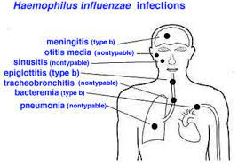
Diseases

Slide 8
Diseases
Meningitis
acute purulent meningitis may follow sinusitis or otitis media.
Acute epiglottitis
this is a dramatic infection in which the inflamed epiglottis and surrounding tissues obstruct the airway.
Pts present with fever, sore throat, inspiratory stridor, inflamed swollen cherry-red epiglottis with protrudes in the airway
Other infections –Ottitis media, cellulitis, bacteremia, Pneumonia etc

Slide 9
Diagnosis
Clinical picture
Gram stain
Blood or CSF culture on chocolate media
PCR
Antigen detection of the capsule

Slide 10
Treatment
Antibiotics – usually 3rd gen cephalosporins (Ceftriaxone IV)
Prevention
Vaccines- conjugate capsular polysaccharide- protein vaccine
Polyribitol capsule conjugated to protein vaccine

Slide 11
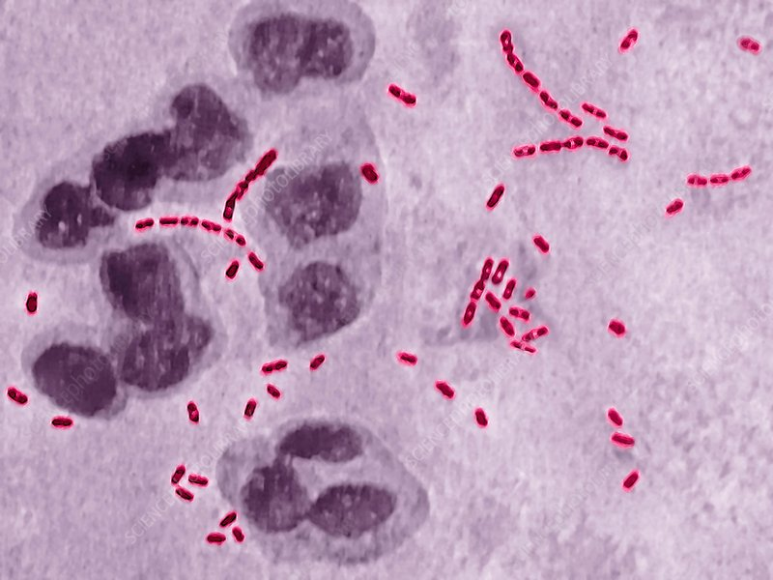
Haemophilus ducreyi
Reservoir – human genitals
Transmission – direct contact /sexual
Diseases-
Chancroid
Genital ulcers ( enhance the risk of HIV )
Diagnosis –very difficult
TX – antibiotics – azithromycin, ceftriaxone, vancomycin

Slide 12
Thank you

