Slide 1
Urinary Tract Infections

Slide 2
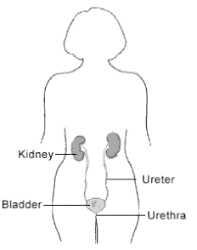
UTI
Lower UTI
cystitis
Upper UTI
Pyelonephritis

Slide 3
UTI
May also be classified as
Isolated UTI
  a single episode of lower tract infection occurs frequently in females and is rarely complicated.
2. Recurrent UTI
  is >2 infections in 6 months, or 3 within 12 months.

Slide 4
Predisposing causes of urinary tract infection
• Incomplete emptying of the bladder,
  bladder outflow obstruction,
  bladder diverticulum,
  neurogenic bladder
• A calculus, foreign body or neoplasm.
Incomplete emptying of the upper tract,
      dilatation of the ureters associated with
      pregnancy, or vesicoureteric reflux VUR.

Slide 5
• Oestrogen deficiency, which may give rise to lowered local resistance.
• Colonisation of the perineal skin by strains of Escherichia coli expressing molecules that facilitate adherence to mucosa
Diabetes.
• Immunosuppression

Slide 6
Acute cystitis
urinary infection of the lower urinary tract, principally the bladder.
Acute cystitis ♀ > ♂.
The primary mode of infection is ascending from the periurethral / vaginal and fecal flora.
The diagnosis is made clinically.

Slide 7
PRESENTATION
There is frequent voiding of small volumes, dysuria, urgency, suprapubic pain, hematuria.
50% of women will have an episode of cystitis in their lifetime
  Fever and systemic symptoms are rare.

Slide 8
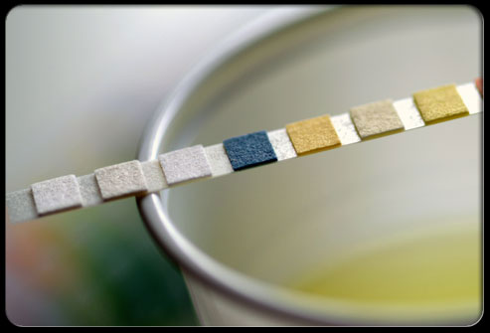
INVESTIGATIONS
Urinalysis WBCs in the urine & hematuria
may be present.
Urine culture is required to confirm the diagnosis & identify the causative organism.

Slide 9
RADIOGRAPHIC IMAGING
In uncomplicated infection of the bladder, radiologic evaluation is often not necessary
recurrent UTI, Fever, UTI in children
U\S
VCUG

Slide 10
Treatment
Management for acute cystitis consists of a short course of oral antibiotics.
      TMP SMX
      Nitrofurantoin
      Quinolones
Short oral course 3-5 d ♀
Days for ♂ & child 7 d

Slide 11
Honeymoon Cystitis
Is the term for a UTI that often occurs after sexual activity. Sexual activity can push infecting bacteria into the urethra resulting in an infection.

Slide 12
Recurrent UTI may be due to
  Reinfection (i.e., infection by a different bacteria) or
  Bacterial persistence (infection by the same organism).
Bacterial persistence is caused by
  the presence of bacteria within calculi
  antimicrobial resistance,
  patient noncompliance with therapy

Slide 13
Recurrent UTI
1. Bacterial persistence
presence of bacteria within a site in the urinary tract, leads to repeat episodes of infection.
Such sites include
  urolithiasis anywhere in the urinary tract,
  chronic bacterial prostatitis,
  obstructed or atrophic kidney

Slide 14
The recurrent UTIs will not resolve until this underlying problem has been addressed and corrected.
e.g. surgical removal of the infected source (such as urinary calculi)

Slide 15
Recurrent UTI
2. Reinfections
usually occur after a prolonged interval (months) from the previous infection and are often caused by a different organism than the previous infecting bacterium

Slide 16
Pyelonephritis

Slide 17
Definition
It is Bacterial infection of the renal pelvis, tubules and interstitial tissue of one or both kidneys
potentially organ- and/or life-threatening infection that characteristically causes some scarring of the kidney with each infection and may lead to significant damage to the kidney
Pathophysiology and aetiology
Infection usually ascends from the urethra most bacterial causes bowel organisms eg Ecoli (70-80%)
Hospital-acquired infections may be due to coliforms and enterococci.
Haematogenous spread is rare eg Staph aureus
Frequently due to ureterovesical reflux

Slide 18
53-72 |  | 18-57
Causes of UTI's | Outpatients (%) | Inpatients (%)
Escherichia coli | 53-72 | 18-57
Coagulase negative Staphylococcus | 2-8 | 2-13
Klebsiella | 6-12 | 6-15
Proteus | 4-6 | 4-8
Morganella | 3-4 | 5-6
Enterococcus | 2-12 | 7-16
Staphylococcus aureus | 2 | 2-4
Staphylococcus saprophyticus | 0-2 | 0.4
Pseudomonas | 0-4 | 1-11
Candida | 3-8 | 2-26

Slide 19
Complicated UTI Etiology
(%)
Escherichia coli
Klebsiella pneumoniae
Enterobacter species
Citrobacter species
Proteus mirabilis
Providencia species
Pseudomonas aeruginosa
Enterococci species
21 – 54
1.9 – 17
1.9 – 9.6
4.7 – 6.1
0.9 – 9.6
18
2 – 19
6.1 – 23

Slide 20
Microbiology of Community-Acquired
Urinary Tract Infection
Dysuria-Pyuria Sydrome in Females
 | Children | Adults
More frequent | . Escherichia coli | . Escherichia coli . Staphylococus saprophyticus (young, sexually active patient)
Less Frequent | . Other Enterobacteriaceae . Enterococci . Streptococcus agalactiae | . Other Enterobacteriaceae . Enterococci
Other Community-Acquired Infection
 | Children | Adults
More frequent | . Escherichia coli | . Escherichia coli
Less Frequent | . Other Enterobacteriaceae . Enterococci | . Other Enterobacteriaceae . Enterococci

Slide 21
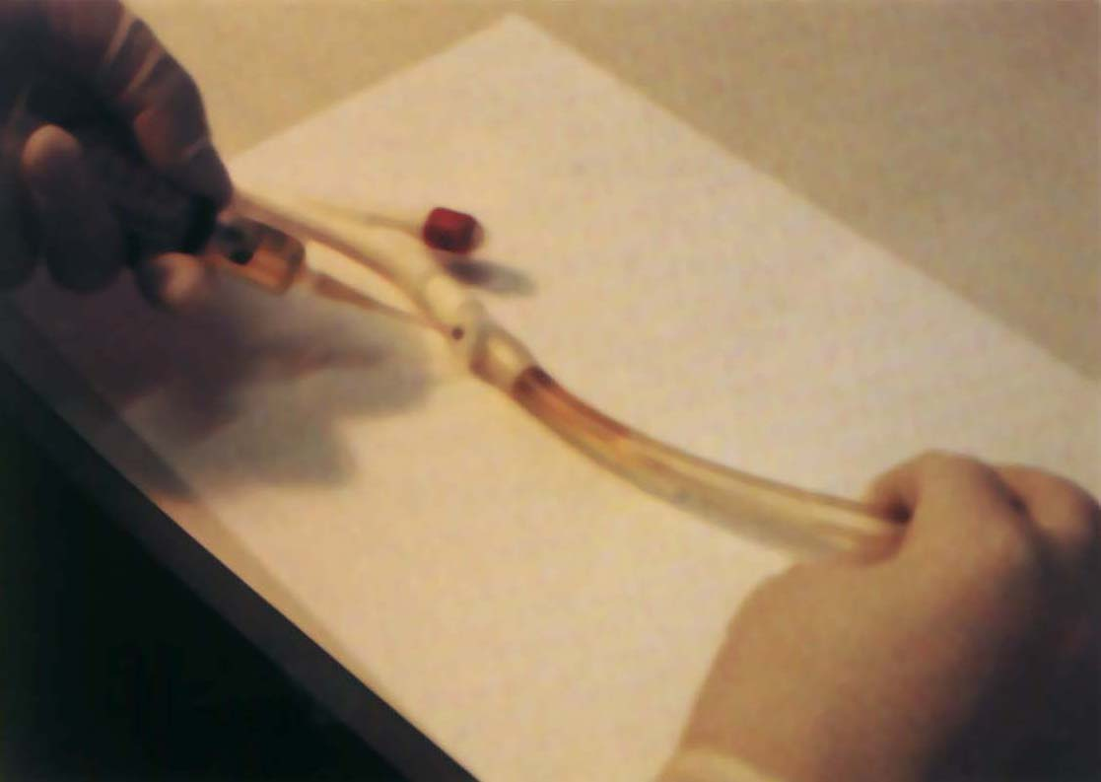
Microbiology of Nosocomial Acquired
Urinary Tract Infection in Children or Adult
Catheter-Associated Short-Term (< 30 –d) Catheterization
More frequent | . Escherichia coli
Less Frequent | . Other Enterobacteriaceae . Pseudomonas Spp. . Staphylococcus epidermidis
Catheter-Associated Long-Term (> 30 –d) Catheterization
More frequent | . Providencia stuartii . Pseudomonas Spp. . Escherichia coli . Other Enterobacteriaceae
Less Frequent | . Staphylococcus epidermidis

Slide 22
Pyelonephritis may be acute or chronic
Pathology
Kidneys enlarge
Interstitial infiltration of inflammatory cells
Abscesses on the capsule and at corticomedullary junction
Result in destruction of tubules and the glomeruli
When chronic, kidneys become scarred, contracted and nonfunctioning

Slide 23
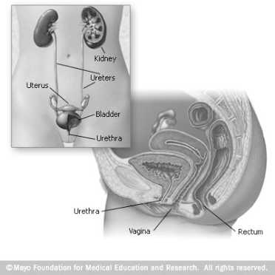
Pathogenesis
• Rectal and/or vaginal reservoirs
• Colonization of perianal area
• Bacterial migration to
perivaginal area
• Bacteria ascend through
urethra to bladder
• Intercourse may contribute
urethral colonization
and ascending infection

Slide 24
Clinical Manifestations of acute pyelonephritis
Symptoms develop rapidly (<24 hours) and may include:
Acutely ill
Chills
Fever >38°C
Flank pain and
Nausea/vomiting
Renal angle tenderness
Confusion in elderly
Leukocytosis
Pyuria
Bacteriuria
In addition symptoms of lower tract involvement
Dysuria
Frequency

Slide 25
Risk factors
Mechanical:
  Structural abnormalities to the kidneys and the urinary tract
    vesicoureteral reflux (VUR) especially in young children,
    calculi
    urinary tract catheterisation
    nephrostomy
    pregnancy
    neurogenic bladder (e.g. due to spinal cord damage, spina bifida or multiple sclerosis) and
    prostate disease (e.g. benign prostatic hyperplasia) in men
    bladder tumours
    urethral strictures
Constitutional:
  diabetes mellitus, immunocompromised states

Slide 26
Diagnosis
Is not always straightforward
A number of studies using immunochemical markers have shown that many women, who initially present with lower tract symptoms, actually have pyelonephritis
The extremes of age, the presentation may be so atypical (feeding difficulty or fever)
In the elderly presentation may be mental status change or fever

Slide 27
Laboratory Diagnosis of pyelonephritis
Urinalysis
10 WBC/hpf is the usual upper limit of normal
Positive nitrate dipstick test result for
bacteriuria is only moderately reliable;
false-negative results are common
Urine culture and sensitivity
Blood culture

Slide 28
Laboratory Diagnosis of UTIs

Slide 29
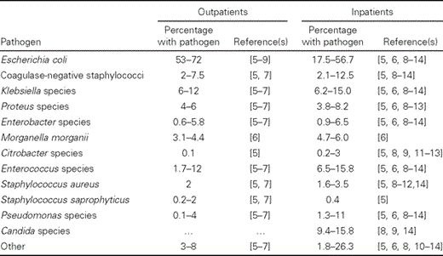
Causes of UTIs

Slide 30
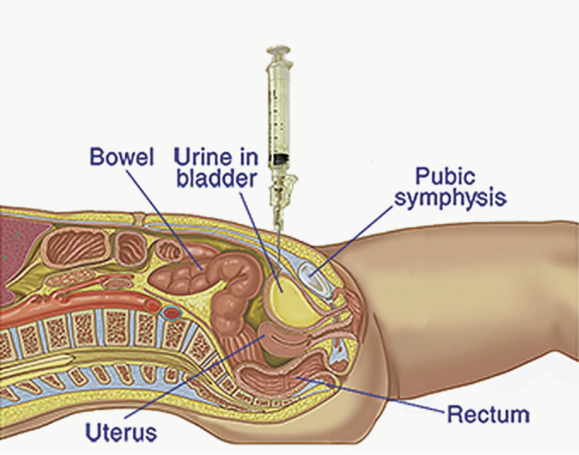
Specimen collection.
Suprapubic aspiration
Midstream
Catheter
Urine Bag

Slide 31
Transportation
Within 2 hours after collection
  Unless refrigerated
  Or in a preservative

Slide 32
Specimen processing
plated using calibrated loops for the semiquantitative method.
Provide information regarding the number of cfu/mL, as well as providing isolated colonies for identification and susceptibility testing.
blood agar and MacConkey's agar
Cultures should be incubated overnight at 35°C–37°C in ambient air before being read.

Slide 33
Detection of bacteriuria by urine microscopy.
Gram staining
  Centrifuged
  Uncentrifuged
Direct wet preparation
  Leukocytes
  RBCs

Slide 34
Critical Points:
Collection
Time to processing
Interpretation of results
  Significant bacteriuria
  Insignificant
  No growth
Sensitivity results

