Slide 1


UNIVERSITY OF ZAMBIA
SCHOOL OF MEDICINE
DEPARTMENT OF MEDICAL EDUCATION
STATISTICS
@2023
ISAAC FWEMBA, PhD
BSc(ZAM), MPH(UK), PhD(GH)
LECTURER
SCHOOL OF MEDICINE
UNIVERSITY OF ZAMBIA
Principles of Statistics

Slide 2

Objective
  Introduce students to statistical concepts
  Students able to use basic inference terms such as population, statistic
  Be able to describe data using central tendency, dispersion and

Slide 3
Key bio statistical concepts
Imagine this (hypothetical) conversation with a man on the taxi cab
  Man: what do you do?
    You: I’m a statistician.
  Man: what does that mean? What do you actually do?
    You:…
…what would you say?
Lets begin the concepts by asking “What is Statistics?”

Slide 4
Key bio statistical concepts
What I would say…
A statistician uses mathematical techniques (sometimes simple, sometimes more complex) to summarize data in a way that can be used to answer (or at least attempt to answer) a scientific question of interest.
As well as attempting to give the most accurate answer that we can, we also attempt to quantify our degree of confidence in this answer. In other words,
  How strong do our data support our conclusion?
  What range of other conclusions are supported almost as strongly?
  How well-suited are these data to answering the question in the first place?
Lets begin the concepts by asking “What is Statistics?”

Slide 5
Some Scientific Questions Of Interest
The scientific questions can differ quite substantially in their nature
For example:
    What is the mean systolic blood pressure for all men between the ages of 35 and 60 in Zambia? –
    Descriptive
  What is the effect of alcohol consumption on blood pressure? – Effect estimation
    Is drug A better than drug B in lowering blood pressure? – Hypothesis

Slide 6
Some Scientific Questions Of Interest
The study of statistics explores the collection, organization, analysis, and interpretation of numerical data.
The concepts of statistics may be applied to a number of fields that include business, psychology, and agriculture.
When the focus is on the biological and health sciences, we use the term biostatistics.

Slide 7
Statistics
Statistics
is the science of planning studies and experiments, obtaining data, and then organizing, summarizing, presenting, analyzing, interpreting, and drawing conclusions based on the data

Slide 8
Statistical Inference
Population
− the set of all elements of interest in a
particular study
Sample
− a subset of the population
Statistical inference
− the process of using data obtained
from a sample to make estimates
and test hypotheses about the
characteristics of a population
Census
− collecting data for a population
Sample survey
− collecting data for a sample

Slide 9
Population
Population
the complete collection of all individuals (scores, people, measurements, and so on) to be studied; the collection is complete in the sense that it includes all of the individuals to be studied

Slide 10
Census versus Sample
Census
Collection of data from every member of a population
Sample
Subcollection of members selected from a population

Slide 11
Parameter
Parameter
a numerical measurement describing some characteristic of a population.
population
parameter

Slide 12
Statistic
Statistic
a numerical measurement describing some characteristic of a sample.
sample
statistic

Slide 13
Types of Data
Data
Qualitative
Quantitative
Numerical
Non-numerical
Numerical
Nominal
Ordinal
Nominal
Ordinal
discrete
continuous

Slide 14
Quantitative Data
Quantitative (or numerical) data
consists of numbers representing counts or measurements.
Example: The weights of students
Example: The ages of respondents

Slide 15
Qualitative Data
qualitative data
consists of names or labels
Example: The genders (male/female) of professional athletes
Example: Shirt numbers on professional athletes uniforms - substitutes for names.

Slide 16
Elements, Variables, and Observations
The elements are the entities on which data are
collected.
A variable is a characteristic of interest for the elements.
The set of measurements collected for a particular
element is called an observation.
The total number of data values in a data set is the
number of elements multiplied by the number of
variables.

Slide 17
Data, Data Sets,
Elements, Variables, and Observations
Observation
Variables
Element
Names
Disease Rates Mortality
District
Kafue
Lusaka
Chilanga
Chongwe
Rufunsa
HIV 13.10 0.86
HIV 16.00 1.67
HIV 23.70 0.86
HIV 1.400 0.33
ENT 0.60 0.13
Data Set

Slide 18
Discrete Data
Discrete data
result when the number of possible values is either a finite number or a ‘countable’ number
(i.e. the number of possible values is
0, 1, 2, 3, . . .)
Example: The number of eggs that a hen lays

Slide 19
Continuous Data
Continuous (numerical) data
result from infinitely many possible values that correspond to some continuous scale that covers a range of values without gaps, interruptions, or jumps

Slide 20
Qualitative and Quantitative Data
Data can be further classified as being qualitative
or quantitative.
The statistical analysis that is appropriate depends
on whether the data for the variable are qualitative
or quantitative.
In general, there are more alternatives for statistical
analysis when the data are quantitative.

Slide 21
Qualitative Data
Labels or names used to identify an attribute of each
element
Often referred to as categorical data
Use either the nominal or ordinal scale of
measurement
Can be either numeric or nonnumeric
Appropriate statistical analyses are rather limited

Slide 22
Quantitative Data
Quantitative data indicate how many or how much:
Quantitative data are always numeric.
Ordinary arithmetic operations are meaningful for
quantitative data.

Slide 23
Descriptive Statistics
Descriptive statistics are the tabular, graphical, and numerical methods used to summarize data.
A measure of central tendency is a descriptive statistic that indicates;
  The average or typical observed value of a variable in a data set.
It gives an indication of where most of the data lies
  or where most of the data is clustered.

Slide 24
Mean
  Center measurement is a summary measure of the overall level of a dataset
  Commonly used methods are mean, median, mode, geometric mean etc.
  Mean: Summing up all the observation and dividing by number of observations. Mean of 20, 30, 40 is (20+30+40)/3 = 30.

Slide 25
Mean
Or mean = sum of value
# of observations
Example: age (yrs) of children (8, 11, 10, 8, 9)
Mean: sum
# obs.
8+8+9+10+11
46
= 9.2 yrs
5
5
Adding an outlier (age = 56) changes the mean dramatically!

Slide 26
Median
Median = Middle value
Example: age (yrs) of children (8, 11, 10, 8, 9)
Median: -Order data: 8,8,9,10, 11
-Pick the middle value
Here it is the 3rd: 9 years

Slide 27
Median
Median: The middle value in an ordered sequence of observations. That is, to find the median we need to order the data set and then find the middle value.
In case of an even number of observations the average of the two middle most values is the median.
For example, to find the median of {9, 3, 6, 7, 5}, we first sort the data giving {3, 5, 6, 7, 9}, then choose the middle value 6. If the number of observations is even, e.g., {9, 3, 6, 7, 5, 2}, then the median is the average of the two middle values from the sorted sequence, in this case,
(5 + 6) / 2 = 5.5.

Slide 28
Mean or Median
  Strength of median: The median is less sensitive to outliers (extreme scores) than the mean and thus a better measure than the mean for highly skewed distributions, e.g. family income. For example mean of 20, 30, 40, and 990 is
  (20+30+40+990)/4=270.
  The median of these four observations is (30+40)/2 =35. Here 3 observations out of 4 lie between 20-40. So, the mean 270 really fails to give a realistic picture of the major part of the data. It is influenced by extreme value 990.
  Thus weakness of mean: does not work well for skewed data and is not robust to outliers.
  Weakness of median: It only relies on the central values and ignores all the other data.

Slide 29
Mean or Median
Mode: The value that is observed most frequently.
Problems with mode:
The mode is undefined for sequences in which no observation is repeated.
At times it might be nowhere near the center of a data set.
Sometimes there is more than one mode.

Slide 30
Mean or Median
Observation that occurs most frequently
9 12 15 15 15 16 16 20 26
Observation | Number of occurrences
9 | 1
12 | 1
15 | 3
16 | 2
20 | 1
26 | 1

Slide 31
Methods of Variability Measurement
Variability (or dispersion) measures the amount of scatter in a dataset.
Commonly used methods: range, variance, standard deviation, interquartile range, coefficient of variation etc.
Range: The difference between the largest and the smallest observations. The range of 10, 5, 2, 100 is (100-2) = 98. It’s a crude measure of variability.

Slide 32
Methods of Variability Measurement
Variance: The variance of a set of observations is the average of the squares of the deviations of the observations from their mean. In symbols, the variance of the n observations x₁, x₂,…x_{n} is
Variance of 5, 7, 3? Mean is (5+7+3)/3 = 5 and the variance is
Standard Deviation (s) : Square root of the variance. The standard deviation of the above example is 2.

Slide 33
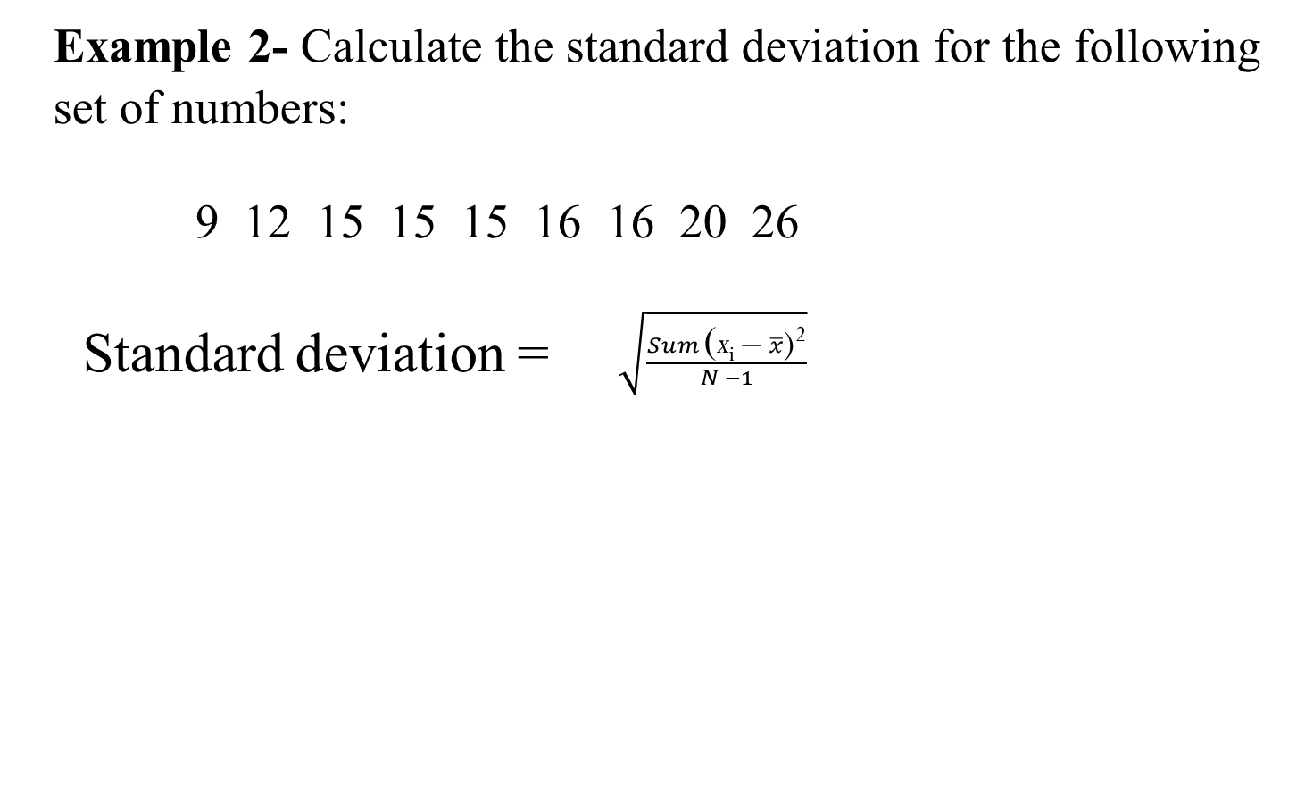
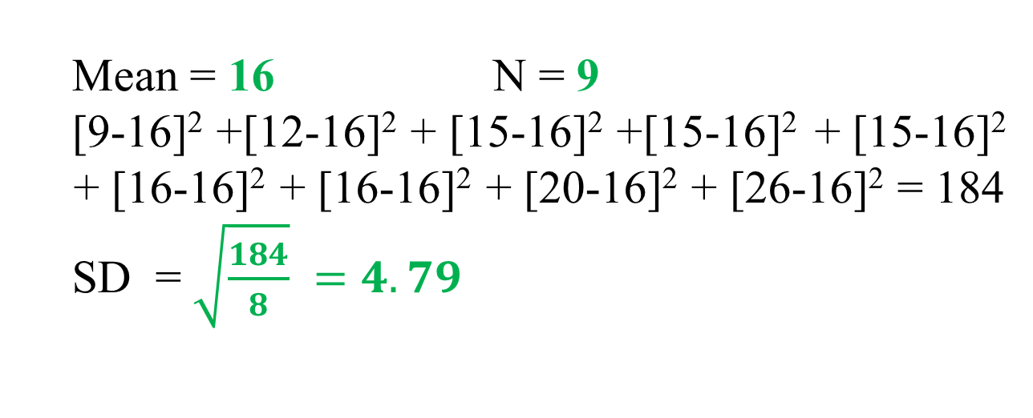
Standard Deviation (s)

Slide 34
Methods of Variability Measurement
Quartiles: Data can be divided into four regions that cover the total range of observed values. Cut points for these regions are known as quartiles.
In notations, quartiles of a data is the (n+1)/4)q^{th} observation of the data, where q is the desired quartile and n is the number of observations of data.
The first quartile (Q1) is the first 25% of the data. The second quartile (Q2) is between the 25th and 50th percentage points in the data. The upper bound of Q2 is the median. The third quartile (Q3) is the 25% of the data lying between the median and the 75% cut point in the data.
Q1 is the median of the first half of the ordered observations and Q3 is the median of the second half of the ordered observations.

Slide 35
Methods of Variability Measurement
In the following example Q1= ((15+1)/4)1 =4th observation of the data. The 4th observation is 11. So Q1 of this data is 11.
An example with 15 numbers
3 6 7 11 13 22 30 40 44 50 52 61 68 80 94 Q1 Q2 Q3
The first quartile is Q1=11. The second quartile is Q2=40 (This is also the Median.) The third quartile is Q3=61.
Inter-quartile Range: Difference between Q3 and Q1. Inter-quartile range of the previous example is 61- 11=50. The middle half of the ordered data lie between 40 and 61.

Slide 36
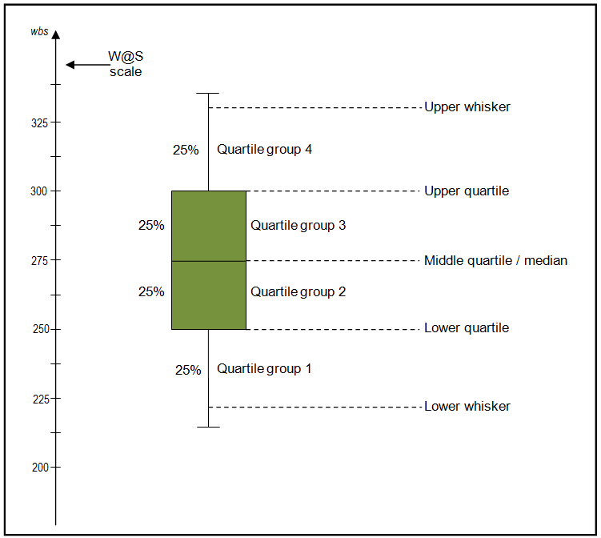
BOX PLOT

