Slide 1


UNIVERSITY OF ZAMBIA
SCHOOL OF MEDICINE
DEPARTMENT OF MEDICAL EDUCATION
IMPLEMENTATION RESEARCH
@2023
ISAAC FWEMBA, PhD
BSc(ZAM), MPH(UK), PhD(GH)
LECTURER
SCHOOL OF MEDICINE
UNIVERSITY OF ZAMBIA
IMPLEMENTATION RESEARCH

Slide 2

Objective
What is “implementation”?
Defining implementation science
What determines implementation success?
Implementation science outcome and strategies

Slide 3
Some Definitions
Dissemination: “targeted spread of information” (from the NIH program announcement for Dissemination & Implementation research)
  Passive approach, focusing on knowledge transfer
Implementation: “An effort specifically designed to get best practice findings… into routine and sustained use via appropriate uptake interventions.” (Curran et al., 2012)
  Active approach, focusing on stimulating behavior change
Implementation SCIENCE: “The scientific study of methods to promote the systematic uptake of research findings and other evidence-based practices into routine practice, and, hence, to improve the quality and effectiveness of health services and care.” (Eccles and Mittman, Implementation Science, 2006)
  Science of how BEST to implement, create generalizable knowledge
  “QI” = more local solutions

Slide 4
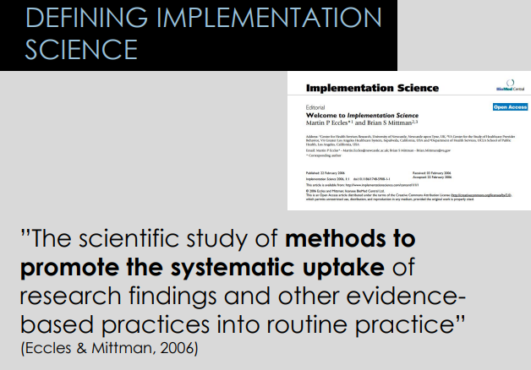
DEFINING IMPLEMENTATION SCIENCE

Slide 5
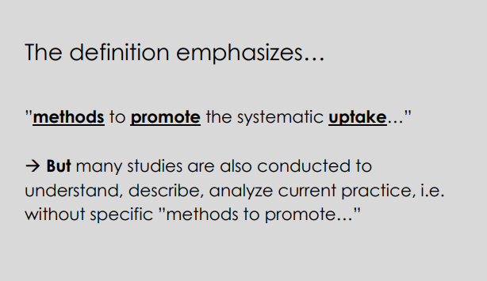
DEFINING IMPLEMENTATION SCIENCE

Slide 6
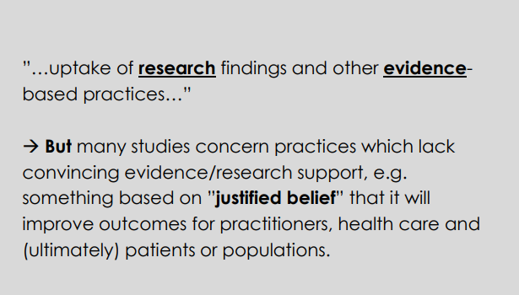
DEFINING IMPLEMENTATION SCIENCE

Slide 7
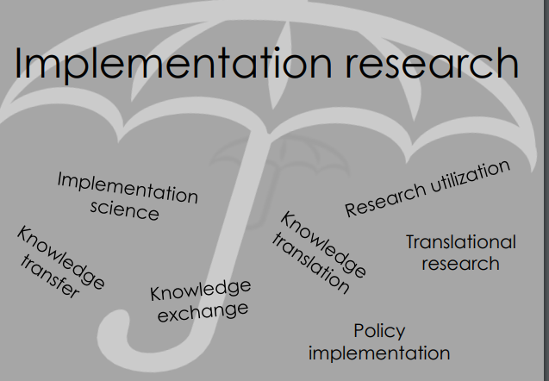
DEFINING IMPLEMENTATION SCIENCE

Slide 8
CLINICAL RESERARCH VS. IMPLEMENTATION RESEARCH
Bauer & Kirchner, 2020: “ The goal of implementation science is not to establish the health impact of a clinical innovation, but rather to identify the factors that affect its uptake into routine use.”
“Perhaps the major difference between clinical research and implementation research is that the latter actively engages with the context into which a clinical innovation is introduced, rather than controlling (efficacy studies) or simply tolerating (effectiveness studies) that context

Slide 9
CLINICAL RESERARCH VS. IMPLEMENTATION RESEARCH
”This field incorporates a scope broader than traditional clinical research, focusing not only at the patient level but also at the provider, organization, and policy levels of healthcare.”
”Accordingly, implementation research requires transdisciplinary research teams that include members who are not routinely part of most clinical trials such as health services researchers; economists; sociologists; anthropologists; organizational scientists; and operational partners including administrators, front-line clinicians, and patients.”

Slide 10
SO, WHY DO WE NEED IMPLEMENTATION RESEARCH?
Only ~50% of patients in the US receive recommended/EB care
  Wide variability across conditions and treatment:
    79% of patients receive recommended care for an age-related cataract
    11% of patients receive recommended care for alcohol use disorder
20–25% patients get care that is not needed or potentially harmful
  So, we also need to DE-implement…
1.3 million people are injured annually by medication errors
Most chronic conditions have solid, evidence-based guidelines for treatment, management, and prevention, but rates of conditions such diabetes continue to rise

Slide 11
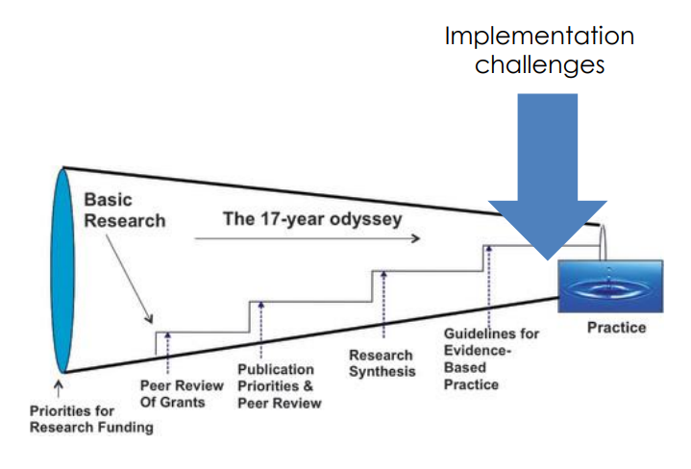
IMPORTANCE OF IMPLEMENTATION RESEARCH

Slide 12
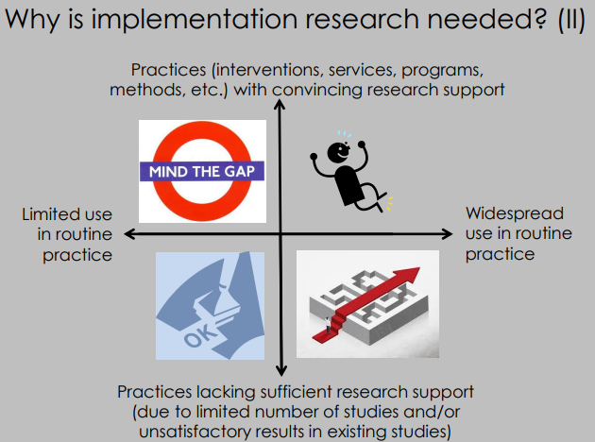
WHY IS IMPLEMENTATION RESEARCH IMPORTANT

Slide 13
MORE… WHY WE NEED THIS
17 years on average from “we know this works” to “routine delivery of it”
  We have been citing this same figure for years…
Dissemination ONLY of research results, clinical practice guidelines (usually driven by research findings), etc., don’t seem to do much on their own to improve practice delivery
  Except in some simpler cases…
Implementation of research findings/EBPs is a fundamental challenge for healthcare systems to optimize care, outcomes and costs

Slide 14
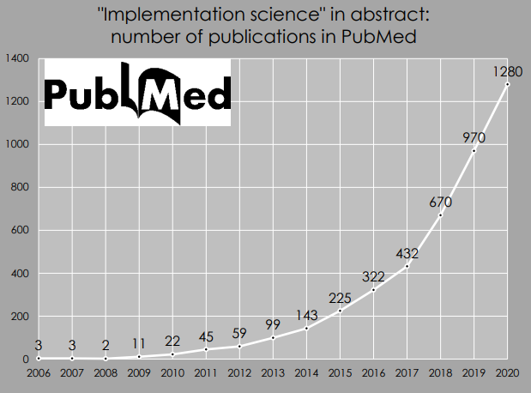
IMPLEMENTATION RESEARCH ON THE INCREASE

Slide 15
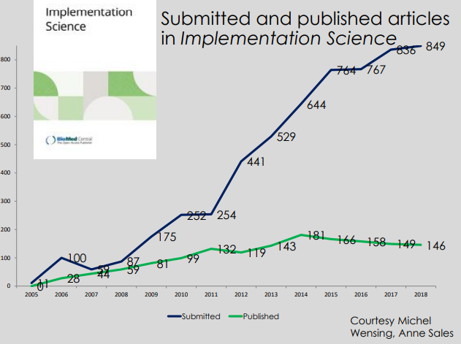
IMPLEMENTATION RESEARCH ON THE INCREASE

Slide 16
WHAT ARE THE OUTCOMES WE CARE ABOUT THEN?
We are trying to measure changes in the delivery of care
  Did the place/people implement the intervention?
    Did they get started? Did they start and stop?
  Did everyone get it who should have gotten it?
    Was the intervention/practice delivered as much as it should have been?
    Were all indicated patients approached? Given intervention/practice?
  Did they do it right when the were delivering the intervention?
    Did they deliver the intervention as intended… with “fidelity”?
    How close did they get?
Do we also look at the “effectiveness” of the intervention?
  Among those who got it, did they get better?
  Symptoms, functioning
    If the field does not have “enough” evidence on THE THING, then yes…

Slide 17
COMMON MEASURES IN IMPLEMENTATION RESEARCH
Adoption
  “Counts and amounts”
    Raw count of delivery
    Rates of delivery
Fidelity
  “How well performed”
  LOTS of different ways to measure this
    Checklist; Expert rating
Sustainability
  “Stick with it or dropped it?”
  Adoption and Fidelity measures over time
If we are doing pilot/early work, then also look at

Slide 18
IMPLEMENTATION STRATEGIES
Depending on the characteristics of the practice, context, and people… uptake interventions of some kind are usually necessary to support adoption– we call those implementation strategies
There are numerous types of implementation strategies available, many with research evidence supporting their use across contexts
We will now discuss a taxonomy presented by Powell et al., and Waltz et al., 2015, Implementation Science
  They cover 73 strategies…
  We’ll hit some highlights (only about 26!)

Slide 19
TAXONOMY OF IMPLEMENTED STRATS
Train and educate stakeholders
  Develop educational materials
  Conduct educational meetings
  Conduct educational outreach visits (academic detailing)
    Personalized 1 on 1 sessions on intervention;
  Provide ongoing consultation
    In person, telephone, tele video…; usually about implementation progress
  Use “train-the-trainer” strategies
    More for widespread “roll-outs”; Train local trainers/mentors
  Create a learning collaborative
    Groupings of learners/practitioners supported by trainers/experts
    Over time, experienced users teach new users (self-sustaining)

Slide 20
TAXONOMY OF IMPLEMENTED STRATS
Provide interactive assistance
  Provide clinical supervision
    Expert supervision focused on the intervention/practice being adopted
  Provide local technical assistance
    Needed usually for medical record, dispensing software tools…
  Provide facilitation
    Interactive problem-solving; recommend and supply additional strategies
Support clinicians
  Remind clinicians
    Electronic reminders in EMR or dispensing software; or manual
    “This patient due for screening…”
  Revise professional roles
    E.g., expand role of pharmacists
  Create new clinical teams

Slide 21
TAXONOMY OF IMPLEMENTED STRATS
Change infrastructure
  Change physical structure and equipment
    Need new tech? Record system? Adequate space to provide interventions to patients??
  Mandate change
    Create policies supportive of adoption of intervention/practice; Make people…?
  Change credentialing/licensing standards
    Make way for changing scope of practice, e.g., prescribing privileges to PharmDs
Utilize financial strategies
  Place intervention on formulary/”covered” list
  Alter incentive/allowance structure
    E.g., pay for performance of practice
    Penalize for not doing the intervention/practice
  Make billing easier

Slide 22
TAXONOMY OF IMPLEMENTED STRATS
Engage consumers
  Prepare patients/consumers to be participants
    Educate and prompt them to act; “ask your pharmacist about…”
  Intervene with patients/consumers to enhance uptake/adherence
    Proactively approach patients; “Let’s talk about your adherence to this medication…”
  Use mass media
    Spread the word… TV, posters, etc.
Develop stakeholder relationships
  Identify and prepare champions
    Champion = local an enthusiastic supporter of intervention; driver of change
  Inform and use local opinion leaders
    Recruit “influential” practitioners to support the implementation
  Recruit, designate, and train for leadership
  Build a coalition
    Make a team that works together on the implementation

Slide 23
TAXONOMY OF IMPLEMENTED STRATS
Adapt and tailor to context
  Promote adaptability of the intervention
    Adapt intervention to match local needs, but don’t sway from evidence-based-ness
  Tailor implementation strategies
    Tailor implementation strategies for local needs too
Use evaluative and iterative strategies
  Audit and feedback
    Measure and feedback performance of practitioners/sites
  Conduct local needs assessment
    Before you start; identify barriers/facilitators to change and target strategies
  Conduct small cyclical tests of change
    Iterate your change process based on data (Plan/Do/Study/Act anyone?)

Slide 24
STRATEGIES: WHAT DO WE KNOW?
Disseminating and Training… not so great on their own
Many work “OK” (5-10% change in adoption)
  Reminders, Audit & Feedback, Academic detailing, Facilitation…
No combo offers a guarantee of success
Many studies support the use of multi-component strategies
  But some do not!
Most multifaceted strategies involve 2 or more of these: education/training, prompts of some kind, audit and feedback
Highly regarded, only somewhat supported, is the idea that strategies work better when matched to barriers/needs identified through diagnostic analysis

Slide 25
STRATEGIES: WHAT DO WE KNOW?
Why don’t the strategies we have now work better?
Which strategies work best under what conditions/contexts?
Which strategies are cost-effective (in which context…)?
How do we get EBPs to low resource counties and countries? Rural US?
How best to feasibly measure fidelity?
How much does fidelity matter to effectiveness outcomes?
De-adoption strategies?
Sustainability?
These are just a few…

Slide 26
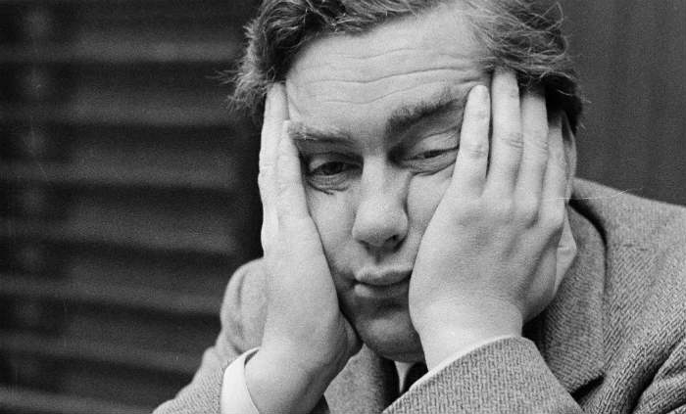
MODELS, THEORIES, FRAMEWORKS…
Yeah, I know…

Slide 27
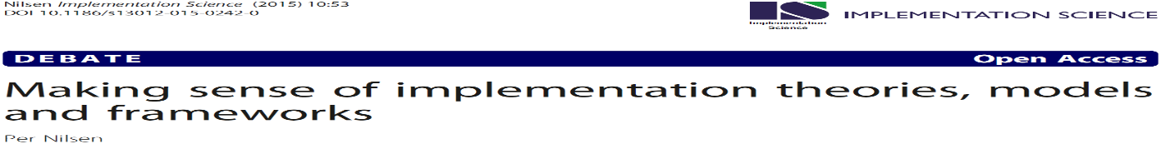
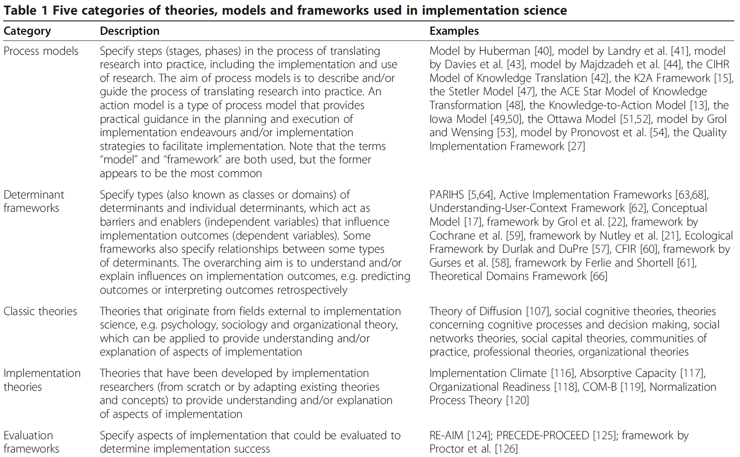
MODELS, THEORIES, FRAMEWORKS…

Slide 28
DETERMINANT FRAMEWORKS
“…understand or explain influences on implementation.”
Consolidated Framework for Implementation Research (CFIR)
  Characteristics of the intervention
    Complexity, cost, relative advantage…
  Outer setting
    External policies, guidelines, incentives...
  Inner Setting
    Organizational culture and climate, readiness for implementation, infrastructure…
  Characteristics of Individuals
    Knowledge, beliefs, self-efficacy…
  Process
    Planning, executing, reflecting…
Used a lot to study barriers/facilitators to uptake
Used a lot to help select strategies to test

Slide 29
OK, FEW MORE FRAMEWORKS, THAT’S IT
Process models
  EPIS: Exploration, Preparation, Implementation, Sustainment
    Why important: Helps think about what kinds of strategies you’ll need for each “step”
Evaluation frameworks
  RE-AIM: Reach, Effectiveness, Adoption, Implementation, Maintenance
  Proctor framework: See above slides…
    Why important: Helps answer the question, “How do I show this strategy worked or didn’t?”

