Slide 1


UNIVERSITY OF ZAMBIA
SCHOOL OF MEDICINE
DEPARTMENT OF MEDICAL EDUCATION
Strategies for Data Analysis
@2023
ISAAC FWEMBA, PhD
BSc(ZAM), MPH(UK), PhD(GH)
LECTURER
SCHOOL OF MEDICINE
UNIVERSITY OF ZAMBIA
MEDICAL STUDENTS 4TH YR

Slide 2
STRATEGIES FOR ANALYZING DATA
First thing to do to analyse quantitative data is convert raw data into useful summaries
  Descriptive measures(qualitative)
    Proportions, frequencies and ratios
  Measures of central tendency(quantitative)
    Mean/average, median, mode
  Measures of dispersion
    Range, standard deviation, percentiles.

Slide 3
REVIEWING DESCRIPTIVE STATISTICS
A fundamental task in many statistical analyses is to estimate a location parameter for the distribution; i.e., to find a typical or central value that best describes the data.
Interval estimates
  Parameter estimated from a sample data (point estimate or sample estimate) as opposed to population (true value) parameter.
    Mean – the true mean is the sum of all the members of the given population divided by the number of members in the population.
    Impractical to measure every member ➔ a random sample is drawn ➔ gives the point estimate of the population mean.
  Interval estimate expand on point estimates by incorporating the uncertainty of the point estimate.
    For example, different samples from the same population will generate different values for the sample mean.
    An interval estimate quantifies this uncertainty in the sample estimate by computing lower and upper values of an interval which will, with a given level of confidence (i.e., probability) contain the population parameter.

Slide 4
REVIEW KNOWN DISTRIBUTIONS
Why different measures
  Normal distribution
    Symmetric distribution – single peak, well-behaved tails
    (estimates for mean, median & mode similar) - use mean as the locator estimate.
  Exponential distribution
    Skewed distribution – mean & median not the same – mean pulled to one side (direction of skewness).
    ➔Use all three central measures.
  Cauchy distribution
    Symmetric distribution – single peak with heavy tails
    extreme values in the tails distort the mean - use median as the locator estimate.

Slide 5
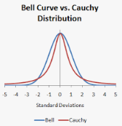
NORMAL AND CAUCHY DISTRIBUTIONS

Slide 6
SAMPLING METHODS
A sampling distribution can only describe the correct behavior of the corresponding statistic if it is derived from a sampling process whose properties are known.
The most common and best-known example of this is sampling process is random sampling:
  In its simple form this implies that all members of a population are equally likely to appear in a sample
  Such simple random sampling allows sampling distributions to be derived in a comparatively simple way, and inference procedures tend to be straightforward.

Slide 7
STATISTICAL MODELS
To elucidate the information about population quantities contained in sample statistic we need a precise and formal description of the whole sampling process from population to sample. This description is called the statistical model.
Relevant features of the population are represented by parameters, such as mean, or variance.
The structure of the population, together with the sampling process, allows a model to be formulated that describes the statistical behavior of the sample, which in turn allows us to postulate sampling distributions for the relevant statistic

Slide 8
RESEARCH VARIABLE
The guiding principles of statistical methodology are mostly the same whatever the nature of the data we are analyzing.
However, their implementation usually depends crucially on the form of the observations made on subjects.
In many situations the subjects are people, but they need not be. For example, they might be urine specimens, rats, or hospitals.
Any aspect of a subject that is measured like blood pressure, or recorded, like age or sex, is called a variable.

Slide 9
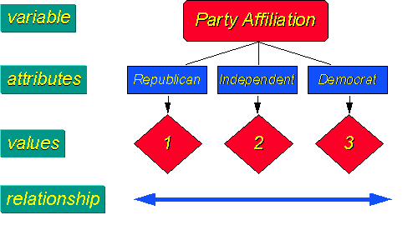
ESTABLISHING MEASUREMENT SCALE FOR A VARIABLE
The level of measurement refers to the relationship among the values that are assigned to the attributes for a variable
What does that mean? Begin with the idea of the variable, in this example "party affiliation.”
UPND
PF
Others

Slide 10
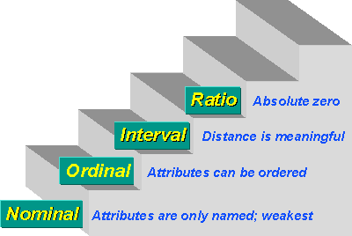
TYPICALLY, FOUR MEASUREMENT SCALES ARE DEFINED
Count is a ratio – no. of clients can be zero
…30-40ºC = 70-80ºC but 80ºC is not twice as hot as 40ºC
… distance b/n attributes do not have any meaning. E.g. Educ
Notes:
Speaker note
Finally, in ratio measurement there is always an absolute zero that is meaningful.
This means that you can construct a meaningful fraction (or ratio) with a ratio variable.
Weight is a ratio variable.
In applied social research most "count" variables are ratio, for example, the number of clients in past six months.
Why? Because you can have zero clients and
because it is meaningful to say that "...we had twice as many clients in the past six months as we did in the previous six months."

Slide 11
VERY IMPORTANT
The choice of analytic technique depends largely on the measurement scale of the “outcome of interest”

Slide 12
CHOICE OF ANALYTIC TECHNIQUES
Continuous outcome
Descriptive
Statistic:
- Mean & standard deviation (for symmetrical distribution)
- Median & inter-quartile range
- Quartiles
- Percentiles
Graphs:
- Histogram
- Box Plot
- Scatterplot/Correlation
Inferential
-Z-test
- T-test,
- ANOVA
- Linear regression
- Gamma regression (nonnegative continuous outcome and +vely skewed data)
Applicable to:
RCT
Cohort
Cross-sectional

Slide 13
CHOICE OF ANALYTIC TECHNIQUES
Binary outcome
Descriptive
Statistic:
- Proportion or Percentage in each category
- Mode
- Cross-tabulation
Graphs:
- Bar Charts
- Pie Charts
Inferential
- Z-test
- Chi2-test,
- Stratified Analysis
- Logistic regression & LRT
- GLM
Applicable to:
RCT
Cohort
Case-Control
Cross-sectional

Slide 14
CHOICE OF ANALYTIC TECHNIQUES
Count outcome
Descriptive
Statistic:
- Incidence Rate
Graphs:
Bar charts
Inferential
- Z-test
- Poisson regression
- Negative binomial regression
Applicable to:
RCT
Cohort

Slide 15
CHOICE OF ANALYTIC TECHNIQUES
Survival data
Descriptive
Statistic:
- Incidence Rate
- Hazard rate
Graphs:
- Kaplan Meier curves
Inferential
- Logrank test,
- Mantel Haenzel methods
- Proportional hazard models including Cox regression
Applicable to:
RCT
Cohort

Slide 16
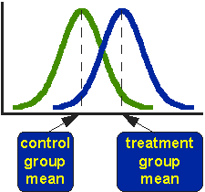
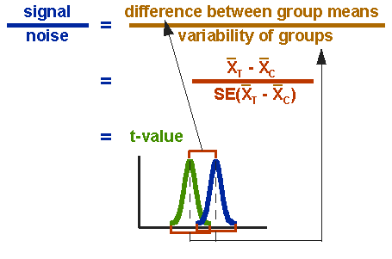


TWO SAMPLE T-TEST
The t-test assesses whether the means of two groups are statistically different from each other. This analysis is appropriate whenever you want to compare the means of two groups, and especially appropriate as the analysis for the posttest-only two –group randomized experimental design

Slide 17
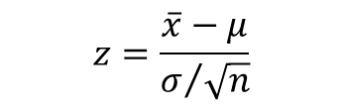

Z test
A Z-test is any statistical test for which the distribution of the test statistic under the null hypothesis can be approximated by a normal distribution.
  One-Sample Z Test-A one-sample z test is used to check if there is a difference between the sample mean and the population mean when the population standard deviation is known.
Two Sample Z Test
$$z=\frac{\overline{x}−μ}{σ/{\sqrt{n}}}$$
$$z=\frac{\left({\overline{x}}_{1}−{\overline{x}}_{2})−(μ_{1}−μ_{2}\right)}{\sqrt{\frac{σ_{1}^{2}}{n_{1}}+\frac{σ_{2}}{n_{2}}}}$$

Slide 18
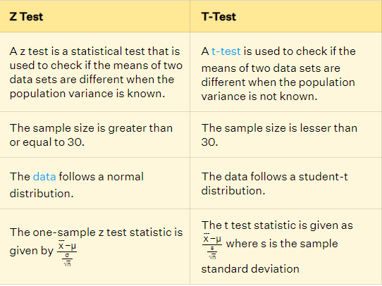
Z test

Slide 19
PARAMETRIC TEST
Assumptions
Normal distribution of data. The p value for parametric tests depends upon a normal sampling distribution. ...
Homogeneity of variance. This refers to the need for a similarity in the variance throughout the data. ...
Continuous/Interval . ...
Independence.
OTHERWISE USE NON PARAMTRIC TEST STRATEGY

Slide 20
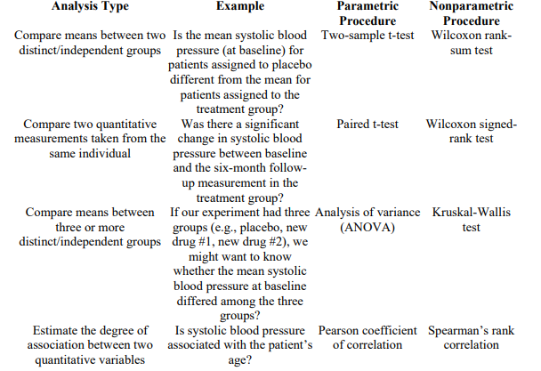
Linking Analysis type ,research questions, statistical technique type

