Slide 1
SAMPLING TECHNIQUES
Bornwell Sikateyo, PhD
University of Zambia
School of Medicine

Slide 2
Lesson
What is sampling
The three principals of sampling
Sampling for quantitative studies
Sampling for qualitative studies

Slide 3
WHAT IS SAMPLING
The selection of a number of study units from a defined study population
Researcher decides:
▪Which population to study
▪ Sample size
▪ Sampling strategy
Decisions depend on the study objectives

Slide 4
Qualitative vs. Quantitative studies
Qualitative
Aim is to identify information rich cases in a purposeful manner
Quantitative
Purpose is not to gain understanding on the matter but to be able to generalize findings.

Slide 5
Advantages and disadvantages of sampling
Advantages
Saves time, financial and human resources
Disadvantages
Findings not based on information from entire population of interest but only an estimate
Hence, the possibility of an error in your estimation exists

Slide 6
Sampling is a trade-off between certain benefits and disadvantages
Trade off
By saving on time and resources we compromise on accuracy of findings.
Effect
Selecting a sample and using it as the basis from which to estimate the situation in the total population, has the possibility of introducing an error is possible.
Tolerance of this possibility of error is an important consideration in selecting a sample.

Slide 7
The 3 principles of sampling
GROUP EXERCISE

Slide 8
HANDOUT

Slide 9
The Three Principles of Sampling
1. There’s usually a difference between the sample statistics and the true population mean, which is attributable to the selection of the units in the sample.
2. The greater the sample size, the more accurate the estimate of the true population mean.
3. The greater the difference in the variable under study in a population for a given sample size, the greater the difference between the sample statistics and the true population mean

Slide 10
Sampling methods for Quantitative Studies
Simple random sampling
Stratified random sampling
Systematic sampling
Cluster sampling
Multi-stage sampling

Slide 11
1. Simple Random Sampling Method
Each element in the population has an equal and independent chance of selection in the sample
● Equal implies that the probability of selection of each element in the population is the same.
● Independence → the choice of one element is not dependent on the choice of another element in the sampling.

Slide 12
Methods of drawing a simple random sample
Lottery (fishbowl draw)
Computer program
Random number tables

Slide 13
The steps in simple random sampling
Determine the sample size
Select the required number of sampling units
Make a numbered list of all the units in the population

Slide 14
Sampling with or without replacement
Sampling without replacement is contrary to our basic definition of randomisation; that is, each element has an equal and independent chance of selection.
Sampling with replacement, the selected element is replaced in the sampling population

Slide 15
2. Stratified Random Sampling
The accuracy of your estimate largely depends on the extent of heterogeneity of study population with respect to the variables with strong correlation with what you are trying to ascertain (Principle 3).
→→Reducing heterogeneity in a population increases accuracy in the estimates
The population is stratified such that the population within a stratum is homogeneous with respect to the characteristic on the basis of which it is being stratified

Slide 16
TYPES OF SYSTEMATIC SAMPLING
A.
Proportionate stratified sampling
The number of elements from each stratum in relation to its proportion in the total population is selected
B. Disproportionate stratified sampling
Consideration is not given to the size of the stratum

Slide 17
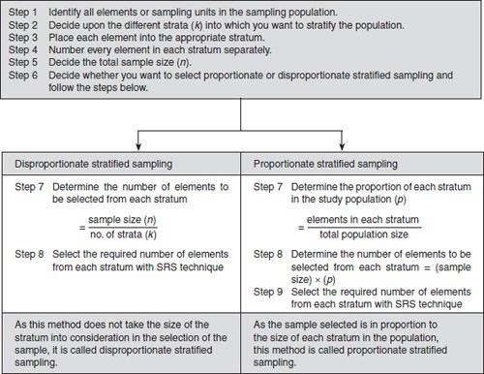

Slide 18
3. Systematic Random Sampling
Approach
Individuals are chosen at regular intervals from the sampling frame.
Classified as a ‘mixed’ sampling design because it has the characteristics of both random and non-random sampling design

Slide 19
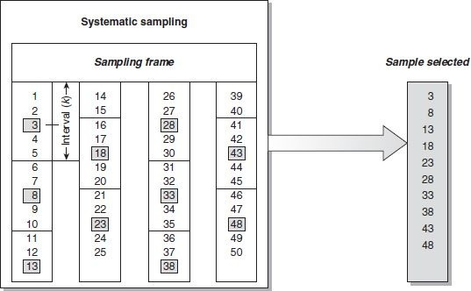

Slide 20
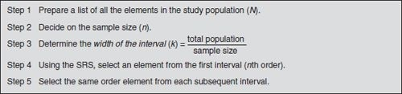

Slide 21
4. Cluster sampling
When to use
When difficult to take a simple random sample of units of a population either because:
→ A complete sampling frame does not exist
Clusters
Geographical units (villages)
→ Logistical difficulties (population widely scattered)
Organizational units (clinics, training groups).

Slide 22
4. Cluster sampling
Based on:
Ability of the researcher to divide the sampling population into groups (based upon visible or easily identifiable characteristics), called clusters.
Elements within each cluster are randomly selected.

Slide 23
5. Multistage sampling
Use
Features
Carried out in phases.
Commonly used in very large and diverse population.
Sampling done at 2 or more levels.
Usually involves more than one sampling method.

Slide 24
Stage 1
Select 5 out of 10 provinces
Stage 2
Select 3 districts in each province
Stage 3
Select 5 health centres from each district

Slide 25
NON-PROBABILITY SAMPLING IN QUANTITATIVE STUDIES
│
Non-probability sampling designs are used when the number of elements in a population is either unknown or cannot be individually identified
│
Selection of elements is dependent upon other considerations.

Slide 26
5 Non-probability sampling methods
Quota or convenient sampling
Accidental sampling
Judgemental or purposive sampling
Expert sampling
Snowball
Notes:
Quota sampling is a non-probability sampling method that relies on the non-random selection of a predetermined number or proportion of units. This is called a quota. You first divide the population into mutually exclusive subgroups (called strata) and then recruit sample units until you reach your quota. Quota sampling is a quick, easy, and inexpensive way to get survey results. The one drawback is that because of the lack of randomization, there is a greater potential for survey bias.
Convenience sampling (also known as grab sampling, accidental sampling, or opportunity sampling) is a type of non-probability sampling that involves the sample being drawn from that part of the population that is close to hand.
This type of sampling is always affordable, less time consuming, subjects are readily available, and easy to conduct. Sometimes, another very important reason for the use of accidental sampling is that the population is homogeneous.
Judgmental (i.e., nonstatistical) sampling includes gathering a selection of items for testing based on examiners' professional judgment, expertise, and knowledge to target known or probable areas of risk.
Judgmental sampling, also called purposive sampling or authoritative sampling, is a non-probability sampling technique in which the sample members are chosen only on the basis of the researcher's knowledge and judgment. By exercising judgment in who to sample, the researcher is able to save time and money when compared to broader sampling strategies. Unsystematic: Judgment sampling is vulnerable to errors in judgment by the researcher, leading to bias.
Snowball sampling enables researchers to conduct studies when finding participants might otherwise be challenging. Concealed individuals, such as drug users or sex workers, are difficult for researchers to access, but snowball sampling helps researchers to connect to these hidden populations. . Snowball sampling enables researchers to conduct studies when finding participants might otherwise be challenging. Concealed individuals, such as drug users or sex workers, are difficult for researchers to access, but snowball sampling helps researchers to connect to these hidden populations. Snowball sampling is a non-probability sampling method where new units are recruited by other units to form part of the sample. Snowball sampling can be a useful way to conduct research about people with specific traits who might otherwise be difficult to identify (e.g., people with a rare disease). The chain referral process allows the researcher to reach populations that are difficult to sample when using other sampling methods. The process is cheap, simple and cost-efficient. This sampling technique needs little planning and fewer workforce compared to other sampling techniques.
Expert sampling is used when your research requires individuals with a high level of knowledge about a particular subject. Your experts are thus selected based on a demonstrable skill set, or level of experience possessed. Judgmental or Expert sampling is usually used in situations where the target population comprises of highly intellectual individuals who cannot be chosen by using any other probability or non-probability sampling technique. Expert sampling is a kind of purposive sampling that finds experts in an area. Researchers use this method in the early phases of a study to become better informed. Experts can help them identify the critical factors, constraints, and issues in a research area.

Slide 27
1. Quota sampling
The main consideration directing quota sampling is the researcher’s ease of access to the sample population.
In addition to convenience, you are guided by some visible characteristic, such as gender.
Disadvantage: Less representative.
Whenever a person with this visible relevant characteristic is seen that person is asked to participate in the study.
The process continues until you have been able to contact the required number of respondents (quota).
Representativeness can be improved by selecting participants from different locations of the study area.

Slide 28
2. Accidental sampling
Based upon convenience in accessing the sampling population.
Whereas quota sampling attempts to include people possessing an obvious/visible characteristic, accidental sampling makes no such attempt
Disadvantage - some people contacted may not have the required information
You stop collecting data when you reach the required number of respondents you decided to have in your sample

Slide 29
3. Judgemental or purposive sampling
The primary consideration is your judgement as to who can provide the best information to achieve the objectives.
Researcher only goes to people thought to have the required information and be willing to share it.
Commonly used in qualitative studies
Useful when you want to construct a historical reality, describe a phenomenon or develop something about which only a little is known.

Slide 30
4. Expert sampling
Your respondents must be known experts in the field of interest to you.

Slide 31
5. Snowball sampling
The process of selecting a sample using networks
Few individuals selected to give information
The individuals recruit their peers, until saturation

Slide 32
QUALITATIVE SAMPLING METHODS
1. Convenient sampling
Most accessible participants
2. Maximum variation sampling
Selects study units which represent a wide range of variation in dimensions of interest.

Slide 33
QUALITATIVE SAMPLING METHODS.
3.Sampling contrasting cases
4.Snow ball sampling
Network sampling
Interest is sampling the opposites
5. Sampling typical cases
The two opposites of a dichotomous phenomenon

Slide 34
THE END

