Slide 1
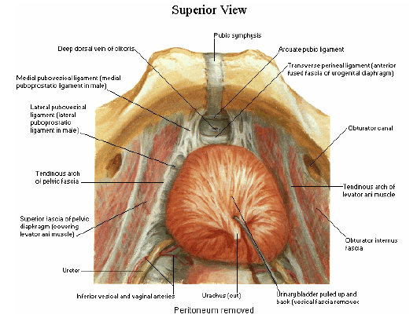
Urinary Bladder, prostate and urethra
Mr. M. Banda

Slide 2
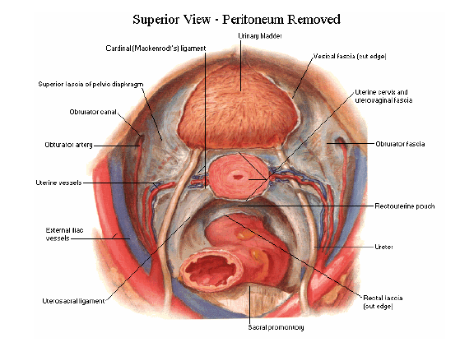
Urinary Bladder
Introduction:
Is a reservoir of urine
Size, shape, position and relations vary according to content and state of neighbouring viscera
When empty: entirely in lesser pelvis
When full: anterosuperiorly in abdominal cavity

Slide 3
Urinary Bladder
Empty bladder: tetrahedral in shape
Base (fundus): directed backwards
Neck: lowest/fixed part
Apex: directed forwards
3 surfaces: superior, Rt/Lt inferolateral surfaces
4 borders: 2 lateral, one anterior and one posterior

Slide 4
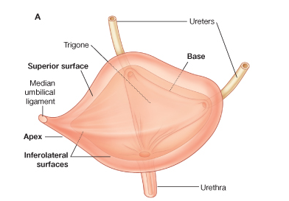
Urinary Bladder

Slide 5
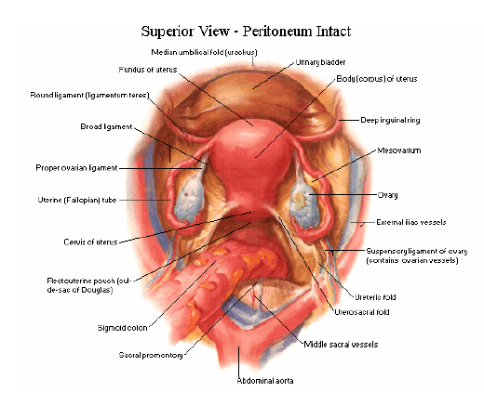
Relations of Urinary Bladder
Base:
Females:
Uterus separating it from rectum

Slide 6
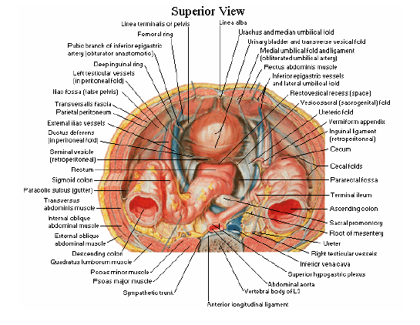
Relations of Urinary Bladder
Base:
Males:
Rectum separated from it by:
Rectovesical pouch anteriorly
Seminal vesicle and vas deferens on each side
Denonvillier’s fascia

Slide 7
Relations of Urinary Bladder
Neck:
Lies most inferiorly
3–4 cm behind symphysis pubis
Is above plane of inferior aperture of lesser pelvis
Essentially internal urethral orifice
In males, rests on base of the prostate
In females, related to pelvic fascia

Slide 8
Relations of Urinary Bladder
Apex:
Both sexes faces towards upper part of the symphysis pubis
Median umbilical ligament (urachus) ascends behind anterior abdominal wall from apex to umbilicus
Ligament covered by peritoneum to form the median umbilical fold

Slide 9
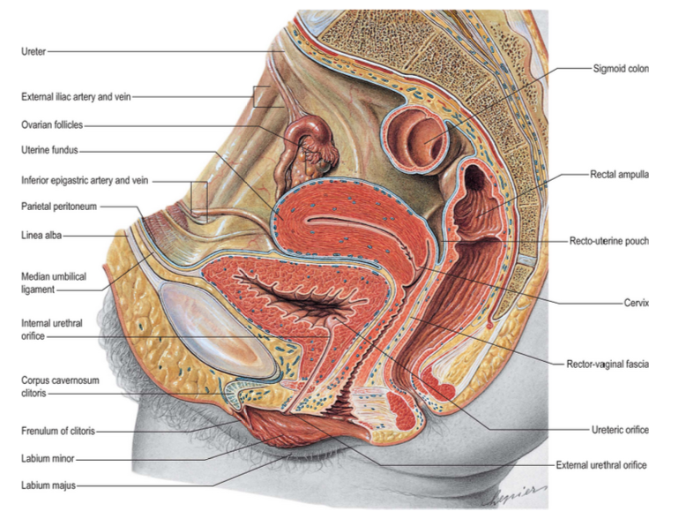

Slide 10
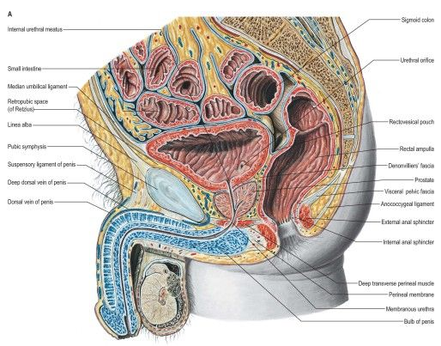

Slide 11
Relations of Urinary Bladder
Anterior surface:
Separated from transversalis fascia by fat in retropubic space (of Retzius)
Inferolateral surface:
In males, anteriorly to pubis and puboprostatic ligaments
In females, relations are similar except that pubovesical ligaments replace the puboprostatic ligaments
Inferolateral surfaces are not covered by peritoneum

Slide 12
Relations of Urinary Bladder
Superior surface:
In males, completely covered by peritoneum
Rectovesical pouch separates it from rectum
Sigmoid colon and terminal coils of the ileum
In females, superior surface is largely covered by peritoneum
Reflected posteriorly onto the uterus to form vesicouterine pouch
Posterior part of the superior surface is devoid of peritoneum

Slide 13
Ligaments of the Bladder
Attach bladder to pubis, lateral pelvic side-walls, and rectum
True ligaments:
Pubovesical ligaments
Pubourethral ligaments
Puboprostatic (medial/lateral)ligaments in male
Median umbilical ligament
Lateral true ligament in male
Posterior vesical ligaments in male

Slide 14
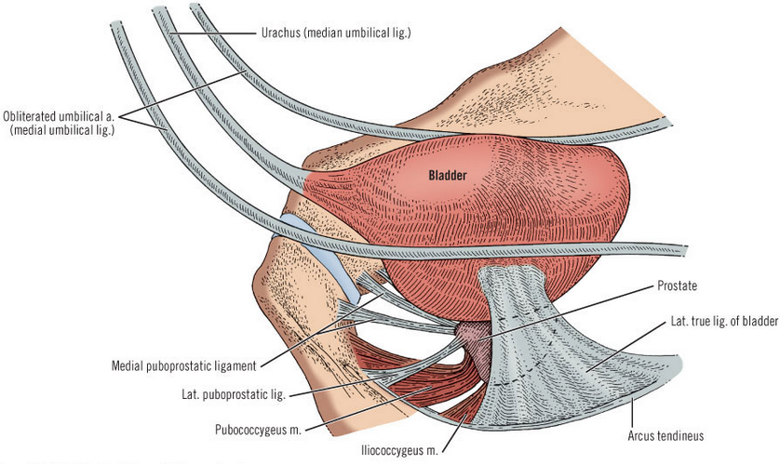
Ligaments of the Bladder

Slide 15
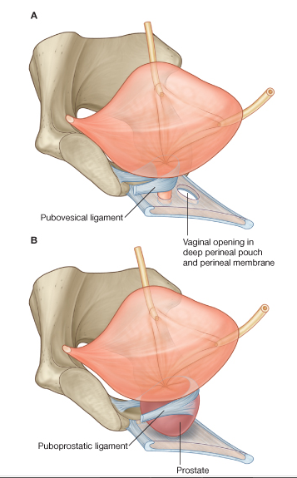
Ligaments of the Bladder

Slide 16
Ligaments of the Bladder
False ligaments:
Median umbilical fold
Two medial umbilical folds
Lateral false ligament
Posterior false ligament

Slide 17
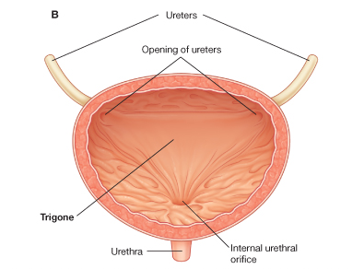
Bladder Interior
Vesical mucosa
Almost all is attached loosely to subjacent muscle
Folds when the bladder empties
Folds stretched flat as it fills
Over trigone, is adherent to the subjacent muscle layer and mucosa is always smooth

Slide 18
Bladder Interior
Trigone is formed by:
Anteroinferior angle: internal urethral orifice
Posterolateral angles: ureteric orifices
Superior trigonal boundary has interureteric bar
Trigone consists of 2 distinct layers:
Superficial trigonal muscle
Deep trigonal detrusor muscle

Slide 19
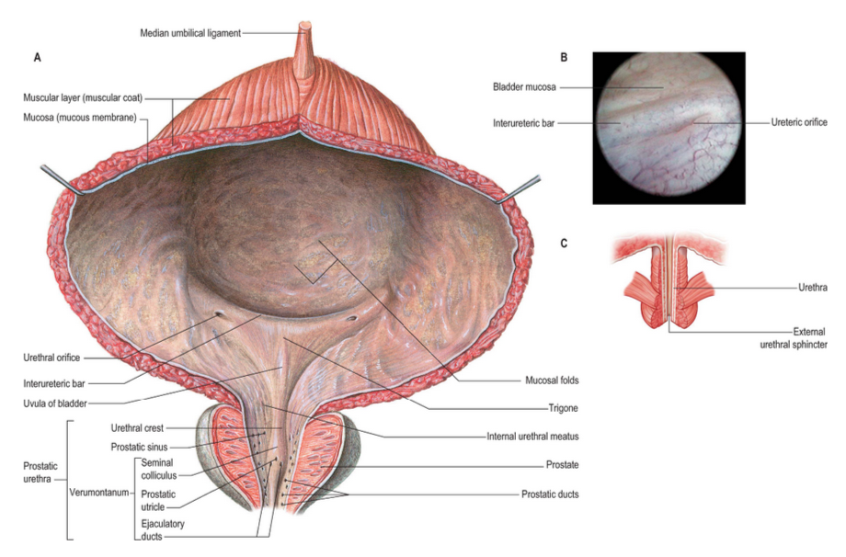

Slide 20
Bladder Interior
Ureteric orifices
Are placed at posterolateral trigonal angles
In empty bladders: 2.5 cm apart, and 2.5 cm from the internal urethral orifice
Bladder distension: measurements may be doubled
Internal urethral orifice
Is sited at the trigonal apex
Lowest part of the bladder

Slide 21
Capacity of Bladder
Mean capacity: 220 mL
Varies from 120-320 mL
Filling beyond 220 mL causes desire to micturate
Filling up to 500mL maybe tolerated but beyond that it becomes painful
Referred pain is felt in lower anterior abdominal wall, perineum, penis (T11 to L2; S2-S4)

Slide 22
Vascular Supply and Lymphatic Drainage of Bladder
Arteries
Principally by superior and inferior vesical arteries
Supplemented by obturator and inferior gluteal arteries
In female: branches of uterine and vaginal arteries
Veins
Vesicle venous plexuses on inferolateral surfaces drain into internal iliac veins
Lymphatics
External iliac nodes

Slide 23
Nerve Innervation of the Urinary Bladder
Both autonomic and somatic
Efferent nerves:
1. Parasympathetic efferent fibres (S2-S4):
Motor to detrusor muscle
Inhibitory to sphincter vesicae (internal sphincter)
If these are destroyed, normal micturition is not possible
2. Sympathetic efferent fibres (T10-L2):
Inhibitory to detrusor muscle
Motor to sphincter vesicae

Slide 24
Nerve Innervation of the Urinary Bladder
3. Somatic: Pudendal nerve (S2-S4)
Supplies the voluntary sphincter urethrae (external sphincter)
Afferent nerves:
Pain sensations pass via mainly the parasympathetic and partly via sympathetic nerves
In spinal cord, pain pass via lateral spinothalamic tract and awareness of bladder distension via posterior columns

Slide 25
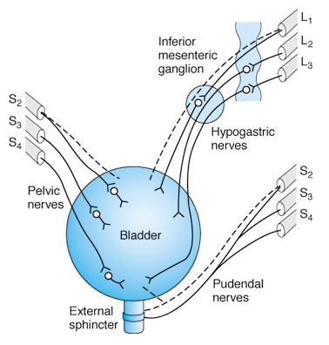
Innervation of the Bladder
Dashed lines indicate sensory nerves
Parasympathetic innervation is shown at the left
Sympathetic at the upper right
Somatic at the lower right

Slide 26
Male Urethra
Is 18–20 cm long
From internal urethral orifice in urinary bladder to external opening, or meatus
Two parts:
1. Anterior urethra (16 cm)
Bulbar
Pendulous or penile
2. Posterior urethra (4 cm)
Preprostatic
Prostatic
Membranous

Slide 27
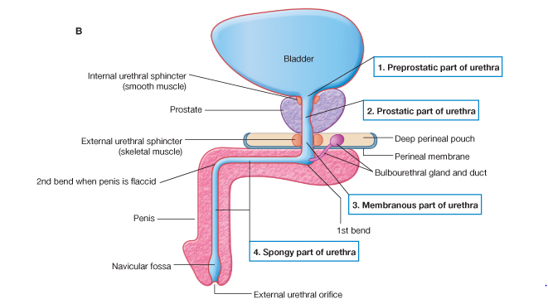
Male Urethra

Slide 28
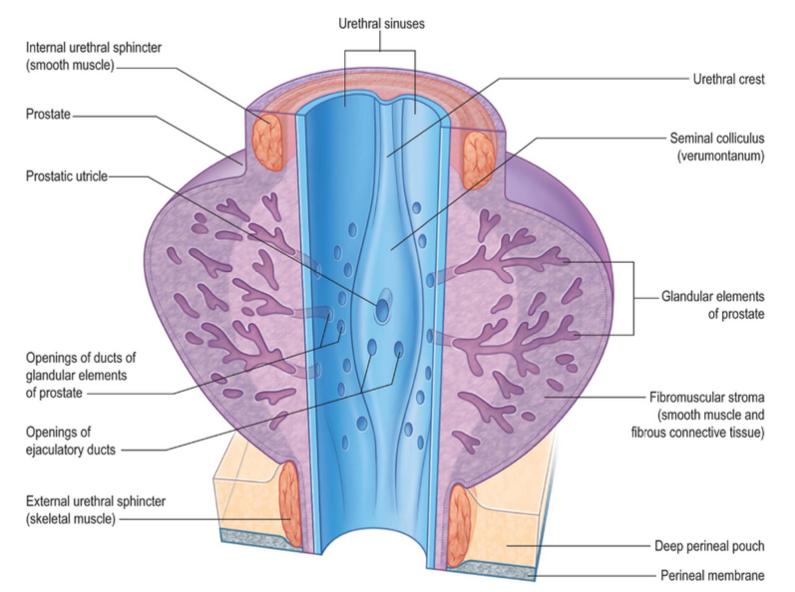

Slide 29
Vascular, lymphatic drainage and innervation of male urethra
Vascular supply:
Artery:
Urethral artery, a branch of internal pudendal artery
Veins:
Dorsal veins of penis and internal pudendal veins
These drain to prostatic plexus
Posterior urethra drains into prostatic and vesical venous plexuses, which drain into the internal iliac veins

Slide 30
Vascular, lymphatic drainage and innervation of male urethra
Lymphatic drainage
Posterior urethra: internal iliac nodes
Anterior urethra: accompany that of glans, then deep inguinal
Innervation:
Prostatic plexus supplies smooth muscle of prostate and prostatic urethra
Greater cavernous nerves carry sympathetic supply for contraction of preprostatic sphincter during ejaculation and prevents reflux of ejaculate into the bladder

Slide 31
Vascular, lymphatic drainage and innervation of male urethra
Parasympathetic preganglionic fibres are axons from neurones in S2-S4 sacral spinal segments
Nerve supply to external urethral sphincter is the neurones in Onuf’s nucleus and by perineal branches of pudendal nerve

Slide 32
Female Urethra
Is approximately 4 cm long and 6 mm in diameter
Begins at internal urethral orifice of bladder, runs anteroinferiorly behind symphysis pubis
Is embedded in anterior wall of the vagina
Ends at external urethral orifice in vestibule as an anteroposterior slit
Many small mucous urethral glands open into urethra
At lower end of urethra, Skene’s glands open into para-urethral duct

Slide 33
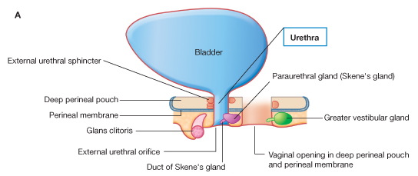
Female Urethra

Slide 34
Female Urethra
Vascular Supply and Lymphatic Drainage
Artery
Internal pudendal artery via the urethral artery is the principal supply
Veins
Urethral venous plexus drains into vesical venous plexus around bladder neck, and into internal pudendal veins
Lymphatic drainage
Internal and external iliac nodes

Slide 35
Female Urethra
Innervation
Parasympathetic preganglionic fibres: S2-S4 pelvic splanchnic nerves
Postganglionic fibres: smooth muscle of the urethral wall
Somatic fibres to the striated muscle: S2 to S4
Postganglionic sympathetic fibres arise from plexus around vaginal arteries

Slide 36
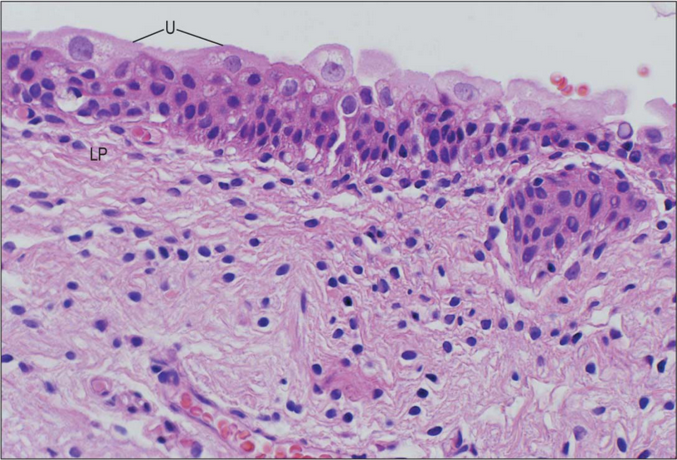
Histology of Urinary Bladder and Urethra

Slide 37
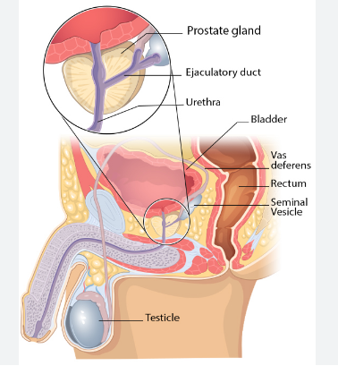
Prostate gland
Is a pyramidal fibromuscular accessory gland
Surrounds prostatic urethra from bladder base to the membranous urethra
Unlike the thyroid gland, its neurovascular bundle lies between the true and the false capsules
During prostatectomy, the neurovascular tissue is preserved to avoid damage to the prostatic plexus which is a component of the inferior hypogastric plexus (autonomic)
Damage to prostatic plexus can cause erectile dysfunction

Slide 38
Prostate gland
Numerous fibromuscular septa which divide glandular tissue into indistinct lobules
Muscular tissue within prostate is mainly smooth muscle
In female, prostate is represented by paraurethral glands of Skene

Slide 39
Prostate gland
Size and weight:
Measures:
4cm transversely at base
2 cm anteroposterior diameter
3 cm vertical diameter
Weight varies:
Average of 8g in youth
In BPH: 40-150 g

Slide 40
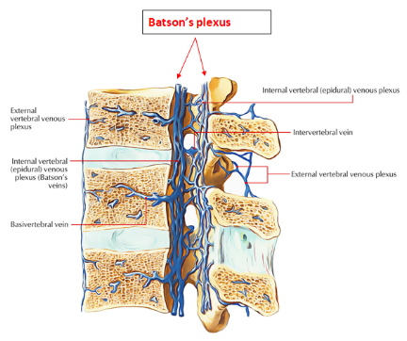
Prostate Gland
Blood supply:
Arteries: branches from
Inferior vesical
Middle rectal
Internal pudendal
Veins:
Prostatic venous plexus communicate with vesical plexus and internal iliac veins
Communicates with Batson’s plexus of veins via which prostate carcinoma can spread

Slide 41
Prostate Gland
Lymphatic drainage:
Internal iliac nodes
Sacral nodes
Partly external iliac nodes
Nerve supply:
Autonomic via the prostatic plexus which comes from inferior hypogastric plexus

Slide 42
Zonal Anatomy of the Prostate
Anatomically; glandular tissue is subdivided into three distinct zones:
Peripheral (70% by volume)
Central (25% by volume)
Transitional (5% by volume)
Non-glandular tissue (fibromuscular stoma) fills up space between peripheral zones anterior to the preprostatic urethra

Slide 43
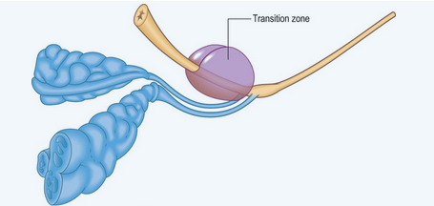
Zonal Anatomy of the Prostate

Slide 44
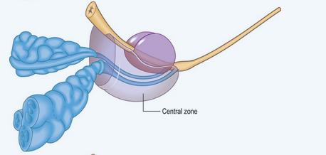
Zonal Anatomy of the Prostate

Slide 45
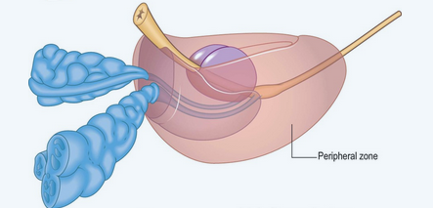
Zonal Anatomy of the Prostate

Slide 46
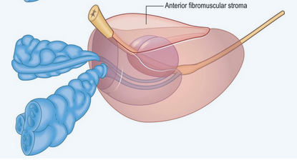
Zonal Anatomy of the Prostate

Slide 47
Histology of the Prostate Gland
Epithelium: pseudostratified columnar
Has tubuloalveolar glands
Rich fibromuscular stroma surrounds the glands
Is surrounded by fibroelastic capsule rich in smooth muscle
Septa from capsule penetrate gland and divide it into lobes that are indistinct in adult men

Slide 48
Histology of the Prostate Gland
Has small spherical bodies of glycoproteins, 0.2-2 mm in diameter and often calcified
Are called prostatic concretions, or corpora amylacea
Their significance is not understood, but their number increases with age
Prostatic secretions are slightly acid, and contain acid phosphatase, amylase, Prostate-specific Antigen (PSA), fibrinolysin and zinc

Slide 49
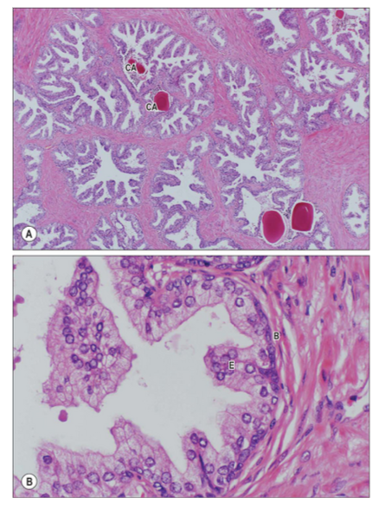
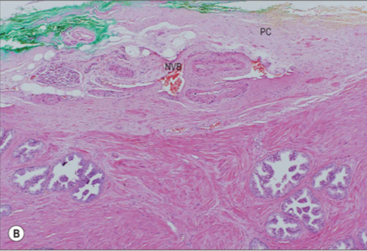
Histology of the Prostate Gland

Slide 50
The End
Thank you!

