Slide 1
Gross and clinical anatomy of the male reproductive system
Dr Mbawe Zulu, MScHA

Slide 2
The learner should be able to:
Outline the parts of the male reproductive system: scrotum, testis, epididymis, vas deferens, seminal vesicles, ejaculatory duct, prostate, urethra and penis
Describe the gross anatomical features of the structures in (1)
Outline the embryological basis of congenital anomalies of the reproductive system
4. Outline other common clinical and applied aspects of the male reproductive system

Slide 3
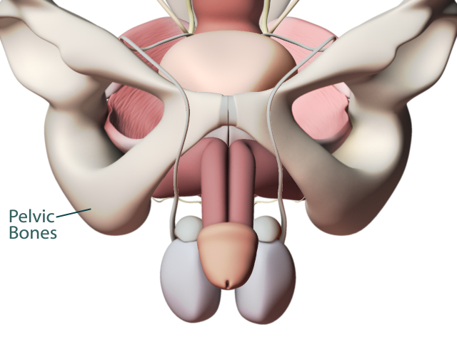

Slide 4
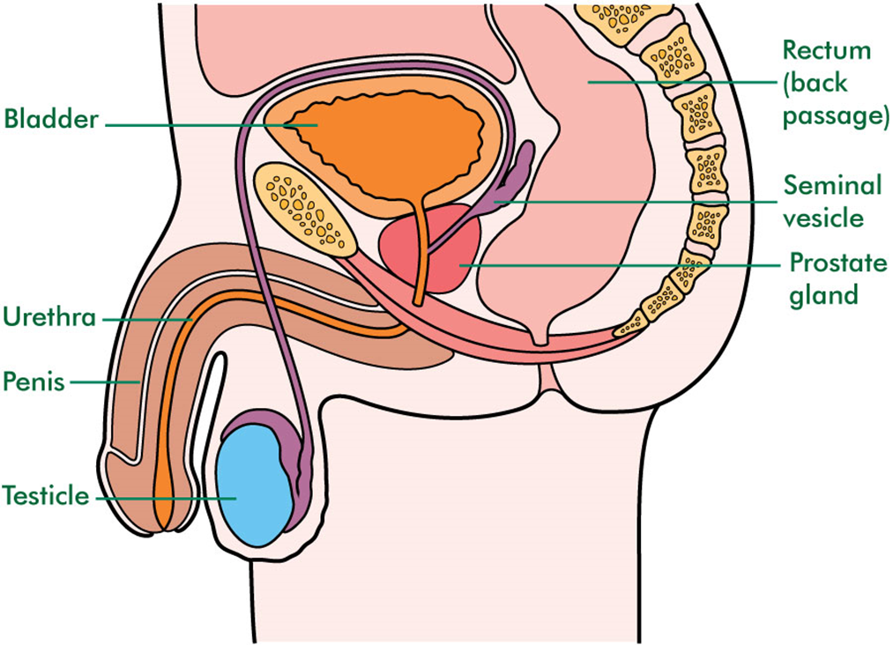

Slide 5
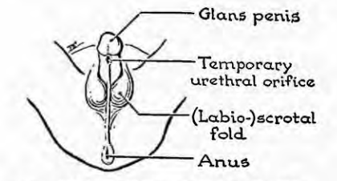
Scrotum
Muscultaneous sac which form pouches in which lies the testes.
Its wall has two layers, viz;
Skin
Superficial fascia
1.Skin
Thin, pigmented, rugose and marked by a longitudinal median raphe.
Richly endowed with sebaceous glands, and consequently a common site for sebaceous cysts, which are often multiple.
2.Superficial fascia
Devoid of fat but contains smooth muscle—dartos.
Contract in response to cold, reducing the surface area of the skin
Continuous anteriorly with the membranous deep layer of the superficial fascia of the anterolateral abdominal wall
Continuous posteriorly with the superficial fascia of the perineum

Slide 6
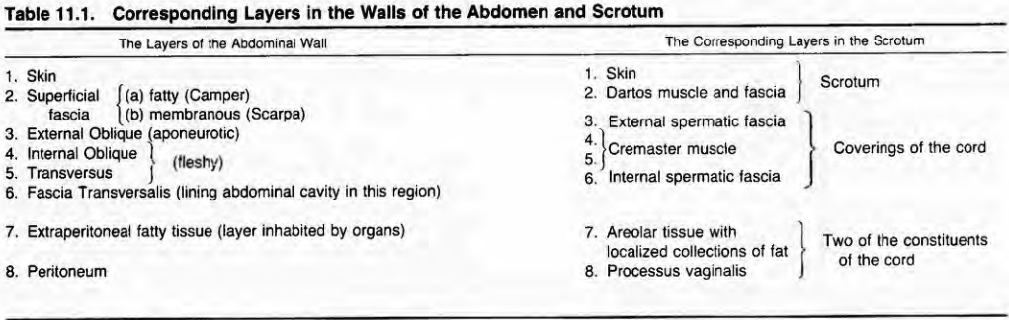

Slide 7
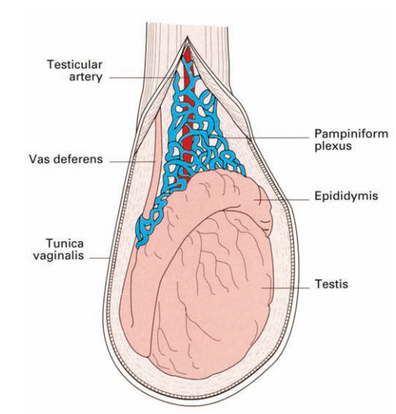
Scrotum: N.A.V.a.L
Nerves
Genitofemoral nerve→ genital branch
Ilioinguinal nerve
Pudendal nerve→ perineal branch
Posterior femoral cutaneous nerve→ perineal branches
Arterial supply
Internal pudendal→perineal branch
Femoral artery→external pudendal branches
Inferior epigastric→cremesteric branch
Venous drainage
Accompany arteries
Lympatic drainage
Efferent vessels drained into superficial inguinal lymph nodes

Slide 8
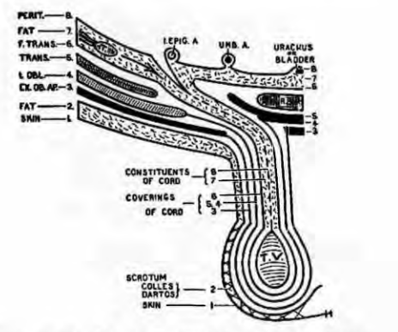
Scrotum in the clinic
Differentiate:
Extravasation
Hydrocoele
Oedema secondary to renal or heart failure

Slide 9
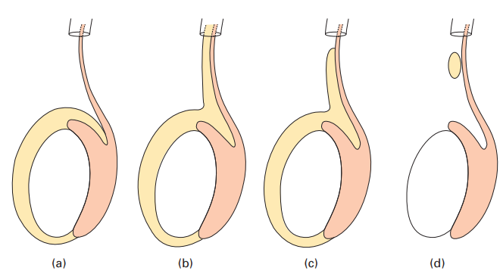

Slide 10
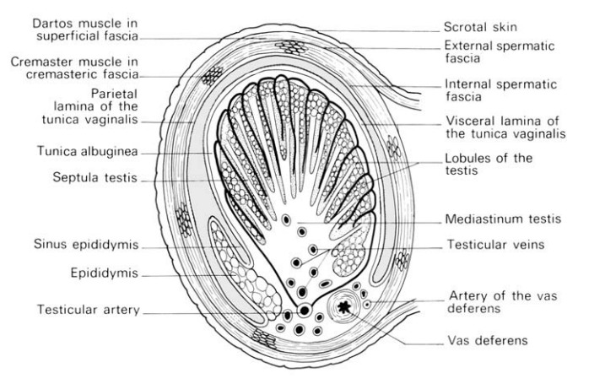
Testes
Bilateral ovoid gland measuring 4 by 3 by 2 cm
Located in the scrotum
Forms sperms and hormones (Testosterone)
Each testis is contained by a white fibrous capsule, the tunica albuginea
Surface covered by visceral layer of tunica vaginalis except where testis is attached to the epididymis and spermatic cord
Tunica vaginalis is a peritoneal sac derived from the processus vaginalis
Parietal layer is adjacent to the internal spermatic fascia
Visceral layer is adherent to the testis and epididymis
A small amount of fluid in the cavity of the tunica vaginalis separate the visceral and parietal layers and enable testis to move freely in the scrotum

Slide 11
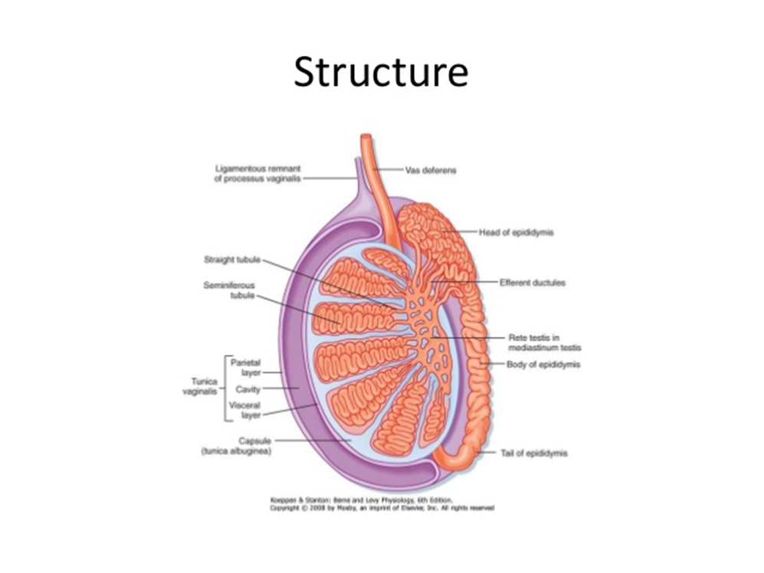
Testes: structure
Posteriorly, the tunica albuginea is thickened and less dense and is known as the mediastinum testis
Areolar septa extend from the mediastinum testis to the tunica albuginea and divide the testis into about 250 elongated pyramidal compartments
Each compartment contains a lobule formed from 2 or more thread-like seminiferous tubules, which are each a half meter long
The seminiferous tubules are closely packed and convoluted, except at the apex of the compartment where they join together and take a short, straight course, the straight tubules.
In the mediastinum, the straight tubules anastomose to form a network, the rete testis. The rete testis is connected to the head of the epididymis by a series of 6-12 fine ducts, the efferent ductules.

Slide 12
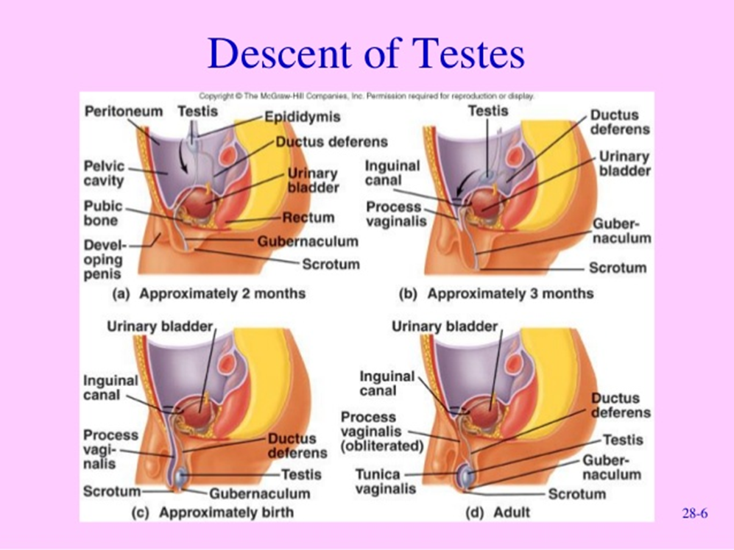
Testes:
The weakening of the anterior wall consequent upon the journey explains frequency of inguinal hernia or rupture
Testis drags into the scrotum with it representatives of layers of abdominal wall which form a tubular elongation of fascia and elongated loops of muscle fibres called coverings of the spermatic cord.
The vessels, nerves and duct are contents of the cord
Each testis develop near the kidney and lies behind the peritoneum to the back of which it is attached

Slide 13
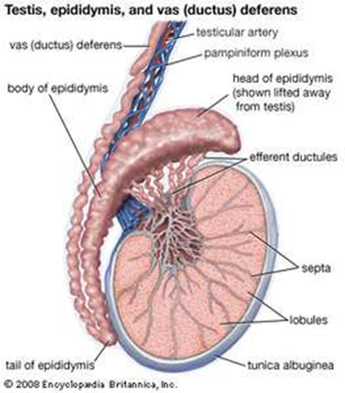
Epididymis:
The epididymis is applied to the upper pole and posterior border of the testis.
It is somewhat larger in diameter that a standard pencil.
It tapers as it descends on the posterior border of the testis to connect to the vas deferens.
It is divided into:
1 an expanded head,
2. body and
3.A pointed tail inferiorly.
Medially, there is a distinct groove, the sinus
epididymis, between it and the testis.
The epididymis is covered by the
tunica vaginalis except at its posterior margin which is free or, so to say, ‘extraperitoneal’.

Slide 14
Epididymis:
In the head of the epididymis, the efferent ductules become coiled to form lobules and empty into the duct of the epididymis.
The duct of the epididymis forms the body and tail of the organ.
The duct is greatly twisted and folded, and when unraveled, it is about 7 meters in length.

Slide 15
Testis & Epididymis:
Each bear at their upper extremities a small stalked body, termed respectively the appendix testis and appendix epididymis (hydatid of Morgagni)
The appendix testis is a remnant of the upper end of the paramesonephric (Müllerian) duct
The appendix epididymis is a remnant of the mesonephros.
These structures, being stalked, are liable to undergo torsion.

Slide 16
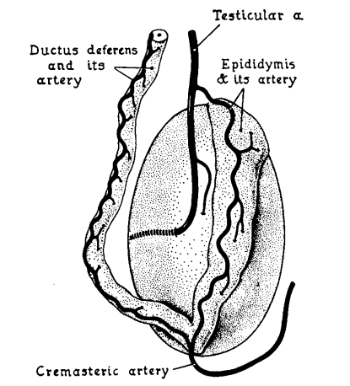
Testis & Epididymis:
Innervation
Fibers derived from thoracic segments T6—10.
Mainly vasomotor.
Accompanying the sympathetic nerves are afferent fibers.
Pain in the testis is referred to the "pit of the stomach" region or T8—10 dermatomes.
Arterial supply
The testicular artery is a branch of the abdominal aorta at the L2 vertebral level.
It pierces the mediastinum testis in a variety of ways, branches, and anastomoses with the artery of the ductus deferens and the cremasteric artery
The artery of the ductus deferens is derived from the inferior vesical branch of the internal iliac artery
The cremasteric artery is a branch of the inferior epigastric artery.

Slide 17
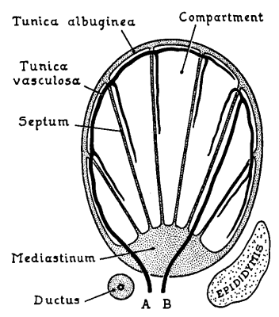
Testis & Epididymis:
Venous drainage
Veins from the region form a anastomising plexus, the pampiniform plexus, which ascends, reducing to 2 or 3 veins and ultimately one testicular vein.
The right testicular vein joins the inferior cava
Left testicular vein drains into the left renal vein.
The testicular veins may become dilated and tortuous, a clinical condition called varicocele.

Slide 18
Testis & Epididymis:
Lymphatic drainage
The lymphatics of the testis, like those of the ovary, end in lymph nodes situated between the common iliac and renal vessels
They are distinctively different from the lymph vessels of the scrotum and penis, which drain into the inguinal nodes.
This anatomical difference is clinically important in the spread of carcinoma from these two closely related structures

Slide 19
Testis & Epididymis:
The testis arises at the level of the mesonephros at the level of L2/3 vertebrae and drags its vascular, lymphatic and nerve supply from this region. Pain from the kidney is often referred to the scrotum and, conversely, testicular pain may radiate to the loin.
2. When searching for secondary lymphatic spread from a neoplasm of the testis, the upper abdomen must be palpated carefully for enlarged paraaortic nodes; because of cross-communications, these may be present on either side. Mediastinal and cervical nodes may also become involved. It is the beginner’s mistake to feel for nodes in the groin; these are only involved if the tumour has ulcerated the scrotal skin and hence invaded scrotal lymphatics which drain to the inguinal nodes.

Slide 20
Testis & Epididymis:
3. Rarely, a rapidly developing varicocele (dilatation of the pampiniform plexus of veins) is said to be a presenting sign of a tumour of the left kidney which, by invading the renal vein, blocks the drainage of the left testicular vein.
Most examples of varicocele are idiopathic; why the vast majority are on the left side is unknown, but theories are that the left testicular vein is compressed by a loaded sigmoid colon, obstructed by angulation at its entry into the renal vein or even that it is put into spasm by adrenalin-rich blood entering the renal vein from the suprarenal vein!

Slide 21
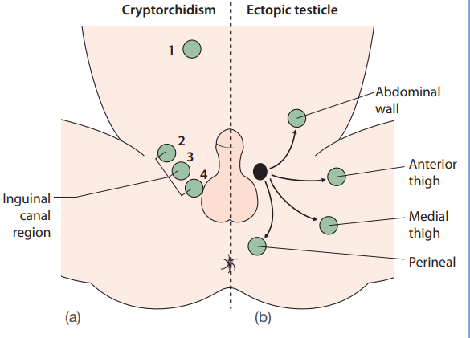
Testis & Epididymis:

Slide 22
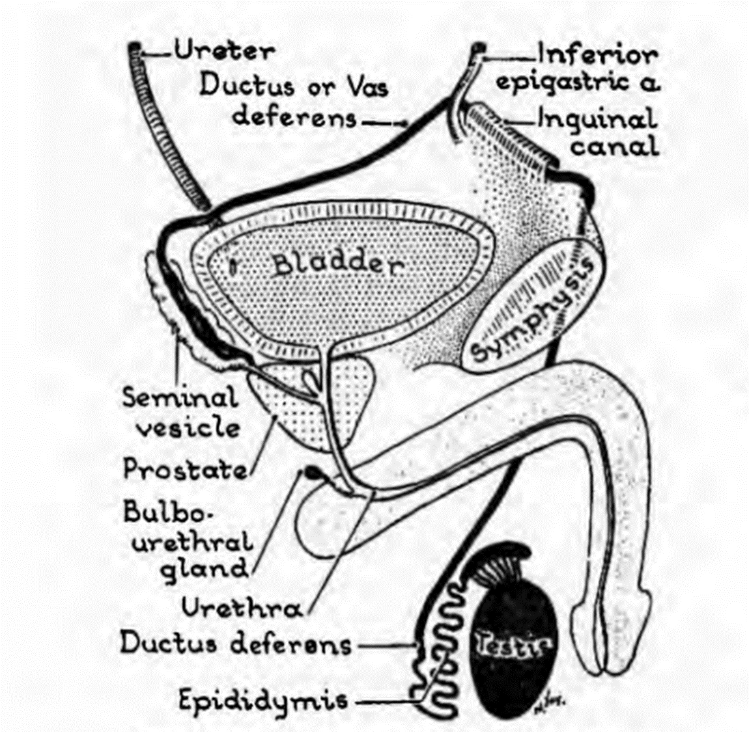
Vas deferens
Muscular tube about 45 cm long
The vas passes from the tail of the epididymis to traverse the scrotum, inguinal canal and so comes to lie upon the side wall of the pelvis.
Here, it lies immediately below the peritoneum of the lateral wall, extends to the ischial tuberosity then turns medially to the base of the bladder.
Here it joins the more laterally placed seminal vesicle to form the ejaculatory duct which traverses the prostate to open into the prostatic urethra at the verumontanum on either side of the utricle.

Slide 23
Vas deferens
Nerves
Fibres from the Inferior hypogastric plexus
Arteries
Artery of the ductus deferens from inferior vesical artery
Venous and lymphatic drainage
Accompany arteries and have similar names

Slide 24
Vas deferens: in the clinic
1.Infections may track from bladder and urethra along the vas to the epididymis (acute epididymitis).
2.The operation of bilateral vasectomy is a common procedure for male sterilization.
The vas is identified by its very firm consistency which, in coaching days, was likened to whipcord but which today might, more aptly, be compared with fine plastic tubing.

Slide 25
Vas deferens: in the clinic
1.Infections may track from bladder and urethra along the vas to the epididymis (acute epididymitis).
2.The operation of bilateral vasectomy is a common procedure for male sterilization.
The vas is identified by its very firm consistency which, in coaching days, was likened to whipcord but which today might, more aptly, be compared with fine plastic tubing.

Slide 26
Seminal vesicle
Bilateral coiled sacculated tubes 5 cm long which can be unravelled to three times that length.
They lie, one on each side, extraperitoneally at the bladder base, lateral to the termination of the vasa.
Each has common drainage with its neighbouring vas via the ejaculatory duct
In spite of their name, they do not act as receptacles for semen, although their secretion does contribute considerably to the seminal fluid.

Slide 27
Seminal vesicle: In the clinic
Can be felt on digital rectal examination if enlarged; this occurs typically in tuberculous infection

Slide 28
Prostate
This is a pyramidal-shaped, fibromuscular and glandular organ, 1.25 in (3 cm) long, which surrounds the prostatic urethra.
Resembles the size and shape of a chestnut.

Slide 29
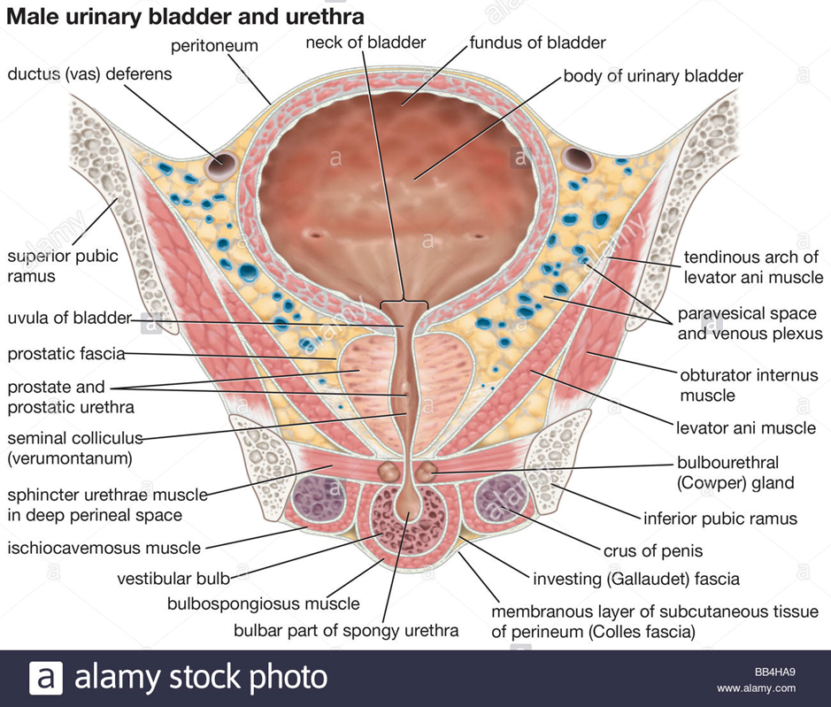
Prostate
Relations
Superiorly: the neck of the bladder. The urethra enters the upper aspect of the prostate near it anterior border.
Inferiorly: the apex of the prostate rests on the external sphincter of the bladder which lies within the deep perineal pouch.
Anteriorly: pubic symphysis separated by the extraperitoneal fat of the cave of Retzius or retropubic space.
Posteriorly: lies the rectum separated by the fascia of Denonvilliers.
Laterally: lies levator ani.

Slide 30
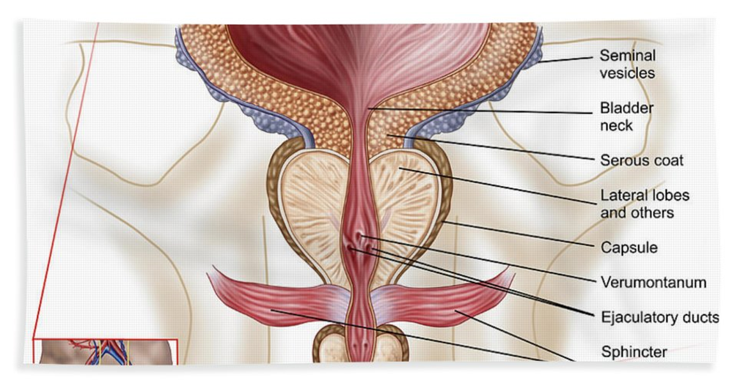
Prostate
The ejaculatory ducts enter the upper posterior part of the gland to open into the urethra at the colliculus seminalis or verumontanum, one on either side of the prostatic utricle, dividing off a median prostatic lobe lying between these three ducts
In benign prostatic hypertrophy, a shallow posterior median groove (which can be felt on rectal examination) further divides the prostate into left and right lobes.
Anterior to the urethra, the prostate consists of a narrow isthmus only

Slide 31
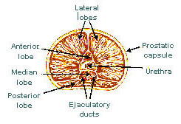
Prostate--lobes

Slide 32
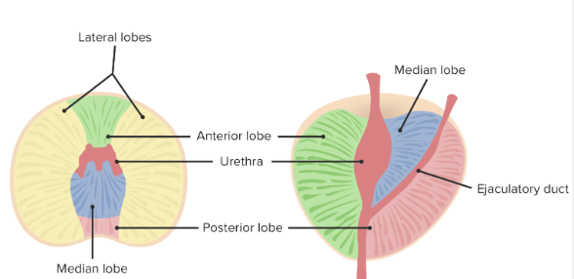
Prostatic lobes

Slide 33
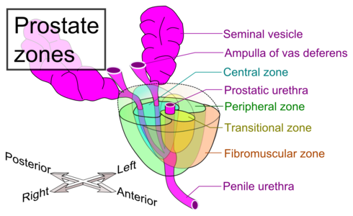
Prostatic zones

Slide 34
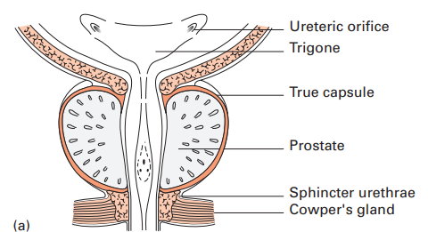
Prostatic capsules
These are normally two in number, viz:
1.The true capsule—a thin fibrous sheath which surrounds the gland.
2.The false capsule — condensed extraperitoneal fascia which continues into the fascia surrounding the bladder and with the fascia of Denonvilliers posteriorly.
Between layers 1 and 2 lies the prostatic venous plexus.

Slide 35
Prostatic capsules
These are normally two in number, viz:
1.The true capsule—a thin fibrous sheath which surrounds the gland.
2.The false capsule — condensed extraperitoneal fascia which continues into the fascia surrounding the bladder and with the fascia of Denonvilliers posteriorly.
Between layers 1 and 2 lies the prostatic venous plexus.

Slide 36
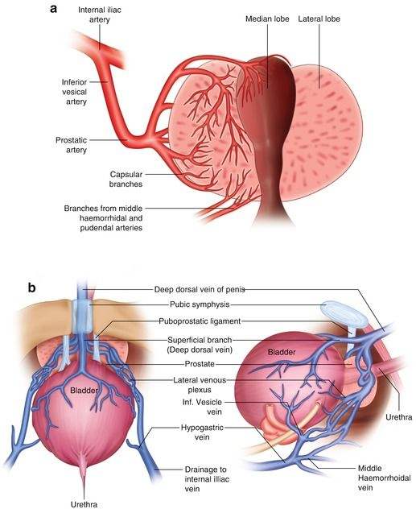
Prostate: NAVaL
Nerves:
Parasympatheic fibres from pelvic splanchnic and inferior hypogastric nerves
Artery:
Inferior vesical branch of the internal pudendal artery
Vein:
Prostatic plexus of veins→ internal iliac vein
Anastomose with valveless vertebral veins
Lymphatics:
Efferent tubules drain into the internal lymph nodes and sacral lymph nodes

Slide 37
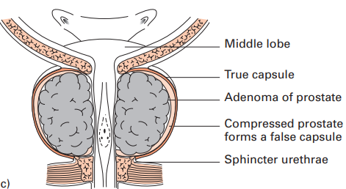
Prostate: in the clinic
Prostatectomy for benign prostatic hyperplasia
Transurethral approach use verumontanum as landmark to avert damage to urethral sphincter
If large BPH, suprapubic approach via retropubic space.
2. BHP affecting median lobe may not be detected at DRE and is associated with urethra obstration and age>45 years
3. Carcinoma rare traverses Denonvilliers fascia which is a surgical landmark to enable sparing of prostate at rectal excision

Slide 38
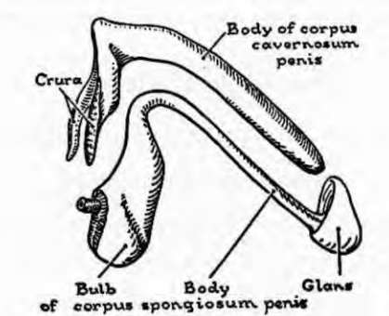
The penis
The penis is composed of 3 fibroelastic cylinders:
1.Right and left corpora cavernosa penis and
2. Corpus spongiosum penis which are filled with erectile tissue and are enveloped in fasciae and skin
The corpora cavernosa fuse with each other in the median plane, except behind where, as 2 diverging crura, they separate to find attachment on each side to 2 cm of he pubic arch.
They support the corpus spongiosum, which lies below and between them.

Slide 39
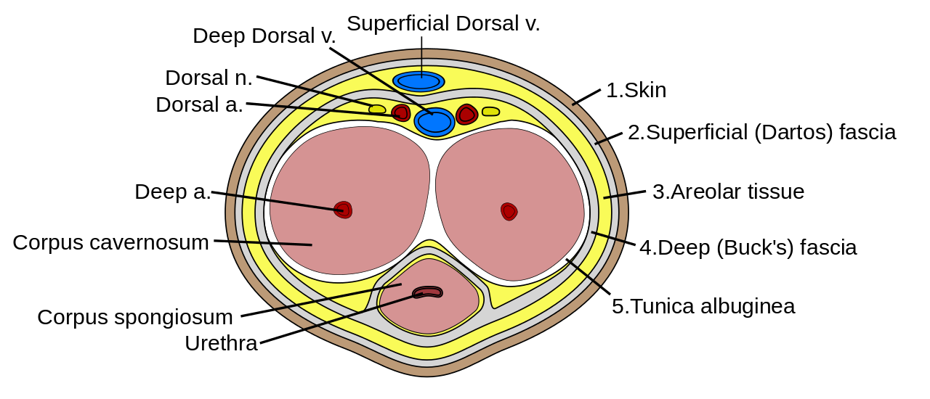
The penis
The penis is composed of 3 fibroelastic cylinders:
1.Right and left corpora cavernosa penis and
2. Corpus spongiosum penis which are filled with erectile tissue and are enveloped in fasciae and skin
The corpora cavernosa fuse with each other in the median plane, except behind where, as 2 diverging crura, they separate to find attachment on each side to 2 cm of he pubic arch.
They support the corpus spongiosum, which lies below and between them.

Slide 40
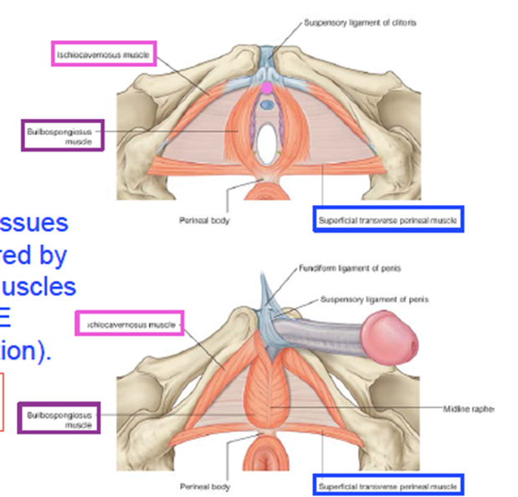
The penis
The corpus spongiosum is traversed by the urethra
Enlarged anteriorly where, as the glans penis, it fits onto the blunt end of the united corpora cavernosa and expanded posteriorly where, as the bulb of the penis,
It is fixed to the perineal membrane.
This membrane moors the bulb between the pubic arches.
The crura and the bulb are the attached parts or root of the penis

Slide 41
The penis: musculature
Bulbospongiosus
O: median raphe, ventral surface of the bulb and perineal body
I:corpus spongiosum and cavernosum
N: Deep branch of the perineal nerve pudendal nerve
A: compresses bulb of the urethra and assist in erection
Ischiocavernosus
O.

Slide 42
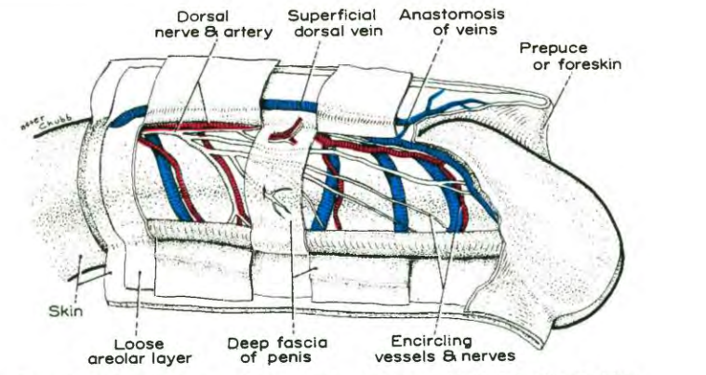
The penis: Skin and fascia
They are prolonged loosely over the glans as the foreskin or prepuce.
The skin is devoid of hairs and the fascia of fat.
Deep to these, a closed tube of denser and more tightly fitting fascia, the deep fascia of the penis, envelops the body of the penis from its root to the corona of the glans
The Suspensory Ligament of the Penis is a thick, triangular fibroelastic band.
Above, it is fixed to the lower part of the linea alba and upper part of the symphysis pubis;
below, it splits to form a sling for the penis at the junction of its fixed and mobile parts (i.e., where the organ is bent), and there it blends with the fascia penis (deep fascia of the penis

Slide 43
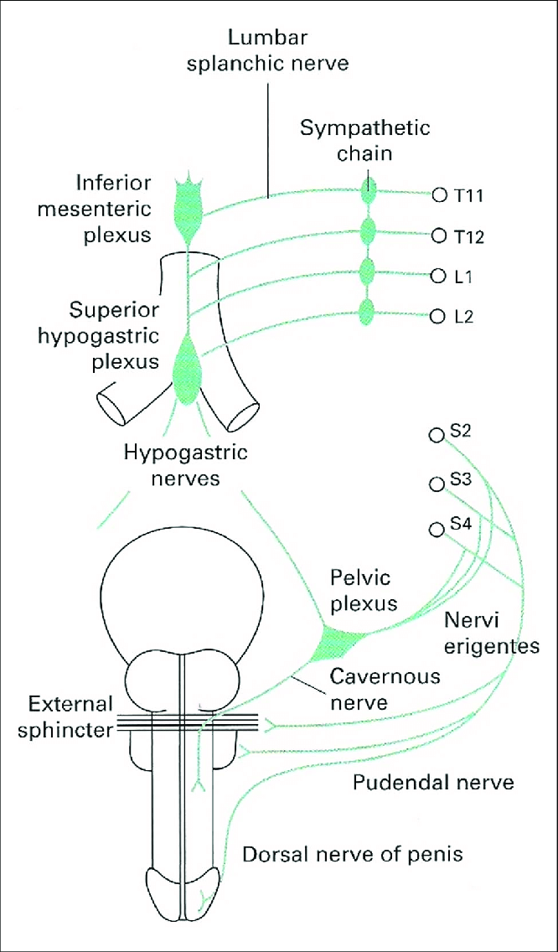
The penis: NAVaL
1a.Cutaneous nerves
branches of the dorsal nerves of the penis (S2,3,4)
The genital branch of the genitofemoral nerve (Ll,2) and
The ilioinguinal nerve supply the parts near the pubis
1b. Vasomotor nerves
Derived from the pelvic splanchnics

Slide 44
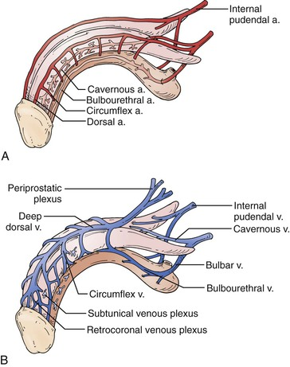
The penis: NAVaL
Arteries
The Erectile Tissue of the penis is supplied by 3 paired arteries that branch from the internal pudendal arteries— artery to the bulb, artery to the crus , and dorsal artery.
The last named artery sends encircling twigs to assist the former 2 arteries
Veins
1. From cavernous sapces→venous plexus→ deep dorsal vein--> prostatic venous plexus
2. Blood superficial to the ddep fascia→superficial dorsal vein→superficial external pudendal vein
Lymphatics
Inguinal lymph nodes

Slide 45
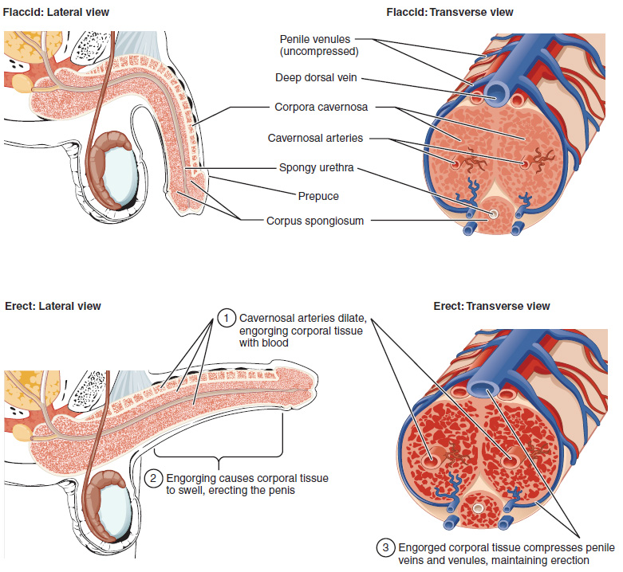
The penis: erection
Erotic stimulation causes smooth muscles to relax→ vasodilation
Bulbospongious and ischiocavernous compress the venous plexus→ blocking venous drainage drainage→ enlarged and rigid

Slide 46
The penis: ejaculation
Emission (L1& L2 nerves)
Delivery of sperms and glandular secretions to the prostatic urethra by peristalsis of ductus deferentes and seminal vesicles
Contraction of smooth muscles of the prostate express prostatic fluid
Ejaculation
semen is expelled from the urethra through the external urethral orifice resulting from:
i.Closure of the vesical sphincter at the neck of bladder (L1&L2)
ii. Contraction of urethral muscles (S2-S4)
iii. Contratction of the bulbospongiosus (pudendal nerve S2-S4)
Flaccidity follows sympathetic stimulation that causes constriction of helicine arteries and relaxation of bulbospongiosus and ischiocavernosus

Slide 47
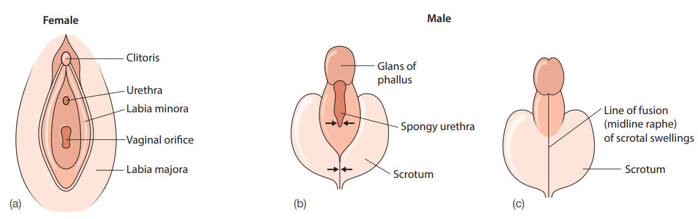

Slide 48
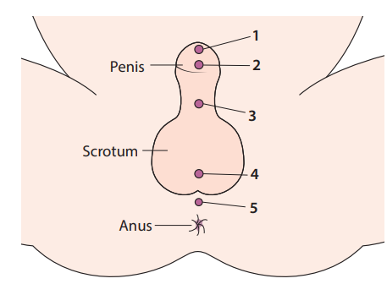

Slide 49
Sample questions

Slide 50
Self –quiz (T/F)
1. Regarding the pelvic splanchnic nerve: T/F
A. crosses the ischial spine medial to the pudendal artery
B. contains postganglionic parasympathetic visceral motor fibres
C. arises from the posterior primary rami of S2, S3 and S4
D. supplies motor fibres to the sigmoid colon
E. produces erection of the penis

Slide 51
Self –quiz (SBA)
2. A young man is admitted the day after falling off
his bicycle at speed. The next day he is found to
have passed no urine and examination reveals an
oedematous scrotum and tender swelling of the lower
abdominal wall. He is thought to have extravasated urine
following urethral trauma. Which part of his urethra is
most likely to have been damaged?
A. the prostatic urethra
B. the pre-prostatic urethra
C. the spongy urethra
D. the urinary bladder
E. the ureter

Slide 52
Self –quiz (short essay)
3.What anatomical knowledge is essential before male
urethral instrumentation is performed?

Slide 53
The learner should also read:
BD Charausia’s Human Anatomy (Theoretic framework)
Grants Atlas of Anatomy (quick facts and atlas)
Zuckerman’s A New System of Anatomy (Dissection guide)
Gray’s Review anatomy (Self assessment)

Slide 54
THANK YOU FOR YOUR ATTENTION

