Slide 1
Front of the Thigh and Femoral Triangle
Mr. M. Banda
University of Zambia

Slide 2
Objectives
Describe the muscles of the anterior; it’s origin, insertion, blood supply and nerve supply.
Describe the boundaries and contents of the femoral triangle.
Describe Clinical correlates of the anterior thigh muscles.

Slide 3
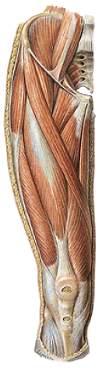
Anterior Compartment Muscles
Act on the hip and knee joints:
  Psoas major and iliacus
  Act on hip joint
  Sartorius and rectus femoris
  Act on both hip and knee joints
  Vastus muscles
  Act on the knee joint

Slide 4
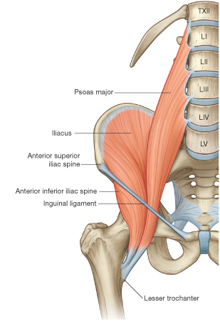
  Iliopsoas Muscle
Innervation
  Psoas major - anterior rami L1-L3
  Iliacus by femoral nerve
Action:
  Hip joint flexion

Slide 5
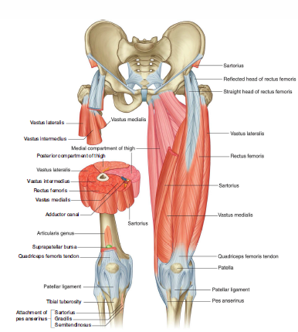
Quadriceps Femoris:
Rectus femoris
Vastus lateralis
Vastus medialis
Vastus intermedius

Slide 6
Rectus Femoris
Origin:
  Straight head: AIIS
  Reflected head: ilium just superior to the acetabulum

Slide 7
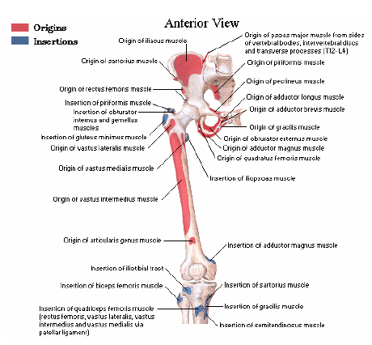
Vastus Lateralis
Origin: Femur
  Lateral part of intertrochanteric line
  Margin of greater trochanter
  Lateral margin of gluteal tuberosity
  Lateral lip of linea aspera

Slide 8
Vastus Medialis
Origin: Femur
  Medial part of intertrochanteric line
  Pectineal line
  Medial lip of the linea aspera
  Medial supracondylar line

Slide 9
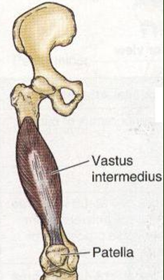
  Vastus Intermedius
Origin:
  Upper 2/3rd of anterior an lateral surfaces of femur

Slide 10
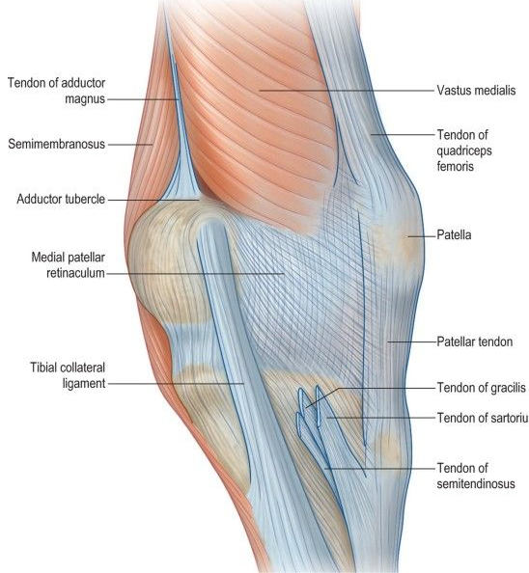
Insertion of Quadriceps Femoris
Nerve supply:
    All innervated by femoral nerve
Action:
  Knee extension
  Hip flexion - Rectus femoris

Slide 11
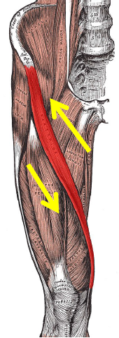
Sartorius
Origin:
  ASIS
Insertion:
  just inferomedial to tibial condyle
Nerve supply:
  Femoral nerve [L2,L3]
Action:
  Hip joint and knee joint flexion

Slide 12
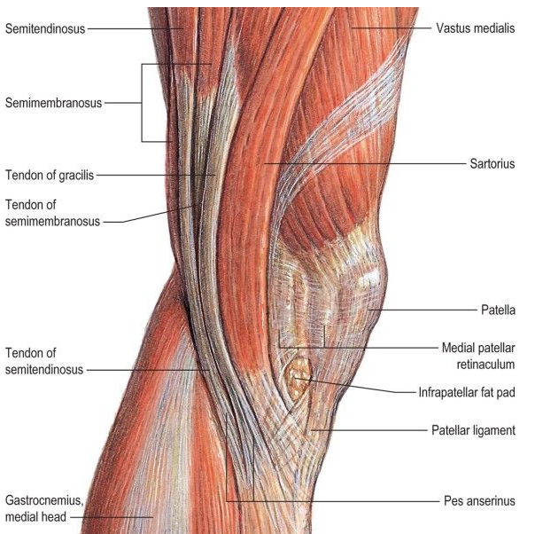
Insertion of Sartorius Muscle

Slide 13
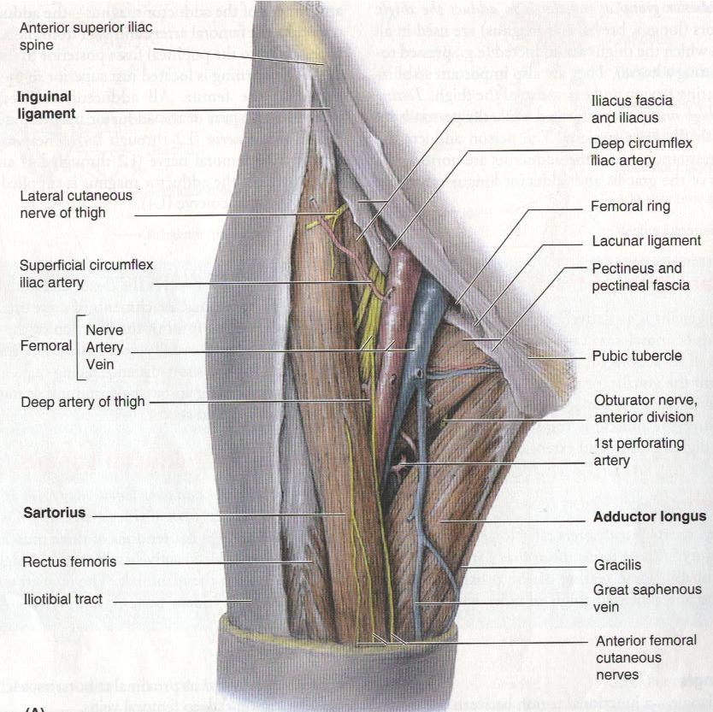
Femoral Triangle
Triangular depression on front of upper 1/3rd of thigh immediately below inguinal ligament

Slide 14
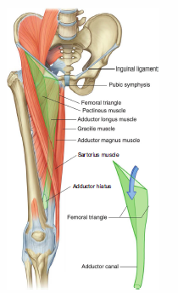
Femoral Triangle: Boundaries
1. Medial Border
Medial margin of the adductor longus muscle
2. Lateral Border
Medial margin of the sartorius muscle
3. Base
Inquinal ligament
4. Apex
Meeting point of the medial and lateral borders

Slide 15
6. Floor:
Adductor longus and pectineus muscles medially
Psoas major and iliacus muscles laterally
5. Roof:
- Skin
- Superficial fascia containing:
  Superficial inguinal lymph nodes
  Femoral branch of genitofemoral nerve
  Ilioinguinal nerve branches
  Superficial branches of the femoral artery/vein
  Upper part of great saphenous vein
- Deep fascia with saphenous opening/cribriform fascia

Slide 16
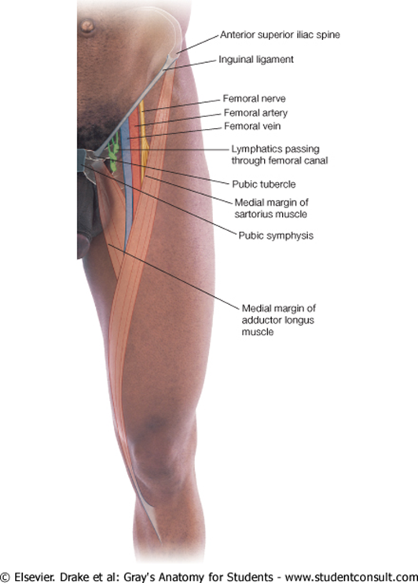
Contents
Femoral artery/branches
Femoral vein/tributaries
Femoral sheath
Nerves:
  Femoral nerve (lies outside femoral sheath
  Nerve to pectineus
  Femoral branch of genitofemoral nerve
  Lateral cutaneous nerve of thigh
5. Deep inguinal lymph nodes

Slide 17
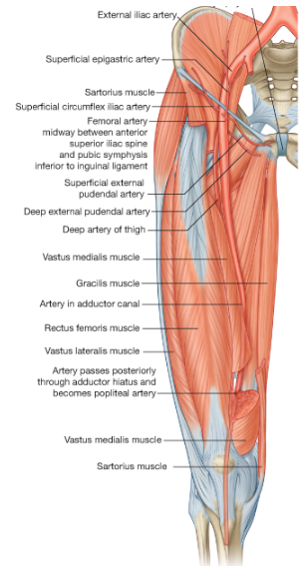
Femoral Artery
Chief artery of lower limb
Starts behind inguinal ligament at mid-inguinal point
Passes downwards and medially, first in femoral triangle and then into adductor canal
At junction of middle and lower thirds of thigh passes via opening in adductor magnus (adductor hiatus) to become popliteal artery

Slide 18
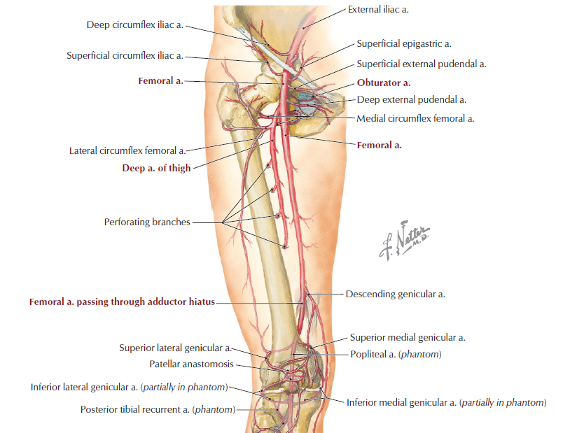
Branches of Femoral Artery
Superficial branches:
  Superficial external pudendal
  Superficial epigastric
  Superficial circumflex iliac
Deep branches:
1. Profunda femoris
  Medial circumflex femoral artery
  Lateral circumflex femoral artery
  Four perforating arteries
2. Deep external pudendal
3. Muscular branches

Slide 19
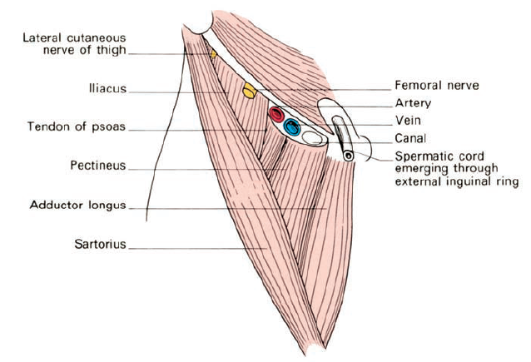
Relations of Femoral Artery in Femoral Triangle
Anterior: skin, fascia (superficial and deep), femoral sheath
Posterior: psoas major, pectineus, adductor longus
Medial: femoral vein just below inguinal ligament
Lateral: femoral nerve in upper part of artery, lower part of artery is related to branches of femoral nerve

Slide 20
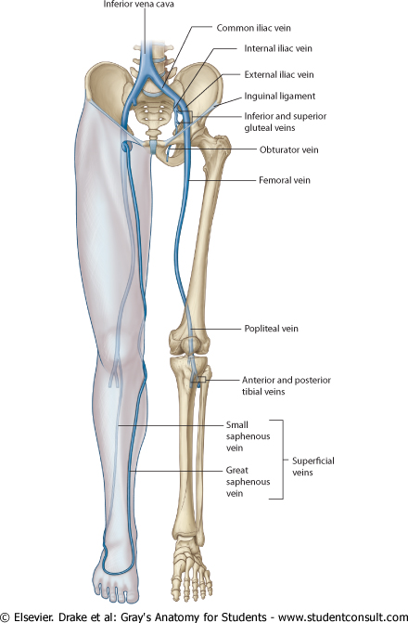
Femoral Vein
Continuation of popliteal vein at lower end of adductor canal
Tributaries:
  Great saphenous vein
  Veins accompanying 3 deep branches of femoral artery
  Lateral and medial circumflex femoral veins
  Descending genicular and muscular veins in adductor canal

Slide 21
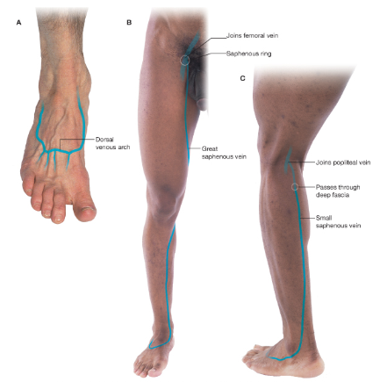
Great Saphenous Vein
Largest and thickest Superficial vein of lower limb
Enters femoral vein through the saphenous opening

Slide 22
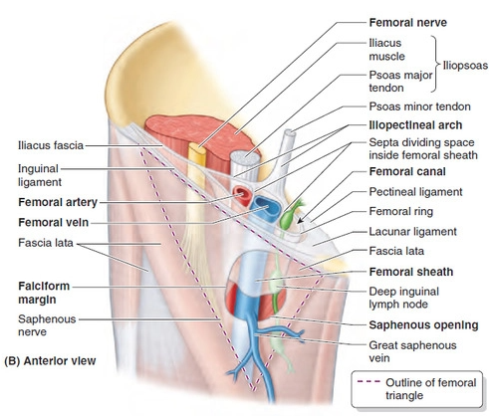
Femoral Sheath
Divided into 3 compartments by septa:
a. Lateral or arterial:
  Femoral artery
  Femoral branch of Genitofemoral nerve
b. Intermediate or venous:
  Femoral vein
c. Medial or lymphatic:
- Also known as femoral canal
contains lymph nodes

Slide 23
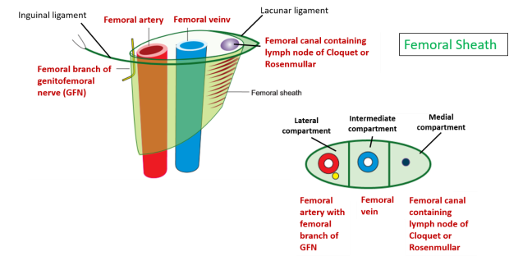
Femoral Sheath

Slide 24
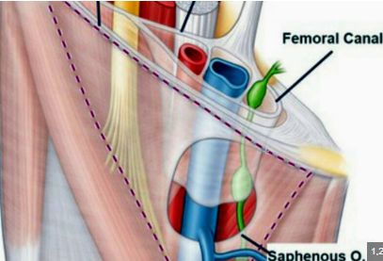
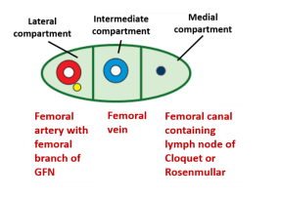
Femoral Canal
Conical in shape
About 1.5cm long and 1.5 cm at base
Base called femoral ring
Boundaries of femoral ring:
  Anterior: inguinal ligament
  Posterior: pectineus/fascia iliaca
  Lateral: septum separating medial & intermediate septum
  Medial: lacunar ligament

Slide 25
Femoral Canal Contents
Lymph node of Cloquet - drains glans penis
Lymph node of Rosenmuller - drains clitoris
Lymphatics
Areolar tissue

Slide 26
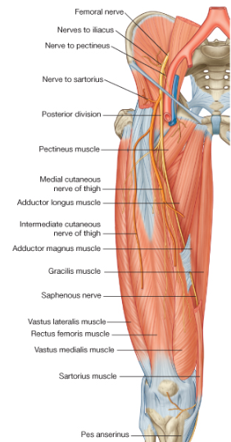
Femoral Nerve
Chief nerve of anterior compartment of thigh
Biggest branch of lumbar plexus
Formed by dorsal divisions of anterior primary rami of spinal nerves (L2,L3,L4)
Lies in groove between iliacus and psoas major muscles, outside femoral sheath and lateral to femoral artery

Slide 27
Branches of Femoral Nerve
Muscular:
  Anterior division: sartorius
  Posterior division: rectus femoris, 3 vasti and articularis genu (supplied by nerve to V. intermedius)
Cutaneous:
  Anterior division - two divisions: intermediate and medial cutaneous nerves of thigh
  Posterior division (1): saphenous nerve
Articular:
  Hip joint: nerve to rectus femoris
  Knee joint: nerves to 3 vasti
Vascular:
To femoral artery and its branches

Slide 28
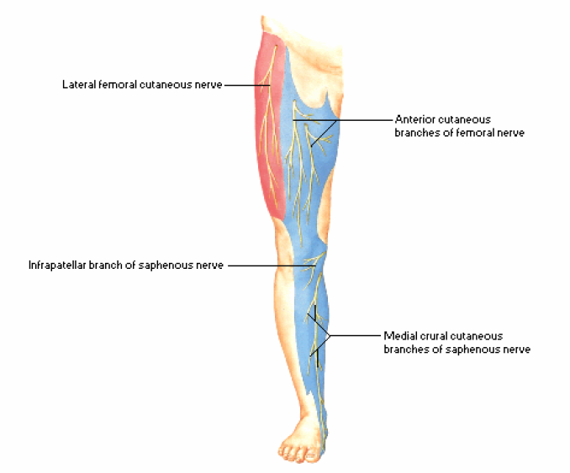
Cutaneous Innervation
Anterior cutaneous nerve of the thigh, a branch of intermediate cutaneous nerve

Slide 29
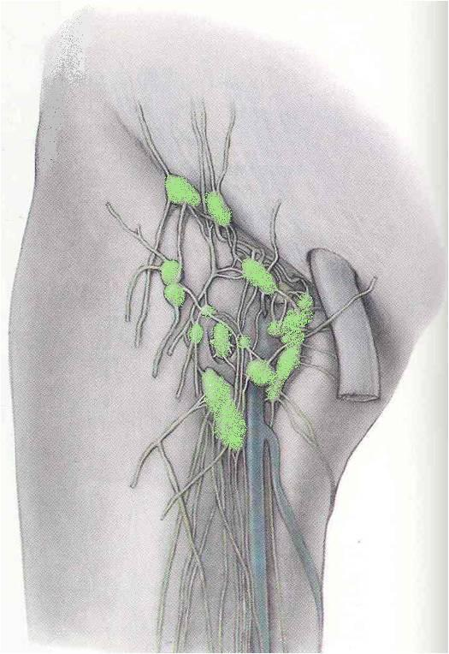
Inguinal Lymph Nodes
Superficial Inguinal Lymph Nodes
Horizontal group
  Lies just below and parallel to inguinal ligament
Vertical group
  Lies along the terminal part of great saphenous vein.

Slide 30
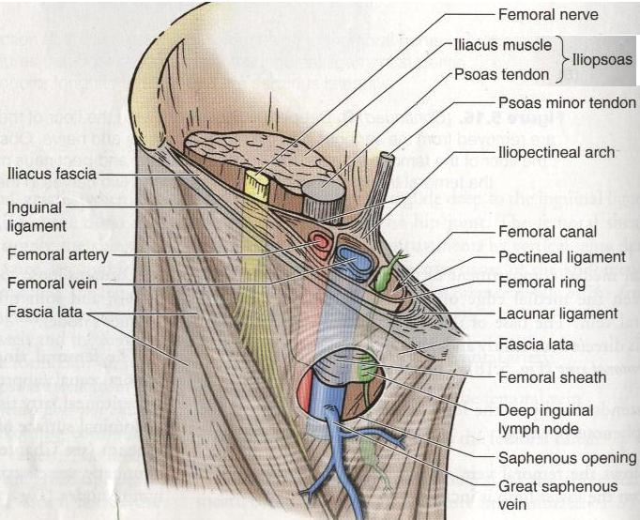
2. Deep Inguinal lymph Nodes
Receive all lymph from superficial inguinal nodes via lymph vessels that pass through the cribriform fascia of the saphenous opening.
Receive lymph from deep structures of the lower limb

Slide 31
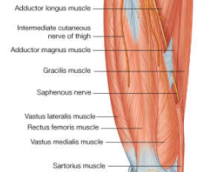
Adductor (Subsartorial/Hunter’s) Canal
An intermuscular cleft situated on medial aspect of middle third of thigh beneath the sartorius muscle
Shape: Triangular
Boundaries:
  Anteromedial wall
    Sartorius muscle and fascia.
  Posterior wall
    Adductor longus and magnus muscles
  Lateral wall
    Vastus medialis muscle

Slide 32
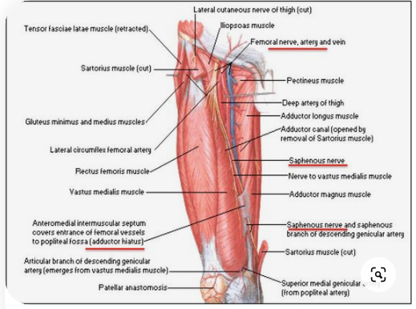
Contents of Adductor Canal
  Femoral artery
  Femoral vein
  Saphenous nerve
  Nerve to vastus medialis
  Branches of two divisions of obturator nerve

Slide 33
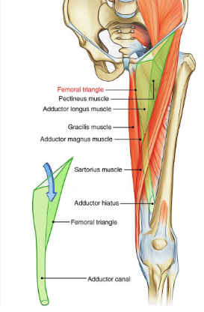
Subsartorial Plexus
Lies on fibrous roof of canal under cover of sartorius muscle
Formed by branches of:
  Medial cutaneous nerve of thigh
  Saphenous nerve
  Anterior division of obturator nerve

Slide 34
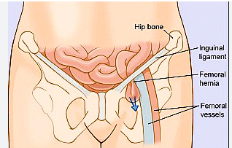
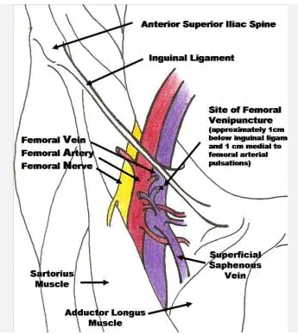
Applied Anatomy
Femoral hernia
Femoral tap

Slide 35
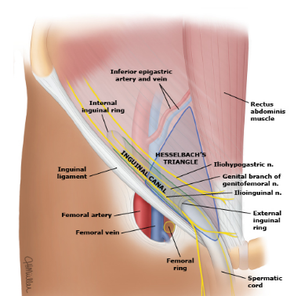
Applied Anatomy
Femoral hernia

Slide 36
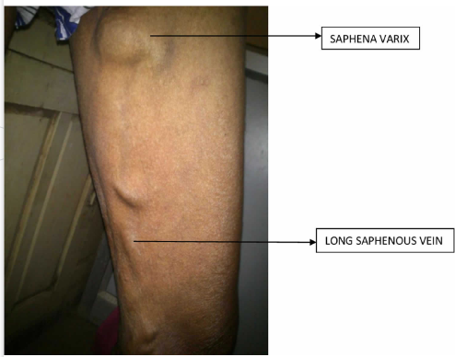
Applied Anatomy
Saphena varix - dilation of the great spheneous vein
Adductor canal block - local anaesthetic is administered in the adductor canal to block the saphenous nerve in isolation, or together with the nerve to the vastus medialis.

Slide 37
Reference Books
1. Standring, Susan and Standring (2015).Gray's anatomy. 41st International edition, Elsevier Health Sciences. ISBN 9780702052309.
2. Keith L. Moore, Arthur F. Dalley, Anne M. R. Agur (2017). Moore's Clinically Oriented Anatomy, 8th edition, Walter Kluwer. ISBN 9781496347213.
3. Alan J. Detton (2020). Grant’s Dissector. 17th edition, Lippincott Williams & Wilkins. ISBN 9781975134600.
4. Adrian Kendal Dixon, David J. Bowden, Bari M. Logan and Harold Ellis (2017). Human Sectional Anatomy - Pocket atlas of body sections, CT and MRI images, 4th edition, CRC Press. ISBN 9781498708548.

Slide 38
The end
Thank You!

