Slide 1
Bony pelvis, fasciae and ligaments
Mbawe Zulu

Slide 2
The learner should be able to:
1. Describe the skeletal components: hip bone, sacrum and coccyx
2. Demonstrate palpable land marks of the ilium, ischium and pubis
3.Describe ligamentous components of the pelvis
4. Describe the anatomy of the pelvic inlet and outlet and recognise their normal orientation.
5.Explain sexual differences in pelvic skeletal anatomy.
6. Interpret standard medical images
7. Use knowledge to solve relevant medical science and clinical problems

Slide 3
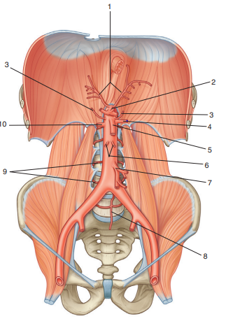

Slide 4
Pelvis in general
Basin between abdomen and perineum with:
1.superior pelvic aperture
2.inferior pelvic aperture &
3.Four gateways.which one(s)?
Walls made up of:
bones,
ligaments &
muscles
Pelvic brim divides it into:
1.False pelvis &
2.True pelvis

Slide 5
Pelvis in general
Four Major Joints
Bilateral Sacroiliac joints (Gliding synovial type)
2. Median Pubic symphysis (Secondary cartilaginous joint)
3. Median Sacrococcygeal joint (Secondary cartilaginous joint)
Others
i.Triradiate cartilage (Synchondrosis)→ synostosis with age.
ii.Posterior sacroiliac interosseous (syndesmosis)

Slide 6
Pelvis in general
1.It protects the pelvic viscera.
2.It supports the weight of the body which is transmitted through the vertebrae, thence through the sacrum, across the sacroiliac joints to the innominate bones and then to the femora in the standing position or to the ischial tuberosities when sitting.
3.During walking the pelvis swings from side to side by a rotatory movement at the lumbosacral articulation which occurs together with similar movements of the lumbar intervertebral joints. Even if the hip joints are fixed, this swing of the pelvis enables the patient to walk reasonably well.
4.As with all but a few small bones in the hand and foot, the pelvis provides attachments for muscles.
5.In the female it provides bony support for the birth canal.

Slide 7
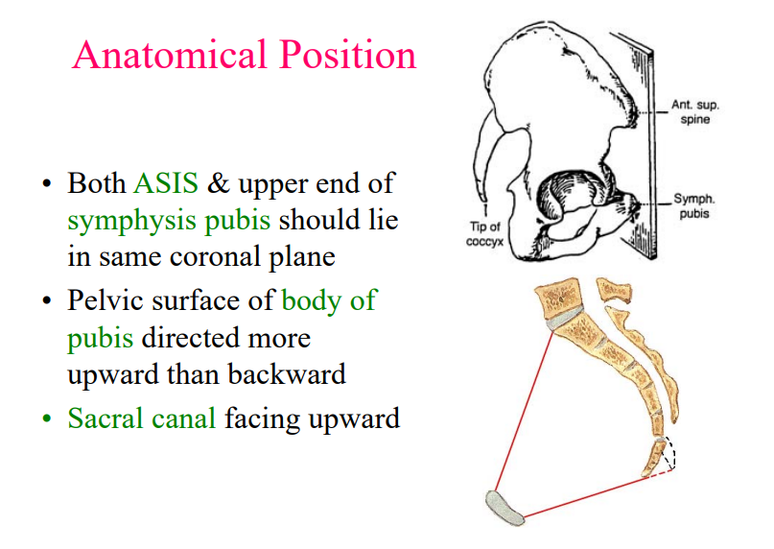

Slide 8
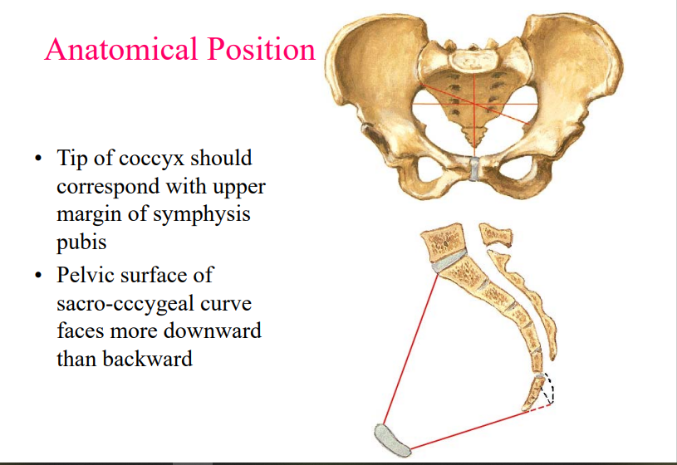

Slide 9
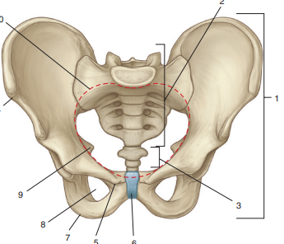
Superior pelvic aperture

Slide 10
Superior pelvic aperture
Divides the bony pelvis into:
False pelvis above
True pelvis below
The boundaries of the pelvic inlet include:
1.The promontory of the sacrum
2.The arcuate line of the ilium
3.The iliopubic eminence
4.The pectineal line
5. The pubic crest
6 The symphysis pubis.

Slide 11
Structures that pass through the superior pelvic aperture
1. Median sacral vessels
2. Sympathetic trunk
3. Lumbosacral trunk
4. Iliolumbar artery
5. Obturator nerve
6. Internal iliac vessels
7. Medial limb of sigmoid mesocolon with superior rectal vessels - left side
Only
8. Ureters

Slide 12
Structures that pass through the superior pelvic aperture
9. Sigmoid colon - on left side only
10. Ovarian vessels in female
11. Ductus deferens in male/round
ligament of uterus in female
12. Lateral umbilical ligament
13. Median umbilical ligament
14. Lymphatics
15. Autonomic nerve
plexuses
16. Coils of intestine
17. Pregnant uterus
18. Full urinary bladder

Slide 13
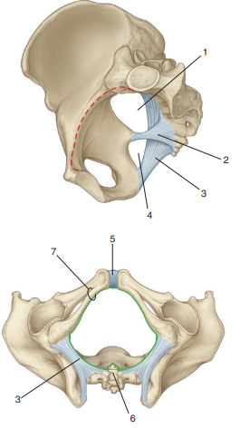
Inferior pelvic aperture

Slide 14
Inferior pelvic aperture: boundaries
The pelvic outlet is widest from front to back and lies between:
1.The lower border of the symphysis pubis anteriorly
2.The ischial tuberosities laterally
3.The tip of the last sacral vertebra posteriorly

Slide 15
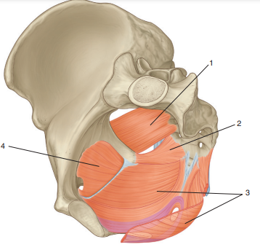
Muscles & other apertures

Slide 16
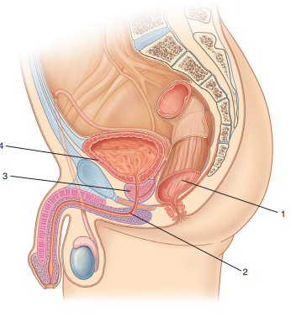
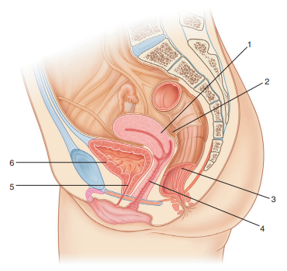
Female
Male

Slide 17
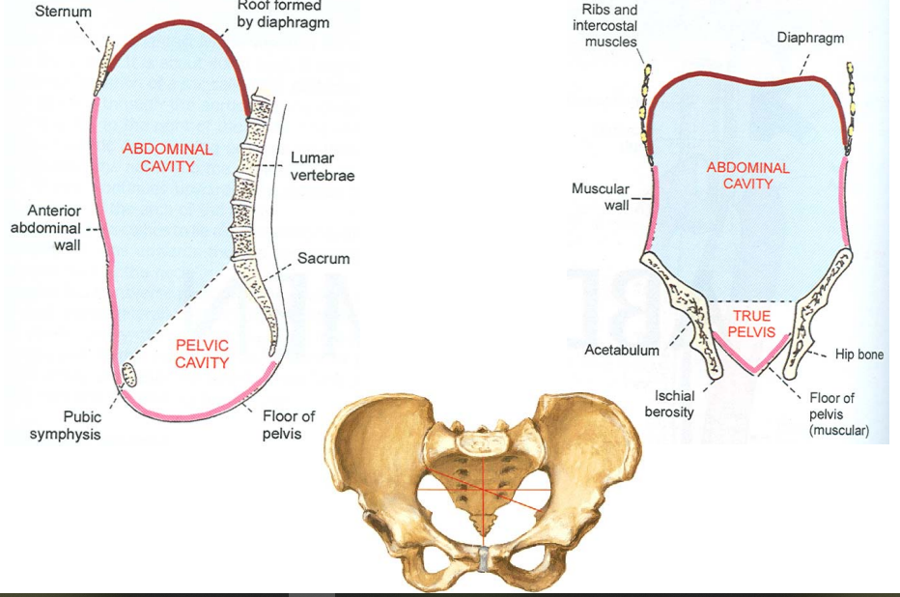

Slide 18
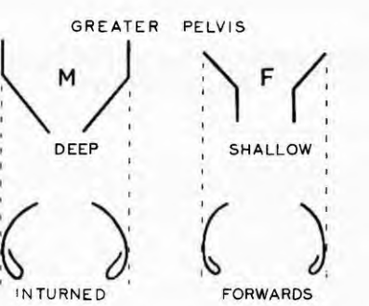

Slide 19
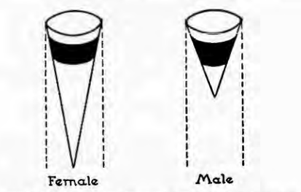

Slide 20
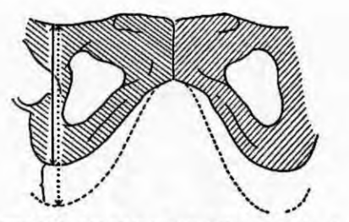

Slide 21
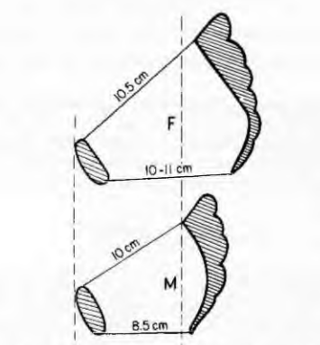

Slide 22
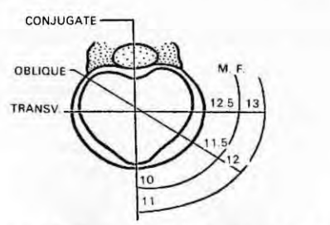

Slide 23
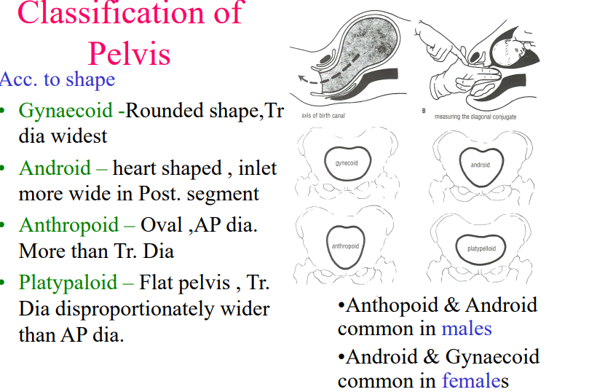

Slide 24
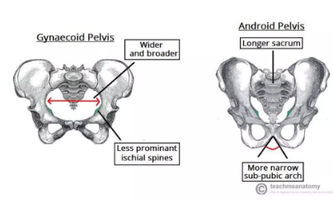

Slide 25
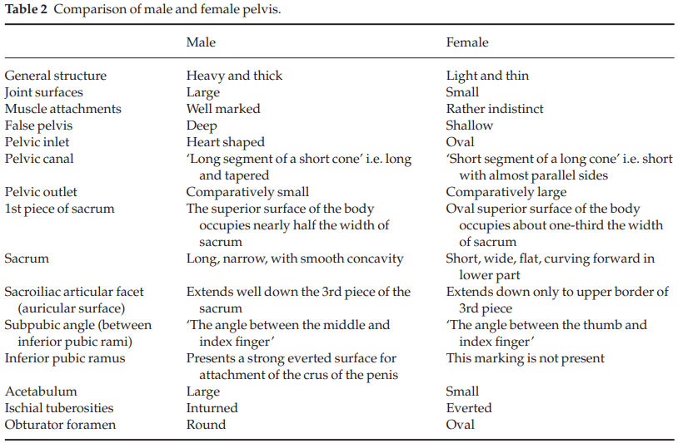

Slide 26
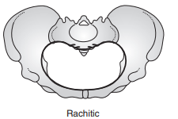

Slide 27
Other classes of the bony plevis
1.Rachitic pelvis –
typical of rickets and the result of vitamin D deficiency.
The sacral promontory projects forwards reducing the anteroposterior diameter
2.The contracted pelvis –
can be symmetrical associated with a small stature, or asymmetrical due to a variety of disease processes
A narrow (gothic) subpubic arch foreshortens the effective pelvic outlet because the narrow anterior triangle (the waste space of Morrison) cannot accommodate the fetal head.
In such circumstances, more space is required posteriorly to enable vaginal delivery

Slide 28
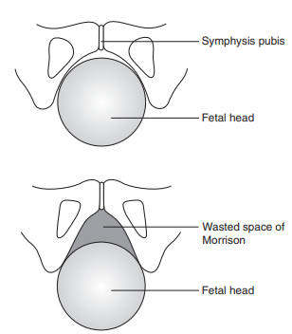

Slide 29
Osteology of the pelvis
Sacrum

Slide 30
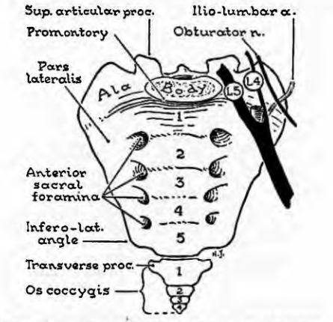

Slide 31
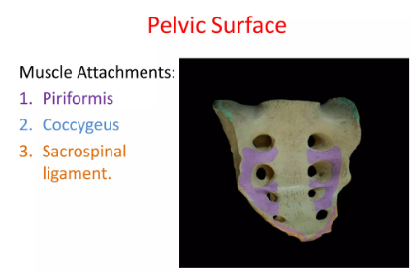

Slide 32
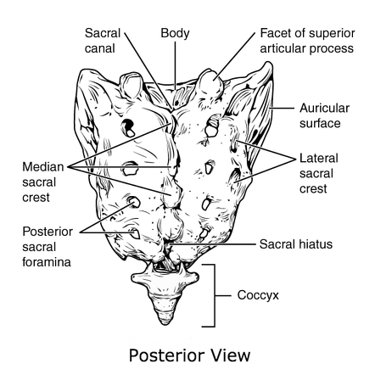

Slide 33
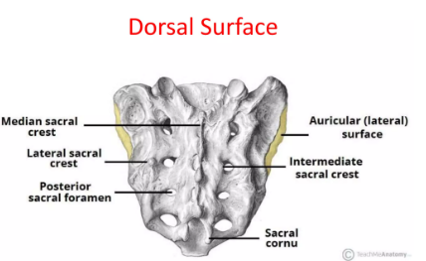

Slide 34
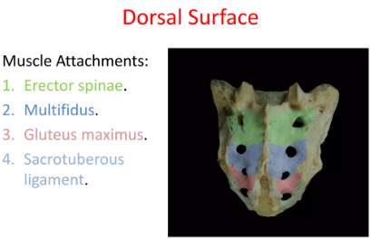

Slide 35
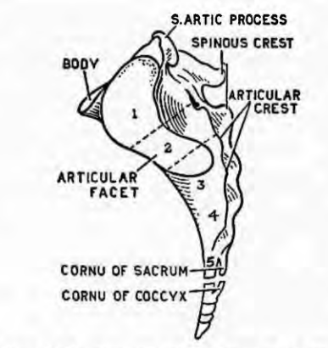

Slide 36
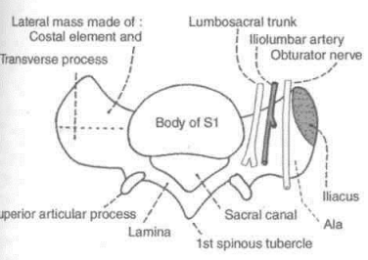

Slide 37
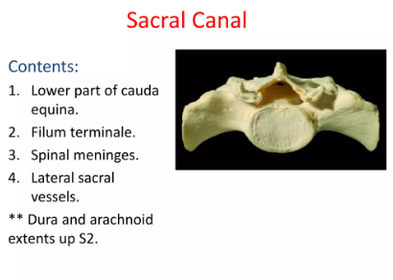

Slide 38
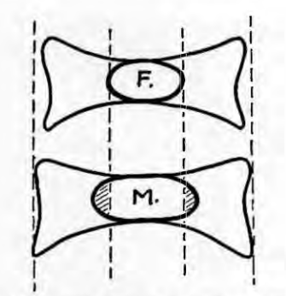

Slide 39
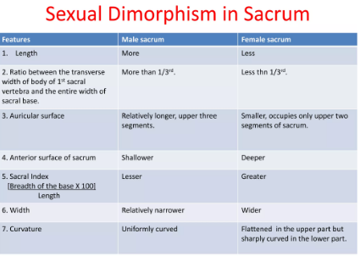

Slide 40
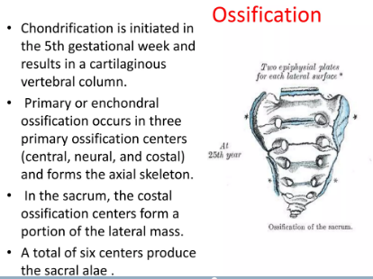

Slide 41
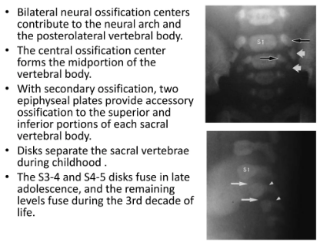

Slide 42
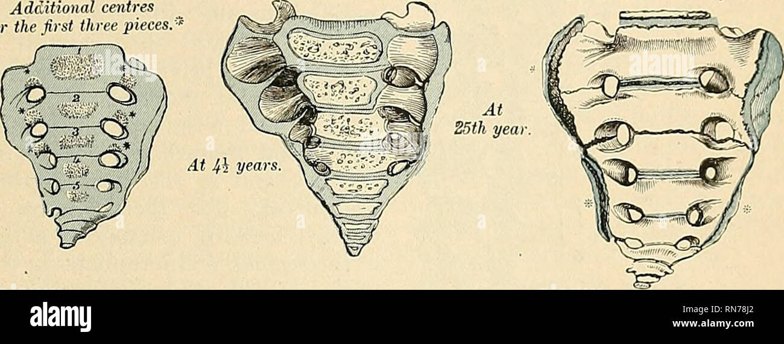

Slide 43
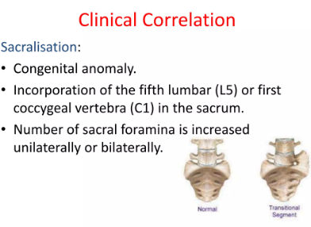

Slide 44
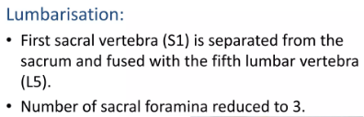

Slide 45
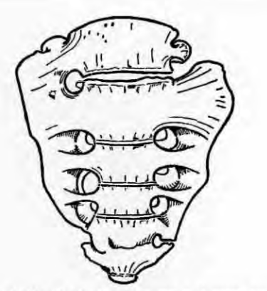

Slide 46
Osteology of the pelvis
Os innominatum

Slide 47
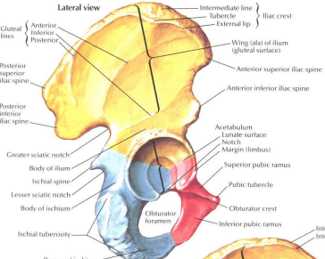

Slide 48
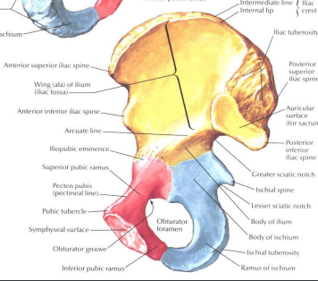

Slide 49
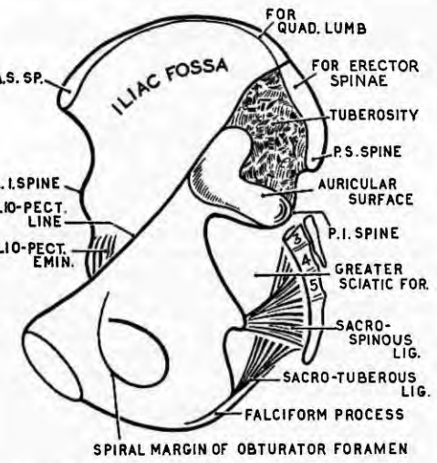

Slide 50
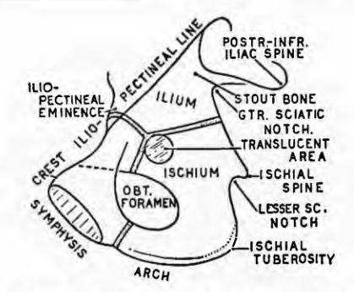

Slide 51
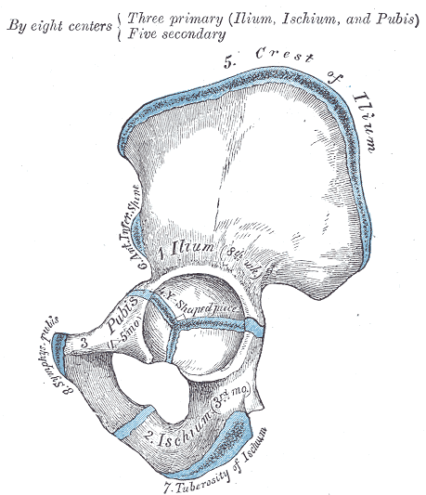

Slide 52
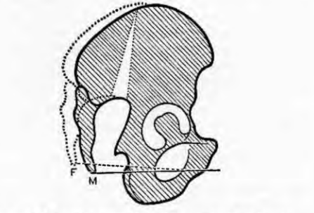

Slide 53
Surface anatomy of the pelvis
A. Bilateral dimples above the buttocks
Centre of the sacroiliac joint
2. Posterior superior iliac spine
3. Level of S2
4. Level of the end of the dural canal and of the spinal meninges

Slide 54
Surface anatomy of the pelvis cont’d
B. Relations of the sacroiliac joint
1.Psoas muscle/tendon
2.Genitofemoral nerve
3. Common iliac bifurcation
4. Ureter
5. Inferior mesenteric artery and apex of sigmoid mesocolon on the left
6. Iliac branches of iliolumbar artery.

Slide 55
Pelvic ligaments

Slide 56
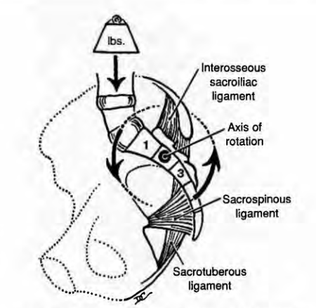

Slide 57
Vertebropelvic ligaments
1. Sacrospinous ligament: from the lower lateral aspect of the sacrum and the upper lateral aspect of the coccyx to insert into the ischial spine
2. Sacrotuberous ligament is extremely strong opposing the forward tilting of the sacral promontory.
It also originates from the lower lateral aspect of the sacrum and the upper lateral aspect of the coccyx inserting into the inner aspect of the ischial tuberosity
The sacrospinous and sacrotuberous ligaments convert the greater and lesser sciatic notches into foramina

Slide 58
Vertebropelvic ligaments
3.liolumbar – this V-shaped ligament extends from the transverse process of L5 to the iliac crest above, and the ventral portion of the sacroiliac ligament below (lumbosacral ligament)
4. Suprapubic
5. Subpubic/arcuate
6. Anterior interpubic
7. Posterior interpubic

Slide 59
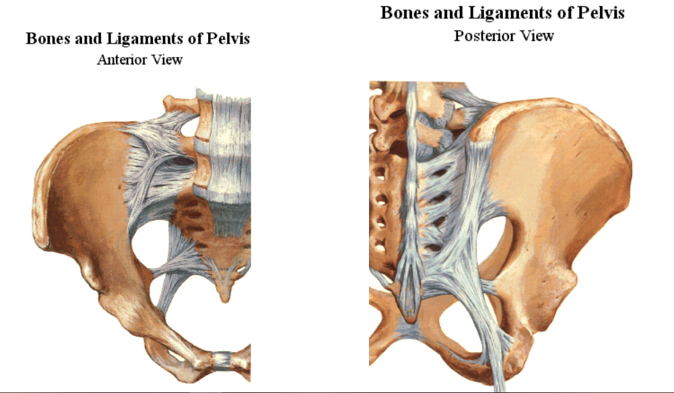

Slide 60
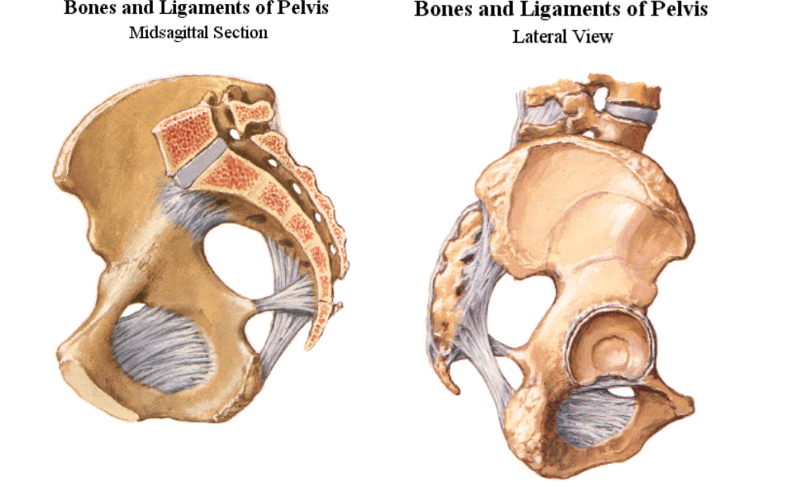

Slide 61
Pelvic fascia

Slide 62
General
Visceral or endopelvic fascia surround viscus and bind them to each other and to the parietal fascia
Parietal fascia lines the pelvic walls as well as part of the pelvic floor (superior and inferior fasciae of the pelvic diaphragm)
Parietal fascia is separated from the from parietal peritoneum by extraperitoneal fat
The parietal fascia attaches to the attaches to the periosteum of the ilium just inferior to the pelvic brim
The parietal pelvic fascia covers the pelvic surfaces of the obturator internus, piriformis, coccygeus, sphincter urethrae and the levator ani.

Slide 63
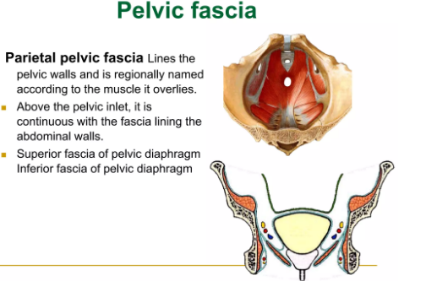

Slide 64
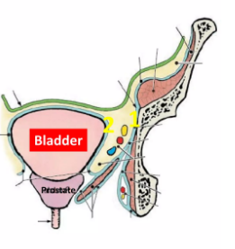

Slide 65
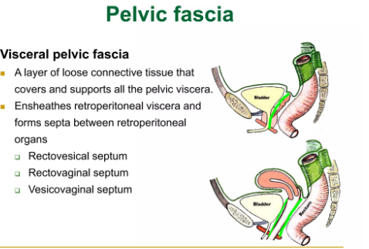

Slide 66
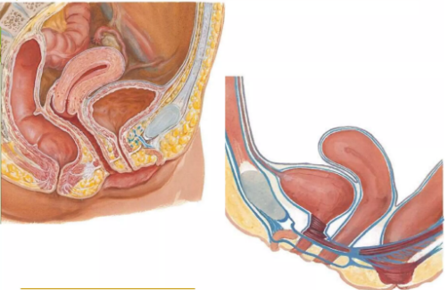

Slide 67
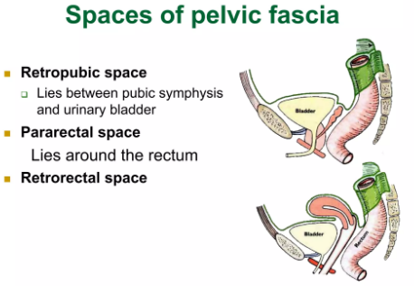

Slide 68
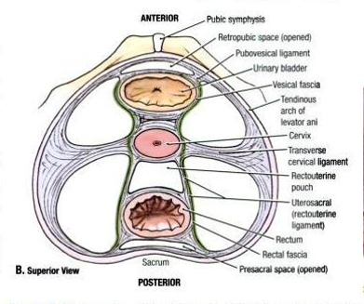

Slide 69
Fascial ligaments
Musculofibrous bands form from condensed connective tissue over the levator ani muscles and insert into the cervix and upper vagina to form important supports of the:
Urinary bladder
2. Uterus
3. Vagina and
4. Rectum

Slide 70
Fascial ligaments
Pubocervical ligament
arises from fascia over the pubic bones and passes around the bladder neck
2. The transverse cervical (cardinal) ligaments
arise from the arcuate line on the pelvic side wall
3. The uterosacral ligaments
arise from the second sacral vertebra, are almost vertical when the woman is standing upright.
As such, they pull the cervix backwards which not only supports the uterus and vagina but maintains the uterus in an anteverted position.

Slide 71
Applied aspects
1. The upper limit of freely mobile peritoneum on the anterior surface of the uterus is a good reliable landmark identifying the junction of lower and upper segments of the uterus at caesarean section
2.Lateral to the inferior portion of the cervix, the ureter lies under the uterine vessels as it passes forwards and medially to enter the bladder. As it is within 1–2 cm of the lateral vaginal fornix, care must be taken to identify, reflect and avoid damage to it at hysterectomy
3. In the fetus, the round ligament is surrounded by a tube of peritoneum, the processus vaginalis, which is usually obliterated at birth, but may remain patent as the canal of Nuck, the rare indirect inguinal hernia in females.

Slide 72


Slide 73
Modality? View? Adult? Female? Justify
Iliac crest
Ilium
Anterior sacral foramina
Sacroiliac joint
Anterior superior iliac spine
Anterior inferior iliac spine
Ischial spine
Superior pubic ramus
Obturator foramen
Inferior pubic ramus
Ischial tuberosity
Symphysis pubis
Coccyx
Femur
Lesser trochanter
Greater trochanter
Femoral neck
Femoral head
Acetabulum

Slide 74
The learner should also read
Garg K (ed.).2023.BD Chaurasia’s Human Anatomy: Regional and applied: Dissection and clinical,vol 2 (9th ed)

Slide 75
THANK YOU FOR YOUR ATTENTION

