Slide 1
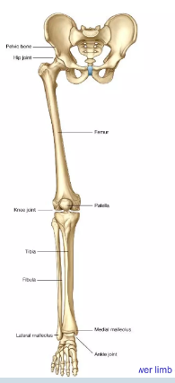
LOWER LIMB OSTEOLOGY

Slide 2
Learning Objective:
Name the bones of the lower limb.
Identify their prominent markings.

Slide 3
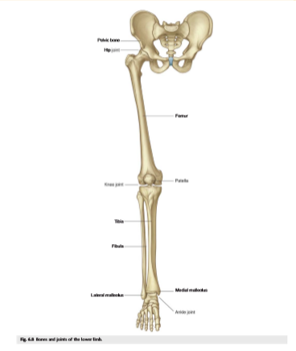
Osteology of lower limb
The skeleton of lower limb is subdivided into:
Hip bone
Bones of free lower limb.
The right and left hip bones together with sacrum and coccyx form the skeleton of pelvis.
In standing position, the weight of the body is transmitted from the vertebral column bilaterally to the hip bones, hip joints, femurs, knee joints, tibias, ankle joints and the bones of the feet in succession

Slide 4

CONT’
Pelvic bone
Femur
Tibia
Fibula
Patella
Tarsal bones
Metatarsal
phalanges

Slide 5
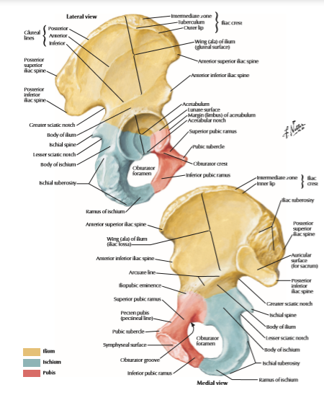
Pelvic bone
Pelvic Bone or Innominate Bone The hip bone is an irregular bone made up of three components,
Ilium,
Pubis and
Ischium
unite to each other at the acetabulum.

Slide 6
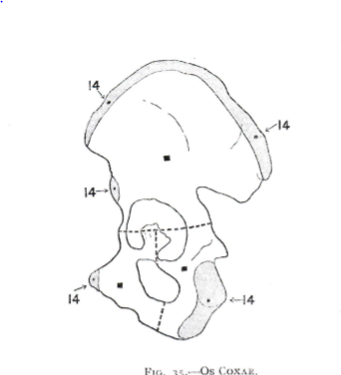
Ossification
The ilium, ischium and pubis have:
Three Primary ossification centres are 2nd , 3rd and 4th month.
Five secondary centres ossifies around puberty for crest, pubic symphysis, anterior inferior iliac spine, ischial tuberosity and acetabula cartilage.
Unite in the 25th year

Slide 7
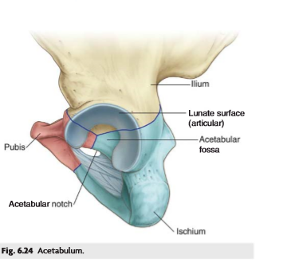
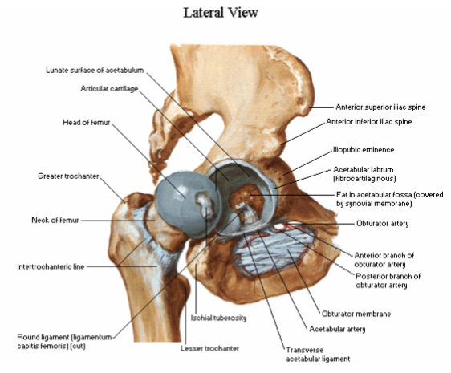
Acetabulum
It is a cup-shaped cavity facing laterally and directed towards the lower limb.
The ilium, ischium and pubis take part in its formation.
It presents a horse shoe shaped articular surface and a nonarticular acetabular fossa.
At birth, the acetabulum presents Y-shaped cartilage known as triradiant ligament.
Puberty, two secondary centers appear in this cartilage to complete the ossification of acetabulum 17 years.
If the acetabulum is fractured before the age of 17 it breaks into three pieces.

Slide 8
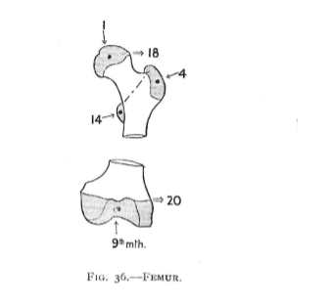
Femur ossification
Primary centres
Shaft 17th week
Secondary centres
Head 1st year
Greater trochanter 4th year
Lesser trochanter 14th year
Unite with shaft 18th year
Distal end 9th month
Unite with shaft in 20th year

Slide 9
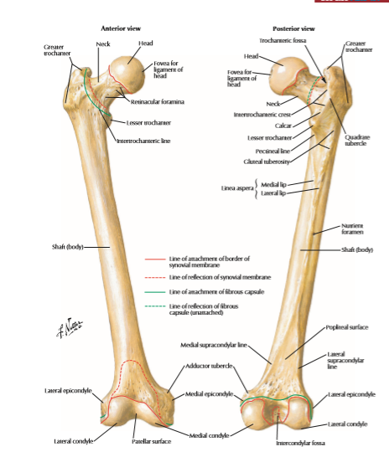
Femur
The femur is the longest and strongest bone in the body.
The femur consists of
i. Head
ii Neck
Iii. Shaft
Iv. Distal end

Slide 10
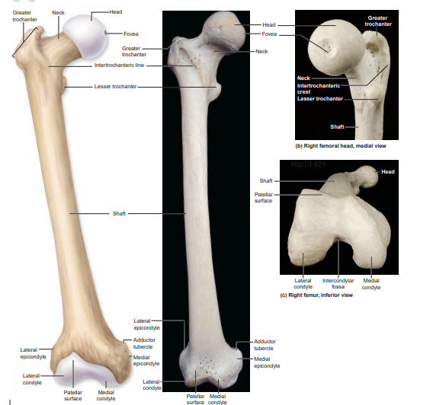

Slide 11
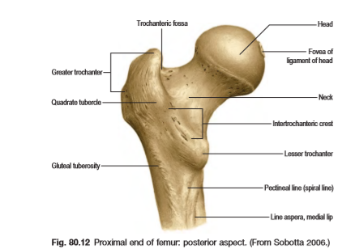
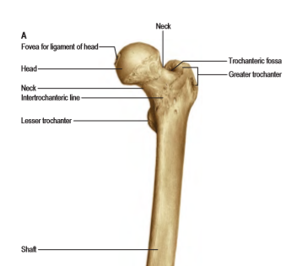
Cont,

Slide 12
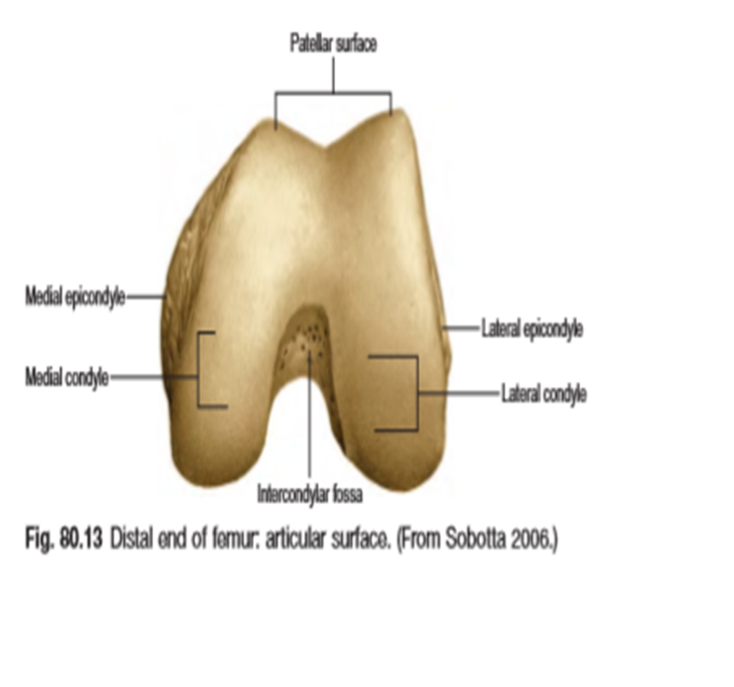
Cont,
The distal end of the femur bears two large condyles;
medial
lateral,
Intercondylar notch or fossa is on posterior aspect.
Anterior surface of distal end bears patellar articular area.
Articular cartilage for articulating with proximal surface of tibia

Slide 13
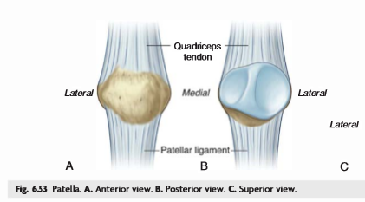
Patella
The patella is the largest sesamoid bone in the body.
i. It develops in the tendon of quadriceps femoris.
ii. lies in front of the knee joint.
iii. The patella functions as both lever and pulley.
As a lever the patella magnifies the force exerted by quadriceps femoris during extension of knee.
As a pulley the patella alters the direction of the pull of quadriceps for better efficiency.
Primary centre of ossification is at 3rd year

Slide 14
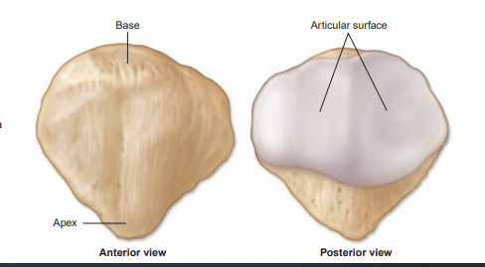

Slide 15
Clinical anatomy
Fractures
Dislocation
Osteoarthritis
Avascular necrosis

Slide 16
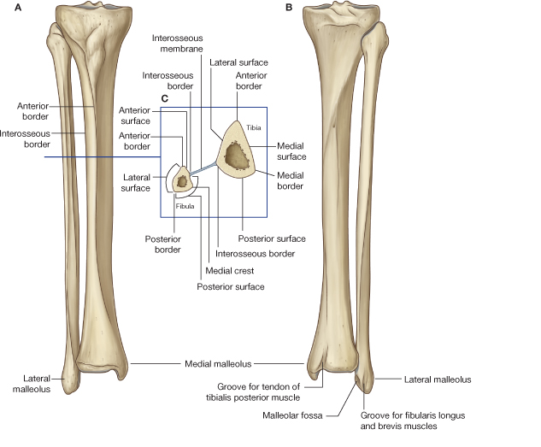
Tibia and Fibula
Tibia
  Receives the weight of body from femur and transmits to foot
  Second to femur in size and weight
  Articulates with fibula proximally and distally
    Interosseous membrane - Bones are connected by an interosseous membrane composed of dense regular connective tissue
Fibula
  Does NOT bear weight
  Muscle attachment
  Not part of knee joint
  Stabilize ankle joint

Slide 17
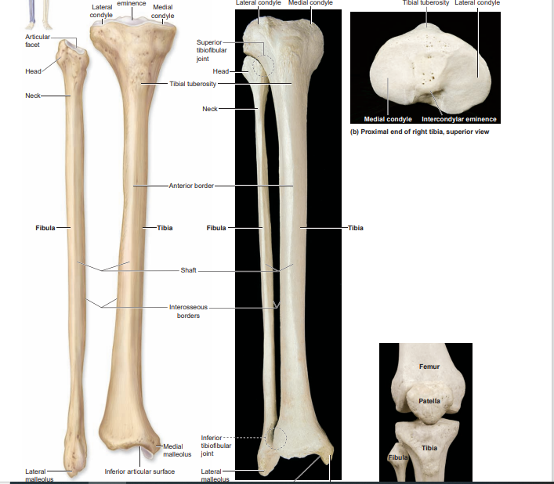

Slide 18
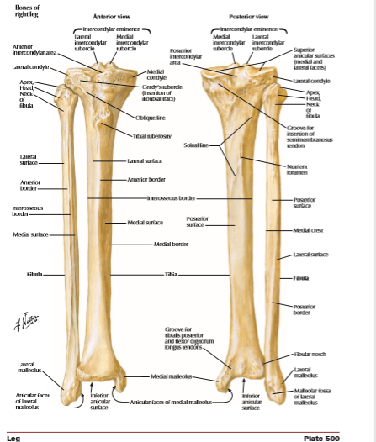

Slide 19
ossification
Primary centres
Shaft of tibia 7th week distal end of fibula 2nd year
Shaft of fibula 8th week unite 21st year
Secondary centres
Proximal end of tibia 1st year
Proximal end of fibula 4th year
Unite with shaft at 24th year
Distal end of tibia 2nd year
Unite at 18th year
distal

Slide 20
CLINICAL ANATOMY
UPPER END OF TIBIA COMMON SITE FOR OSTEOMYELITIS
FRACTURES OF TIBIA UPPER 2/3 AND LOWER 1/3 OF SHAFT
FIBULAR IDEAL BONE FOR BONE GRAFTING

Slide 21
FOOT
Function:
  Supports the weight of the body
  Act as a lever to propel the body forward
Parts:
  Tarsals
    Talus = ankle
      Between tibia and fibula
      Articulates with both
    Calcaneus = heel
      Attachment for Calcaneal tendon
      Carries talus
    Navicular
    Cuboid
    Medial, lateral and intermediate cuneiforms
  Metatarsals
  Phalanges

Slide 22
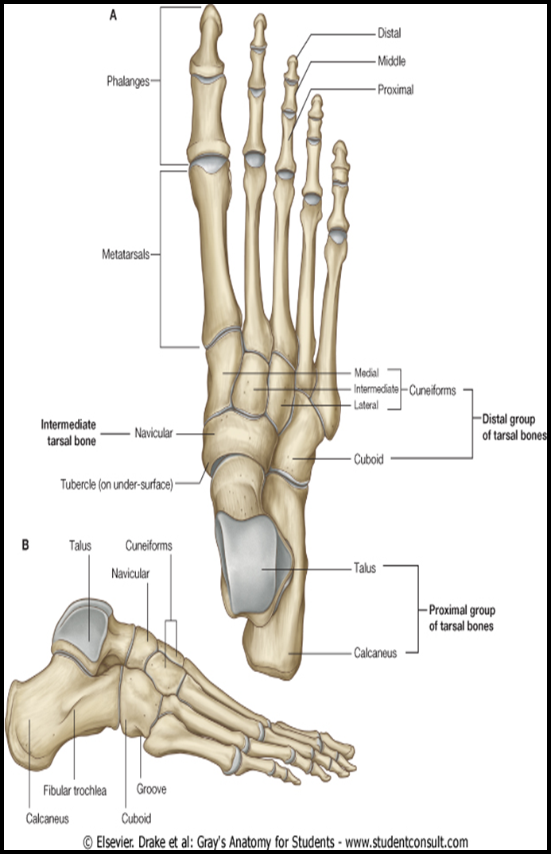

Slide 23
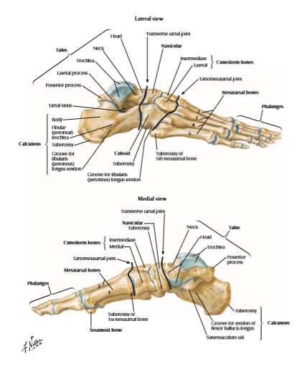
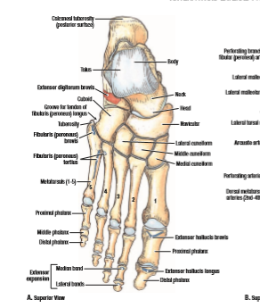
Foot

Slide 24
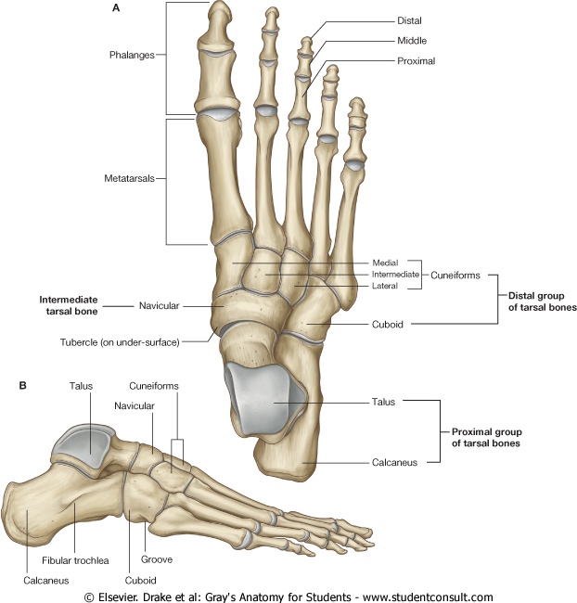
Cont,
Function:
  Supports the weight of the body
  Act as a lever to propel the body forward
Parts:
  Tarsals
    Talus = ankle
      Between tibia and fibula
      Articulates with both
    Calcaneus = heel
      Attachment for Calcaneal tendon
      Carries talus
    Navicular
    Cuboid
    Medial, lateral and intermediate cuneiforms
  Metatarsals
  Phalanges

Slide 25
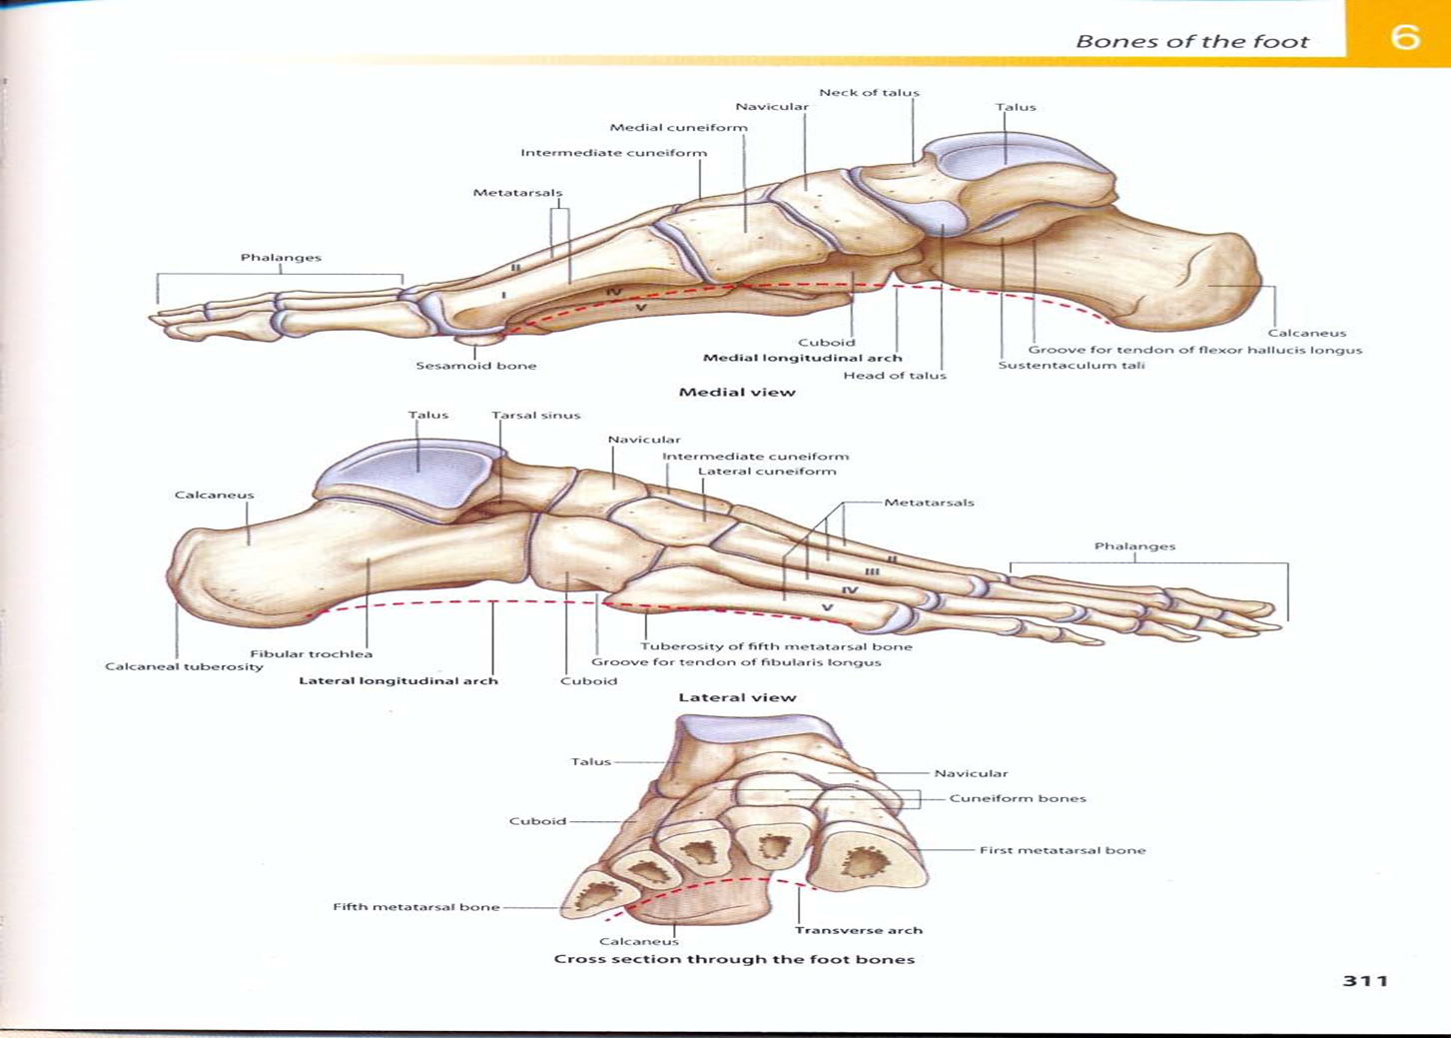

Slide 26
CLINICAL ANATOMY
FLAT FEET
FRACTURES
OSTEOARTHRIST

Slide 27
Hip joint
It’s a synovial joint
Articulate with head of femur and acetabulum of pelvic bone
It’s a multiaxial ball and socket joint
Designed for of stability and weight bearing
Non articular acetabular fossa contains loose connective tissue
Hyaline cartilage covers the acetabular inferior
The fovea is not covered
Femur is covered by hyaline

Slide 28
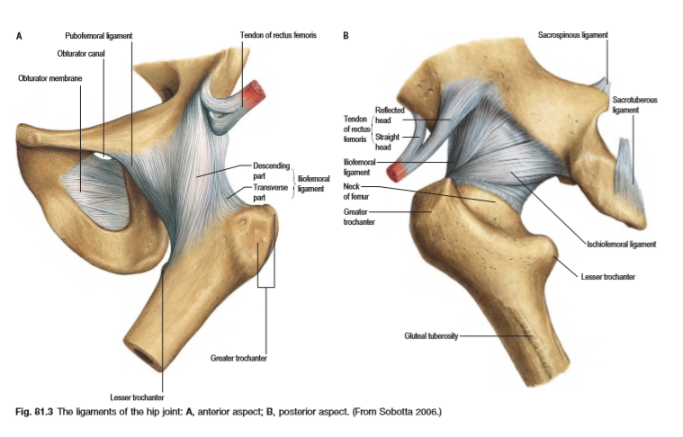
Hip joint

Slide 29
Cont,
Its stabilized by:
i. acetabular labrum
ii. Fibrous capsule
iii. Capsular ligaments
Cavity is fibrocartilaginous acetabular labrum and is completed below by transverse acetabular ligament
Receives blood from branches:
i. of medial and lateral femoral circumflex,
ii. superior and inferior gluteal
iii. obturator arteries

Slide 30
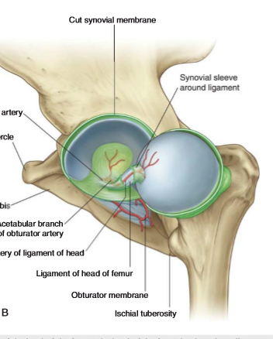
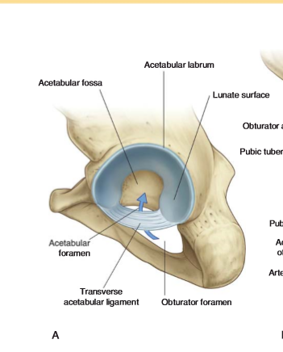
Cont,

Slide 31
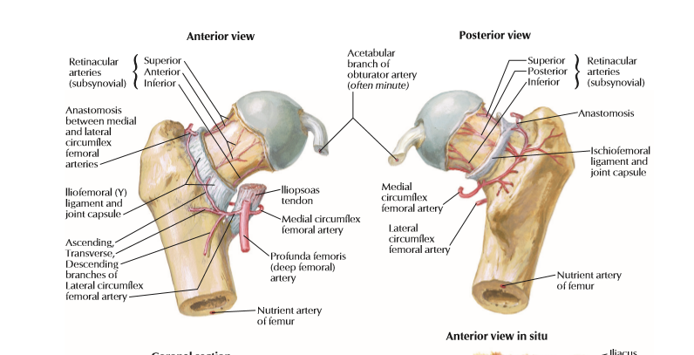
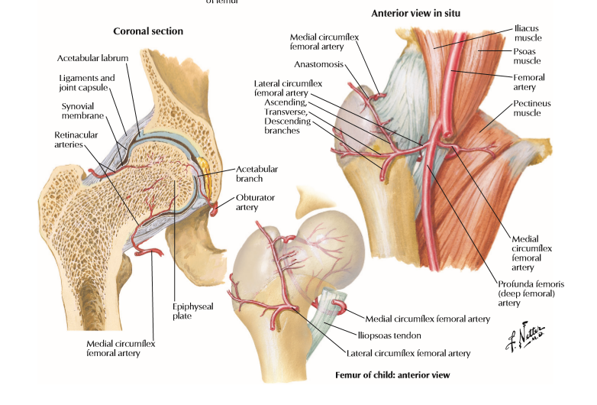
Cont,

Slide 32
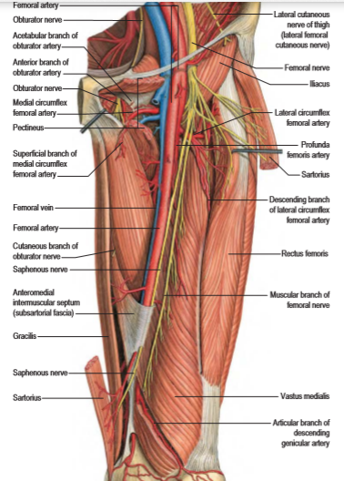
innervation
Branches of:
Femoral
Obturator
Sciatic
Superior gluteal nerves
Nerve to the quadratus femoris

Slide 33
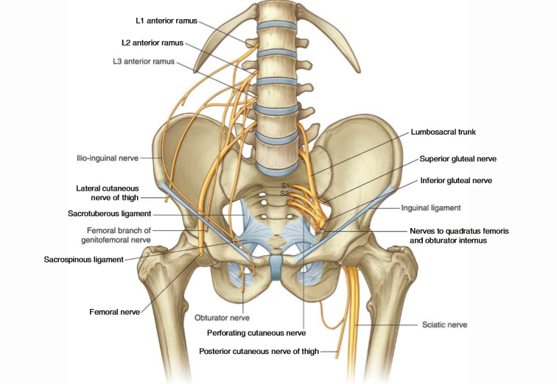
Cont,

Slide 34
ligaments
Iliofemoral ligaments: largest and it reinforces the capsule anteriorly
Ischiofemoral ligament: it reinforces the fibrous capsule posteriorly
Pubofemoral ligament: reinforces fibrous capsule inferiorly
Ligamentum teres capitis femoris: arises from the floor of acetabular fossa and attaches to the fovea
a. provides a pathway for artery of the Ligamentum capitis femoris from obturator artery, supplies blood to femoral head during childhood
Transverse acetabular ligament: allows nutrient vessels to enter the joint

Slide 35
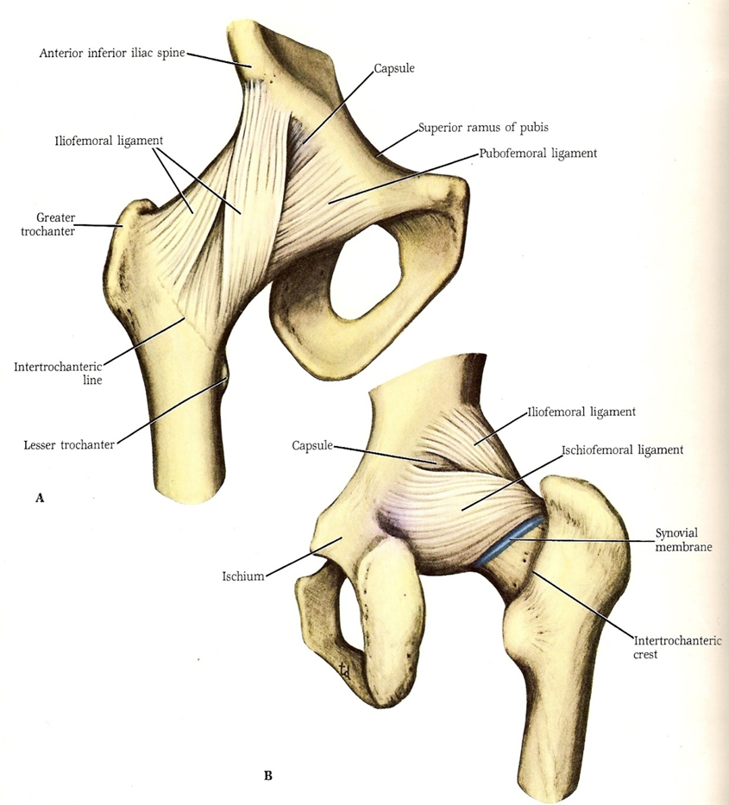

Slide 36
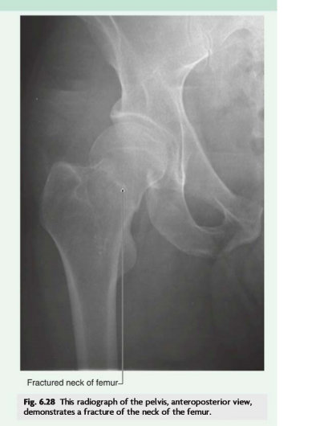
Clinical anatomy
Fractures
Dislocation:
a. posterior: through posterior joint capsule
b. anterior: through tearing of joint capsule anteriorly
Perthes disease: childhood disease occurs when there disruption of blood supply leading to avascular necrosis

Slide 37
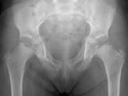
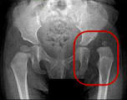
Cont,
Osteoarthritis
Coxa vara: neck –shaft angle is reduced less than 135
Coxa valga: femoral neck is more
Tuberculosis
Hip dysplasia

