Slide 1
The Leg:
Anterior, Posterior & Lateral Compartments
Presenter: Richwell Hakacha, Dip PT, BSc PT, PGC SM, Msc HAN Candidate

Slide 2
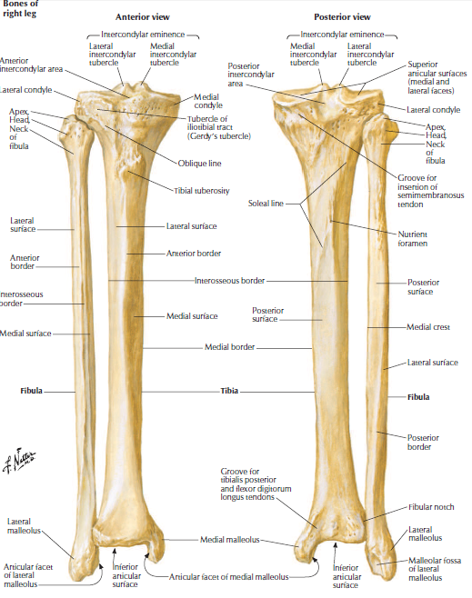

Slide 3
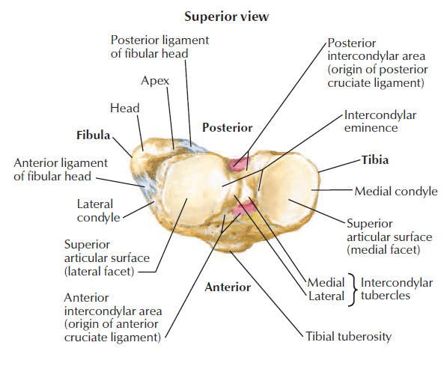

Slide 4
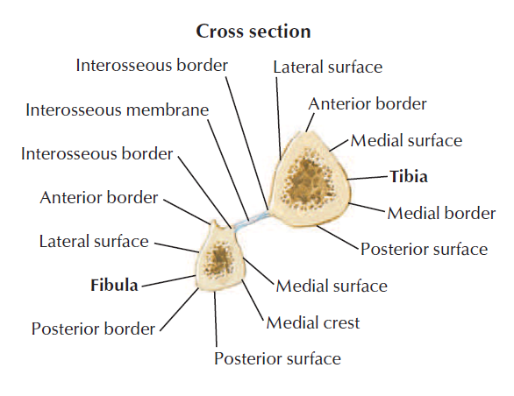

Slide 5
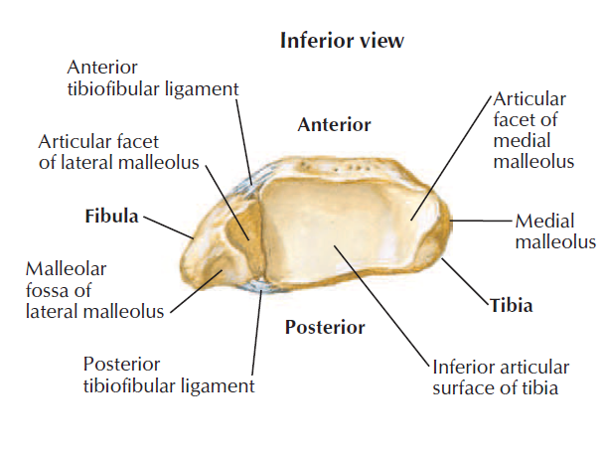

Slide 6
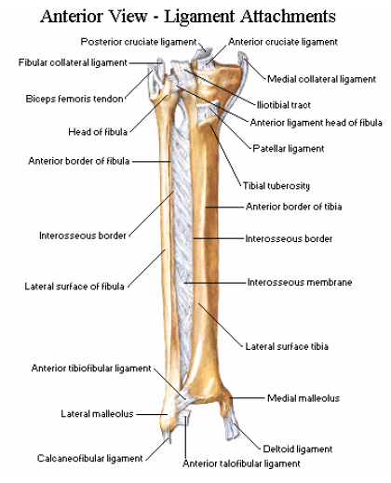

Slide 7
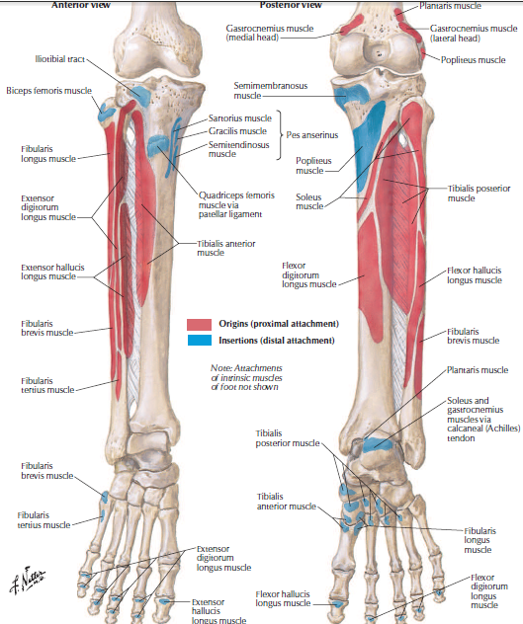
Muscle attachments

Slide 8
Ossification
Tibia
  Primary centre (centre of the shaft)
  Secondary centre – (proximal and distal ends and an extra centre gives the tibial tuberosity)
Fibular
  Primary centre (centre of the shaft)
  Secondary centre (proximal and distal ends)

Slide 9
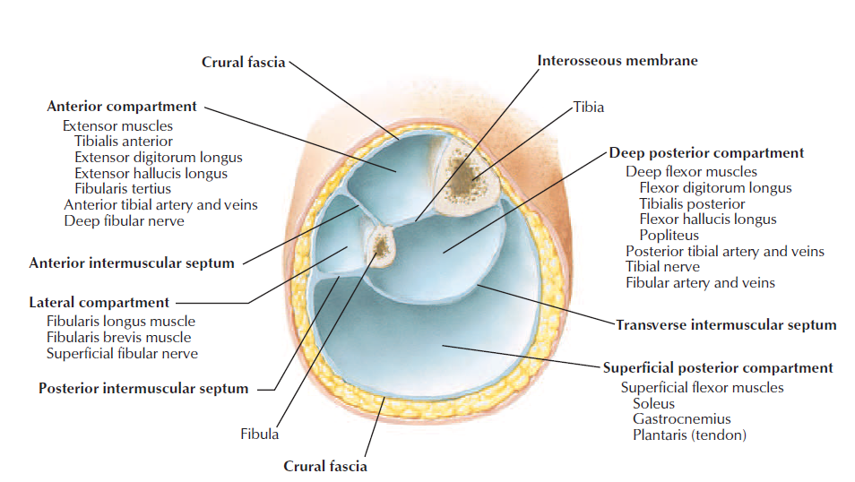
Fascial compartments

Slide 10
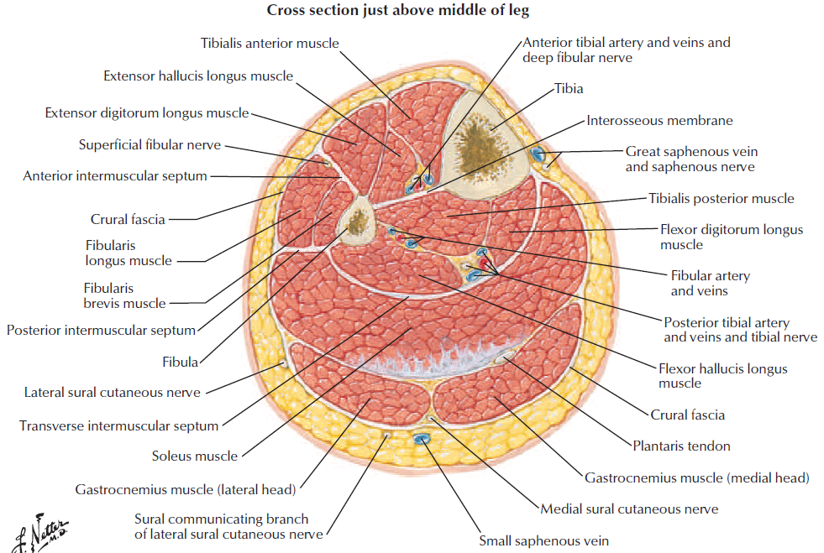

Slide 11
Anterior compartment

Slide 12
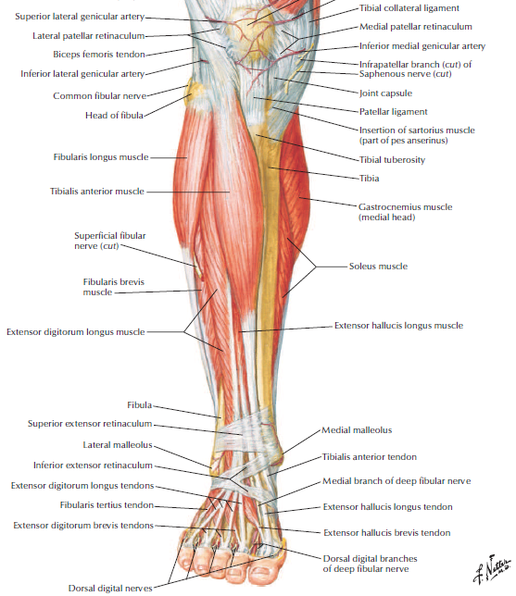
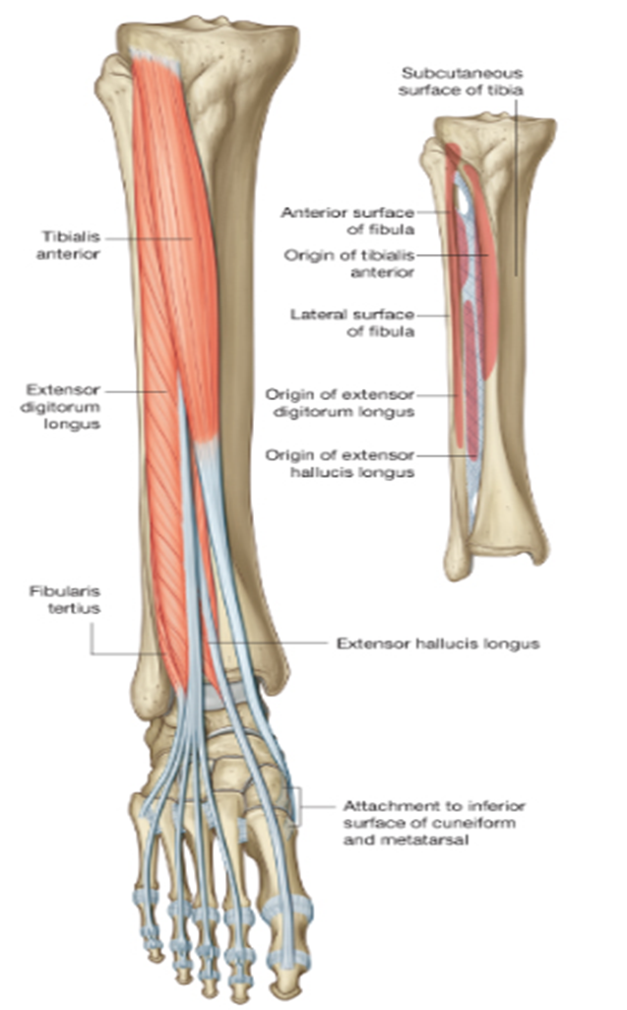
Introduction
Collectively:
Dorsiflex foot at ankle joint
Extend toes
Invert foot
Innervation - All by deep fibular nerve
Arterial supply: Anterior tibial artery (ATA)

Slide 13
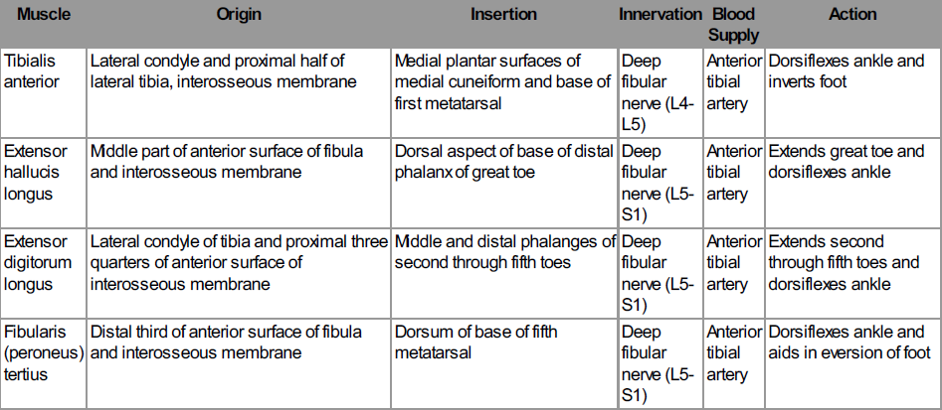
Muscles of anterior of leg

Slide 14
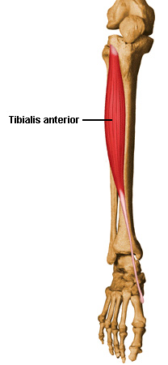
Tibialis anterior (TA)
Origin:
  Lateral surface of tibia
  Adjacent interosseous membrane
Insertion:
  Medial and inferior surfaces of medial cuneiform
  Adjacent surfaces on base of metatarsal I
Nerve supply:
  Deep fibular nerve [L4,L5]
Actions:
  Dorsiflexion of foot at ankle joint
  Inversion of foot at the subtalar joint
  Dynamic support of medial arch of foot

Slide 15
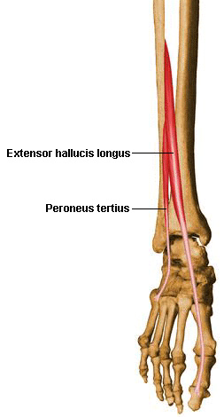
Extensor hallucis longus (EHL)
Origin:
  Middle one-half of medial surface of fibula
  Adjacent surface of interosseous membrane
Insertion:
  Dorsal surface of base of distal phalanx of great toe
Nerve supply:
  Deep fibular nerve [L5,S1]
Action:
  Extension of great toe
  Dorsiflexion of foot at the ankle jt

Slide 16
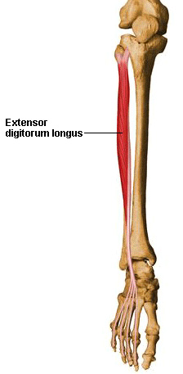
Extensor digitorum longus (EDL)
Origin:
  Proximal one-half of medial surface of fibula
  Related surface of lateral tibial condyle
Insertion:
  Via dorsal digital expansions into bases of distal and middle phalanges of lateral four toes
Nerve supply:
  Deep fibular nerve [L5,S1]
Action:
  Extension of lateral four toes
  Dorsiflexion of foot at the ankle joint

Slide 17
Peroneus tertius
Origin: Distal part of medial surface of fibula
Insertion: Dorsomedial surface of base of metatarsal V
Nerve supply: Deep fibular nerve [L5,S1]
Action: Dorsiflexion of the ankle joint and eversion at the subta.lar jt

Slide 18
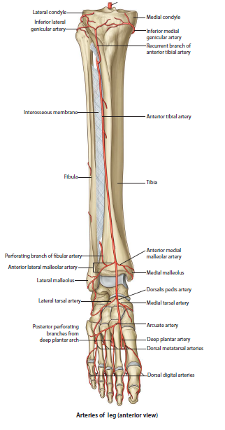
Anterior Tibial Artery (ATA)
Terminal branch of popliteal artery
Reinforced by perforating branch of fibular artery
  Begins on back of leg at lower border of popliteus
  Enters AC via an opening in upper part of interosseous membrane
  Runs vertically downwards to point midway between the two malleoli to become dorsalis pedis artery

Slide 19
Branches of ATA
Muscular branches
Anastomotic branches
  Knee
  Anterior and posterior tibial recurrent branches
  Ankle
  Anterior medial and anterior lateral malleolar branches

Slide 20
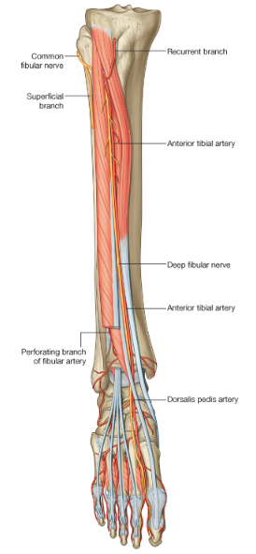
Deep fibular nerve
Terminal branch of common fibular nerve
  Begins at lateral side of neck of fibula
  At the ankle joint it divides into lateral and medial terminal branches
  Lateral terminal branch ends in a pseudoganglion deep to extensor digitorum brevis

Slide 21
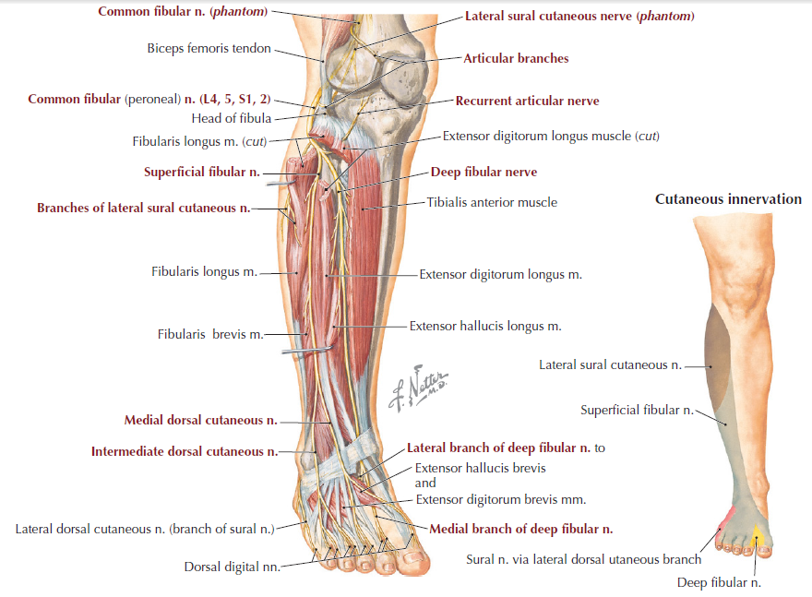

Slide 22
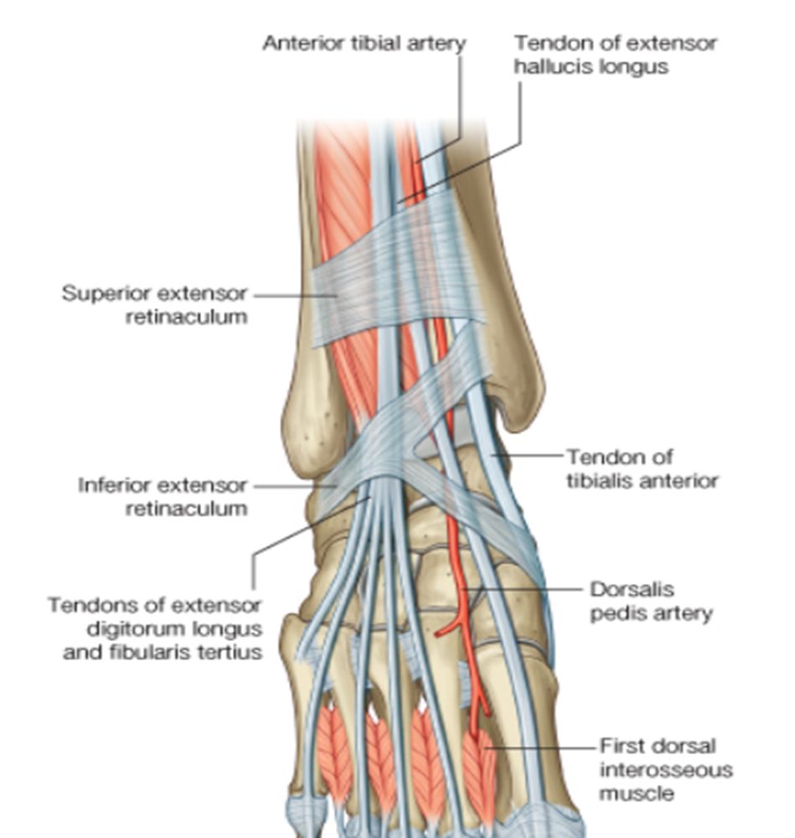
Extensor retinacula
2 extensor retinacula:
  Superior
  Inferior
Superior extensor retinaculum:
  Medially attached to lower part of anterior border of tibia
  Laterally attached to lower part of anterior border of fibula

Slide 23

Extensor Retinacula cont’d
Structures passing under from medial to lateral:
  Tibialis anterior
  Extensor hallucis longus
  Extensor digitorum longus
  Peroneus tertius
  Anterior tibial vessels
  Deep fibular nerve

Slide 24
Posterior compartment of leg

Slide 25
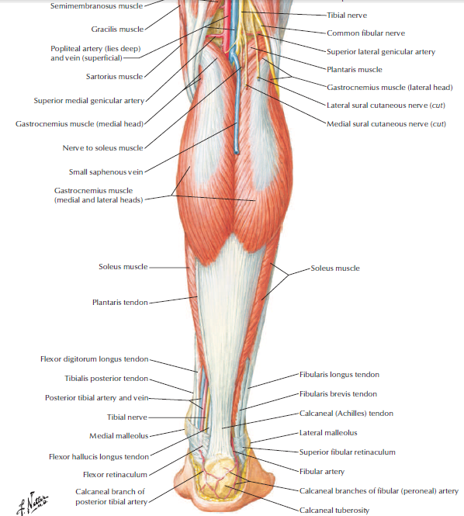
Introduction
Makes the calf muscles
Bulkiest of the 3 compartments of leg
2 arteries (posterior tibial and peroneal)
1 nerve (tibial nerve)
Divided into superficial & deep groups

Slide 26
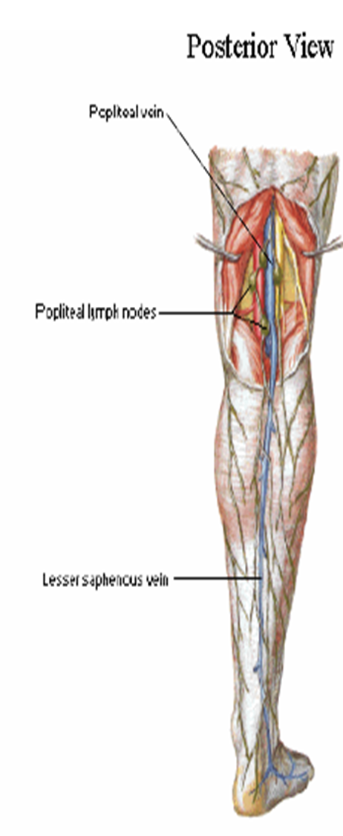
Superficial fascia of posterior compartment
Contents:
  Small (short) saphenous vein
  Great (long) saphenous vein
  Several cutaneous nerves
  Medial and lateral calcanean arteries

Slide 27
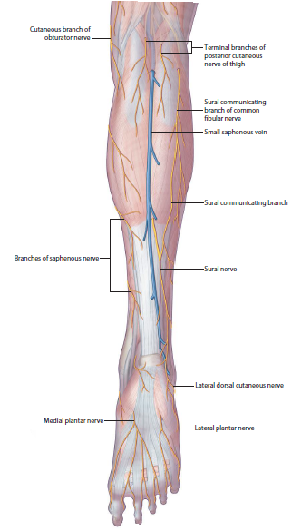
Small saphenous vein
Formed on dorsum of foot by union of lateral end of dorsal venous arch with lateral marginal vein
  Enters back of leg by passing post. to lateral malleolus
  Pierces deep fascia and opens into popliteal vein
  Drains lateral border of foot, heel and back of leg
  Connected with great saphenous and with deep veins
  Is accompanied by sural nerve

Slide 28
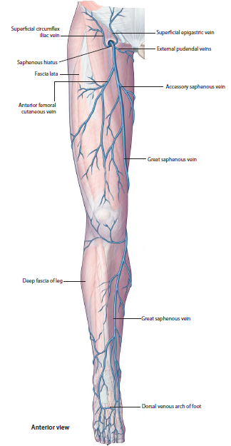
Great saphenous vein
Largest and longest superficial vein of lower limb
Formed by the dorsal venous arch
  Runs on the medial aspect of the leg in front of the medial melleolus
  In thigh, inclines forwards to reach saphenous opening where it pierces cribriform fascia and opens into femoral vein
  Before emptying into femoral vein, it receives 3 tributaries

Slide 29
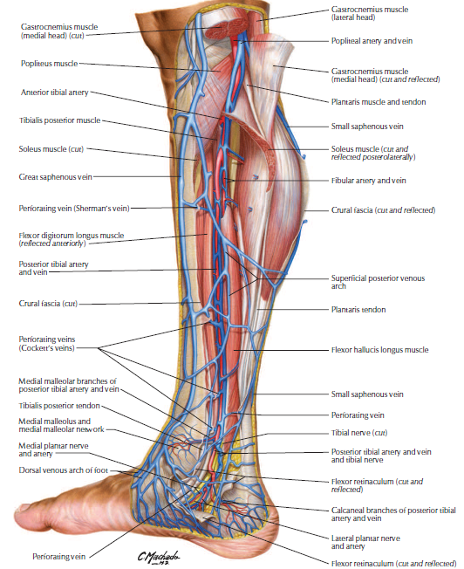

Slide 30
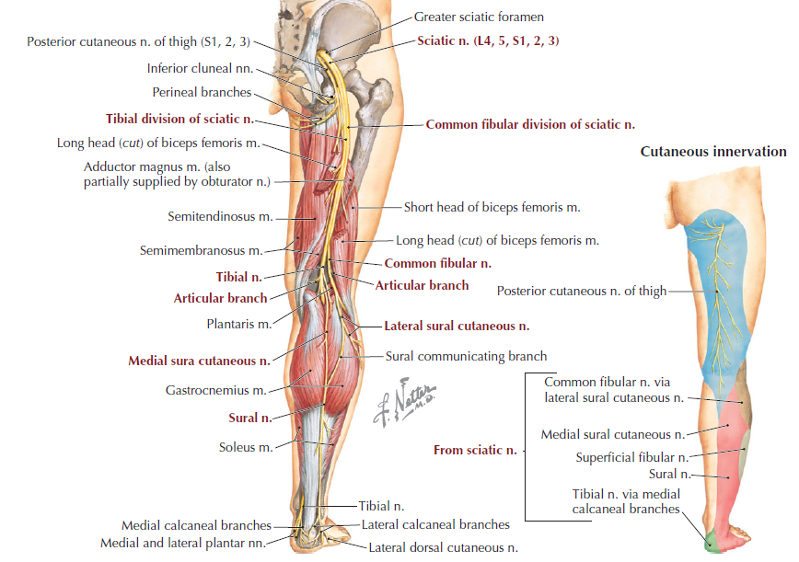
Cutaneous nerves of posterior leg

Slide 31
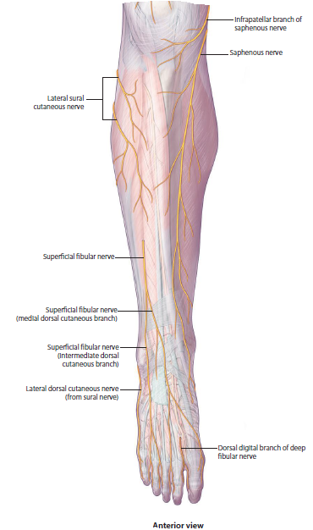
Saphenous nerve (L3, L4)
Largest and longest cutaneous branch from posterior division of femoral nerve
Descends along medial tibial border with great saphenous vein
Divides distally into:
  A branch which continues
  along tibia to the ankle
  A branch which passes
  anterior to the ankle to supply
  skin on the medial side of foot

Slide 32
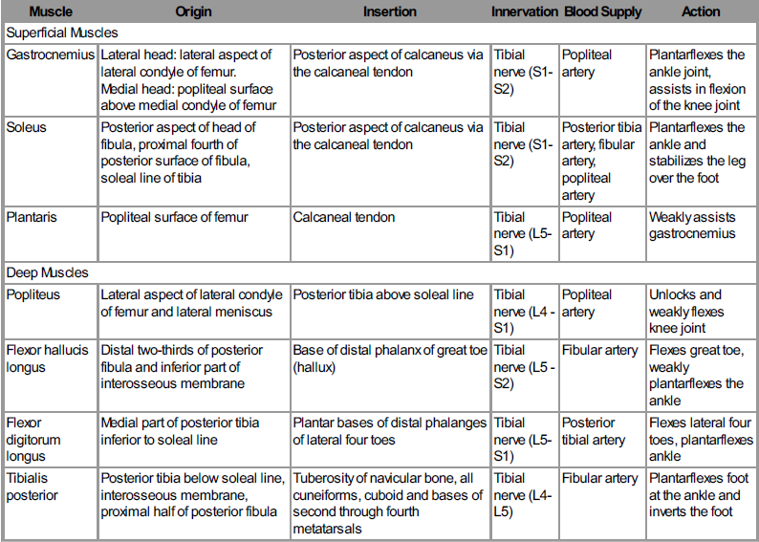
Muscles of posterior leg

Slide 33
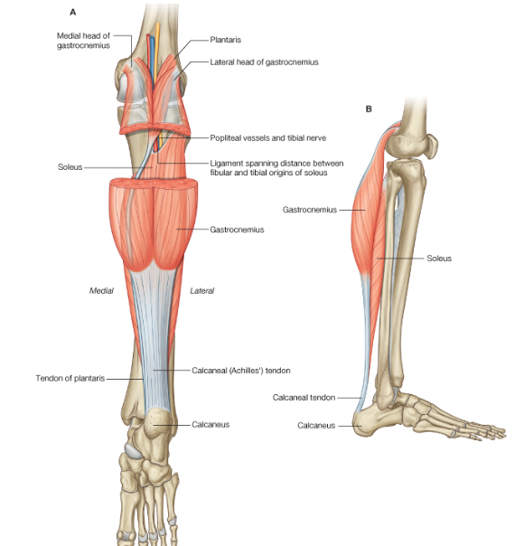
Gastrocnemius
Origin:
  Medial head-posterior surface of distal femur just superior to medial condyle
  Lateral head-upper posterolateral surface of lateral femoral condyle
Insertion: Via calcaneal tendon, to posterior surface of calcaneus
Nerve supply:
  Tibial nerve [S1,S2]
Action:
  Plantarflexes the ankle joint
  Flexes knee joint

Slide 34
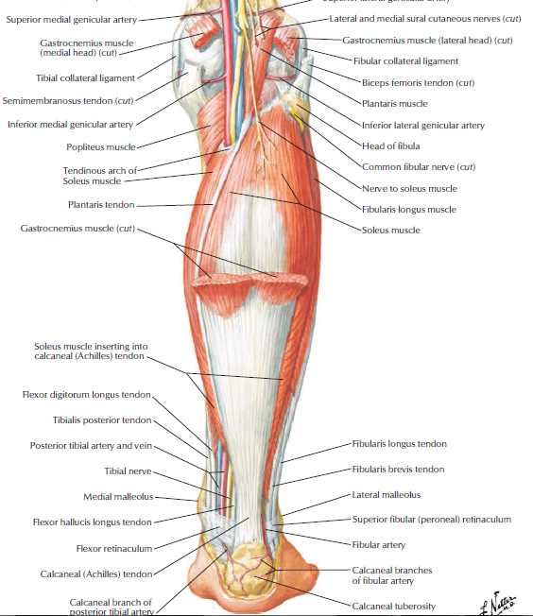
Plantaris muscle
Origin:
  Inferior part of lateral supracondylar line of femur
  Oblique popliteal ligament of knee
Insertion:
  Via calcaneal tendon, to posterior surface of calcaneus
Nerve supply:
  Tibial nerve [S1,S2]
Action:
  Plantarflexes the ankle joint
  Flexes knee joint

Slide 35
Soleus muscle
Origin:
  Soleal line & medial border of tibia
  Posterior aspect of fibular head and adjacent surfaces of neck and proximal shaft
  Tendinous arch between tibial and fibular attachments
Insertion - Via calcaneal tendon, to posterior surface of calcaneus
Nerve supply:
  Tibial nerve [S1,S2]
Action: Plantarflexes the ankle jt

Slide 36
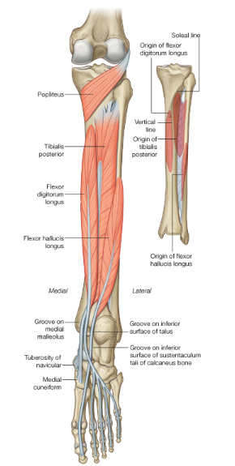
Popliteus muscle
Origin:
  Posterior surface of proximal tibia
Insertion:
  Lateral femoral condyle
Nerve supply:
  Tibial nerve [L4 to S1]
Action:
  Unlocks knee joint (laterally rotates femur on fixed tibia)

Slide 37
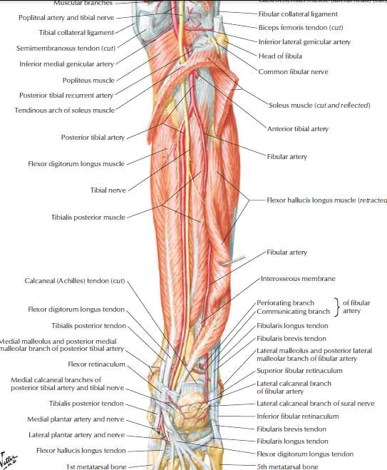
Flexor hallucis longus (FHL)
Origin
  - Posterior surface of fibula and adjacent interosseous membrane
Insertion:
  Plantar surface of distal phalanx of great toe
Nerve supply - Tibial nerve [S2,S3]
Action - Flexes great toe

Slide 38
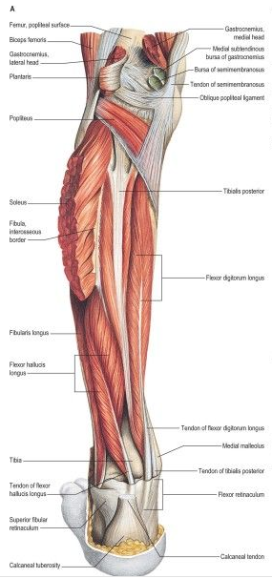
Flexor digitorum longus (FDL)
Origin:
  Medial side of posterior surface of the tibia
Insertion:
  Plantar surfaces of bases of distal phalanges of the lateral four toes
Nerve supply:
  Tibial nerve [S2,S3]
Action:
  Flexes lateral four toes

Slide 39
Tibialis posterior
Origin:
  Posterior surfaces of interosseous membrane
  Adjacent regions of tibia and fibula
Insertion:
  Mainly to tuberosity of navicular
  Adjacent region of medial cuneiform
Nerve supply:
  Tibial nerve [L4,L5]
Actions:
  Inversion of the subtalar joint and plantarflexion of the ankle joint
  Support of medial arch of foot during walking

Slide 40
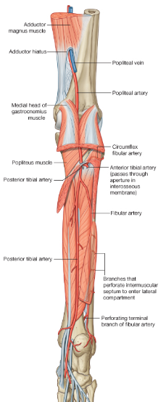
Posterior tibial artery (PTA)
Begins at lower border of popliteus, lies deep to gastrocnemius
  Enters back of leg by passing deep to tendinous arch of soleus
  Runs downwards and slightly medially to reach posteromedial side of ankle, midway between medial malleolus and medial tubercle of calcaneum
  Terminates deep to flexor retinaculum by dividing into lateral and medial plantar arteries

Slide 41

Branches of posterior tibial artery
Fibular artery (largest branch)
Muscular branches
Nutrient artery to tibia
Anastomotic branches:
  Circumflex fibular branch to knee joint
  Malleolar branch to medial malleolus
  Calcaneal branches
Terminal branches: medial and lateral plantar arteries

Slide 42
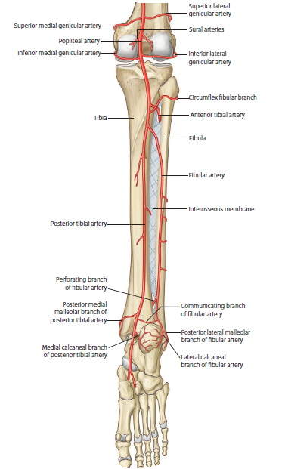
Fibular artery
Supplies posterior and lateral compartments of leg
  Runs obliquely towards fibula and descends along medial crest of fibula
  Gives nutrient artery to fibula
  Terminates by dividing into number of lateral calcanean branches

Slide 43
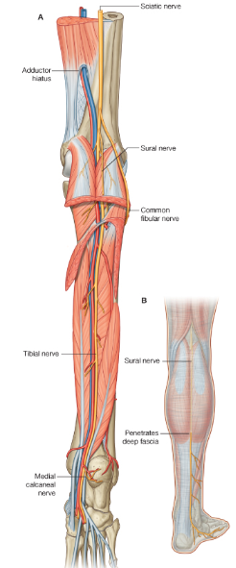
Tibial nerve
Course and relations similar to those of posterior tibial artery
Branches:
  Muscular: TP, FDL, FHL, deep part of soleus
  Cutaneous: medial calcaneum branches pierce flexor retinaculum to supply skin on back and lower surface of heel
  Articular: ankle joint
  Terminal: medial and lateral plantar nerves

Slide 44
Lateral compartment of leg

Slide 45
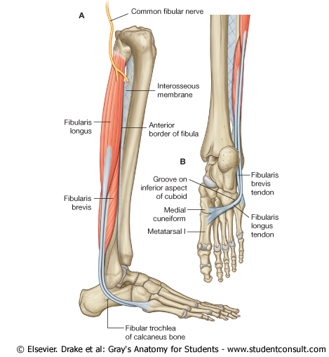
Introduction
2 muscles: fibularis longus and fibularis brevis
Innervation : superficial fibular nerve
Arteries: branches of fibular artery
Veins: drain into small saphenous vein

Slide 46
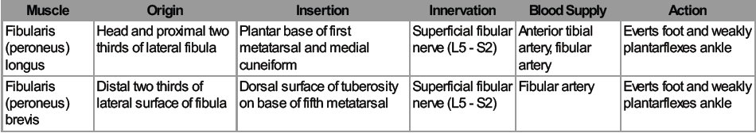
Muscles of the lateral compartment

Slide 47
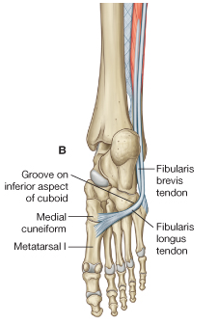
Fibularis longus muscle
Origin: Upper lateral surface of fibula, head of fibula
Insertion: Under-surface of lateral sides of distal end of medial cuneiform and base of metatarsal I
Nerve supply: Superficial fibular nerve [L5,S1,S2]
Actions:
  Eversion of foot
  plantarflexion of the subtalar joint
  Supports arches of foot

Slide 48
Fibularis brevis muscle
Origin: Lower two-thirds of lateral surface of shaft of fibula
Insertion: Lateral tubercle at base of metatarsal V
Nerve supply: Superficial fibular nerve [L5,S1,S2]
Action: Eversion of the subtalar joint

Slide 49
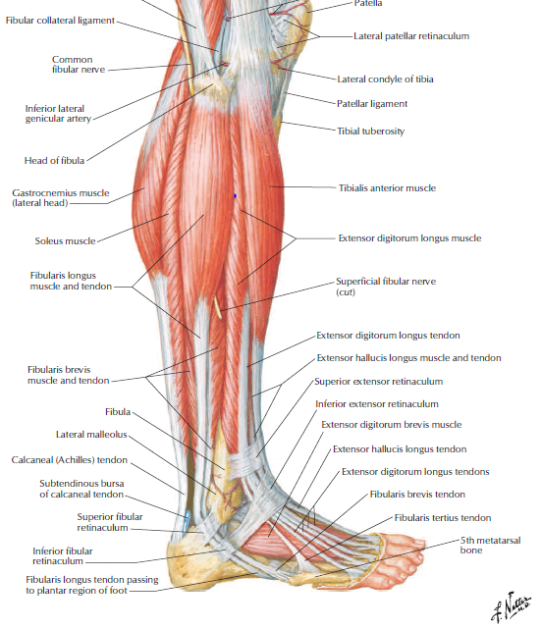
Superficial fibular nerve
Terminal branch of common fibular nerve
Runs via peroneal muscles and becomes superficial at junction of upper 2/3rd and lower 1/3rd of leg
Branches:
  Muscular: fibularis longus, fibularis brevis
  Cutaneous

Slide 50
Applied anatomy
Injury to the common fibular nerve
Deep fibular nerve entrapment – due to oedema in the anterior compartment
Gastrocnemius strain
Ruptured tendo-achilles
Calcaneal tendon reflex
Posterior tibial pulse

Slide 51
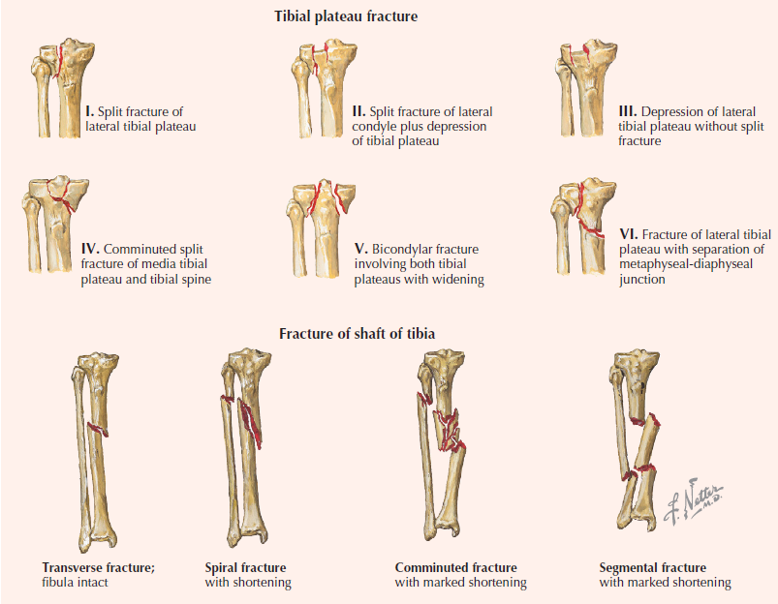
Fractures of T/F

Slide 52
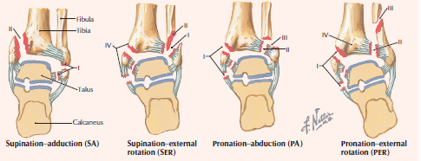
Fractures of Tibia/Fibula

Slide 53
The End!
Thank you

