Slide 1
PELVIC FLOOR MUSCLES
Dr S. Mutemwa

Slide 2
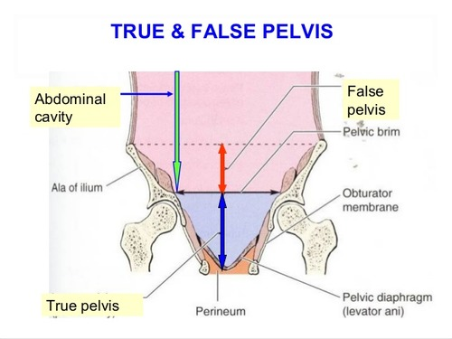

Slide 3
The walls of the pelvic cavity consist of the sacrum, the coccyx, the pelvic bones inferior to the linea terminalis, two ligaments, and two muscles

Slide 4
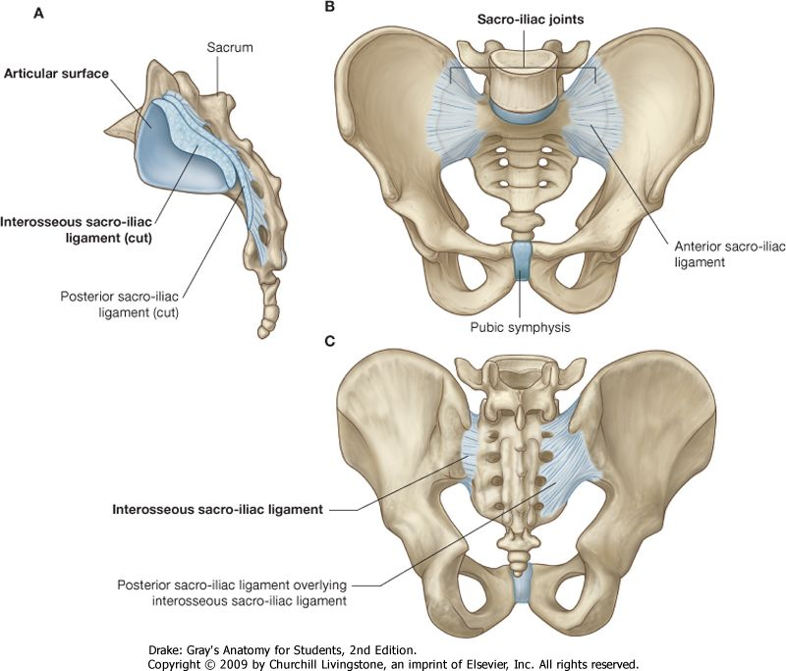

Slide 5
Muscles in pelvic wall
-Piriformis –posterolateral wall
-Obturator internus-Lateral wall
lateral rotators of the hip joint
Muscles that form pelvic floor
-Levator ani
-Ischiococcygeus

Slide 6
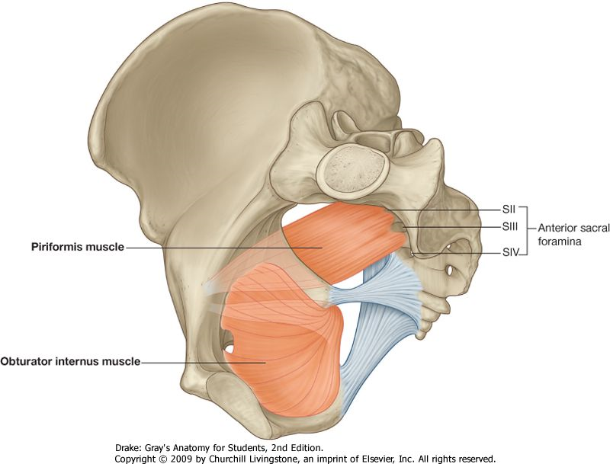

Slide 7
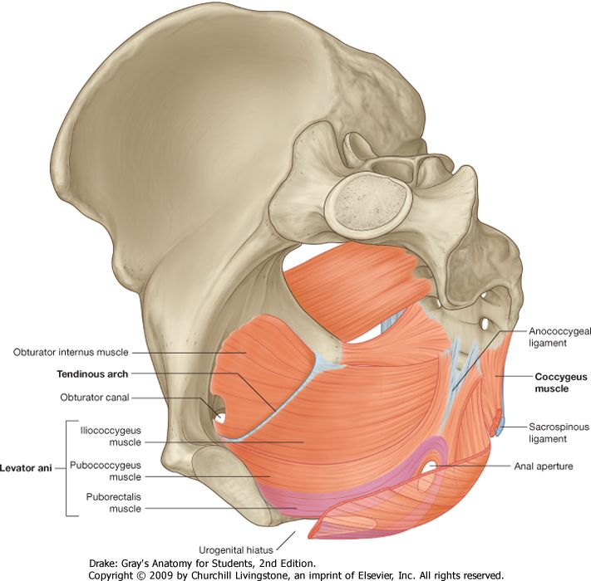

Slide 8
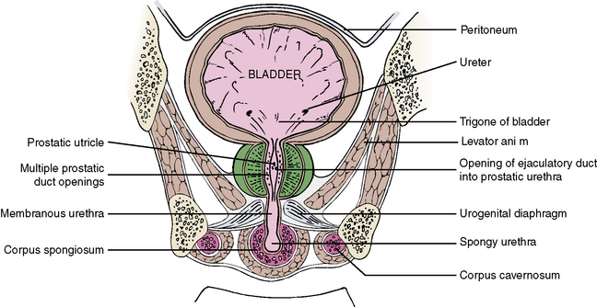

Slide 9
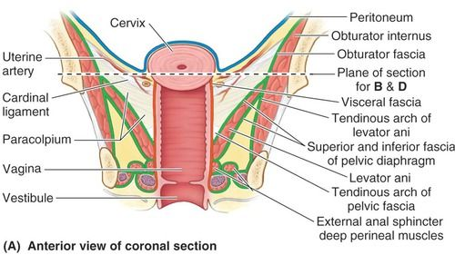

Slide 10
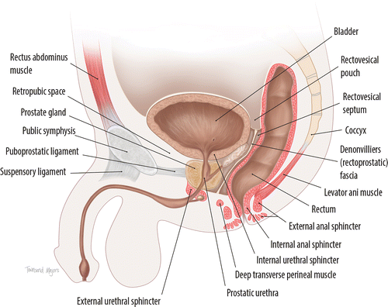
Disposition of viscera in pelvic cavity
Males

Slide 11
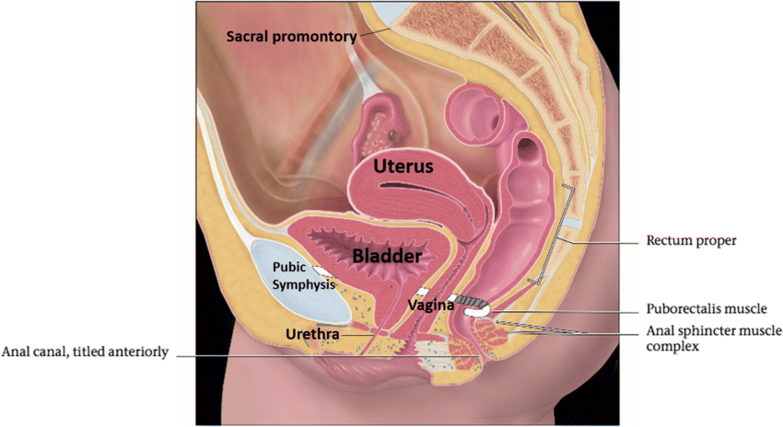

Slide 12
Pelvic Floor
Divides cavity of lesser pelvis into
-Pelvic cavity and
-Perineum
The pelvic floor is formed by the pelvic diaphragm, and in the anterior midline, the perineal membrane, fasciae covering their superior and inferior surfaces, and the muscles in the deep perineal pouch.
The pelvic diaphragm is formed by the levator ani and the ischiococcygeus muscles from both sides.

Slide 13
Pelvic diaphragm
The pelvic diaphragm is shaped like a bowl or funnel and is attached superiorly to the pelvic walls

Slide 14
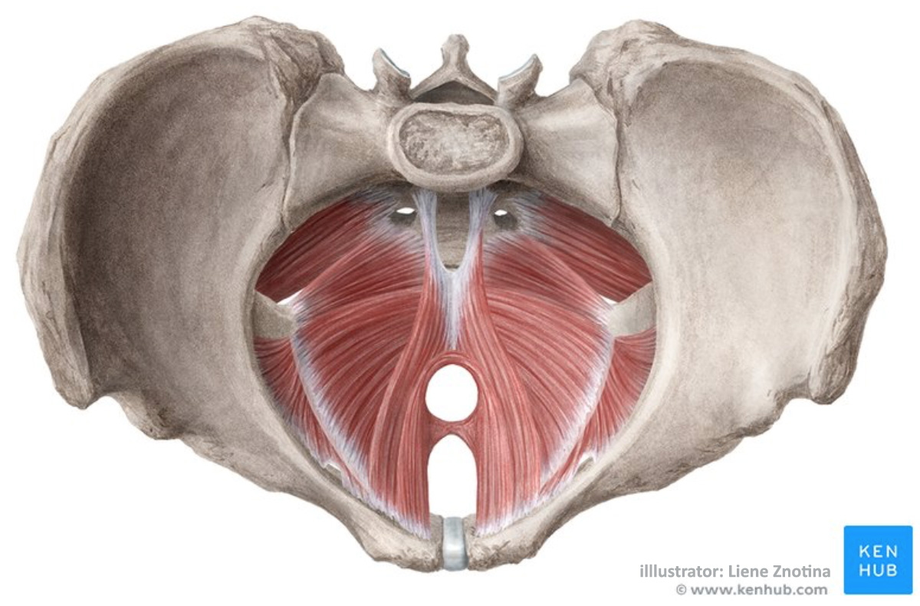

Slide 15
The levator ani and ischiococcygeus may be regarded as one morphological entity, divisible from before backwards into the pubococcygeus, the iliococcygeus and the ischiococcygeus or coccygeus.
They have an origin from the pelvic surface of the body of the pubis, the obturator fascia or white line or tendinous arch and the ischial spine.
The muscle fibres slope downwards and backwards to the midline, making a gutter-shaped pelvic floor

Slide 16
LEVATOR ANI
The muscle is divisible into a
-pubococcygeus part,
-an iliococcygeus part and
-an ischiococcygeus part

Slide 17
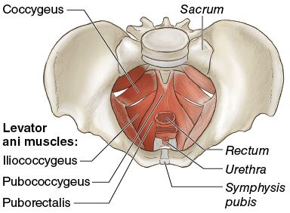

Slide 18
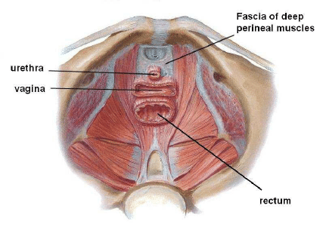

Slide 19
Pubococcygeus
The anterior fibres of this part originate from the medial part of the pelvic surface of the body of the pubis.
Parts:
- Pubourethralis - fibres that closely surround the urethra
-Puboprostaticus/ levator prostatae ;Only in males, and are fibres surrounding the prostate. Insert in the perineal body
-Pubovaginalis ; surround the vagina and form the sphincter vaginae, insert in the perineal body
-Puboanalis
-Puborectalis

Slide 20
Puborectalis; These are the middle fibres arising from the lateral part of the pelvic surface of the body of the pubis.
-They partly form a loop or sling around the anorectal junction; Help maintain fecal continence
and are partly continuous with the longitudinal muscle coat of the rectum.
-In female, the anterior portion of puborectalis is thinner and shorter
-Cannot be seen from inside the pelvis.
Behind the rectum, other fibers of pubococcygeus form a tendinous intersection (anococcygeal ligament/body) as part of the levator raphe/plate.

Slide 22
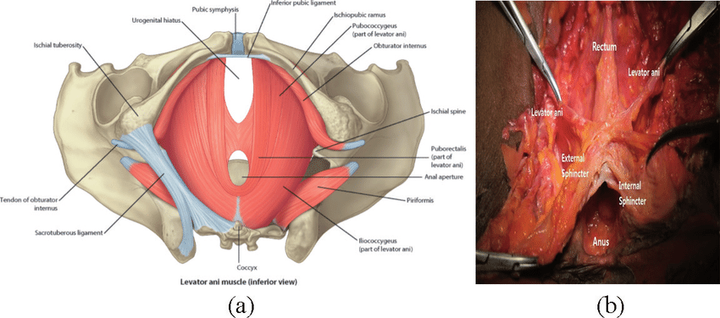

Slide 23
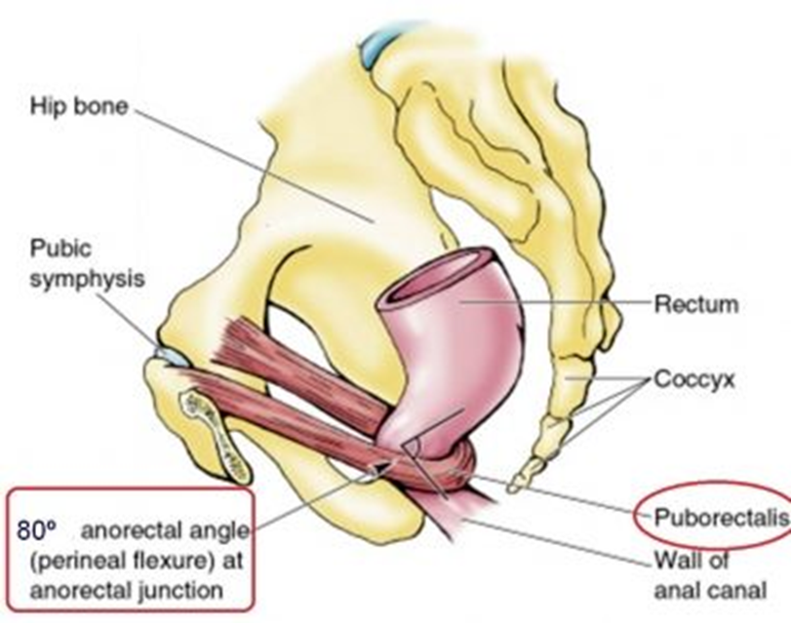
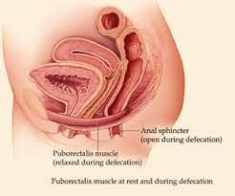

Slide 24
Iliococcygeus Part
Origin; The posterior half of the tendinous arch on the obturator fascia, and the pelvic surface of the ischial spine.
Inserted: into the anococcygeal ligament and into the side of the last two pieces of coccyx.
Nerve Supply to the Levator ani: S3, S4 and few fibers of S2

Slide 25
Ischiococcygeus/ Coccygeus Part
represents the posterior part of the pelvic diaphragm.
It is triangular in shape.
It is partly muscular and partly tendinous.
Origin/Apex: The pelvic surface of the ischial spine and the sacrospinous ligament.
Insertion/base :into the side of the coccyx, and into the fifth sacral vertebra.
Action; supports pelvic viscera and flexes coccyx
Nerve supply: Branches of S4 and S5

Slide 26
Actions of Levator Ani and Coccygeus
The levators ani and coccygeus close the posterior part of the pelvic outlet.
The levators ani fix the perineal body and support the pelvic viscera.

Slide 27
3. During coughing, sneezing, lifting and other muscular efforts, the levators ani and coccygei counteract or resist increased intra-abdominal pressure and help to maintain continence of the bladder and the rectum.
In micturition, defaecation and parturition, a particular pelvic outlet is open, but contraction of fibres around other openings resists increased intraabdominal pressure and prevents any prolapse through the pelvic floor. The increase in the intraabdominal pressure is momentary in coughing and sneezing and is more prolonged in yawning, micturition, defaecation and lifting heavy weights.
It is most prolonged and intense in second stage of labour.

Slide 28
3. The sling formed by the puborectalis muscles pulls the anorectal junction forwards, thus it prevents untimely descent of the faeces.
4. The coccygeus pulls forwards and supports the coccyx, after it has been pressed backwards during defaecation, parturition or childbirth.

Slide 29
Functions of the pelvic diaphragm
Forms a dynamic floor to support the abdominopelvic viscera
Assists in maintenance of urinary and fecal continence. Relaxes to allow urination and defecation
Actively contracts during forced expiration, coughing, sneezing, vomiting
Supports the fetal head during childbirth

Slide 30
Clinical significance of pelvic diaphragm
May get torn during labour; commonly pubococcygeus, thus, decreased support for pelvic organs
Prolapse of rectum/uterus
Can also cause urinary stress incontinence
Kegel exercises strengthens pelvic floor muscles which weaken with pregnancy, childbirth and ageing.

Slide 31
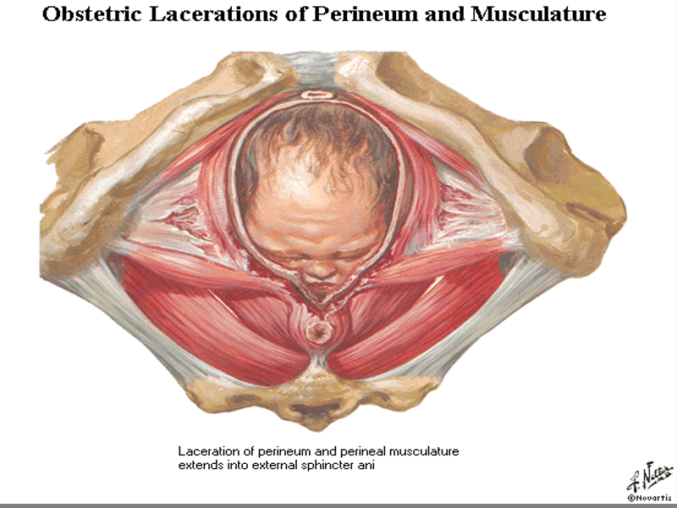

Slide 32
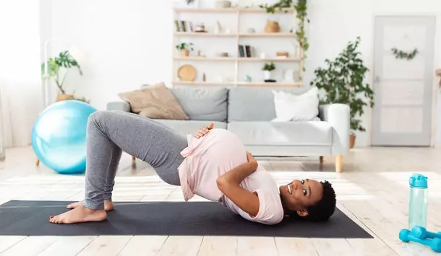

Slide 33
Pelvic peritoneum
It is continuous with that of the abdominal cavity
It does not reach the pelvic floor
Reflects on pelvic viscera forming folds and fossae
Most pelvic viscera are infraperitoneal except the fallopian tubes and ovaries
Peritoneum is loosely attached to bladder.

Slide 34
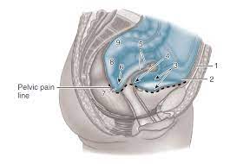
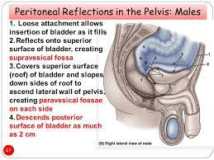

Slide 35
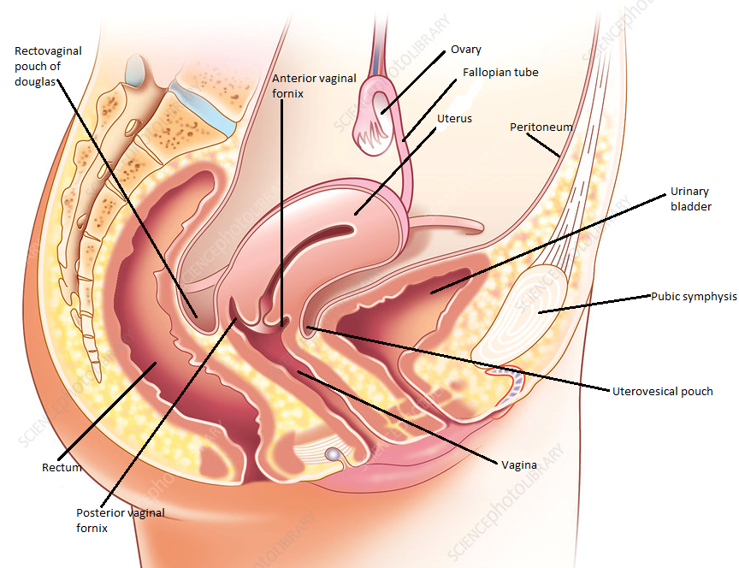

Slide 36
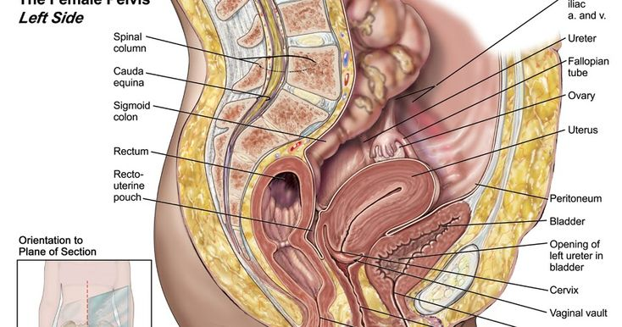

Slide 37
Rectouterine pouch of Douglas( Cul-de-sac)
Between uterus and rectum
Base lies 5.5 cm above anal orifice
Uterovesical pouch
Between uteru and urinary bladder

Slide 39
Rectovesical pouch
Between urinary bladder and rectum
Base lies 7.5 cm above anal orifice

Slide 40
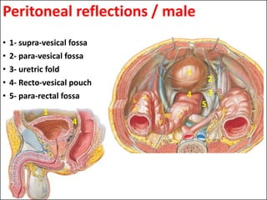

Slide 41
