Slide 1
POSTERIOR ABDOMINAL WALL
Mr Mickey Banda

Slide 2
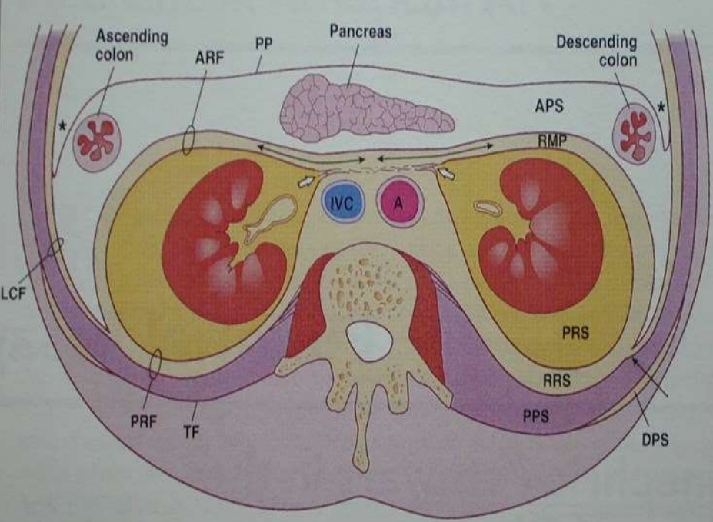
Retroperitoneal organs
Between the peritoneum and the posterior wall of the abdominal cavity
Organs not completely covered by the visceral peritoneum

Slide 3
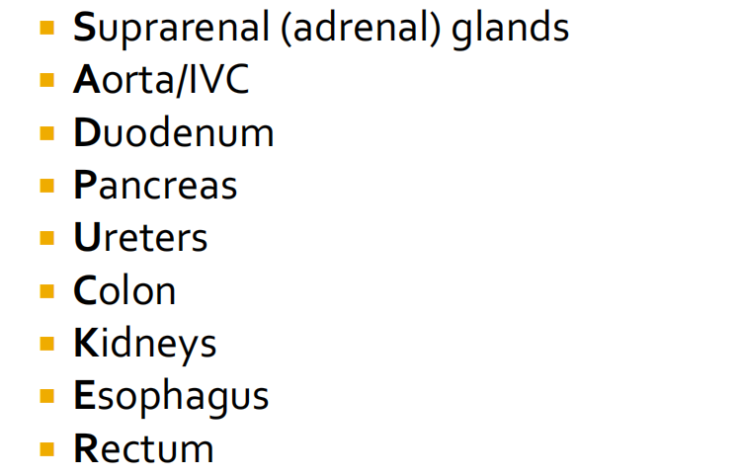
Retroperitoneal Organs: ‘SAD PUCKER’

Slide 4
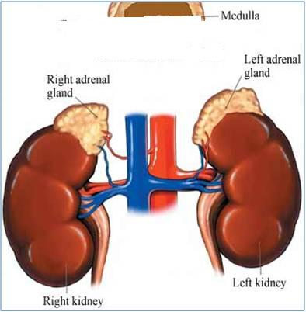
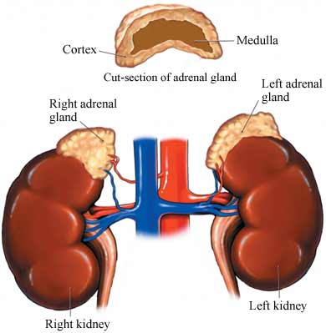
Suprarenal (adrenal) glands
- is a component of the endocrine glands
- consists of 2 parts – cortex & medualla
- yellowish retroperitoneal organs
- lie on the upper poles of the kidneys
- surrounded by renal fascia (Gerota)
- separated from the kidneys by the peri-renal fat.
- right gland is pyramidal & left crescent shaped

Slide 5
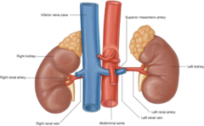
Relations
Right suprarenal gland
Relations:
Anterior - right lobe of the liver & anteromedially - inferior vena cava.
Posteromedially - diaphragm.
Inferolaterally - the kidney
Superiorly - lies on bare area of the liver

Slide 6
Left suprarenal gland
Relations:
Anteriorly- pancreas, lesser sac & stomach
Posteromedially- diaphragm.
Inferomedially – kidney
Superiorly - diaphragm

Slide 7
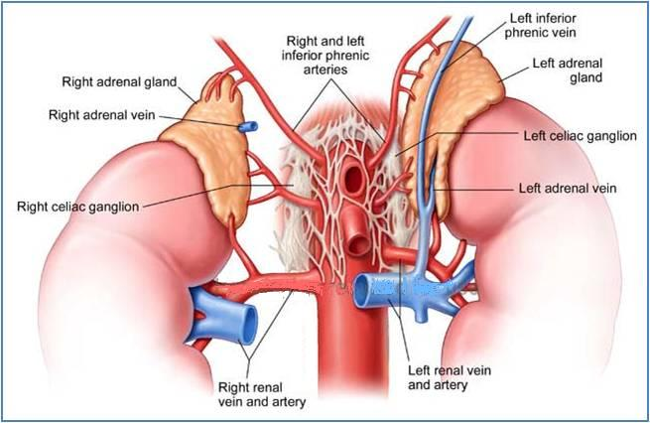
Blood supply
Arteries: 3 arteries supply each gland
- superior, middle & inferior suprarenal arteries
Arise from;
- inferior phrenic artery, abdominal aorta &
renal artery.
Venous drainage
- A single vein emerges from the hilum of each gland
- drains into the inferior vena cava on the right & into the left renal vein on the left

Slide 8
Lymphatic & innervation
Lymph Drainage:
- drains into the lateral aortic nodes.
Nerve Supply:
Preganglionic sympathetic fibers
- derived from the splanchnic nerves supply the glands.
- Most of the nerves end in the medulla of the gland.

Slide 9
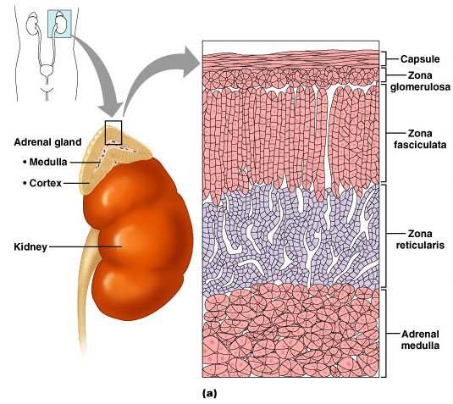
Functional anatomy
- Zona glomerulosa is composed of clumps (nest) of cell
- Zona fasciculata formed of parallel columns of cells
- Zona reticularis is a mesh of interlaced cords of cells

Slide 10
Function
- cortex of the glands secretes hormones that include:
= Mineral corticoids- concerned with the control of fluid & electrolyte balance
= Glucocorticoids - control metabolism of carbohydrates, fats and proteins
- Small amounts of sex hormones- play a role in the prepubertal development of the sex organs.
- medulla of the suprarenal glands secretes the catecholamines: epinephrine and norepinephrine

Slide 11
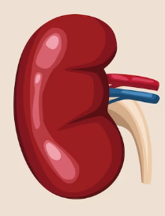
The kidneys
- Paired bean shaped structure
- retroperitoneal
- partially protected by the 11th and 12th ribs
right slightly lower due to liver
weighing about 135g -150g
about 10cm long
- 5cm wide & 2.5 cm thick

Slide 12
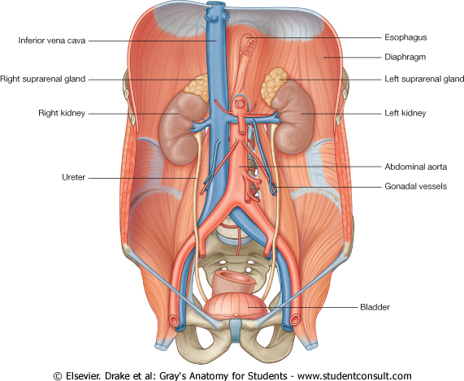
Kidney functions
- Excrete most of the waste products of metabolism
- Control the water & electrolyte balance - Body
- Maintain acid-base balance of the blood
- Waste products leave the kidneys as urine
- Passes down the ureters to the urinary bladder
- Urine leaves the body through the urethra

Slide 13
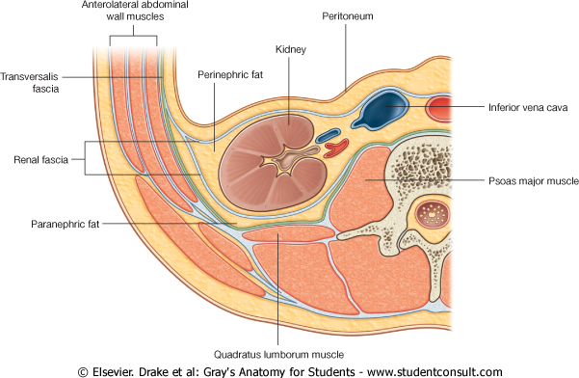
Coverings
1- Fibrous capsule:
- encloses the kidney
2 - Perirenal (perinephric) fat:
- surrounds the fibrous capsule
3 - Renal fascia (Gerota):
- is a condensation of connective tissue that encloses the kidneys and suprarenal glands,
- it is continuous laterally with the fascia transversalis
4 - Pararenal (paranephric) fat:
- lies external to the renal fascia, and forms part of the retroperitoneal fat

Slide 14
Structure of kidneys
- has 2 smooth surfaces = anterior & posterior
- 2 poles = superior & inferior
- 2 margins = lateral & medial
- on the medial margin of each kidney is the hilum

Slide 15
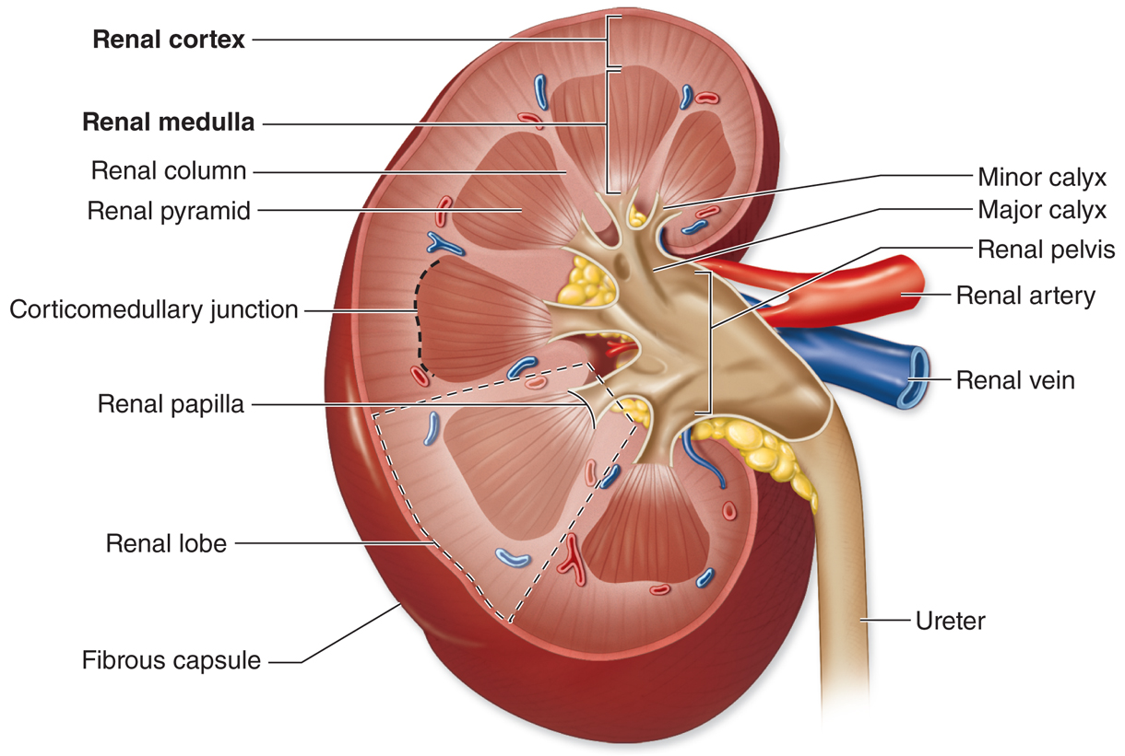
Kidney structure
- hilum
- renal artery and vein
- renal cortex
- renal columns
- renal medulla
- renal pyramids
- renal papillae
- major & minor calyces
- renal Pelvis
- ureters

Slide 16
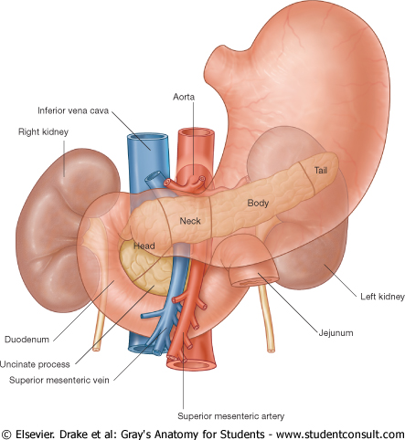
Anterior relations
RIGHT KIDNEY
- Suprarenal gland
- Liver
- Second part of the duodenum
- Right colic flexure
- Coils of ileum
LEFT KIDNEY
- Suprarenal gland
- Spleen
- Stomach
- Pancreas (body)
- Left colic flexure
- Descending colon
- Coils of jejunum

Slide 17
Posterior relation
RIGHT KIDNEY
- Diaphragm,
- Costodiaphragmatic recess of the pleura
- 12th rib
- Psoas major
- Quadratus lumborum,
- Transversus abdominis muscle
- Subcostal vesssels & nerves (T12)
- Iliohypogastric nerve (L1)
- Ilioinguinal nerve (L1)
LEFT KIDNEY
Same as the right except it is higher it reaches up to the 11th rib.

Slide 18
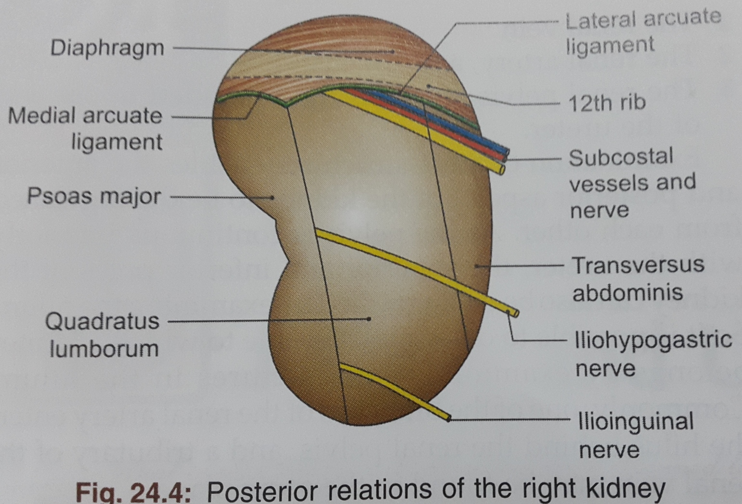

Slide 19
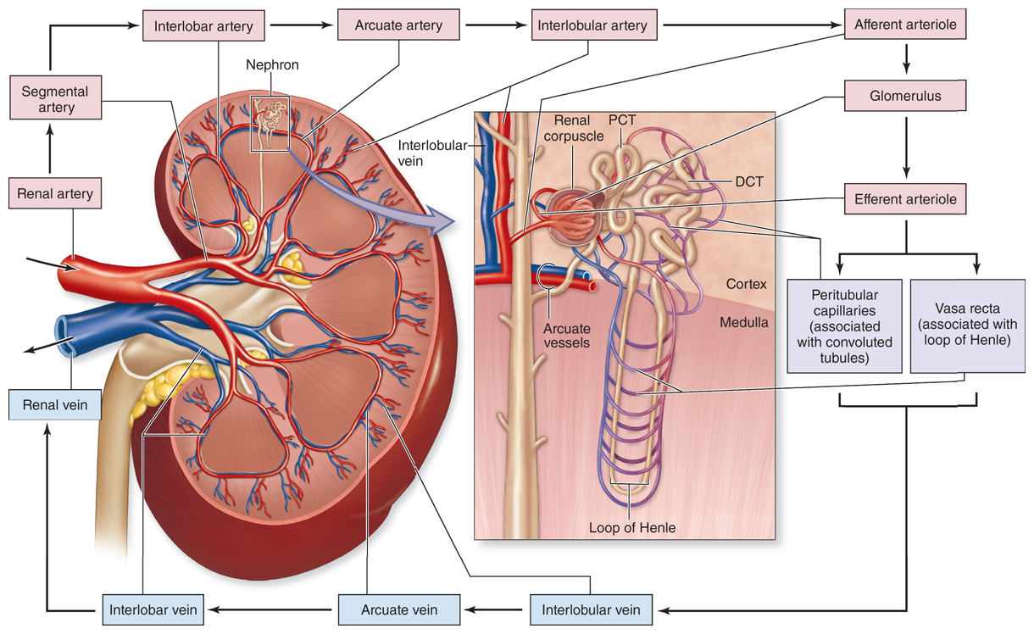
Blood supply

Slide 20
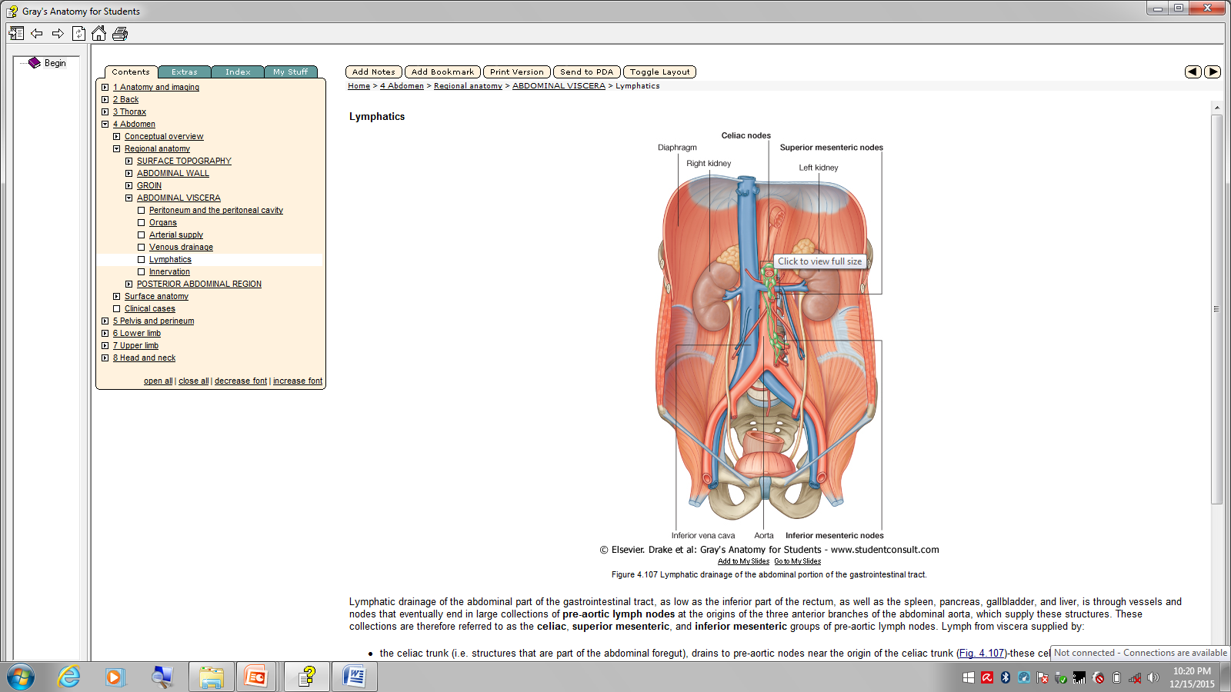
lymphatics
- follows the origin of arteries supplying the kidneys
- lateral aortic (lumbar) nodes

Slide 21
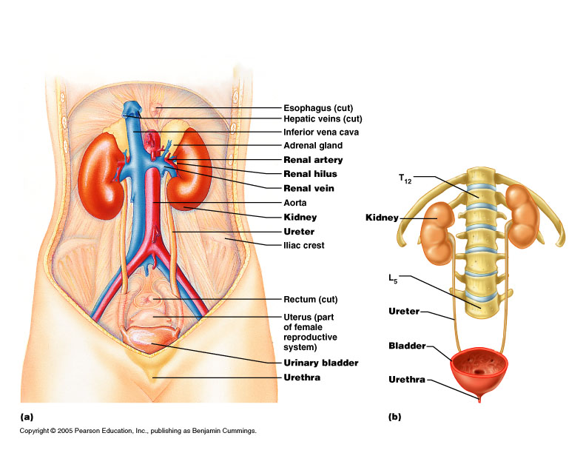
Ureters
- Paired muscular tubes
- Transport urine from kidneys to urinary bladder.
- Continues superiorly as renal pelvis
- Inferior to renal pelvis for ureteropelvic junction
- Descends as retroperitoneum - medial to psoas major muscle

Slide 22
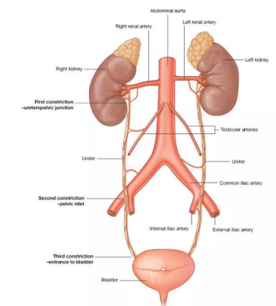
Constrictions of ureters
- at 3 points along their course the ureters are constricted
- 1st point is at the uretero-pelvic junction
- 2nd point is where they cross the common iliac vessels at pelvic brim
- 3rd point is where they enter the wall of the bladder
- kidney stones easily lodge at these points

Slide 23
Ureteric vasculature & lymphatics
Vasculature
- receive from adjacent vessels
1. Upper part – renal arteries
2. Middle part
abdominal aorta
testicular or ovarian arteries
common iliac arteries
3. Pelvic part - branches of internal iliac arteries
Lymphatics
- follow pattern of arterial supply
- upper part - lateral aortic (lumbar) nodes
- middle part - common iliac vessels lymph nodes
- pelvic part - associated to external & internal iliac vessels lymph nodes

Slide 24
Innervation
- from renal, aortic, superior hypogastric & inferior hypogastric plexuses through nerves that follow blood vessels
- visceral efferent fibers from both sympathetic & parasympathetic sources
- visceral afferent return to T11 to L2 spinal cord levels

Slide 25
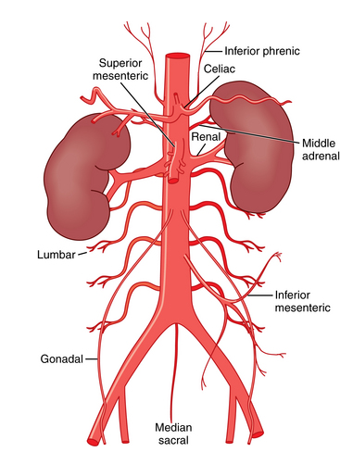
Abdominal Aorta
enters the abdomen through the aortic opening of the diaphragm
- opening lies in front of T12 vertebra
- descends retroperitoneal on the anterior surface of the bodies of the L1- L4 vertebrae
- divides into right & left common iliac arteries at L4

Slide 26
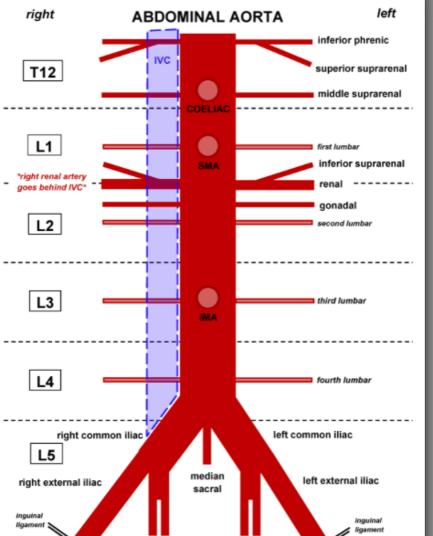
Branches of abdominal aorta
Classified as
= visceral branches
= posterior branches
= terminal branches

Slide 27
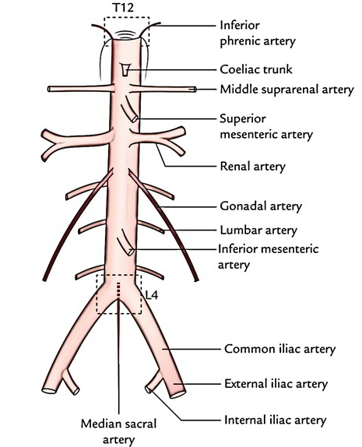
Visceral branches
- either paired or unpaired
- 3 unpaired anterior vessels:
= celiac artery supply foregut
= superior mesenteric artery supply midgut
= inferior mesenteric artery supply hindgut
- 3 paired lateral vessels
= middle suprarenal arteries
= renal arteries
= testicular or ovarian arteries

Slide 28
Posterior branches
- supply the abdominal wall & diaphragm:
= the inferior phrenic artery
= 4 pairs of lumbar arteries
- 3 terminal branches:
= two common iliac
= median sacral artery

Slide 29
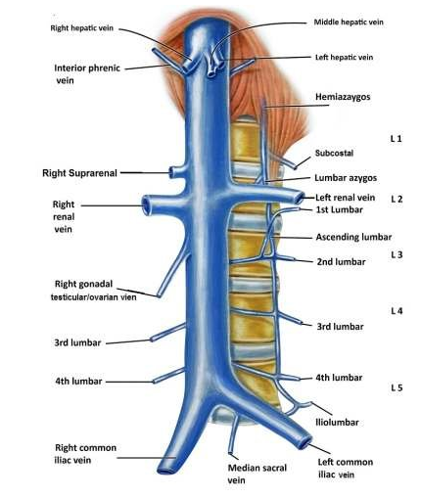
Inferior vena cava
- returns blood from all structures below the diaphragm to the right atrium of the heart
- formed by the union of 2 common iliac veins at the level of L5 vertebra
- ascends on the right side of the aorta
- Pierces the central tendon of the diaphragm at the level of the T8 vertebra

Slide 30
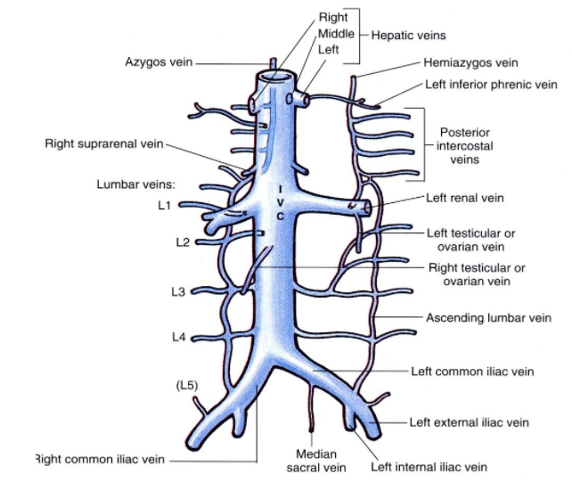
Tributaries
- hepatic veins
- right suprarenal vein
- renal veins
- right testicular/ovarian v.
- inferior phrenic vein
- lumbar veins
- common iliac veins
- median sacral vein

Slide 31
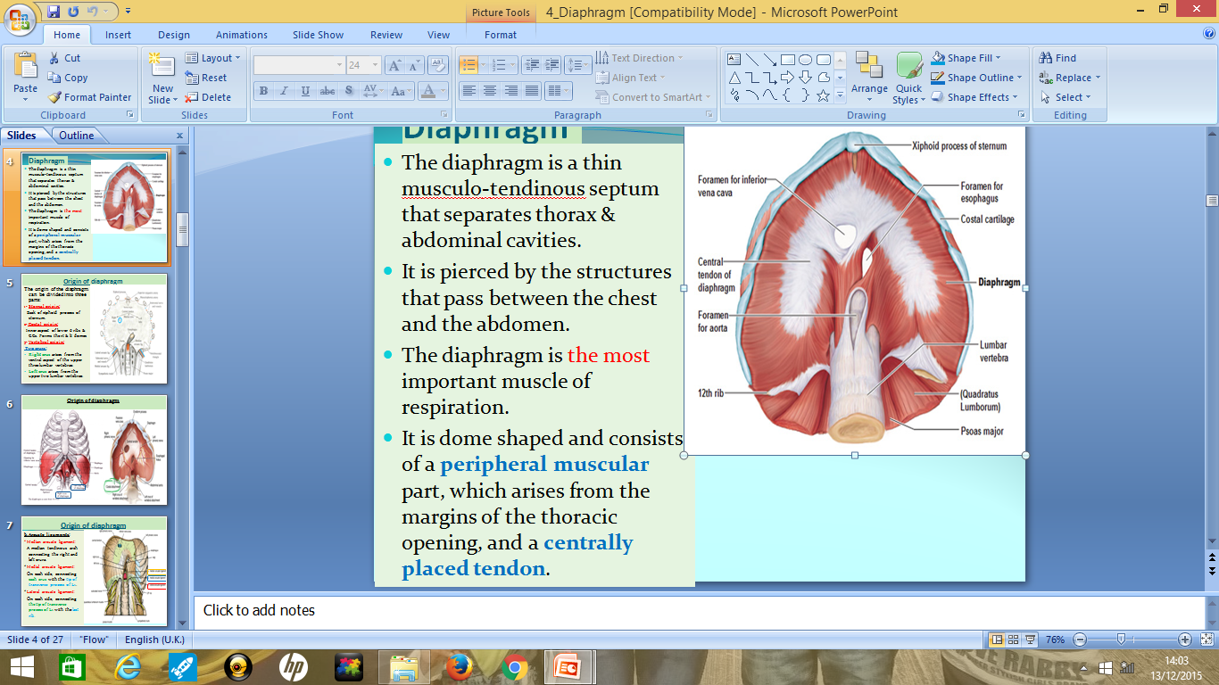
Diaphragm
The diaphragm is a thin musculo-tendinous septum that separates thorax & abdominal cavities
Superiorly, the diaphragm forms the boundary of the abdominal cavity.
It is pierced by the structures that pass between the chest and the abdomen

Slide 32
Diaphragm
The diaphragm is the most important muscle of respiration.
It is dome shaped and consists of a peripheral muscular part, which arises from the margins of the inferior thoracic aperture and a centrally placed tendon.

Slide 33
Origin of diaphragm
Three parts:
1- Sternal origin:
Back of xiphoid process of sternum.
2- Costal origin:
Inner aspect of lower 6 ribs & Costal Cartilages.
3- Vertebral origin:
Right crus arises from the ventral aspect of the upper three lumbar vertebrae.
Left crus arises from the upper two lumbar vertebrae.

Slide 34
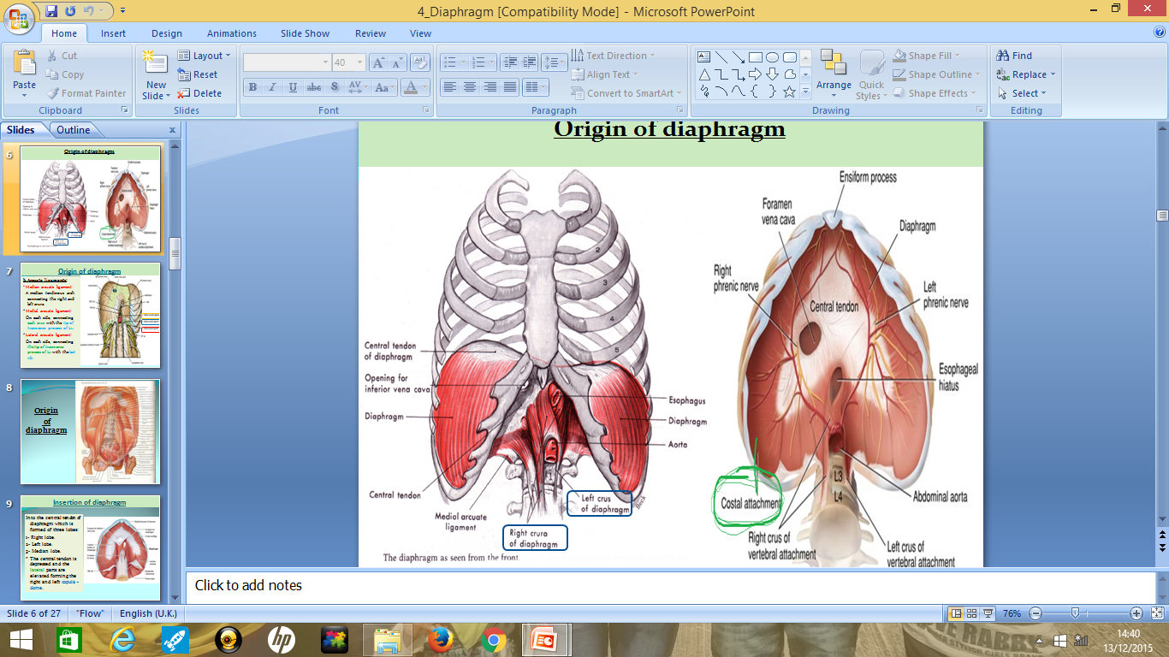

Slide 35
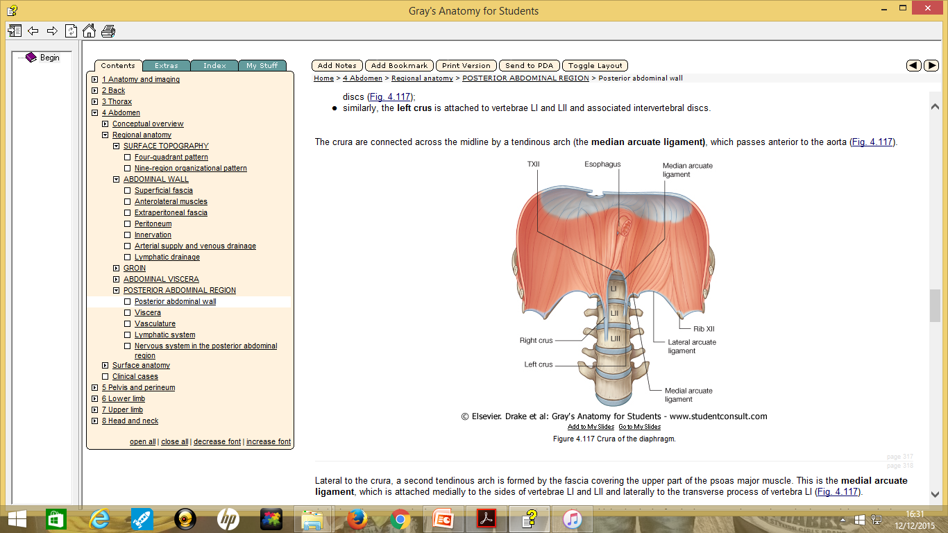
Arcuate ligaments
Median arcuate ligament - connects the right and left crura.
Medial arcuate ligament - connect each crus with the tip of transverse process of L1.
Lateral arcuate ligament - connecting the tip of transverse process of L1 with the last rib.

Slide 36
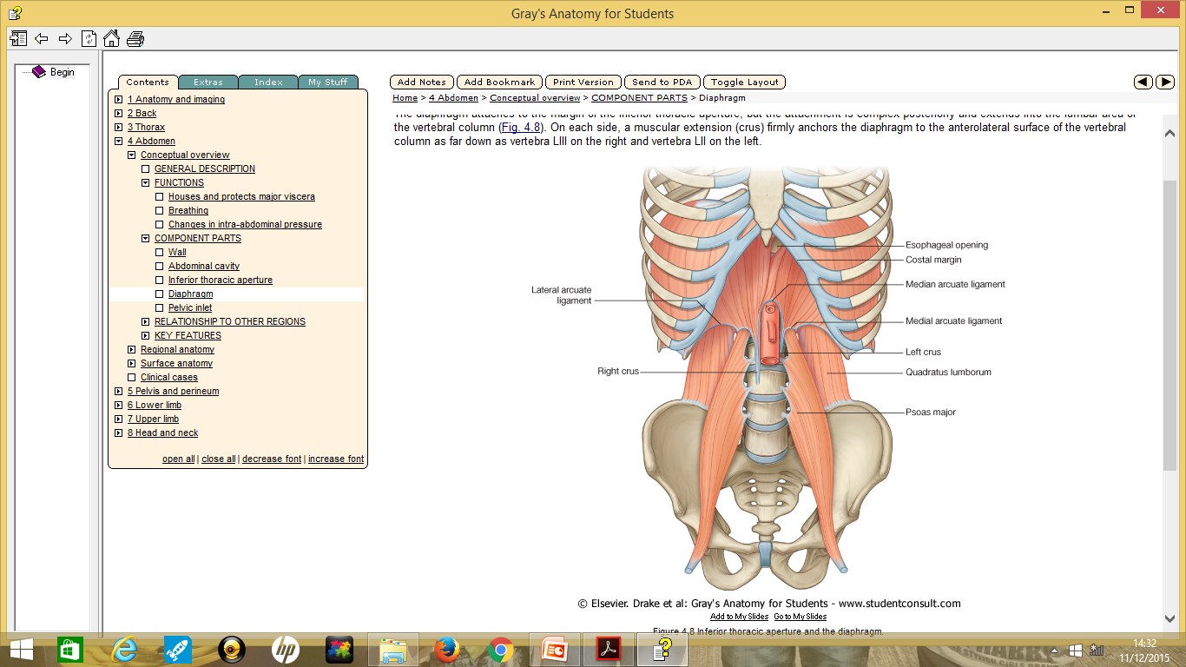

Slide 37
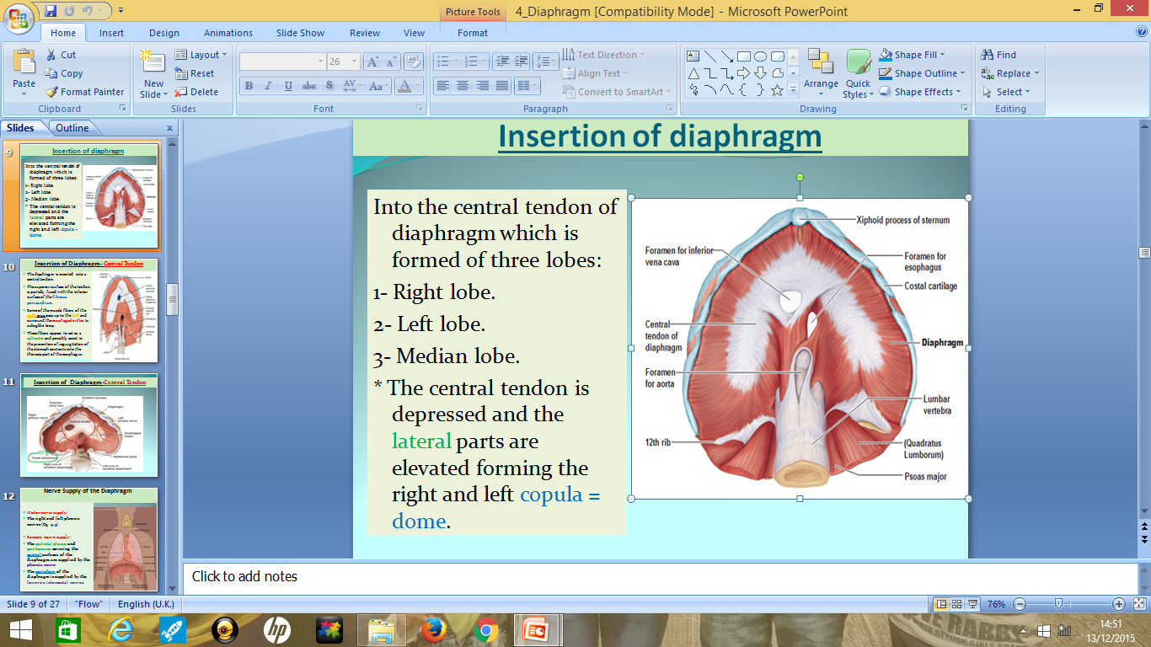
Insertion of the diaphragm
Into the central tendon of diaphragm which is formed of three lobes:
1- Right lobe.
2- Left lobe.
3- Median lobe.

Slide 38
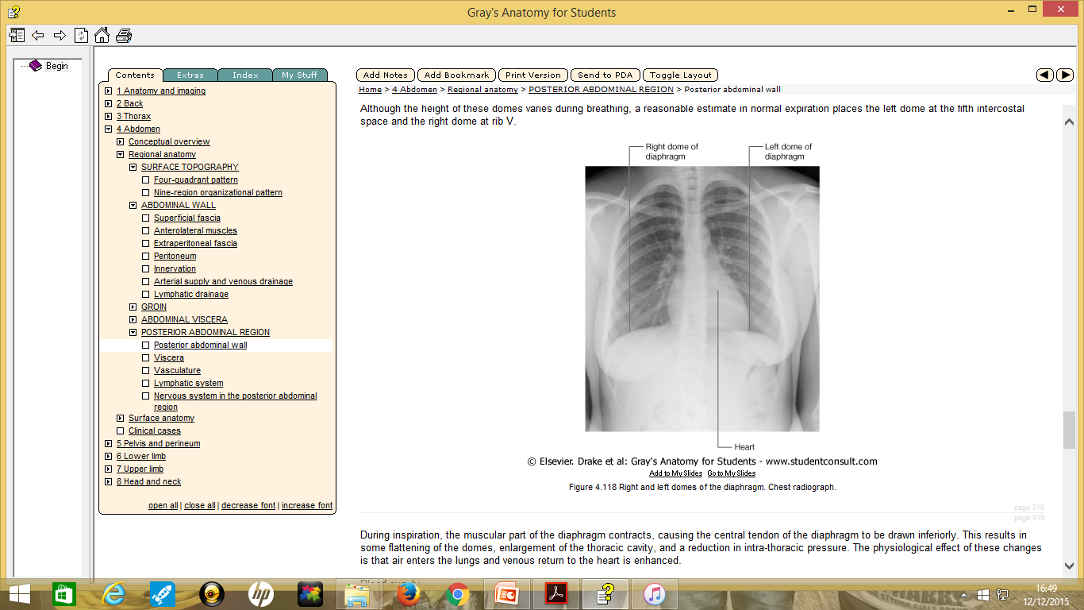
Diaphragm and pericardium
Pericardial sac is situated on the anterior half of the diaphragm; one third to the right of the median plane and two thirds to the left.

Slide 39
Nerve Supply of the Diaphragm
Motor nerve supply:
The right and left phrenic nerves (C3, 4, 5)
Sensory nerve supply:
The parietal pleura and peritoneum covering the central surfaces of the diaphragm are supplied by the phrenic nerve
The periphery of the diaphragm is supplied by the lower six intercostal nerves.

Slide 40
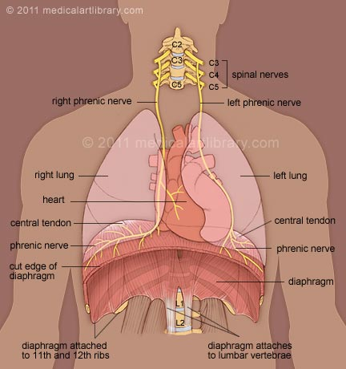

Slide 41
Actions of the diaphragm
Muscle of inspiration:
On contraction the diaphragm pulls its central tendon down and increases the vertical diameter of the thorax. The diaphragm is the most important muscle used in inspiration
2. Increase the intra abdominal pressure in forced actions:
Assists the contraction of the muscles of the anterior abdominal wall in raising the intra-abdominal pressure for micturition, defecation, and parturition
3. Right crus acts as a sphincter to the lower end of esophagus.

Slide 42
Action continues
4- Thoracoabdominal pump:
The descent of the diaphragm decreases the intrathoracic pressure & increases the intra-abdominal pressure.
This compresses the blood in the inferior vena cava and forces it upward into the right atrium of the heart.
The abdominal lymph vessels are also compressed, and its passage upward within the thoracic duct is aided by the negative intrathoracic pressure.

Slide 43
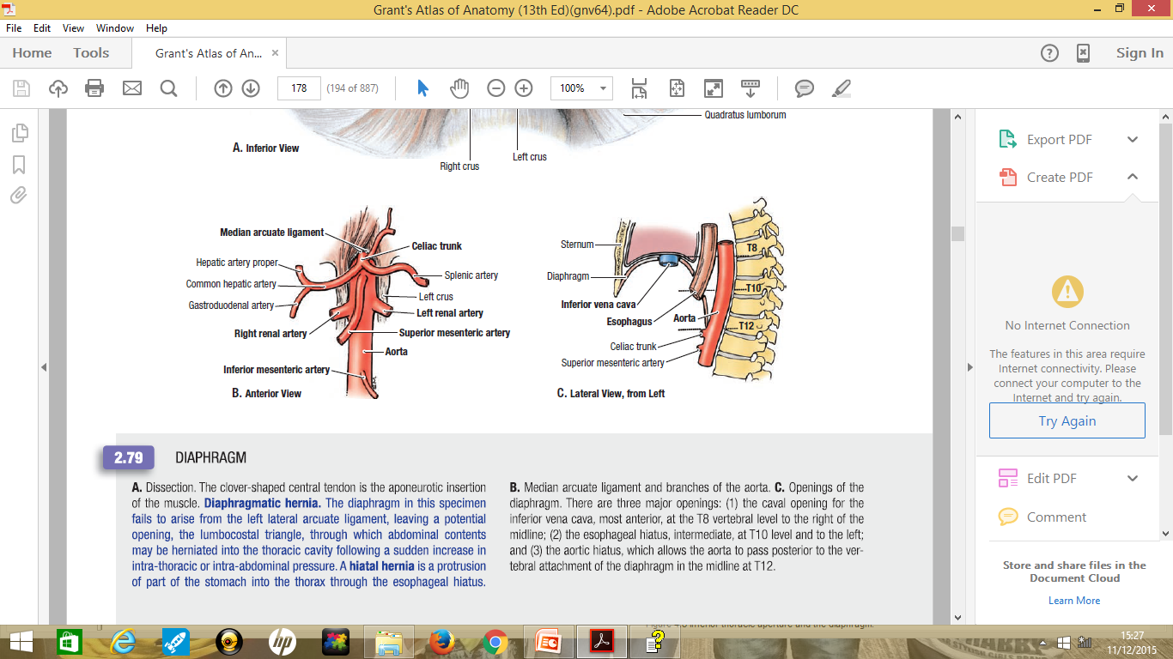
MAJOR OPENINGS OF THE DIAPHRAGM
Caval opening of the IVC -most anterior at T8 vertebral level to the right of the mid-line.
Esophageal hiatus- immediate at T10 level and to the left.
Aortic hiatus –which allows the aorta to pass posterior to the attachment of the diaphragm in the midline at T12.

Slide 44
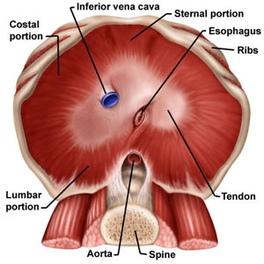
1- IVC opening
A. Site: In the central tendon of diaphragm between right and median lobe.
B. Level: T8
C. Structures passing through:
1)Inferior vena cava.
2)Right phrenic nerve.
3)Lymphatics.

Slide 45
2- Aortic opening:
A. Site: Median arcuate ligament.
B. Level: T12
C. Structures passing through:
1)Aorta.
2)Azygos vein.
3)Thoracic duct.

Slide 46
3- Oesophageal opening
Site: Right crus at T10
Structures passing through:
1) Oesophagus.
2) Vagus
3) Anastomotic branches between left gastric and aortic oesophageal arteries.

Slide 47
Other structures passing through the diaphragm
1. Splanchnic nerves which pierce the crura.
2. Inferior hemiazygos vein which pierce the left crus.
3. Sympathetic trunk (pass deep to the medial arcuate ligament).
4. Psoas major
5. Quadratus lumborum
6. Subcostal nerve
(Pass deep to the lateral arcuate ligament).

Slide 48
Other structures passing through the diaphragm
7-Lower five intercostal Nerves and vessels.
8-Superior epigastric vessels.
9-Musculophrenic vessels.
10- Lt phrenic nerve

Slide 49
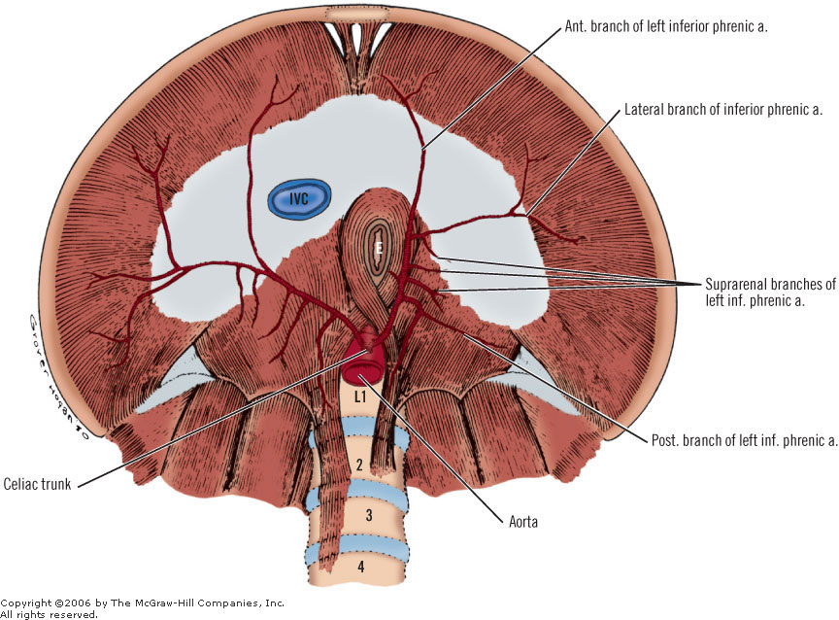
BLOOD SUPPLY
superiorly
  Musculophrenic
  pericardiacophrenic arteries, both branches of the internal thoracic artery, and the
  superior phrenic artery, a branch of the thoracic aorta
inferiorly
  inferior phrenic arteries, branches of the abdominal aorta

Slide 50
Venous drainage
Venous drainage is through companion veins to these arteries

Slide 51
Clinical correlates
Irritation to the mediastinal and central diaphragmatic areas of the parietal pleura results in pain that is referred to the root of the neck and over the shoulder ( C3-C5 dermatomes)

Slide 52
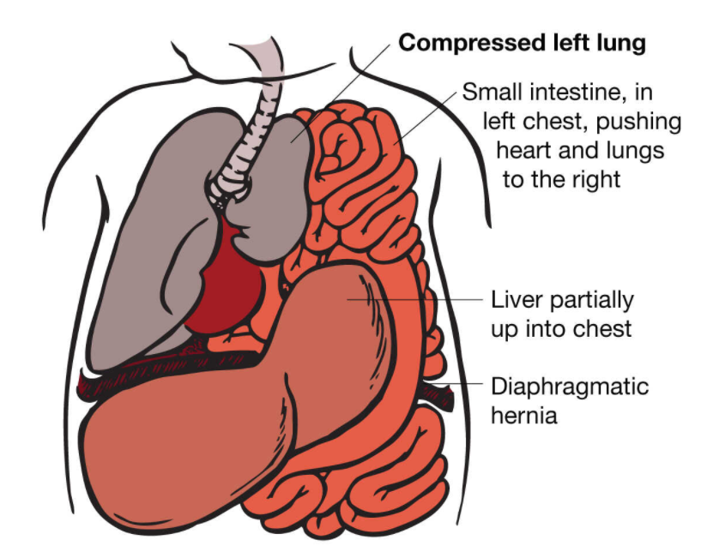
Diaphragmatic hernias
Hiatal hernia
Protrusion of part of the stomach into the thorax through the esophageal hiatus.
Hernias may also occur through the central tendon and through a congenitally large esophageal hiatus

Slide 53
Morgagni's (retrosternal or parasternal hernia)
Herniation through the foramen of morgagni located near and posterior to xiphoid process
Bochdalek's hernia (posterolateral diaphragmatic hernia)
Hole in the posterolateral corner of diaphragm
Both Tend to present at or around the time of birth or in early infancy. They allow abdominal bowel to enter the thoracic cavity, which may compress the lungs and reduce respiratory function

Slide 54
LUMBAR PLEXUS
This network is composed of the anterior rami of L1-L4 nerves
Lies within the psoas major muscle
Innervates anterior and medial muscles of thigh through femoral and obturator nerves respectively
Femoral nerve also innervates skin on anterior thigh (including quads) and medial leg

Slide 55
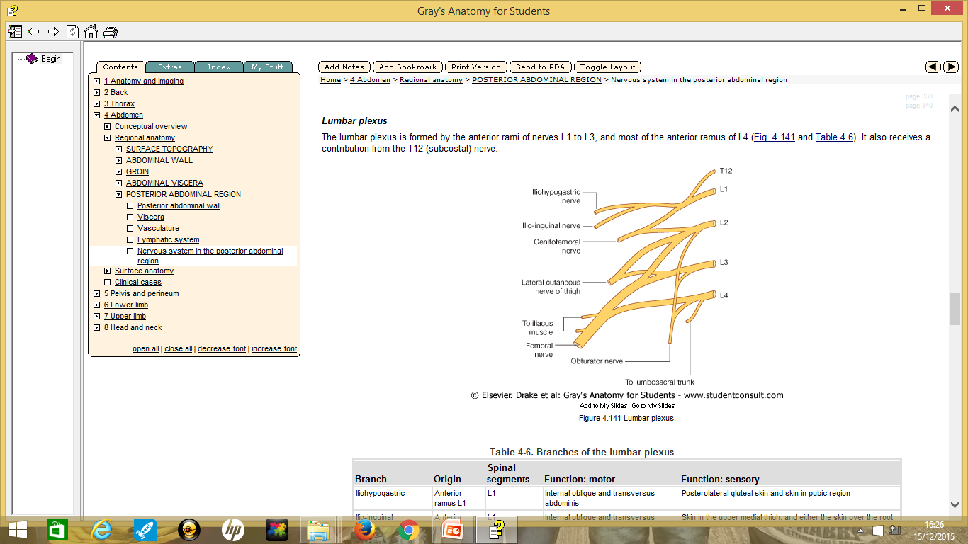

Slide 56
BRANCHES OF THE LUMBAR
iliohypogastric
ilio-inguinal
Genitofemoral
Lateral cutaneous nerve of thigh (lateral femoral cutaneous)
Femoral
Obturator nerves.

Slide 57
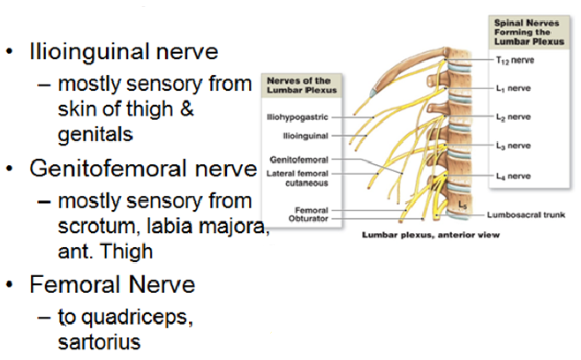
Lumber plexus

Slide 58
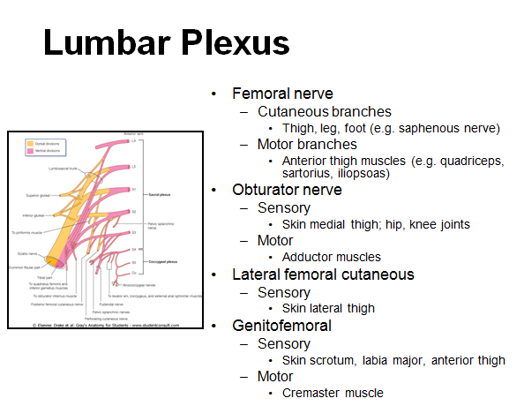

Slide 59
Reference Books
1. Standring, Susan and Standring (2015).Gray's anatomy. 41st International edition, Elsevier Health Sciences. ISBN 9780702052309.
2. Keith L. Moore, Arthur F. Dalley, Anne M. R. Agur (2017). Moore's Clinically Oriented Anatomy, 8th edition, Walter Kluwer. ISBN 9781496347213.
3. Alan J. Detton (2020). Grant’s Dissector. 17th edition, Lippincott Williams & Wilkins. ISBN 9781975134600.
4. Adrian Kendal Dixon, David J. Bowden, Bari M. Logan and Harold Ellis (2017). Human Sectional Anatomy - Pocket atlas of body sections, CT and MRI images, 4th edition, CRC Press. ISBN 9781498708548.

Slide 60
The End
Thank you

