Slide 1
Back Of The Thigh & Popliteal Fossa
Presenter: Mr.KABANGASHESHE
Moderator : Dr ZULU

Slide 2
Posterior/back Of The Thigh
- The region between the Hip & Knee Joints
- It is divided into 3 compartments by the Intermuscular Septa; Anterior, Medial & Posterior***
- The posterior compartment consists of muscles that Extend the thigh at the Hip & Flex the leg at the Knee joints
- These muscles are innervated by Sciatic Nerve (L 4, 5 - S 1, 2, 3)

Slide 3
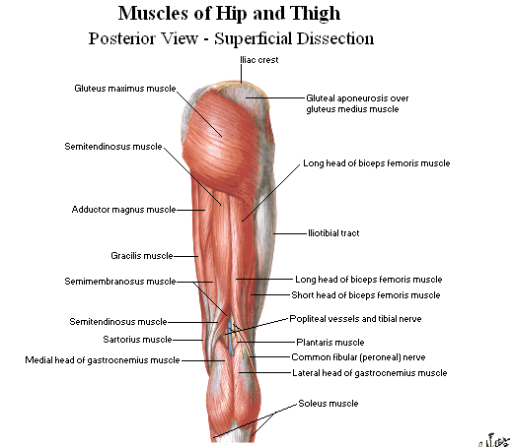

Slide 4
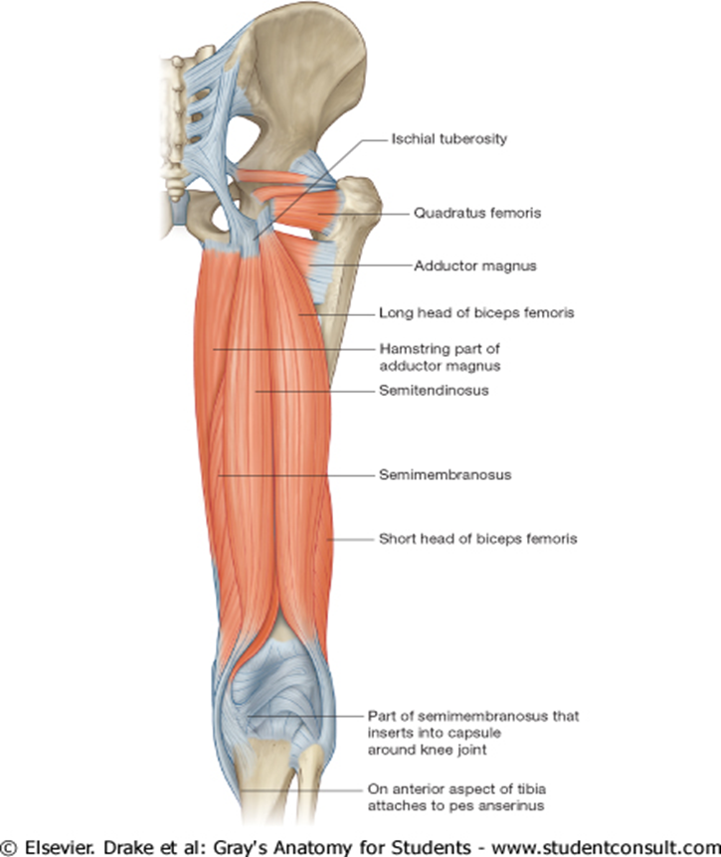
Muscles OF THE Posterior Thigh
3 long muscles of the posterior compartment of the thigh
Biceps Femoris
Semitendinosus
Semimembranosus
Collectively known as Hamstrings
- All Except Short head of Biceps Femoris cross both Hip & Knee Joint

Slide 6
Biceps Femoris
Origin
Short head: Linea Aspera
Long head: Ischial tuberosity
Insert: Head of fibula
Innervation: Sciatic nerve
Action: Extend the hip joint, flex &
lateral rotates

Slide 7
Semitendinosus
origin: Ischial tuberosity
Insert: Proximal medial Tibia (Pes Anserinus)
Nerve: Tibial division of sciatic Nerve
Action: Extend the hip joint, flex knee & medial rotates both joints

Slide 8
Semimembranosus
Origin: Ischial tuberosity
Insert: Medial Tibial condyle & capsule of the knee joint
Innervation: Tibial division of sciatic
Action: extend the hip joint, flex knee & medial rotates both joints

Slide 9
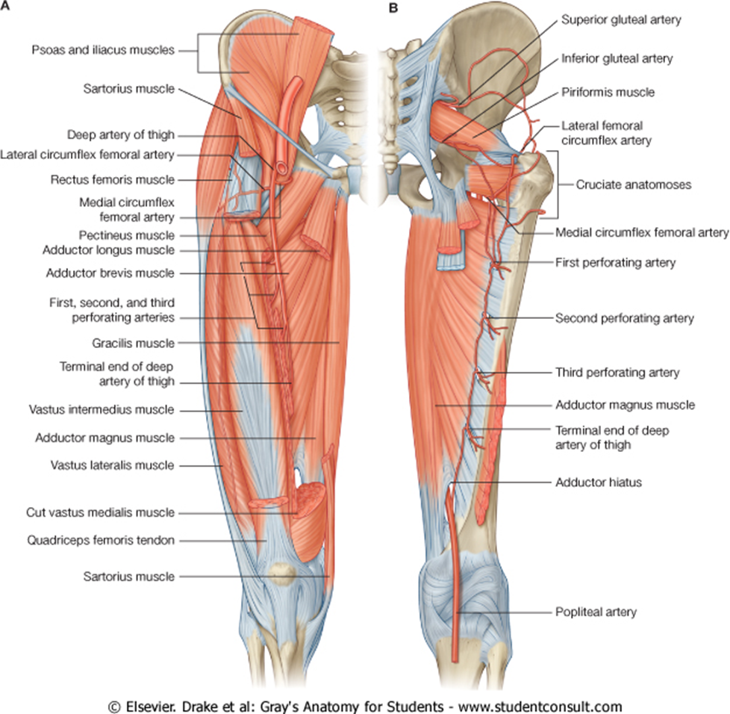
Neurovascular
A.Blood supply: 4 perforating Arteries, branches from the Profunda Femoris Artery
B.Venous drainage : profunda femoris vein
C.Innevertion: - sciatic nerve
D.Lymphatics: - drains into the superficial inguinal nodes
- Deep nodes follows blood vessel into pelvic cavity to internal iliac nodes

Slide 11
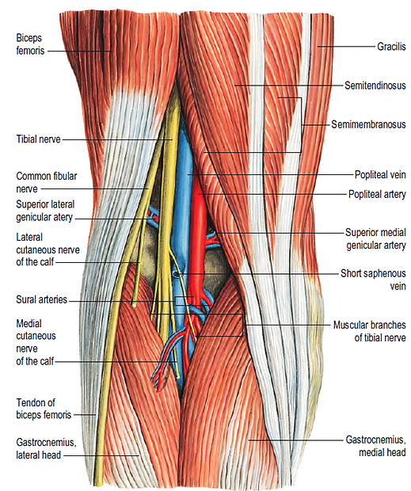
The Popliteal Fossa
Diamond-shaped hollow situated behind the knee joint.
Boundaries
Superolateral: Tendon of biceps femoris
Superomedial: Tendons of semitendinosus & semimembranosus muscles
Inferolateral: Lateral head of gastrocnemius & plantaris muscles
Inferomedial: Medial head of gastrocnemius muscle
Roof: popliteal fascia, small saphenous vein, superficial lymphatics and posterior cutaneous nerve
Floor: popliteal surface of femur, fibrous capsule & fascia covering popliteus Muscles

Slide 13

Contents
Popliteal artery and its branches
Popliteal vein and its tributaries
Terminal branches of the sciatic nerve (Tibial & common peroneal nerves)
Posterior cutaneous nerve of thigh
Descending genicular branch of the posterior division of the obturator nerve
Popliteal lymph nodes

Slide 14
Some Applied anatomy
Effusion of the knee
Fractures of patella
Dislocations knee joint
Osgood-Schlatter disease; inflammation of the area just below the knee where the ligamentum patellae attaches to the tibia
Chondromalacia patella (also called patellofemoral syndrome): Irritation of the cartilage on the underside of the patella
Arthritis i.e. osteoarthritis, rheumatoid, septic

Slide 15
REFERENCES
Atlas of Human Anatomy, 6th Edition. Frank H Netter MD. Philadelphia, 2014
Gray`s Anatomy The Anatomical Basis of Clinical Practice 40th Edition. Susan Standring. 2008.
Grant`s Atlas of Anatomy, 12th Edition. Anne

