Slide 1
THE FOOT
Mr. M. Banda
University of Zambia

Slide 2
Objectives
Describe the osteological features of the foot bones
Describe the muscles of the dorsum of the foot.
Describe the muscles of plantar foot.
Discuss the Clinical correlates of the foot.

Slide 3
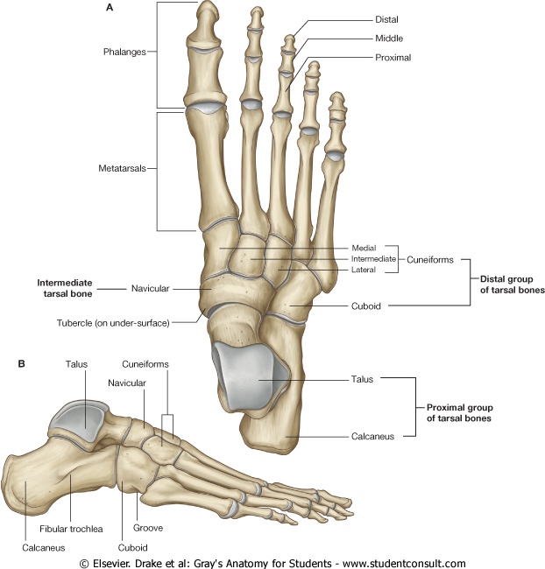
Foot
Region of lower limb distal to ankle joint.
Supports body weight
Act as a lever to propel the body
Subdivisions:
    Hindfoot (Rear foot)
      Talus & calcaneus
    Midfoot
      Navicular, three cuneiforms & cuboid
    Forefoot
      Metatarsals & Phalanges

Slide 4
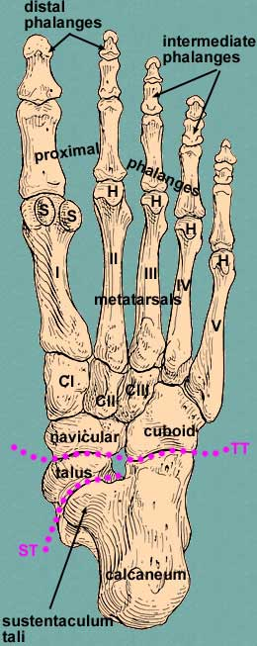
Bone Anatomy
Three groups of bones in the foot
  Tarsal bones - form skeletal framework for the ankle
  Metatarsals (I to V)
  Phalanges - bones of the toes
  Sesamoid bones
    Present at metatarsophalangeal (MTP) joint of great toe
    Protect the tendon that flexes the toe

Slide 5
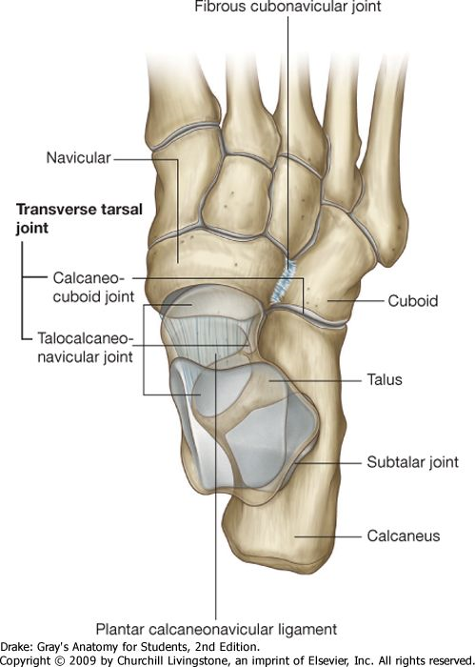
Articulations
Joints of mid foot
  Talocalcaneonavicular
  Calcaneocuboid
  Cuboideonavicular
  Intercuneiform
  Cuneocuboid
  Cuneonavicular
Fore-foot joints
Tarsometatarsal (Lisfranc’s Joint)
Intermetatarsal
Metatarsophalangeal
Interphalangeal
  PIP
  DIP

Slide 6
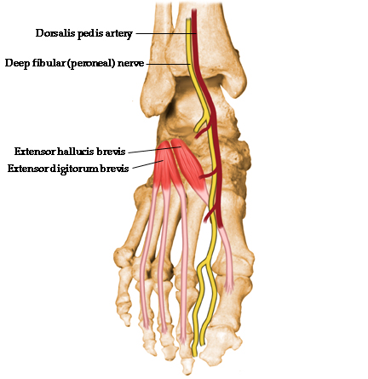
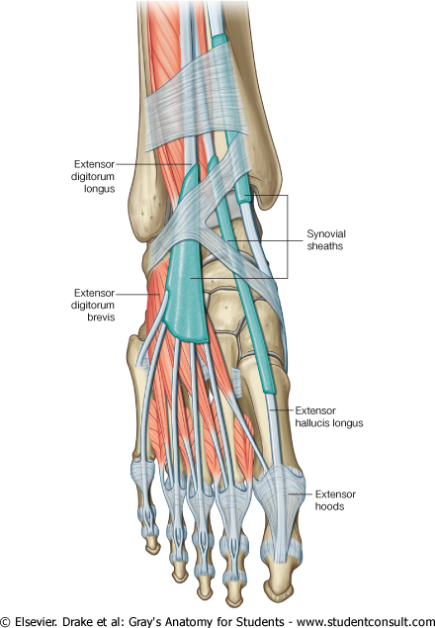
Dorsum of the Foot Muscles
Extrinsic and Intrinsic muscles
  Intrinsic muscles
    Originate and insert in the foot
  Extrinsic muscles
    Anterior compartment muscles of the leg
    Lateral compartment muscles of the leg

Slide 7
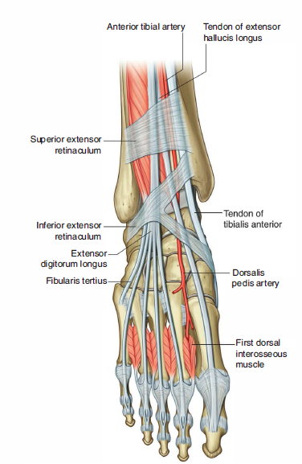
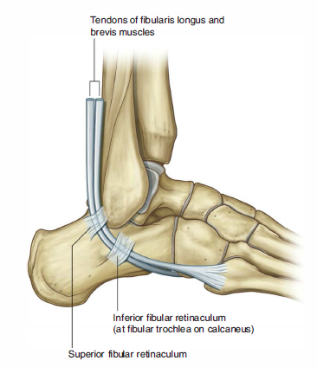
Tendons of the anterior and posterior compartments

Slide 8
Dorsal Surface - Intrinsic foot muscles
1. Extensor Digitorum Brevis
The only intrinsic muscle on the dorsal surface
Origin:
Calcaneum
Insertion:
By four tendons into the proximal phalanx of the toes
Innervation
Deep peroneal
Action:
Extends toes

Slide 9
Dorsal Surface - Intrinsic foot muscles
2. Extensor hallucis brevis
Origin – calcaneum
Insertion – base of proximal phalanx of great toe.
Innervation – deep peroneal.
Action – extends great toe

Slide 10
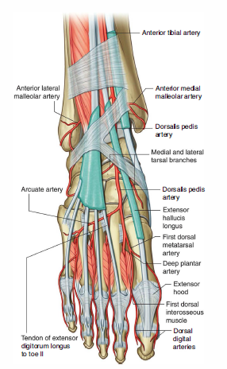
Dorsalis Pedis Artery
Arises at anterior aspect of ankle joint as a continuation of anterior tibial artery
Supplies the dorsum of the foot

Slide 11
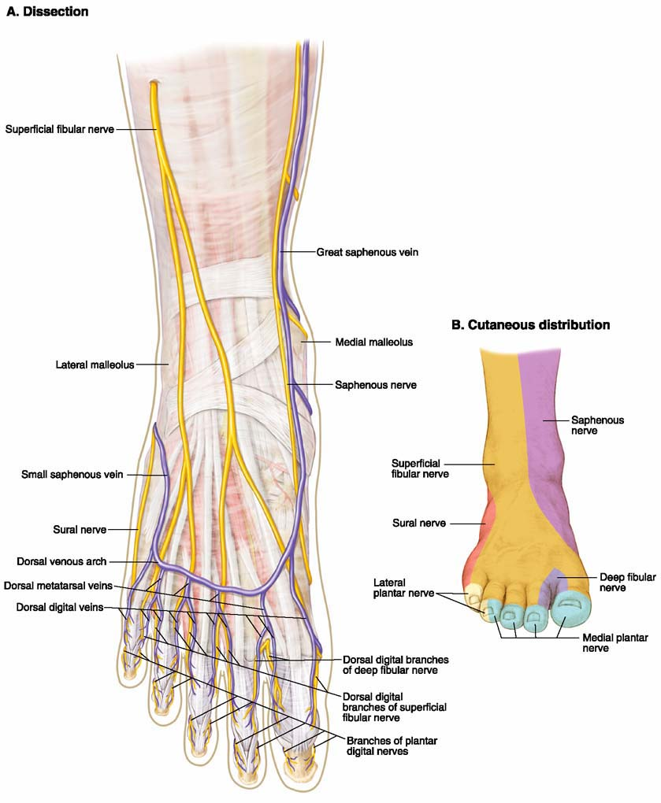
Dorsal Venous Arch
Lies in subcutaneous tissue over heads of metatarsals
Drainage
  Great saphenous vein
  Small saphenous vein

Slide 12
Dorsum of the Foot
Thin skin, hairy, and freely mobile on underlying tendons and bones.
Sensory nerve supply:
  Superficial peroneal nerve
  Deep peroneal nerve
  Saphenous nerve
  Sural nerve
  Nail beds and skin covering dorsal surfaces of terminal phalanges are supplied by medial and lateral plantar nerves

Slide 13
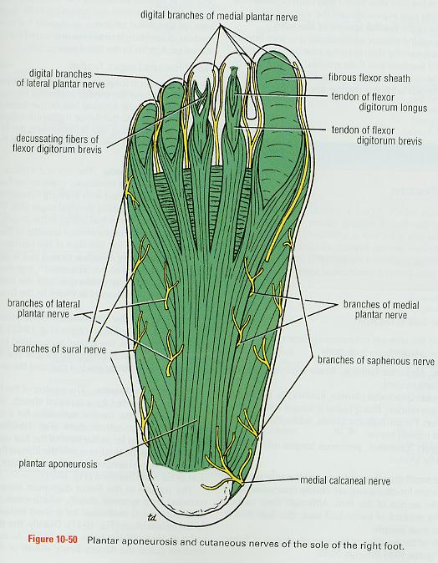
Sole of the foot
Skin
Cutaneous nerves
Superficial fascia
Deep fascia
Muscles

Slide 14
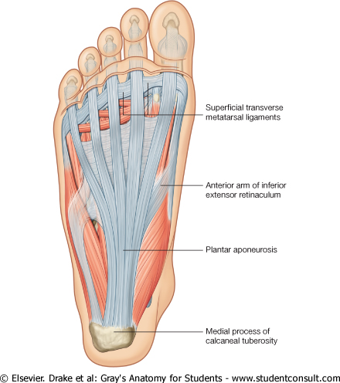
Plantar Aponeurosis
  Thickening of deep fascia in the sole of the foot
    Apex
    Base
Function
  Fixes the skin of the sole
  Protects deeper structures
  Maintain the longitudinal arches of the foot
  Origin of muscles of the first layer of the sole

Slide 15
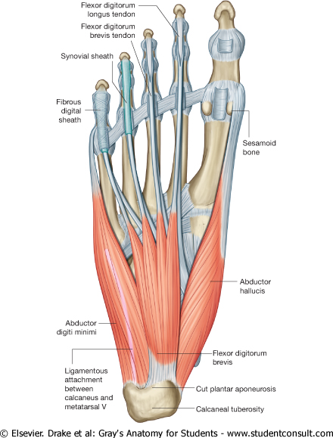
Muscles in the sole of the foot
Organized into four layers. From superficial to deep ( plantar to dorsal)
  First layer
    Flexor digitorum brevis
    Abductor hallucis
    Abductor digiti minimi
  Second layer
    Flexor digitorum longus
    Flexor digitorum accessorius (quadratus plantae)
    Lumbricals
    Flexor hallucis longus
  Third layer
    Flexor hallucis brevis
    Adductor hallucis
    Flexor digit minimi brevis
  Fourth layer
    Interosseous muscles

Slide 16
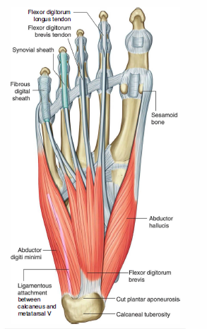
Muscles of First layer
Flexor digitorum brevis
Origin
  Medial tubercle of calcaneum, plantar aponeurosis
Insertion
  Four lateral toes at bases of middle phalanges
Nerve supply
  Medial planter nerve
Action
  Flexion of toes at proximal IP and MTP joints

Slide 17
2. Abductor hallucis
Origin:
  Medial tubercle of calcaneum, flexor retinaculum, deep fascia covering and medial intermuscular septum
Insertion
  Medial side of the base of proximal phalanx of great toe
Nerve supply
  Medial plantar nerve
Action
  Abduction of great toe

Slide 18
3. Abductor Digiti Minimi
Origin
  Medial and lateral tubercles of calcaneum
  Insertion
  Lateral side of base of proximal phalanx of little toe
Nerve supply
  Main trunk of lateral plantar nerve
Action
  Abduction of little toe

Slide 19
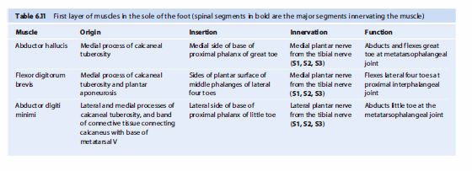
Muscles of First layer

Slide 20
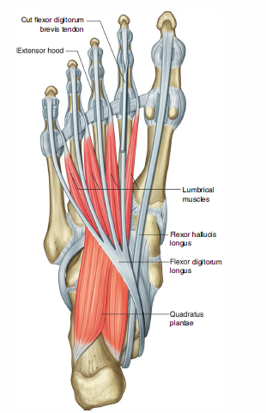
Muscles of the Second Layer
1. Flexor Digitorum Accessorius (Quadratus Plantae)
Origin:
Medial head from medial calcaneum
Lateral head in front of the lateral tubercle
Insertion
Lateral side of tendon of flexor digitorum longus
Nerve supply
Main trunk of lateral plantar nerve
Action
Straightens the pull of long flexor tendons and flexes the toes through the long tendons

Slide 21
2. Lumbricals
Origin:
Tendons of long flexor digitorum longus
Insertion:
Medial sides of MTP joints of lateral toes and then dorsally for the insertion into the extensor expansion
Nerve supply
1st by medial plantar nerve and other 3 by deep branch of lateral plantar nerve
Action
Maintain extension of digits at IP joints when walking and running the toes do not buckle under

Slide 22
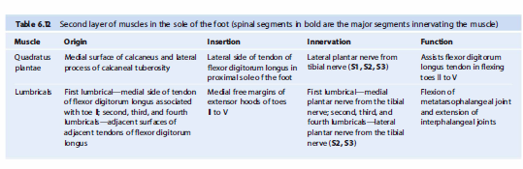
Muscles of the Second Layer

Slide 23
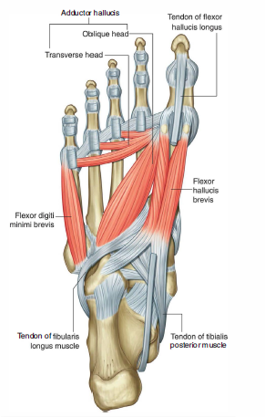
Muscles of the Third Layer
1. Flexor hallucis brevis
Origin:
Y shaped, lateral limb from medial part of plantar surface of cuboid bone and medial limb direct continuation of the tendon of tibialis posterior into the foot
Insertion:
2 slips into lateral and medial parts - base of proximal phalanx of the great toe
Nerve supply
Medial plantar nerve
Action
Flexes proximal phalanx at MTP joint of great toe

Slide 24
2. Adductor hallucis
origin:
  Transverse head-ligaments MTP joints of lateral 3 toes; oblique head-bases of metatarsals II to IV and from sheath covering fibularis longus
Insertion:
  Lateral side of base of proximal phalanx of big toe
Nerve supply
  deep branch of lateral plantar nerve
Action
  Adductor of great toe towards the second toe and maintains transverse arch of the foot

Slide 25
3. Flexor digiti minimi brevis
Origin:
  Base of 5th metatarsal bone and sheath of tendon of peroneus longus
Insertion:
  Lateral side of base of proximal phalanx of little toe
Nerve supply
  Superficial branch of lateral plantar nerve
Action
  Flexes proximal phalanx at MTP joint of little toe

Slide 26
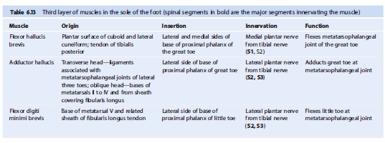
Muscles of the Third Layer

Slide 27
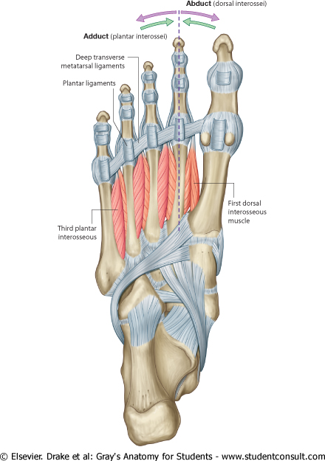
Muscles of the Fourth layer
Interosseous muscles
  3 plantar interossei
  4 dorsal interossei
Action
  Plantar interossei are adductors of 3rd 4th & 5th toes
  Dorsal interossei are abductors.

Slide 28
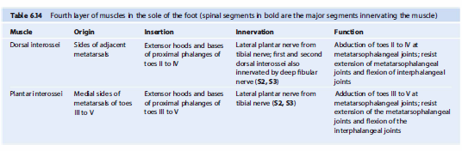
Muscles of the Fourth layer

Slide 29
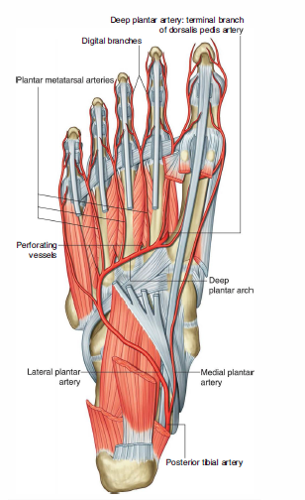
Arteries

Slide 30
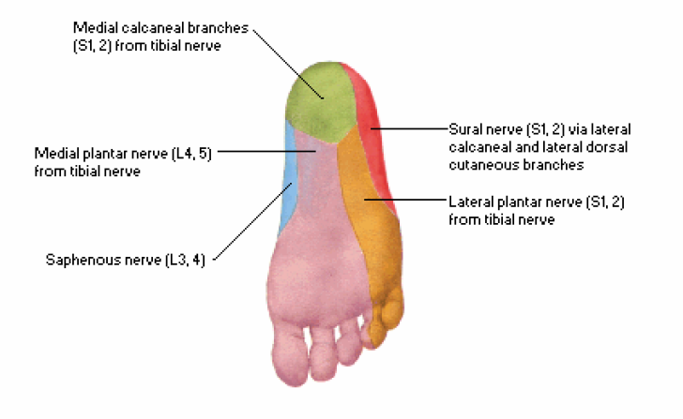
Skin
Thick and hairless.
few flexure creases at the sites of skin movement
Sweat glands present in large numbers
Sensory nerve supply
  Medial calcaneal branch of tibial nerve, innervates medial side of the heel
  Medial plantar nerve innervate medial two thirds of the sole
  Lateral plantar nerve, supply lateral third of the sole

Slide 31
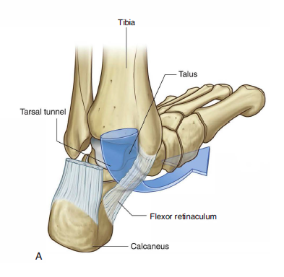
Tarsal Tunnel
Formed on the posteromedial side of the ankle by:
medial malleolus of the tibia
medial and posterior surfaces of the talus
Medial surface of the calcaneus
inferior surface of the sustentaculum tali of the calcaneus
overlying flexor retinaculum

Slide 32
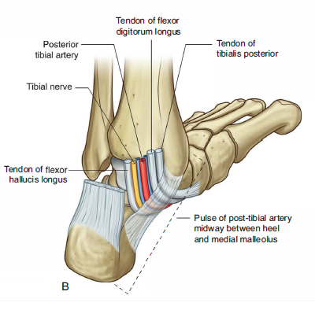
Tarsal Tunnel
Contents
Tendon of the Tibialis Posterior
Tendon of the Flexor Digitorum Longus
Tendon of Flexor Hallucis Longus
Posterior Tibial Artery
Tibial Nerve

Slide 33
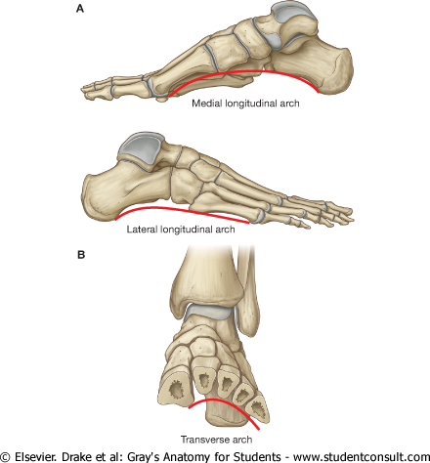
Arches of the foot
1. Longitudinal arch:
has 2 parts
Medial longitudinal arch
Lateral longitudinal arch

Slide 34
Arches of the foot
2. Transverse arch:
found between medial and lateral aspects of the foot formed by the navicular, 3 cuneiform and the bases of the five metatarsals.

Slide 35
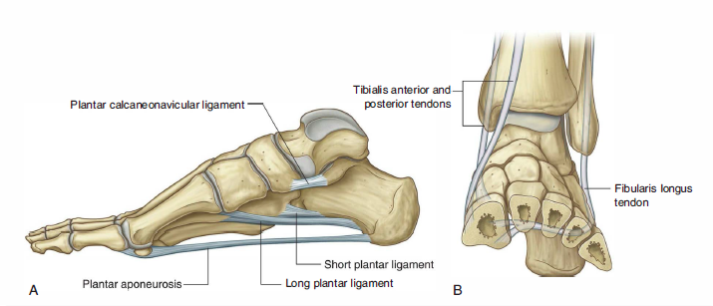
Tendons supporting the arches of the foot

Slide 36
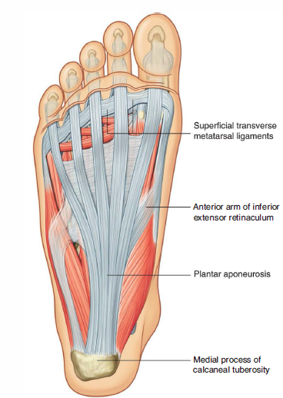
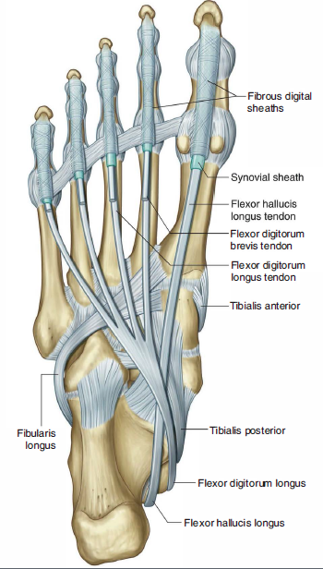

Slide 37
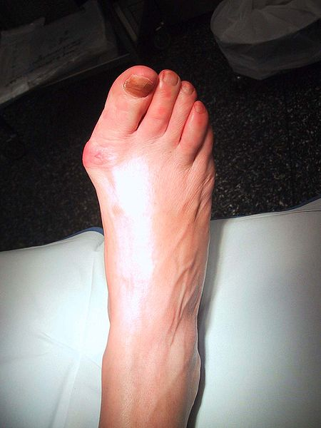
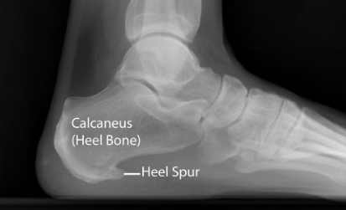
Clinical Correlates
      Hallux valgus
Tarsal Tunnel Syndrome
Calcaneal spur – due to constant stress on the heel leading to deposits of calcium
Plantar fascitis – chronic local inflammation of the ligament under the sole of the foot
Hallux valgus – medial deviation of the 1st metatarsal, lateral deviation or rotation of the hallux as a result of the pull of the conjoined adductor tendon, extensor/flexor hallucis longus tendon
      Calcaneal Spur

Slide 38
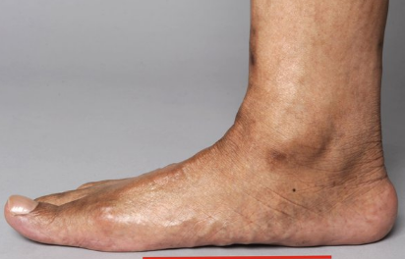
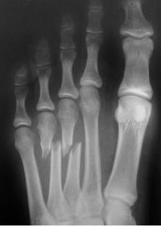
Clinical Correlates
Pes planus (flat foot) – condition in the longitudinal arch has not developed normally
Pes planus
Metatarsal fractures

Slide 39
Reference Books
1. Standring, Susan and Standring (2015).Gray's anatomy. 41st International edition, Elsevier Health Sciences. ISBN 9780702052309.
2. Keith L. Moore, Arthur F. Dalley, Anne M. R. Agur (2017). Moore's Clinically Oriented Anatomy, 8th edition, Walter Kluwer. ISBN 9781496347213.
3. Alan J. Detton (2020). Grant’s Dissector. 17th edition, Lippincott Williams & Wilkins. ISBN 9781975134600.
4. Adrian Kendal Dixon, David J. Bowden, Bari M. Logan and Harold Ellis (2017). Human Sectional Anatomy - Pocket atlas of body sections, CT and MRI images, 4th edition, CRC Press. ISBN 9781498708548.

Slide 40
THANK YOU

