Slide 1
Rectum and Anal Canal
Mr. M. Banda

Slide 2
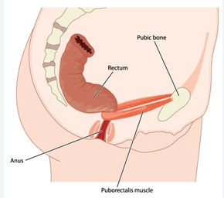
Rectum
Rectum is continuous with the sigmoid colon at the level of S3 or at the end of the sigmoid mesocolon because the rectum is a retroperitoneal structure
Terminates at the upper end of the anal canal
The anorectal junction is 2–3 cm in front of and slightly below the tip of the coccyx

Slide 3
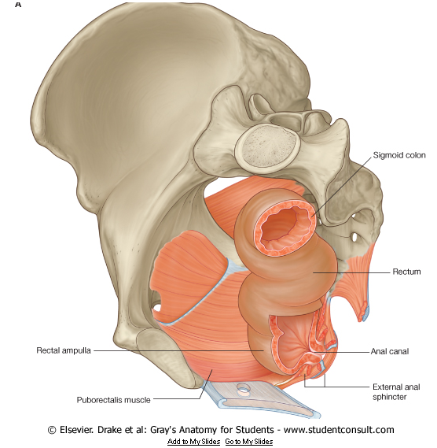
Rectum: Curvatures
The rectum also deviates in three lateral curves: upper, convex to the right; middle, convex to the left; lower, convex to the right
Anteroposterior curvatures: sacral and anorectal curvature
Variable length (15 cm on average)
Initial diameter is similar to that of the sigmoid colon

Slide 4
Rectum
Inferiorly it becomes dilated as the rectal ampulla
Rectum is the most posterior element of the pelvic viscera, is immediately anterior to, concave contour of the sacrum.

Slide 5
Rectum
Rectum differs from the sigmoid colon in having no sacculations or appendices epiploicae
Rectum lacks distinct taeniae coli muscles
Rectum is encircled by layer of longitudinal muscle, which invests the entire length

Slide 6
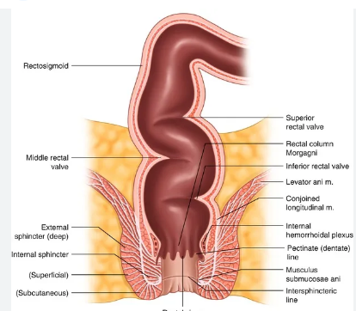
Rectum
Rectum has three permanent semi-lunar transverse folds or valves of Houston
Superior fold is at the beginning of the rectum may be either on the left or right
The middle fold is largest projecting from the anterior and right wall
inferior fold is found on the left

Slide 7
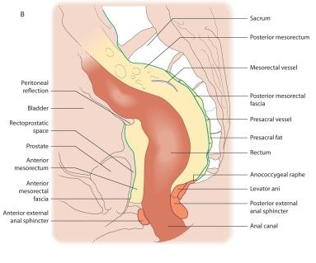
Rectum
The upper third of the rectum is covered by peritoneum on its anterior and lateral aspects
The peritoneum is reflected superiorly onto the urinary bladder in males to form the rectovesical pouch
In females, onto the posterior vaginal wall to form the recto-uterine pouch (pouch of Douglas)

Slide 8
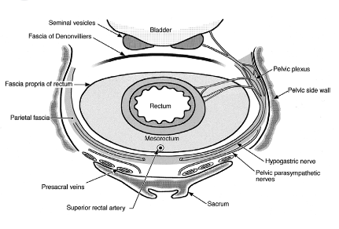
Mesorectum
mesorectum is enclosed by mesorectal fascia
It contains the superior rectal artery and its branches, the superior rectal vein and its tributaries, the lymphatic vessels and nodes that lie along the superior rectal artery

Slide 9
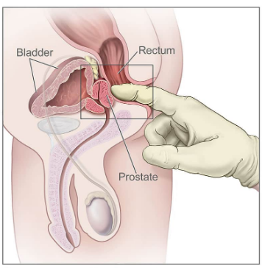
Applied Anatomy
Digital Rectal Examination

Slide 10
Anal Canal
The anal canal begins at the terminal end of the rectal ampulla where it narrows at the pelvic floor.
It terminates as the anus after passing through the perineum.
As it passes through the pelvic floor, the anal canal is surrounded along its entire length by the internal and external anal sphincters, which normally keep it closed.

Slide 11
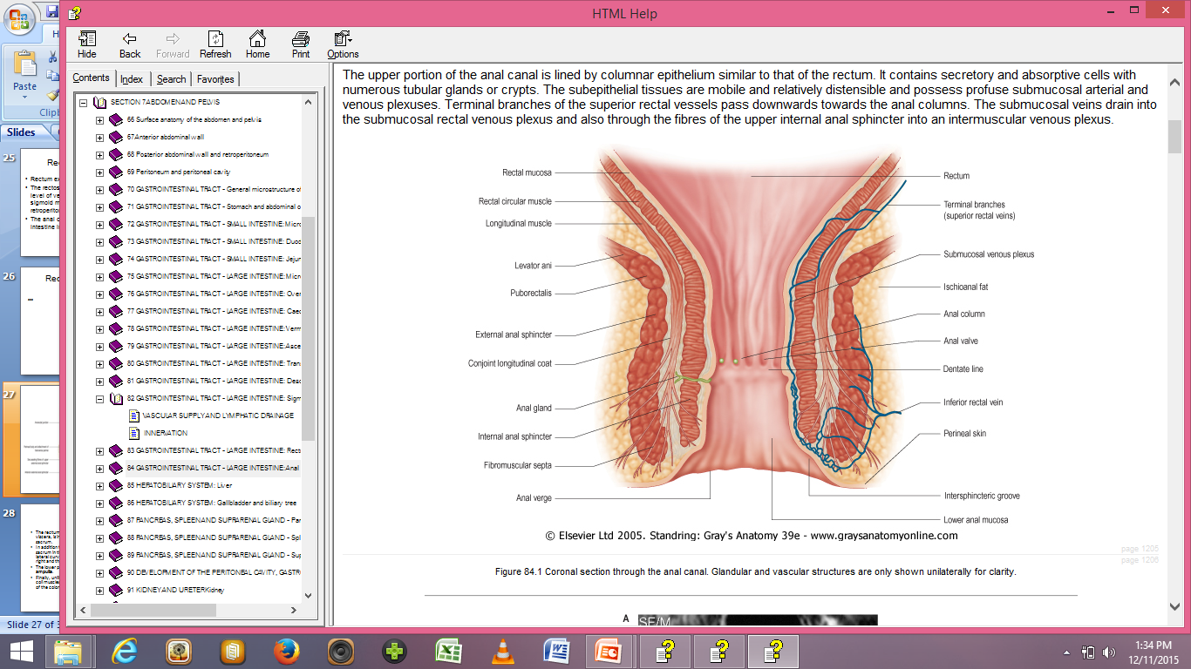

Slide 12
Rectal mucosa lines the upper part of the anal canal.
Anal region distinguished by a number of longitudinally oriented folds known as anal columns, which are united inferiorly by crescentic folds termed anal valves.

Slide 13
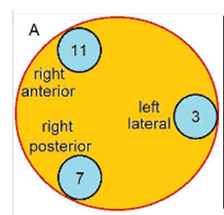
Anal cushions
Infolding of anal mucosa
Three anal cushions located at the 3 o'clock, 7 o'clock and 11 o'clock in lithotomy position
These cushions play an important role in closing the anal canal and promoting continence

Slide 14
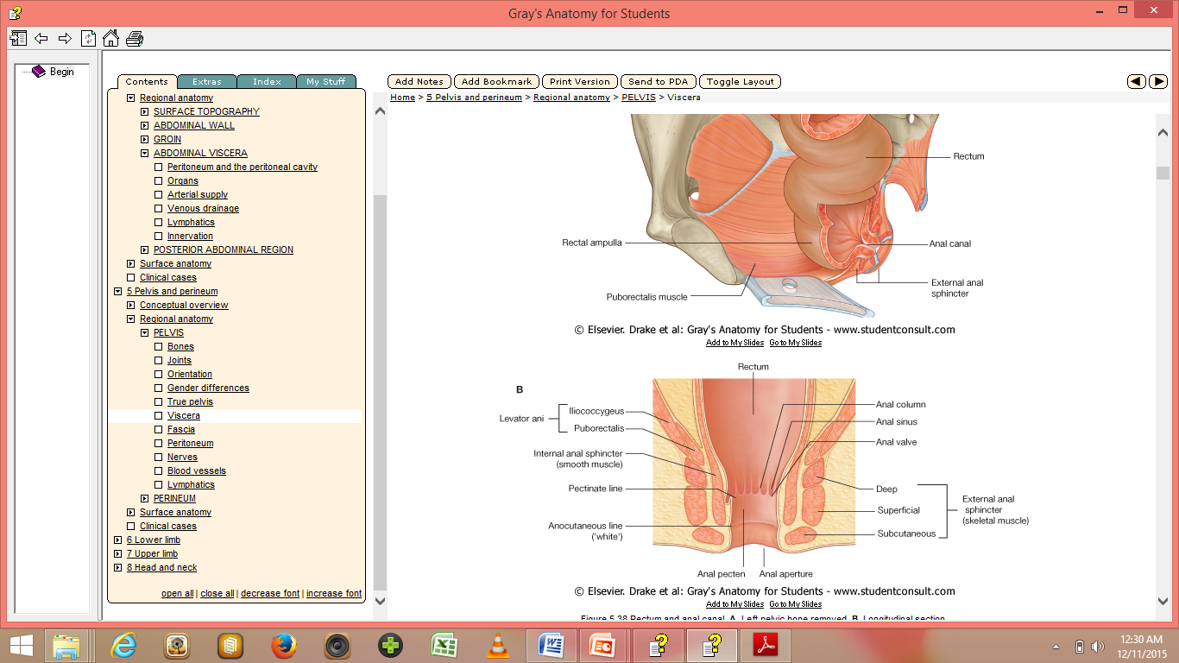
Anal Canal

Slide 15
Superior to each valve is a depression termed an anal sinus.
The anal valves together form a circle around the anal canal at a location known as the pectinate line,
Inferior to the pectinate line is a transition zone known as the anal pecten, which is lined by nonkeratinized stratified squamous epithelium.
The anal pecten ends inferiorly at the anocutaneous line ('white line'), or where the lining of the anal canal becomes true skin.

Slide 16
The internal anal sphincter
is a well-defined ring of obliquely orientated smooth muscle fibres continuous with the circular muscle of the rectum.
terminates at the junction of the superficial and subcutaneous components of the external sphincter.
It is usually thinner in females and becomes thicker with age.

Slide 17
External anal sphincter
is an oval tube-shaped complex of slow twitch skeletal muscle fibres, which are well suited to prolonged contraction.
Innervated by the inferior rectal nerve a branch of pudendal nerve

Slide 18
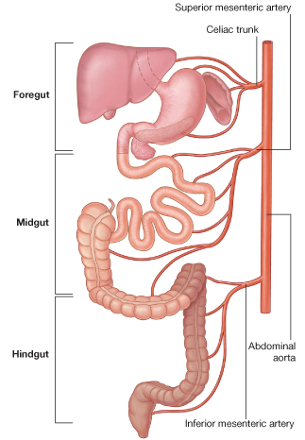
BLOOD SUPPLY
From abdominal aorta
Superior mesenteric artery
Inferior mesenteric artery

Slide 19
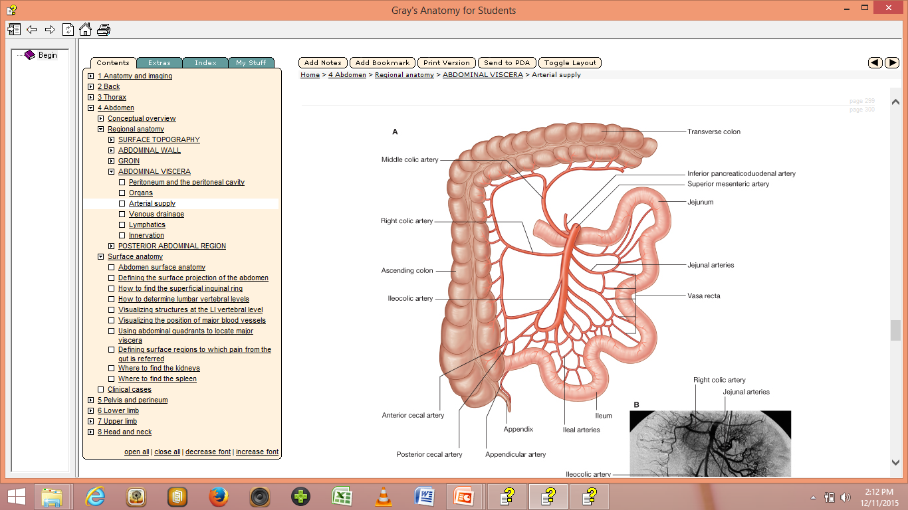
Superior mesenteric
Sends branches to the appendix,
caecum, ascending and transverse
colons

Slide 20
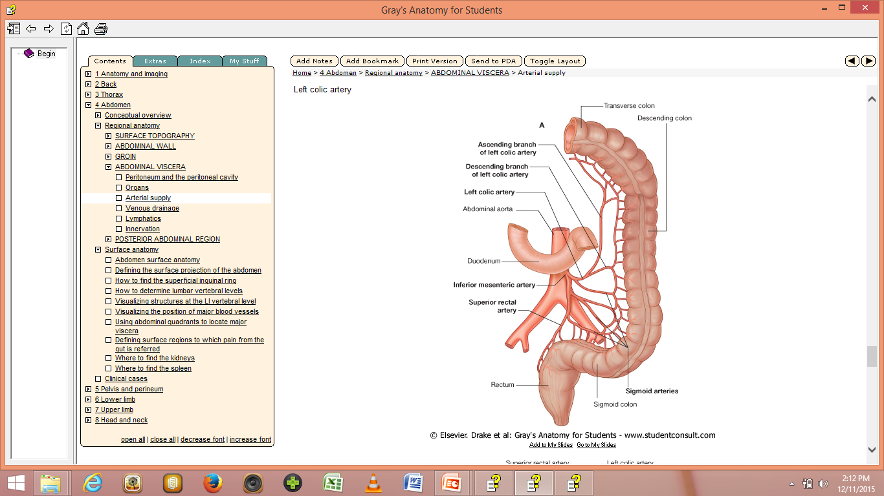
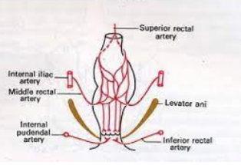
Inferior mesenteric a.
Supplies the part of transverse, descending and sigmoid colon including rectum

Slide 21
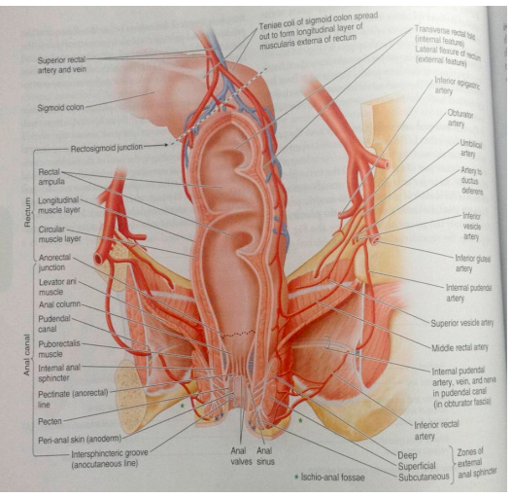
BLOOD SUPPLY

Slide 22
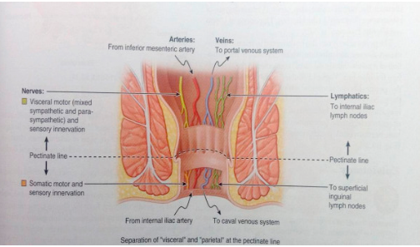

Slide 23
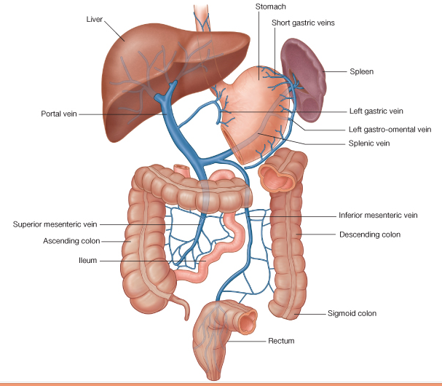
Venous drainage

Slide 24
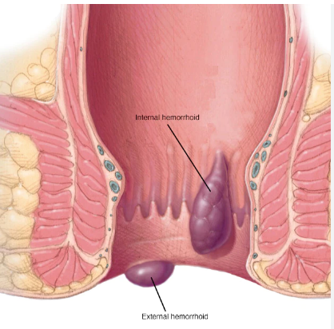
Clinical correlates

Slide 25
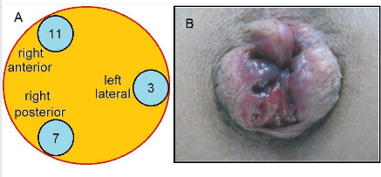
Clinical correlates

Slide 26
Reference Books
1. Standring, Susan and Standring (2015).Gray's anatomy. 41st International edition, Elsevier Health Sciences. ISBN 9780702052309.
2. Keith L. Moore, Arthur F. Dalley, Anne M. R. Agur (2017). Moore's Clinically Oriented Anatomy, 8th edition, Walter Kluwer. ISBN 9781496347213.
3. Alan J. Detton (2020). Grant’s Dissector. 17th edition, Lippincott Williams & Wilkins. ISBN 9781975134600.
4. Adrian Kendal Dixon, David J. Bowden, Bari M. Logan and Harold Ellis (2017). Human Sectional Anatomy - Pocket atlas of body sections, CT and MRI images, 4th edition, CRC Press. ISBN 9781498708548.

Slide 27
The End
Thank you

