Slide 1
Gluteal region: (Abductors and lateral rotators Muscles)
Mr. M. Banda

Slide 2
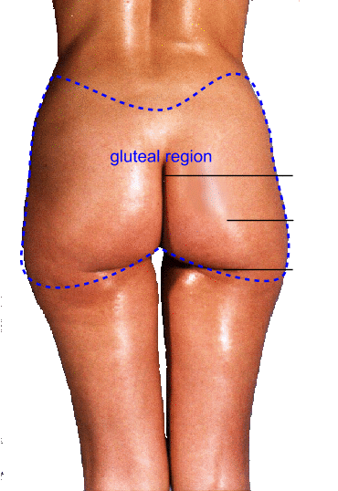
Gluteal region
- it lies posterolateral the bony pelvis & proximal end of femur
- extending from the iliac crest to the gluteal fold
- gluteal fold indicate the lower limit of the gluteus maximus muscle
- gluteal fold is a transverse skin crease of the hip joint
- a deep midline groove, (intergluteal) cleft separates the buttocks from each other

Slide 3
Superficial fascia
- Thick, dense, well developed, laden with large quantities of fat (especially in women)
- Gives the characteristic convexity to the buttock
- Forms a thick cushion over the ischial tuberosity

Slide 4
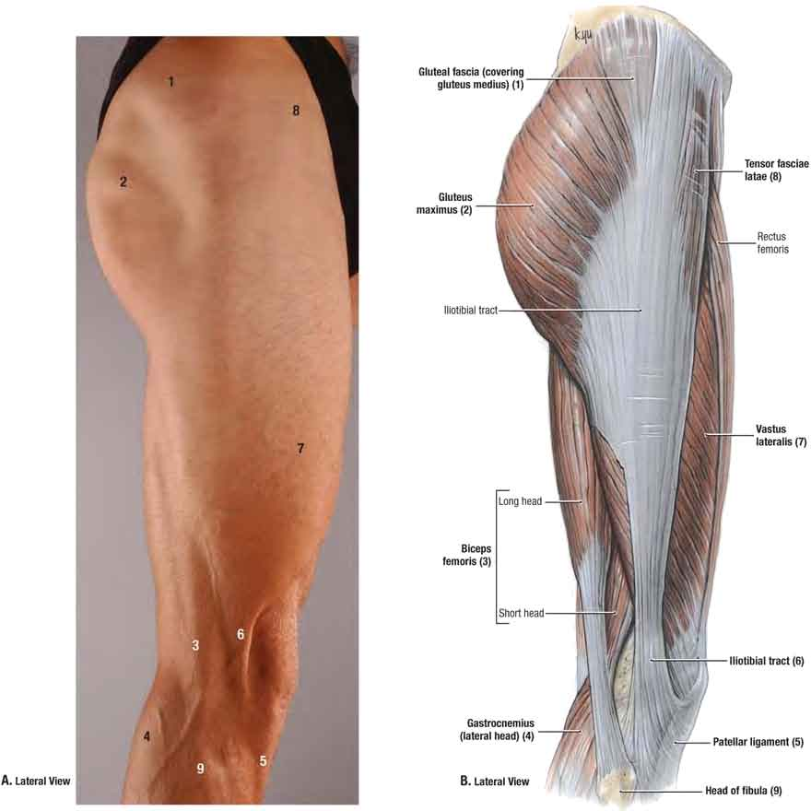
Deep fascia
- Is a continuation of the fascia lata (deep fascia of the thigh)
- At the lower border of the gluteus maximus, fascia lata splits to enclose the muscle
- Above the gluteus maximus, the deep fascia continues as one layer covering the gluteus medius & gets attached to iliac crest
- Laterally the fascia merges with the iliotibial tract

Slide 5
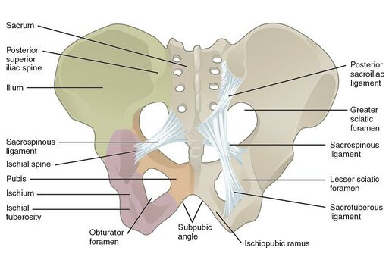
Ligaments
- Sacotuberous: connect the sacrum to ischium tuberosity
- Sacrospinous: connect from sacrum to ischial spine
- the 2 covert the greater & lesser sciatic notches into greater & lesser sciatic foramen
- Posterior sacroiliac: from sacrum to ilium
- stabilise the sacrum
- prevent posterior rotation at the saroiliac joint

Slide 6
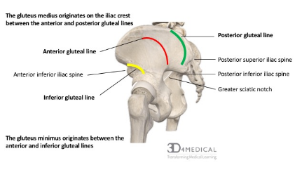
Gluteal lines
- there are 3 gluteal lines
= Anterior
= Posterior
= Inferior

Slide 7
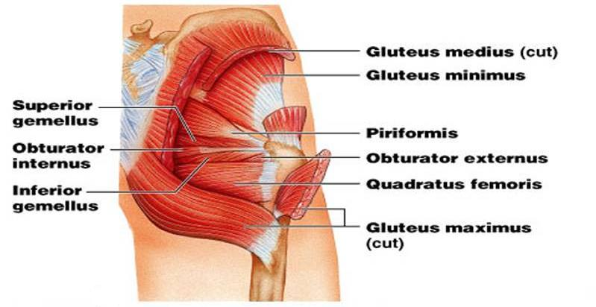
Muscles
- Divided into 2 groups
Superficial group are larger muscles
- Gluteus maximus
- Gluteus medius
- Gluteus minimus
- Tensor fasciae latae
- are mainly the abductor & extensor of the hip

Slide 8
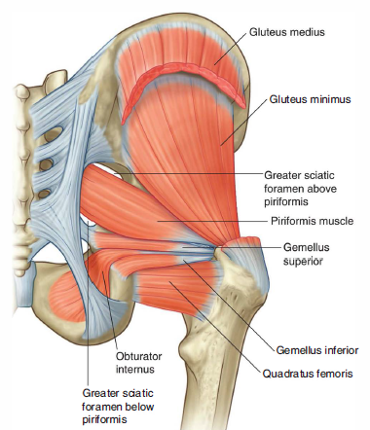
Deep group muscles
- are small muscles
- Piriformis
- Superior Gemellus
- Obturator internus
- Inferior Gemellus
- Quadratus femoris
- mainly lateral rotators of the femur on the hip

Slide 9
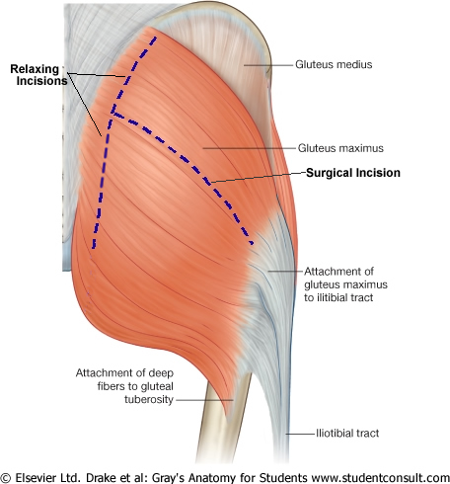
Gluteus maximus
- Largest muscle in the body
- Forms the prominence of buttock
Origin:
- Outer surface of ilium superior (above) the posterior gluteal line
- fascia of erector spinae
- Posterior surface of sacrum & coccyx
- Sacrotuberous ligament

Slide 10
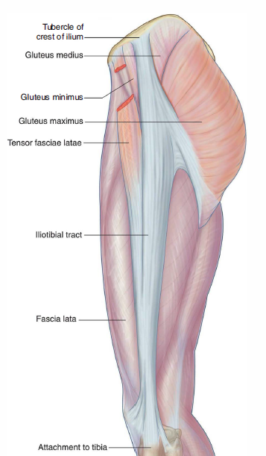
cont..
Insertion:
- into the iliotibial tract
- gluteal tuberosity
Innervation:
- Inferior gluteal nerve (L5, S1, 2)
Action:
- extend the thigh & lateral rotate the hip joint
- stabilises the hip & knee joints through iliotibial tract

Slide 11
Gluteus medius (Abductor)
Origin:
- outer surface of ilium between the anterior & posterior gluteal lines
Insertion:
- greater trochanter
Innervation:
- Superior gluteal nerve (L4,5, S1)
Action:
- Abducts & medially rotates the thigh
- Steady pelvis in walking

Slide 12
Gluteus minimus (abductor)
Origin:
- ilium between the anterior & inferior gluteal lines
Insertion:
- greater trochanter
Innervation:
- Superior gluteal nerve (L4,5, S1)
Action:
- Abducts & medially rotates the thigh

Slide 13
Tensor fasciae latae
Origin:
- iliac crest between anterior superior iliac spine & iliac tubercle
Insertion:
-Into the iliotibial tract
Innervation:
- Superior gluteal nerve (L4,5, S1)
Action:
- stabilises the knee in extended position

Slide 14
Piriformis
Origin:
- Anterior surface of sacrum
Insertion: - greater trochanter
innervation:
- nerve to piriformis S1,2
Action:
- Lateral rotator of thigh
- Assists in stabilizing hip joint especially in abduction
- divides the greater sciatic foramen into 2

Slide 15
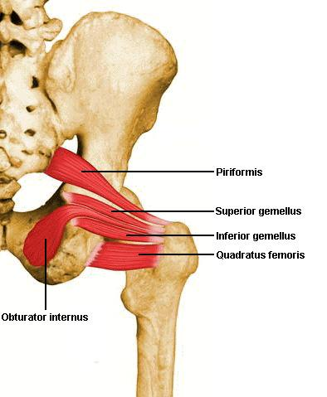
Obturator internus
Origin:
- Inner surface of obturator membrane & adjacent bone
Insertion:
- greater trochanter along with gemelli
innervation:
- nerve to obturator internus (L4,S1)
Action:
- Lateral rotator of thigh

Slide 16
Superior & inferior gemelli
Origin:
- Superior from ischial spine
- Inferior from ischial tuberosity
Insertion: greater trochanter
Innervation:
- Superior G. from nerve to obturator internus (L4, S1)
- Inferior G. from nerve to quadratus femoris (L4, S1)
Action:
- Lateral rotators of thigh

Slide 17
Quadratus femoris
Origin:
- ischial tuberosity
Insertion:
- Quadrate tubercle of femur
Innervation:
- nerve to quadratus femoris (L4,S1)
Action:
- Lateral rotator of thigh

Slide 18
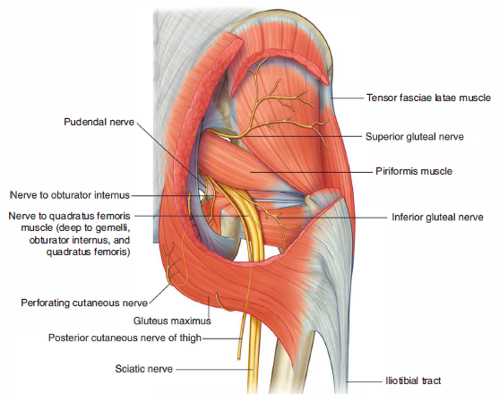
Neurovascular
- Sciatic
- Posterior cutaneous nerve of the thigh
- Superior gluteal
- Inferior gluteal
- Nerve to quadratus femoris
- Pudendal nerve
- Nerve to obturator internus
- sciatic & pudendal just pass through
- found in the plane between superficial & deep muscles

Slide 19
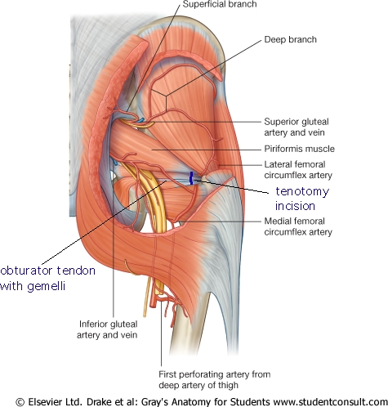
Arteries of the gluteal region
Branches of internal iliac artery:
- Superior gluteal artery
- Inferior gluteal artery
Branches of femoral artery:
- Lateral circumflex
- Medial circumflex
Branches of profunda femoris artery:
- First perforating branch

Slide 20
Superior & Inferior gluteal arteries
- Are branches of the internal iliac artery
- Enter through the greater sciatic foramen
- superior gluteal artery above the piriformis,
- inferior gluteal artery below the piriformis
- Supply the gluteal region & contribute to the anastomosis around the hip joint

Slide 21
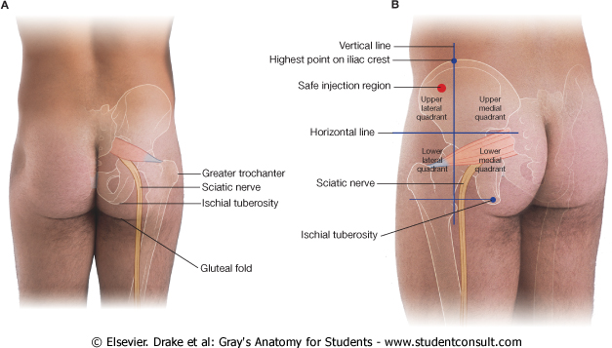
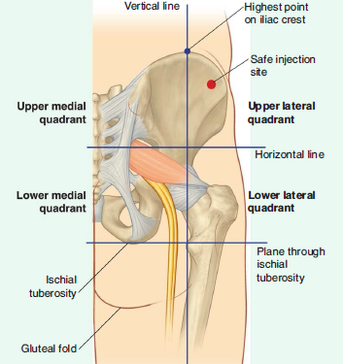
Applied anatomy
- Intramuscular injection enables a large amount of a drug to be introduced at once but absorbed gradually.
- The injection site must be carefully selected to avoid injury to the underlying large vessels and nerves.

Slide 22
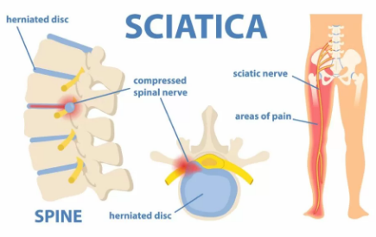
Sciatica
Sciatica is pain from irritation of the sciatic nerve
compressed nerve in the lower spine
cause symptoms throughout the back and legs

Slide 23
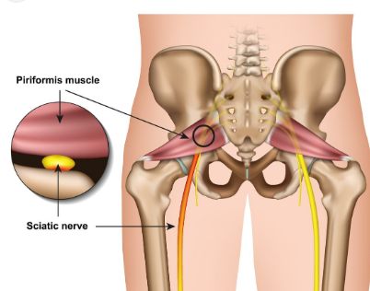
Piriformis syndrome
Piriformis muscle spasms can irritate the sciatic nerve to cause pain, numbness and tingling along the back of the leg and into the foot

Slide 24
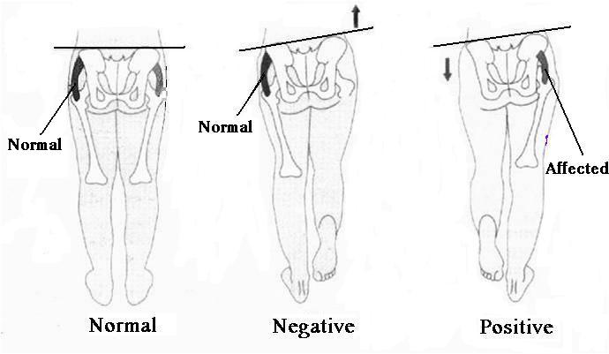
Trendelenburg test
- tests the integrity of the superior gluteal nerve

Slide 25
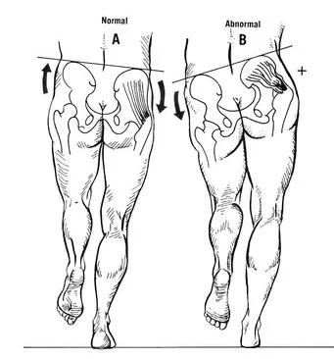
Trendelenburg test

Slide 26
Reference Books
1. Standring, Susan and Standring (2015).Gray's anatomy. 41st International edition, Elsevier Health Sciences. ISBN 9780702052309.
2. Keith L. Moore, Arthur F. Dalley, Anne M. R. Agur (2017). Moore's Clinically Oriented Anatomy, 8th edition, Walter Kluwer. ISBN 9781496347213.
3. Alan J. Detton (2020). Grant’s Dissector. 17th edition, Lippincott Williams & Wilkins. ISBN 9781975134600.
4. Adrian Kendal Dixon, David J. Bowden, Bari M. Logan and Harold Ellis (2017). Human Sectional Anatomy - Pocket atlas of body sections, CT and MRI images, 4th edition, CRC Press. ISBN 9781498708548.

Slide 27
Thank you!!

