Slide 1
UNIVERSITY OF LUSAKA
SCHOOL OF LAW
UNIT 2:
WORLD LEGAL SYSTEMS

Slide 2
UNIT 2
Characteristics of a good legal system
Introduction into different legal systems
  English common law legal system
  Civil law legal system
    Difference between adversarial and inquisitorial systems
  Sharia/Islamic law

Slide 3
Introduction
What is a ‘legal system’?
“the set of laws of a particular state and the ways in which they are made, interpreted and enforced.’
It has also been described as referring to “the nature and content of the law generally, and the structures and methods whereby it is legislated upon, adjudicated upon and administered, within a given jurisdiction”.

Slide 4
CHARACTERISTICS of a good legal system
A good legal system is one which possesses the following characteristics:
1.Certain-the law should clearly state what is permitted and prohibited, as well as the consequences for failure to abide by the law.
2. Simple-the law should be written in a language that can be understood by a large section of citizens within a particular state.
3. Comprehensive- the law should be detailed as well as broad in scope and content in order to cover both current and anticipated or future problems and disputes

Slide 5
CHARACTERISTICS of a good legal system (CONT’D)
4. Accessible- The law should be made available to the public.
5. Flexible- The law has to keep up with social change. It should not be too rigid to prevent change with the dynamic society. Circumstances, places, times and other factors should definitely be considered in the law-making process.

Slide 6
CHARACTERISTICS of a good legal system
8. Written-
9. Thorough procedures-
10. Equal and fair application of the law-No one is above the law (one of the principles of the ‘rule of law’)

Slide 7
Introduction
Does it then follow that there exists as many ‘legal systems’ as the known countries of the world?
True. However, many of them exhibit certain commonalities of principle and practice. Because of the historical background of most countries, their legal systems tend to replicate, with minor variations, the characteristics of major legal systems of the world.

Slide 8
Introduction
There are several legal systems practiced by states around the world. Some of the most common include the following:
1. English Common law legal system;
2. Civil law legal system;
3. Roman-Dutch law legal system;
4. Islamic law legal system; and
5. Customary law legal system.
NOTE: Some countries around the world practice one of the above-mentioned legal systems, while others practice a mixed system (two or more of the above legal systems).
See: http://chartsbin.com/view/aq2 for more information.

Slide 9
1. English Common law
Common law is the legal tradition which evolved in England from the 11th century onwards. It is defined as that ‘part of the law of England formulated, developed and administered by the common law courts, based originally on the common customs of the country and unwritten’.

Slide 10
1. English Common law
Common law is the foundation of private law, not only for England, Wales and Ireland, but also in forty - nine U.S. states, nine Canadian provinces and most countries which first received that law as colonies of the British Empire and which, in many cases, have preserved it as independent States of the British Commonwealth.

Slide 11
1. English Common law
The main characteristic features of the English common law system :
the doctrine of judicial precedent.
the practice of the adversarial system.
Common law judges are appointed from among the practicing lawyers and need not undergo any specialized training.
Also, the doctrine of equity is given a lot of emphasis when compared to the civil law legal systems.

Slide 12
1. English Common law
What is equity?
Equity simply put, refers to justice and fairness. These are legal rules formulated by the English Court of Chancery to supplement the rules and procedures of common law.
The Zambian legal system practices the English common law system by virtue of being a former British colony.
As such, our court system has also adopted the doctrines of equity. On this point, see section 15 of the Subordinate Court Act and section 13 of the High Court Act.

Slide 13
1. English Common law
As we have already seen, doctrines of equity as well as equitable remedies, are applied at the discretion of a Judge.
However, where equity and common law conflict, equity prevails.
Maxims of equity:
Equity will not suffer a wrong to be without a remedy
Equity will not assist a volunteer
Equity deems as done, that which ought to be done
Delay defeats equity

Slide 14
1. The English Common law LEGAL SYSTEM:
Equitable remedies are granted at the discretion of the court
Equity aids the vigilant
He who comes to equity, must come with clean hands
Equity follows the law
Equity looks to the content rather than the form

Slide 15
1. English Common law
Equity imputes an intent to fulfill an obligation
He who seeks equity must do equity
Equity regards the balance of convenience
QUESTION: Doctrines of equity were formulated to remedy the harshness of common law. Do you agree? Can you cite examples?

Slide 16
  2. CIVIL LAW
What is civil law? ‘Civil law’ may be defined as a legal system practiced in continental Europe in countries such as France.
Origins of French civil law: has its origin in Roman law, and predominantly based on a ‘code of law’ known as the ‘Civil Code’ or ‘Napoleonic Code’.
The Civil Code or Napoleonic Code laid down the rights and duties of citizens as well as the laws of property, contract, inheritance, etc. It was thus an adaptation to the needs of 19th century France.
The code has over the years been amended and updated to suit the changing times.

Slide 17
2. CIVIL LAW
The main features of the Civil Law system are:
One of the main sources of law are codes such as the Civil Code; Code of Civil Procedure; Code of Commerce; Code of Criminal Procedure; and the Penal Code and statutes.
the practice of the inquisitorial system. See: Jones v National Coal Board [1957] 2 QB 55, 63−64 per Denning LJ.
civil law jurisdictions place very little emphasis on the doctrines of precedent and equity, unlike the English common law system
The judges undergo specialized training.

Slide 18
2CIVIL LAW LEGAL
The civil law legal system: The civil law legal system is practiced in most western European countries such as France. Unlike the English Common law legal system which is practiced in most former British colonies, the civil law system is one that is freely adopted by most west European countries known as the Benelux countries namely Belgium, Luxembourg, the Netherlands, Italy, Spain and Portugal and their former colonies. It has also been adopted by countries such as Tunisia, Egypt, the state of Louisiana in South America, and Quebec, Canada.
QUESTION: Can you think of countries that practice the civil law legal system?
Visit: https://www.cia.gov/library/publications/the-world-factbook/fields/2100.html and for more information.

Slide 19
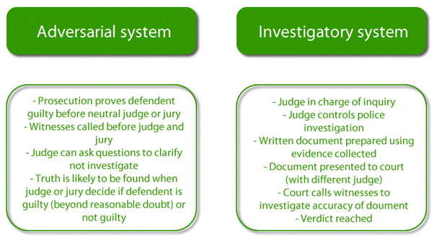
DIFFERENCE BETWEEN ADVERSARIAL & INQUISITORIAL SYSTEMS

Slide 20
3SHARIA / ISLAMIC LAW
What is Sharia / Islamic law? This refers to a legal system practiced in most Islamic states.
Origins of Sharia / Islamic law: The word Sharia means “the right path” and represents traditional Islamic law. Sharia / Islamic law teachings and commandments is that contained in the Quran and is believed to have been revealed to the Prophet Mohammed by Allah (God). It is thus considered sacred since it originated from Allah.

Slide 21
Origins of Sharia / Islamic law:
Saudi Arabia is the birthplace of Muhammad, Quran, Islam and the Sharia Law.
The country that most strictly applies the Sharia law is also Saudi Arabia,
Sharia is the de facto Constitution of Saudi Arabia.

Slide 22
3SHARIA / ISLAMIC LAW
The overall goal of Islamic law is to promote the welfare of mankind. This goal in broad general terms implies, among others, to ensure growth and justice and in specific terms relates to the protection of religion, life, reason, progeny and property.

Slide 23
SHARIA / ISLAMIC LAW (CONT’D)
Sources of Islamic law
The main sources of Islamic Law are:
The Holy Qu’ran – Is the foremost source of Islamic law. It is the book given by God.
Sunna – sayings and deeds of Prophet Mohammed.
Ijma- or consensus of opinion of learned Islamic scholars;
Qiyas – or analogy reasoning. Process of independent reasoning by qualified scholars to obtain legal rules from Shariah using the analogical reasoning and induction
Istihad – Legal presumptions, customs, public interest

Slide 24
FEATURES OF SHARIA LAW
As a legal system, the Sharia law is exceptionally broad.
While other legal systems regulate public behaviour, Sharia regulates public behaviour, private behaviour, and even private beliefs.
Compared to other legal systems, the Sharia law also prioritizes punishment over rehabilitation and favours corporal and capital punishments over incarceration (imprisonment).
Of all legal systems in the world today, the Sharia law is considered the most intrusive and restrictive, especially against women.
• Continue...

Slide 25
EXAMPLES OF SHARIA LAWS
1. Theft is punishable by amputation of the hands (Quran 5:38).
2. Criticizing or denying any part of the Quran is punishable by death.
3. Criticizing Muhammad or denying that he is a prophet is punishable by death.
4. Criticizing or denying Allah is punishable by death (see Allah moon god).
5. A Muslim who becomes a non-Muslim is punishable by death (See Compulsion).
6. A non-Muslim who leads a Muslim away from Islam is punishable by death.
7. A non-Muslim man who marries a Muslim woman is punishable by death.
8. A woman or girl who has been raped cannot testify in court against her rapist(s).

Slide 26
EXAMPLES OF SHARIA LAWS
9. Testimonies of 4 male witnesses are required to prove rape of a female (Quran 24:13).
10. A woman or girl who alleges rape without producing 4 male witnesses is guilty of adultery.
11. A woman or girl found guilty of adultery is punishable by death (see "Islamophobia").
12. A male convicted of rape can have his conviction dismissed by marrying his victim.
13. Muslim men have sexual rights to any woman/girl not wearing the Hijab (see Taharrush).
14. A woman can have 1 husband, who can have up to 4 wives; Muhammad can have more.
15. A man can marry an infant girl and consummate the marriage when she is 9 years old.

Slide 27
EXAMPLES OF SHARIA LAW (CONT’D)
16. Girls' clitoris should be cut (genital mutilation) (Muhammad's words, Book 41, Kitab Al-Adab, Hadith 5251).
17. A man can beat his wife for insubordination (see Quran 4:34 and Religion of Peace).
18. A man can unilaterally divorce his wife; while a wife needs her husband's consent to divorce.
19. A divorced wife loses custody of all children over 6 years of age or when they exceed it.
.

Slide 28
EXAMPLES OF SHARIA LAW (CONT’D)
20. A woman's testimony in court, allowed in property cases, carries ½ the weight of a man's.
21. A female heir inherits half of what a male heir inherits (see Mathematics in Quran).
22. A woman cannot speak alone to a man who is not her husband or relative.
23. Meat to eat must come from animals that have been sacrificed to Allah - i.e., be "Halal."
24. Muslims should engage in Taqiyya and lie to non-Muslims to advance Islam

Slide 29
  4. ROMAN DUTCH LAW
What is Roman Dutch Law? It is a legal system practised in some Southern African Countries formerly colonised by the Dutch.
Origins of Roman Dutch Law: Roman Dutch law has its origins in Roman law whose influence in most parts of Europe came about as a result of the spread of the Roman Empire.
After the Germanic tribes conquered the Western Roman empire, the Roman Law started to decline.
In the Eastern Roman empire Justinian ruled. He instructed a commission to codify (put in writing) the legal system. This codification was called the Corpus Iuris Civilis and consisted of 4 parts:

Slide 30
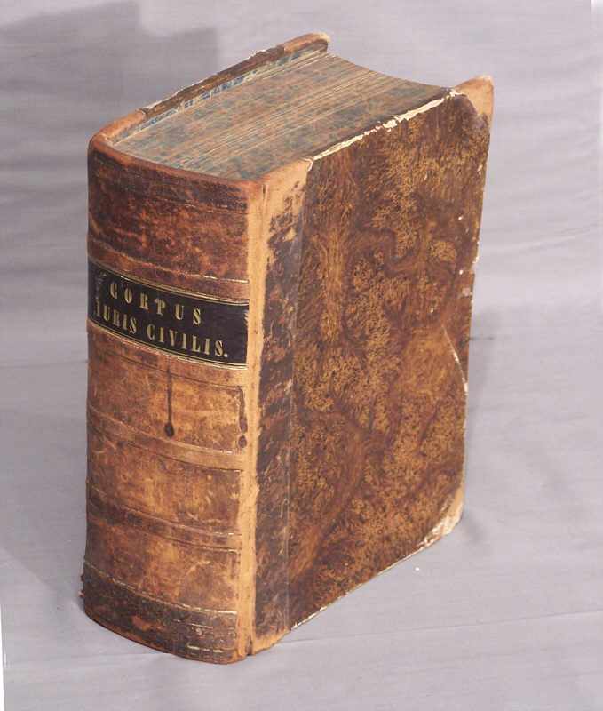
4. ROMAN DUTCH LAW
  Digest Opinions and writings of Roman jurists.
  Institutes Textbook for students.
  Codex Collection of current legislation.
  Novellae Collection of legislation enacted after the above mentioned works.

Slide 31
4. ROMAN DUTCH LAW
By the end of the Middle Ages there was an increasing need for a developed legal system, this was also the position in Holland (province of the Netherlands).
Holland applied the principles of the Roman Law adjacent to the indigenous law. This led to the adoption of the Roman Law.
Various jurists produced writings on Roman and Dutch law. Their opinions are still today accepted as authoritative by South African courts. Examples are Hugo de Groot, Johannes Voet, Simon van Leeuwen, ect. They are known as “old writers”.
Today, Roman Dutch law is practiced in some Southern African countries, notable among them being South Africa, Lesotho, Namibia, Zimbabwe, Lesotho and Swaziland.

Slide 32
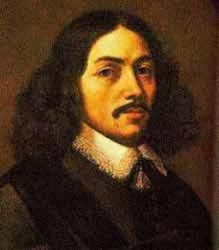
4. ROMAN-DUTCH
Development of Roman Dutch Law in South Africa:
Jan van Riebeeck brought the Roman-Dutch law to South Africa in 1652. Despite the English occupation in 1806 – this system remained in force.
The South African law was also strongly influenced by English law due to the following factors:
  Judges and Magistrates were imported from England.
  Local jurists studied in England.
  English court decisions were often referred to.
  Many South African Acts were based on corresponding English Acts.
  Final court of appeal was the Privy Council in England.
The South African system is therefore a “mixed” system consisting of the Roman-Dutch law influenced by local customs

Slide 33
5. CUSTOMARY LAW
What is customary law? According Lon L. Fuller, Customary law is the oldest form of law known to man worldwide. It consists of customs, practices and beliefs that are accepted by a given society as obligatory rules of conduct. It is not enacted but grows or develops with time. It expresses itself not in a succession of words, but in a course of conduct. It has no definite authors; there is no person or defined human agency one can praise or bless for its being good or bad.
The definition of customary law can thus be broken down as follows:
practices, which by common adoption and long unvarying habits, have come to have the force of law;

Slide 34
5. CUSTOMARY LAW
rules, which in a particular community, have from long usage obtained the force of law;
a body of customs, accepted by members of the community as binding upon them;
organic or living laws of the indigenous people, which regulate their lives and transactions;
unrecorded tradition and history of the people, which has “grown” with the “growth” of the people to stability and eventually become an intrinsic part of their customs; or
usages or practices of the people, which by common adoption and acquiescence and by long and unvarying habits, have become compulsory and have acquired the force of law with respect to place, or the subject matter to which it relates.

Slide 35
5. CUSTOMARY LAW
Fundamental features of customary Law:
There are six fundamental features of customary law as follows:
1. It must be in existence at the material time
2. It must be an existing native law and custom and not that of by gone days;
3. It must be flexible (elastic), organic (not static), regulatory and a living law of the indigenous people subject to it;

Slide 36
5. CUSTOMARY LAW
4. It must be of universal application in a given community;
5. It must enjoy acceptability as a custom; and
6. It must be unwritten (or partly written and partly unwritten
NOTE: The Zambian legal system is dualistic in nature. It predominantly consists of the statute law which takes precedence but also recognises the country’s different tribe specific customary laws, provided that the latter are not contrary to written law or repugnant to natural justice, good conscience and morals. See the case of Kaniki v Jairus (1967) ZR 71
Also note that in Zambia, customary law is administered by the Local Courts although the High Court may in certain cases have jurisdiction over customary law. See the case of Nkhoma v Nkhoma(HC) [2004] ZMHC 1 (7 March 2004)

Slide 37
CUSTOMARY LAW
What makes customary law applicable and binding?:
It must be reasonable
It must have been long established
It must be universally observed among its subjects
It must be certain

Slide 38
CUSTOMARY LAW
Note: Even where a customary law satisfies the four requirements above, the court may still refuse to enforce it for the following reasons:-
It is repugnant to natural justice, good conscience and morals; (Kaniki v Jairus)
It is incompatible with any law at the time being in force or other currently binding customs; (Kaniki v Jairus)
It is contrary to public policy; or
It is injurious to public interest.

Slide 39
CUSTOMARY LAW
How does one prove the existence of customary law?
A customary law must be proved by strong evidence in any of the following ways:
Expert evidence and opinion e.g. evidence of traditional leaders (chiefs) who possess special knowledge of the subject matter;
Evidence of credible witnesses e.g. evidence of persons who are sufficiently acquainted with the custom;
Assessors: Persons with local knowledge and duly appointed assessors may assist with their knowledge;

Slide 40
CUSTOMARY LAW
Writers: Text books, manuscripts that are recognized by the subject people may be used in evidence; or
Problems of customary law:
There are two major problems of customary law. As follows:
It is not codified. For this reason it is uncertain and vague; and only in the minds of those who administer it or those who are subjects to it especially the custodian of traditions and customs; and
It is a question of facts and difficult to apply by reason of its multiplicity, diversity, cultural apathy, ideological conflicts, influence of civilization etc.

Slide 41
END OF LECTURE
THANK YOU!

