Slide 1
UNIVERSITY OF LUSAKA
SCHOOL OF LAW
L403
THE NATURE OF JURISPRUDENCE

Slide 2
INTRODUCTION
Jurisprudence (juris prudencia = the knowledge, wisdom of law)
the ability to distinguish between what law is and what it is not.
it is the study/ the explanation of the nature of law and the manner of its working.
It maybe helpful to think of Jurisprudence as a sort of jigsaw puzzle in which each piece fits with the others in order to construct a whole picture. The picture in this sense would be a complete model of law.

Slide 3

INTRODUCTION

Slide 4
INTRODUCTION
In its nature = entirely a different subject from other social sciences.
Reason = it is not codified but a growing and dynamic subject having no limitation on itself.
has no limited scope being a growing subject.

Slide 5
INTRODUCTION
It is called both an art and science.
But to call it science would be more proper and useful.
reasons for this is that just as in science we draw conclusions after making a systematic study by inventing new methods.
Therefore, jurisprudence comprises philosophy of law and its object is not to discover new rules but to reflect on the rules already known.

Slide 6
INTRODUCTION
jurisprudence has been said to be a Leviathan (an enormous discipline that involves interdisciplinary study and research.
We cannot learn law by learning law because law is made as part of other disciplines e.g. history, economics, sociology etc.
Freeman says that there are many rooms in the mansion of jurisprudence. ‘ it gives jurisprudence a somewhat amorphous ( something without shape or form) if not parasitic nature which makes it difficult to characterize the discipline.

Slide 7
WHAT IS LAW
The law = system of norms that sets or describes standards and rules of human behavior that should be followed.
Failure to follow these rules and standards will attract sanctions.
According to HL Harts (1961) he analyses law as a system of rules/ statements of accepted standards of behavior.

Slide 8
WHAT IS LAW
The eyes are one of the most important parts of human body.
Almost all human activities and the movements of the body are possible only through them.
Unless man can see anything properly, he cannot do any work.
The reason for calling jurisprudence the ‘ the eye of law’ is that jurisprudence functions for law in the same manner as the eyes do in the human body.

Slide 9
FUNCTIONS OF JURISPRUDENCE
The main function of jurisprudence is to study the origin of law, its development and its contribution towards society.
The matters of birth, marriages, death, succession etc., are equally controlled by laws.
It is the well known saying that “ignorance of the law is no excuse,” hence it is essential to know the correct basic principles of law which are contained only in the jurisprudence.

Slide 10
FUNCTIONS OF JURISPRUDENCE
Jurisprudence offers an overall view of the law, a unified and systematic picture, in which the nature of legal institutions and theories becomes more comprehensible. Austin viewed jurisprudence as providing a ‘map’ of the law which presents it as ‘a system or organic whole’
Jurisprudence is aimed at a wise, pertinent and just solution of problems

Slide 11
FUNCTIONS OF JURISPRUDENCE
The intellectual discipline required for a study of this area of thought must be of a high order. Intensive, systematic analysis, the ability to exercise one’s critical faculties, and to engage in a continuous questioning of one’s own basic assumptions – all can be heightened by a study of jurisprudence.

Slide 12
FUNCTIONS OF JURISPRUDENCE
The form of jurisprudence offered here focuses on finding the answer to such questions as:
What is law?
What are the criteria for legal validity?
What is the relationship between law and morality?
How do judges (properly) decide cases?
There is a classic debate over the appropriate sources of law between positivists and natural law schools of thought.

Slide 13
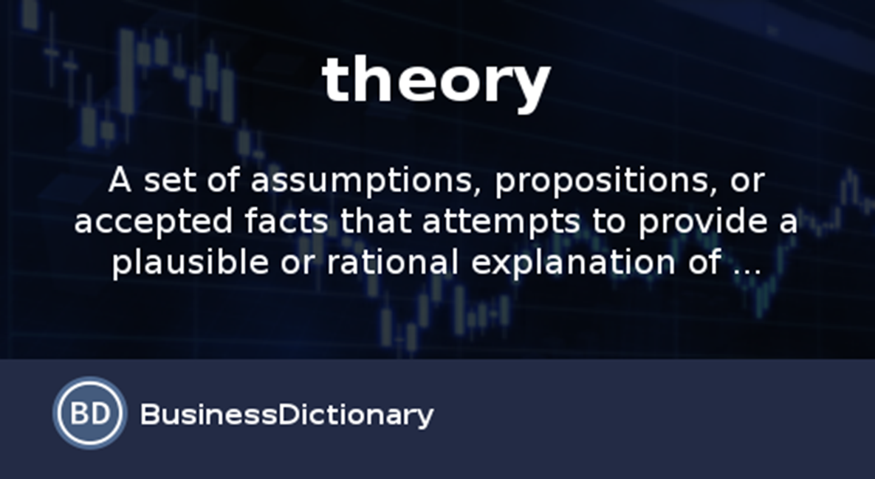
Theory v. law

Slide 14
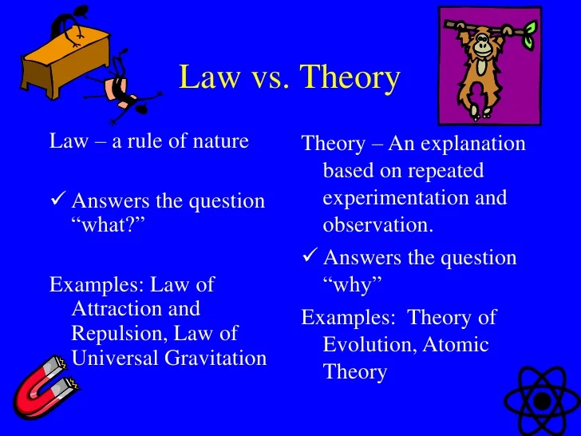
Theory v. law

Slide 15
DISCUSSION
‘For those who study jurisprudence today, it is nothing but a troubling mass of conflicting ideas’: Arnold. Why, then, study the subject?

