Slide 1
UNIVERSITY OF LUSAKA
SCHOOL OF LAW
L403
NATURAL LAW THEORY

Slide 2
INTRODUCTION
It’s just not right.’ ‘It’s not natural.’ How many times have you heard these sorts of judgements invoked against a particular practice or act? What do they mean? When abortion is pronounced immoral, or same-sex marriages unacceptable, what is the basis of this censure?
Is there an objectively ascertainable measure of right and wrong, good and bad? If so, by what means can we retrieve it?

Slide 3
What is natural law?
‘The best description of natural law’, according to one leading natural lawyer, ‘is that it provides a name for the point of intersection between law and morals.’ Its main claim, put simply, is that what naturally is, ought to be.
In his widely acclaimed book Natural Law and Natural Rights, John Finnis asserts that ‘when we attempt to explain what law is, we make assumptions, willy-nilly, about what is ‘good’

Slide 4
What is natural law?
The Roman lawyer, Cicero, drawing on Stoic philosophy, usefully identified the three main components of any natural law philosophy:
“True law is right reason in agreement with Nature; it is of universal application, unchanging and everlasting. . . . It is a sin to try to alter this law, nor is it allowable to attempt to repeal any part of it, and it is impossible to abolish it entirely. . . . [God] is the author of this law, its promulgator, and its enforcing judge.”
CONSIDER THE EXAMPLE SAME SEX MARRIAGES AND ABORTION??????????

Slide 5
What is natural law?
This underlines natural law’s universality and immutability, its standing as a ‘higher’ law, and its discoverability by reason (it is in this sense ‘natural’)

Slide 6
Catholic church
The Catholic Church gave expression to the full-blown philosophy of natural law, as we understand it today. As early as the 5th century, St Augustine asked, ‘What are States without justice, but robber Natural law bands enlarged?

Slide 7
Catholic church
But the leading exposition of natural law is to be found in the writings of the Dominican, St Thomas Aquinas (1225– 74), whose principal work Summa Theologiae contains the most comprehensive statement of Christian doctrine on the subject. He distinguishes between four categories of law:
the eternal law (divine reason known only to God), According to St Augustine nothing which is just is to be found in positive law (lex temporalis).
natural law (the participation of the eternal law in rational creatures, discoverable by reason),
divine law (revealed in the scriptures), and
human law (supported by reason, and enacted for the common good).

Slide 8
Catholic church
One aspect of Aquinas’s theory has attracted particular attention and controversy. He states that a ‘law’ that fails to conform to natural or divine law is not a law at all. This is usually expressed as lex iniusta non est lex (an unjust law is not law)
Aquinas who seems to have meant that laws which conflict with the requirements of natural law lose their power to bind morally. A government, in other words, that abuses its authority by enacting laws which are unjust (unreasonable or against the common good) forfeits its right to be obeyed because it lacks moral authority. Could this explain why the constitution of Zambia has failed to stand the test of time? The constitution does not appeal to the morals of the citizens of the country…arguably RECONSIDER

Slide 9
Natural law and revolutions
The principles of natural law have been used to justify revolutions – especially the American and the French – on the ground that the law infringed individuals’ natural rights.
Thus in America the revolution against British colonial rule was based on an appeal to the natural rights of all Americans, in the lofty words of the Declaration of Independence of 1776, to ‘life, liberty and the pursuit of happiness’. As the Declaration puts it, ‘We hold these truths to be self-evident, that all men are created equal, that they are endowed by their Creator with certain unalienable rights.’
Similarly inspiring sentiments were included in the French Déclaration des droits de l’homme et du citoyen of 26 August 1789 which refers to certain ‘natural rights’ of mankind.

Slide 10
The RISE and FALL of natural law
Classical
middle
Renaissance
modern

Slide 11
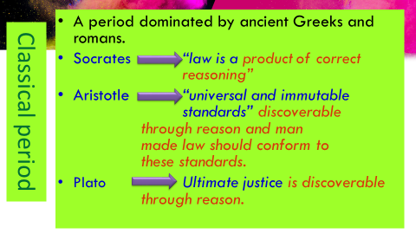
The RISE and FALL of natural law

Slide 12
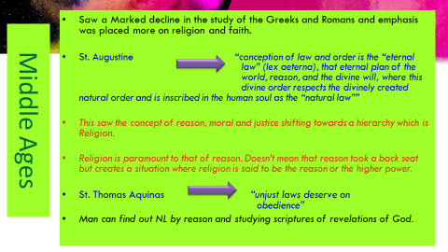
The RISE and FALL of natural law

Slide 13
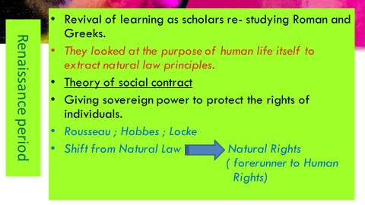
The RISE and FALL of natural law
JOHN LOCKE

Slide 14
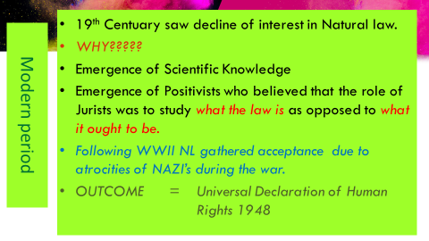
The RISE and FALL of natural law

Slide 15
The RISE and FALL of natural law
The 20th century witnessed a renaissance in natural law theory. This is evident in the post-war recognition of human rights and their expression in declarations such as the Charter of the United Nations, and the Universal Declaration of Human Rights, the European Convention on Human Rights, and the Declaration of Delhi on the Rule of Law of 1959.
Natural law is conceived of not as a ‘higher law’ in the constitutional sense of invalidating ordinary law but as a benchmark against which to measure positive law.

Slide 16
The RISE and FALL of natural law
The Nuremberg war trials of senior Nazi officials regenerated natural law ideals. They applied the principle that certain acts constitute ‘crimes against humanity’ even if they do not violate provisions of positive law. The judges in these trials did not appeal explicitly to natural law theory, but their judgments represent an important recognition of the principle that the law is not necessarily the sole determinant of what is right.

Slide 17
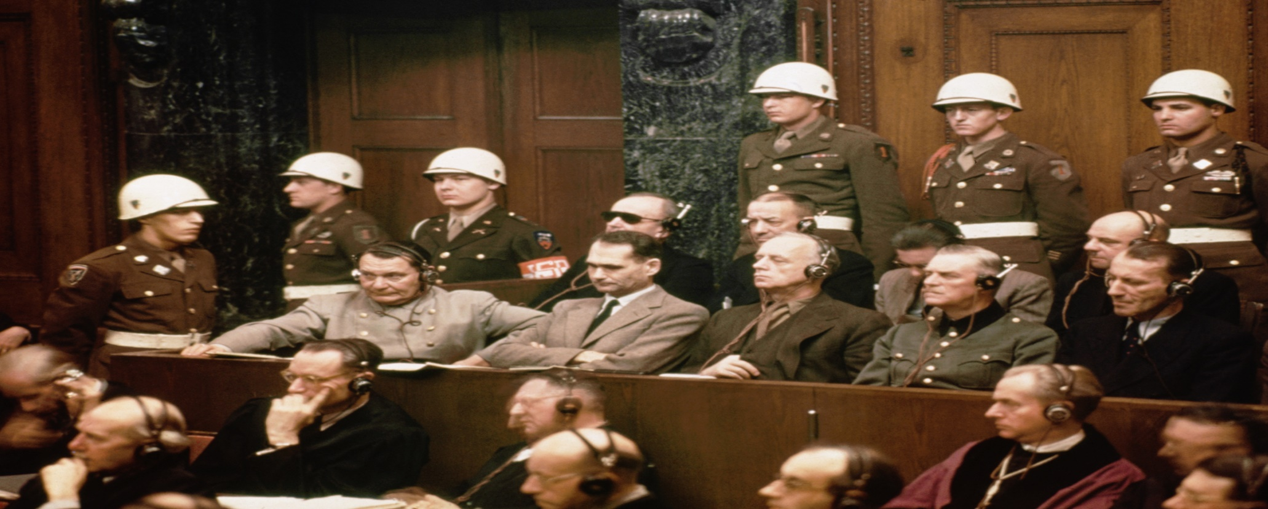
Nuremberg war trials of senior Nazi officials

Slide 18
The RISE and FALL of natural law
Another significant development was the enactment of constitutional safeguards for human or civil rights in various jurisdictions (e.g. the Zambian and American Bill of Rights and its interpretation by the Court).

Slide 19
naturalists
Lon Fuller: the ‘inner morality of law’
The American jurist, Lon L. Fuller (1902–78) famously developed a secular natural law approach that regards law as having an ‘inner morality’. By this he means that a legal system has the specific purpose of ‘subjecting human conduct to the governance of rules’. It follows that in this purposive enterprise there is a necessary connection between law and morality.

Slide 20
naturalists
Lon Fuller: the ‘inner morality of law’
Fuller recounts the ‘moral’ tale of a fictional King Rex and the eight ways in which he fails to make law. He goes wrong because;
(1) he fails to achieve rules at all, so that every issue must be decided on an ad hoc basis;
(2) he does not publicize the rules that his subjects are expected to observe;
(3) he abuses his legislative powers by enacting retroactive legislation (i.e. on Tuesday making unlawful those acts that were lawful on Monday);
(4) his rules are incomprehensible;
(5) he enacts contradictory rules or
(6) rules that require conduct beyond the powers of the affected party;
(7) he introduces such frequent changes in the rules that his subjects cannot adjust their action; and
(8) he fails to achieve congruence between the rules as announced and their actual administration.

Slide 21
naturalists
Lon Fuller: the ‘inner morality of law’
Fated King Rex bites the dust because he disregards Fuller’s eight principles:
1. Generality
2. Promulgation
3. Non-retroactivity
4. Clarity
5. Non-contradiction
6. Possibility of compliance
7. Constancy
8. Congruence between declared rule and official action.

Slide 22
naturalists
Lon Fuller: the ‘inner morality of law’
Fuller concludes that where a system does not conform to any one of these principles, or fails substantially in respect of several, it could not be said that ‘law’ existed in that community.
But, though he insists that these eight principles are moral, they appear to be essentially procedural guides to effective lawmaking. Some, however, would argue that they implicitly establish fairness between the government and the governed and therefore exclude evil regimes.

Slide 23
naturalists
Lon Fuller: the ‘inner morality of law’
The general view, however, is that compliance with Fuller’s eight ‘desiderata’ certifies only that the legal system functions effectively, and hence, since this cannot be a moral criterion, an evil regime might just as easily satisfy the test. Indeed, it is arguable that, in pursuit of efficacy, a wicked legal system might actually seek to fulfil Fuller’s principles. Certainly, the rulers of apartheid South Africa.

Slide 24
Naturalists john Finnis
The Aquinian tenets of natural law have been revived and meticulously explored by the Oxford legal theorist, John Finnis (b. 1940), most accessibly and comprehensively in his book, Natural Law and Natural Rights.
It represents a significant restatement of classical natural law doctrine, especially its application of analytical jurisprudence to a theory that, as we shall see, is normally regarded as its opposite.

Slide 25
Naturalists john Finnis
Finnis prefers an Aristotelian foundation: what constitutes a worthwhile, valuable, desirable life? And his menu contains what he calls the seven ‘basic forms of human flourishing’:
1. Life
2. Knowledge
3. Play
4. Aesthetic experience
5. Sociability (friendship)
6. Practical reasonableness
7. ‘Religion’

Slide 26
Naturalists john Finnis
These are the essential features that contribute to a fulfilling life. Each is universal in that it governs all human societies at all times, and each has intrinsic value in that it should be valued for its own sake and not merely to achieve some other good. The purpose of moral beliefs is to provide an ethical structure to the pursuit of these basic goods.
To flourish as human beings, we require these basic goods, though one could easily add to this list. Note that by ‘religion’, Finnis does not mean organized religion, but the need for spiritual experience. These seven basic goods are combined by Finnis with the following nine ‘basic requirements of practical reasonableness’:

Slide 27
Naturalists john Finnis
RECONSIDER
The active pursuit of goods
A coherent plan of life
No arbitrary preference among values
No arbitrary preference among persons
Detachment and commitment
The (limited) relevance of consequences: efficiency within reason
Respect for every basic value in every act
The requirements of the common good
Following one’s conscience

Slide 28
Naturalists john Finnis
The overriding rationale of natural law theory thus seems to be, as Finnis says, to establish ‘what is really good for human persons’. We cannot pursue human goods until we have a community. And the authority of a leader derives from his serving the best interests of that community.
Hence, should he enact unjust laws, because they militate against the common good, they would lack the direct moral authority to bind.

Slide 29
Natural theory
How would you apply natural law theory to the following cases?
RAJAN PATEL v ATTORNEY GENERAL [2002] ZR 59
“Where goods are sold in the market, according to the usage of the market, the buyer caries good title to the goods provided that he buys them in good faith and without notice of any defect or want of title on the part of the seller. (iii) A market overt is defined as an open, public and legally constituted place” But you cannot buy stolen goods in market overt.

Slide 30
Natural theory
Lwali and Others v Mumbi (SCZ 7 of 2009) [2009] ZMSC 161 (31 March 2009) the supreme court said
“We all know that laws evolve from good morals and wishes of the society and once these are enacted into law it becomes, not only a moral duty, but a legal duty of the society to obey”
Nuremberg trials and article 11(2) of the Universal Declaration of Human Rights. Retrospective application of laws.

Slide 31
Natural theory
COUNCIL OF CIVIL SERVICE UNION V. MINISTER FOR THE CIVIL SERVICE (4), where Lord Diplock said that:
"Irrationality applies to a decision which is so outrageous in its defiance of logic or of the accepted moral standards that no sensible person who had applied his mind to the question to be decided could have arrived at it."

