Slide 1
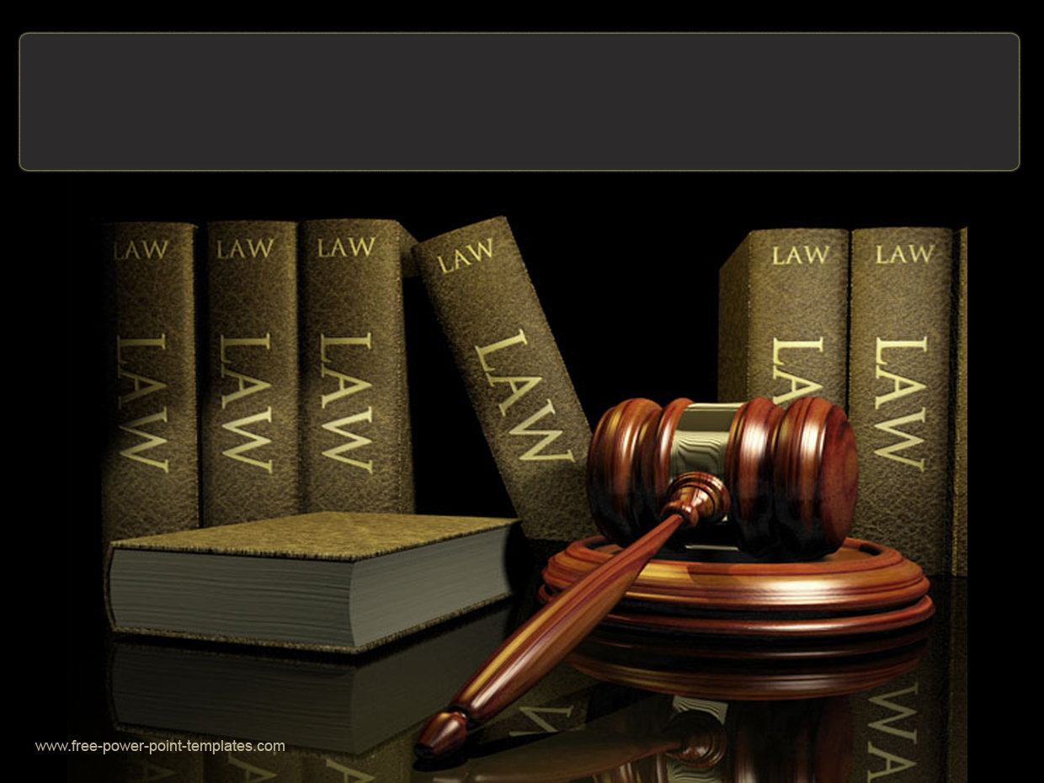
INFORMATION TECHNOLOGY LAW
[L470]
LECTURE ONE [1] – INTRODUCTION TO ICT LAW
[L470]
Thomas K. Malama LLM, LLB, Law Practice Certificate Post Graduate Diploma – Legislative Drafting

Slide 2
COURSE AIMS
:
The aim of this course is to look at the interaction between Information Communication Technology on the one hand, and the law, on the other.

Slide 3
COURSE OBJECTIVES
1. To examine whether and to what extent information, computing, data communications, information technologies and Information Communication Technology at large have given rise to a distinctive relatively new field of law (referred to as ‘Information Communication Technology Law);
2. To scrutinize and identify the above referred to body of law, consider legal concepts and analytic techniques particular to such a field; and
3. To scrutinize aspects of existing law which have arisen, changed or been adversely affected by these new technologies.

Slide 4
OUTLINE OF THIS SECTION
ITU’s “Definition” of the term “ICT.”
IFIC’s take on definition of the term “ICT.”
3. 2006 ICT Policy [Zambia] Definition of the term “ICT.”
4. ICT Act’s definition of the term “ICT.”
5. Michalson’s take on definition of the term “ICT.”

Slide 5
WHAT IS INFO. COM. TECH
The Little Data Book on Information and Communication Technology 2018
https://www.itu.int/en/ITU-D/Statistics/Documents/publications/ldb/LDB_ICT_2018.pdf
ICT service exports comprise communications services (telecommunications, business network services, teleconferencing, support services, and postal services) and computer and information services (database, data Processing, software design and development, maintenance and repair, and news-related service transactions).

Slide 6
WHAT IS INFO. COM. TECH
Approaches for Systematic Planning of Development Projects / Information and Communication Technology
https://www.jica.go.jp/jica-ri/IFIC_and_JBICI-Studies/english/publications/reports/study/topical/approaches/pdf/information_02.pdf
The World Bank and other international organizations generally abbreviate “Information and Communication Technology” as “ICT,” but since the abbreviation “IT” is commonly used in Japan, this report will use “IT.”IT includes both Information Technology and Communication Technology. It is technology for input, storage, processing, transmission, and output (display and printing) of information and is divided into hardware (such as computers and peripheral devices) and software (such as information processing systems).

Slide 7
WHAT IS INFO. COM TECH [cont]
Zambia ICT POLICY 2006
Information and Communication Technology is a generic term used to express the convergence of Communication telecommunications, information, broadcasting and Technology communications.

Slide 8
WHAT IS INFO. COM. TECH
ICT ACT DEFINITION
" the application of modern communications and computing technologies to the creation, management and use of information through the utilisation of hardware, software, networks, and media for the collection, storage, processing, transmission and presentation of information and related services”;

Slide 9
WHAT IS INFO. COM. TECH
Michalson
http://www.michalson.com/blog/what-is-ict/2525
“Men’s lives may depend on a coma”
(a) Information and Communication Technology - Info+ [Com Tech]
(b) Information, Communication and Technology – [Info Com] Tech
(c) Information Communication Technology - [Info +Tech] + [Com + Tech]
(d) Info + Com + Info Tech + Com Tech

Slide 10
WHAT IS INFO. COM. TECH
WATER TANK | ICT | EXAMPLES
Storage Tank | Information Technology | Hard drive, Processor, Content Management System
Pipes | Communication Technology | Fibre Optic cable, Internet Protocol, Point of Presence, Email and VoIP
Sanding Water | Information | File in PDF format or HTML format
Flowing Water | Communication | Data Message , Voice Data Packet

Slide 11
OK, NOW WE KNOW ICT, BUT WHAT IS LAW?
OUTLINE OF THIS SECTION
Philosophical Legal Theories about the Law:
(a) Naturalists Theory of Law
(b) Positivists Theory of Law
(c) Marxists Theory of Law
(d) Realists Theory of Law
2. Black’s Legal Dictionary’s definition of the Law

Slide 12
WHAT IS THE LAW NATURALIST’S THEORY
Natural ist Theory
There are two (2) types of Law –
One is Man-Made and exists to control relationships in society[Positive Law]
The other is natural and controls everything [Natural Law]
Natural Law includes “Principles of Natural Justicer”

Slide 13
WHAT IS THE LAW POSITIVITIST THEORY
The Law is that which is actually put in place and enacted thereby separating “is” from “ought.”
Law is rule made and enforced by the sovereign body of the state
There is no need to use Reason, Morality or Justice to determine the validity of the Law. .

Slide 14
WHAT IS THE LAW MARXIST THEORY
[Marxist are more interested in where Law originated & how to extinguish it.]
(a) Law came about due to the existence of private property
(b) Private property created classes in society
(c) Those with means of production use laws to exploit those without
(d) Communism can extinguish classes and bring about perfect equality and negate the need for the Law.

Slide 15
WHAT IS THE LAW REALIST THEORY
Interested in actual working of the Law as opposed to its origin or what is.
(a) Law is what the Judge “wants it to be” [what judge decides]
(b) Rules not put to practical use to solve practical issues are not laws but rather “Dead Words.”
(c) Judges Decision as opposed to enactments by the legislature is what the Law is [hence the binding nature of precedents in applicable in cases in Legal Jurisdictions such as Zambia,]

Slide 16
WHAT IS THE LAW ACCORDING TO BLACK
BLACK'S LAW DICTIONARY - Definitions of the Terms and Phrases of American and English Jurisprudence, Ancient and Modern
“That which is laid down, ordained, or established. That which must be obeyed and followed by citizens, subject to sanctions or legal consequences, is Law”
See the case:
Koenig v. Flynn, 258 N.Y. 292, 179 N.E. 705.

Slide 17
SO, NOW WE CAN MAKE OUT WHAT ICT LAW IS
ICT Law is therefore -
(a) legally binding ordinances enacted by Parliament or issued by any other body or person authorized so do; and
(b) which have to be obeyed, failure to which legal consequences or sanctions will, where applicable, be meted out; and
(c) such ordinances relate to the application of modern communications and computing technologies to the creation, management and use of information through the utilisation of hardware, software, networks, and media for the collection, storage, processing, transmission and presentation of information and related services”

Slide 18
SCRUTINIZING THE NATURE OF INFO. COM. TECH. LAW
We are, under this section seeking to understand, not what ICT Law is [recall, we have already done this] but rather how it is.
What constitutes ICT Law?
How does it Interact With Other Branches of the Law?
How does it interact With Technology ?

Slide 19
INFORMATION COMMUNICATION TECHNOLOGY LAW
Field of law encompassing elements of various branches of law including but not limited to:
Contract law, Consumer Protection law
Criminal Law, IP law, Privacy and Data Protection Law
Constitutional Law and Law of Evidence

Slide 20
RELATIONSHIP BETWEEN TECHNOLOGY AND THE LAW
Law finds technology to be too impulsive and reckless
Technology considers law to slow, traditionalist and controlling
Law should not unduly hinder technology and technology sometimes needs to be controlled

Slide 21
RELATIONSHIP BETWEEN TECHNOLOGY AND THE LAW
The Law more often than not, seeks to regulates technology. These attempts by the Law to regulate Technology often leave the Law down and out reeling with defeat
Technology, on the other hand also
(a) sometimes seeks shape the Law; or
(b) with great success dictates the efficacy of the Law.

Slide 22
THE RELATIONSHIP TECHNOLGY AND LAW [continued]
Effects of Technology to Administration of Law
Efficiency in handling cases
Storage of info more efficient but risky
Evidence verification more difficult

Slide 23
THE RELATIONSHIP TECHNOLGY AND LAW [continued]
Effects of Technology on Individuals’ Rights as Provided in the Constitution.
The Right to Privacy, a basic Human Righty and is “guaranteed” by the Republic Constitution, is under great threat of extinction as never before.
The Right to Anonymity, which is a corollary of the Constitutional Right to Privacy is slowly diminishing into oblivion

Slide 24
RELATIONSHIP TECHNOLOGY AND THE LAW [continued]
Effects of Technology on other Rights such as IP Rights
Technology makes it difficult to enforce one’s IP Rights
Easier to breach IP rights and get away with it [screen shot]
Do you, technically allow everyone to copy your work when to post it on the Internet?.

Slide 25
THE PRINCIPLE LAWS IN THE ZAMBIAN ICT SECTOR
There are, for our purposes, two (2) primary pieces of legislation in the sector:
Information and Communication Technologies Act No. 15 of 2009 [ICT ACT]
&
Electronic Communications and Transactions Act No. 21 of 2009 [ECT ACT]

Slide 26
INFORMATION TECHNOLOGY LAW [L470]
END OF LECTURE

