Slide 1
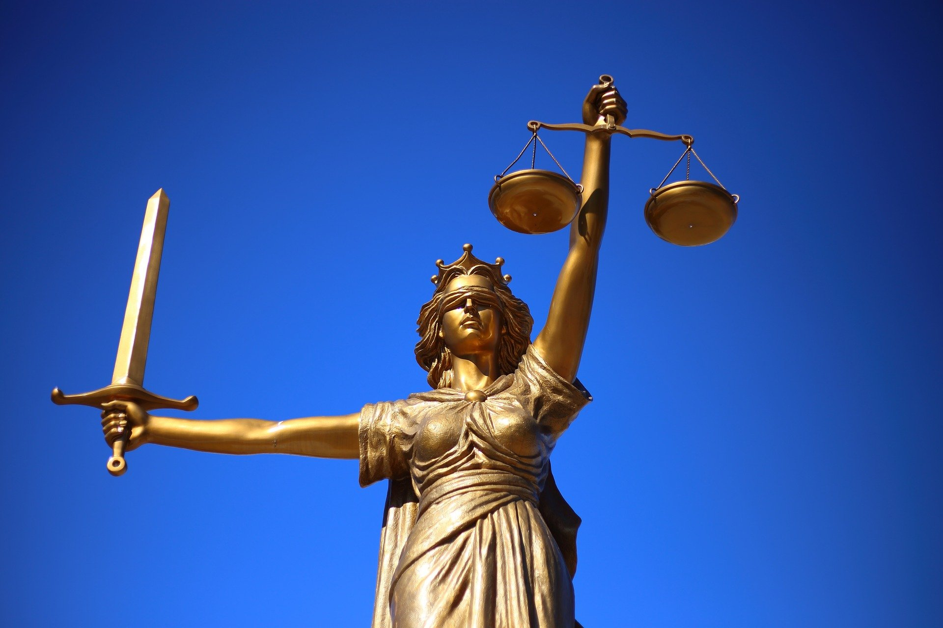
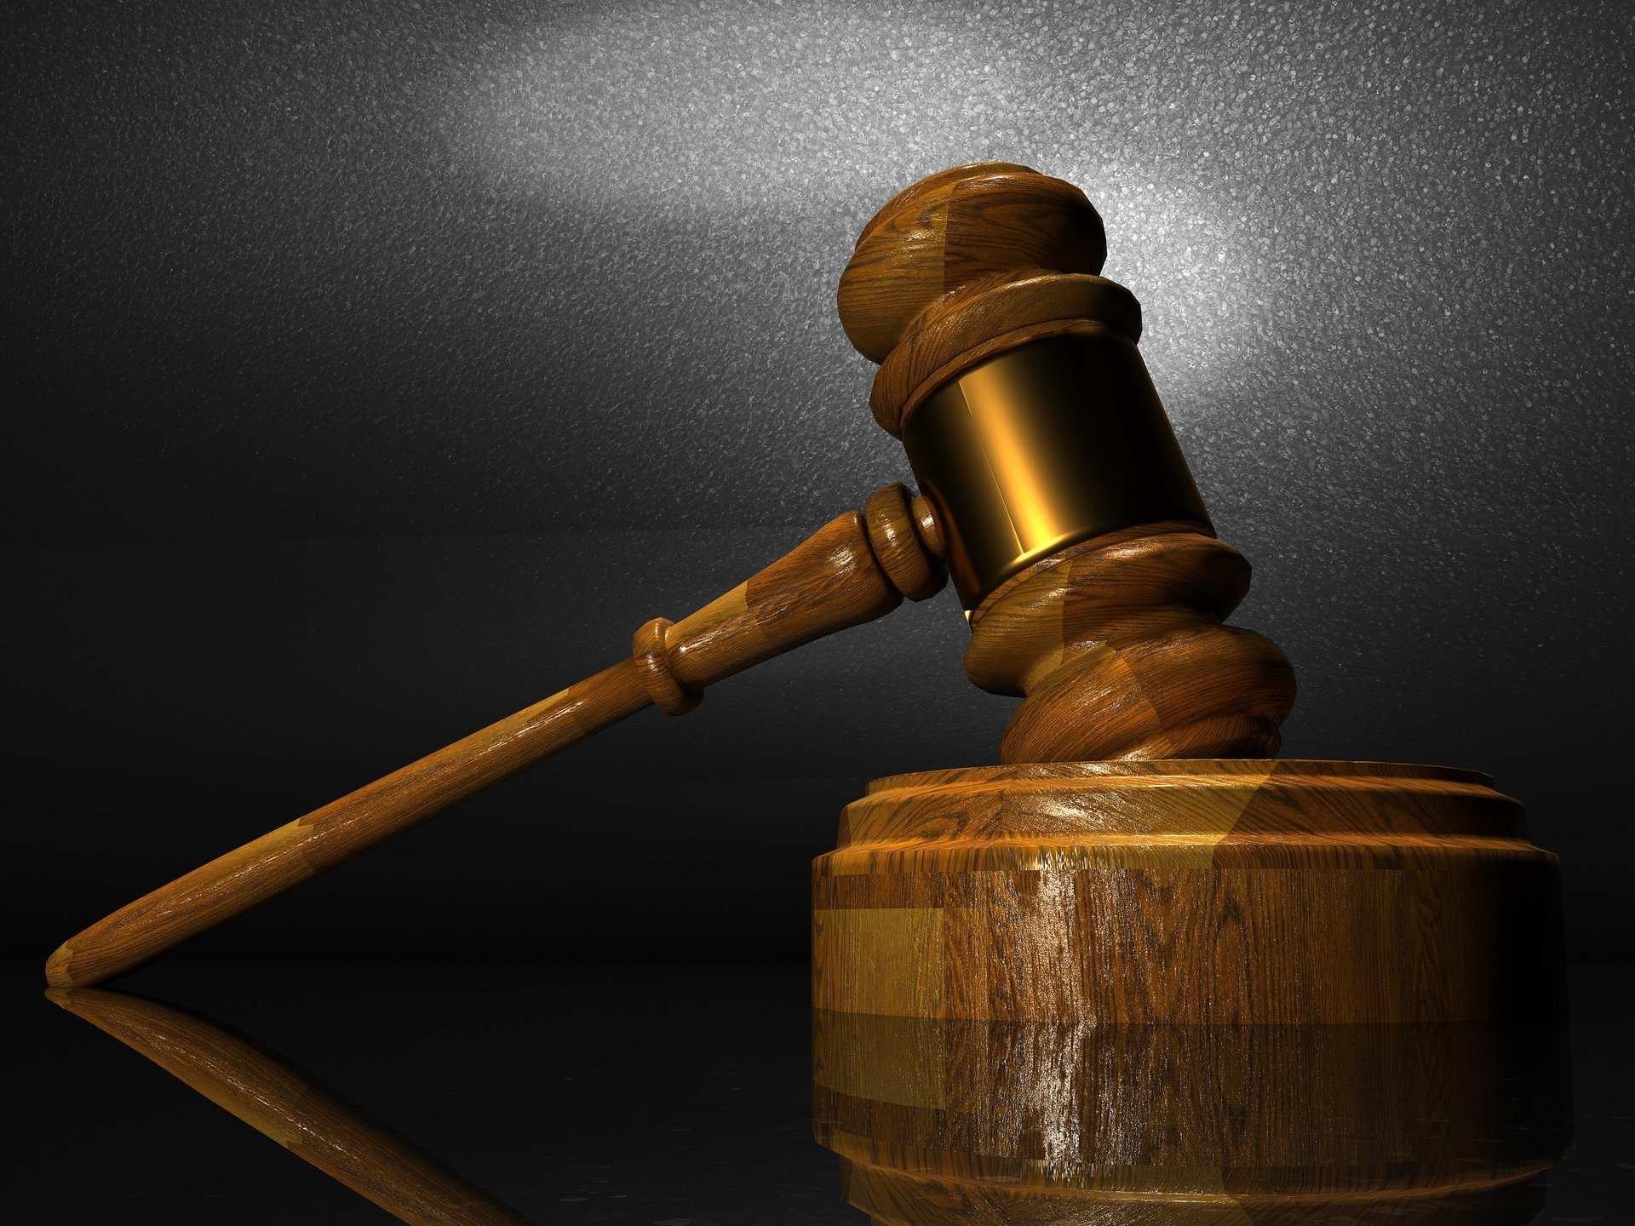
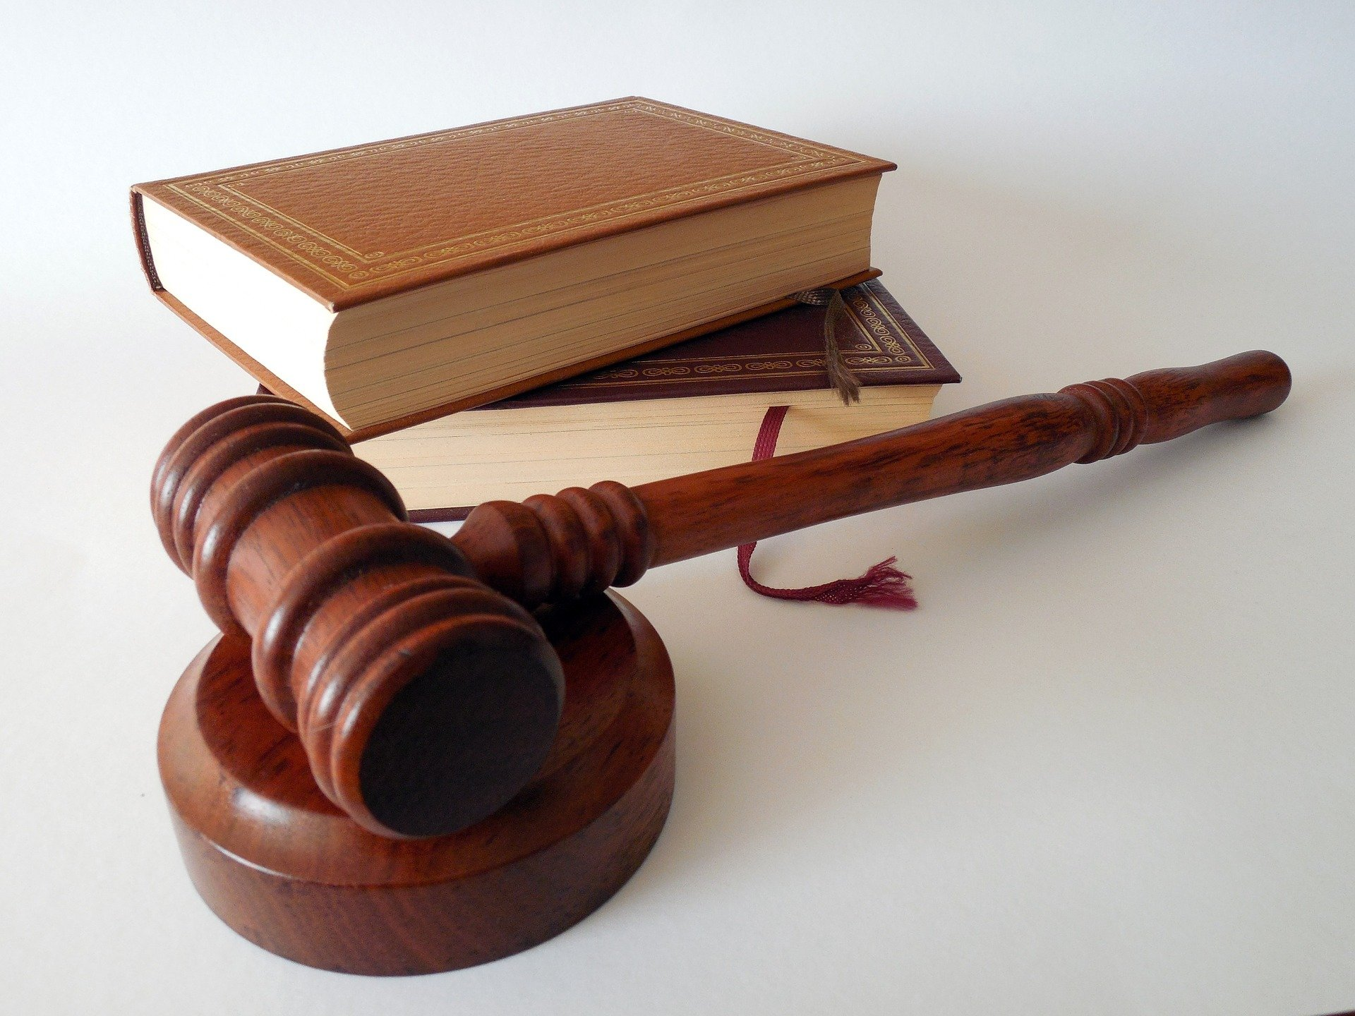
CVE 9020 PRESENTATION
GROUP TWO (2)
QUESTION: Itemize and briefly explain the salient features of proceedings in a criminal case.

Slide 2
NAMES : COMPUTER NUMBERS
BANDA MARY : 2020005646
NALISHIWA CHAABILA : 2020780755
SICHIKOLO BUBALA : 2020001845

Slide 3
STEPS IN A CRIMINAL CASE PROCEDURE
Investigation
Arrest
Bail
Arraignment
Plea-bargaining
Preliminary hearing
Public trail
Verdict
Sentencing
Appeal

Slide 4
INTRODUCTION
They are two categories of cases handled by the court.
Civil and criminal cases.
The procedure of the criminal case depends on how serious the crime is the less the crime the faster the procedure will be.
Criminal cases involves a crime against the state.
The government is the legal representative of society.

Slide 5
1. INVESTIGATION
Define the scope of the investigation for example, suppose an employee complains that their manager is bullying them and the decision is made to use an internal resource to investigate. The investigator must also determine whether there was a violation of the company policy
Plan the investigation
Collect relevant evidence
Review and analyze the information
Document the findings

Slide 6
2. ARREST
The criminal proceedings begin with an arrest.
If an officer witness a crime, he or she can make an arrest on the spot.
If not, a warrant for the person's arrest must be obtained.
(A warrant is a court order explaining the charges being brought against a suspect.
Every single person that is arrested everywhere in the world has rights, these rights begin the moment that person is arrested.
He or her rights must be read to them before any information they give can be used against them in court and the rights must be read to as the person is been arrested.

Slide 7
CONT
Once arrested the person is taken to the police station to be booked.( that names and other information are recorded.
The suspect is photographed and his or her finger print are taken).
During this time the suspect has the right to contact a lawyer or provided by the state.
There are two (2) fundamental categories of crime which are:
Misdemeanors (e.g. vandalism, trespassing)
Felonies (e.g. murder, rape)

Slide 8
3. BAIL
Bail is not granted to every defendant it depends on the crime committed.
Bail is always in money form paid to the court.
When bail is granted a person is released on few conditions based on the crime and criminal history
The defendant has to sign the bail in writing to present in court on the trail dates.
Bail is usually in money from, which is returned when the suspect shows up for court.

Slide 9
4. ARRAIGNMENT
Up to this point, a person accused of a crime is only a suspect.
The accused is presumed to be innocent until proven guilty by the court of law.
The suspect is formally charged with a crime before the case can be brought to trial.
This is a court hearing were the defendent is informed of the charges against them and asked to enter a plea.
This is usually the first time appearance in court in a criminal case.

Slide 10
CONT
The suspect is formally charged with a a crime before the case can be brought to trial.
The prosecutor on behalf of government decided can decide to charge the suspect with either
An indictment or a formal charge.
This is written down.
If the suspect pleas not quilty, a trial will be scheduled.

Slide 11
5. PLEA-BARGAINING
Plea-bargaining this is the practice of negotiating an agreement between the prosecution and the defense
Plea-bargaining is claimed to speed up the court proceedings.
It is used mostly when both sides have something to gain.
There are three types of plea-bargaining namely:
Charge bargaining (the defendant agrees to plead guilty to reduced charges e.g. assault rather than murder)

Slide 12
CONT
b. Sentence bargaining ( prosecutors agree to reduce a defendant’s punishment)
c. Count bargaining (defendants who face multiple charges may be allowed to plead guilty to fewer counts e.g. the prosecution charges Joy with both robbery and simple assault)

Slide 13
6. PRELIMINARY HEARING
  The main purpose of a preliminary hearing is for the judge to decide whether the accused person should be released before being brought to trial.
  If the judge finds lack of evidence against the defendant the crime is dismissed
  There are three (3) common outcomes during the preliminary hearing which are:
  The judge decides that the defendant has to remine in police custody waiting for the trail

Slide 14
CONT
  The judge decides to reduce the charges to a less serious offense
  The judge decides to dismiss the case entirely

Slide 15
7. PUBLIC TRAIL
Here both sides spend time to prepare and gather as much information about the case as possible.
Jury selection in counties like the USA and people may be subpoenaed. Zambia does not have jurors during court case.
Both sides give their opening statement starting with the prosecutor, witness are questioned.
After both sides have presented their evidence closing statements are given from both sides.

Slide 16
8. VERDICT
Following the closing statements, the jury leaves the court room and begins deliberation in private and a foreperson is choosen.
The jury decide weather the defendant is quilty or innocent thought a vote.
A judgement by a judge sitting without a jury is not a verdict
If the jury fails to reach a complete verdict, the judge may declare a mistrial and the case will either be dismissed or a new jury will be chosen

Slide 17
9. SENTENCING
Sentencing is always the decision made by the judge only
Some of the aspects taken into account for reaching sentencing decision are:
The circumstances of the crime and the arrest
The criminal history of the defendant
The aggravating and mitigating factors related to the case
NOTE: after considering those factors the judge announces the sentence

Slide 18
10. APPEAL
If the defendant is unhappy with the sentence made by the judge, the defendant can file an appeal
The defense attorney is the one who files a notice of appeal
The appeal process continues at the appeal court of high jurisdiction
The defense attorney presents the instances of the case not being handled efficiently through the court

Slide 19
CONT
At last the judge decides whether the sentencing remains or it is reduced

Slide 20
CONCLUSION
The courts are critical institutions were matters of crime arising among an individual and the state are resolved from.
Just as there are different courts and laws that are applicable in dealing with matters of crime, cases are either criminal or civil in nature.
Criminal cases are settled in courts of law using criminal case procedure before, during and after trial.
The notable stages involved in handling with a criminal case are investigation, arrest, bail, arraignment, plea-bargaining, preliminary hearing, public trial, verdict, sentencing and appeal.

