Slide 1
CIVIC EDUCATION 9020
GROUP THREE
NAME COMPUTER NUMBER
PATRICIA CHABONSE 2020209482
CHIBESA MUBANGA 2020031345
CHIKANKU CHARLES 2020990237

Slide 2
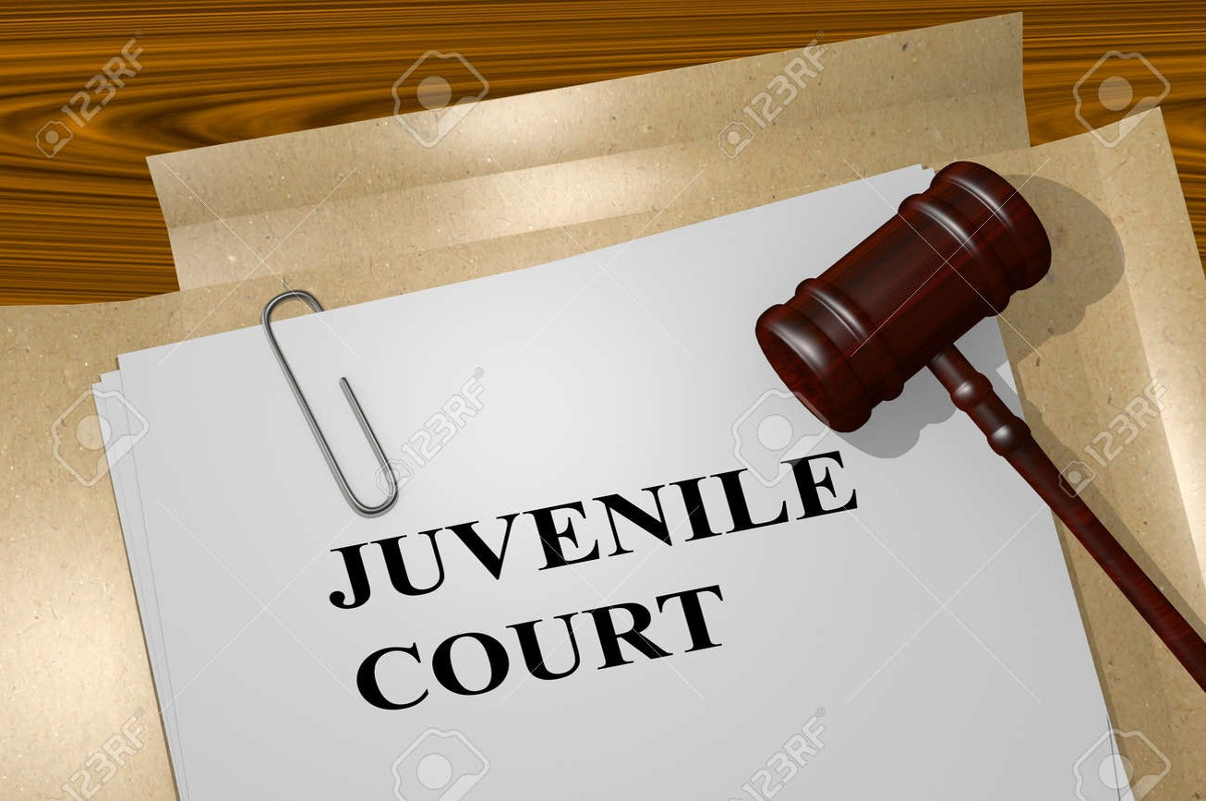
Question: Itemize and briefly explain the salient features of proceedings in a juvenile case

Slide 3
JUVENILE PROCEEDINGS
CONTENT:
INTRODUCTION
KEY TERMS
SALIENT FEATURES
CONCLUSION
REFERENCES

Slide 4
INTRODUCTION
It has been accepted by almost every country in the world today that children have rights. Adults and children are entitled to enjoy the same rights and fundamental freedoms and are subject to the same limitations in their enjoyment.

Slide 5
CON’……INTRODUCTION
However, there is special emphasis that children’s rights are considered to be of critical important because young people who come into contact with the law are a particularly vulnerable group and Zambia’s domestic laws recognize this vulnerability and grant them special legal protections through a distinct legal procedure called a juvenile court system.

Slide 6
KEY TERMS
A juvenile is a person who is not legally an adult. The age at which a young person is considered to be an adult varies from country to country. However, according to article one of the convention on the rights of the child, any person under the age of eighteen (18) is a child. However, he or she is treated differently in the legal system that is according to their law or constitution.
Salient means the most noticeable or important features.
Itemize means to state by items or give particulars of or list the individual units or parts.

Slide 7
PURPOSE OF THE JUVENILE JUSTICE SYSTEM
Why do we have the juvenile legal system?
The juvenile justice system is there or exists because it responds to young people who come into contact with the law enforcement and are accused of breaking the law. Crimes may include murder, theft, assault, fights etc
The juvenile justice system does not recognize punishment as a legitimate purpose but rather to help the young person to avoid future delinquency or to be involved in any acts of crime.

Slide 8
STAGES INVOLVED IN A JUVENILE CASE
Delinquent behavior: this is the first stage where a juvenile is caught in a delinquent act.. Depending on how serios the delinquent is, he or she is then taken to the police station or arrested by an officer present.
Referral: This is where a juvenile enters the justice system by being Arrested or apprehended: If a juvenile commits a delinquent ( minor crime or a crime act committed by a minor), he or she will be arrested or apprehended by a police officer.
It is an arrest or referral.

Slide 9
Intake or Diversion: At this stage the lawyers in the prosecutor’s office determine whether the case should be formally processed in juvenile court depending on the seriousness of the crime e.g murder
Transfer or Waiver: At this stage the person accused of a very serious offence maybe transferred (or waived) out of the juvenile court to stand trial as adults in criminal court.

Slide 10
STAGES CONT’D
Detention: At this stage, if a juvenile is deemed to be a danger to society then he or she will be detained if not then they will remain at home during the adjudication period.
Adjudication: Juvenile maybe adjudicated delinquent, roughly equivalent to being found guilty in a criminal court.

Slide 11
Cont’
Disposition: This stage is like sentencing hearing in adult court.
Probation: A Juvenile is placed under the supervision of a probation officer and maybe required to adhere to the rules, participate in mandatory treatment activities, and perform community services

Slide 12
Cont’d
Placement: Some juvenile are removed from their homes and placed into residential facilities.
Aftercare: The juvenile is supervised and supported during the transition back to the community.

Slide 13
SALIENT FEATURES IN JUVENILE CASES
The first feature to take note of in a juvenile case is that the judge needs to act in the best interests of the child.
The juvenile justice system does not recognize punishment as a legitimate purpose but rather to help the young person to avoid future delinquency or to be involved in any acts of crime.

Slide 14
CONT’
The juvenile court is entrusted to focus on the child or adolescent as a person in need of assistance, not on the act that brought him or her before the court.

Slide 15
SALIENT FEATURES CONT’D
The proceedings in a juvenile court are civil as opposed to criminal. So, instead of being formally charged with a crime, juvenile offenders are accused of committing a delinquent act
The Commissioner of Police is responsible for taking steps to prevent juveniles from associating with adults accused of crimes.

Slide 16
SALIENT FEATURES CONTI’D
Intake workers at the juvenile court or probation agency or attorneys in the prosecutor’s office determine whether the case should be formally processed in juvenile court, handled informally (diverted from court) or dismissed.
In most states, judge’s order pretrial detention only when the juvenile is deemed a danger to the community or a flight risk. Typically, a detention hearing is convened within 24 hours of arrest or other referral.

Slide 17
SALIENT FEATURES CONT’D
Most of the juveniles adjudicated delinquent are sentenced either to community supervision, better known as probation, or to residential placement.
Under probation arrangements, juvenile on probation remain at home under the supervision of a probation officer and may be required to adhere to rules, participate in mandatory treatment activities, perform community service and/or pay restitution ( recompensation for injury or lost.

Slide 18
SALIENT FEATURES CONT’D
Brown (1987) argued to say that in the adjudication phase, a juvenile may be adjudicated delinquently, roughly equivalent to being found guilty in criminal court. Alternatively, a juvenile may be found innocent or the charges may be dismissed
Most Juvenile cases are usually resolved in plea agreements in which the youth admits to a lesser charge or in consent decrees or similar agreements to defer prosecution

Slide 19
SALIENT FEATURES CONT’D
For juveniles who are removed from home and placed in a correctional institution or other residential facility after being adjudicated, the final phase of the process may be a period of aftercare, where the young person is supervised and supported during the transition back to the community.

Slide 20
CONT’
Another salient feature upheld in the proceedings of a juvenile case is confidentiality.
The courts of law are required to deal with all juvenile cases in confidence, this is done to safeguard the juveniles from the community or any interested individuals who may want to use the information about the juvenile’s case against the juvenile

Slide 21
CONCLUSION
It can be noted that young people who commit offenses against the law do so due to many reasons, some of such reasons include; ignorance, bad company, poverty, drug abuse and so on. Regardless of the reason that bring young people before the law, they still need special care and protection from the negative judgment that may come from the community.
The most noticeable feature in a juvenile case is that the courts of law are more forgiving towards adolescents who commit delinquent act, this is because they have a higher chance of rehabilitating and reintegrating into the community as better citizens who have learnt from their previous mistakes.

Slide 22
REFERENCES:
Birckhead, T.R., 2009. Toward a theory of procedural justice for juveniles. Buff. L. RevBrown, W.K., Miller, T.P. and Jenkins, R.L., 1987. The favorable effect of juvenile court adjudication of delinquent youth on the first contact with the juvenile justice system. Juv. & Fam. Ct. J.
Fagan, J., Forst, M. and Vivona, T.S., 1987. Racial determinants of the judicial transfer decision: Prosecuting violent youth in criminal court. Crime & Delinquency, 33(2).
Furdella, J. and Puzzanchera, C., 2015. Delinquency cases in juvenile court, 2013. Drugs, 23, p.23.

Slide 23
REFERENCES:
Goldstein, J., Solnit, A.J., Goldstein, S. and Freud, A., 1996. The best interests of the child: The least detrimental alternative. Simon and Schuster.
Mason, J., 2004. Confidentiality in juvenile delinquency proceedings. UNC School of Government.

Slide 24
THANK YOU!!

