Slide 1
THE UNIVERSITY OF ZAMBIA
SCHOOL OF EDUCATION
DEPARTMENT OF LANGUAGES AND SOCIAL SCIENCES
CVE 9020(2022/2023)
LEGAL EDUCATION AND PUBLIC POLICY
GROUP 12

Slide 2
GROUP PRESENTERS
TWAAMBO MUDENDA :2020000636
SETWELL MULEYA :2020001829
WAMUSUWILA SINYANGWE :2018264354

Slide 3
PRESENTATION QUESTION
THE AIM OF POLICY ANALYSIS IS TO PRODUCE POLICY-RELEVANT INFORMATION. ITEMIZE AND DESCRIBE FIVE TYPES OF POLICY RELEVANT INFORMATION

Slide 4
PRESENTATION OVERVIEW
INTRODUCTION
POLICY
POLICY ANALYSIS
POLICY RELEVANT INFORMATION
TYPES OF POLICY RELEVANT INFOPRMATION
SUMMARY
CONCLUSION

Slide 5
INTRODUCTION (1/6)
Policy analysis helps to define and outline the goals of a proposed policy and identify the most possible options.
It helps to examine the various strengths and weaknesses of each policy option.

Slide 6
DEFINITION OF POLICY (2/6)
A policy is a set of rules or guidelines that are used to guide decisions and actions in a certain situation or context.
A policy can be formal or informal, and it can be adopted by different types of organizations, such as governments, businesses, schools, etc.
A policy usually reflects the goals and values of the organization that creates it, and it helps to ensure consistency and quality in its operations.

Slide 7
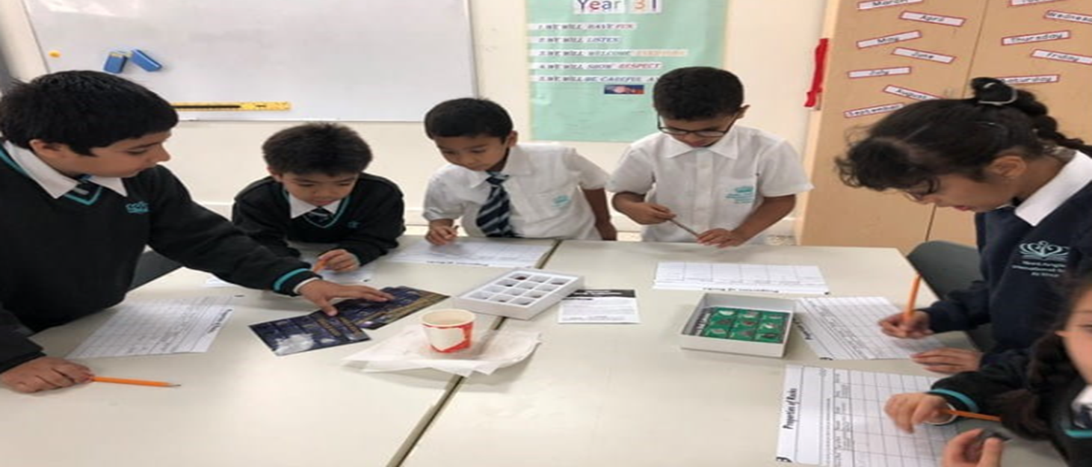
EXAMPLE OF POLICY (3/6)
For example, a school policy on homework, which specifies how much homework students should do, how it will be graded, and what are the consequences for not doing it.

Slide 8
DEFINITION OF POLICY ANALYSIS (4/6)
Policy analysis is the process of identifying and comparing potential public policy options that could address a problem and achieve a set of goals.
It involves both art and science, as it requires putting together pieces of information and evidence to determine what will work in public policy.
Policy analysis can be done by different entities, such as government agencies, private organizations, academic institutions or individuals.

Slide 9
EXAMPLE OF POLICY ANALYSIS (5/6)
An example of policy analysis, is when the government wants to evaluate the effectiveness of a policy aimed at improving student performance in schools.
Analysts will gather data on student achievement, graduation rates, teacher qualification and school funding.
Then they would analyze data to determine if they are leading to positive outcomes e.g. improved academic performance and make recommendations to improve policy`s effectiveness.

Slide 10
POLICY-RELEVANT INFORMATION (6/6)
Policy relevant information refers to how effective research findings inform decisions made by decision-makers.
In other words, policy relevant information is determined by how applicable and practical research findings are to decisions that need to be made on policy priorities.

Slide 11
TYPES OF POLICY RELEVANT INFORMATION(1/11)
Basically there are five types of policy relevant information and these are represented in the diagram below;
POLICY PROBLEM
POLICY ALTERNATIVES
POLICY ACTIONS
POLICY OUTCOME
POLICY PERFORMANCE

Slide 12
POLICY PROBLEM (2/11)
When providing policy-relevant information, one of the key policy problems is ensuring that the information is accurate, unbiased, and up-to-date.
Policymakers rely on information to make informed decisions, and if the information is defective or incomplete, it can lead to ineffective policies or unintended consequences.

Slide 13
POLICY PROBLEM CONT; (3/11)
For example, Let's consider a policy problem related to healthcare reform. If policymakers are debating a new healthcare policy, they need accurate data on factors such as healthcare costs, patient outcomes, and the impact of various interventions.
However, if the information provided to them is based on outdated or biased studies, it can lead to misguided policy decisions that may not effectively address the healthcare system's problems. Therefore, the policy problem here is the need for reliable and current information to inform the decision-making process.

Slide 14
POLICY ALTERNATIVES (4/11)
A policy alternative, in the context of providing policy-relevant information, refers to a potential solution or course of action that policymakers can consider when addressing a specific policy problem.
It represents different options or approaches that can be taken to achieve a desired policy objective.
When providing policy-relevant information, it's essential to present a range of policy alternatives along with their potential benefits, drawbacks, and implications. Policymakers can then use this information to make informed decisions about which alternative is most suitable for addressing the problem at hand.

Slide 15
POLICY ALTERNATIVES CONT;(5/11)
For example, if the policy problem is improving public transportation in a city to reduce traffic congestion, policy alternatives might include: Investing in expanding the existing public transit system, Implementing congestion pricing to reduce private car use, Promoting the development of bike lanes and pedestrian-friendly infrastructure and Subsidizing rideshare services for commuters.
Each of these alternatives would have its own set of implications, costs, and benefits, and policymakers would need comprehensive information to evaluate them effectively and choose the most appropriate course of action.

Slide 16
POLICY ACTIONS (6/11)
Policy actions, refer to the specific steps or measures that policymakers can take to implement a chosen policy alternative. These actions outline how a policy will be executed, monitored, and evaluated to achieve its intended goals.

Slide 17
POLICY ACTIONS CONT;(7/11)
For example, if a city decides to implement a policy alternative to reduce air pollution by promoting electric vehicle adoption, the policy actions might include passing new regulations to incentivize electric vehicle purchases, allocating funds for charging infrastructure and establishing a monitoring system to track the reduction in emissions over time.
Policy actions are critical for ensuring that policies are not only well-conceived but also effectively executed to achieve their intended outcomes.

Slide 18
POLICY OUTCOMES (8/11)
Policy outcomes, refer to the results or consequences of implementing a particular policy. These outcomes can be both intended and unintended and are used to evaluate the success or impact of a policy.
When presenting policy-relevant information, it's essential to include a discussion of potential policy outcomes to help policymakers understand what to expect and how to assess the policy's effectiveness.

Slide 19
POLICY OUTCOMES CONT;(9/11)
For instance, if a government introduces a policy to increase access to higher education by providing tuition subsidies, the policy outcomes might include more students enrolling in college an intended outcome, potential increases in student debt an unintended consequence.
By presenting a comprehensive assessment of policy outcomes, policymakers can make informed decisions about whether a policy is achieving its intended goals and whether adjustments or modifications are needed.

Slide 20
POLICY PERFORMANCE (10/11).
Policy performance refers to the assessment of how well a policy is functioning in practice. It involves evaluating whether the policy is achieving its intended goals and objectives and whether it is delivering the desired outcomes.
Policy performance analysis helps policymakers understand whether a policy is effective, efficient, and meeting the needs of the target population.

Slide 21
POLICY PERFORMANCE CONT; (11/11)
For instance, if a government implements a policy to reduce childhood obesity by regulating food marketing to children, policy performance analysis might involve measuring changes in childhood obesity rates effectiveness, evaluating the costs of implementing and enforcing the regulations efficiency.
Policy performance assessment is crucial for evidence-based policymaking, as it informs decisions about whether to continue, modify, or terminate a policy based on its real-world impact.

Slide 22
SUMMARY (1/2)
NO | TYPES | IMPORTANCE
1 | PILICY PROBLEM | Conceptualizing problems from different angles
2 | POLICY ALTERNATIVES | Assist the public officials to come with solutions to solve a problem.
3 | POLICY ACTIONS | Forecasting and evaluating consequences of actions based on different alternatives.
4 | POLICY OUTCOMES | Ensuring an observed consequences of policy actions
5 | POLICY PERFORMNCE | Finding the degree of value contributed by the policy outcome

Slide 23
CONCLUSION (2/2)
In conclusion, policy relevant information plays a critical role in shaping effective and informed decision-making processes. By identifying and understanding different types of policy relevant information, policy makers can develop comprehensive strategies to address pressing issues or problems.

Slide 24
END OF OUR PRESENTATION
THANK YOU
Q & A SESSION
COMMENTS, CONCERNS AND COMPLAINTS

