Slide 1
HTML 5 Section Elements overview

Slide 2
Overview
Common HTML elements (recap)
HTML 5: new section elements
HTML 5: new multimedia elements
HTML 5: new graphic elements

Slide 3
Common HTML elements:
(Summary recap)
<html>
<head>
<body>
<title>
<div> (division)
<p> (paragraph)
<h1> (heading 1)
<a> (anchor element, links to other web pages)
<ul> (unordered list)
List of HTML elements:
https://www.w3schools.com/tags/default.asp

Slide 4
Common HTML elements:
<html> element
  The <html> tag is the container for all other HTML elements
  Indicates, to the web browser, that the file is an html file

Slide 5
Common HTML elements:
<head> element
  provides information about the web page
  content of the head element is not visually displayed on the web page

Slide 6
Common HTML elements:
<body> element
  Content in the body element is visually displayed (to a user) when the web page loads
  An HTML file should have only 1 body and 1 head element

Slide 7
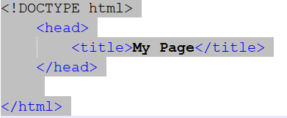
Common HTML elements:
<title> element
  An element that specifies the name of a web page
  For the search engines and web browsers
  <title> element has to be placed within the head element
For example:

Slide 8
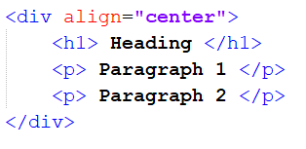

Common HTML elements:
<div> element (division)
  The <div> element groups together multiple block elements
  This can be done to give multiple elements similar formatting
For example:
(using a div)
(without a div)

Slide 9
Common HTML elements:
<p> element (paragraph)
  Displays a paragraph within the web page
<h1> element (heading 1)
  Used to indicate a heading within a web page
  There is <h1> to <h6>
    ( h1 used to indicate the most important headings in the web page)
    ( h6 used to indicate lower-level headings in the web page)

Slide 10
HTML 5: new section elements
Section elements
  <header>
  <footer>
  <main>
  <article>
  <section>

Slide 11
HTML 5: new section elements (cont.)
<header> element
  Represents introductory content for the web page, or for a section within web page
  Usually includes:
    a heading (i.e. <h1> heading element)
    a logo
    set of navigation links
  Cannot be included in a <footer> element, nor in another <header> element

Slide 12
HTML 5: new section elements (cont.)
<footer> element
  Represents a footer for the web page or for a section
  (a footer is an area at the bottom of a document page that contains data which is common to other pages)
  Usually includes:
    author information
    copyright notice
    additional links

Slide 13
HTML 5: new section elements (cont.)
<main> element
  A section representing the most important content of the web page
  Content which is unique to that web page
    (whereas the header and footer may be repeated on other pages of the same website)
  There must be only 1 main element in a web page
  The <main> element must not be nested inside a <header> or <footer> element

Slide 14
HTML 5: new section elements (cont.)
<article> element and <section> element
A <article> element is used to represent an article within a web page
  Contains other elements such as: paragraph element and a heading element
A <section> element represents a group of elements which convey a similar meaning

Slide 15
HTML 5: new section elements (cont.)
<section> element vs <div> element comparison
A <section> element represents a group of elements which convey a similar meaning (or message)
A <div> element represents a group of elements which usually have similar formatting

Slide 16
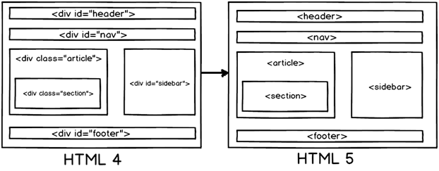
HTML 5: new section elements (cont.)
<section> element vs <div> element
  The new section elements in HTML 5 were designed to improve the clarity and readability of the html file
(Previously, most sections in the html file, were defined using the <div> element)

Slide 17
HTML 5: new section elements (cont.) : HTML 5 example
<!DOCTYPE html>
<html lang=“en”>
<head>
<meta charset=“UTF-8”>
<meta name=“keywords” content=“html 5, webpage”>
<title> My Webpage </title>
</head>
<body>
<header>
…
</header>
<main>
...
</main>
<footer>
…
</footer>
</body>
</html>

