Slide 1
Introduction to HTML 5

Slide 2
Overview
What is HTML
HTML elements and tags
HTML attributes
XHTML vs HTML 5 overview

Slide 3
What is HTML?
Hyper Text Markup Language
  HTML is a set of codes and symbols used for creating web pages and web-based applications
  HTML is not a programming language:
    A mark-up language uses <tags> to control the structure and content of a text file
  HTML is published and maintained by the World Wide Web Consortium (W3C)
    (The main international standards organization for the World Wide Web)

Slide 4

HTML elements and tags
Element: component of HTML which controls the structure and content of a specific section of an HTML file
  Together, multiple elements will create an HTML file
An HTML element usually includes a start tag and an end tag, with the content between the two tags:
For example:

Slide 5
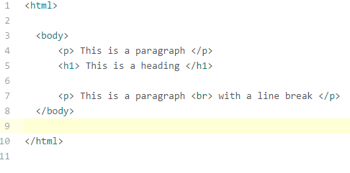
HTML elements and tags (cont.)
Nested elements:
  HTML elements can be nested ( elements within other elements)
  For example:

Slide 6
HTML elements and tags (cont.)
Common HTML elements:
<html>
<head>
<title>
<body>
<div> (division)
<p> (paragraph)
<h1> (heading 1)
<a> (anchor element, links to other web pages)
<ul> (unordered list)
List of HTML elements:
https://www.w3schools.com/tags/default.asp

Slide 7
HTML elements and tags (cont.)
HTML has two groups of elements:
  Block elements
  Inline elements
A block element will start on a new line and take up the full width available on the page (from left to right).
  i.e. a line break before and after the element
  e.g. <div> , <p> , <h1> elements
Inline elements do not force line breaks
  usually elements within a block element
  e.g. <em> , <strong> elements

Slide 8
HTML elements and tags (cont.)
Single tag elements:
Elements which do not contain content can usually be represented with a single tag
  e.g. <br> (break line)
HTML 5 does not require empty elements to be closed (no ‘/’ forward slash, like a start tag)
Single tag example:

Slide 9
HTML elements and tags (cont.)
HTML elements can be used to control the structure and content for
  Text
  Headings
  Links
  Images
  Graphics
  Special Characters
  Lists
  Tables
  Forms
  Meta information

Slide 10
HTML elements and tags (cont.) – Head and Body
Head element:
  The content of the head element is not visually displayed on the web page.
  This content only provides information about the web page for web browsers and for search engines
Body element:
  Content in the body element is visually displayed (to a user) when the web page loads
Usually, an HTML file will contain only 1 head element and 1 body element (which includes all the other visual elements)

Slide 11

HTML elements and tags (cont.) – Meta element
Meta element:
Metadata (or meta information) describes the web page.
Meta elements are not visually displayed within the web page. Instead, metadata is usually used by search engines to identify a web page
  (meta elements have to be placed within a head element)
Meta element example:

Slide 12
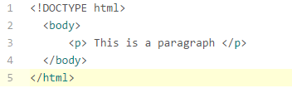
HTML elements and tags (cont.) – DOCTYPE
DOCTYPE declaration:
The DOCTYPE declaration is a statement which indicates (to a web browser) the type of file to expect
For HTML files, the DOCTYPE declaration should be included in the start tag of the html element. E.g.

Slide 13
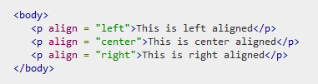
HTML attributes
An HTML attribute is additional information of an element which adds to the structure (appearance) of the element
An attribute is placed within the start tag of an element
For example:
attribute name
attribute value

Slide 14
XHTML vs HTML 5 overview
HTML 5 is the fifth revision of the HTML standard (published by W3C)
XHTML (Extensible Hypertext Mark-up Language)
  combination of HTML 4 with elements of XML 1.0
  XHTML was designed to fix challenges of using HTML by including additional capabilities to HTML 4.

Slide 15

XHTML vs HTML 5 overview (cont.)
Most of what XHTML was designed to do has been covered by HTML5
  (As such, HTML 5 became the primary HTML standard (over XHTML) for developers and for web browsers)
HTML 5 includes new elements to improve the multi-media capabilities, mobile presentation and responsive design of HTML

Slide 16
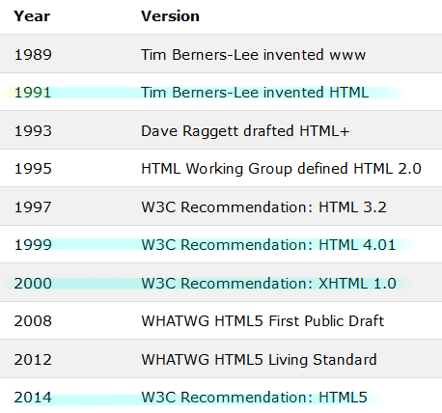
XHTML vs HTML 5 overview (cont.)
History overview of HTML:

Slide 17
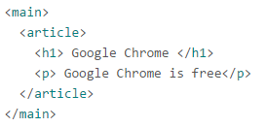
XHTML vs HTML 5 overview(cont.)
HTML 5 includes new elements not found in XHTML, for example:
Section elements:
  <footer>
  <header>
  <article>
  <section>
  <main>
Multimedia elements:
  <video>
  <audio>

Slide 18

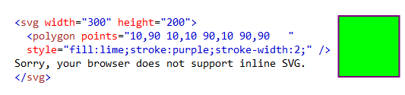
XHTML vs HTML 5 overview(cont.)
Example of HTML 5 new attributes for form elements:
  Number
  Date
  Time
  Calendar
  Range
New graphics elements:
  <svg> (Scalable Vector Graphics)
  <canvas>
time example:
svg example:
HTML 5 file
Web browser display

Slide 19

XHTML vs HTML 5 overview(cont.)
HTML 5 was designed to be simpler to use than XHTML
DOCTYPE declaration:
  DOCTYPE declaration was simplified in HTML 5
For example:
HTML 5
XHTML
(additional metadata was required)

Slide 20
XHTML vs HTML 5 overview(cont.)
HTML 5 was designed to be simpler to use than XHTML
  In XHTML: the DOCTYPE is required
  In XHTML: <html>, <head>, <title>, and <body> are required

Slide 21
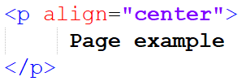
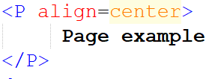
XHTML vs HTML 5 overview(cont.)
HTML 5 was designed to be simpler to use than XHTML
  In XHTML: elements must be in lowercase
    (where as uppercase tags may still work in HTML 5)
  In XHTML: attribute names must be in lowercase
  In XHTML: attribute values must be in quotes
For example:
XHTML
HTML 5

Slide 22
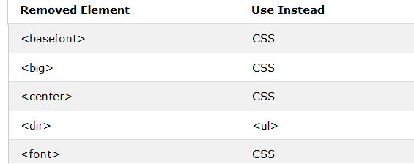
XHTML vs HTML 5 overview(cont.)
HTML 5 was designed to be simpler to use than XHTML
  Some HTML 4/ XHTML elements have been removed in HTML 5 (to simplify the elements used in HTML 5)
For example:

Slide 23
XHTML vs HTML 5 overview(cont.)
XHTML and HTML 5 differences (summary):
  XHTML is a hybrid between HTML and XML (another mark-up language), whereas HTML 5 is solely a version of HTML
  XHTML is almost identical to HTML 4.01. HTML 5 is the latest version of HTML
  HTML 5 includes new elements such as <video>, <canvas>, <audio> which are not available in XHTML
  Some HTML 4/ XHTML elements have been removed in HTML 5

Slide 24
XHTML vs HTML 5 overview(cont.)
XHTML and HTML 5 differences (summary):
  In XHTML, all tags must be closed (end tag). HTML 5 is less strict
    (some slightly invalid HTML 5 code may still display proper results in certain web browsers)
  DOCTYPE declaration was simplified in HTML 5
  In XHTML:
    the DOCTYPE declaration is required
    <html>, <head>, <title>, and <body> are required
    elements must be in lowercase
    attribute names must be in lowercase
    attribute values must be in quotes

Slide 25
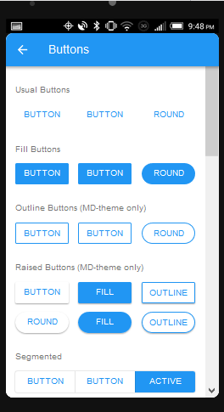
HTML 5 beyond web browsers
In addition to standard web pages, HTML 5 and CSS 3 are being used for the structure and content of web based applications:
  mobile applications
  and even some desktop application

