Slide 1
HTML Tables

Slide 2
Overview
  Four main table elements
  Table caption element
  Table attributes – not supported in HTML 5
  colspan and rowspan attributes
  When to use HTML tables
  Nested tables

Slide 3
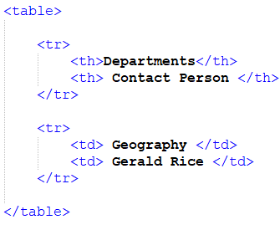

Four main table elements
  <table> defines an HTML table within a web page
  <tr> (table row) defines a table row within a table element
  <th> (table header) defines a table heading within a table row
  <td> (table data) defines a table cell within a table row
For example:
Web browser
HTML 5 file

Slide 4
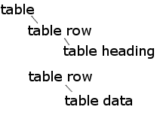
  Four main table elements (cont.)
4 main table elements (hierarchy)
  <table> within a web page (or other block element)
  <tr> within a table element
  <th> within a table row
  <td> within a table row
For example:
HTML 5 file
Hierarchy

Slide 5
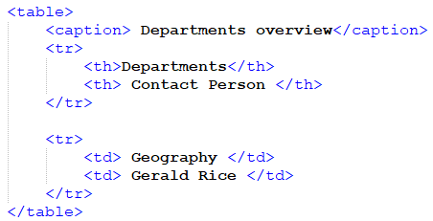

Table caption element
<caption> specifies the title of the table
  Optional
  If used: should be the first child element of the table
For example:
Web browser

Slide 6
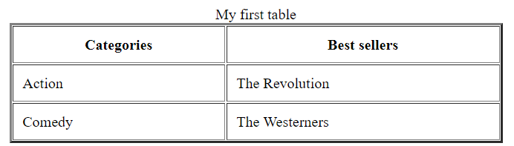
table attributes – not supported in HTML 5
XHTML had 4 main table attributes
  align (alignment of the table in relation to surrounding elements)
  border (defines a border-lines around the table cells)
  width (defines the horizontal size of the table)
  cellpadding (defines spacing between a cell’s wall and content)
For example:

Slide 7
table attributes – not supported in HTML 5 (cont.)
XHTML had 4 main table attributes
  align
  border
  width
  cellpadding
Note: these table attributes are not supported in HTML 5.
  They may still work in some browsers
  Recommended to use CSS to control the table appearance
  By default: HTML 5 table has no border-lines, unless CSS is used (or old XHTML border attribute)

Slide 8
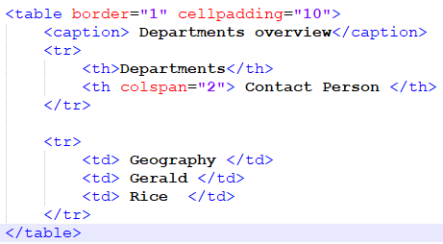
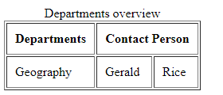
  colspan and rowspan attributes
colspan:
  An attribute of <th> and <td> elements
  Allows a table cell to span the width of more than one column
For example:
Web browser
HTML 5 file

Slide 9
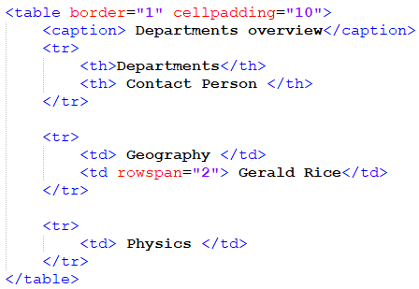
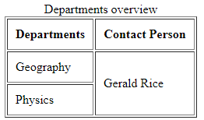
  colspan and rowspan attributes (cont.)
rowspan:
  An attribute of <th> and <td> elements
  Allows a table cell to span the width of more than one row
Web browser
HTML 5 file

Slide 10
  colspan and rowspan attributes (cont.)
The values for colspan and rowspan must be positive integers
  For example:
  <th rowspan=“3”> (table cell spans the width of 3 rows)
  <td colspan=“2”> (table cell spans the width of 2 columns)

Slide 11
  When to use HTML tables
HTML tables should only be used to display data that naturally belongs in a grid format (for example tabulated results)
  In the past, it was common to use <table> elements for the layout and alignment of elements on an entire web page
  Table-based layout is now strongly discouraged, CSS is recommended for page layout and alignment purposes

Slide 12
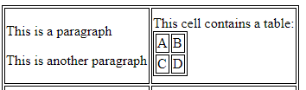
Nested tables
HTML can have nested tables ( a table inside another table)
HTML table cell <td> can contain other elements
  such as <p>, <img>
However it is recommended to use tables exclusively for representing data that naturally belongs in a grid format
For example – table inside a table, possible but not recommended

