Slide 1
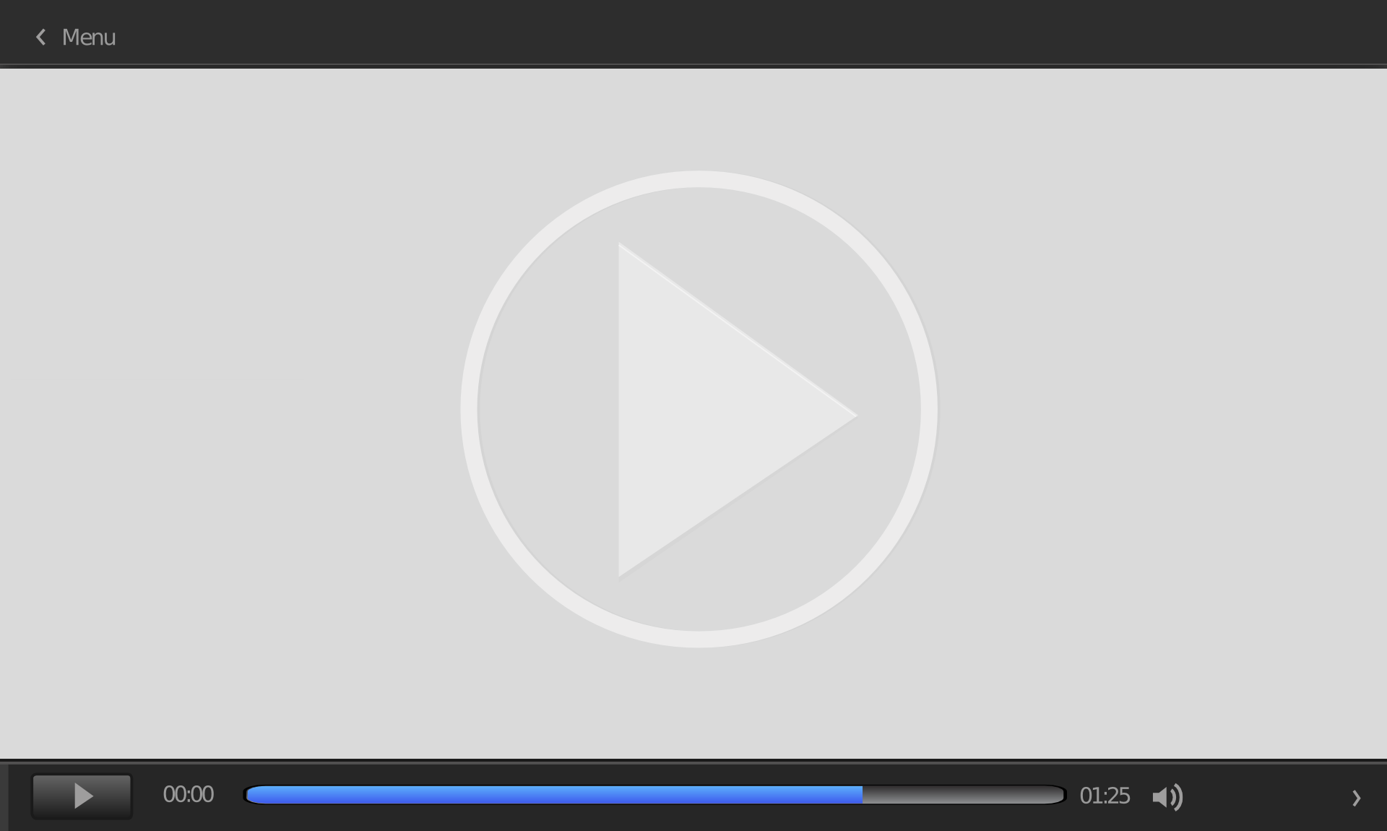

HTML 5 Video and Audio

Slide 2
Overview
HTML 5 video element
  video attributes
  video supported file types
HTML 5 audio element
  audio attributes
  audio supported file types
video and audio additional menu

Slide 3
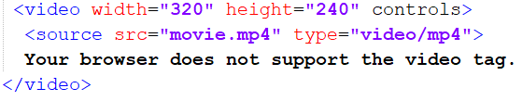
HTML 5 video element
<video> element
  Embeds a video file within a web page
  Uses source element to specify the filename and file type of the video to be displayed
  The <video> element is new in HTML 5
For example:

Slide 4
video attributes
4 main attributes:
  width
  height
  controls
  autoplay
For example:

Slide 5
video attributes (cont.)
width and height attributes:
  used to adjust the video’s displayed size in pixels (unit of measurement for computer screens)
  video’s default size will be displayed if height and width attributes are not specified
  Attribute value can be a percentage (represents a percentage of the browser window size) to improve responsive design
For example:

Slide 6
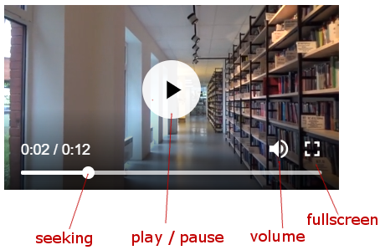
video attributes (cont.)
controls attribute:
  Displays video controls (additional options for the video)
  Video controls include:
    play
    pause
    seeking
    volume
    fullscreen
    subtitles (if available)
    track (if available)
(additional text available
for certain videos)

Slide 7
video attributes (cont.)
autoplay attribute:
  Used to automatically begin video playback when the web page is loaded
  Note: autoplay is disabled in Chrome and Safari web browsers (should not be relied on when designing a webpage)

Slide 8
video attributes (cont.)
  In addition to width, height, controls and autoplay
    <video> element has more attributes such as:
    loop and muted
      (practice and check loop and muted attributes)

Slide 9
video attributes (cont.)
Source element
  <source> element has 2 main attributes:
  src (includes filename of the video to be displayed)
  type (includes file type of the video)
For example:

Slide 10
video supported file types
HTML 5 currently supports 3 video file types:
  MP4
  WebM
  Ogg
  Possible values for type attribute (source element)
    “video/mp4”
    “video/webm”
    “video/ogg”
For example:

Slide 11
video supported file types (cont.)
The text within the <video> element will be displayed in web browsers which do not support the video element
  (not displayed if the video file loads)
For example:

Slide 12
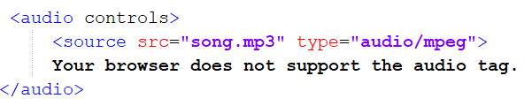
HTML 5 audio element
<audio> element
  embeds an audio file within the web page
  Uses source element to specify the filename and file type of the audio file
  The <audio> tag is new in HTML 5
For example:

Slide 13
audio attributes
2 main attributes:
  controls
  autoplay
For example:

Slide 14
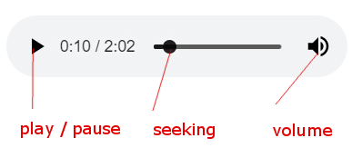
audio attributes (cont.)
controls attribute:
  Displays audio controls (additional options for the audio file)
  Audio controls includes:
    play
    pause
    seeking
    volume

Slide 15
audio attributes (cont.)
autoplay attribute:
  Used to automatically begin audio playback when the web page is loaded
  Note: autoplay is disabled in Chrome and Safari web browsers (should not be relied on when designing a webpage)

Slide 16
audio attributes (cont.)
  Other than controls and autoplay attibutes
    <audio> element has additional attributes such as:
    loop and muted

Slide 17
audio attributes (cont.)
Source element
  <source> element has 2 main attributes:
  src (includes filename of the audio file to be displayed)
  type (includes file type of the audio file)
  (<source> has similar usage for both <video> and <audio> elements)
For example:

Slide 18
audio supported file types
currently supports 3 file types:
  MP3
  WAV
  Ogg
  Possible values for type attribute (source element)
    “audio/mpeg”
    “audio/wav”
    “audio/ogg”
For example:

Slide 19
audio supported file types (cont.)
The text within the <audio> element will be displayed in web browsers which do not support the audio element
  (not displayed if the audio file loads)
For example:

Slide 20
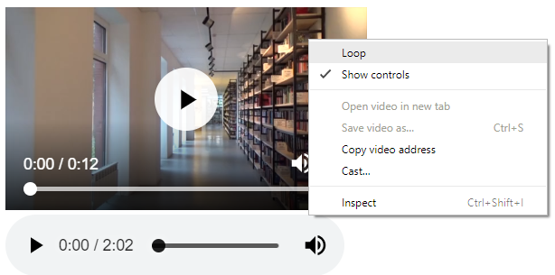
video and audio additional menu
Note: right-click on a displayed video or audio element for additional menu options such as controls and loop
(Note 2: As some users may not be aware of this menu option, should not be relied on during web design)

