Slide 1
HTML Lists

Slide 2
Overview
HTML list elements
  HTML unordered list
  HTML ordered list
  HTML description list
  Nested lists
  Lists summary
HTML boolean attribute

Slide 3
HTML list elements
HTML: 3 list elements
<ul> unordered list
<ol> ordered list
<dl> description list

Slide 4
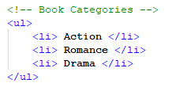

HTML unordered list
<ul> unordered list element
Defines a list where the order of list items is not important
<li> list item element defines a list item within an unordered list
For example:

Slide 5

HTML unordered list (cont.)
Unordered list element has 4 default bullet point
styles:
Disc (default)
Circle
Square
None
Bullet point style can be changed using CSS
  (Currently beyond our scope)
With CSS: a lists’ bullet points can be further customized to use an image
Bullet point:

Slide 6
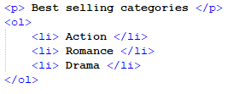

HTML ordered list
<ol> ordered list element
Defines an ordered list: a list whereby the list items will be numbered
  (which implies that the order of list items is important)
<li> list item element defines a list item within an ordered list
  (similarly, like with an unordered list)
For example:

Slide 7
HTML ordered list (cont.)
ordered list type attribute:
defines how the list is numbered
example: <ol type =“a”>
Attribute Value | 1 | a | A | i | I
Description | Uses numbers (default) | Uses lowercase letters | Uses uppercase letters | Uses lowercase Roman numerals | Uses uppercase Roman numerals
Example | 1. One 2. Two 3. Three | a. One b. Two c. Three | A. One B. Two C. Three | i. One ii. Two iii. Three | I. One II. Two III. Three
(Type attribute values)

Slide 8
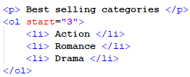
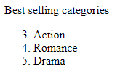
HTML ordered list (cont.)
ordered list start attribute:
defines the starting number of an ordered list
For example:
(Type attribute values)

Slide 9
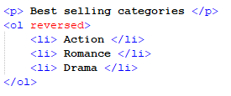
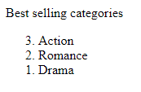
HTML ordered list (cont.)
ordered list reversed attribute:
Reverses the order of the list
  Note: no value is required
For example:
(Type attribute values)

Slide 10
HTML description list
<dl> description list element
Used to create a list of terms and their definitions
<dt> description term defines a term in a description list
<dd> description data describes a term in a description list
  Both <dt> and <dd> elements should be used together

Slide 11
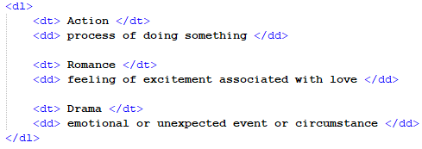
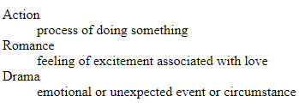
HTML description list (cont.)
<dl> description list example
(HTML 5 file)
(Web browser)

Slide 12
HTML description list (cont.)
<dl> description list name change:
HTML 4.01, the <dl> element was referred to as a definition list
In HTML 5, the <dl> element is called a description list
(Note: documents which mention HTML definition lists are most likely referring to the same <dl> description list element )

Slide 13
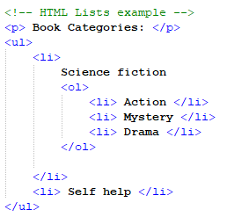
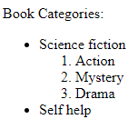
Nested lists
HTML lists can be nested (lists within other lists)
For example:

Slide 14
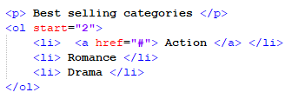
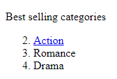
Nested lists (cont.) nested list content
HTML lists can contain HTML elements, like images and links
For example:

Slide 15
Lists summary
<ul> unordered list element defines an unordered list, whereby order is not important for the list items
<ol> ordered list element defines an ordered list, whereby list items are numbered
<li> list item element defines a list item within an ordered list or an unordered list
<dl> description list element defines a list of terms and their definitions
  <dt> description term defines a term in a definition list
  <dd> description data describes a term in a definition list

Slide 16
Lists summary (cont.)
HTML lists can be nested (lists within other lists)
HTML lists can contain other HTML elements, like images and links
HTML lists are vertical by default
  CSS can be used to create horizontal lists

Slide 17


HTML Boolean attribute
An attribute which has two opposing values: true or false
Note:
  The values "true" and "false" are not allowed on boolean attributes.
    To represent a false value, the attribute has to be omitted altogether.
    To represent a true value, the attribute name is included with no value
For example:
(<ol> element with true
reversed attribute)
(<ol> element with false
reversed attribute, attribute
removed altogether)

