Slide 1

HTML Links
Phyela Mbewe
Department of Library and Information Studies
University of Zambia

Slide 2
Overview
anchor element introduction
  href attribute
  target attribute
  download attribute
  Linking images
  Linking to locations on a page
  Linking to locations on another webpage
  Linking to mail software
  HTML 5 <nav> element

Slide 3
anchor element introduction
<a> (anchor) element defines a hyperlink to:
  other web pages
  other files (e.g. PDF)
  locations on a web page
  email addresses
Anchor element is an inline element
  (text or image link does not begin on a new line by default)

Slide 4
href attribute
the href attribute (hypertext reference):
  Specifies the destination name of the link
For example:
(HTML 5 file)
(Web browser)
Text between the <a> start tag and </a> end tag, is visible within the web browser
value of href attribute specifies the destination of the link
  This text (attribute value) is not visible in the web browser

Slide 5
href attribute (cont.)
By default:
  text links will be displayed in blue and underlined
  Once visited (clicked), link color changes to purple
(Link appearance can be altered using CSS)
For example:
(default link color in most web browsers)
(link has been clicked at least once)

Slide 6

href attribute (cont.)
By default:
  text links and image links will display a hand cursor (pointer) when the mouse cursor hovers over the link
(The hand cursor (pointer) can also be altered using CSS)
For example:
Default cursor (mouse pointer)
hand cursor (pointer) indicating a clickable link

Slide 7
href attribute (cont.) file path
File path:
  When linking to a file on the same website (on the same server), a relative file path is used
For example:
<a href=“contact.html”>
(Link to a file in the same folder (only file name is needed)
<a href=“folder1/contact.html”>
(Link to a file in a subfolder called folder1)
<a href=“../contact.html”>
( ../ means link to a file in a higher (parent) folder

Slide 8


href attribute (cont.) file path
File path:
  When linking to a file or page which is external to your site server(on another server), an absolute file path is used
    Absolute file path usually includes the protocol HTTP with the file path of the link destination
For example:
HTML 5 file
Web browser
(http:// included, when linking to a file / resource on another website)

Slide 9

target attribute
<a> element’s target attribute:
  Specifies where the linked document will be opened
common values:
  _blank (opens the linked document in a new window)
  _self (opens the linked document in the same window, this is the default)
  framename (opens the linked document in a named frame) – not supported in HTML 5
For example:
(“_blank” will make the link
open in a new window, in the
web browser)

Slide 10
download attribute
<a> element’s download attribute:
  Instructs the web browser to download the target file (or resource) when the hyperlink is clicked
attribute value:
  is optional
  value will become the new filename of the downloaded file
  No restriction on the type of file (e.g. HTML, PDF, JPG)
Note: attribute is new in HTML 5
For example:

Slide 11
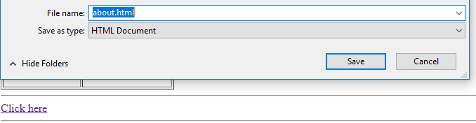
download attribute (cont.)
<a> element’s download attribute (cont.):
For example:
(In the example: clicking the link Click here will make the linked file downloadable,
download will begin automatically or a download window will be opened
depending on the browser setting)

Slide 12


Linking images
The anchor element can specify a hyperlink using text or using an image
  An image element can be placed within an anchor element (nested)
  The image will become a clickable hyperlink
For example:
HTML 5 file
(Image, within anchor element, will become a clickable link)
Web browser

Slide 13
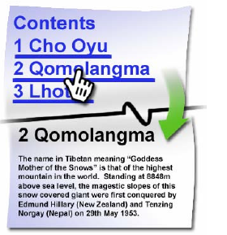
Linking to locations on a page
The anchor element can also create a link to a specific section on the same web page
Also known as linking to an HTML bookmark
  (HTML bookmarks allow the user to jump to specific section on the same web page)

Slide 14
Linking to locations on a page (cont.)
Two requirements for linking to an HTML bookmark:
  Creating the HTML bookmark
    Using the id attribute to create a bookmark
    In HTML 5: the id attribute can be used with any element
  Linking to the HTML bookmark
    Link to the destination using # (hashtag symbol) with the bookmark name
For example:
<p id=“s2“> Section Two </p>
(id attribute creates HTML bookmark)
<a href="#s2“> Jump to Section Two </a>
(# and bookmark name, allows the link
to jump to the HTML bookmark within
the same web page)

Slide 15
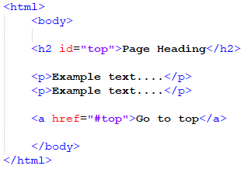
Linking to locations on a page (cont.)
Example 2:
In the example above
  <h2> will have an HTML bookmark, because of the id attribute
  <a> element href value uses # (hashtag symbol) to link to a bookmark
    (browser will jump to the <h2> element when the user clicks the Go to top link)

Slide 16


Linking to locations on a page (cont.)
  Creating an HTML bookmark using id attribute:
    In HTML 5: the id attribute can be used with any element
    In HTML 4.01, the id attribute cannot be used with certain elements such as <html>, <head>, <title>, <script>, <style>
    id value must be unique, to identify an element within the web page
      i.e. no two elements can have the same id value (may lead to wrong results when the id or bookmark used)
    id value must not contain space characters
    id value must contain at least one character
      (i.e. cannot be numbers exclusively)
<p id=“s2“> Section Two </p>
<p id=“72“> Section Two </p>

Slide 17
Linking to locations on another webpage
Linking to an HTML bookmark on another page requires:
  Including the page name in the <a> href attribute
  Followed by # (hashtag symbol)
  Then the bookmark name
    (which should match an id attribute’s value on the destination page)
For Example:
Click here link will:
open the about.html file
and jump to the element with an id value section2

Slide 18
Linking to locations on another webpage (cont.)
Examples:
1)
Jump to section2 bookmark on another page, within the same website (on the same server)
2)
Jump to section2 bookmark on another page, on another website (on another server)
3)
Jump to section2 bookmark on the same page (page with the Click here link)

Slide 19

Linking to mail software
Use the mailto protocol
  Allows users to send email using their default email application
  The <a> href attribute must begin with mailto:
For Example:
Starts with mailto:
Followed by an email address
(In the above example, the Click here link will open a default email
application (such as Microsoft Outlook) with a blank email.
However, the Recipient email address (To) will be set based
on the email address included in the link’s href attribute

Slide 20
Linking to mail software (cont.)
For Example:
Starts with mailto:
Followed by an email address
Practice using the mailto link to understand its use
However, note: including an email address in an HTML file is a spam risk (for security it is recommended not to use an email address in a link, or in an HTML file (unless email address is encrypted)

Slide 21
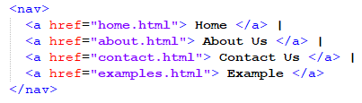

HTML 5 <nav> element
The <nav> element specifies a set of navigational links:
  Navigational links are hyperlinks to other pages on the same website which aid the user in accessing core information of the website
  <a> elements will be included within a <nav> element to indicate (to the browser) that they are navigational links
  Navigational links are commonly displayed as a horizontal list of links at the top of each page (but not always)
For Example:

