Slide 1
ICT 3010
Data Bases

Slide 2
What is a database
A database is an organized collection of data, so that it can be easily accessed and managed. A database can be organized into tables, rows, columns, and index it to make it easier to find relevant information

Slide 3
Definition of concepts
Database
David (2005, p.11) defines a database as a self describing collection of integrated tables. Integrated tables store both data and relationships among the data.
For example, tables that store data about employees’ names, qualifications and contacts will equally store data about relationships among the rows of data and tables.

Slide 4
What is a database
Databases are created by all of us in life. We often write down (either on paper, tablet or on a computer) a list of people who for example have borrowed books from us or a list of pupils in Class.
That simple act of listing names of borrowers /pupils in a class
is synonymous or database creation.
Organizations do create databases to keep records of among other things employees/students/clients
Details that are recorded about employees/students/clients include their full names, year they started work, qualifications and contacts or if they are students, Names.Contact Numbers. Address. Year of study, performance for each year etc.

Slide 5
Characteristics of Database
Regardless of size, databases have the following characteristics
Databases store data and information in tables
A database has data and relationships
Databases create information

Slide 6
Characteristics of Database
Databases store data and information in tables
Data and information about things (instances) is stored in tables which are made of columns and rows.

Slide 7
Characteristics of Database
COMP | TEST 1 | TEST 2 | TEST 3 | TOTAL | CA | GRADE
20190556 | 78 | 45 | 43 | 166 | 53 | C+
20190355 | 34 | 43 | 89 | 166 | 53 | C+
20190405 | 66 | 78 | 43 | 187 | 62 | B
20194504 | 77 | 56 | 78 | 211 | 70 | B+

Slide 8
Characteristics of Database
A database has data and relationship
Name | Test 1 | Test 2 | Ca A
Benson | 56 | 65 | 61
Chrispin | 66 | 44 | 55
AKA | 77 | 66 | 72
Name | Year of Study | Course
Benson | 2 | Lis 2010
Chrispin | 1 | LIS 1010
Aka | 5 | LIS 4014

Slide 9
Characteristics of Database
A database has data and relationship
The relationships could be on the basis of primary key. For the two tables above, table 1 is related to table 2 on the basis of a name; the name is the link between the two tables which is considered a primary key.

Slide 10
Characteristics of Database
Databases create information
From the data that all databases keep, information can be extracted and presented in a meaningful context.
  Eg we can extract information that Mr Hamooya had
CA of 55% in LIS 1010

Slide 11
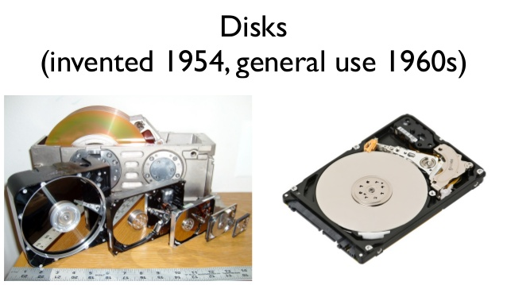
History databases
Five stages in the development of databases:-
1960s
During the above period, data was stored in separate files, most of which were kept on reels of magnetic tapes e.g each reel will contain a class list for a particular course
No data integration
No simultaneous access to data.

Slide 12
History databases Cont…
b) 1970s
The need for integrated databases heightened
Organizations were compelled to develop database management systems
Database systems such as database systems such as ADABAS, IDMS, System 2000, Total and IMS emerged
Two systems came to be established. The Hieratical System and one based Network.

Slide 13
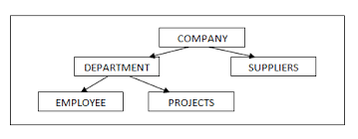
History databases Cont…
Hieratical Databases included database systems such as ADABAS, IDMS, System2000, and IMS These systems represented data relationship in a hierarchical or tree structure based on a Child to parent relationship concept.

Slide 14
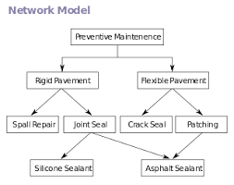
History databases Cont.…
Other database systems were based on network model
Access to data in these databases systems was on sequence

Slide 15
History databases Cont…
(c) 1980s
In 1980, relational databases were introduced IBM under the guidance of Mr. Codd
In the relational model, data was/ is represented in the form of tables
SQL language was introduced as a database language at this stage

Slide 16
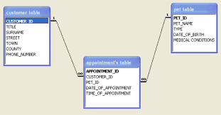
History databases Cont.…

Slide 17
History databases Cont.…
(d) 1990s
Internet was born in the 1990s.
Client/server computing, data warehousing and Internet applications emerged
Database systems that could keep not only structured data but also unstructured data such as sounds, images, video and graphs emerged

Slide 18
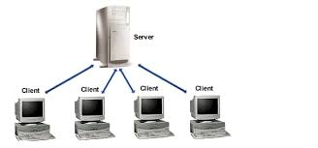
History databases Cont.…
Object oriented database management systems (OODBMSs) combine database capabilities with object-oriented programming languages (Java, C++, Perl etc) capabilities appeared

Slide 19
History databases Cont.…
(e) 2000 and beyond
Birth of object-relational database management system (ORDBMS)
Hybrid model born from the relational and object oriented models. This model has borrowed features from the above mentioned database models
The idea is to keep multimedia data in tables

Slide 20
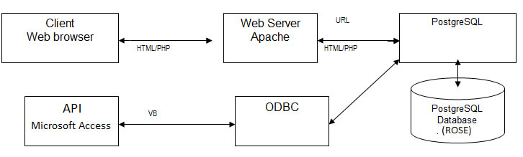
History databases Cont.…

Slide 21
Advantages of Databases
A. Control of data redundancy
In the traditional file-based systems, information about an object was stored in separate files.
Each Class will keep their own register
Or each Programme with their own students
This results in duplications as the same information is kept in many places making it difficult to use it

Slide 22
Advantages of Databases
A. Control of data redundancy
Database approach eliminates this flaw by keeping all related information together in tables and integrate it through the use of primary key so that it becomes easy to access and use related information.

Slide 23
Advantages of Databases
b. Data consistency
One is able to update tables of the database once which would lead to accurate retrieval of Information unlike when there are multiple files then when updating other files may be forgotten resulting into storage and retrieval of inaccurate information

Slide 24
Advantages of Databases
c. Easy access to information
Since data is stored in a database (server based database) in an organization, a user with access rights can access it at any time.
Many users can access information at the same time

Slide 25
Advantages of Databases
d. Improved data integrity
Database enforces data integrity in the sense that restrictions and rules are applied when dealing with stored information.
For example, the database system will not allow any one apart from the database administrator to change information stored in the tables. This protects data and makes it trust worthy

Slide 26
Advantages of Databases
e. Improved security
Related to data integrity, data/ information stored in the database is secure as only authorized users can access the information. This does not mean the system cannot be hacked by hackers.
f. Economy of scale
As information is stored in one place, few people are required to take care of it. However, the initial cost of equipment is costly

Slide 27
Advantages of Databases
g. Increased productivity
Since database helps to organization and keep information in an efficient manner, it can therefore be said that people in the organization can quickly and easily access the information they need in the execution of the mandate/ mission of your organization. Therefore, they can work fast and produce more result

Slide 28
Components of a Database
a) Hardware
A computer hardware is the physical components of the computer that you and I can see. All database Management systems (DBMS) require computer hardware for them to work. They run on hardware.
Note that some DBMS require a minimum amount of memory from your hardware if you have to install them.

Slide 29
Components of a Database
b) Computer Software: According to Thomas and Carolyn (2013), the software component comprises the DBMS software itself and the application programs, together with the operating systems, including network software if the DBMS is being used over a network.
Databases applications are normally written in third –generation languages such as C, C++, Java, Visual Basic etc.

Slide 30
Components of a Database
Software: They are also written in fourth-generation languages such as Structural Query Language (SQL), embedded in most of the third-generation programming languages. Some of the network software that is used in databases includes Server software such as Apache.

Slide 31
Components of a Database
c) Data This is probably one of the most important components of a database from the user’s point of view. Data in any database acts as a bridge between machines and people components. This data is directly accessed or through some application programs. There are basically three types of data found in databases. T

Slide 32
Components of a Database
c) Data
  i) User Data - It consists of a table(s) of data called relation(s) where Column(s) are called fields of attributes and rows are called records for tables.
  ii) Metadata - A description of the structure of the database is known as Metadata. It basically means "data about data". System tables store the Metadata which includes; number of tables and table names, number of fields and field names and primary key fields.

Slide 33
Components of a Database
c) Data
  iii) Application metadata - It stores the structure and format of Queries, reports and other applications components.

Slide 34
Components of a Database
c) Users
Database administrators (In charge of day o day issues of the database, rights allocation etc
Database designers (Architects of Database)
End users: personnel, staff, clerical, managers, executives etc. On the basis of the job and requirements made by them they are provided access to the database totally or partially

Slide 35
Components of a Database
c). Procedures:
users of the database requires documented rules and procedures on how to work or interact with the system.
Similarly, in the database environment, procedures are needed to spell how to run and use the database. For example, users rules on how to login and logout should be given out to the users. Further, rules how to backup data from the database need to be explained.

Slide 36
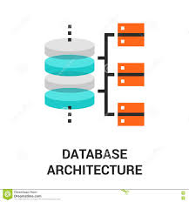
Types of Database Systems Architecture
There are four types of database systems architecture
1-tier (Single user category)
2-tier (Multi User Category)
3-tier (Multi User Category)
N-tier (Multi User Category)

Slide 37
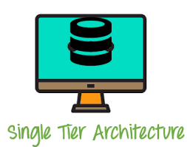
One tier database system
This is sometimes refers to Single-database architecture
In this architecture, the database system is stored on the personal computers and accessed through an interface programme
When you installed MySQL database on your personal computer and access it directly on your PC, you are working with 1-tier system
Another example of a 1-tier is the excel spread sheet saved on your PC

Slide 38
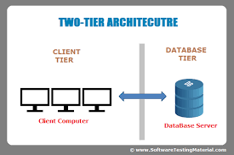
Two-tier/Server Database Systems
These database system allow many users to access and share information
Two-tier or groupware databases are installed and created on servers therefore by allowing many users to access data
Client computers direct communication to the server database through an application interface.
Ewan students Information System at UNZA an example.

Slide 39
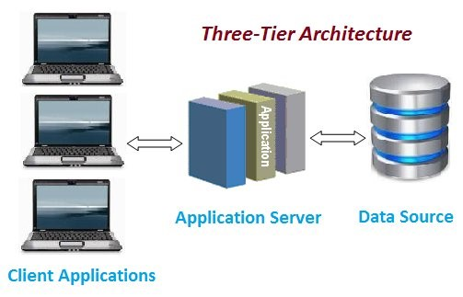
Three-tier databases
There are three tiers in this database; client application, application server and Database server
In this tier, database is installed on a server and the client computer access the database using the application program stored on another server

Slide 40
Three layers Cont.….
Client layer
This layer is called the presentation layer which contains the user interface (UI) part of the application. The user interface is accessed from the client computers using a browser or any written application. This layer presents data to the user or takes queries from the users to the server application.
Business layer
This is a server application which talks to the database on behalf of the client. The database understands this application not the client application. It gets queries or requests from the client and translates them and forwards the translation to the database so that the requested information can be retrieved.
Data layer- This is the server database. The Data Access Layer contains methods to connect with database and to perform insert, update, delete, get data from database based on our input data.

Slide 41
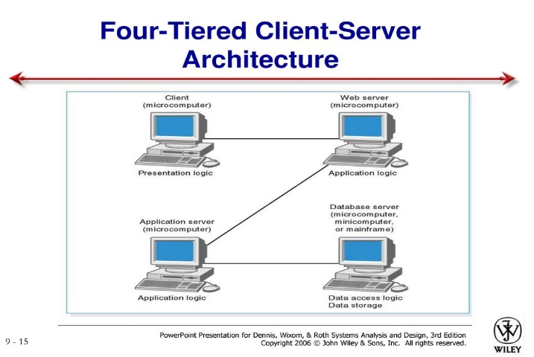
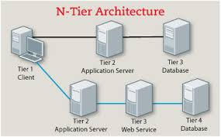
N-tier Database System
This is the many tier database system architecture
This is an extension of the three tier system
Additional layers of are added to the system to improve scalability

Slide 42
End of unit two

