Slide 1
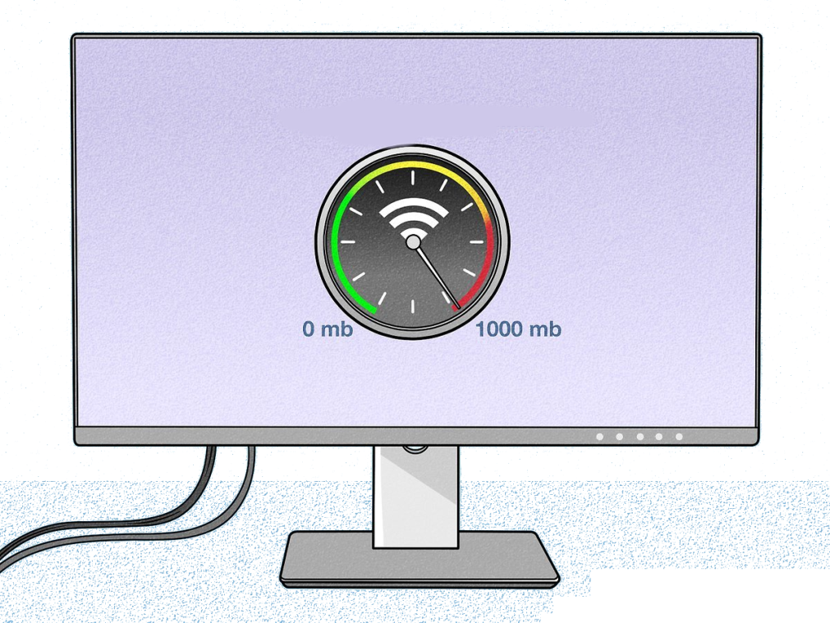
Fast Ethernet and Gigabit Ethernet
ICT 4010
Data and Communication Networks
Lecture 10
Phyela Mbewe
LIS Department
University of Zambia
September 2022

Slide 2
Ethernet Overview
Most popular packet-switched LAN technology
Bandwidths: 10Mbps, 100Mbps, 1Gbps, 10Gbps etc.
  to the latest 400Gbps (currently)
Bus and Star topologies are used to connect hosts

Slide 3
Ethernet Overview
Ethernet was developed by Xerox, DEC, and Intel in the mid-1970s as a 10-Mbps (Megabits per second) networking protocol
  very fast for that time period
  operating over a heavy coax cable
Today, although many networks have migrated to Fast Ethernet (100 Mbps) or even Gigabit Ethernet (1000 Mbps),
  10-Mbps Ethernet is still available and is used by many networks.

Slide 4
Ethernet Overview
Ethernet is defined by the IEEE 802.3 international standards:
  It enables the connection of up to 1024 nodes over coax, twisted-pair, or fiber optic cable.
  Most new installations today use economical, lightweight cables such as Category 5 or Category 6 unshielded twisted-pair cable and fiber optic cable

Slide 5
Ethernet Overview
Ethernet is a broadcast protocol
  Any signal can be received by all hosts
  Switching enables individual hosts to communicate

Slide 6
Ethernet Overview – How it works
Ethernet signals are transmitted from a station (end device) sequentially one bit at a time, to every other station on the network
Ethernet uses a broadcast access method called Carrier Sense Multiple Access/Collision Detection (CSMA/CD) whereby:
  Each computer can send a message at anytime.
  The signal it sends travels to every computer on the network. Every computer hears the message, but only the intended receiver-computer recognizes the message because the message contains its address.
  The message also contains the address of the sending computer so the message can be acknowledge

Slide 7
Ethernet Cabling
Cabling (2, 5, T, F, S, L)
  5 - Thick coax (original Ethernet cabling)
  T – Twisted Pair
  F – Optical fiber
  S – Short wave laser over multimode fiber
  L – Long wave laser over single mode fiber

Slide 8
Ethernet is Switched
Switches forward and filter frames based on LAN addresses (IP Addresses)
Ethernet is very scalable
  Options for many interfaces (connection types)
  Supports Full duplex operation (send/receive frames simultaneously)

Slide 9
Carrier Sense Multiple Access (CSMA) Recap
CSMA is a Media Access Control (MAC) protocol
  Used to control the flow of data in a transmission media so that packets do not get lost and data integrity is maintained
Recap of Lecture 5 Slides 9

Slide 10
CSMA Recap
CSMA senses the state of medium in order to prevent or recover from a collision
  Collision happens when two transmitters transmit at the same time
  Data gets scrambled and receivers would not be able to discern one from another causing information to get lost
Two general categories of CSMA
  CSMA/CD
  CSMA/CA
Recap of Lecture 5 Slides 10

Slide 11
CSMA Recap
CSMA/CD (CSMA with Collision Detection)
  Listens for collisions in the media
  Immediately terminates transmission once a collision is detected
  Minimizes recovery time
  Transmits bits which are assembled at the receiver
  Used mostly in wired installations

Slide 12
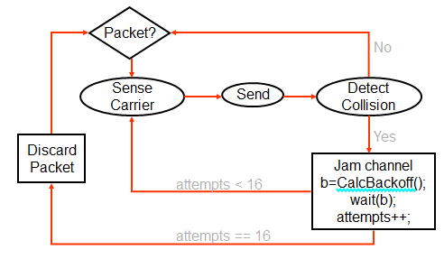
State Diagram for CSMA/CD

Slide 13
Collisions
Collisions are caused when two adaptors (end devices) transmit at the same time
adaptors sense collision based on time and voltage differences

Slide 14
Collision Detection
How can A know that a collision has taken place?
  A’s message reaches B at time T
  B’s message (response) reaches A at time 2T
IEEE 802.3 standard specifies a max value of 2T to be 51.2us (nano seconds)
  This relates to a maximum distance of 2500m between hosts
  At 10Mbps it takes 0.1us to transmit one bit so 512 bits (64B, minimum frame size) takes 51.2us to send
A jamming signal is sent after collision is detected to ensure all hosts acknowledge the collision
  48 bit signal

Slide 15
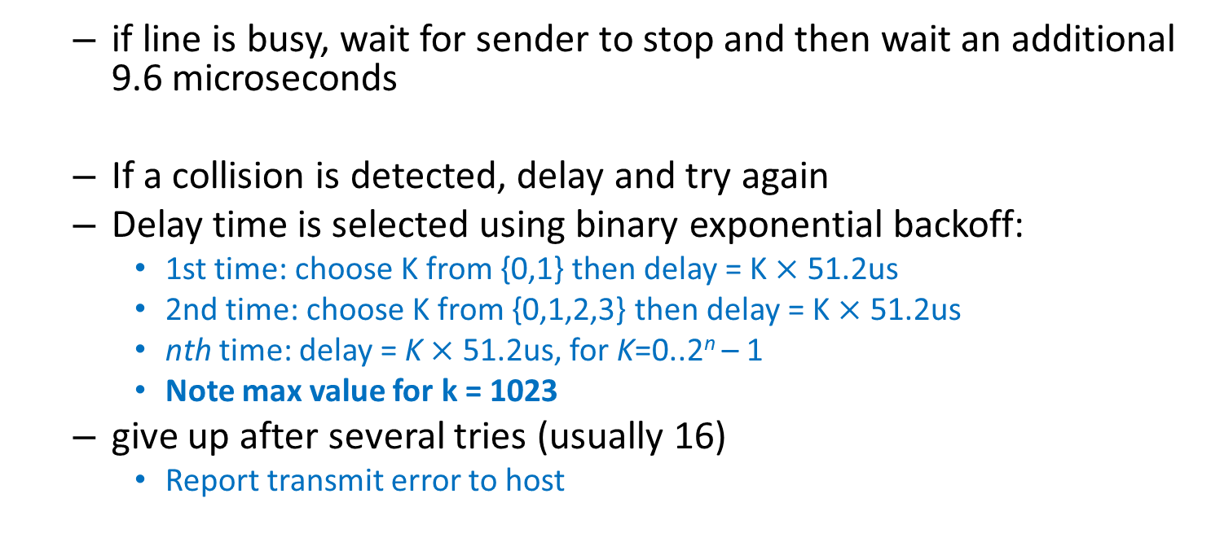
Exponential Backoff
  if line is busy, wait for sender to stop and then wait an additional 9.6 microseconds
  If a collision is detected, delay and try again
  Delay time is selected using binary exponential backoff:
    1st time: choose K from {0,1} then delay = K $×$ 51.2us
    2nd time: choose K from {0,1,2,3} then delay = K $×$ 51.2us
    nth time: delay = K $×$ 51.2us, for K=0..2^{n} – 1
    Note max value for k = 1023
  give up after several tries (usually 16)
    Report transmit error to host

Slide 16
Exponential Backoff
If delay times were not random, then there is a chance that sources would retransmit at the same time
Why not just choose from small set for K (delay values):
  This works fine for a small number of hosts
  Large number of nodes would result in more collisions

Slide 17
Fast Ethernet Overview
Fast Ethernet (100Mbps) has technology very similar to 10Mbps Ethernet
  Uses different physical layer encoding (4B5B)
  Many NICs are capable with 10Mbps and 100Mbps networks
    Can be used at either speed

Slide 18
Gigabit Ethernet Overview
Gigabit Ethernet (1,000Mbps)
  Compatible with lower speeds
  Uses standard framing and CSMA/CD algorithm
  Typically used for network backbones and inter-router connectivity
  Becoming cost competitive

Slide 19
Ethernet Overview (cont.)
Ethernet works best under light loads
    network capacity is wasted by collisions
Most networks are limited to about 200 hosts
  Specification allows for up to 1024
Ethernet is inexpensive, fast and easy to administer

Slide 20
Ethernet Problems
Ethernet’s peak utilization is pretty low
  network capacity is wasted by collisions (as previously mentioned)
Peak throughput worsens with:
  More hosts
    More collisions needed to identify single sender
  Smaller packet sizes
    More frequent arbitration (processing from end devices)
  Longer links (Longer cable connection distances)
    Collisions take longer to observe, more wasted bandwidth
    Efficiency is improved by avoiding these conditions (ie shorter links)

Slide 21
Why did Ethernet Win?
There are several LAN protocols
Ethernet became the dominant LAN protocol due to:
  Price
  Performance
  Availability
  Ease of use
  Scalability

Slide 22
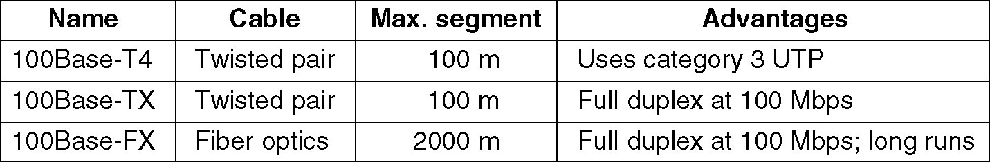
Fast Ethernet
Ethernet with 100 Mbps data transfer speed
Also known as 100BASE-T Network
Three Choices

Slide 23
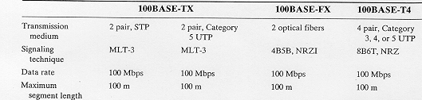
Fast Ethernet
Note: maximum network segment length for 100Base-FX networks was initially 100 but has been improved to 2 km (see table on Slide 22)

Slide 24
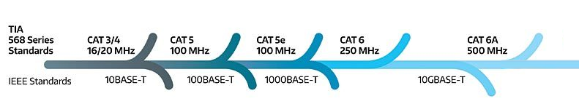
Ethernet Evolution
Ethernet Data speeds
  from: 10 Mbps (1970s)
  to: beyond 400 Gbps (currently)

Slide 25
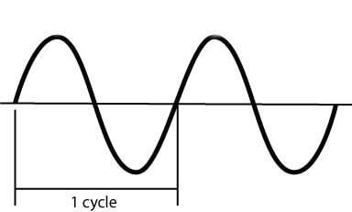
Ethernet - Frequency
Frequency
  the number of complete cycles per second for an oscillating current or varying current
Hertz
  represented by symbol Hz.
  Hertz is cycles per one second. If the frequency is 500 MHz, then it is 500,000,000 Hertz or cycles per second
  MHz and Mbps are not equal
    MHz is normally used to indicate analogue signals rate
    while Mbps indicates digital bandwidth speed

Slide 26
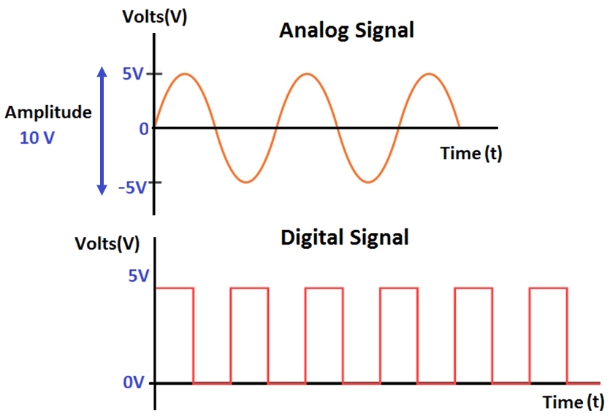
Ethernet - Frequency
a digital signal can only have discrete values, for binary digital those values are 0 and 1
a digital signal can only have discrete values, for binary digital signals those values are 0 and 1
traditionally, a high-to-low voltage transition represents a '0' bit and a low-to-high transition represents a '1' bit.

Slide 27
Ethernet - Frequency
UTP Category | Frequency | Bandwidth
Category 5e | 100 MHz | 1 Gbps
Category 6 | 250 MHz | Up to 10 Gbps
Category 6a | 500 MHz | Up to 10 Gbps
Category 7 | 600 MHz | Up to 10 Gbps
Category 7a | 1 GHz (1000 MHz) | 40 to 100 Gbps
Category 8 | 2 GHz (2000 MHz) | 25 to 40 Gbps
Note: higher frequencies are associated to higher bandwidth, however, remember that MHz and Mbps are not equal

Slide 28
Ethernet - Clocking
When bits are sent from a sender to a receiver across a network they need a mechanism to synchronize their clocks so they both know when a bit starts and when it stops.
This means that clocking information needs to be sent as well as the data so that the receiving station can synchronizes its own clock with the sender's clock.

Slide 29
Fast Ethernet - Encoding
The bandwidth of twisted pair cables (Mbps) is dependent on which encoding method the Ethernet standard is using
  Manchester encoding was used for 10 Mbps Ethernet
  4B/5B code (and other encoding schemes) used for Fast Ethernet (100 Mbps)
  PAM-5 encoding used for Gigabit Ethernet (1000 Mbps)
Note: while higher frequencies are associated to higher bandwidth, it is the encoding method that affects the overall bandwidth of the different Ethernet speeds

Slide 30
Fast Ethernet - Encoding
Manchester encoding
  is an encoding method commonly used on Legacy Ethernet networks (10 Mbps Ethernet)
  There are two rules to follow using this encoding method:
    To send a '0' data bit, increase the voltage up from 0 to +V from the start to the middle of the bit period.
    To send a '1' data bit, decrease the voltage down from +V to 0 from the start to the middle of the bit period

Slide 31
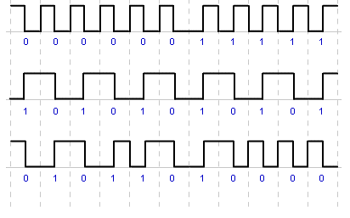
Fast Ethernet - Encoding
Manchester encoding
example
a high-to-low transition represents a '0' data bit and a low-to-high transition represents a '1' data bit.

Slide 32
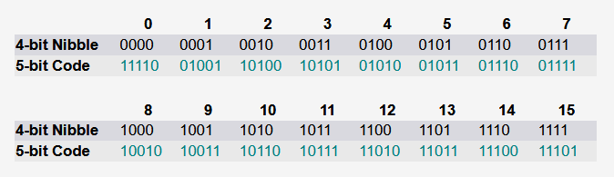
Fast Ethernet - Encoding
4B/5B encoding
  is an encoding method that replaces every group of 4 bits by a 5-bit code. The code ensures that at least one voltage level transition occurs for every 5 bits.

Slide 33

Fast Ethernet - Encoding
4B/5B encoding
  For example: sending the data 0111010000100000. As shown below, the data is first grouped into 4-bit nibbles. Then a 5-bit code is applied to each separate 4-bit group.

Slide 34
Fast Ethernet - Encoding
4B/5B encoding
Note: with Fast Ethernet, after 4B/5B encoding, MLT-3 or NRZ-I encoding is applied depending on whether copper of fiber is being used - 100BASE-TX or 100BASE-FX.
Note 2: details of MLT-3 and NRZ-I encoding is beyond our current scope, however, it is important to note the different encoding methods are used for different speeds of Ethernet
* Exercise: find out more on the 4D-PAM5 Encoding used in 1000BASE-T (Gigabit Ethernet) networks

Slide 35
Gigabit Ethernet History
In February 1997 the Gigabit Ethernet Alliance announced that IEEE802.3z Task Force met to review the first draft of the Gigabit Ethernet Standard
1000 BASE X (IEEE802.3z) was approved in June 1998

Slide 36
Gigabit Ethernet (1000 BASE X)
Provides speeds of 1000 Mbps
  one billion bits per second capacity)
  for half-duplex and full-duplex operation
Uses Ethernet frame format and MAC technology
  (similar to Fast Ethernet), includes CSMA/CD access method for collision detection
  Backward compatible with 10 BASE-T and 100 BASE-T

Slide 37
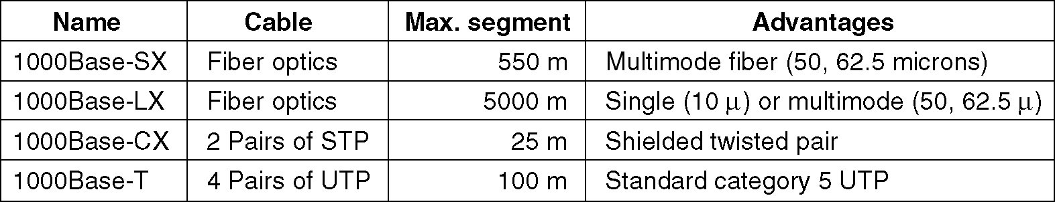
Gigabit Ethernet Technology
1000 BASE SX fiber - short wavelength
1000 BASE LX fiber - long wavelength
1000 BASE CX copper - shielded twisted pair
1000 BASE T copper - unshielded twisted pair

Slide 38
1000 BASE SX
Short Wavelength Fiber Optic Cable
  Supports maximum length up to 550 meters
  770-860 nm range; 850 nm laser wavelength
  Includes 8B/10B encoding and NRZ encoding
  Only uses multimode fiber
  Cheaper than 1000 BASE LX

Slide 39
1000 BASE LX
Long Wavelength Fiber Optic Cable
  Supports maximum length up to 550 meters
  1270-1355 nm range; 1300 nm laser wavelength
  includes 8B/10B encoding and NRZ encoding
  Uses either single mode or multimode fiber.

Slide 40
1000 BASE CX
Shielded twisted pair
  Supports 25 meters or less
  includes 8B/10B encoding and NRZ encoding
  Includes 2 shielded twisted pair wires/links with the cable

Slide 41
1000 BASE T
Twisted Pair Gigabit Ethernet
  Four pairs of Category 5 UTP wires within the cable
    for cat 5 UTP cables: each wire can carry 250 Mbps of data
  Can use Category 5, 6 and 7 copper cables
  data is encoded twice; 8B1Q4 encoding is used first then 4D-PAM5 encoding is applied
  support maximum length of up to 100 meters
    (whether using Cat 5, 6 or 7)

