Slide 1
LEVELS OF LINGUISTIC ANALYSIS
PHONETICS-ORGANS OF SPEECH

Slide 2
LEVELS OF LINGUISTIC ANALYSIS
Human language is a system which is divided into subsystems. The subsystems are called levels of linguistic analysis.
Phonetics: the scientific study of how sounds are produced, their physical properties and how they are perceived by the human ears.
Phonology: the study of speech sounds of particular languages, their functions and how they combine in particular languages.

Slide 3
LEVELS OF LINGUISTIC ANALYSIS
Morphology: the study of the structure, forms and classes of words.
Syntax: the study of how words combine into phrases and sentences.
Semantics: the system and study of meaning in language.

Slide 4
LEVELS OF LINGUISTIC ANALYSIS
Studies on each of these levels can either be diachronic(as in diachronic phonetics) or synchronic.
Synchronic phonology can be called phonemics and synchronic morphology can be called morphemics.

Slide 5
PHONETICS
There are three types of the study of the sounds of language.
Acoustic Phonetics is the study of the physical properties of sounds.
Auditory Phonetics is the study of the way listeners perceive sounds.
Articulatory Phonetics (the type this lesson is concerned with) is the study of how the vocal tracts produce the sounds.

Slide 6
Articulatory Phonetics
The orthography (spelling) of words in misleading, especially in English.
One sound can be represented by several different combinations of letters.
For example, all of the following words contain the same vowel sound: he, believe, Lee, Caesar, key, amoeba, loudly, machine, people, and sea.

Slide 7
INTERNATIONAL PHONETIC ALPHABET
The discrepancy between spelling and sounds led to the formation of the International Phonetics Alphabet (IPA.)
The symbols used in this alphabet can be used to represent all sounds of all human languages.
The following is the English Phonetic alphabet. You might want to memorize all of these symbols, as most foreign language dictionaries use the IPA.

Slide 8
Phonetic Alphabet for English Pronunciation

Slide 9
p | pill |  | d | dig |  | h | heal |  | ʌ | but
b | bill |  | n | nil |  | l | leaf |  | ai | light
m | mill |  | s | seal |  | r | reef |  | ɔi | boy
f | feel |  | z | zeal |  | j | you |  | ɪ | bit
v | veal |  | t̠ʃ | chill |  | w | witch |  | ɛ | bet
θ | thigh |  | ʤ | jam |  | i | beet |  | ʊ | foot
ð | thy |  | ʍ | which |  | e | bait |  | ɔ | awe
ʃ | Sharp |  | k | kill |  | u: | boot |  | a: | bar
ʒ | Measure |  | g | gill |  | o | box |  | ə | sofa
t | till |  | ŋ | ring |  | æ | bat |  | aʊ | cow

Slide 10
PHONETICS cont’d
The production of any speech sound involves the movement of air.
Air is pushed through the lungs, larynx (vocal folds) and vocal tract (the oral and nasal cavities.)
Sounds produced by using air from the lungs are called pulmonic sounds.

Slide 11
PHONETICS
If the air is pushed out, it is called egressive. If the air is sucked in, it is called ingressive.
Sounds produced by ingressive airstreams are ejectives, implosives, and clicks.
These sounds are common among African(Xhosa, Khoisan Languages) and American Indian languages.
The majority of languages in the world use pulmonic egressive airstream mechanisms, and I will present only these types of sounds in this lesson.

Slide 12
ORGANS OF SPEECH
The organs of speech or articulators are involved in the production of speech sounds.
The airstream expelled from the lungs passes out of the trachea (windpipe) through the glottis.
This is the gap between the vocal cords/folds in the frame of cartilage at the top of the trachea.
In the production of speech sounds, there is a modification of the volume and the shape of the vocal tract.

Slide 13
ORGANS OF SPEECH
The vocal tract is made of the following cavities:
a) Oral cavity
b) Nasal cavity
c) Pharyngeal cavity
d) Pulmonic cavity (which include lungs and the trachea)

Slide 14
ORGANS OF SPEECH
Organs used for speech include the lips, teeth, alveolar ridge, hard palate, velum (soft palate), uvula, glottis and various parts of the tongue.
They can be divided into two types: passive articulators and active articulators.
The passive articulator is the articulator that remains stationary in the production of a speech sound.

Slide 15
ORGANS OF SPEECH
The active articulator is the articulator that moves towards another articulator in the production of a speech sound.
Descriptions for Different Organs of Speech
The study of speech sound is essentially important for getting the fundamental idea about producing speech sounds.
The various organs work in different ways to produce speech sounds.

Slide 16
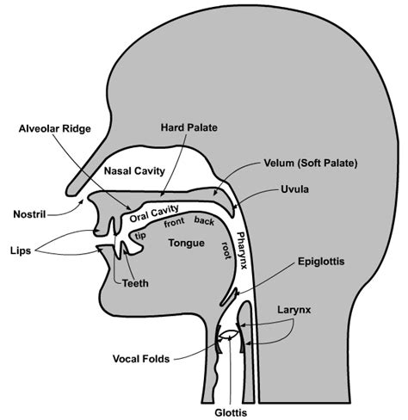
ORGANS OF SPEECH

Slide 17
Descriptions for Different Organs of Speech
Lips
The two lips are involved in the production different sounds -mainly the labial, bilabial e.g. /p/, /b/, /m/ and /w/
Labio-dental (lower lip and upper teeth) consonant sounds e. g. /f/ and /v/

Slide 18
Descriptions for Different Organs of Speech
Teeth
The upper and lower teeth are used to produce a lot of speech sounds, especially dental and labiodentals consonants. For example: to produce the dental /ð/and
/θ/, the tongue tip is pushed between the upper and lower front teeth and to produce the labiodentals /f/, /v/, the upper front of teeth are brought into contact with the lower lip.

Slide 19
Descriptions for Different Organs of Speech
Tongue
The tongue is the most important articulator in the speech organs.
It moves in different ways in different shapes to produce speech sounds.
Tongue is divided into five parts namely tip, blade, front, back and root.

Slide 20
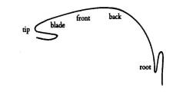
PARTS OF THE TONGUE

Slide 21
Descriptions for Different Organs of Speech
Alveolar Ridge
The alveolar ridge includes the area between the upper
front teeth and the hard palate.
To produce alveolar consonant sounds such as /t d l n s z/, the alveolar ridge and the blade of the tongue are used.

Slide 22
ALVEOLAR RIDGE…parts that are highlighted

Slide 23
Descriptions for Different Organs of Speech
Hard palate a thin horizontal bony plate of the skull, located in the roof of the mouth.
the interaction between the tongue and the hard palate is essential in the formation of certain speech sounds, notably /t/, /d/, and /j/.

Slide 24
Hard palate…highlighted parts

Slide 25
Descriptions for Different Organs of Speech
Soft Palate or Velum
It should have holes forming that function during speech to separate the oral cavity (mouth) from the nose, in order to produce the oral speech sounds.
If this separation is incomplete, air escapes through the nose during speech and the speech is perceived as hyper nasal.

Slide 26
SOFT PALATE/VELUM

Slide 27
Descriptions for Different Organs of Speech
Pharynx
The pharynx is like a tube beginning just above the
larynx and ending two parts.
The structure that holds and manipulates the vocal cords. The "Adam's apple" in males is the bump formed by the front part of the larynx.

Slide 28
Descriptions for Different Organs of Speech
Uvula
it functions in tandem with the back of the throat, the palate, and air coming up from the lungs to create a number of guttural and other sounds.
In many languages, it closes to prevent air escaping through the nose when making some sounds

Slide 29
Descriptions for Different Organs of Speech
Glottis
combination of vocal folds and space in between the folds
 as the vocal folds vibrate, the resulting vibration produces a “buzzing” quality to the speech called voice or voicing or pronunciation.
 sound production involving only the glottis is called glottal. Example is the sound /h/.

Slide 30
Next …description of sounds…vowels and consonants

Slide 31
THE
END

