Slide 1
1.1
Introduction To Computer Architecture

Slide 2
Session Objectives
Define the term computer and discuss the four basic computer operations: input, process, output, and storage
Explain the primary components of the computer and their use
State and explain the different types of computer software.

Slide 3
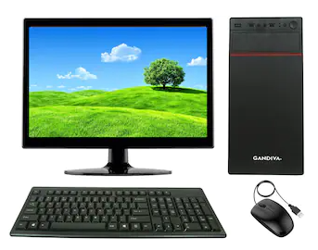
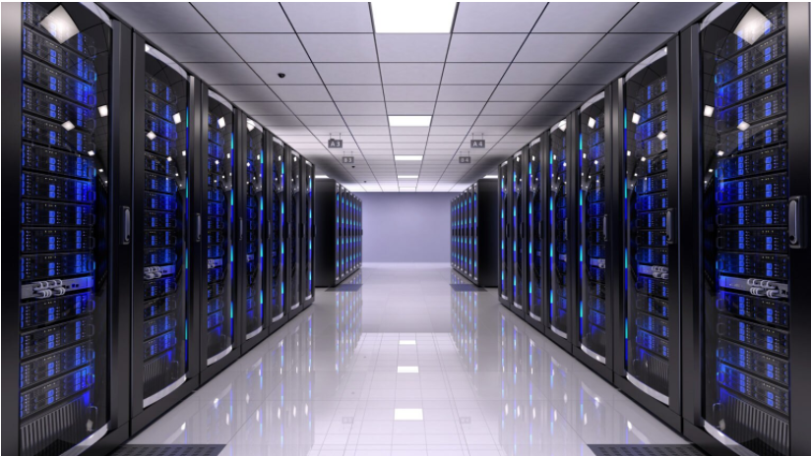
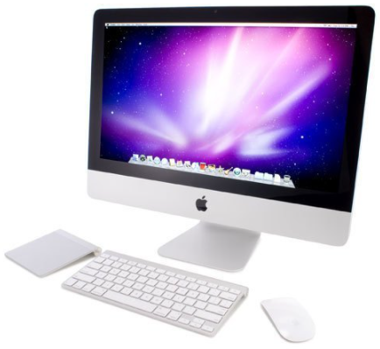
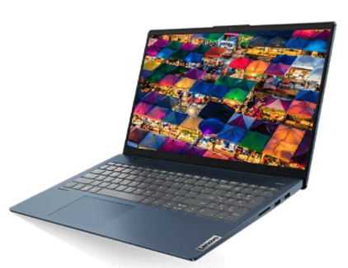
What Is a Computer?

Slide 4
What Is a Computer?
An electronic device, operating under the control of instructions stored in its own memory, that can:
  Accept data (input)
  Process the data according to specified rules (process)
  Produce results (output)
  Store the results (storage) for future use
  Generally, a Computer is a device that accepts input, processes it, stores data, and produces output.

Slide 5
What Is a Computer?
a machine that manipulates data according to a list of instructions
a device capable of performing computations and making logical decisions at speed millions and even billion of times faster them human beings can
an electronic machine which is use for data processing. The output which comes after processing data through computer is known as Information.

Slide 6
Booting
Starting a computer or a computer-embedded device is called booting. Booting takes place in steps −
Switching on power supply
Loading operating system into computer’s main memory
Keeping all applications in a state of readiness in case needed by the user

Slide 7
Booting
The first program or set of instructions that run when the computer is switched on is called BIOS or Basic Input Output System. BIOS is a firmware, i.e. a piece of software permanently programmed into the hardware.
If a system is already running but needs to be restarted, it is called rebooting. Rebooting may be required if a software or hardware has been installed or system is unusually slow.

Slide 8
Booting
There are two types of booting −
Cold Booting − When the system is started by switching on the power supply it is called cold booting. The next step in cold booting is loading of BIOS.
Warm Booting − When the system is already running and needs to be restarted or rebooted.
Warm booting is faster than cold booting because BIOS is not reloaded.

Slide 9
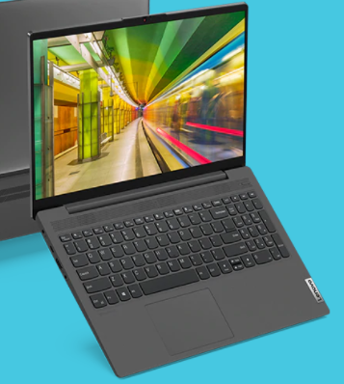
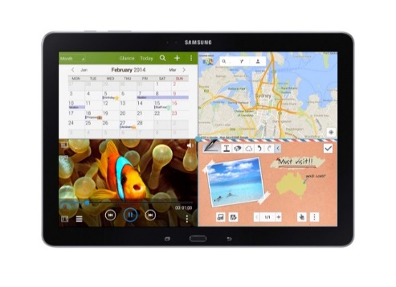
Types of Computers
Tablet and Laptop computers
  handheld computers that are even more portable than laptops. Tablets use a touch-sensitive screen for typing and navigation. The iPad is an example of a tablet.

Slide 10
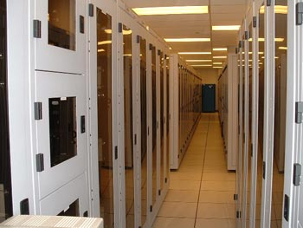
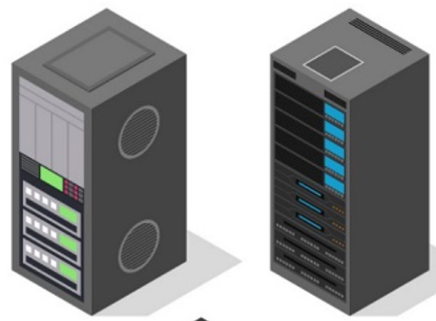
Types of Computers
Servers
  a computer that serves up information to other computers on a network.
  high processing speeds that provide one or more services to other systems on the network.

Slide 11
Types of Computers
Mainframes
used by organizations like banks, airlines and railways to handle millions and trillions of online transactions per second. Important features of mainframes are −
Big in size & Very expensive
Hundred times Faster than servers, typically hundred megabytes per second
Use proprietary OS provided by the manufacturers
In-built hardware, software and firmware security features

Slide 12
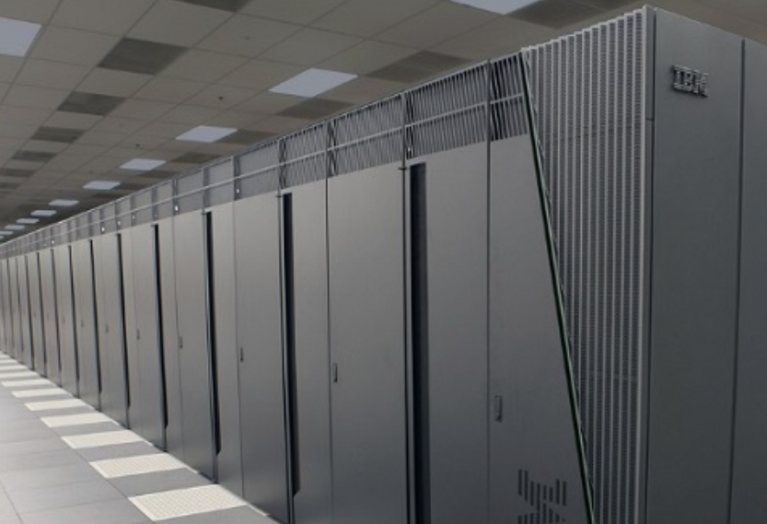
Types of Computers
Super Computers
fastest computers on Earth used for carrying out complex, fast and time intensive calculations for scientific and engineering applications.
Speed or performance is measured in teraflops, i.e. 1012 floating point operations per second.
Molecular mapping & research
Weather forecasting
Environmental research
Oil and gas exploration

Slide 13
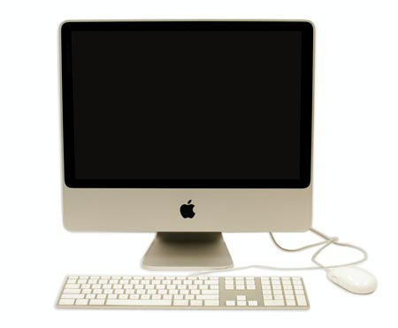
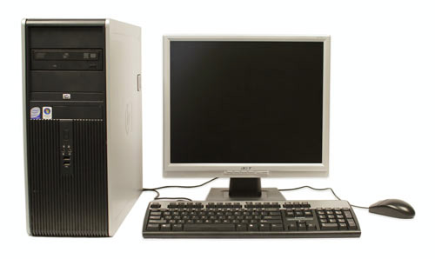
Types of Computers
Personal computers
  Two main styles: PC and Mac. Both are fully functional, but have a different look and feel, and many people prefer one or the other.

Slide 14
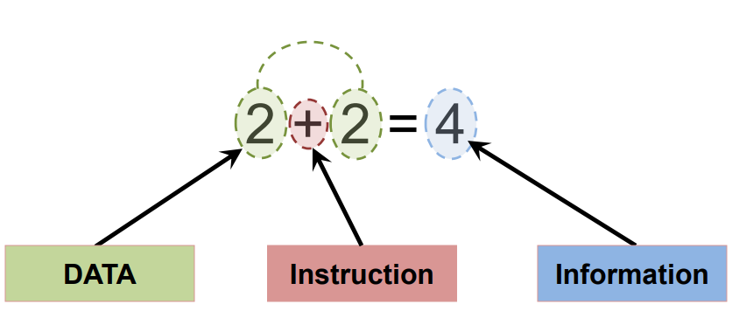
Functions of a Computer
Input data
Process data
Output information
Store data and information

Slide 15
Computer categories
A computer can be divided into two main categories:
  Hardware
  Hardware is basically anything that you can touch with your fingers.
  Software
  For computer hardware to work it must follow a set of instructions that is supplied to it as software.

Slide 16
Computer Hardware
refers to the computer’s physical components;
  Computer Case
  CPU (central processing unit...Pentium chip)
  Monitor
  Keyboard & Mouse
  Disk Drive, Zip Drive, CD-ROM, DVD,
  Hard Drive
  Memory (RAM)
  Speakers
  Printer

Slide 17
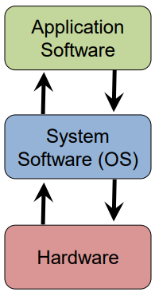
Computer Software
The term software refers to the set of instructions that directs the hardware to accomplish a task.
  System Software
  Application Software
  Utility Software

Slide 18
System software
Any set of instructions that tells the hardware what to do and how to do it.
consists of programs to control the operations of computer and its devices.
designed to provide a platform for running application software
AKA Operating System
serves as an interface between user and hardware.
  Control all Components of Computer
  Interface b/w user and Hardware

Slide 19
Computer Software
System software consists of programs to control the operations of computer and its devices.
designed to operate and control the computer hardware and to provide a platform for running application software
  Operating system
  Utility program

Slide 20
Computer Software
Operating System: Runs the computer
  Intermediary between the physical hardware and the software
Determines factors such as:
  The interface: familiarity, ease of use
  Configurability of the computer “tweakability”
  Security

Slide 21
Computer Software
Application software consists of programs designed to make users more productive and/or assist them with personal tasks
Application software is a set of one or more programs designed to carry out operations for a specific application
  Word processing
  Presentation
  Spreadsheet
  Database
  E-mail

Slide 22
Application software
Application software is used or design for the specific purpose of the user.
for example;
  MS-WORD
  MS-POWER POINT
  MS-EXCEL
  MS-ACCESS
  Corel Draw
  Paint
  Games

Slide 23
Utility software
Used to remove any problem or solve a complex situation in a computer.
for example;
  Partition Magic
  Backup utility
  Antivirus
  Data Recovery
  Security Software

Slide 24
Computer peripherals
A peripheral is a device that connects to the system unit and is controlled by the processor in the computer.
Compatibility: can it fit?
Interoperability: Can they communicate?

Slide 25
Summary
Computers are electronic devices that can accepts, process and produce or store information.
Software is computer instructions that tell the hardware what and how to do it
Hardware is, physical components of the computer that we can see and touch.
Different types of computers (PC, Note/Net Books, Servers and Super Computers)
Input, Output, Storage and the Processor are major components of a computer

Slide 26
END

