Slide 1
1.2
Components of a Computer

Slide 2
Session Objectives:
  Describe the Computer Components
  Understand Computing terminologies

Slide 3
Computer
An electronic device that manipulates information, or data.
It has the ability to store, retrieve, and process data.
Computers come in many shapes and sizes, and they perform many different functions in our daily lives.

Slide 4
Computer
Hardware – contains software
Software – eg system software (OS)

Slide 5
Operating System
The objectives of the operating system are;
To make the computer system convenient to use in an efficient manner.
To hide the details of the hardware resources from the users.
To provide users a convenient interface to use the computer system.

Slide 6
Operating System
The objectives of the operating system are;
To act as an intermediary between the hardware and its users, making it easier for the users to access and use other resources.
To manage the resources of a computer system.

Slide 7
Operating System
The objectives of the operating system are;
To keep track of who is using which resource, granting resource requests, and mediating conflicting requests from different programs and users.
To provide efficient and fair sharing of resources among users and programs.

Slide 8
Basic Terminologies
All types of computers follow the same basic logical structure and perform the following five basic operations for converting raw input data into information useful to their users.

Slide 9
Description
1 | Take Input | The process of entering data and instructions into the computer system.
2 | Store Data | Saving data and instructions so that they are available for processing as and when required.
3 | Processing Data | Performing arithmetic, and logical operations on data in order to convert them into useful information.
4 | Output Information | The process of producing useful information or results for the user, such as a printed report or visual display.
5 | Control the workflow | Directs the manner and sequence in which all of the above operations are performed.

Slide 10
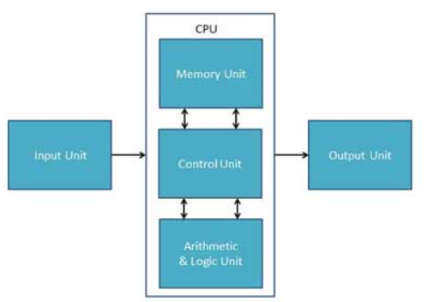
Basic Terminologies

Slide 11
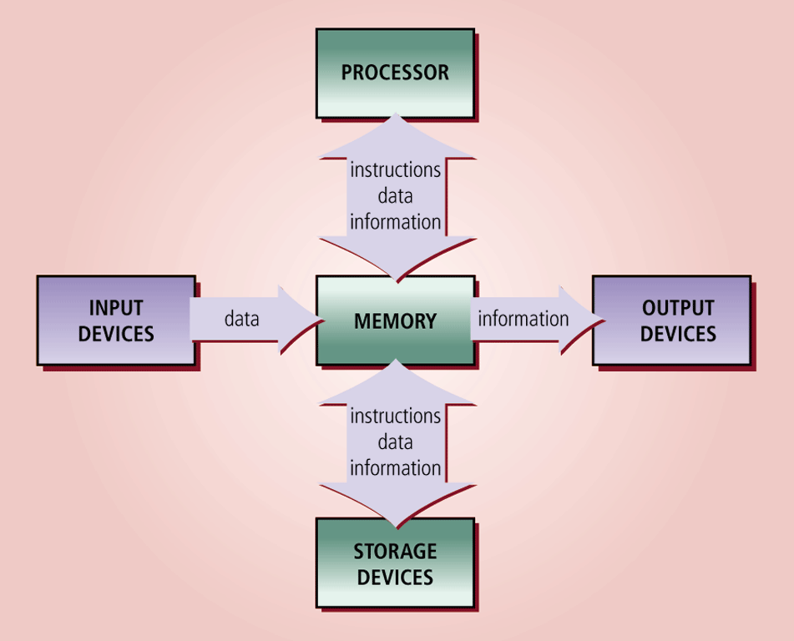
The Components of a Computer
Scalable

Slide 12
The Components of a Computer
The six primary components of a computer are input devices, the processor (control unit and arithmetic/logic unit), memory, output devices, storage devices, and communications devices
The processor, memory, and storage devices are housed in a box-like case called the system unit
A peripheral is a device that connects to the system unit and is controlled by the processor in the computer

Slide 13
Input Unit
This unit contains devices with the help of which we enter data into the computer. This unit creates a link between the user and the computer.
The input devices translate the information into a form understandable by the computer.

Slide 14
Input Devices
An input device is any hardware component that allows you to enter data and instructions into a computer
  A keyboard is an input device that contains keys users press to enter data and instructions into the computer
  A stylus is a small metal or plastic device that looks like a tiny ink pen, but uses pressure instead of ink
  A mouse is a pointing device that fits comfortably under the palm of your hand
  Most notebook computers have a touchpad, a small, flat, rectangular pointing device

Slide 15
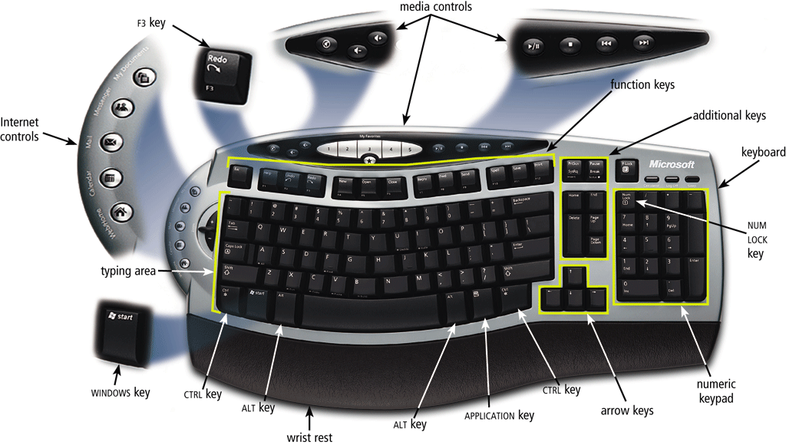
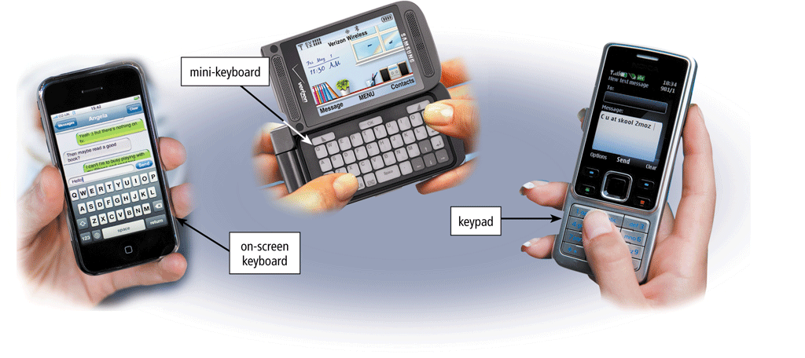
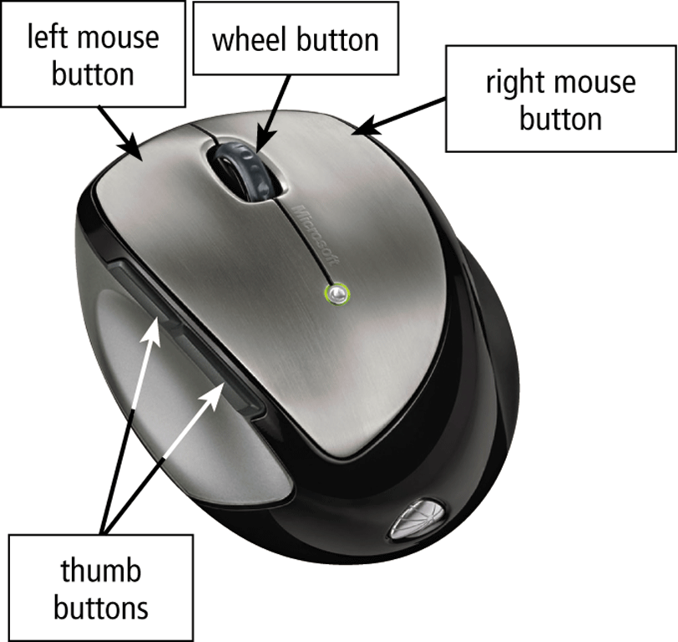
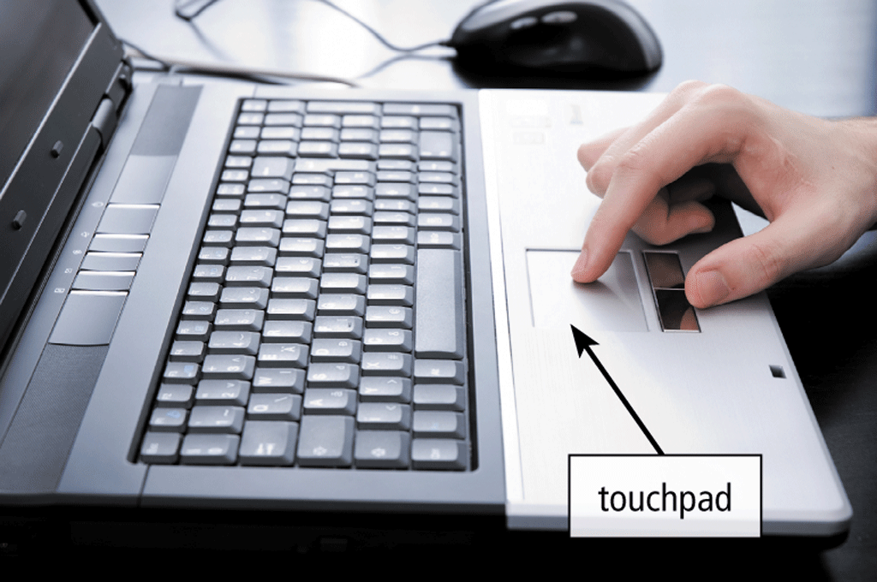
Input Devices

Slide 16
Central Processing Unit
CPU is considered as the brain of the computer. CPU performs all types of data processing operations. It stores data, intermediate results, and instructions (program). It controls the operation of all parts of the computer.
CPU itself has the following three components −
ALU (Arithmetic Logic Unit)
Memory Unit
Control Unit

Slide 17
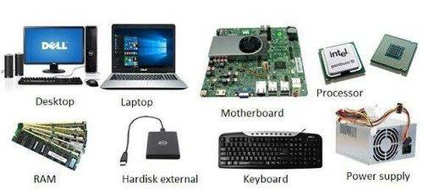
Central Processing Unit
CPU operation is divided into four basic steps:
  Fetch
  Decode
  Execute
  writeback

Slide 18
Central Processing Unit
Fetch
  The processor retrieves program instructions from memory
Decode
  The instruction is broken down into parts

Slide 19
Central Processing Unit
Execute
  CPU performs the operation implied by the program instruction.
Writeback
  The CPU writes back the results of execution to the computer’s memory.

Slide 20
Central Processing Unit
Central processing unit also known as processor is an electronic circuit that executes computer programs.
Primary responsibility is to execute a sequential set of instructions that constitute a program.

Slide 21
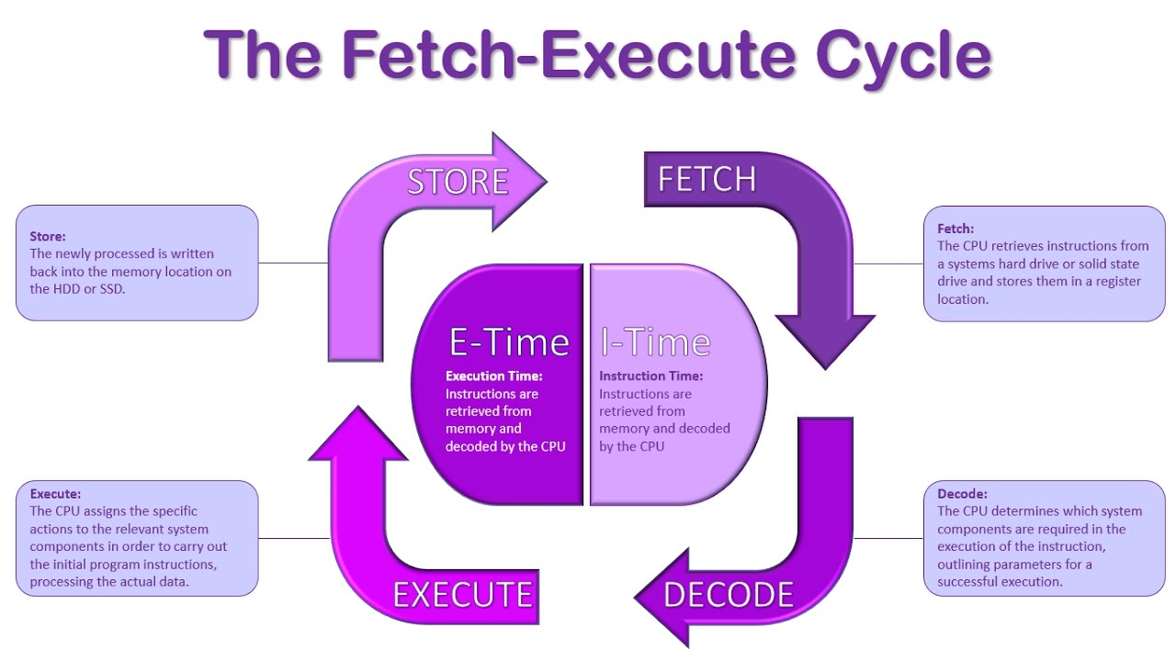

Slide 22
Control Unit
Core unit which manages the entire functioning of the computer device.
Collects the data entered using the input unit, leads it on for processing and once that is done, receives the output and presents it to the user.

Slide 23
Control Unit
Centre of all processing actions taking place inside a computer device.
Basically, the instructions taken, interpretation of entered data, issuing signals to execute the data and then finally retrieving the data is all done in the Control Unit.

Slide 24
Arithmetic and Logical Unit
As the name suggests, all the mathematical calculations or arithmetic operations are performed in the Arithmetic and Logical Unit of the CPU.
It can also perform actions like a comparison of data and decision-making actions.
The ALU comprises circuits using which addition, subtraction, multiplication, division and other numerical based calculations can be performed.

Slide 25
Memory Unit
When we enter the data into the computer using an input device, the entered information immediately gets saved in the memory unit of the Central Processing Unit (CPU). Because of the presence of some existing programming, the Memory Unit transmits the data further to the other parts of the CPU.
Similarly, when the output of our command is processed by the computer, it is saved in the memory unit before giving the output to the user.

Slide 26
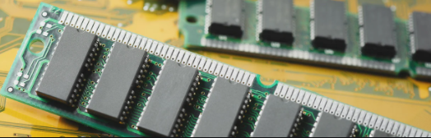
Computer Memory
Components of the computer that retain digital data.
  RAM: small sized light and volatile form of computer memory.

Slide 27
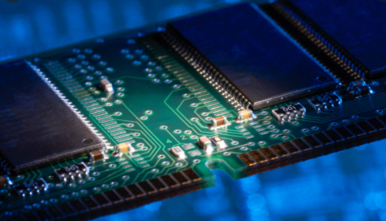
Computer Memory
RAM
  ROM: non volatile primary storage that reads large programs.
  Secondary storage: flash memory, punch cards etc

Slide 28
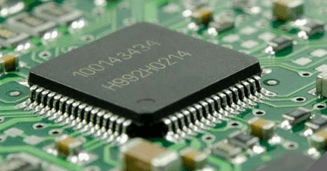
Computer Memory
Cache memory
  Extremely fast memory type that acts as a buffer between RAM and the CPU.

Slide 29
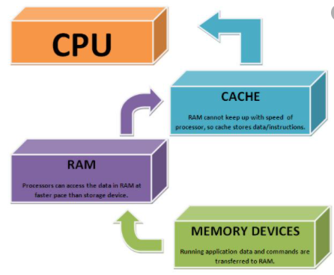
Computer Memory
Cache memory
  Holds frequently requested data and instructions so that they are immediately available to the CPU when needed.
  Used to reduce average time to access data from main memory.

Slide 30
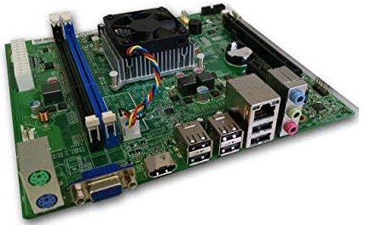
Motherboard
Consists of sockets in which microprocessors are installed, memory slots, a chipset, non volatile memory chips, clock generator.
Some motherboards also contain logic and connectors.

Slide 31
Output Unit
The output unit consists of devices with the help of which we get the information from the computer.
This unit is a link between the computer and the users. Output devices translate the computer's output into a form understandable by the users.

Slide 32
Output Devices
Output devices are hardware components that convey information to one or more people
A computer produces the output through an output device such as the monitor to display the result of the processing operations.
  A printer is an output device that produces text and graphics on a physical medium such as paper

Slide 33
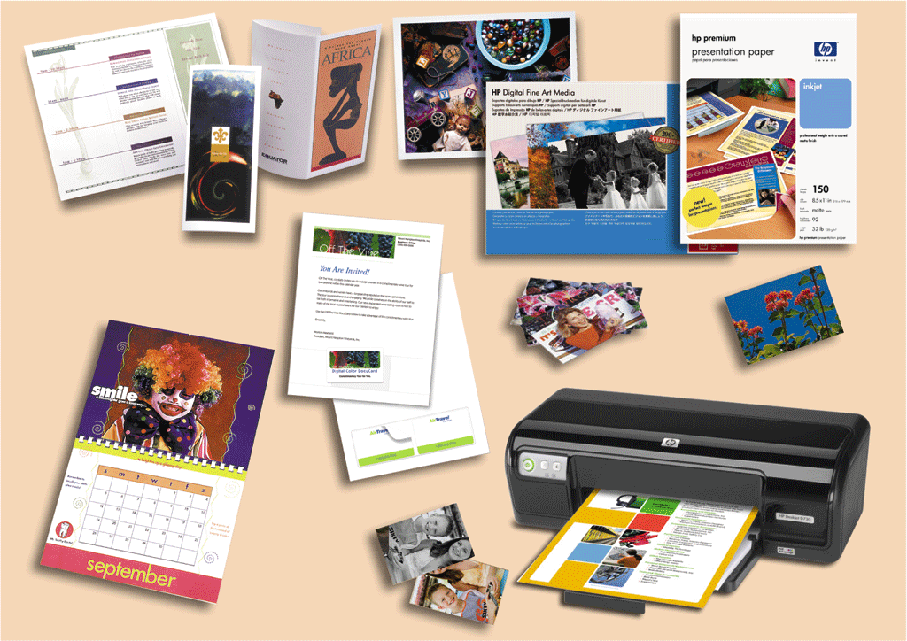
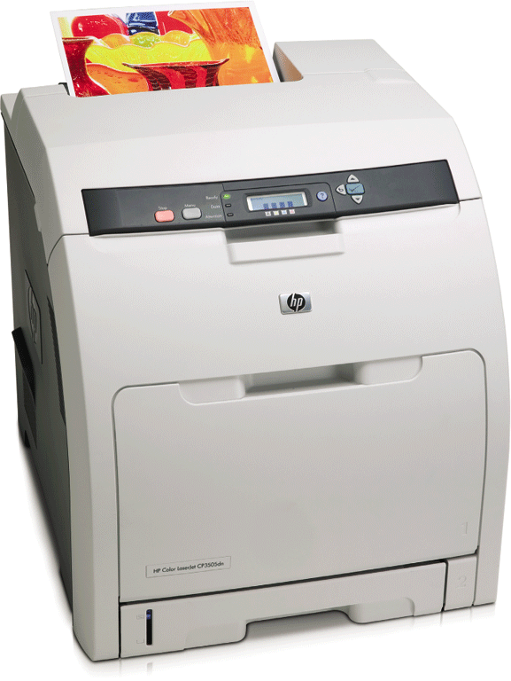
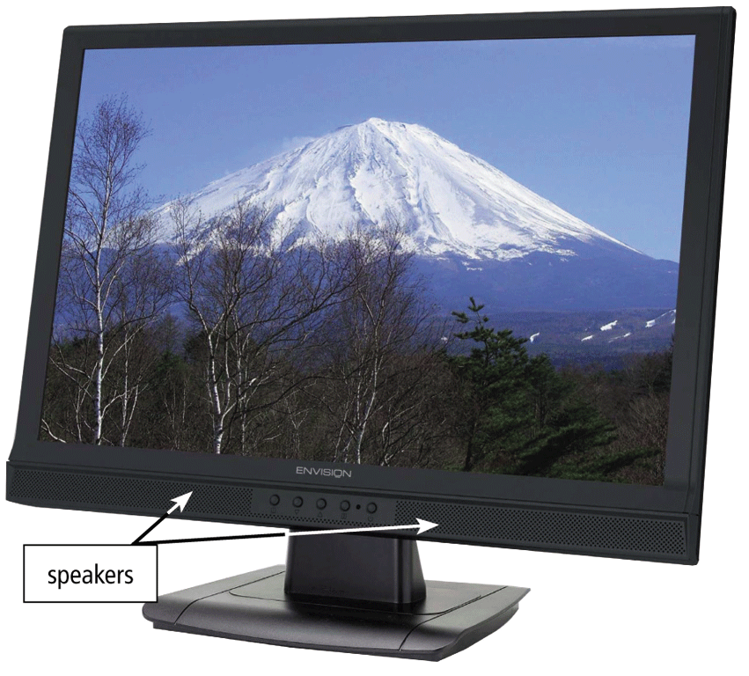
Output Devices

Slide 34
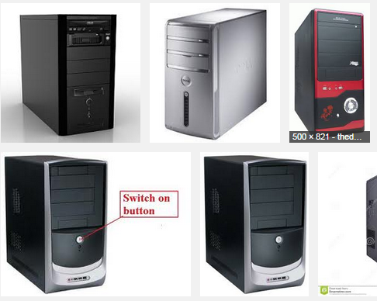
System Unit
The system unit is a case that contains electronic components of the computer used to process data

Slide 35
System Unit
Contains
  The processor (CPU) interprets and carries out the basic instructions that operate a computer
    Arithmetic/logic unit
  Memory (RAM) consists of electronic components that store instructions waiting to be executed and data needed by those instructions

Slide 36
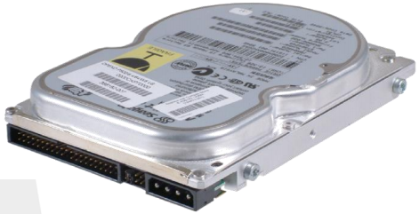
Storage Devices
A computer stores the result of the processing operations in a storage device such as the hard disk;
HDD: a personal computer storage device that uses fixed media, which means that the disk is built into the drive and the drives are not removed from the computer unless you are performing an upgrade or a repair.

Slide 37
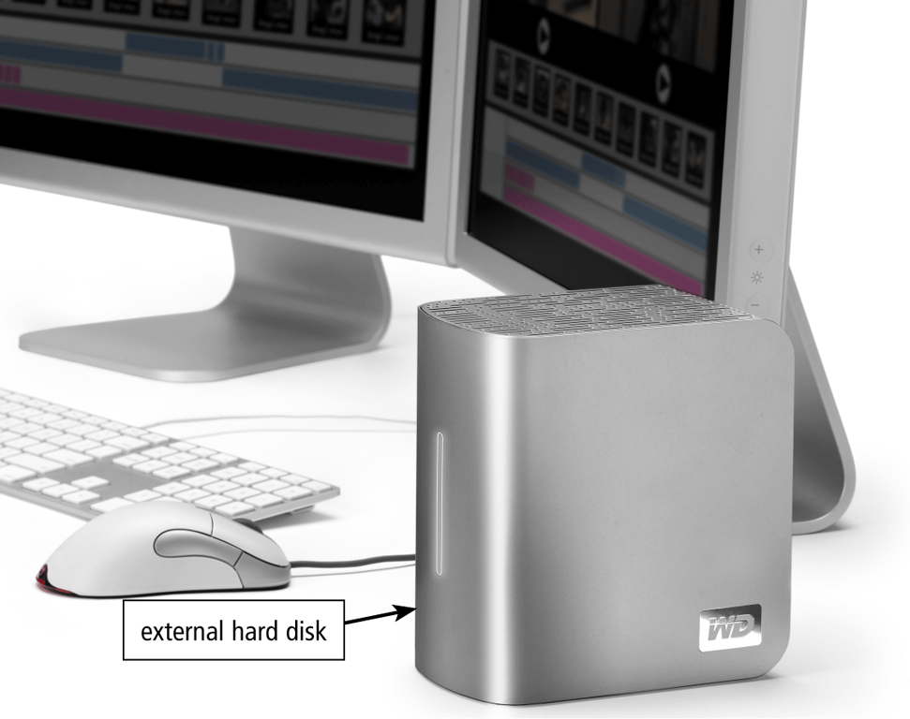
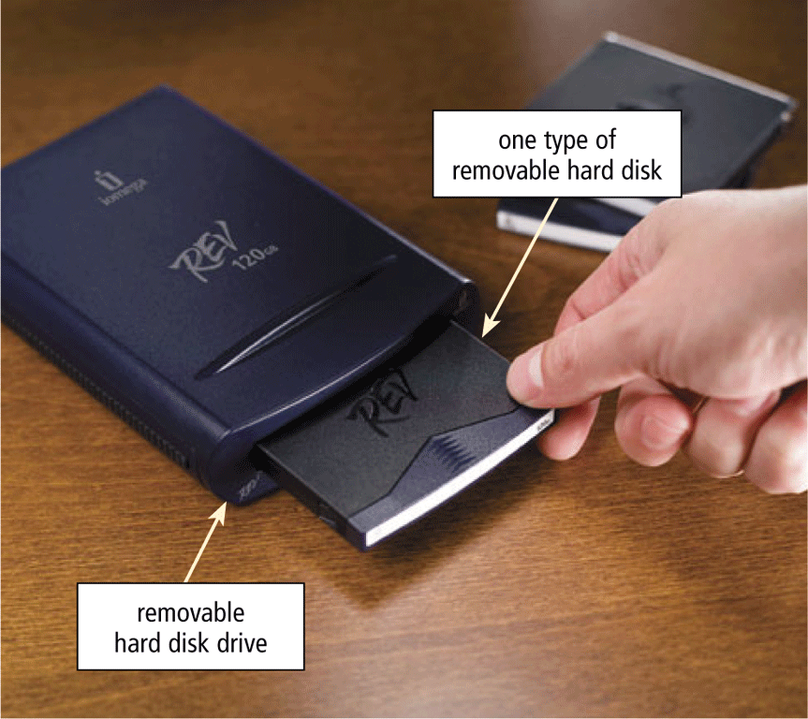
Storage Devices
An external hard disk is a separate freestanding hard disk that connects with a cable to a port on the system unit or communicates wirelessly
A removable hard disk is a hard disk that you insert and remove from a drive

Slide 38
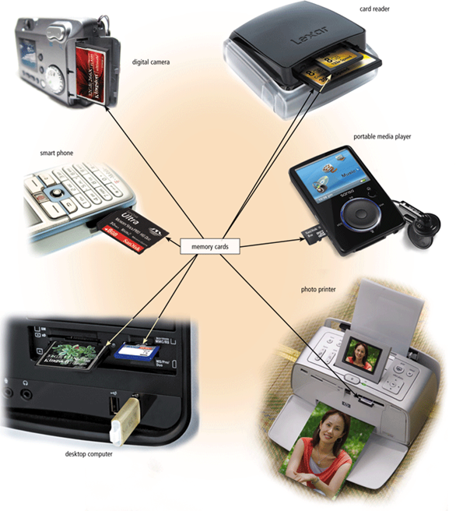
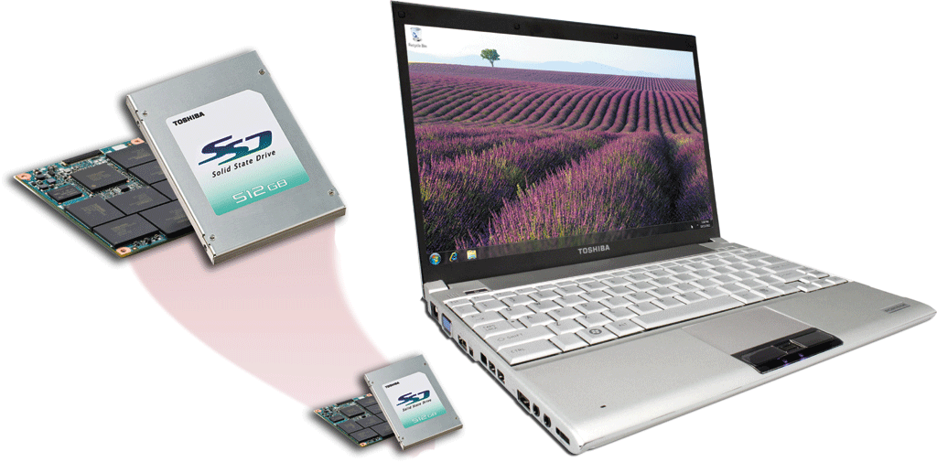
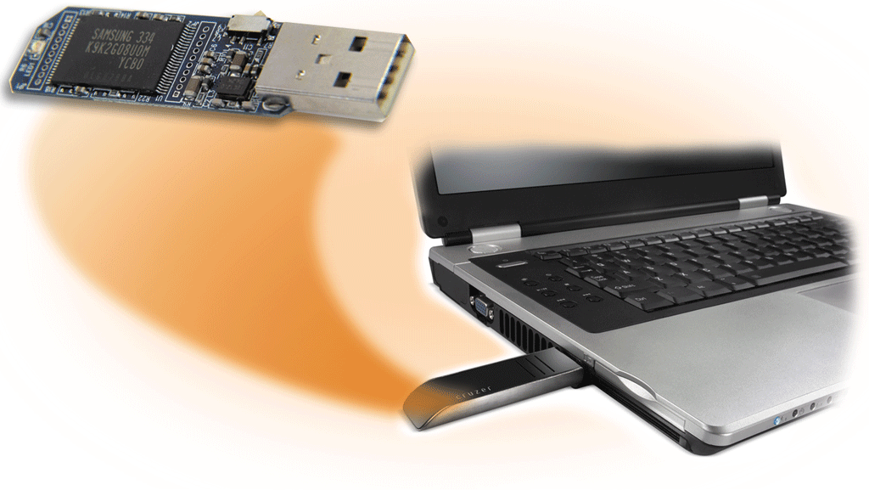
Storage Devices
Flash memory is a type of memory that can be erased electronically and rewritten
  Solid state media
  A solid state drive (SSD) is a storage device that typically uses flash memory to store data, instructions, and information

Slide 39

User
An individual who uses a computer the user.
This includes expert programmers as well as novices.
An end user can also be looked at as any individual who runs an application program.

Slide 40
Summary
IT is technology that helps to produce, manipulate, store, communicate, and/or disseminate information.
Computers are electronic devices that can accepts, process and produce or store information
Different types of computers
Different types of interfaces

Slide 41
END

