Slide 1
4.0
Understanding the Von Newmann Architecture

Slide 2
Objectives
At the end of this module, the student should demonstrate;
  Understanding the Von Newmann Architecture.
  Understanding the components of the Von Newmann Architeicture

Slide 3
Introduction
The von Neumann Architecture is a fundamental concept in computer science and computer engineering.
Named after mathematician and physicist John von Neumann, this architecture forms the basis of most modern computer systems.
This teaching note aims to provide a comprehensive understanding of the von Neumann Architecture, its components, and its significance in computing.
Notes:
A cluster is a group of independent servers that function as a single system.

Slide 4
Overview of von Neumann Arch:
  The von Neumann Architecture describes a computer design model based on the notion of a central processing unit (CPU) that can execute a stored set of instructions.
  It encompasses four main components: the CPU, memory, input/output (I/O) devices, and a system bus for communication between these components.
Notes:
A cluster is a group of independent servers that function as a single system.

Slide 5
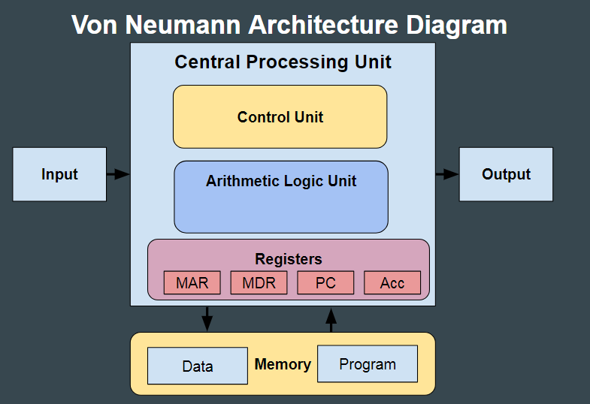
Overview of von Neumann Arch:
Notes:
A cluster is a group of independent servers that function as a single system.

Slide 6
Components of von Neumann Arch:
Central Processing Unit (CPU):
  The CPU is the brain of the computer, responsible for executing instructions.
  It consists of an Arithmetic Logic Unit (ALU) for performing arithmetic and logical operations, and a Control Unit (CU) for managing the execution of instructions.
  The CU fetches instructions from memory, decodes them, and controls the flow of data within the CPU.
Notes:
A cluster is a group of independent servers that function as a single system.

Slide 7
Components of von Neumann Arch:
Memory:
  Memory stores both data and instructions that the CPU can access.
  In von Neumann Architecture, memory is unified, meaning that both data and instructions are stored in the same memory space.
  Common types of memory include Random Access Memory (RAM) for temporary storage and Read-Only Memory (ROM) for permanent storage of instructions.
Notes:
A cluster is a group of independent servers that function as a single system.

Slide 8
Components of von Neumann Arch:
Input/Output (I/O) Devices:
  I/O devices allow the computer to interact with the external world.
  Examples include keyboards, mice, monitors, printers, and network interfaces.
  Data is transferred between the CPU and I/O devices through input and output operations.
Notes:
A cluster is a group of independent servers that function as a single system.

Slide 9
Components of von Neumann Arch:
System Bus:
  The system bus is a communication pathway that connects the CPU, memory, and I/O devices.
  It consists of address lines, data lines, and control lines for transmitting addresses, data, and control signals between components.
  The system bus enables the CPU to fetch instructions from memory, transfer data between memory and I/O devices, and execute instructions.
Notes:
A cluster is a group of independent servers that function as a single system.

Slide 10
Components of von Neumann Arch:
Instruction Execution Cycle:
  The von Neumann Architecture follows a sequential instruction execution cycle, consisting of the following steps: a. Fetch: The CPU fetches the next instruction from memory. b. Decode: The CPU decodes the instruction to determine the operation to be performed. c. Execute: The CPU executes the instruction, which may involve arithmetic, logic, or data transfer operations. d. Store: If necessary, the CPU stores the result of the operation back to memory.
Notes:
A cluster is a group of independent servers that function as a single system.

Slide 11
Significance of von Neumann Arch:
  The von Neumann Architecture provides a simple and efficient design model for computers.
  It allows for the sequential execution of instructions, enabling complex computations and program execution.
  The separation of program and data storage in memory facilitates the development of flexible and versatile software.
  Von Neumann Architecture serves as the foundation for the design of modern digital computers, influencing the development of computing systems over the decades.
Notes:
A cluster is a group of independent servers that function as a single system.

Slide 12
Conclusion
Understanding the von Neumann Architecture is essential for grasping the fundamental principles of computer design and operation.
By comprehending its components and execution cycle, one gains insight into how computers process instructions and manipulate data.
As technology continues to evolve, the principles of von Neumann Architecture remain relevant, guiding the development of advanced computing systems.
Notes:
A cluster is a group of independent servers that function as a single system.

Slide 13
Thankyou.
Q and A

