Slide 1
1.1
The History of Computing

Slide 2
Objectives
At the end of this module the student will understand the following tasks and concepts.
Computer organisation and architecture
History of computing: Major milestones
Evolution of computers
Generations of electronic computers

Slide 3
A Computer
a programmable machine that can execute a set of instructions (a program) to perform a wide range of tasks.
Computers are designed to process data, store information, and perform calculations.
Modern computers are electronic devices that use digital circuits to represent and manipulate information.
Notes:
A cluster is a group of independent servers that function as a single system.

Slide 4
A Computer
A computer is a versatile tool that can be used for a variety of purposes, from simple calculations to complex scientific simulations. Computers are essential components of modern society, and they play a critical role in almost every aspect of our lives..
Notes:
A cluster is a group of independent servers that function as a single system.

Slide 5
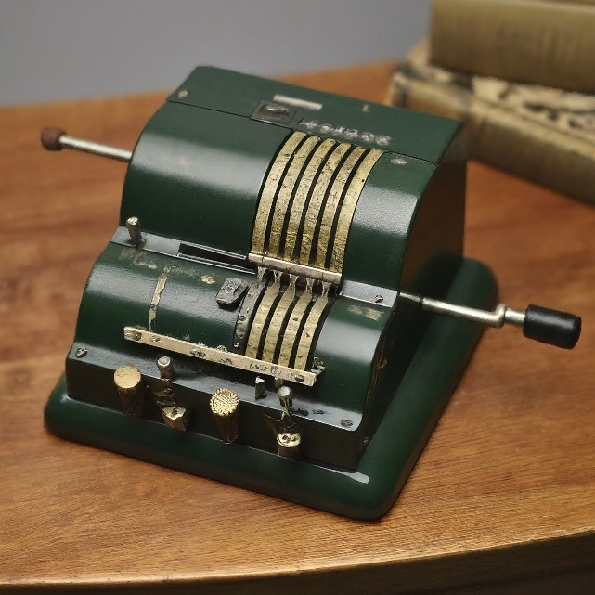
Computer Organization & Architecture
A computer is a versatile tool that can be used for a variety of purposes, from simple calculations to complex scientific simulations. Computers are essential components of modern society, and they play a critical role in almost every aspect of our lives.
Notes:
A cluster is a group of independent servers that function as a single system.

Slide 6
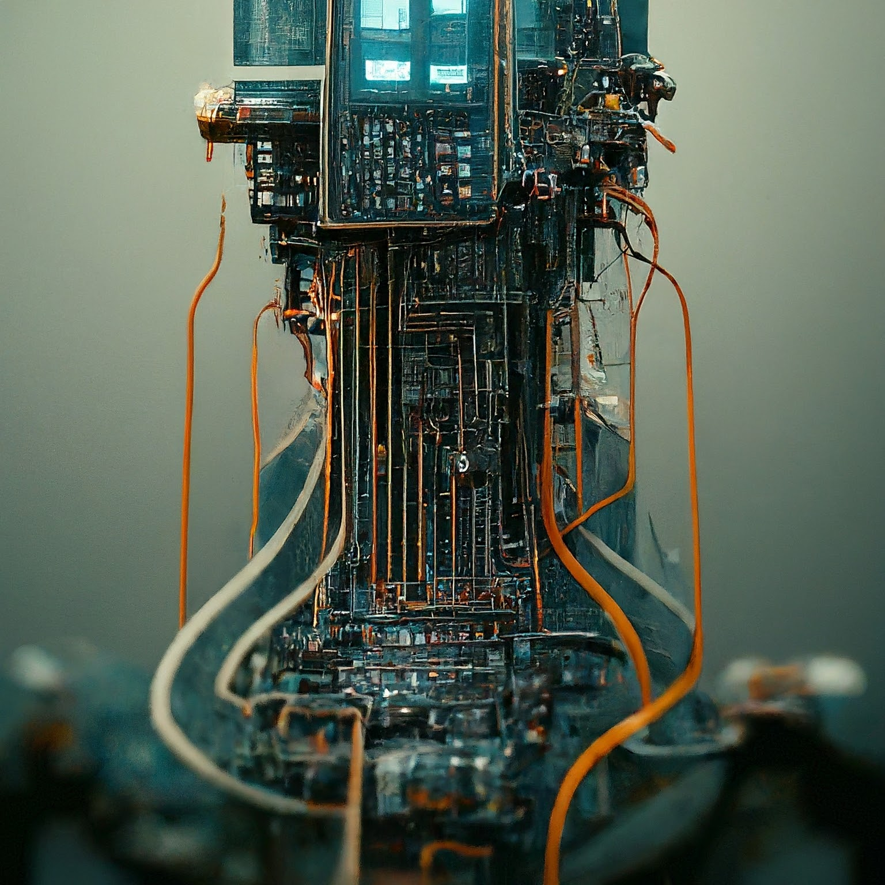
Computer Organization & Architecture
Notes:
A cluster is a group of independent servers that function as a single system.

Slide 7
Computer Arch & Organization
Computer organization refers to the logical structure of a computer system, including the major components and their interconnections.
Computer architecture refers to the design principles and specifications that govern the operation of a computer system.
The organization and architecture of a computer system determine its performance, functionality, and cost.
Notes:
A cluster is a group of independent servers that function as a single system.

Slide 8
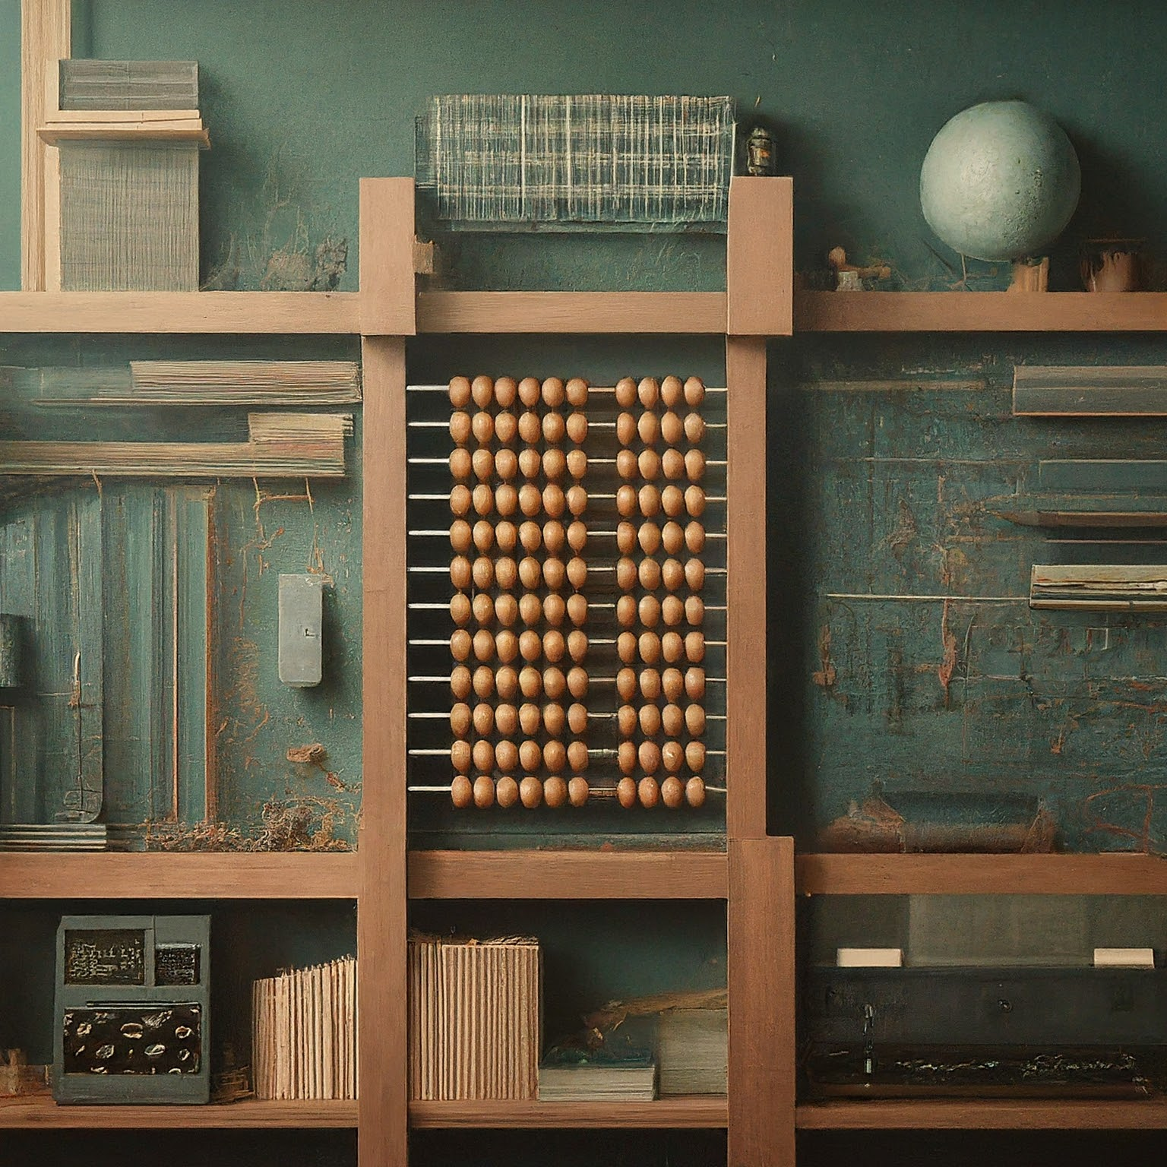
Major Milestones in Computing History
Notes:
A cluster is a group of independent servers that function as a single system.

Slide 9
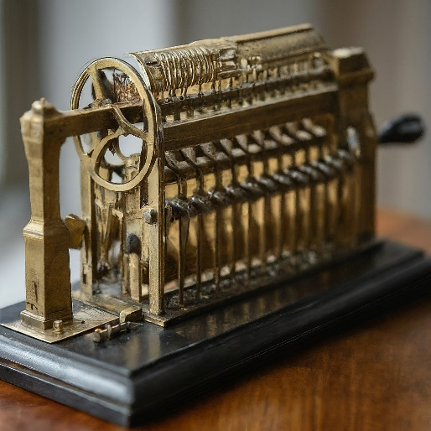
History of Computing
1642: Blaise Pascal invents the mechanical calculator, a machine that could perform addition, subtraction, multiplication, and division.
The mechanical calculator marked a significant step forward in computing as it allowed for more complex calculations than were previously possible.
Notes:
A cluster is a group of independent servers that function as a single system.

Slide 10
History of Computing
1801: Joseph Marie Jacquard invents the Jacquard loom, a programmable weaving machine that could create complex patterns using punched cards.
The Jacquard loom demonstrated the concept of programmability, which is a key principle of modern computers.
Notes:
A cluster is a group of independent servers that function as a single system.

Slide 11
History of Computing
1822: Charles Babbage proposes the Analytical Engine, a mechanical general-purpose computer that could perform a wide range of mathematical operations.
The Analytical Engine is considered to be the first conceptual design for a modern computer, although it was never actually built.

Slide 12
History of Computing
1936: Alan Turing publishes his paper "On Computable Numbers," which lays the theoretical foundation for modern computers.
Turing's paper introduced the concept of the Turing machine, a theoretical model of computation that is still used today to study the capabilities and limitations of computers.

Slide 13
History of Computing
1943: The Colossus computer is built to break German codes during World War II.
The Colossus computer was one of the first electronic computers, and it played a critical role in Allied victory in World War II.
Notes:
A cluster is a group of independent servers that function as a single system.

Slide 14
History of Computing
1946: The Electronic Numerical Integrator and Computer (ENIAC) is built at the University of Pennsylvania.
The ENIAC was the first general-purpose electronic computer, and it was used for a variety of scientific and engineering applications.
1971: The Intel 40
Notes:
A cluster is a group of independent servers that function as a single system.

Slide 15
Generations of E- Computers
Overview of each generation:
  First Generation: Vacuum tube computers (e.g., ENIAC, UNIVAC)
  Second Generation: Transistor computers (e.g., IBM 1401, DEC PDP-8)
  Third Generation: Integrated circuit computers (e.g., IBM System/360, DEC PDP-11)
Notes:
A cluster is a group of independent servers that function as a single system.

Slide 16
Generations of E- Computers
Overview of each generation:
  Fourth Generation: Microprocessor-based computers (e.g., Apple II, IBM PC)
  Fifth Generation: AI and parallel processing (e.g., IBM Watson, Cray-1)
Notes:
A cluster is a group of independent servers that function as a single system.

Slide 17
First Generation of E- Computers
1. Vacuum Tubes: These bulky and power-hungry electronic components acted as the primary technology for performing calculations and logic operations.
2. Machine Language Programming: Instructions were directly coded in machine language, a system of ones and zeros specific to the computer's architecture. This made programming incredibly difficult, requiring a deep understanding of the hardware.
Notes:
A cluster is a group of independent servers that function as a single system.

Slide 18
First Generation of E- Computers
3. Limited Memory: Memory capacity was very limited in first-generation computers, measured in kilobytes (KB) compared to the gigabytes (GB) or terabytes (TB) of today. This restricted the amount of data and programs that could be stored and processed simultaneously.
Notes:
A cluster is a group of independent servers that function as a single system.

Slide 19
First Generation of E- Computers
4. Punched Cards and Paper Tape: These served as the primary input and output methods. Programs and data were punched onto cards or tape, which the computer could then read and process. This method was slow and prone to errors.
Notes:
A cluster is a group of independent servers that function as a single system.

Slide 20
First Generation of E- Computers
5. Large Size and High Cost: First-generation computers were enormous, often taking up entire rooms. They were also incredibly expensive to build and maintain, limiting their use primarily to government agencies, universities, and large corporations.
Notes:
A cluster is a group of independent servers that function as a single system.

Slide 21
First Generation of E- Computers
6. Slow Processing Speed: Due to the limitations of vacuum tubes, these computers operated at very slow speeds compared to modern machines. Even basic calculations could take significant time to complete.
Notes:
A cluster is a group of independent servers that function as a single system.

Slide 22
Examples of 1st gen of E- Computers
ENIAC (Electronic Numerical Integrator and Computer)
UNIVAC I (Universal Automatic Computer I)
IBM 650
Notes:
A cluster is a group of independent servers that function as a single system.

Slide 23
Second Generation of E- Computers
Transistors: Replaced vacuum tubes as the primary electronic component. Transistors are smaller, faster, and more reliable than vacuum tubes. This resulted in:
  Smaller Size: Computers became significantly smaller and more portable compared to their first-generation counterparts.
  Lower Power Consumption: Transistors required less power to operate, leading to lower energy bills and less heat generation.
Notes:
A cluster is a group of independent servers that function as a single system.

Slide 24
Second Generation of E- Computers
  Increased Reliability: Transistors were less prone to failure than vacuum tubes, leading to more reliable computer operation.
Magnetic Core Memory: Replaced mercury delay lines and drum memory as the main form of primary memory. Magnetic core memory offered:
  Faster Access Times: Data could be retrieved from memory much faster compared to previous technologies.
  Non-volatile Memory: Data was not lost when the computer was turned off, unlike previous memory types.
Notes:
A cluster is a group of independent servers that function as a single system.

Slide 25
Second Generation of E- Computers
Magnetic Tape Storage: Emerged as the primary form of secondary storage. Magnetic tape offered:
  Higher Storage Capacity: Compared to punched cards used in the first generation, tapes could store significantly more data.
  Reusable Storage: Magnetic tapes could be overwritten with new data, unlike punched cards.
Notes:
A cluster is a group of independent servers that function as a single system.

Slide 26
Second Generation of E- Computers
High-Level Programming Languages: The introduction of languages like FORTRAN (FORmula TRANslation) and COBOL (COmmon Business Oriented Language) made programming easier. These languages were closer to human language than machine code used in the first generation, allowing programmers to write code more efficiently.
Notes:
A cluster is a group of independent servers that function as a single system.

Slide 27
Examples of 2nd Gen Computers
IBM 1401: A widely used business computer known for its reliability and ability to handle large data sets.
IBM 7090/7094: High-performance scientific computers used for complex calculations in engineering and scientific research.
UNIVAC 1107: A commercial computer used for various applications such as business data processing and scientific calculations.
DEC PDP-1: A minicomputer, a smaller and less expensive computer designed for specific tasks like scientific research and laboratory automation.
Notes:
A cluster is a group of independent servers that function as a single system.

Slide 28
Third Generation of E- Computers
Characteristics of third-generation computers
Introduction of integrated circuits
Examples of third-generation computers
Slide 9: Fourth Generation Computers
Characteristics of fourth-generation computers
Introduction of microprocessors
Advancements in computing power and portability
Examples of fourth-generation computers
Slide 10: Fifth Generation Computers
Characteristics of fifth-generation computers
Focus on AI and parallel processing
Examples of fifth-generation computers
Notes:
A cluster is a group of independent servers that function as a single system.

Slide 29
Fourth Generation of E- Computers
Characteristics of fourth-generation computers
Introduction of microprocessors
Advancements in computing power and portability
Examples of fourth-generation computers
Notes:
A cluster is a group of independent servers that function as a single system.

Slide 30
Fifth Generation of E- Computers
Characteristics of fifth-generation computers
Focus on AI and parallel processing
Examples of fifth-generation computers
Notes:
A cluster is a group of independent servers that function as a single system.

Slide 31
Thankyou.
Q and A

