Slide 1
4.0
Abstraction in Computing in Computer Architecture

Slide 2
Objectives
At the end of this module, the student should demonstrate;
  Understanding the Layers of Abstraction
  explore the concept of abstraction in computer architecture.

Slide 3
Abstraction
Abstraction plays a critical role in simplifying the complexities of computer systems and making them more manageable for developers and users. We will delve into the different layers of abstraction, starting from the physical hardware to the high-level programming languages, and how each layer builds upon the one below. By understanding abstraction, we can gain a deeper appreciation for the intricate architecture of modern computers.
Notes:
A cluster is a group of independent servers that function as a single system.

Slide 4
What is Abstraction?
Abstraction is a fundamental concept in computer science that involves hiding low-level implementation details and exposing only the essential features and functionalities required by the user.
It allows us to focus on the "what" rather than the "how" of computing.
Abstraction simplifies complex systems by breaking them down into smaller, more manageable layers.
Notes:
A cluster is a group of independent servers that function as a single system.

Slide 5
Layers of Abstraction
Physical Layer: Hardware Components (Transistors, Gates, Circuits)
Logical Layer: Digital Logic (Boolean Algebra, Logic Gates)
Microarchitectural Layer: Processor Components (ALU, Control Unit)
Instruction Set Architecture (ISA) Layer: Machine Language Instructions
Operating System Layer: System Calls, Process Management
Application Layer: Software Applications, User Interface
Notes:
A cluster is a group of independent servers that function as a single system.

Slide 6
Levels of Abstraction?
The layers can be broadly categorized as:
  Hardware (Physical components: CPU, memory, storage)
  Microarchitecture (Functional units and control logic within the CPU)
  Instruction Set Architecture (ISA: Set of instructions the CPU understands)
  Operating System (OS: Manages resources and provides services to applications)
  Application Programs (User-facing software like web browsers, word processors)
Notes:
A cluster is a group of independent servers that function as a single system.

Slide 7
Benefits of Abstraction?
Simplified Programming: High-level languages like Java or Python enable developers to write code without worrying about the underlying hardware details.
Increased Efficiency: Abstraction allows developers to focus on the problem at hand rather than getting bogged down in low-level implementation details.
Notes:
A cluster is a group of independent servers that function as a single system.

Slide 8
Benefits of Abstraction?
Portability: Programs written for a specific ISA can be easily ported to other machines with compatible ISAs, as they are not tied to the specific hardware.
Hardware Independence: Advancements in hardware can be implemented without affecting existing software layers, as long as the ISA remains compatible.
Notes:
A cluster is a group of independent servers that function as a single system.

Slide 9
Physical layer in Abstraction
Hardware Components
The physical components like the CPU, memory, and storage devices.
Role of Transistors in Digital Circuits
  Switching (ON/OFF), amplification (weak electric signals), logic gates-electronic circuits that perform basic logical operations on one or more binary inputs (0 or 1), producing a single binary output (0 or 1) based on a specific rule.
Notes:
A cluster is a group of independent servers that function as a single system.

Slide 10
Logical layer of Abstraction
Boolean Algebra
a branch of mathematics that deals with logical operations on binary variables.
Notes:
A cluster is a group of independent servers that function as a single system.

Slide 11
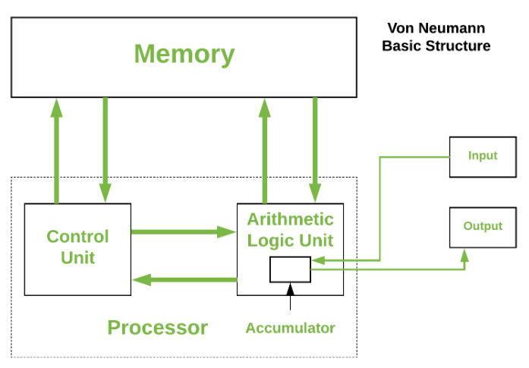
Microarchitectural Layer of Abstr
Overview of Processor Components (ALU, Control Unit)
Instruction Execution Cycle
Role of Registers and Memory
Notes:
A cluster is a group of independent servers that function as a single system.

Slide 12
Microarchitectural Layer of Abstr
Registers – Registers refer to high-speed storage areas in the CPU. The data processed by the CPU are fetched from the registers. There are different types of registers used in architecture :-
Accumulator: Stores the results of calculations made by ALU. It holds the intermediate of arithmetic and logical operatoins.it act as a temporary storage location or device.
Program Counter (PC): Keeps track of the memory location of the next instructions to be dealt with. The PC then passes this next address to the Memory Address Register (MAR).
Notes:
A cluster is a group of independent servers that function as a single system.

Slide 13
Microarchitectural Layer of Abstr
Memory Address Register (MAR): It stores the memory locations of instructions that need to be fetched from memory or stored in memory.
Memory Data Register (MDR): It stores instructions fetched from memory or any data that is to be transferred to, and stored in, memory.
Current Instruction Register (CIR): It stores the most recently fetched instructions while it is waiting to be coded and executed.
Instruction Buffer Register (IBR): The instruction that is not to be executed immediately is placed in the instruction buffer register IBR.
Notes:
A cluster is a group of independent servers that function as a single system.

Slide 14
Microarchitectural Layer of Abstr
Buses – Data is transmitted from one part of a computer to another, connecting all major internal components to the CPU and memory, by the means of Buses. Types:
  Data Bus: It carries data among the memory unit, the I/O devices, and the processor.
  Address Bus: It carries the address of data (not the actual data) between memory and processor.
  Control Bus: It carries control commands from the CPU (and status signals from other devices) in order to control and coordinate all the activities within the computer.
Notes:
A cluster is a group of independent servers that function as a single system.

Slide 15
Instruction Set Architecture (ISA) Layer of Abstr
acts as an intermediary between the software and hardware in a computer system. It defines the set of instructions a processor can understand and execute, along with the format of those instructions and how they interact with the memory and other hardware components.
Notes:
A cluster is a group of independent servers that function as a single system.

Slide 16
Instruction Set Architecture (ISA)
Machine Code: low-level language that processors directly understand. It's a series of binary codes that instruct the processor on specific operations to perform.
Assembly Language: This is a human-readable version of machine code, using mnemonics (abbreviated instructions) that correspond to the underlying binary codes. It's still quite complex and requires an understanding of the ISA.
Higher-Level Languages: Python, Java, or C++ that are much easier for humans to read and write, translated into machine code (using the ISA) by a compiler or interpreter before the processor can execute them.
Notes:
A cluster is a group of independent servers that function as a single system.

Slide 17
Operating System Layer of Abstr
Role of Operating System in Managing Hardware Resources
System Calls
Overview of Process Management (Scheduling, Memory Management)
Notes:
A cluster is a group of independent servers that function as a single system.

Slide 18
Application Layer of Abstraction
Description of Software Applications
Importance of User Interface (UI) Design
Examples of Applications at the Application Layer
Notes:
A cluster is a group of independent servers that function as a single system.

Slide 19
Conclusion -Abstraction
Abstraction is a cornerstone concept in computer architecture.
It provides a layered approach that simplifies complex systems and enables efficient development and operation of computer systems.
By understanding abstraction, we gain a deeper appreciation for the intricate architecture of modern computers and how each layer contributes to the overall functionality.
Notes:
A cluster is a group of independent servers that function as a single system.

Slide 20
Thankyou.
Q and A

